Slide 1
Health and Economic Consequences of Childhood Lead Exposure in Low- and Middle Income Countries
Leonardo Trasande, MD, MPP
Associate Professor of Pediatrics, Environmental Medicine and Population Health, NYU School of Medicine

Slide 2
Main messages
Lead is harmful to health, especially for children
Banning lead in gasoline is producing large health and economic benefits in low- and middle-income countries
Lead in paint is the major source of childhood exposure
Governments can require use of alternatives
  Laws are needed, and tools are available

Slide 3
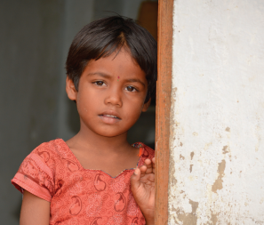
Lead is harmful, especially to children
Neurological, cardiovascular, reproductive, renal, gastrointestinal and hematological effects
Children uniquely vulnerable
  Pound for pound, drink more water, eat more food and breathe in more air
  Developing organ systems are more susceptible
Life-long consequences in children including cognitive and behavioral deficits
No level of exposure is safe

Slide 4
Removal of lead from gasoline
Average child born to day 4-7 IQ points smarter than children born in the 1970s
One of major public health victories of past 50 years
Annual benefits ongoing and range from $1-$6 trillion/year, with a best estimate of $2.45 trillion/year (4% of global GDP)
Tsai and Hatfield J Environmental Health 2011

Slide 5

Yet we have a long way to go!
In many countries, it is still legal to use lead paint for decorating homes, schools, and children’s toys
Lead is not a necessary component of paint
Lead-free additives are affordable and easily available
Both industry and governments agree that the solution is enacting and enforcing lead paint laws in countries worldwide

Slide 6
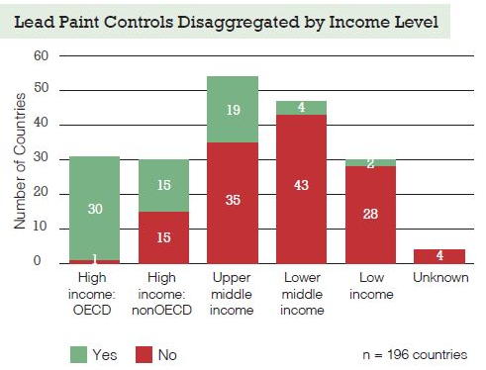
Lead Laws in Low- and Middle-Income Countries
Notes:
Over the years, legal restrictions on lead have successfully decreased the use of lead in fuel, plumbing and other products and processes. These restrictions have effectively reduced the level of lead exposure in human populations. However, paints containing lead are still widely manufactured and purchased in many countries across the world. The global status report on phasing out lead paint is a comprehensive report on legislations and regulations of lead paint limits in 128* countries. The report further analyses the importance of legislation and regulations which are still needed in many countries around the world to reduce exposure to lead, only 68 of the 128 (53%) countries assessed have legally binding LPLs with labelling requirements. The majority of countries with binding LPLs have a limit of 600 ppm, developed countries such as Canada and The USA have LPLs as low as 90 ppm and countries such as Armenia and Algeria have as high as 1000 ppm or more LPLs. In practice, countries like Japan and India follow a voluntary LPLs. Regardless of the limits, the report further looks towards enforcement on manufacture, use and trade to phase-out lead in paint. On a continental level, Europe dominated highest number of countries with LPLs and Africa has the highest number of countries with no LPLs. Showing a direct linkage between LPL and income level of countries. On the brighter side, progress has been made in some countries over the last 5 year, however lead paint still remains largely unregulated or subject to purely voluntary standards in many countries throughout the world. The report is launched at UNEA 2 and is available at www.unep.org/noleadinpaint.

Slide 7
Estimated Costs of Childhood Lead Exposure in Low- and Middle-Income Countries
Total estimated cost in LMICs = $977 billion (range $728.6–1162.5 billion) of international dollars in 2008
Regional economic losses estimated as:
    Africa: $134.7 billion, i.e. 4.03% of regional GDP
    Latin America & Caribbean: $142.3 billion, i.e. 2.04% of regional GDP
    Asia: $699.9 billion, i.e. 1.88% of regional GDP

Slide 8
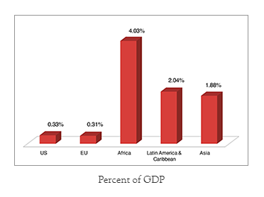
Comparison to Developed Countries
Overall burden associated with childhood lead exposure in LMICs amounted to 1.20% of world GDP in 2011; approximately $977 billion of international dollars in 2008
For comparison, economic impact of lead exposure in high-income countries (such as U.S. and EU countries) is $50.9 and $55 billion, respectively

Slide 9
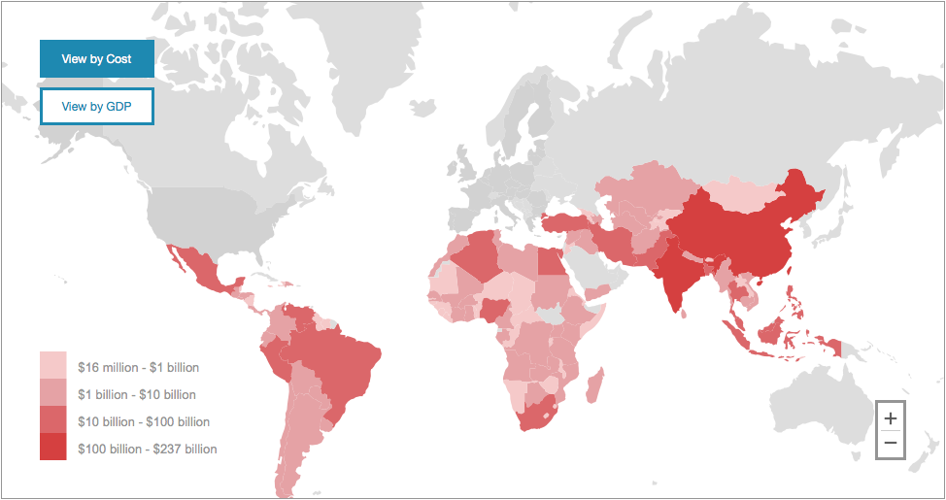
Costs of Childhood Lead Exposure in International Dollars
Notes:
Interactive map based on the findings of this analysis in LMICs displays cost and corresponding percent GDP loss by country.
Provides comparison information:
among countries in the same region
to the costs in EU countries and the U.S.

Slide 10
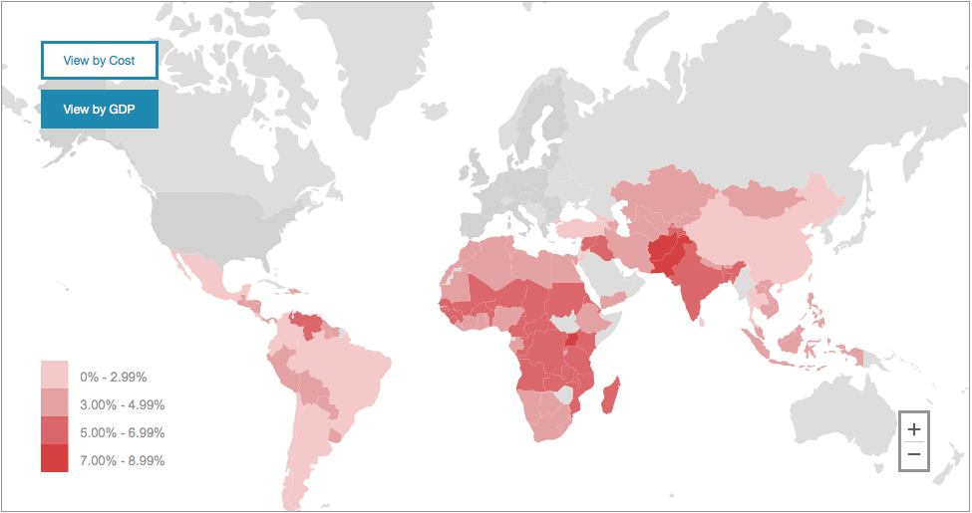
Costs of Childhood Lead Exposure as Percent of GDP
Notes:
The map helps stakeholders and decision makers understand and quantify the preventable economic burden of childhood lead exposure in LMICs

Slide 11
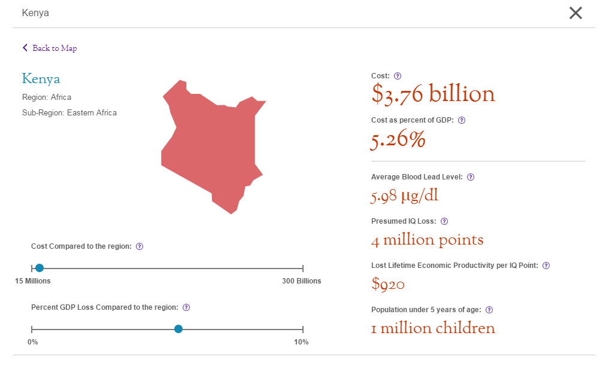
Costs of Childhood Lead iExposure by Country

Slide 12
Comparison with Net Overseas Development Assistance
Country | Net ODA for 2008 (US $, millions) | Lost economic productivity per each 1-year cohort of children under 5yrs (US $, millions)
Cameroon | $299 | $1,260
Côte d'Ivoire | $200 | $881
Ethiopia | $1,845 | $1,790
Ghana | $726 | $860
Kenya | $955 | $1,504
Mali | $532 | $460
Mozambique | $1,345 | $812
Nigeria | $638 | $4,866
Rwanda | $452 | $316
South Africa | $882 | $8,854
Uganda | $1,009 | $1,062
Zambia | $705 | $721
Sources: OECD ODA statistics (ref B.iii.4) and NYU School of Medicine

Slide 13
Summary
Lead is harmful to health, especially for children
Banning lead in gasoline is producing large health and economic benefits in low- and middle-income countries
Lead in paint is the major source of childhood exposure
Governments can require use of alternatives
  Laws are needed, and tools are available

Slide 14
What Can You Do?
Enact laws limiting lead paint
Enforce existing laws that limit lead paint
Contact the Lead Paint Alliance
noleadinpaint@unep.org
www.nyulmc.org/pediatricleadexposure
Leonardo.trasande@nyumc.org

