Slide 1





Workshop “Elements to consider when designing a Global Monitoring Plan for Mercury”
13 – 14 February 2018, Rome, Italy
Monitoring sites of Pilot survey and Mongolian experience with passive air sampling project
Davaadorj Rendoo MD, MSc
Head, Epidemiology and Emergency Operations Unit, Baatartsol Dayanjav MPH,
Chemist, Environmental Health and Toxicology
National Center for Public Health

Slide 2
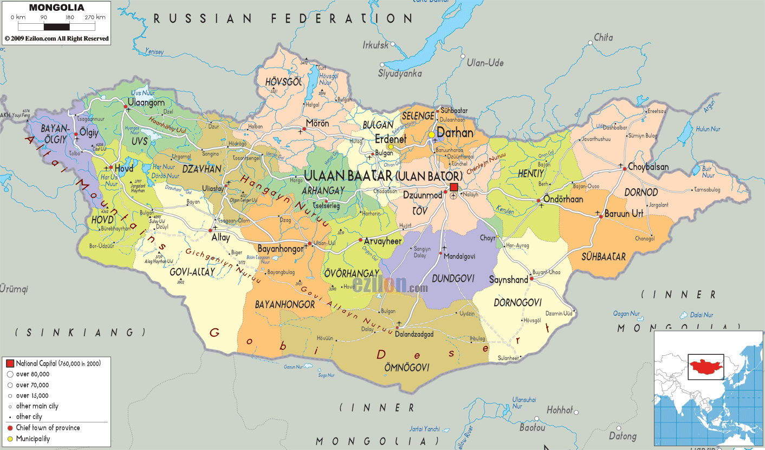

Slide 3




Background Information
PAS survey participants: Baatartsol Dayanjav, Davaadorj Rendoo
Institution name: The National Center for Public Health
Site location: 21th area, Bayanzurkh District
Site coordinates: Latitude: 47.927791, Longitude: 106.973774
Site type: Urban (city suburbs)
Sampling site is located north eastern place of Ulaanbaatar city, inside vicinity of “ger” district (Mongolian traditional dwellings which are heated by coal and wood burning).
Distance from PAS site to our laboratory was about 5 km, travel time about 30 min
Workshop “Elements to consider when designing a Global Monitoring Plan for Mercury”
13 – 14 February 2018, Rome, Italy

Slide 4
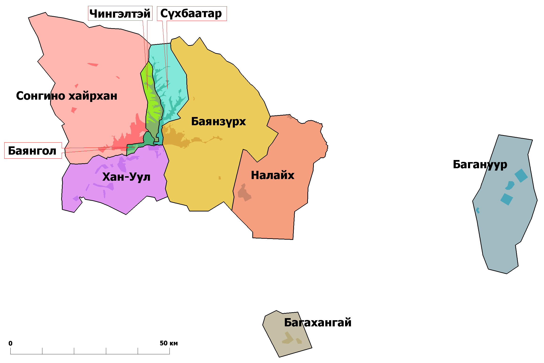

Ulaanbaatar city Districts
Downtown area, less smoke
PAS Site
Ger District
Bayanzurkh District
Ger District
Ger District

Slide 5
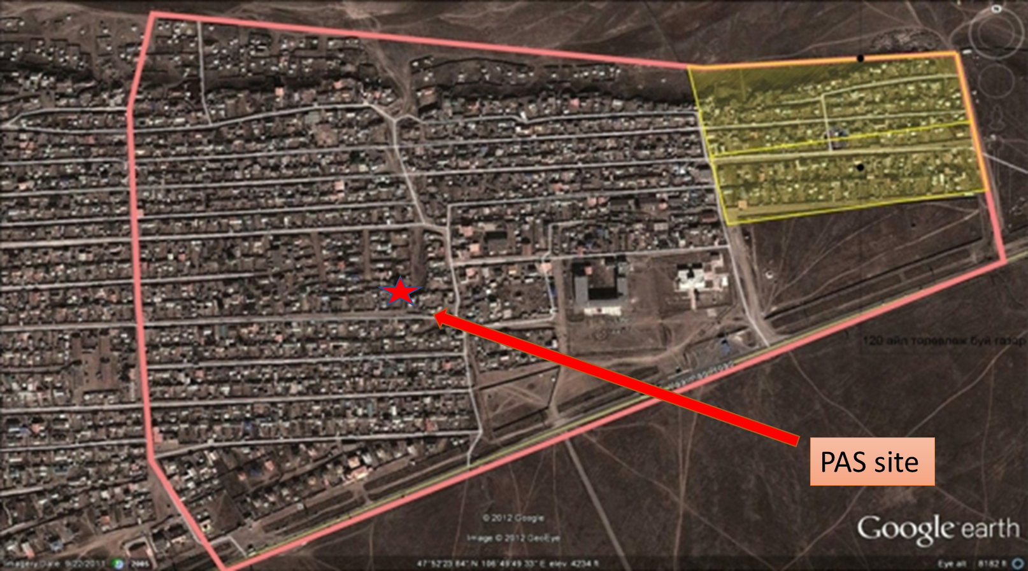
Workshop “Elements to consider when designing a Global Monitoring Plan for Mercury”
13 – 14 February 2018, Rome, Italy

Slide 6




General Site Characteristics
Much polluted area because of coal combustion and smokes.
During winter time, especially morning and evening there are covered by brown fog and acrid smoke from coal fires.
High ground and heavily populated.
We placed our PASs according to SOP and sampling tray was hanged 2m above ground and more than 0.5m distance from the one story building.
Workshop “Elements to consider when designing a Global Monitoring Plan for Mercury”
13 – 14 February 2018, Rome, Italy

Slide 7
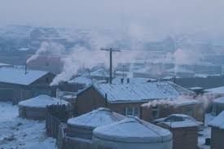
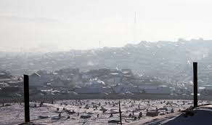
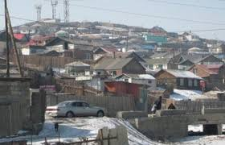
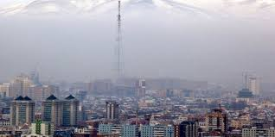
Ulaanbaatar suburbs winter time
Part of downtown

Slide 8
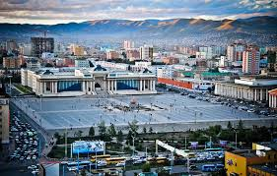
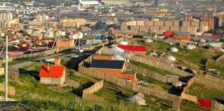
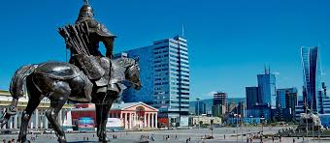
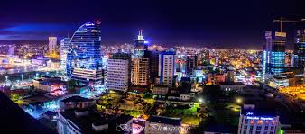
Ulaanbaatar suburbs summer time
Downtown
Workshop “Elements to consider when designing a Global Monitoring Plan for Mercury”
13 – 14 February 2018, Rome, Italy

Slide 9
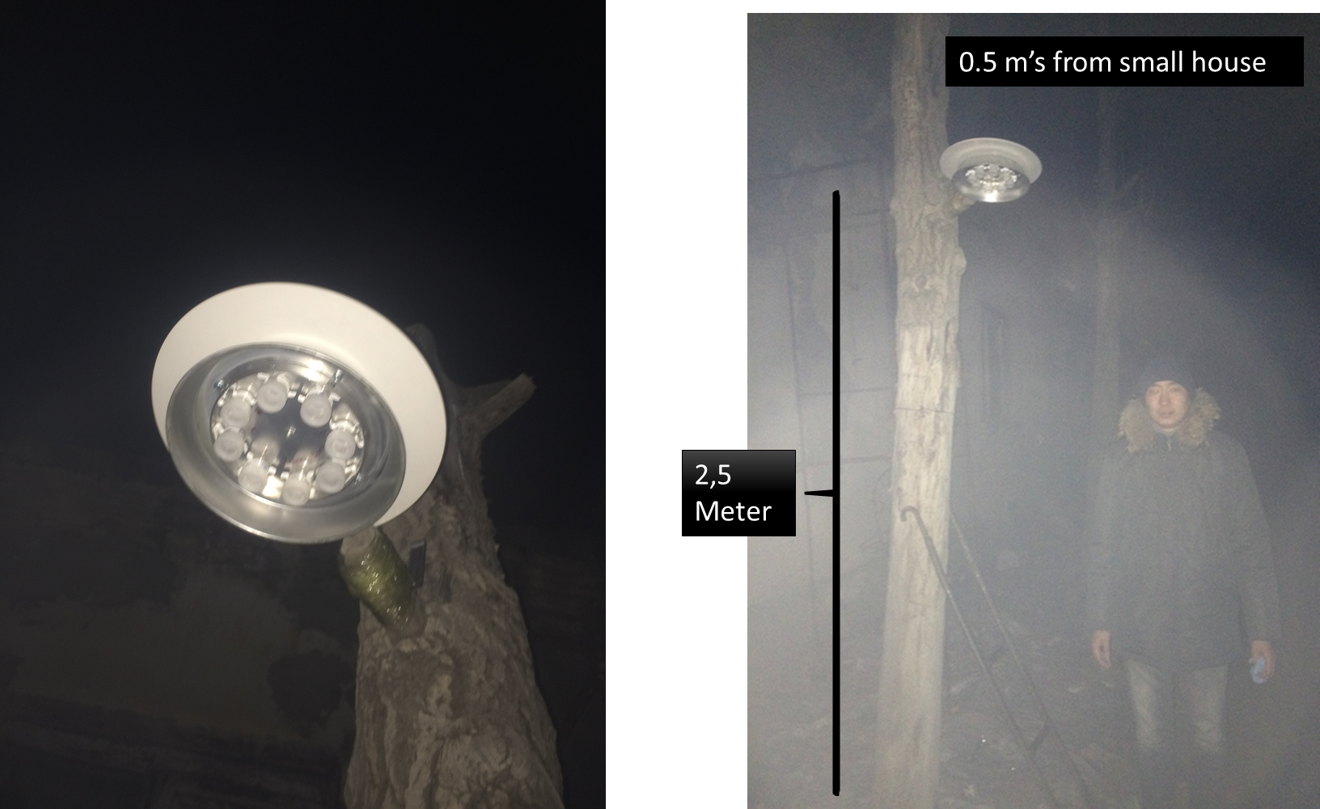
Workshop “Elements to consider when designing a Global Monitoring Plan for Mercury”
13 – 14 February 2018, Rome, Italy

Slide 10
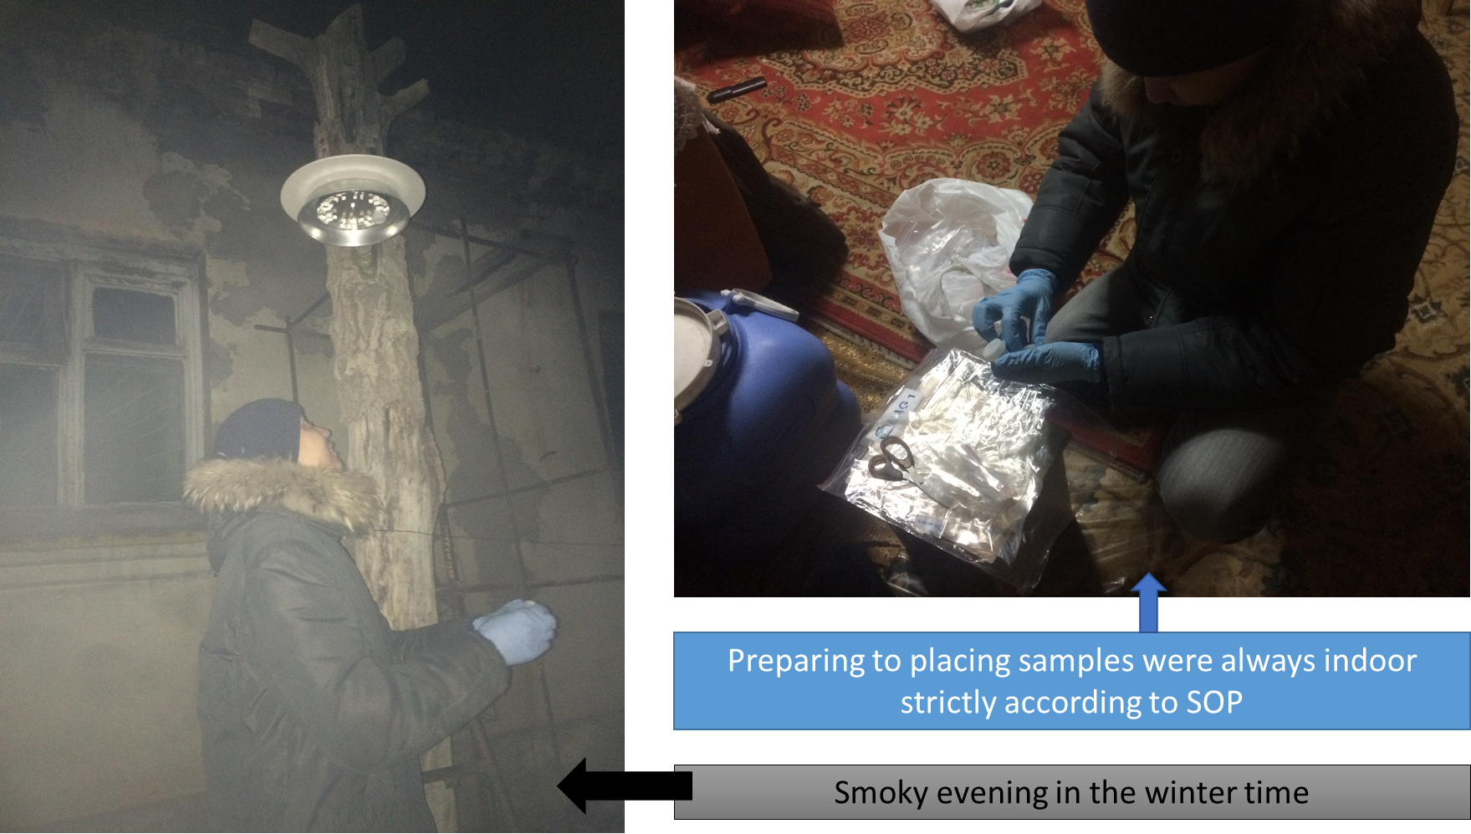
Workshop “Elements to consider when designing a Global Monitoring Plan for Mercury”
13 – 14 February 2018, Rome, Italy

Slide 11
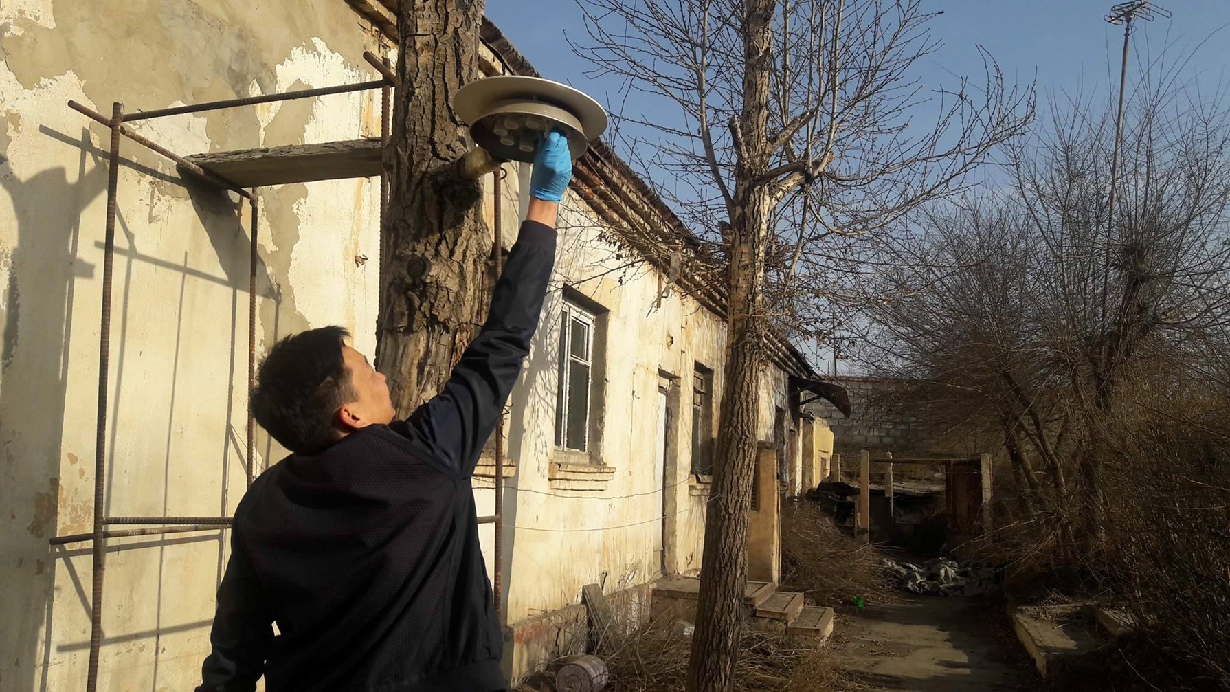
Workshop “Elements to consider when designing a Global Monitoring Plan for Mercury”
13 – 14 February 2018, Rome, Italy

Slide 12
Thank you
Workshop “Elements to consider when designing a Global Monitoring Plan for Mercury”
13 – 14 February 2018, Rome, Italy

