Slide 1





Workshop “Elements to consider when designing a Global Monitoring Plan for Mercury”
13 – 14 February 2018, Rome, Italy
GMOS network: characteristics and data management
Francesca Sprovieri and Nicola Pirrone
CNR-Institute for Atmospheric Pollution Research
CNR-IIA

Slide 2





Global Mercury Observation Network
Workshop “Elements to consider when designing a Global Monitoring Plan for Mercury”
13 – 14 February 2018, Rome, Italy

Slide 3
GMOS Oceanographic Program
Oceanographic Observation program including:
  Cruises over the Pacific Ocean
  Cruises over the Atlantic Ocean
  Cruises over the Mediterranean and North/Baltic Seas
Workshop “Elements to consider when designing a Global Monitoring Plan for Mercury”
13 – 14 February 2018, Rome, Italy

Slide 4
GMOS Aircraft-Based Program
Aircraft program which includes:
  Intercontinental Flights in the Upper Troposphere / Lower Stratosphere
  Regional scale flights in Europe up to the mid Troposphere
Workshop “Elements to consider when designing a Global Monitoring Plan for Mercury”
13 – 14 February 2018, Rome, Italy

Slide 5
GMOS: ground-based monitoring network
Workshop “Elements to consider when designing a Global Monitoring Plan for Mercury”
13 – 14 February 2018, Rome, Italy

Slide 6
  Equipment installed at all GMOS sites
Standard Operating Procedures (SOPs) for Hg
To ensure high quality, comparable atmospheric Hg measurements at all GMOS sites.
  TGM/GEM: Tekran 2537 or Lumex RA 915 AM
  Speciated Hg: Tekran 2537/1130/1135
Workshop “Elements to consider when designing a Global Monitoring Plan for Mercury”
13 – 14 February 2018, Rome, Italy

Slide 7
Data collection and Control System in the Global Mercury Observation network
GMOS - Near real-time data from GMOS sites
Workshop “Elements to consider when designing a Global Monitoring Plan for Mercury”
13 – 14 February 2018, Rome, Italy

Slide 8
Flagging Criteria and Flag Code
Raw Data
Raw Data
Raw Data
Flagging Criteria
Date | Time | Typ | C | Stat |  | AdTim | Vol | Bl | BlDev | MaxV | Area | ng/m3 | Automated Flag
8/7/2012 | 15:00:00 | CONT | A | OK | 0 | 300 | 4.98 | 0.096 | 0.078 | 0.11 | 69197 | 2.698 | W_{x}
8/7/2012 | 15:05:00 | CONT | B | OK | 0 | 300 | 5 | 0.096 | 0.057 | 0.123 | 105947 | 3.188 | W_{x}
8/7/2012 | 15:10:00 | CONT | A | OK | 0 | 300 | 5 | 0.097 | 0.075 | 0.11 | 64483 | 2.506 | W_{x}
8/7/2012 | 15:15:00 | CONT | B | OK | 0 | 300 | 5 | 0.097 | 0.084 | 0.123 | 115426 | 3.474 | OK
8/7/2012 | 15:20:00 | CONT | A | OK | 0 | 300 | 5 | 0.097 | 0.042 | 0.11 | 68667 | 2.669 | OK
8/7/2012 | 15:25:00 | CONT | B | OK | 0 | 300 | 4.99 | 0.097 | 0.08 | 0.124 | 112975 | 3.4 | I_{x}
8/7/2012 | 15:30:00 | CONT | A | OK | 0 | 300 | 5 | 0.097 | 0.082 | 0.111 | 67968 | 2.642 | I_{x}
8/7/2012 | 15:35:00 | CONT | B | OK | 0 | 300 | 4.99 | 0.097 | 0.062 | 0.125 | 115421 | 3.474 | OK
8/7/2012 | 15:40:00 | CONT | A | OK | 0 | 300 | 5 | 0.098 | 0.1 | 0.111 | 75448 | 2.932 | I_{x}
8/7/2012 | 15:45:00 | CONT | B | OK | 0 | 300 | 5 | 0.098 | 0.075 | 0.125 | 121046 | 3.642 | W_{x}
8/7/2012 | 15:50:00 | CONT | A | OK | 0 | 300 | 5 | 0.098 | 0.07 | 0.112 | 71704 | 2.788 | W_{x}
8/7/2012 | 15:55:00 | CONT | B | OK | 0 | 300 | 5 | 0.098 | 0.066 | 0.124 | 117140 | 3.525 | OK
8/7/2012 | 16:00:00 | CONT | A | OK | 0 | 300 | 5 | 0.098 | 0.088 | 0.111 | 66353 | 2.58 | OK
8/7/2012 | 16:05:00 | CONT | B | OK | 0 | 300 | 5 | 0.098 | 0.062 | 0.124 | 112641 | 3.389 | I_{x}
8/7/2012 | 16:10:00 | CONT | A | OK | 0 | 300 | 5 | 0.098 | 0.083 | 0.11 | 58405 | 2.271 | W_{x}
8/7/2012 | 16:15:00 | CONT | B | OK | 0 | 300 | 5 | 0.098 | 0.072 | 0.123 | 105796 | 3.183 | I_{x}
8/7/2012 | 16:20:00 | CONT | A | OK | 0 | 300 | 5 | 0.098 | 0.048 | 0.11 | 67993 | 2.643 | OK
8/7/2012 | 16:25:00 | CONT | B | OK | 0 | 300 | 4.99 | 0.098 | 0.085 | 0.123 | 102309 | 3.079 | I_{x}
8/7/2012 | 16:30:00 | CONT | A | OK | 0 | 300 | 5 | 0.099 | 0.073 | 0.11 | 63127 | 2.454 | OK
8/7/2012 | 16:35:00 | CONT | B | OK | 0 | 300 | 4.99 | 0.099 | 0.063 | 0.124 | 101409 | 3.052 | OK
8/7/2012 | 16:40:00 | CONT | A | OK | 0 | 300 | 5 | 0.099 | 0.047 | 0.111 | 56470 | 2.195 | OK
Date | Time | Typ | C | Stat |  | AdTim | Vol | Bl | BlDev | MaxV | Area | ng/m3 | Auto
8/7/2012 | 15:00:00 | CONT | A | OK | 0 | 300 | 4.98 | 0.096 | 0.078 | 0.11 | 69197 | 2.698
8/7/2012 | 15:05:00 | CONT | B | OK | 0 | 300 | 5 | 0.096 | 0.057 | 0.123 | 105947 | 3.188
8/7/2012 | 15:10:00 | CONT | A | OK | 0 | 300 | 5 | 0.097 | 0.075 | 0.11 | 64483 | 2.506
8/7/2012 | 15:15:00 | CONT | B | OK | 0 | 300 | 5 | 0.097 | 0.084 | 0.123 | 115426 | 3.474
8/7/2012 | 15:20:00 | CONT | A | OK | 0 | 300 | 5 | 0.097 | 0.042 | 0.11 | 68667 | 2.669
8/7/2012 | 15:25:00 | CONT | B | OK | 0 | 300 | 4.99 | 0.097 | 0.08 | 0.124 | 112975 | 3.4
8/7/2012 | 15:30:00 | CONT | A | OK | 0 | 300 | 5 | 0.097 | 0.082 | 0.111 | 67968 | 2.642
8/7/2012 | 15:35:00 | CONT | B | OK | 0 | 300 | 4.99 | 0.097 | 0.062 | 0.125 | 115421 | 3.474
8/7/2012 | 15:40:00 | CONT | A | OK | 0 | 300 | 5 | 0.098 | 0.1 | 0.111 | 75448 | 2.932
8/7/2012 | 15:45:00 | CONT | B | OK | 0 | 300 | 5 | 0.098 | 0.075 | 0.125 | 121046 | 3.642
8/7/2012 | 15:50:00 | CONT | A | OK | 0 | 300 | 5 | 0.098 | 0.07 | 0.112 | 71704 | 2.788
8/7/2012 | 15:55:00 | CONT | B | OK | 0 | 300 | 5 | 0.098 | 0.066 | 0.124 | 117140 | 3.525
8/7/2012 | 16:00:00 | CONT | A | OK | 0 | 300 | 5 | 0.098 | 0.088 | 0.111 | 66353 | 2.58
8/7/2012 | 16:05:00 | CONT | B | OK | 0 | 300 | 5 | 0.098 | 0.062 | 0.124 | 112641 | 3.389
8/7/2012 | 16:10:00 | CONT | A | OK | 0 | 300 | 5 | 0.098 | 0.083 | 0.11 | 58405 | 2.271
8/7/2012 | 16:15:00 | CONT | B | OK | 0 | 300 | 5 | 0.098 | 0.072 | 0.123 | 105796 | 3.183
8/7/2012 | 16:20:00 | CONT | A | OK | 0 | 300 | 5 | 0.098 | 0.048 | 0.11 | 67993 | 2.643
8/7/2012 | 16:25:00 | CONT | B | OK | 0 | 300 | 4.99 | 0.098 | 0.085 | 0.123 | 102309 | 3.079
8/7/2012 | 16:30:00 | CONT | A | OK | 0 | 300 | 5 | 0.099 | 0.073 | 0.11 | 63127 | 2.454
8/7/2012 | 16:35:00 | CONT | B | OK | 0 | 300 | 4.99 | 0.099 | 0.063 | 0.124 | 101409 | 3.052
8/7/2012 | 16:40:00 | CONT | A | OK | 0 | 300 | 5 | 0.099 | 0.047 | 0.111 | 56470 | 2.195
OK
I_{x}
W_{x}
Workshop “Elements to consider when designing a Global Monitoring Plan for Mercury”
13 – 14 February 2018, Rome, Italy

Slide 9

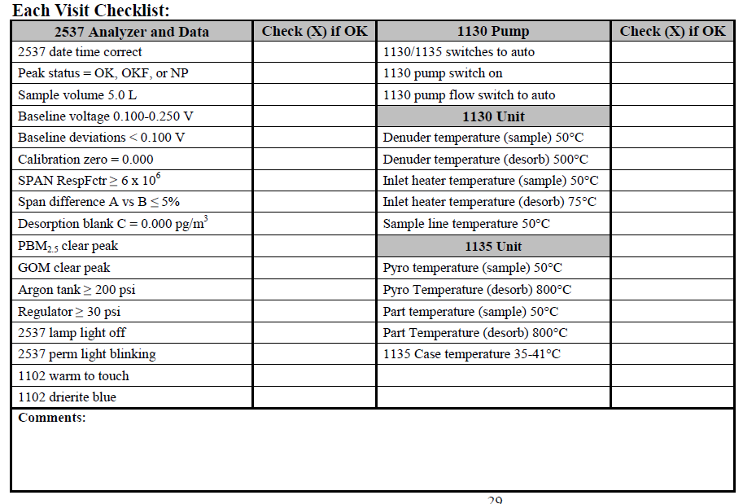
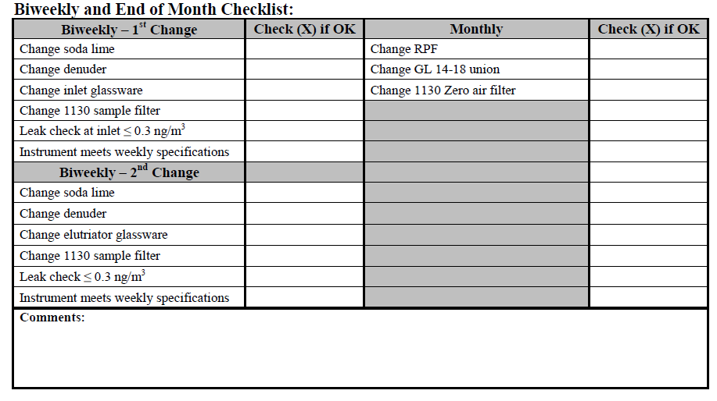
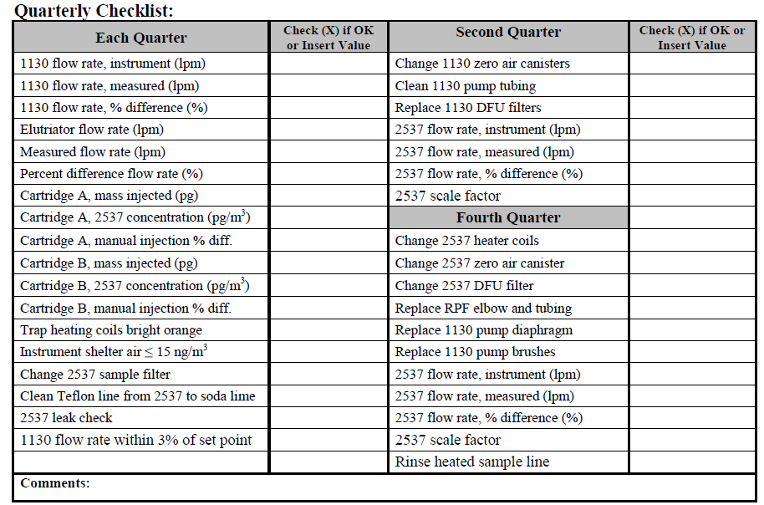
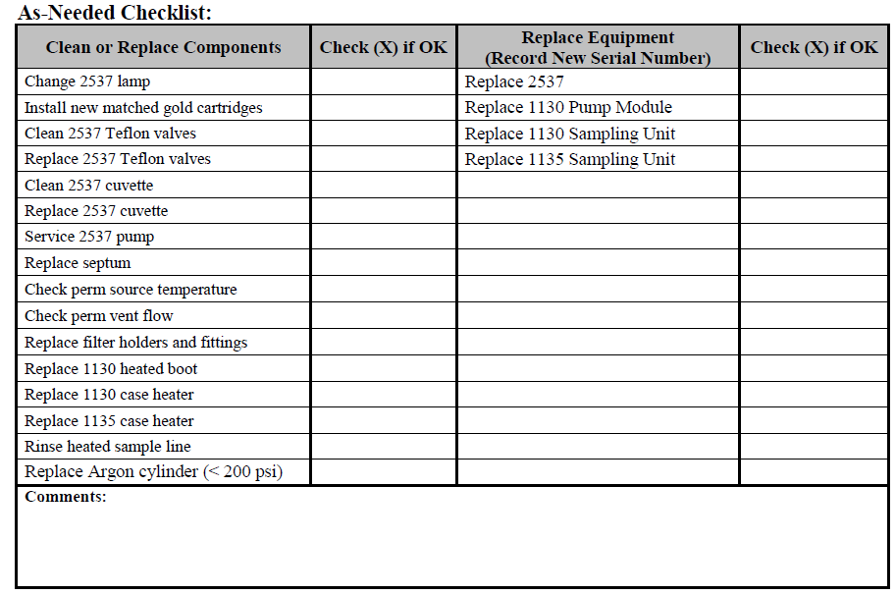
Log Book service
How to help site operators to strictly follow the GMOS SOPs?
How to take into account the maintenance period?
Workshop “Elements to consider when designing a Global Monitoring Plan for Mercury”
13 – 14 February 2018, Rome, Italy

Slide 10
GMOS - Data Quality Management System
- GDQM -
Workshop “Elements to consider when designing a Global Monitoring Plan for Mercury”
13 – 14 February 2018, Rome, Italy

Slide 11
Time-series highlighting the final (valid or invalid) Longobucco GEM dataset after all the G-DQM step processes.
Workshop “Elements to consider when designing a Global Monitoring Plan for Mercury”
13 – 14 February 2018, Rome, Italy

Slide 12
GMOS – Spatial Data Infrastructure
Workshop “Elements to consider when designing a Global Monitoring Plan for Mercury”
13 – 14 February 2018, Rome, Italy

Slide 13
GMOS Raw Data Coverage
Workshop “Elements to consider when designing a Global Monitoring Plan for Mercury”
13 – 14 February 2018, Rome, Italy

Slide 14
GOM & PBM Consistency
Workshop “Elements to consider when designing a Global Monitoring Plan for Mercury”
13 – 14 February 2018, Rome, Italy

Slide 15
Workshop “Elements to consider when designing a Global Monitoring Plan for Mercury”
13 – 14 February 2018, Rome, Italy

Slide 16
GEM yearly distribution at GMOS stations
for (a) 2013 and (b) 2014.
The sites have been organized according to their latitude from those in the Northern Hemisphere to those in the tropics and in the Southern Hemisphere.
The 2013 and 2014 GEM annual mean concentrations:
1.55 and 1.51 ngm-3, in NH
1.23 and 1.22 ngm-3 in Tropical
0.93 and 0.97 ngm-3 in SH
A clear gradient of GEM concentrations between the Northern and Southern hemispheres is seen in the data for both 2013 and 2014, in line with previous studies
(Soerensen et al., 2010a, b; Sommar et al., 2010;
Lindberg et al., 2007;
Sprovieri et al., 2010b).
Sprovieri et al., Atmospheric Mercury Concentrations observed at ground-based monitoring sites globally distributed in the framework of the GMOS network, Atmos. Chem. Phys., 16, 1–21, 2016;
Workshop “Elements to consider when designing a Global Monitoring Plan for Mercury”
13 – 14 February 2018, Rome, Italy

Slide 17
Monthly statistical GEM distribution and spatial gradient from Northern to Southern Hemispheres
2013
Sprovieri et al., Atmospheric Mercury Concentrations observed at ground-based monitoring sites globally distributed in the framework of the GMOS network, Atmos. Chem. Phys., 16, 1–21, 2016;
Workshop “Elements to consider when designing a Global Monitoring Plan for Mercury”
13 – 14 February 2018, Rome, Italy

Slide 18
Monthly statistical GEM distribution and spatial gradient from Northern to Southern Hemispheres
2014
Sprovieri et al., Atmospheric Mercury Concentrations observed at ground-based monitoring sites globally distributed in the framework of the GMOS network, Atmos. Chem. Phys., 16, 1–21, 2016;
Workshop “Elements to consider when designing a Global Monitoring Plan for Mercury”
13 – 14 February 2018, Rome, Italy

Slide 19
Workshop “Elements to consider when designing a Global Monitoring Plan for Mercury”
13 – 14 February 2018, Rome, Italy

Slide 20
GMOS sites Selected for Hg wet deposition flux assessment
Sprovieri et al., Five-year records of mercury wet deposition flux at GMOS sites in the Northern and Southern hemispheres, Atmos. Chem. Phys., 17, 2689-2708, doi:10.5194/acp-17-2689-2017, 2017.
Workshop “Elements to consider when designing a Global Monitoring Plan for Mercury”
13 – 14 February 2018, Rome, Italy

Slide 21
Annual wet deposition fluxes and corresponding rainfall recorded
Wet deposition samples were collected from 2011 to 2015, at 17 selected GMOS monitoring sites located in the Northern and Southern hemispheres, as well as in the tropical area.
The magnitude of Hg wet deposition varies geographically and seasonally due to different meteorological and climatic conditions, atmospheric chemistry, and anthropogenic influences.
In the NH and specifically at the European stations, a geographical trend with an increase in THg wet deposition from north to south has been observed. These findings are in good agreement with the geographical distribution of atmospheric Hg data obtained during the same period within the GMOS network with a downward gradient from the Northern to the Southern Hemisphere.
Sprovieri et al., Five-year records of mercury wet deposition flux at GMOS sites in the Northern and Southern hemispheres, Atmos. Chem. Phys., 17, 2689-2708, doi:10.5194/acp-17-2689-2017, 2017.
Workshop “Elements to consider when designing a Global Monitoring Plan for Mercury”
13 – 14 February 2018, Rome, Italy

Slide 22
Annual wet deposition fluxes and corresponding rainfall recorded at GMOS sites
Annual and seasonal patterns in Hg wet deposition are clearly evident at all GMOS sites, implying a significant dependence on meteorological conditions throughout the years.
Interannual differences in THg wet deposition are mostly linked with precipitation amounts, with the greatest deposition flux occurring in the wettest years.
Geographic differences in THg wet deposition may be explained in part by the proximity to atmospheric sources and regional difference in anthropogenic emission sources.
Workshop “Elements to consider when designing a Global Monitoring Plan for Mercury”
13 – 14 February 2018, Rome, Italy

Slide 23


GMOS Major findings and goals…..
❖ As a starting point of a global network, these results provided a set of useful data for modeling applications on regional and global scale to understand patterns, transformation, and deposition mechanisms of atmospheric Hg worldwide.
It is necessary to point out therefore, the need to expand the global network particularly in areas with scarce Hg data coverage, such as in the Southern Hemisphere and Tropics, including contaminated sites to provide new and more information throughout long-term monitoring activities to support:
The objectives of GEO Flagship on Global Observation System for Mercury (GOS⁴M) aimed to develop a coordinated global observation network for Mercury in the framework of the GEO Strategic Plan (2016-2025) as well as…. (www.gos4m.org)
The goals of GEOSS, International programmes i.e., UNEP Mercury Program - Global Partnership on Mercury (F&T), and International conventions on toxic compounds i.e., Minamata Convention.
Integrated Global Observing Systems for Persistent Pollutants
www.igosp.eu
www.era-planet.eu
Workshop “Elements to consider when designing a Global Monitoring Plan for Mercury”
13 – 14 February 2018, Rome, Italy

Slide 24




As part of UNEP F&T, GMOS network is supporting EC, UNEP and Nations in the
MC Convention implementation in conjunction with on-going initiatives, i.e., UNEP-GEF Project
Development of a Plan for Global Monitoring of Human Exposure
to and Environmental Concentrations of Mercury
Workshop “Elements to consider when designing a Global Monitoring Plan for Mercury”
13 – 14 February 2018, Rome, Italy

Slide 25
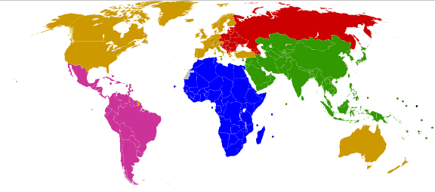
Development of a Plan for Global Monitoring of Human Exposure
to and Environmental Concentrations of Mercury
Development of an air monitoring plan to:
Establish a network for atmospheric Hg measurements by developing
passive air sampling devices to complement the GMOS work;
Conduct a pilot testing of the atmospheric network for one year;
Draft a proposal for a worldwide air monitoring plan, including interaction between active and passive sampling techniques.
Expected Outcome:
Enhanced understanding of
mercury concentrations
in ambient air through the
strengthening of the
GMOS network and the
development of the
complementary passive
air sampling (PASs) network
for ambient air concentrations.
Italy
Russian Federation
Mongolia
Japan
China
Costa Rica
Ghana
Argentina
India
South Africa
Workshop “Elements to consider when designing a Global Monitoring Plan for Mercury”
13 – 14 February 2018, Rome, Italy

