Slide 1
Disposal of waste containing mercury
Sven Hagemann
GRS

Slide 2
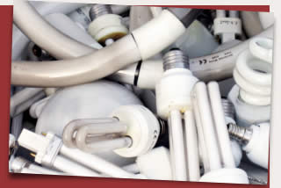
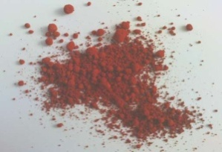
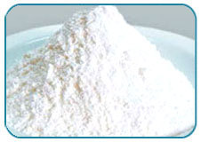
Whate are Mercury Containing Wastes?
End of life products
Stabilized mercury
Other mercury compounds

Slide 3
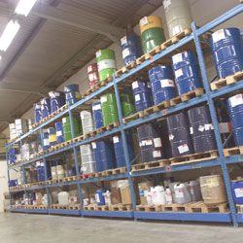
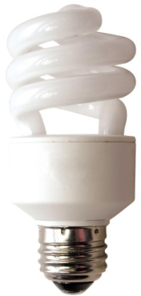
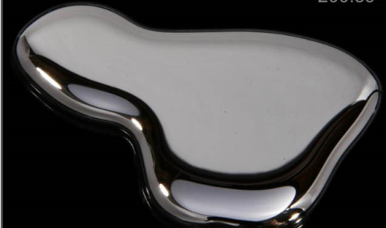
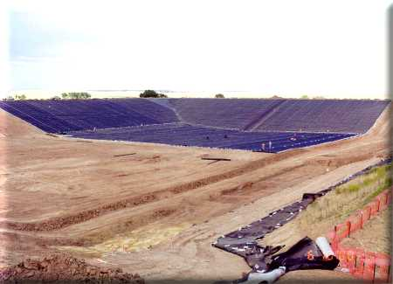
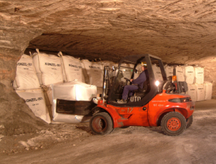
Management Options for Mercury Containing Wastes
Extraction
?
Use
Temporary storage
End of life products
Stabilization
?
Temporary storage
Specially engineered landfill
Stabilized mercury
Temporary storage
Other mercury compounds
Permanent storage in underground mines

Slide 4
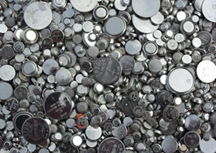
Other, not recommended disposal options
→ Source of mercury emissions during disposal and after closure
Municipal waste landfill
End of life products
Direct disposal without treatment
Specially engineered landfill
Stabilized mercury
Direct disposal
→ hydrogen gas generation (corrosion)
Batteries
Permanent storage in underground mines

Slide 5
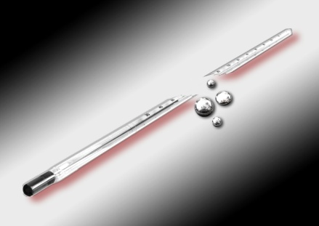
Important steps in managing Mercury containing wastes
Separate Collection
  Waste Collection Stations or Drop-off Depots
  Collection at Public Places or Shops
  Collection at Households by Collectors
Storage pending recycling/ extraction operations

Slide 6
Important steps in managing Mercury containing wastes
Recycling/ extraction operations
  Pre-treatment
  Thermal treatment
Management of extracted mercury
  Storage
  Stabilization
Final disposal (operations not leading to re-use)

Slide 7
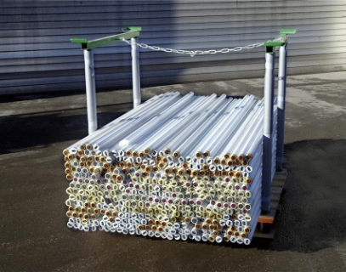
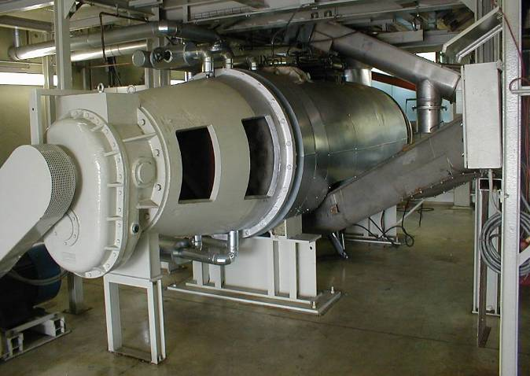
Treatment and disposal of mercury containing lamps
Mechanical crushing + sieving
Sealed with constant exhaust gas control
Glas
(containing Hg)
Phospor powder
(containing Hg)
Metal end caps
(containg Hg)
Thermal treatment
Rotary kiln/
vaccum mixer
Condensation
Glas
(Hg-free)
Phospor powder
(Hg free)
Metal end caps
(Hg free)
Re-Use
Re-Use
Re-Use

Slide 8
Treatment and disposal of mercury containing batteries
Separation
Sealed with constant exhaust gas control
Mercury containng batteries
Mercury free batteries
Mixed batteries
Thermal treatment
Metal
Scrap
Condensation
Metall recycling
Re-Use

Slide 9
Recycling and disposal – some general observations
Separate collection
With few global exceptions, collection quota for mercury added products are low or negligable
→ Larger part: → municipal waste → solid waste landfill/ waste incineration
Recycling of mercury products
Performed by specialized companies, often operating internationally
As far as known, in most Asian countries no or not sufficient recycling plants
→ mercury waste cannot be recycled and not environmentally sound disposed

Slide 10
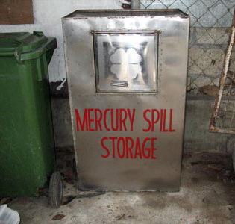
Disposal of mercury containing waste
– Opportunities and Challenges
Opportunities
Well established technologies exist
Recycling generates Hg-free material that may be used again
Small amount of remaining waste that has to be disposed
Challenges
Final disposal without treatment not recommended
Separate management requires effective separate collection
Recycling plants in Asia often lacking

