Slide 1
Storage and disposal of mercury and mercury waste in Asia - Conclusions
Sven Hagemann
GRS

Slide 2
Summary – Situational analysis
Regional level
Regional mercury surplus probably expected after 2020
(5,500 – 7,500 t)
Regional amount of mercury in waste unknown, but will probably be in the order of the annual regional demand (2,000 t) plus legacy of past uses
National level
National surplus already exist (1 country) or may be expected soon in some other countries
Due to national mercury waste management programs: increasing amounts of mercury waste for which no national or regional disposal/ extraction option exists

Slide 3
Summary – intermediate management options
Temporary storage
Established concepts for storing waste including mercury waste exist

Slide 4
Summary – Management options for surplus mercury
Stabilization
Industrial scale stabilization technology commercially available
New concept:
Stabilization - storage - final disposal
(underground or landfill?)
Storage/ Disposal
Two concepts principally available and technically feasible for implementation:
  Aboveground warehouse storage of elemental mercury
  Underground storage of stabilized mercury
Costs 3,000 – 5,000 USD/t
Both concepts with specific strengths and challenges
Further Evaluation needed for:
Aboveground disposal of stabilized mercury
Deep injection of mercury sulphide need more investigation

Slide 5
Comparison of main management concepts
 | Opportunities | Challenges
Aboveground storage of elemental mercury | May be realized soon Many potential sites | Institutional stability Fate of mercury after planned storage period Mercury remains in biosphere
Stabilization/ Underground storage | Stabilized Hg less hazardous Permanent isolation from biosphere Option also for Hg waste | Lengthy site selection process Costly stabilization
Export | May be necessary as long domestic storage/disposal facilities are not available | May be more expensive than regional solution
Temporary storage | Necessary as long as regional storage/disposal facilities are not available Could be done nationally using existing facilities | No final solution

Slide 6
Summary – Intermediate management options
All discussed concepts need considerable time to be implemented (5-10 years)
need for intermediate solutions: temporary storage in adequate facilities
Temporary storage in specialized waste storage buildings
  at private or state owned waste management centres
Export for storage in another region probably not feasible
Export for disposal may be an intermediate option

Slide 7
Summary – Legal constraints
Classification of surplus mercury
Surplus mercury may automatically be considered waste if intended for treatment/ disposal within or beyond national borders
Regional approaches
Regional solutions for the management of mercury waste hampered by national + international trade restrictions
If regional cooperation is desirable: need to adjust national legislation on transboundary shipment of waste
Safety requirements
Need to develop safety requirements consistent with national legislative framework in order to address mercury specific issues like storage, treatment, disposal

Slide 8
Conclusions 1
Surplus mercury
Although a regional surplus is still well ahead, national surpluses already exist or may occur soon
Need to prepare for national surpluses:
  Evaluate national or regional options,
  Develop management strategies
  Begin development of disposal facilities

Slide 9
Conclusions 2
Mercury waste
Some countries are ‘punished’ for introducing mercury management programs, since they have no possibility to dispose the collected waste
Mercury wastes piling in hospitals where they do not belong
Waste avoidance programs won’t help solving the problem of existing mercury waste
Urgent need to find adequate disposal solutions for mercury wastes
  Centralized temporary storage
  Access to or installation of recycling facilities
  Access to or installaition of facilities for stabilization
  Development of facilities for final disposal

Slide 10
Conclusions 3
Stabilization of elemental mecury
Technology available, but so far, not in the Asian region
Even if established in one Asian developing country, waste legislation may prevent shipment of mercury considered waste to it
→ Investigate option of a mobile plant that is shipped to the waste instead of shipping the waste to the plant

Slide 11
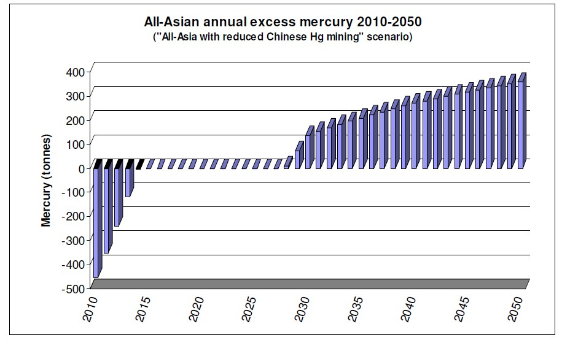
Summary - Timelines
Prepare for: →
Site selection, FS, Fin.Plan
Legal framework
Need for regional stabilization/
disposal
Need for regional treatment and disposal of Hg waste
Low quantities of national
surplus Hg:
Export for stabilization/ disposal
High quantities:
National stabilization/ disposal Export for stabilization/ disposal

Slide 12
Recommendations for environmentally sound management of surplus mercury
Effective Collection
Early Stabilization
Safe Disposal
Remove as much mercury from society as possible
Avoid use
Separate waste collection
Obligation to deliver surplus mercury
Avoid transport and storage of elemental mercury
Temporary storage of stabilized mercury
Isolate mercury from the biosphere
Underground storage
Specially engineered landfills?
Deep injection?

Slide 13
Milestones of environmentally sound management of surplus mercury
Effective Collection
Early Stabilization
Safe Disposal
0. Inventory/ National mercury management strategy

Slide 14
Milestones of environmentally sound management of surplus mercury
Effective Collection
Early Stabilization
Safe Disposal
1. Legal framework
2. Improved collection system and transport quality
4. Availability of stabilization plant
Availability of temporary storage facilities for stabilized mercury
5. Availability of facilities for the disposal of stabilized mercury, mercury waste
3. Availability of temporary storage facilities (end-users/ waste collection centers

Slide 15
Potential activities to improve the environmentally sound management of surplus mercury
Effective Collection
Early Stabilization
Safe Disposal
1. Legal framework
Develop regulatory toolbox
  Proposals for legislative structures and core elements of legislation/ regulation
  Management of mercury waste
  Management of non-waste elemental mercury, mercury compounds and mercury-added products
  Capacity building and assistance in developing appropriate national legislation (in cooperation with Basel regional centres)

Slide 16
Potential activities to improve the environmentally sound management of surplus mercury
Effective Collection
Early Stabilization
Safe Disposal
2. Collection system
Develop overview on best practices in national mercury waste management in the region
Analyse existing collection systems and explore ways to improve them
Assist countries in improving collection concepts

Slide 17
Potential activities to improve the environmentally sound management of surplus mercury
Effective Collection
Early Stabilization
Safe Disposal
3. Temporary storage facilities
Develop guidance on temporary storage at waste collection centres + industry
Develop guidance on the temporary storage of stabilized mercury
Inventory of Hazwaste management facilities

Slide 18
Potential activities to improve the environmentally sound management of surplus mercury
Effective Collection
Early Stabilization
Safe Disposal
4. Treatment/ stabilization
Inventory of mercury treatment/ recycling plants
Analyse feasibility of applying stabilization techn. in the region
Site selection (possibly after identification of disposal site), site-specific feasibility study

Slide 19
Potential activities to improve the environmentally sound management of surplus mercury
Effective Collection
Early Stabilization
Safe Disposal
5. Disposal
If a suitable options, identify specially engineered landfills that could be used for the disposal of stabilized mercury
Guidance on site selection criteria and process to identify suitable underground mines for permanent storage

Slide 20
Questions to guide the discussion
What are the most urgent needs related to surplus mercury and mercury wastes in your country?
What are the obstacles to implement an effective management program?
Do you think national strategies will suffice or a (sub-)regional cooperation is needed?
Could you imagine a (sub-) regional cooperation to manage hazardous waste?
Do you prefer one or the other management option? Why?
Your question

