Slide 1
Above ground storage of elemental mercury in warehouses
Sven Hagemann
GRS

Slide 2
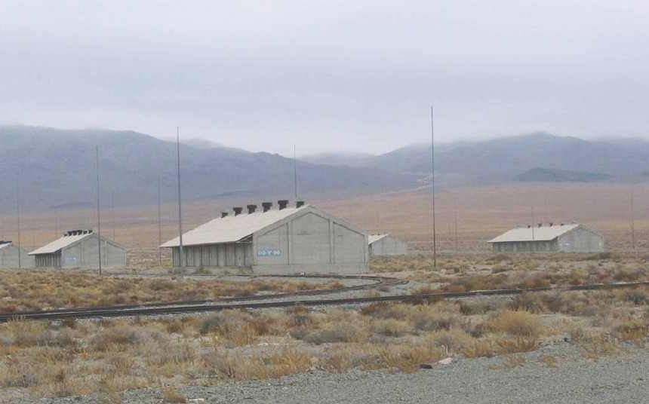
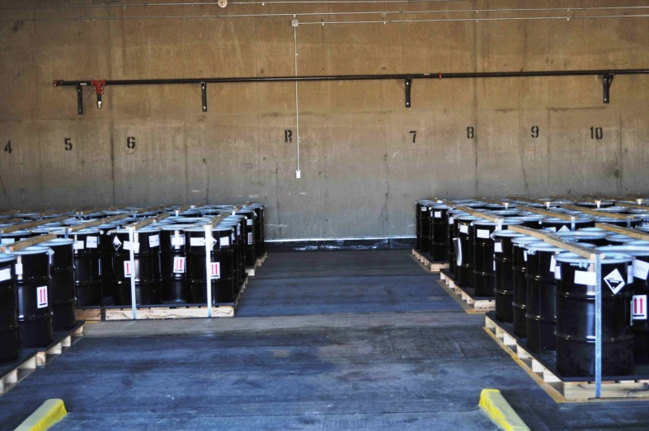
Long-term Management and Storage of Elemental Mercury in Warehouses
Concept
Placement of containers in aboveground warehouses
Technical safety measures:
  flooring, containers, fire protection
Organizational safety measures
  Monitoring, inspection, security
Implementation and options
USA: several facilities in use
Global options: locations with distance to sensible areas (population, water basins) and
low risk of environmental hazards
Notes:
In the USA, elemental mercury has been safely stored in form of govermental stockpiles for more than 50 years.
Costs:
US DOD: 15,000 USD/t for 40 years (US DOD storage facility for 4436 t). Project costs: 68,2 Mio USD. One-time costs: 11,2 Mio USD, Rent for 40 years: 57 Mio USD. Source Lynch (2007) DNSC Mercury Storage Costs
US DOE: 2400 – 7000 USD/t for 40 years (US DOE storage facility for 7,500 to 10,000 t). Project costs 17,8 to 51 Mio USD (all net present values)
Costs include closures costs (addtional 10 years of storage or stabilization & disposal). Source: USEPA 2007 Mercury Storage Cost Estimates

Slide 3
Important elements of warehouse operation
Mercury
Containers
Building
Operation
Security
Siting

Slide 4
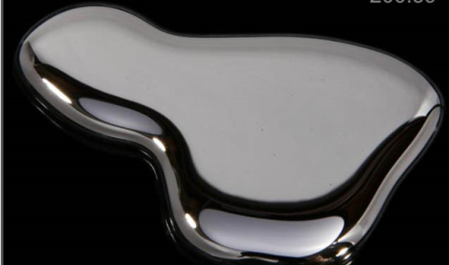
Requirements for mercury
Store only mercury of high purity (proposal for EU directive)
Mercury content greater than 99,9 % per weight;
No impurities capable of corroding carbon or stainless steel
(e.g. nitric acid solution, chloride salts solutions)
Impure mercury has to be purified before stored > 1 year

Slide 5
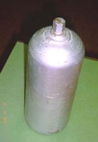
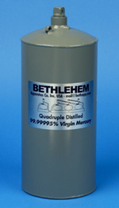
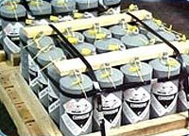
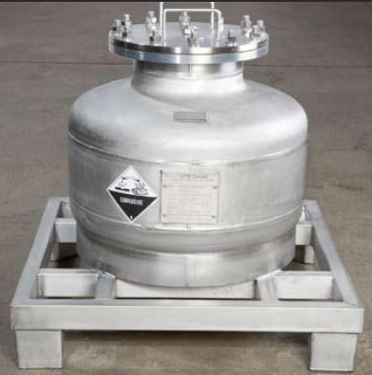
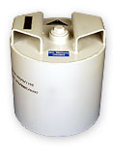
Mercury Container
Functions:
  Allows safe transport/ movement
  No releases of mercury to atmosphere/ floor (gas+ liquid tight)
  Resistance against storage conditions /climate/ temperature/ moisture
Standard container: 3 litre flask,
allowed for sea shipment, typically on palettes
Alternative: 1 t container, steel or stainless steel with or without inlay
(for sea shipment and storage only)
→ more expensive, but more robust

Slide 6
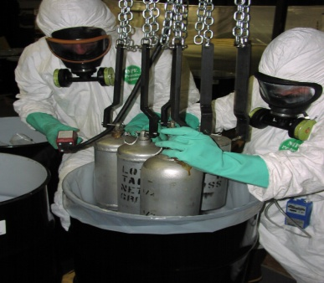
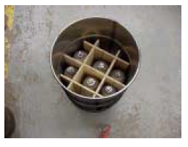

What to do with old flasks?
If integrity unknown → overpacking→ USA/ DNSC: Mercury in flasks (historically)/ overpacked in steel drums
Alternative: repackaging
→ more expensive, specialized facility needed

Slide 7
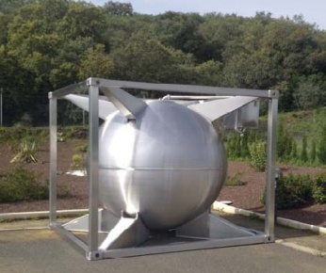
What to do with large quantities?
More effective to use large containers
  - commercially available
  1 t transport containers)
  Specialized storage containers of large capacity
Consider using specialized storage containers like the MERSADE50
(50 t capacity, double shell, monitoring system)
Mersade container (50t)

Slide 8
Building design and equipment
The storage site shall be provided with engineered or natural barriers adequate to protect the environment against mercury emissions
Floors covered with mercury-resistant sealants.
Slope with a collection sump
Fire protection system
Typical capacity: several 100 to 1,000 t
(Proposal for EU directive)

Slide 9

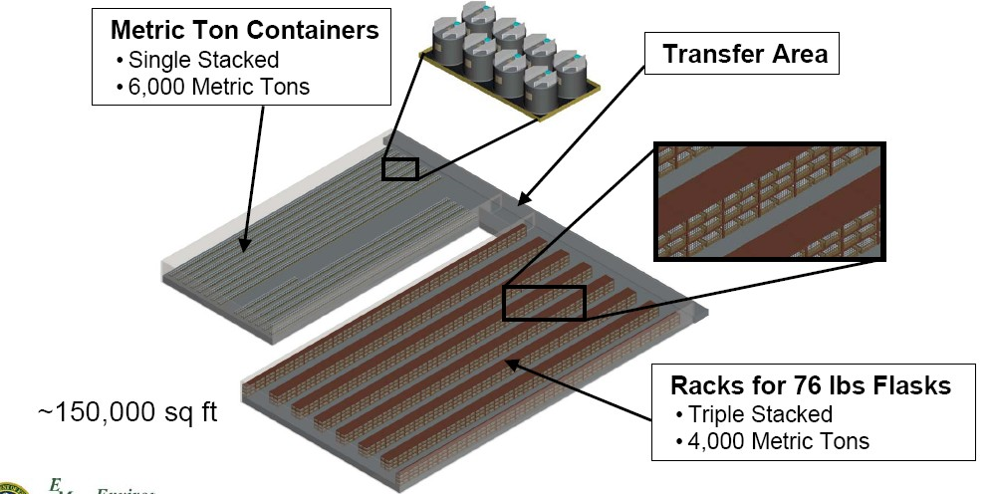
Operation
Ensure that all containers are easily retrievable
Metallic mercury shall be stored separately from
other waste
Containers shall be stored in collecting basins
(proposal for EU directive)
Proposed layout of US storage facility (DOE)

Slide 10
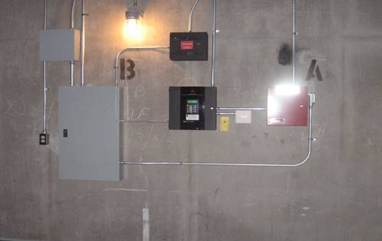
Security
Prevent unauthorized access (damaging, removal of containers)
Security (alarm) system
Frequent inspection
Enclosed area (fences)
Guarding

Slide 11
Siting: General criteria
      Infrastructure: Proximity of roads,
      transportation structure
      power + water supply
      Populated areas: Appropriate distance, considering the
      wind direction (150 m, UNDP 2010)
      Nature conservation: Apropriate distance from
      national parks, conservation areas,
      fragile environmental systems
      Stability: Country/region with predicted political, economical,
      institutional stability
      for the planned operation time
      Skilled workforce Trained in the handling of hazardous materials
  UNDP (2010) Guidance on the cleanup, temporary or intermediate storage, and transport of mercury waste from healthcare facilities

Slide 12
Site exclusion criteria (EPA 1997)
Factor | Avoid
Floodplains | Facilities below 100 year flood-level
Unstable Terrain | (1) Movement of rock and soil on steep slopes by gravity (e.g., landslides), (2) Rock and soil sinking, swelling, or heaving
Wetlands | Swamps, marshes, bayous, bogs, and Arctic tundra
Unfavorable Weather | Areas with stagnant air
Groundwater Conditions | Sites located over high-value groundwater or areas where the underground conditions are complex and not understood
Earthquake Zones | Site within 200 feet of a Holocene fault (that is, faults that have been active within the last 10,000 years)
Incompatible Land Use | Site near sensitive populations (elderly, children, sick) or in densely populated areas
Karst Soils | “Active” karst areas

Slide 13
Site exclusion criteria (EPA 1997)
Unfavorable Weather
Karst Soils
US EPA (1997) Sensitive
Environments and the
Siting of Hazardous Waste
Management Facilities
http://www.epa.gov/oswer/ej/pdf/sites.pdf

Slide 14
Siting: Social factors that may influence the site decision
  Historic land uses (official and unofficial)
  Vision of sustainable uses of land, water, and air resources
  Existing environmental conditions
  Conflicting land uses (e.g., use of a stream for fishing, use of a vacant lot for community vegetable gardening)
  Acceptable alternatives or modifications to proposed plans
  Religious, cultural, or other special values of the land
US EPA (2000) Social Aspects of Siting Hazardous Waste Facilities
http://www.epa.gov/osw/hazard/tsd/permit/site/k00005.pdf

Slide 15
Siting : Environmental Hazards in Asia

Slide 16
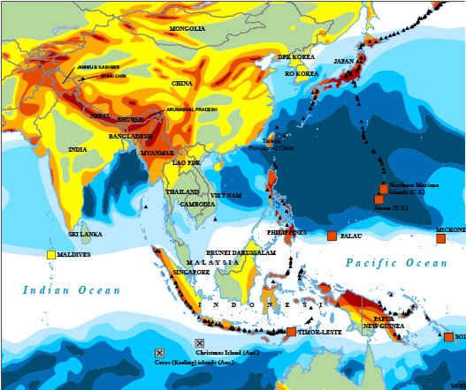
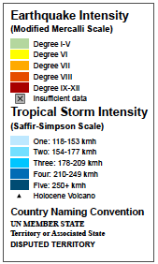
Environmental Hazards in the Region
Earthquakes, Tropical Storms, Vulcanism
Source: UN OCHA
Office for the Coordination of
Humanitarian Affairs
→ Construct warehouse so that it withstands local environmental conditions

Slide 17
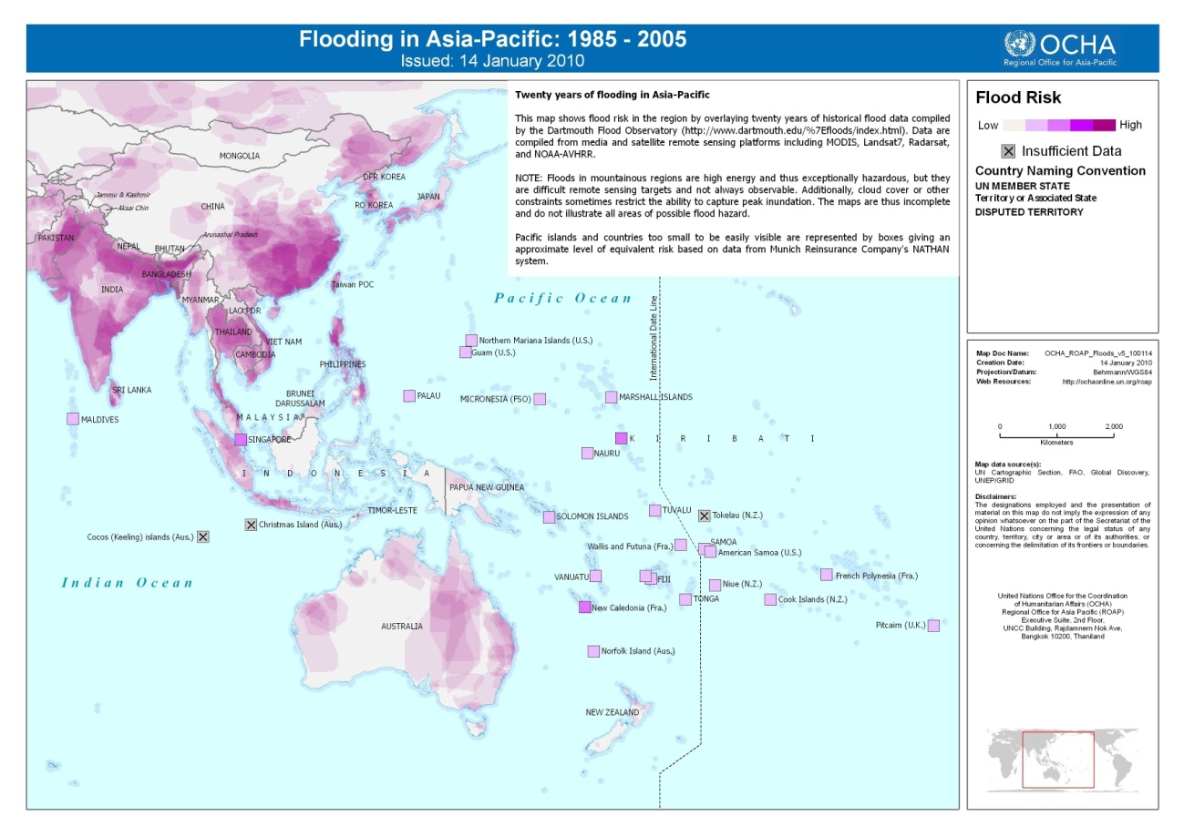
Environmental Hazards in the Region
Flooding

Slide 18
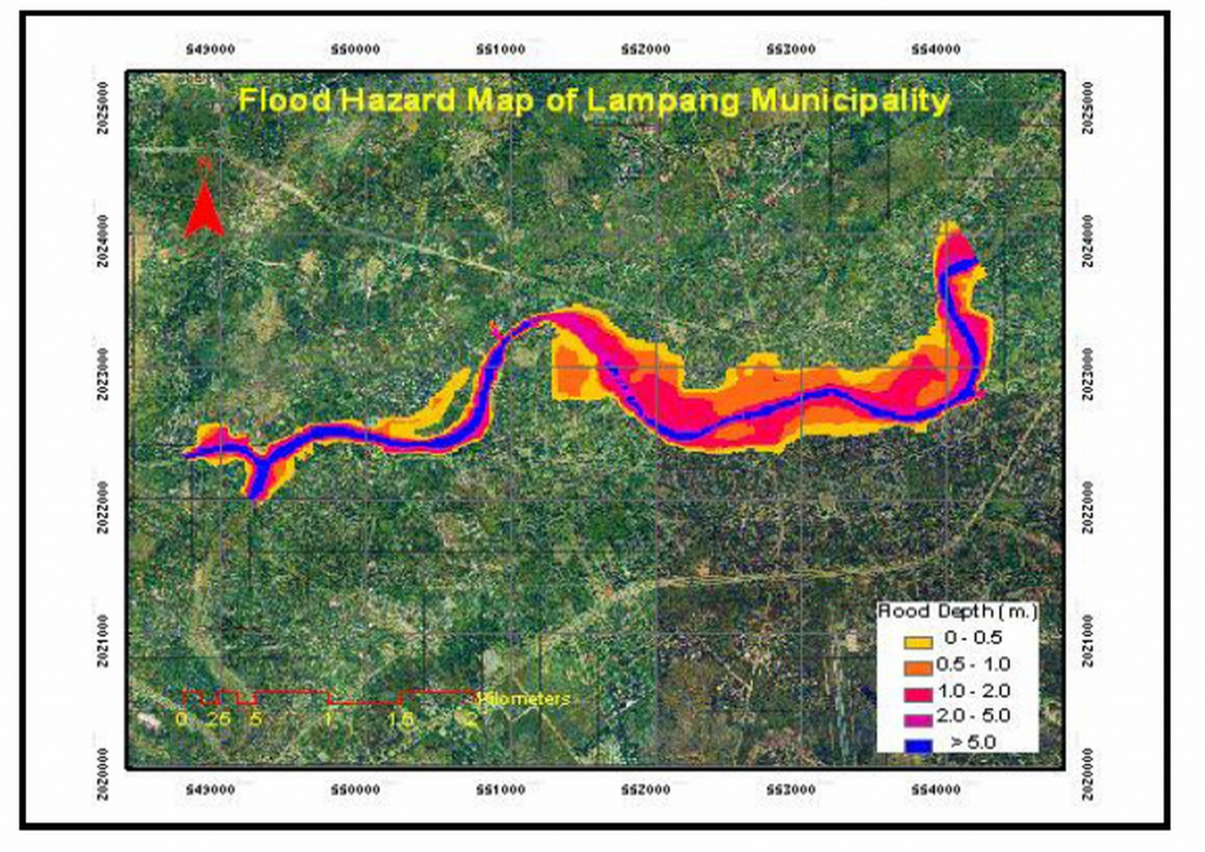
Environmental Hazards in the Region
Flooding
  Flood Hazard maps available for many major river systems
  Alternative:
  collect historical data/ memories from residents

Slide 19
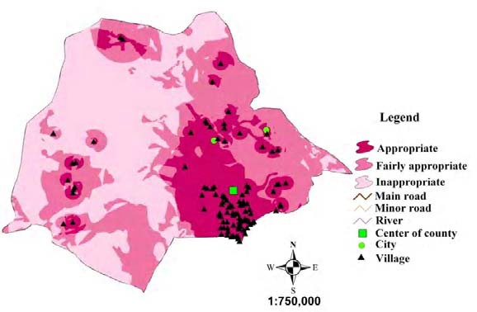
Identify candidate sites
Result of a stepwise site selection process.
Identification of appropriate areas for a landfill using
Geographic information systems (Kerman province of Iran)

Slide 20
Siting of a mercury warehouse: conclusions
A number of criteria exists that may guide through the site selection process
Most probably, many locations may be found, where a above ground facility may be constructed and operated
Not necessary to restrict on dry, cold areas, since warehouse and container could provide sufficient resistance against climatic conditions
To avoid unnecessary traffic, warehouse should be located near main producer (industry, recycling plant) or at a place easily accessible for transport (e.g. near harbour)

Slide 21
Conceptual study:
Aboveground storage of elemental mercury

Slide 22
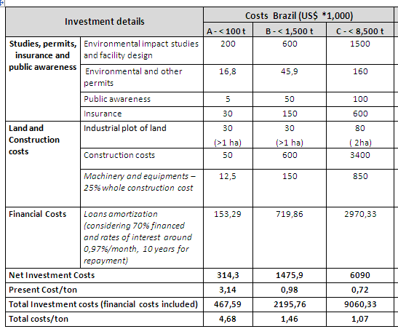
Aboveground storage of elemental mercury:
Investment costs (LAC)

Slide 23
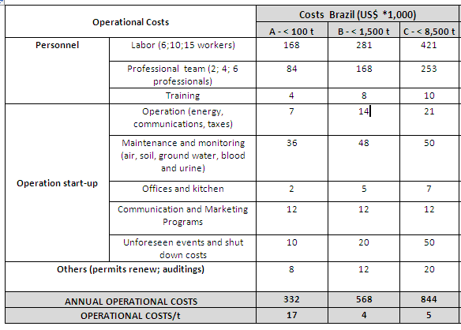
Aboveground storage of elemental mercury
Operational costs (LAC)

Slide 24
Aboveground storage of elemental mercury
Comparison LAC/ AP
Data for Asia/ Pacific: AIT/RRCAP
Data for LAC: LATU
Different approaches, similar results
→ Additional costs after 20 years!

Slide 25
Opportunities and challenges of above ground storage
Opportunities
Proven concept
Most probably, many suitable sites in most countries
Implementation (licensing, construction) within several years
Challenges
Does not „solve“ the problem: mercury still has to be actively managed
Further costs after planned life time of facility
Long-term safety depends on long-term political, economical and institutional stability
Liability remains with the owner
Not economical below a certain total quantity per country

