Slide 1
Permanent storage of hazardous wastes in underground mines
Sven Hagemann
GRS

Slide 2
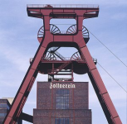
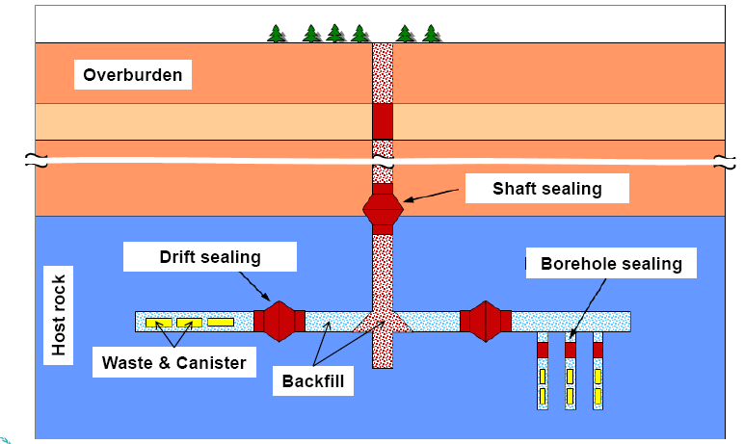
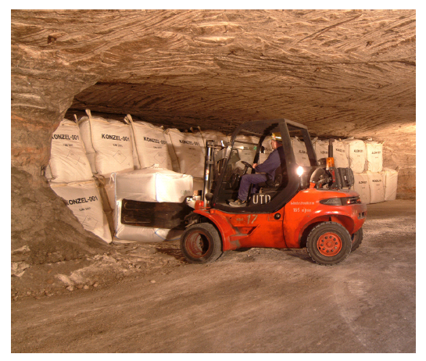
Permanent storage (=disposal) of hazardous wastes in underground mines
Concept:
Placement of containers in an underground mine
Sealing of mine and permanent isolation of mercury from the biosphere: >10,000 years
Passive long-term safety through multibarrier system (geological+technical)
Implementation and options
Some European countries
Notes:
Costs: Stabilization + disposal: 2,000 EUR (2,700 USD) (one time cost). Source: DELA/ SAKAB

Slide 3
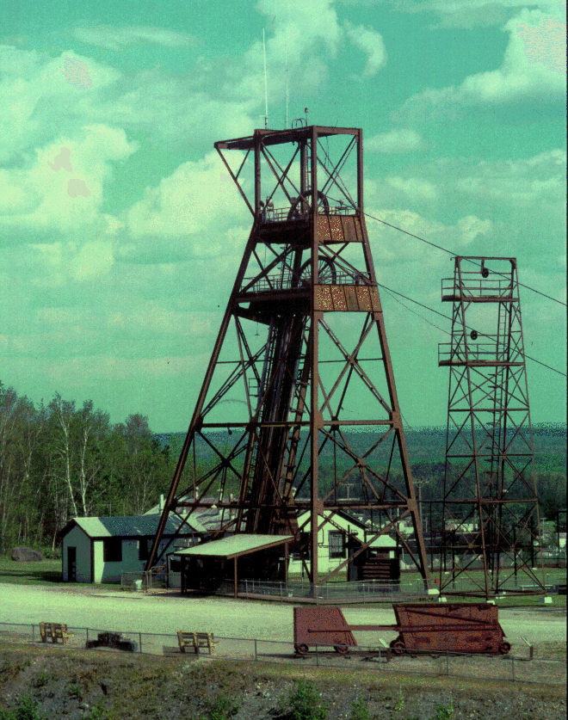
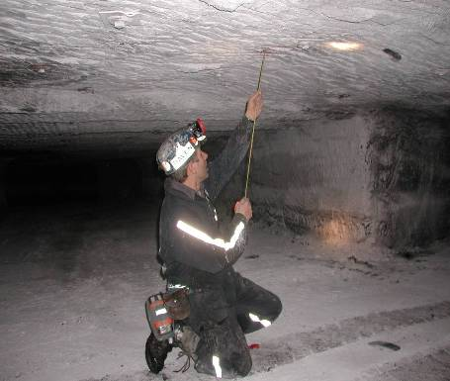
What you need to run an underground waste disposal facility
Operational underground mine
Part of it no longer used for extraction of ore
Cavities that are physically stable and may
be filled with waste
Suitable overall geological situation:
Disposal of waste does not lead to adverse enviromental or health effects during the next 10,000+ years
= no or extremely slow dispersion of waste components
Long-term safety assessment

Slide 4
Important elements of permanent storage of if waste in underground mines
Suitable overall situation
Host rocks and mine types
Waste types and containers
Operation
Long-term safety
Siting
Costs

Slide 5
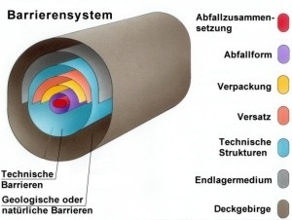
Suitable overall geological situation:
Waste Isolation Multibarrier System (1)
Waste content
Waste form
Canister
Technical barriers
Backfill
Sealing
Host rock
Geological barriers
Overburden

Slide 6
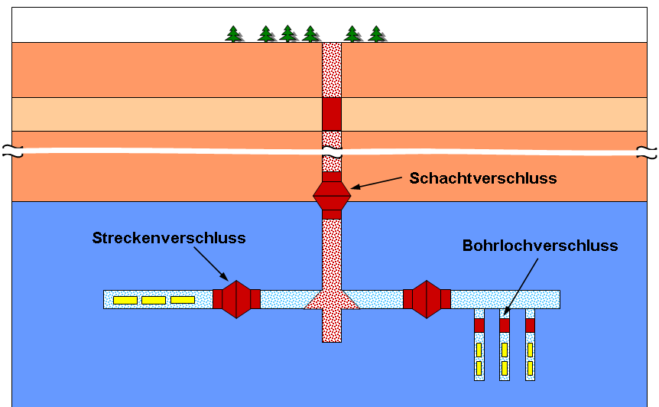
Waste Isolation Multibarrier System (2)
Overburden
Shaft sealing
Drift sealing
Borehole sealing
Host rock
Waste & Canister
Backfill

Slide 7
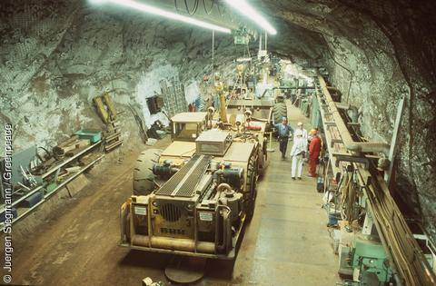
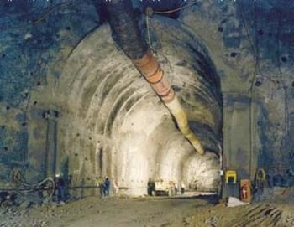
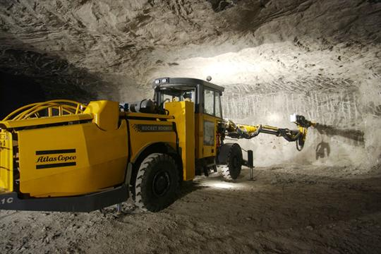
Host rocks
Host rock: rock type (ore) where the cavities are located
Rock types used or under consideration for disposal of hazardous or radioactive waste:
  Salt (HazWaste, RadWaste)
  Iron ore (RadWaste)
  Granite (RadWaste)
  Clay (RadWaste)
  Volcanic tuff (RadWaste)
  Gypsum (HazWaste)
→ Practically no restrictions: all rock types may be suitable if overall situation is favourable

Slide 8
Waste types
Operating underground waste disposal facilities accept broad range of wastes
  Sources: chemical industry, metal production, waste incineration, contaminated soil and debris, ...
Waste types not accepted:
  explosive
  self inflammable
  spontaneous combustile
  infectious
  radioactive
  releasing hazardous gases
  liquid (such as elemental mercury!)
  increasing their volume

Slide 9
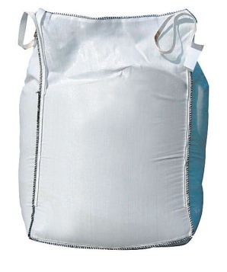
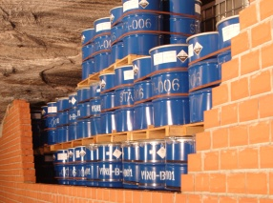
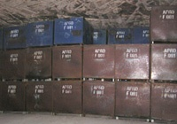
Containers
Plastic bags (‘big bags’)
Steel Drums
Steel boxes
→ Main purpose: safe transport to facility/ unloading/ placement into cavity
→ Does not have a long-term barrier function after placement in mine

Slide 10
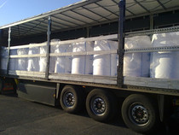
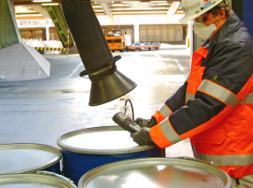
Operation (1)
Delivery at the facility
Acceptance control

Slide 11
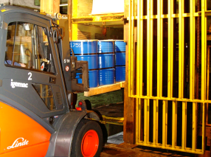
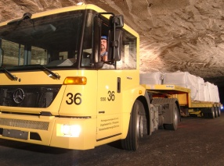
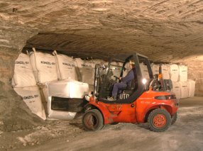
Operation (2)
Shaft transport
Underground transport

Slide 12
Operation (3)
Placement in storage chambers
Sealing off storage chambers when full

Slide 13
Long-term safety assessment
Technical planning
Long-term-safety
evidence
Assessment of:
natural and technical barriers
incidents and contingencies
the overall system
Hydro-geological data
Risk assessment of the operational phase
Safety of:
operation
stability of
cavities
Geological data
Safety concept
Waste data
Environ-mental impact assessment
Geotechnical risk assessment

Slide 14
Strategy of Long-term Safety Assessment
Geo-scientific long-term prognosis of site development
Basis: Knowledge of site characteristics
    Rocks and their properties
    Hydrology (regional/local)
    Hydrogeology
    (Biosphere)
    Technical Barriers
    Waste
    Design of disposal facility
    Geological processes

Slide 15
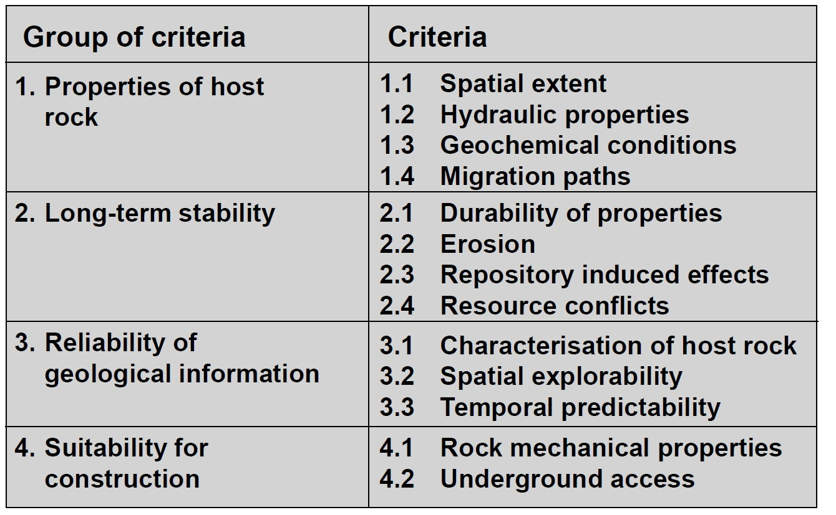
Site selection criteria

Slide 16
Obviously unfavourable geological conditions
Extensive vertical movements
Criterion: No uplift/subsidence of several millimetres per year during the required isolation time
Active disturbance zones
Criterion: No active disturbance zones in the repository area
Seismic activity
Criterion: No seismic activity greater than in earthquake zone 1 according to DIN 4149
Volcanic activity
Criterion: No quaternary or expected volcanic activity in the repository region

Slide 17
Favorable integral geological setting
None or only slow ground water movement at repository level
Favorable hydro-chemical conditions (e.g. absence of oxidizing acid mine waters)
High retention potential of the rocks regarding pollutants
Low tendency to build new pathways
Favorable configuration (e.g. spatial extension) of the rock formations
Situation which allows a good spatial characterisation of the rock formation
Situation which allow a reliable prognosis of the long-term stability of the favorable conditions of the rock formation

Slide 18
Potential Sites
Which host rock?
  Salt: many deposits but few underground mines in Asia
  (too little information at the moment)
  Clay: typically not extracted by deep underground mining
  Metal ores: abundant in Asia
Which mines?
  Suitable geology (multibarrier system/ very slow water current)
  Possibility to seal mine/ waste area
  Mechanically stable drafts/ cavities
  No volcanism/ low risk of strong earthquakes/flooding

Slide 19
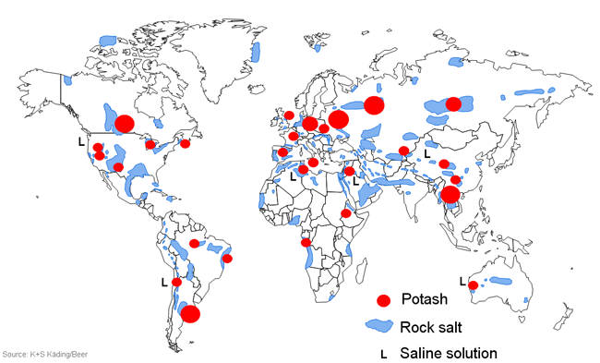
Salt deposits
Jintan, Huai'an
(CHN)
Khorat (THA)/
Ban Nonglom
(LAO)
(both projected)
Khewra (PAK)
Mandi (IND)
→ Several deposits present in Asia, few underground mines. Availability has to be checked

Slide 20
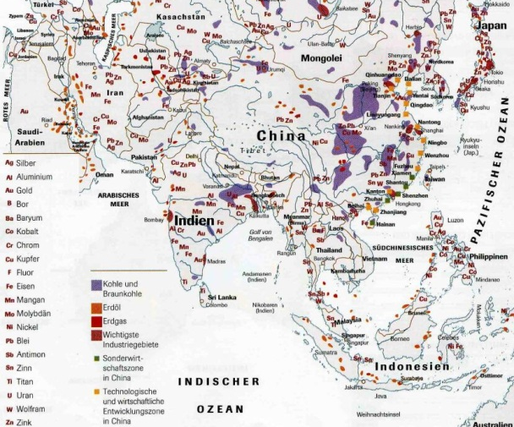
Metal Ore Deposits in Asia
→ Very many deposits and mines

Slide 21
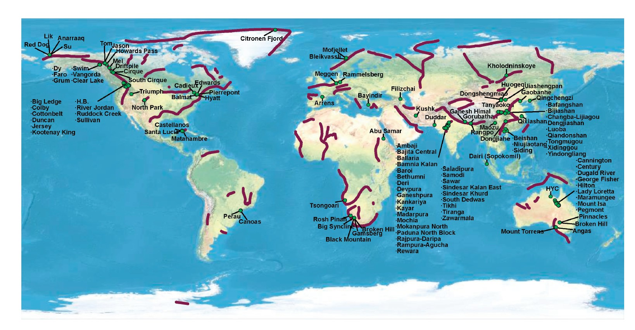
Metal Sulphide deposits in Asia
Example: zinc deposits
→ Many deposits and mines present in Asia,

Slide 22
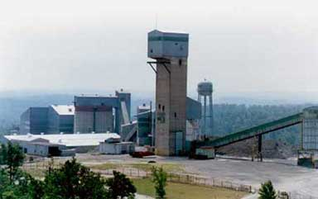
Permanent Storage (Disposal) in Underground Mines:
Potential Implementation
Concept:
New cavities in operating underground
zinc, lead or copper mines
(sulphide ores)
Use of existing infrastructure
(cost-sharing with extractive mining)
Why sulphide deposits?
Geochemically stable conditions
Mercury sulphide minor component of many sulphide ores
Returning mercury sulphide into deposit type
where it originally comes from may be environmentally neutral
→ Suitability of site must be proven based on a site specific safety assessment

Slide 23
Cost estimates – generic study
Cost estimates very site specific
Total amount of stored mercury: 7,500 t
May vary significantly from mine to mine
A typical mine in one Asian country was chosen as an example
Study performed by DMT, Essen Germany

Slide 24
Cost Estimate for Disposing stabilized Mercury –
Handling and Emplacement
Crude Mercury is shipped to sea harbour in one country
Stabilisation of mercury as mercury (II) sulphide
Transport of mercury (II) sulfide in sealed big bags to the mine
Unloading at the mine site with forklift
Hoisting of the big bags to the disposal level
Loading onto a underground truck
Unloading and placing of the big bags in a prepared room
01.12.2010 Brunswick/Germany Slide 24

Slide 25
Cost Estimate for Disposing Stabilized Mercury – Layout
Main drift and rooms after disposal
in fishbone arrangement
supported by rock bolts
and shotcrete liner
                Main drift 15 m², rooms 36 m² face, room length 26 m with big bags placed bolting, shotcrete and backfill, sealed with a shotcrete retention dam
01.12.2010 Brunswick/Germany Slide 25

Slide 26
Cost Estimate for Disposing stabilized Mercury – CAPEX
Item |  |  |  | Price
Highway Truck |  |  |  | $ 150,000.00
Forklift 2x |  |  |  | $ 40,800.00
Rear-dump Truck |  |  |  | $ 632,000.00
Transmixer |  |  |  | $ 258,000.00
Drilling Rig |  |  |  | $ 620,000.00
Wheel Loader |  |  |  | $ 479,000.00
Backfill Centrifuge |  |  |  | $ 200,000.00
Crew Transporter |  |  |  | $ 35,900.00
Shotcretesystem (includes truck) |  |  |  | $ 422,500.00
Concrete Batching Plant |  |  |  | $ 81,400.00
Development Drift & Rooms |  |  |  | $ 1,183,500.00
Ventilation Fan |  |  |  | $ 14,800.00
Air Duct |  |  |  | $ 2,211.00
Pumps 2x |  |  |  | $ 2,660.00
Pipes |  |  |  | $ 832.00
Switchboard |  |  |  | $ 4,010.00
Cables |  |  |  | $ 2,980.90
Other Equipment |  |  |  | $ 25,000.00
Equipment Transport |  |  |  | $ 8,000.00
Planning |  |  |  | $ 624,539.09
Sum Capital Expenditure |  |  |  | $ 4,788,132.99
Capital Expenditure per tonne Waste |  |  |  | 550.36 $/t
Conservative calculation. Some of the equipment may alread be available at the site
Development of new drifts and storage chambers. There may be existing that could be used
Costs for 5,500 t:
638 USD/t
01.12.2010 Brunswick/Germany Slide 26

Slide 27
Cost Estimate for Disposing stabilized Mercury – OPEX
Task |  |  |  | Price
Transport to Mine |  |  |  | 21.26 $/t
Transport Underground |  |  |  | 3.01 $/t
Emplacement |  |  |  | 36.87 $/t
Administration & Management |  |  |  | 24.17 $/t
Usage fee |  |  |  | 100.00 $/t
Sum Operating Expenditure |  |  |  | 185.32 $/t
01.12.2010 Brunswick/Germany Slide 27

Slide 28
Permanent Storage (Disposal) in Underground Metal Ore Mines: Cost Estimate for Model Mine
Cost factor | Cost estimate [USD/t]
Stabilization | 2,300
Capital cost (excavation, machinery) | 600
Operating costs (transport from harbour to mine, Administration, usage fee) | 200
Total | 3,100 (one time)
Estimated costs similar to costs in Europe (2,700 USD/t minimum)

Slide 29
Cost Estimate for Disposing stabilized Mercury – Conclusion
Mercury sulphide can be easily filled into big bags, sealed and handled with forklifts.
Big bags will be disposed in rooms developed from a main drift in a fishbone arrangement in an existing copper/zinc mine (example).
Needed:
  Study to evaluate future market for underground disposal of mercury together with the market area and financing of the project
  Investigation in sufficient detail the geological conditions of suitable underground mines in the region and chose three to five suitable candidates.
On the basis of the achieved knowledge a scoping or prefeasibility study can be conducted then.
01.12.2010 Brunswick/Germany Slide 29

Slide 30
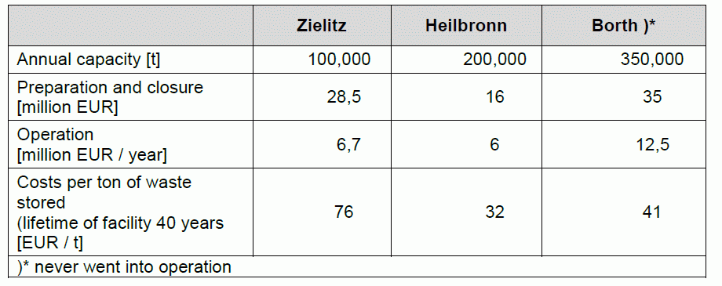
A greater picture:
Mercury waste disposal as part of a national hazardous waste disposal concept
3 options to operate an underground disposal facility:
For stabilized elemental mercury only
As 1) but also for mercury waste types (possibly also stabilized)
As 2) but also for other hazardous waste types
Example: Estimated disposal costs for hazardous waste in Germany:
economies
of scale:
cost per ton
decrease
Disposal Prices
(to be paid by producer):
start at 280 EUR/t
- does not include
treatment, packaging,
transport

Slide 31
Opportunities and challenges of underground disposal
Opportunities
Mercury permanently isolated from the biosphere
One-time cost
No aftercare needed
Concept could be used for other waste types as well
Facility, once found, could be flexibly expanded
In many countries, capacity has been built for similar geological disposal of radioactive waste
Challenges
Demanding long-term safety assessment
Site selection process may be lengthy
Some research will be needed to adapt concept to geological situation at a chosen site
Several years may be needed before facility could be found and brought into operation

