Slide 1
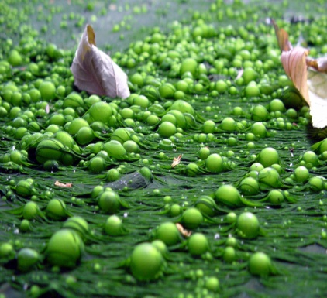
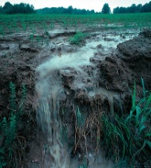


Targeted Research for improving understanding of the Global Nitrogen Cycle towards the establishment of an International Nitrogen Management System (INMS)
Kick Off PPG Meeting, Washington, DC
7-10 October
Session with Partners, 8 October 2014

Slide 2
Objectives of the session
Objectives
To seek collaborative opportunities (especially component 3 – demos) & be made aware of other on-going baseline activities in reactive nitrogen management
To clarify the steps needed for securing co-finance including engaging with the private sector
To agree on the communication modalities throughout PPG execution
To ensure there is a common understanding about the Project objective, its scope and outcome as presented in conceptual form in the PIF
To outline the PPG process
To seek comments on Component activities and the governance structure for the FPS execution

Slide 3
About INI and GPNM
The International Nitrogen Initiative (INI) is a scientific partnership that addresses the problems of too much nitrogen in some parts of the world and too little nitrogen in others. It is a joint initiative of the International Geosphere Biosphere Program (IGBP) and the Scientific Committee on Problems of the Environment (SCOPE). CEH provides the Secretariat of INI
The Global Partnership on Nutrient Management (GPNM) of the GPA is a multi-stakeholders partnership comprising of governments, private sector, scientific community, civil society organizations and UN agencies committed to promote effective nutrient management to achieve the twin goals of food security through increased productivity and conservation of natural resources and the environment. UNEP provides the Secretariat of GPNM.

Slide 4

PPG Road Map

Slide 5
Milestones & events | Dates
PPG Kick-off meeting | October 2014
N PPG Website with workspace (IW:LEARN) | Oct – Nov 2014
Monthly communication via Email updates (CEH) | Monthly
Project write up | Oct 2014 to July 2015
FSP Costed outline | October 2014
FSP Logframe | November 2014
Demonstration sites selection criteria formulation | November 2014
Selection Demo sites | November 2014
Baseline data gathering for demos | November – Feb 2014
GPA Review | Nov. 14 to Jan 2015

Slide 6
Milestones & events | Dates
Addressing GEF and STAP comments (at PIF approval) (Annex B1 of CEO DOC) | Oct. 2014 to July 2015
Avoiding overlap with GNF (Annex to FSP)
Details on Policy Options for track 1 (FSP)
Strengthen stakeholder participation/communication processes (C4)
Better explain the global trade of N based products
INMS sustainability plan (as part of GPA review/FSP formulation)
Partner consultation meeting | March 2015
Co-financing commitment written confirmation | By June 2015
CEO endorsement documentation validation meeting or thru circulation | June 2015
STAP Review of CEO endorsement package | July 2015
UNEP’s review by the UNEP Project Review Committee | July 2015
Submission to GEF Sec for CEO endorsement | August 2015
Launching of the FSP at IWC8 | October 2015

Slide 7
CEO endorsement requirements

Slide 8
File Nbr | Appendix # | Documents
01 |  | CEO Endorsement Document
02 |  | UNEP ProDoc
03 | Appendix 01 & 02 | GEF and CF Budget by component and UNEP budget categories
04 | Appendix 3 | Incremental cost analysis
05 | Appendix 4 | Results framework (logframe)
06 | Appendix 5 | Workplan and Timetable
07 | Appendix 6 | Key deliverables
08 | Appendix 7 | Costed M&E plan
09 | Appendix 8 | Summary of reporting requirements and responsibilities
10 | Appendix 9 | Standard ToR for Terminal Evaluation
11 | Appendix 10 | Decision making flowchart and organization chart
12 | Appendix 11 | Agreements and TORs
13 | Appendix 12 | Co-financing commitment letters
14 | Appendix 13 | Draft procurement plan
15 | Appendix 14 | GEF IW Tracking tool
16 | Appendix 15 | Component 3 - Demonstration projects (3 + 1)
17 | Appendix 16 | Component 1 - Tools for understanding the Global Nitrogen Cycle
18 | Appendix 17 | Component 2 - Quantification of Nitrogen
191 | Appendix 18 | Component 4 - Awareness raising and knowledge sharing

Slide 9
FSP Governance/Project Management structure

Slide 10
GEF
1. Overall INMS Project Decision–Making Flow Chart
UNEP
Implementing Agency
Project Steering Committee (PSC)
CEH
Executing Agency
Project Coordinating Unit (PCU)
Overall project management and monitoring
Component 1
Tools for understanding the global nitrogen cycle
Component 2
Quantification of nitrogen
Component 3
Demonstration management tools
Component 4
Awareness raising and knowledge sharing
Scientific & Policy Advisory Panel (SPAG)

Slide 11
GEF
2. INMS Project Governance
UNEP
Project Steering Committee (PSC)
UNEP
CEH
Chair of SPAG
Country representatives
International Organizations
Component/Activity Leaders
Key Partners
Implementing Agency
Executing Agency
Project Coordinating Unit (PCU)
(PSC and SPAG Secretariat)
Demonstration Projects – C3
C1
C2
C4
Project Coordinating Unit (PCU)
Regions with excess reactive nitrogen loss.
Regions with insufficient reactive nitrogen
Regions with transition economies
Developed countries with excess reactive nitrogen loss
Project Coordinator
Technical Specialists
Communications Specialist
Finance Officer
Team Assistant
Scientific Policy Advisory Group (SPAG)

Slide 12
Co-financing commitment process

Slide 14
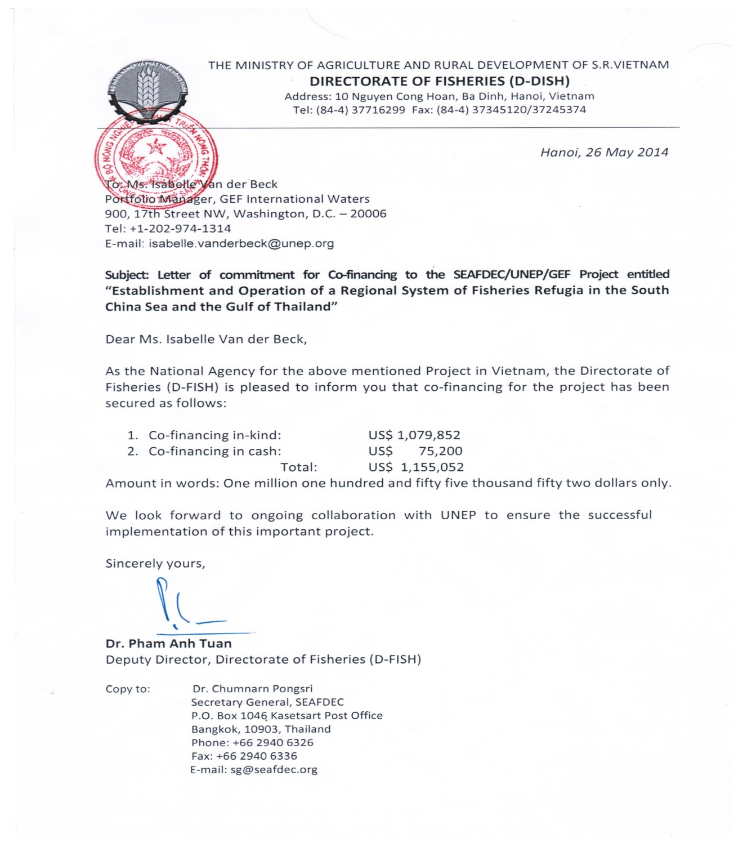

Slide 16
Communication process during the PPG

Slide 17
Communication mechanisms | Timeline
N PPG Website with workspace (IWLEARN) | Oct – Nov 2014
Monthly communication via Email updates (CEH) | Monthly
Events | Dates
PPG Kick-off meeting | October 2014
Partner consultation meeting | March 2015
CEO endorsement documentation validation meeting or thru circulation | June 2015

Slide 18

Thank you for joining us in our PPG working session and sharing your ideas with us.
UNEP – INI

