Slide 1
Mercury Reduction in Mongolia ASGM
Patience Singo, SAM Project Manager
Swiss Cooperation Office Mongolia

Slide 2
Introduction
Mercury use in ASGM is illegal, banned in 2008
Miners were practicing whole ore amalgamation with serious environmental contamination.
No mercury free technical solution available at the time of the ban
Miners turned to clandestine mercury use.
Today, there is both mercury free processing and clandestine amalgamation.

Slide 3
Mercury Reduction in ASGM
An ASGM community with a vision for mercury free life developed a proposal for a Hg-free processing plant. The initiative supported by the Ministry of Mining, MRAM and SAM Project.
A pilot plant established and various mercury free gravity options tested.
Several tests conducted jointly with miners.
Processes optimized in line with local conditions and preferences.
Notes:
SAM provided technical solutions, Government provided a soft loan, and the Miners provided investment finance. SAM set up a pilot plant to investigate suitable options of mercury free approaches.
Techniques appropriate for Mongolia and suitable for Mongolian legal framework.
Its not enough to bring hardware and think that is the solution. The hardware has to be introduced, people trained, miners committed, government support though policy initiatives etc.

Slide 4
Lessons in Mercury Reduction
Lesson 1: Mercury ban or (any ban) without alternatives and accessible options for miners creates a “black market” and exacerbates the situation.
Lesson 2: Mercury ban is not always the “magic bullet”. A staged approach from worst practices to amalgamation best practices and eventually mercury free practices should be considered.
  Not all miners will immediately move away from Hg use.
Lesson 3: ASGM is poverty driven and miners have a human right to income and life. The most vulnerable are affected. Have states ever compared the cost of criminalizing against the cost of formalizing and supporting best practices.? Arrests, destroying mills etc against training and technical support or even setting up mercury free centres.

Slide 5
Lessons in Mercury Reduction
Lesson 4: Hg reduction technologies should be tested and accepted by miners based on operational evidence and clear benefits: (better recovery, better health and environment).
  What is the incentive for change?
  Previous amalgamation tailings were processed and miners could still recover gold.
Lessons 5: Moving away from mercury requires change in mindset, training and miners gaining strong confidence in the new approaches. The technologies must pass the miners’ belief system and experiences.
Lesson 6: Sustainable Hg reduction approaches require broader stakeholder engagement and commitments. Miners and other support actors!
Notes:
SAM provided technical solutions, Government provided a soft loan, and the Miners provided investment finance. SAM set up a pilot plant to investigate suitable options of mercury free approaches.
Techniques appropriate for Mongolia and suitable for Mongolian legal framework.
Its not enough to bring hardware and think that is the solution. The hardware has to be introduced, people trained, miners committed, government support though policy initiatives etc.

Slide 6
Mercury Reduction in ASGM
Mercury free techniques in Mongolia
Gravity concentration techniques; carpet sluices and shaking tables.
Amalgamation replaced by highly efficient secondary concentration: Shaking tables.
Gold recovery ranges from 71-81%, free gold.
Replicated by miners & private investors-sustainability.
Notes:
Tested and verified by the Mineral Research Institute of Mongolia

Slide 7
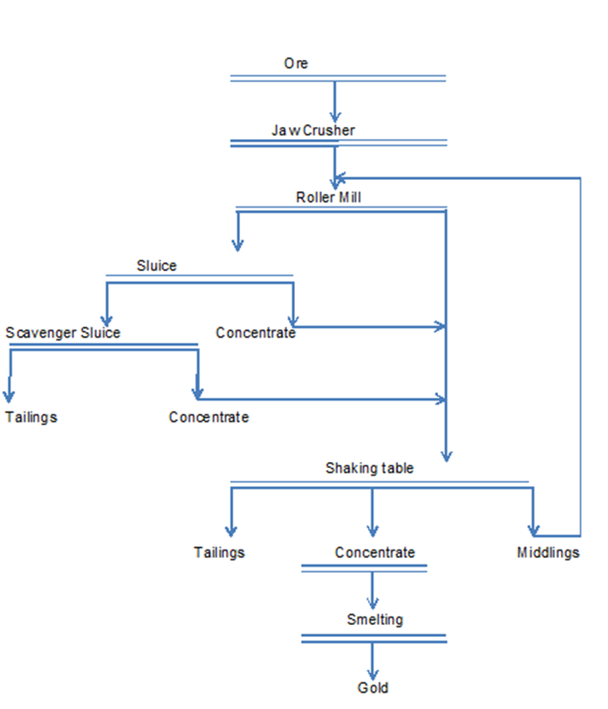
Mercury Reduction Mineral Processing
Notes:
80% of the free gold is retained in the mill cup.
Primary gravity concentration takes care of the 20% balance.
Concentrates upgraded at the shaking table. 60-90% gold by content depending on sulphide contents.
Table efficiency is 96-97 % recovery of free gold.
Very fine gold is lost to tailings either as locked gold (not yet liberated, or still associated with pyrites or too fine for the system to recover)

Slide 8
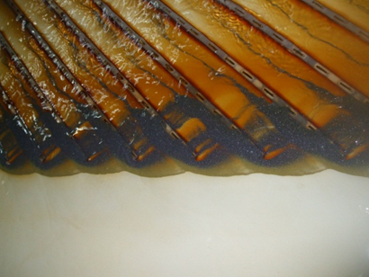
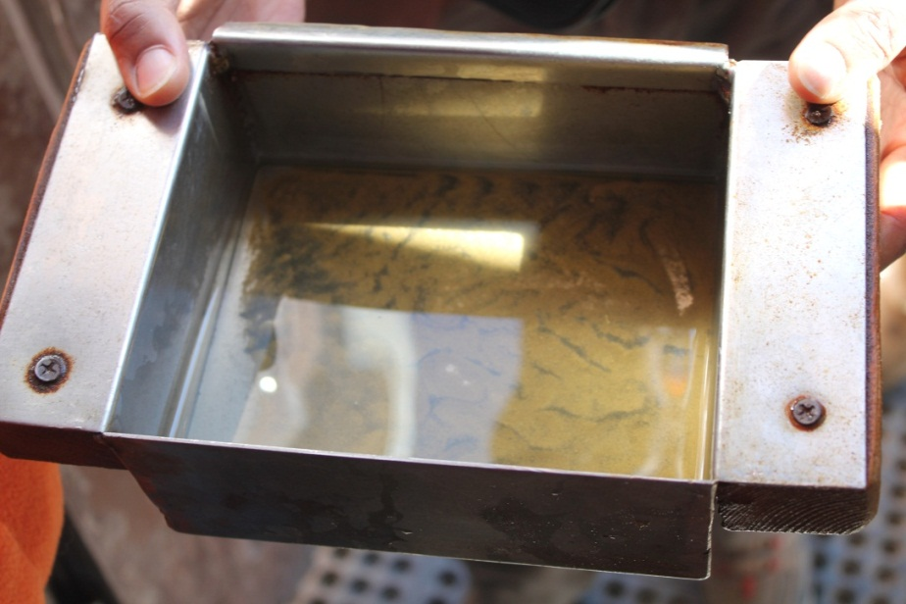
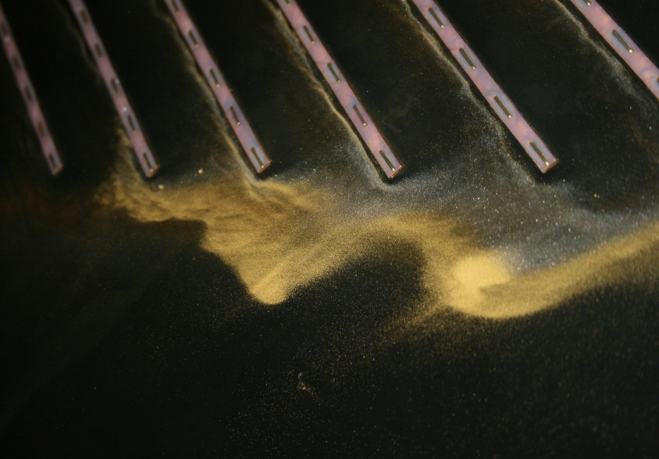
Mercury Reduction Mineral Processing
Good concentration is a must for mercury free techniques.
Concentration replaced whole ore amalgamation.
Notes:
The table replaces Hg amalgamation process. The middlings are re-loaded into the mill to enhance recovery.

Slide 9
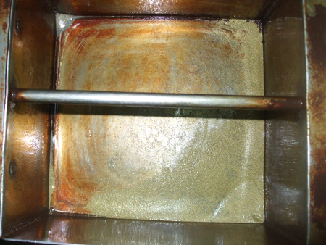
Mercury Reduction Mineral Processing
Shaking table gold concentrate.
Final table concentrate has about (70-90% gold content) depending on other heavy minerals.
Heavy minerals in concentrate removed by leaching with nitric acid

Slide 10
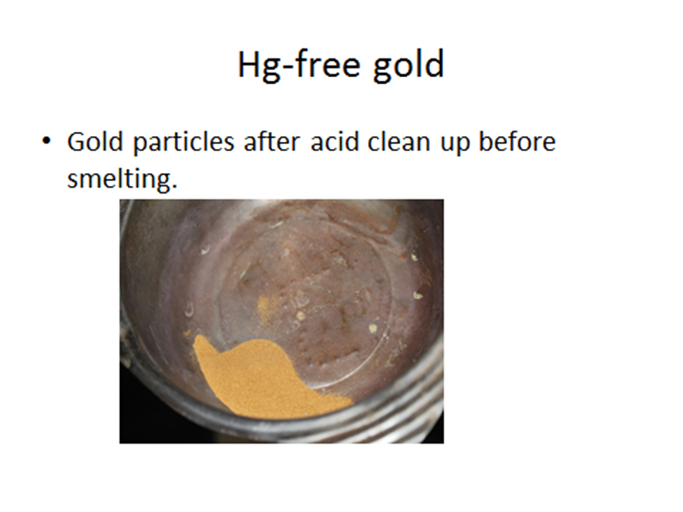
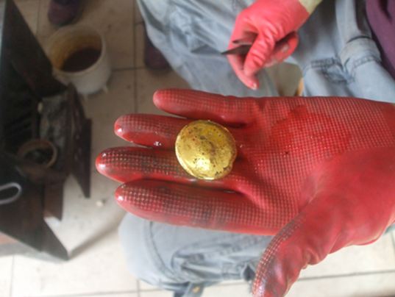
Mercury Reduction Mineral Processing
Borax used as a flux during smelting.

Slide 11
Success factors
Factor 1: Local solutions are sustainable
Use of locally available equipment, knowledge and skills supported by international expertise. Respect of local conditions and context.
  Improved equipment that miners previously used for whole ore amalgamation to be compatible with Hg-free processes. Local fabrication.
  Introduced components to replace amalgamation.
  Miners and experts worked together to define the most optimal solution, that miners had confidence with.
  To have strong uptake, miners have a strong say!
Notes:
Some ores work better with cyanidation than gravity techniques. So mercury reduction should not only be viewed from gravity only.
In some instances proper use of mercury/elimination of worst practices need to be promoted. Hg provides for high recovery of fine gold.

Slide 12
Success factors
Factor 2: Miners are agents of sustainable change and are part of the solution.
Miners were part of the change process creating ownership and sustainability in mercury reduction.
  Several miners from across the country took part during the experimental phase.
  Miners brought in their ores and compared recovery results with previous whole ore amalgamation results.
  Miners gained confidence in the new technology based on achieved gold recoveries.
  The major outcome: Miners invested in the technology and up-scaled the pilot plant.
Notes:
Some ores work better with cyanidation than gravity techniques. So mercury reduction should not only be viewed from gravity only.
In some instances proper use of mercury/elimination of worst practices need to be promoted. Hg provides for high recovery of fine gold.

Slide 13
Success factors
Factor 3: The team on the ground.
Strong technical team that demonstrated the technologies and trained miners on application.
  Hg- reduction technologies should be demonstrated, and miners’ questions and concerns addressed.
  The practical field work should be sustained until miners replicate the technologies themselves.

Slide 14
Success factors
Factor 4: Formalization and responsible practices
Formalized groups apply Hg free techniques and other environmentally sound practices as opposed to informal groups.
Mercury reduction without some form of formalization and organization is easily a “myth” and a “dream”
Reduction should be part of a broader ASM intervention strategy (formalization, organization, financing, etc ) for a sustainable results.

Slide 15
Success factors
Factor 5: The Role of the State
The State has a duty to achieve mercury reduction. The Ministry of Mining provided the miners with a loan to replicate the mercury free technologies.
  State duty:
  Appropriate and pragmatic policies.
  Technical and financial support for mercury reduction.
  Donor agencies and projects have a “temporary support role” but the ultimate call is for the State and the miners.
  Globally, if State (s) took ownership of donor outputs and outcomes, ASGM mercury reduction should have progressed much more than what it has done over the last 20years. Sustainability mechanisms for donor support have to be re-visited.

Slide 16
Success factors
Factor 6: Geological factors
Ores were compatible with gravity concentration only, techniques, otherwise the technical solution could have been a failure.
  No “ one size fits all” solution. Policy makers and projects should promote solutions that fit within local context and technical parameters.
  In general, gravity concentration as a stand-alone for primary mining ores, has limitations : total mineral recovery and minimizes miners’ potential earnings.

Slide 17
Constraints and Concerns
Policy Coordination amongst Ministries. Success in mercury reduction requires coordinated effort from both Ministry of Mining and Nature, Environment and Green Development, agencies of government and other stakeholders.
  In Mongolia approval of ASGM plants DEIA has been very slow and frustrating. This hinders miners’ genuine efforts to transfer to mercury reduction techniques.
The differing views and approaches on ASGM by Environment and Mining ministries hinder progress in formalizing ASGM and reduction of mercury emissions.

Slide 18
Things to remember..
No “one size fits all”
No “silver bullet”
Miners are part of the solution, engage them.
There is strong evidence that formalized miners are responsible.
The state has a duty in mercury reduction and protecting the miners rights.
Multi-stakeholder efforts.
Policy coordination
What is the cost, policy and actions.
It has been done, it can be done.

Slide 19
Thank you
Gracias
Merci

