Slide 1
GEF and Mercury
Anil Sookdeo
GEF Secretariat
November 21, 2013
Medellin, Columbia

Slide 2
What is the GEF?
Established in 1991 and located in Washington DC, USA
The GEF serves as the Financial Mechanism of a number of Multilateral Environmental Agreements including the Minamata Convention on Mercury.
GEF member countries: 183
The largest public funder worldwide of projects aiming to generate global environmental benefits
Governance: GEF Assembly (every 4 years) and GEF Council (biannual)
Current CEO and Chairperson: Dr. Naoko Ishii (Japanese)
The World Bank serves as the trustee
To Date, USD 11.5 billion allocated and USD 57 billion in co-financing
Funded over 3,215 projects and over 16,030 small grants to CSOs/NGOs

Slide 3
What difference does the GEF make?
The GEF serves as the financial mechanism of the following multilateral environmental agreements:
  UN Framework Convention on Climate Change
  Convention on Biological Diversity
  UN Convention to Combat Desertification
  Stockholm Convention on Persistent Organic Pollutants
  Minamata Convention on Mercury (after the Convention comes into force – currently serving on an interim basis)
  Additionally on a voluntary basis provides funding to support the implementation of the Montreal Protocol in CEITS.

Slide 4
GEF Agencies
GEF Agencies are the operational arm of the GEF in project implementation.
Asian Development Bank (ADB)
African Development Bank (AfDB)
European Bank for Reconstruction and Development (EBRD)
Food and Agriculture Organization of the United Nations (FAO)
Inter-American Development Bank (IDB)
Conservation International (CI)
International Fund for Agricultural Development (IFAD)
United Nations Development Programme (UNDP)
United Nations Environment Programme (UNEP)
United Nations Industrial Development Organization (UNIDO)
World Bank (WB)
WWF (US)

Slide 5
Minamata Convention on Mercury
The Intergovernmental Negotiating Committee agreed to the text of the Minamata Convention on Mercury.
The Convention will be adopted and opened for signature at the Diplomatic Conference in Kumamoto and Minamata on October 9 to 11, 2013. There are 93 Signatories and one Party (USA)
The Convention designates the GEF as an element of the financial mechanism under the Convention.

Slide 6
GEF’s Work on Mercury
For the current GEF-5 replenishment period, the GEF has funded 17 projects in 21 countries with $34 million GEF funding, leveraging nearly $254 million.
The GEF mercury projects include:
  Reducing Mercury emissions from artisanal and small-scale gold mining;
  Reducing atmospheric mercury Emissions in healthcare;
  Development of Mercury inventory;
  Delivering the transition to energy efficient lighting through collection; and recycling of spent lamps containing Mercury.

Slide 7
GEF ASGM Projects
Countries | Project Title | GEF Amount
Burkina Faso, Mali, Senegal | Improve the Health and Environment of Artisanal and Small Scale Gold Mining (ASGM) Communities by Reducing Mercury Emissions and Promoting Sound Chemical Management | 990,000
Ecuador, Peru | Implementing Integrated Measures for Minimizing Mercury Releases from Artisanal Gold Mining | 999,900
Honduras | Environmental Sound Management of Mercury and Mercury Containing Products and their Wastes in Artisanal Small-scale Gold Mining and Healthcare | 1,300,000
Philippines | Improve the Health and Environment of Artisanal Gold Mining Communities in the Philippines by Reducing Mercury Emissions | 550,000

Slide 8
GEF Mercury Projects in Latin America and the Caribbean
Country | Implementing Agency | Project Title | Project Type | GEF Amount
Argentina | UNIDO | Preparatory Project to Facilitate the Implementation of the Legally Binding Instrument on Mercury (Minamata Convention) in Argentina to Protect Health and the Environment | Initial Assessment | 350,000
Argentina, Ecuador, Nicaragua, Peru, Uruguay | UNEP | Development of Mercury Risk Management Approaches in Latin America | Inventory/Action Plans | 916,000
Ecuador, Peru | UNIDO | Implementing Integrated Measures for Minimizing Mercury Releases from Artisanal Gold Mining | ASGM | 999,900
Honduras | UNDP | Environmental Sound Management of Mercury and Mercury Containing Products and their Wastes in Artisanal Small-scale Gold Mining and Healthcare | ASGM/Healthcare waste | 1,300,000
Uruguay | UNDP | Environmental Sound Life-Cycle Management of Mercury Containing Products and their Wastes | Products and Waste | 700,000

Slide 9
GEF’s Next Step
The GEF is going to provide continuous support for developing countries to ratify and implement the Convention.
GEF 5 – in addition to the 15M allocated for pilot activities on Mercury, the GEF 44th GEF Council approved a 10M pre-ratification program to assist signatory countries to move to ratification
GEF 6 – Currently a mercury program is being proposed in GEF 6 to support early action in addition to eligible enabling activities.

Slide 10
GEF 5 Pre-ratification program
To be eligible countries must have signed the Convention and until otherwise guided by the INC or COP must be eligible under 9(b) of the GEF Instrument.
The Minamata Convention Initial Assessment (MIA) will assist eligible signatory countries access their national situation in regard to mercury and enable them to make a ratification decision.
The GEF has developed draft guidelines which are open for comment until December 11 by GEF Council members, agencies and NGOs/CBOs.
The maximum has been set at 200K unless a justification can be made for additional resources

Slide 11
ASGM National Action Plans
The GEF has developed guidelines for the National Action Plans for ASGM which is open for comment until Dec 11.
To be eligible countries must have signed the Convention, be eligible under 9(b) of the GEF instrument (until the GEF is guided by the INC or COP) and have notified the Secretariat of the Convention.
The maximum is 500K unless a justification is made for additional resources.

Slide 12
Sources of Mercury Emissions in the World
By source
By region
Source: UNEP Global Mercury Assessment 2013

Slide 13
GEF 6 Mercury Program
The GEF 6 Chemicals and Waste Strategy is being developed.
It contains three programs related to the Minamata Convention.
Program 2 – Enabling activities – will support additional MIAs and NAPs
Program 6 – Supports implementation of early action in SIDS and LDCs

Slide 14
GEF 6 Mercury Program cont’d
Program 4 - Reduction or elimination of anthropogenic emissions and releases of mercury to the environment:
Phase out and elimination of the use of mercury in ASGM
Reduction and elimination of mercury from emissive sources, including coal fired power plants, primary metal processing and health care waste, non-ferrous smelting, cement production, and waste incineration
Phase out and elimination of mercury in the global supply chain including mercury in products
Reduction, phase out or elimination of mercury used in industrial processes
Assessment and sound management of mercury storage
Framework for the environmentally sound management of mercury-containing wastes in accordance with the Basel Convention and its relevant technical guidelines
Development of detailed inventories on mercury.
Development of material flows of mercury and introduction of life cycle management of mercury

Slide 15
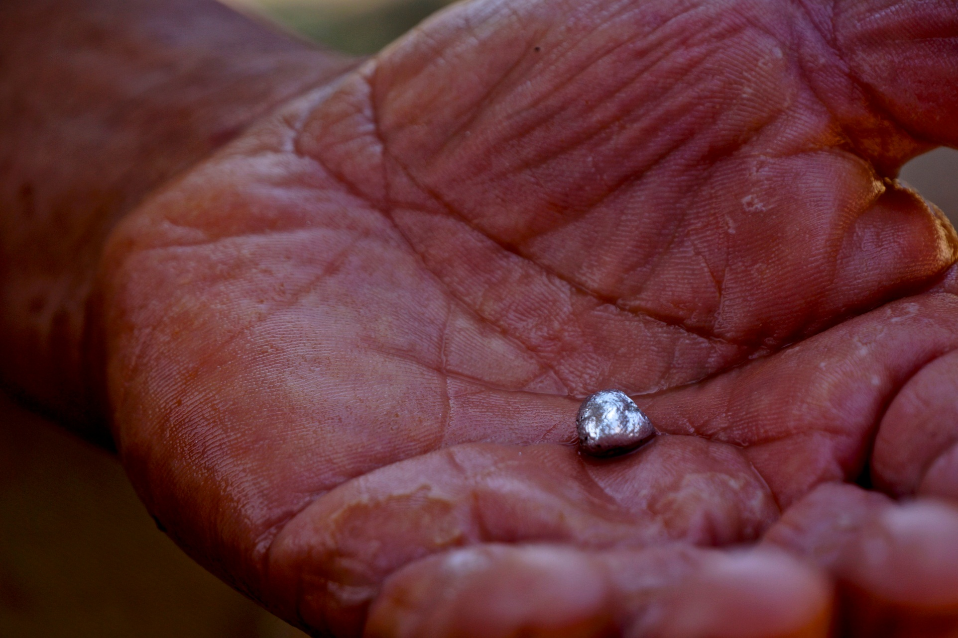
Thank You
asookdeo@thegef.org

