Slide 1

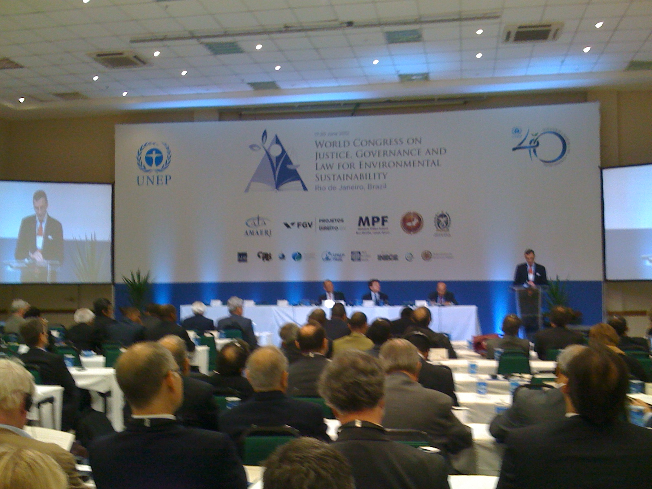

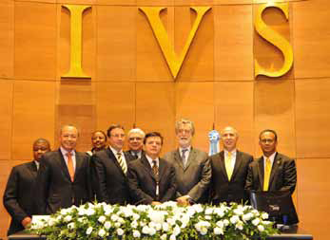
CARIBBEAN WORKSHOP ON PRINCIPLE 10 Theme 3: ACCESS TO JUSTICE
BRIEF INTRODUCTION TO THE BALI GUIDELINES
AND THE WORLD CONGRESS
Andrea Brusco – UNEP Legal Officer ROLAC
Notes:
Access to Information, Public Participation and Access to Justice (the rights of access) as enshrined in Principle 10 of the Rio Declaration from 1992, are:
a key element of good environmental governance,
a foundation for the full exercise of substantive environmental rights,
one of the most representative examples of the close and direct linkages between human rights and environment.
Environmental Justice includes the effective judicial and administrative remedies and procedures available to a person (natural or legal) who is aggrieved or likely to be aggrieved by environmental harm. The term includes not only the procedural right of appearing before and appropriate body but also the substantive right of redress for harm done.

Slide 2
RIO DECLARATION PRINCIPLE 10
… Effective access to judicial and administrative proceedings, including redress and remedy, shall be provided.”
BALI GUIDELINES 15 to 26, to assist countries in:
• filling possible gaps in their respective legal norms and regulations as relevant and appropriate;
• to facilitate broad access to justice in environmental matters.
Notes:
Principle 10 has spawned laws providing access to environmental information in over 100 countries, public participation provisions in over 120 countries and environmental courts and tribunals in over 44 countries. However, major gaps remain, especially in developing countries, and implementation of laws is low across the world.
During the past decades, many LAC countries have made considerable efforts for improving environmental governance, including the application of Principle 10, mainly through the incorporation of the rights of access into their national legislations. However the great breakthrough is still missing, particularly with respect to effective implementation and enforcement of these rights within the challenging context of LAC cultural diversity and social inequity. Many of the current socio environmental conflicts that emerged in the last years in the region are directly associated to lack of information, weak participation of relevant stakeholders, deficiencies of mechanisms for public consultations, lack of appropriate judicial remedies, among others. All these affect in particular the groups in situations of vulnerability, thus leading to the creation or exacerbation of inequality, discrimination and violation of human rights.
At the global level, UNEP Governing council adopted the “Guidelines for the Development Of National Legislation on Access to Information, Public participation in decision-making and Access to Justice in Environmental Matters (BALI GUIDELINES)” in 2010. The Guidelines are voluntary and Governments are invited to take them into consideration in the development or amendment of national legislation. Government representative and Major groups discussed extensively the content of the guidelines during the negotiations and they represent the consensus of the international community on the efforts that can and should be taken in order to advance in implementation of Principle 10 at the national level.Where existing legislation or practice provides for broader access to information, more extensive public participation or wider access to justice in environmental matters than the Bali guidelines should not be perceived as recommendations to amend national legislation or practice.

Slide 3
BALI GUIDELINES: III. ACCESS TO JUSTICE
A person who considers her/his request for INFORMATION or her/his RIGHT OF PARTICIPATION has been unreasonably refused, has access to a review procedure before a court of law or other independent and impartial body to challenge such a decision, act or omission by the public authority in question. (Guidelines 15 -16)
Members of the public concerned should have access to a court of law or other independent and impartial body or administrative procedures to challenge any decision, act or omission by public authorities or private actors that affects THE ENVIRONMENT or allegedly violates THE SUBSTANTIVE OR PROCEDURAL LEGAL NORMS OF THE STATE RELATED TO THE ENVIRONMENT (Guideline 17).
BROAD INTEPRETATION OF STANDING in proceedings concerned with environmental matters with a view to achieving effective access to justice (Guideline 18).
Notes:
Guidelines 15 and 16 requires that any person whose right to access environmental information or participation is impaired be given access to a review procedure in order to provide for the enforcement of such rights in practice. They neither link access to justice to specific interests nor do they stipulate any preconditions. NGOs are deemed to have equivalent standing to individual citizens.
This statement is similar to the first part of Art 9.1 of the Aarhus convention – ANY PERSON PRINCIPLE
Guideline 17 States should ensure that the members of the public concerned have access to a court of law or other independent and impartial body or administrative procedures to challenge any decision, act or omission by public authorities or private actors that affects the environment or allegedly violates the substantive or procedural legal norms of the State related to the environment.
This is also similar to Article 9.2 of the Arhus convention, but it doesn´t indicate the elements to define when the public is concern interest or impairment of right where this is requirement of the procedural right of the country requires it is a prerequisite. Guideline 18 provides the basis for definition as ot expressly refers to broad interpretation of standing in proceedings concerned with environmental matters with a view to achieving effective access to justice . For example, this can only be provided to recognised NGOs through ‘access-friendly’ mechanisms.
In general , domestic legislation requires that an association possesses some specific form of legal personality. This requirement reflects the
need of a legally responsible person before the court. Often, the association also has to be non-profit, respectively should not have other
professional activities competing with activities of companies or self-employed persons. a condition found widely is that there be a connection between the
subject matter of the case and the goals of the NGO, as reflected in its statute. This criterion is also used to identify the “sufficient interest” of the association. In most instances, this requirement includes that the interests as stake have to be reflected in the statute of the
Association. In a number of countries, NGOs may only act in the public interest if they are recognised by
the state.
The standing requirements can also represent a barrier for transboundary actions by NGOs. In most member states it is currently not possible for NGOs from one member state to bring an action in another member state

Slide 4
BALI GUIDELINES: III. ACCESS TO JUSTICE
EFFECTIVE AND TIMELY PROCEDURES. Proceedings to be fair, open, transparent and equitable. (Guideline 19)
Appropriate assistance mechanisms to REMOVE OR REDUCE FINANCIAL AND OTHER BARRIERS to access to justice. (Guideline 20)
Framework for PROMPT, ADEQUATE AND EFFECTIVE REMEDIES In cases relating to the environment, such as interim and final injunctive relief. Compensation and restitution and other appropriate measures. (Guideline 21)
Timely and effective ENFORCEMENT OF DECISIONS in environmental matters taken by courts of law, and by administrative and other relevant bodies. (Guideline 22)
Notes:
Guideline 19
Effective and timely Procedures: States should provide effective procedures for timely review by courts of law or other independent and impartial bodies, or administrative procedures, of issues relating to the implementation and enforcement of laws and decisions pertaining to the environment. States should ensure that proceedings are fair, open, transparent and equitable.
Guideline 20
States should ensure that the access of members of the public concerned to review procedures relating to the environment is not prohibitively expensive and should consider the establishment of appropriate assistance mechanisms to remove or reduce financial and other barriers to access to justice.
Guideline 21:States should provide a framework for prompt, adequate and effective remedies In cases relating to the environment, such as interim and final injunctive relief. States should also consider the use of compensation and restitution and other appropriate measures.
While civil penalties are usually for single, non-continuous violations. However, in cases in which the violations continue, a civil penalty in itself is insufficient to bring the violator into compliance. Therefore, judges can order a violator to cease its violative behavior - this is what is known as "injunctive relief." An injunction is simply a court order to do, or refrain from doing, a particular act. An injunction is limited to those measures which a violator must undertake to achieve and maintain final compliance (and to reduce the adverse effect(s) of the violations to the greatest extent practicable pending the achievement of final compliance).
Technically, only courts can issue "injunctions." and administrative agency in the Executive Branch, can issue orders but, unlike judges in the Judicial Branch, it cannot independently enforce those orders through contempt authority.
.
Guideline 22: States should ensure the timely and effective enforcement of decisions in environmental matters taken by courts of law, and by administrative and other relevant bodies.

Slide 5
BALI GUIDELINES: III. ACCESS TO JUSTICE
Adequate INFORMATION TO THE PUBLIC ABOUT THE PROCEDURES operated by courts of law and other relevant bodies in relation to environmental issues. (Guideline 23)
PUBLIC AVAILABILITY OF DECISIONS relating to the environment taken by a court of law, or other independent and impartial or administrative body, as appropriate and in accordance with national law. (Guideline 24)
CAPACITY-BUILDING PROGRAMMES in environmental law for judicial officers, other legal professionals and other relevant stakeholders (Guideline 25 )
ALTERNATIVE DISPUTE RESOLUTION MECHANISMS where these are appropriate. (Guideline 26)
Notes:
Guideline 23
States should provide adequate information to the public about the procedures operated by courts of law and other relevant bodies in relation to environmental issues.
Guideline 24
States should ensure that decisions relating to the environment taken by a court of law, or other independent and impartial or administrative body, are
publicly available, as appropriate and in accordance with national law. States should, on a regular basis, promote appropriate capacity-building programmes in environmental law for judicial officers, other legal professionals and other relevant stakeholders (Guideline 25 )
Guideline 26
States should encourage the development and use of alternative dispute resolution mechanisms where these are appropriate.
Taking into consideration that Environmental Courts already exist in some Caribbean SIDS, notably Trinidad and Tobago and the Dominican Republic, there is a debate on the need for the establishment of specialized and independent courts or specialized environmental divisions of the High Court judicial system. In the establishment of such mechanisms, emphasis is placed on the need of , inter alia, the training of judicial and legal personnel, the adoption
The Jurisdiction of Environmental Courts in Caribbean SIDS, where they exist, should be extended to include, inter alia, the built environment, indigenous peoples rights, development planning issues and land tenure .
Alternative Dispute Resolution ("ADR") refers to any means of settling disputes outside of the courtroom. ADR typically includes early neutral evaluation, negotiation, conciliation, mediation, and arbitration. Not only the cost of litigation rising but also time delays, have moved some states to experiment with ADR programs. Some of these programs are voluntary; others are mandatory.
While the two most common forms of ADR are arbitration and mediation, negotiation is almost always attempted first to resolve a dispute. It is the preeminent mode of dispute resolution. Negotiation allows the parties to meet in order to settle a dispute. The main advantage of this form of dispute settlement is that it allows the parties themselves to control the process and the solution.
Mediation is also an informal alternative to litigation. Arbitration is a simplified version of a trial involving limited discovery and simplified rules of evidence. The arbitration is headed and decided by an arbitral panel. T

Slide 6
DECLARATION ON JUSTICE, GOVERNANCE AND LAW FOR SUSTAINABLE DEVELOPMENT
RIO + 20 WORLD CONGRESS:
… Recognizing the important contribution made by the legal and auditing community worldwide to the enforcement of standards and safeguards for environmental sustainability, and noting that the Judiciary in particular, has been the guarantor of the rule of law in the field of the environment worldwide and that judicial
independence is indispensable for the dispensation of environmental justice;
Messages to Heads of State and Government, other high-level representatives, and the world community at large
Principles for the advancement of Justice, Governance and Law for Sustainable Development.
Institutional Framework for the advancement of Justice, Governance and Law for Sustainable Development.
A
Notes:
The Rio+20 Declaration on Justice, Governance and Law for Environmental Sustainability is a vital document for everyone working in the field of environmental law, providing an authoritative reference and guiding principles to assist them with their work in their institutions. UNEP was privileged to have assisted the process and will honour the recommendations and conclusions from the Congress, with the participants’ active engagement and support, and in close cooperation with our partners.The World Congress on Justice, Governance and Law for Environmental Sustainability was a gathering in Rio of more
than 150 judges, prosecutors, public auditors and enforcement agencies from some 60 countries, hosted by the UN Environment Programme (UNEP). The event marked a decade of progress
since the Global Judges’ Symposium in Johannesburg in 2002, which spelled out for the first time in unequivocal terms the crucial role that judges have to play in interpreting and enforcing environmental law, nationally and internationally.
One of the purposes of the Rio Congress was to review progress and to learn from our successes and failures.
There is now widespread acknowledgement of an international “common law” of the environment based on principles such as sustainability, and inter-generational equity. There is now greatly expanded awareness of environmental issues among the judiciary, and the development of specialist courts and tribunals in many countries. A recent study1 identified over 360 specialist environmental courts or tribunals in forty-two countries.
Recalling the importance of the first Global Judges Symposium convened by the United Nations Environment Programme (UNEP) in 2002, in conjunction with the World Summit on Sustainable Development in Johannesburg, South Africa, and noting that since then, the importance of the Judiciary in environmental matters has further increased and resulted in a rich corpus of decisions as well as in the creation of a considerable number of specialized courts and green benches, and a lasting effect on improving social justice, environmental governance and the further development of environmental law, especially in developing countries
The Johannesburg Global Symposium was an important step forward. Fundamental was the recognition that laws are nothing without judges and courts familiar with the issues, with the power to enforce them, and able to provide accessible justice to individuals and representative agencies. The Rio Congress was a reaffirmation of that commitment
In the Declaration, the participants recall the importance of the first Global Judges Symposium in 2002. They note among other things that since then, the importance of the judiciary in environmental matters has further increased and resulted in a rich corpus of decisions and the further development of environmental law, especially in developing countries. The several messages include statements that an independent judiciary and judicial process are vital for the implementation, development and enforcement of environmental law; that environmental law is essential for the protection of natural resources and ecosystems and reflects our best hope for the future of our planet; and that environmental sustainability cannot be achieved without good quality data, monitoring, auditing and accounting for performance.

Slide 7
DECLARATION ON JUSTICE, GOVERNANCE AND LAW FOR SUSTAINABLE DEVELOPMENT
“ An independent judiciary and judicial process are vital for the implementation, development and enforcement of
environmental law, and members of the judiciary, as well as those contributing to the judicial process at the national, regional and global levels, are crucial partners for promoting compliance with, and the implementation and enforcement of, international and national environmental law”.
Rio+20 Declaration on Justice, Governance and Law for Sustainable Development
“

Slide 8
“Though it may be perceived as utopian to expect judges to solve the global environmental crisis by themselves, hope for the future will be dimmer if judges are not on its side—or remain silent”
Justice Antonio Herman Benjamin
THANK YOU

