Slide 1
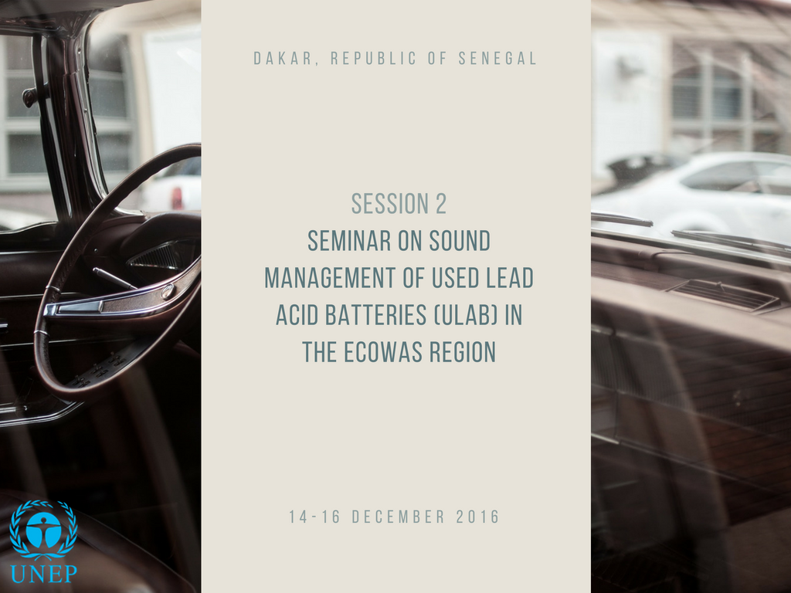

Slide 2
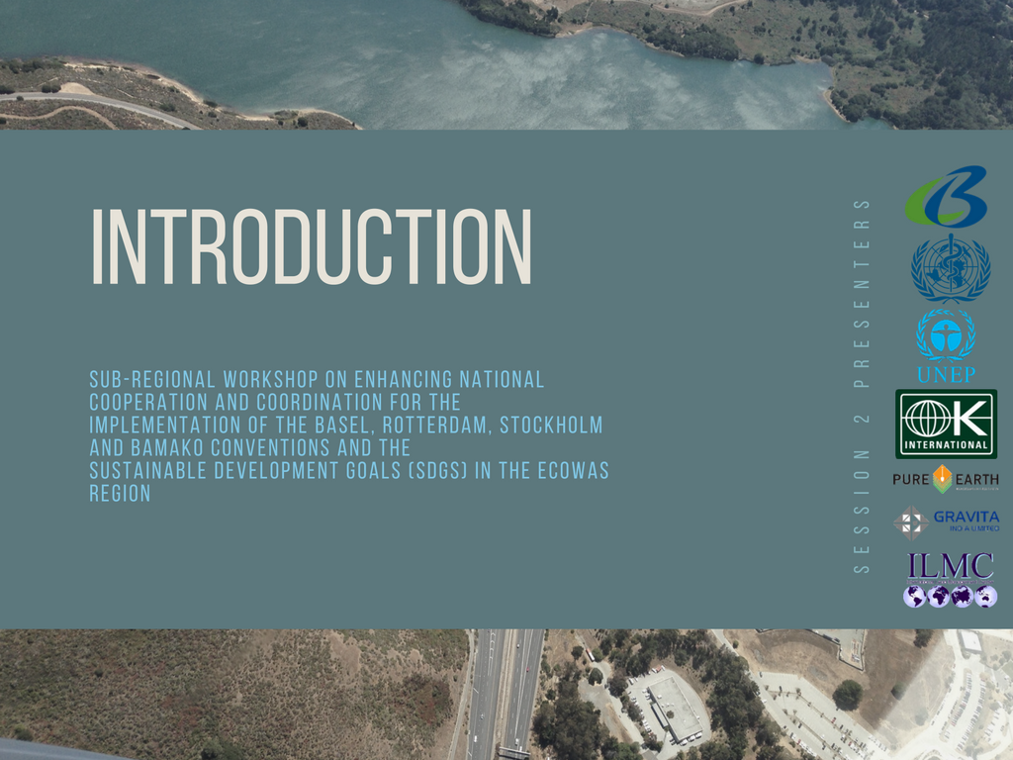

Slide 3

1. Context: Why we are here?
* United Nations Environment Assembly of the United Nations Environment Programme (Second session, Nairobi, 23–27 May 2016). Resolution 2/7. Sound management of Chemicals and waste
* Recognizing the significant risks to human health and the environment arising from releases of lead and cadmium into the environment
*Deeply concerned by the health and environmental impact of waste lead-acid battery recycling, in particular through activities in the informal sector in developing countries, and the lack of adequate infrastructure needed to recycle the rapidly growing number of waste lead-acid batteries in an environmentally sound manner in certain developing countries
* Need to further reduce releases, emissions and exposures and to increase workers’ safety and protection, including through the work of the United Nations Environment Programme in promoting air quality

Slide 4
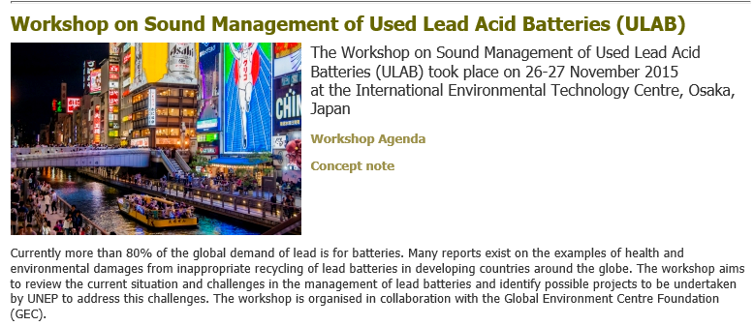

2. What have we done?

Slide 5
2. Purpose of this session?
The overall goal of this session is to advance international analysis, understanding, commitment and action to address the challenges associated with the management and recycling of ULAB in the ECOWAS region.
Specific objectives of this session are the following:
* Share information and raise awareness on environmental and health impact of improper used lead-acid batteries;
* Strengthening the knowledge on technologies for sound recycling of ULAB;
* Exchange information on the government policies and stakeholder actions to address risks;
* Identify potential future UN Environment activities towards the e.s.m of ULAB, among others with elements of a regional strategy for sound ULAB recycling.

Slide 6

Chair:
UN Environment
Africa Office
Farida Were

Slide 7
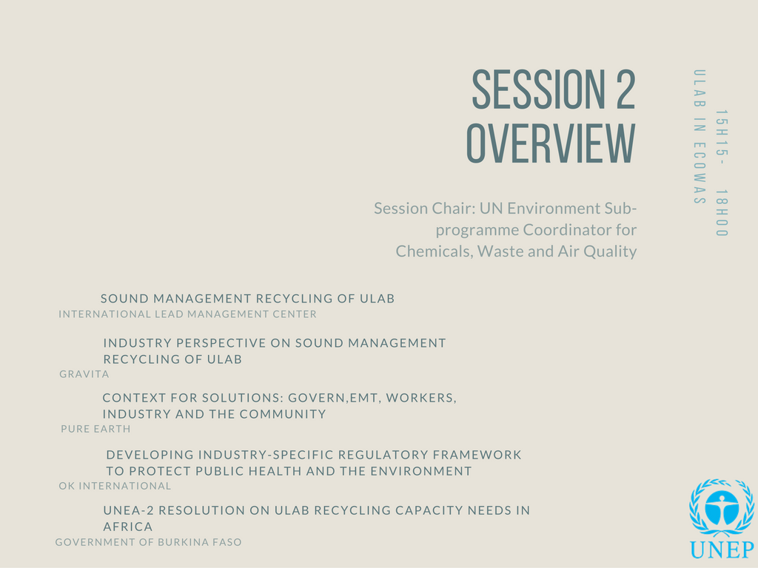
Chair:
UN Environment
Africa Office

Slide 8

Chair:
UN Environment
Africa Office

