Slide 1
Chlor Alkali Industry
Indian Experience
Satish Sinha
Toxics Link

Slide 2
Global capacity- chlor alkali
Cell membrane technology- first commercial plant commissioned in 1975 in Japan
Chemfab Alkalis -first ones to shift to membrane technology in India in 1985.

Slide 3
Industry overview
First Plant 1959
First conversion to Membrane 1985
Total number of plants 32
Number of plants closed 5
Installed capacity 3.39 MMTA
Production 2.76 MMTA
Capacity utilization 81%

Slide 4
Factors influencing technology shift
Reduction in energy consumption
Expansion in plant capacity
Addressing environmental concerns
Availability of technology UDHE, De Nora and Ashai
Regulatory compliance benefits
Indirect benefits to community , workers relations and health

Slide 5
Charter on Corporate responsibility for Environmental Protection- 2003 ( CREP)
17 industrial sectors
Shift to Membrane technology by 2012
Mercury distillation
De-mercurisation of caustic soda
Reduction of mercury consumption
Reduced mercury release

Slide 6
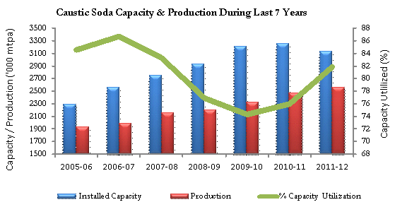
Economic outlook Chemical industry
Indian GDP- Between 7 & 8%
Chemical market – growth between 2009-14 around 14-15%- Future projection 10-13%
Chlor Alkali growth rate 5 % against 7-8%
Anti dumping duty and strengthening of caustic soda prices around 2009
Chemical growth statistics- FICCI
http://forum.valuepickr.com/t/chemfab-alkalis-well-poised-for-the-caustic-soda-chlorine-cycle/1202/2
Notes:
12
th
In
12th largest producer of chemicals globally

Slide 7
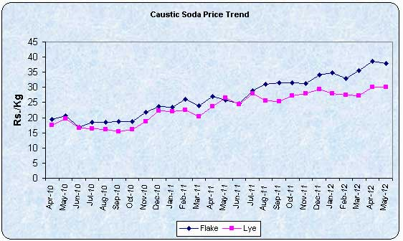
Anti dumping duty on imports - strengthening of domestic prices

Slide 8
Economic Driver
Energy requirement 60-70%
Mercury cell 3000 kwh/t
Membrane cell 2300-2400 kwh/t
Net saving > 20%
Saving per/ton 3670 INR

Slide 9
Cost consideration
Cost of conversion 100 ton plant 11-12 m USD
Cost of conversion Indian Industry 750 m USD
Import duty reduction 4%
Membrane replacement 3-5 years
Indigenous manufacturing
Maintenance cost 3% /project cost
Return on investment without 7 years
expansion
With 20% expansion 5 Years

Slide 10
Membrane cell advantages
Improved product quality
Mercury free - toxicity reduction
Energy savings - Reduced carbon footprint and costs
Reduction in mercury management costs

Slide 11
Protocol Mercury Management
Increase in capacity or new site- EIA
Mercury management plan for partial or complete conversion
Reuse of excess mercury, status unknown ?
Removal of mercury from pipelines, equipments
Testing of ground water and soil , remedial action
Not viable for old plants - leading to closure

Slide 12
Lessons learnt
Environment consideration key driver
Critical business decision
Analyze business information from each country
Age of existing plants and its viability for shifting
Capital intensive

