Slide 1


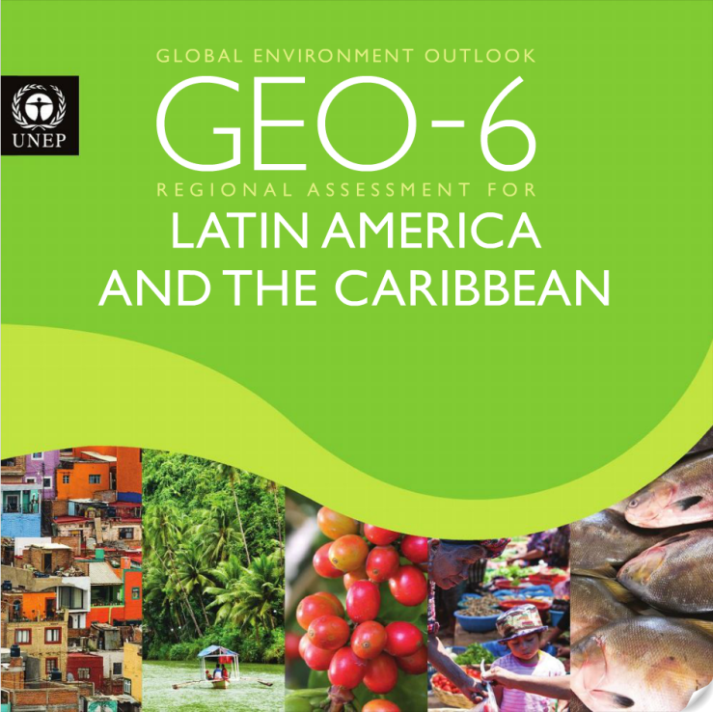



Orientation: Writing for Assessments
Pierre Boileau (GEO Head)
Nov. 11, 2016

Slide 2
GEO-6 Work programme
Author Draft of SPM
Review Draft of full GEO
Draft State and Trends with Policy Response
Progress Report to UNEA-3
Final GEO-6
HLG Draft SPM
Final GEO-6 and SPM
1st Order Draft
Review Draft
2017
2018
2019
Zero Order Draft
4-6 December
October
May
Review Period
Review Period
February
May
October
March
November
February
UNEA-3
UNEA-4
First global authors’ meeting
Second global authors’ meeting
Third global authors’ meeting + RE
Fourth global authors’ meeting
Review editors meeting
MS SPM negotiation
HLG SPM drafting meeting
Acronyms: High Level Intergovernmental and Stakeholder Advisory Group (HLG),
Global Environment Outlooks (GEO), Summary for Policy Makers (SPM), Review Editors (RE)
Notes:
The GEO-6 work programme has been designed to deliver two separate review drafts, one for the first two parts of the document (State and Trends, Policy Response) and the second to deliver the full GEO-6 including outlooks. The meeting schedule will encourage authors to prepare the drafts at the appropriate times to ensure the process moves forward. Here are some details:
First author’s meeting in Feb. 2017 with all three main groups (State and Trends, Policy Response, Innovative Outllooks group) and the GEO-6 advisory bodies meeting. There will be parallel sessions and combined sessions to allow an appropriate level of interaction among the groups as well as allow them time to plan their individual activities. The Innovative Outlooks Group will outline the work they will do to develop new Outlooks methods and tools that will be used in GEO-6.
Second author’s meeting in May, 2017 with only the State and Trends and Policy Response groups meeting. Here the goal is to prepare a review draft of the first two chapters and to provide input to the progress report being prepared for UNEA-3.
Third author’s meeting, all groups come back together. Here the goal is to ensure the review drafts of the first two chapters are completed (State and Trends, Policy Response) and that the drafting begins for the Outlooks chapter. Review editors will be present here to ensure authors have dealt with review comments appropriately and to prepare their summary report of the review process. The HLG and SAP will meet to ensure adequate planning and also to finalize the progress report for UNEA-3.
Fourth author’s meeting, March, 2018. Here the goal is to prepare the review draft of the full GEO, including Outlooks. Authors will also prepare the first draft of the Summary for Policy Makers. HLG and SAP will meet for planning purposes but also to observe the author drafting process and ensure it’s credibility and relevance for the needs of Member States.
2nd Review Editor’s meeting will address review comments from the second review period and prepare a summary report of how these were dealt with.
HLG SPM drafing meeting will review the draft SPM prepared by the authors and prepare a review draft that Member States will receive.
Member State SPM negotiation meeting. The draft SPM will be finalized by Member States in preparation for endorsement by UNEA-4.
The full GEO-6 as well as the translated SPM will be made available to UNEA-4 for endorsement.

Slide 3
Working Structure of GEO-6
High-level Intergovernmental and Stakeholder Advisory Group (HLG)
Scientific Advisory Panel (SAP)
UN Environment Secretariat
State & Trends + Policy Response
Co-chairs & vice-chairs
Innovative Outlooks Group
Coordinating Lead Authors
Coordinating Lead Authors
Lead Authors
Lead Authors
AMDG
Contributing Authors
GEO Fellows
Review Editors
Contributing Authors
Assessment Methodologies, Data and Information Group (AMDG)
Notes:
The working structure of GEO-6 is different from GEO-5 in that it includes Co-chairs and vice-chairs. This structure was recommended by the Scientific Advisory Panel to help ensure the scientific credibility of the GEO-6 process. Other details of the structure include:
Policy advice will be received from the HLG
Scientific integrity of the process will be overseen by the SAP
Both advisory bodies will provide advice on the overall management of the GEO-6 process
The Co-Chairs (Dr. Ekin, Dr. Gupta) will act as the bridge between the advisory bodies and the author teams and will be supported by the Secretariat.
The Secretariat will continue to support the advisory bodies in their planning activities.
The author teams will be separated somewhat by the timing of the process, with the two first chapters being prepared in the first half of 2017 and the last chapter on Outlooks begin prepared in the last months of 2017 and the first months of 2018.
However, the main authors meetings will allow for interactions among all of the author teams in order to ensure coherence of the assessment.
GEO Fellows will support the process by assisting the authors with research questions and performing quality assurance tasks for citations and references.
Review editors will conduct evaluations at the end of each review period to ensure that review comments were dealt with appropriately. They will prepare a summary report from each review period.

Slide 4
GEO-6 Timeline to February Meeting
November
Nov. 11
Writing for Assessments
December
January
February
March
Oct. 20
Co-chairs call
Webinar
Citations, References
Invitation
Alternate
Authors
First Authors Meeting
Nov. 23 SAP
2017
2017
SAP
Webinar
Matrix Drafting Approach
Nov. 22
HLG
Webinar
SDGs & Indicators
Oct. 24 HLG
Nov. 5 Authors Selected
Webinar
Charts, Graphs, Maps
GEO
Fellows
Jan. 31 HLG
Co-chairs
Oct. 21 First Authors Invitations
November
December
Call
Authors
‘Outlooks’
January
February
March
Oct. 28 Second Invitations
Call
Authors
‘Fresh water’
Call
Authors
Land
Call
Authors
‘Air’
Call
Authors
‘Oceans/marine’
Call
Authors
‘Biota’
First Authors Meeting
2017
Authors timeline
Nov. 5 Authors Selected
Call
Authors
‘Air’
Call
Authors
‘Oceans/marine’
Call
Authors
‘Biota’
Call
Authors
‘Fresh water’
Call
Authors
Land
Call
Authors
‘Outlooks’
Monthly HLG planning calls – timeline, deliverables, budget, policy approach etc.;
2 SAP planning calls – guidance to authors, ensuring scientific integrity, SAP interaction with Co-chairs, etc.
Regular Co-chairs calls (likely bi-weekly) – orientation, co-chair approach, working style with vice-chairs and Secretariat;
Face-to-face Co-chairs meeting in Bonn (mid-Oct.) – Overall GEO-6 planning + coordination with IPBES;
12 Authors calls – overall workplan and timeline + 5 orientation sessions (webinars) to prepare for February meeting.
Internal UNEP coordination meetings – core focal points for environmental themes and cross-cutting issues (Economics Division, Ecosystem Division, Law Division, SDGs, etc.)
Coordination meetings with science bodies (IPBES, IPCC, BRS, Ozone, etc.)
Advisory Bodies
Co-chairs & vice-chairs
Authors
Secretariat
Conventions

Slide 5
Principle
Result
Policy Relevant
Succinct and to the point
Synthesis of findings
Avoid advocacy
Scientifically Credible
Independence of process
Justification is contained in references
Consolidation of knowledge from expert community
Data and Indicators
Respected data sources
Effective Assessments
Data tells a story
Timely information
No new research
Balanced selection of authors and viewpoints
Based on analysis of existing research
Accepted by user community
Arguments are justified
Not policy prescriptive
Well referenced and summarized
Informs Policy Development

Slide 6
Example: Policy relevant but not policy prescriptive
“In order to ensure protection of land and marine biodiversity, more land reserves and marine protected areas must be created”
“Policy options for protecting land and marine biodiversity include: creating more land reserves and marine protected areas, acting on the demand-side for biodiversity resources…”
Example: Scientifically credible
“Population growth and economic development will be significant over the coming decades, leading to more environmental degradation”
“Population is expected to grow by x% between 2015 and 2030, while gross domestic product is expected to grow by y%. These drivers could impact the environment in the following ways…”

Slide 7
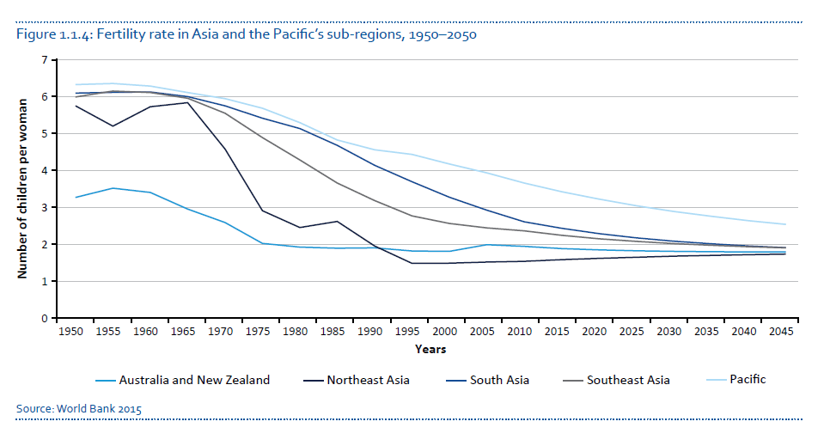
Example: Data and indicators
“The fertility rate in the Asia-Pacific region is expected to decline and level out over the next decades (World Bank, 2012) ”

Slide 8
Example: Based on existing research
Follows scientific publication methodology – Intro, Method, Results, Discussion, Conclusion
Extracts Conclusion and cites the relevant research that supports it.
Example: Well referenced and summarized
“In many Latin American cities air quality exceeds the norms, which leads to many deaths.”
“In most cities exposure to PM2.5 exceeds the international recommended standards (Green and Sanchez 2012), and many deaths occur on account of diseases related to air pollution (WHO 2014c).”

Slide 9
Writing Style
Impact
Easily extractible – bite/byte size
Non-technical (where possible)
Avoid reader fatigue
Grade 6 level English
Examples, case studies
Clear results, no complicated
Creates demand for action
Reach community of influencers + teachers, students
Graphics, charts, maps
For visual learners
Readable Assessments
Ideal for social media
Picture is worth a thousand words
Reach a new audience
Use new media – video, podcasts, interactive websites
Easy to showcase
Create a real-world feel to the findings
Space for more issues
Easier to translate & understand
Keep it short – only enough words to make your point
More take-up by non-scientists

Slide 10
Example: Non-technical language
“If temperature rises, many air pollution models project an increase in ground level ozone production, particularly in urban areas and surroundings (Hesterberg et al. 2009). Increased temperature also accelerates ozone destruction, and it is believed that the net direct impact of climate change on ozone concentrations around the world can be reduced (IPCC 2013).
“If temperature rises, many air pollution models show an increase in ground level ozone production, particularly in cities and surroundings (Hesterberg et al. 2009). Increasing temperature also speeds up ozone destruction, and it is thought that the effect of climate change on ozone levels around the world can be reduced (IPCC 2013).

Slide 11
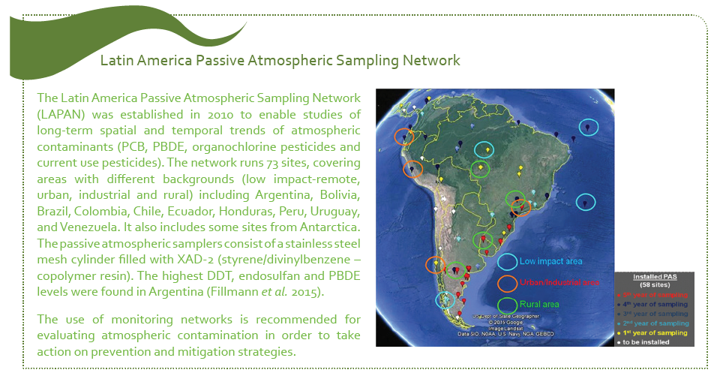
Examples and Case Studies

Slide 12
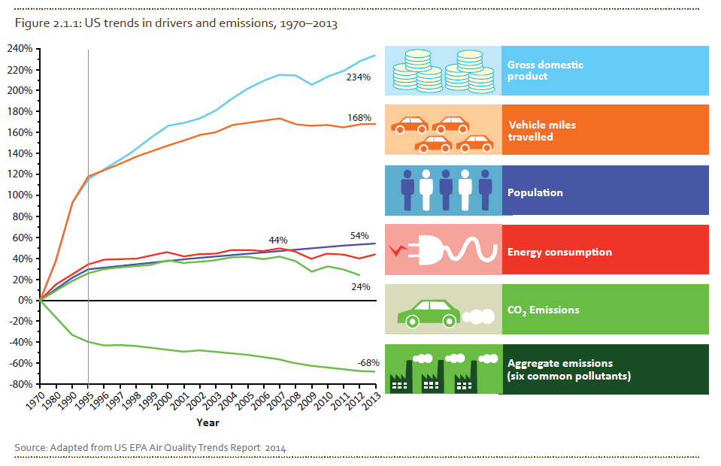
Example: Graphs, charts and maps

Slide 13
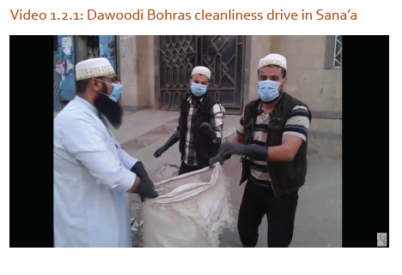
Example: New media
https://www.youtube.com/watch?v=0OiRvCkitYc

Slide 14
Example: Keep it short
“However, current knowledge on the state of fish stocks in European seas should also be appraised on a sub-regional scale, because catches of commercially exploited species reveal strong sub-regional differences. For instance, most stocks of herring in the North Sea west of Scotland, and the Irish and Celtic Seas, are fished at or within maximum sustainable yield (MSY).”
“However, current knowledge on the state of fish stocks in European seas should also be appraised on a sub-regional scale, because catches of commercially exploited species show strong sub-regional differences. For example, most stocks of herring in the North Sea west of Scotland, and the Irish and Celtic Seas, are fished at or within maximum sustainable yield (MSY).”

Slide 15
Questions ???

