Slide 1

OARE Module 6B:
  E-journal, E-books and Internet Resources: Free E-book Access

Slide 2
Contents Module 6: E-journal, E-books and Internet Resources
Module 6A: Background; Free E-journals Access
Module 6B: Free E-book Access
Module 6C: Environment Gateways/Portals

Slide 3
Section C: Free E-book Access
  Booksee.org
  National Academy Press/USA
  Intech
  Open Textbook Library

Slide 4
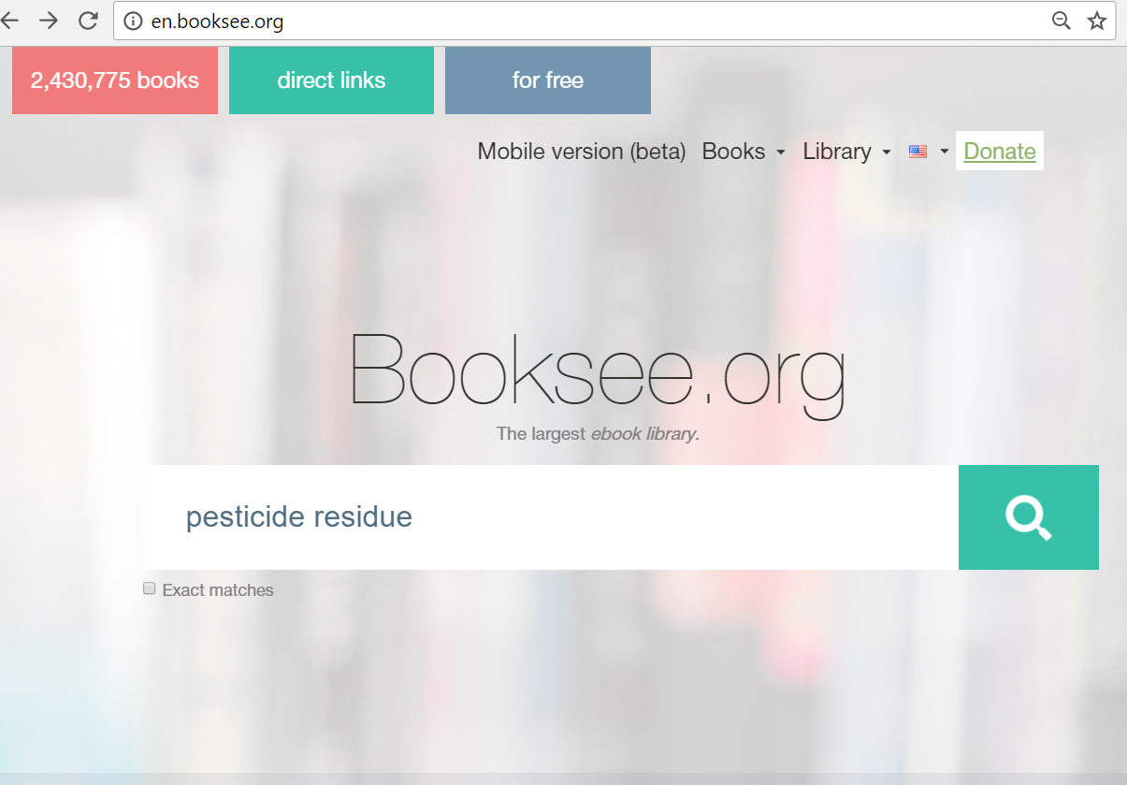
Booksee.org is a huge list of downloadable books that can be searched by keyword subjects Enter pesticide residue and click on the magnifying glass.

Slide 5
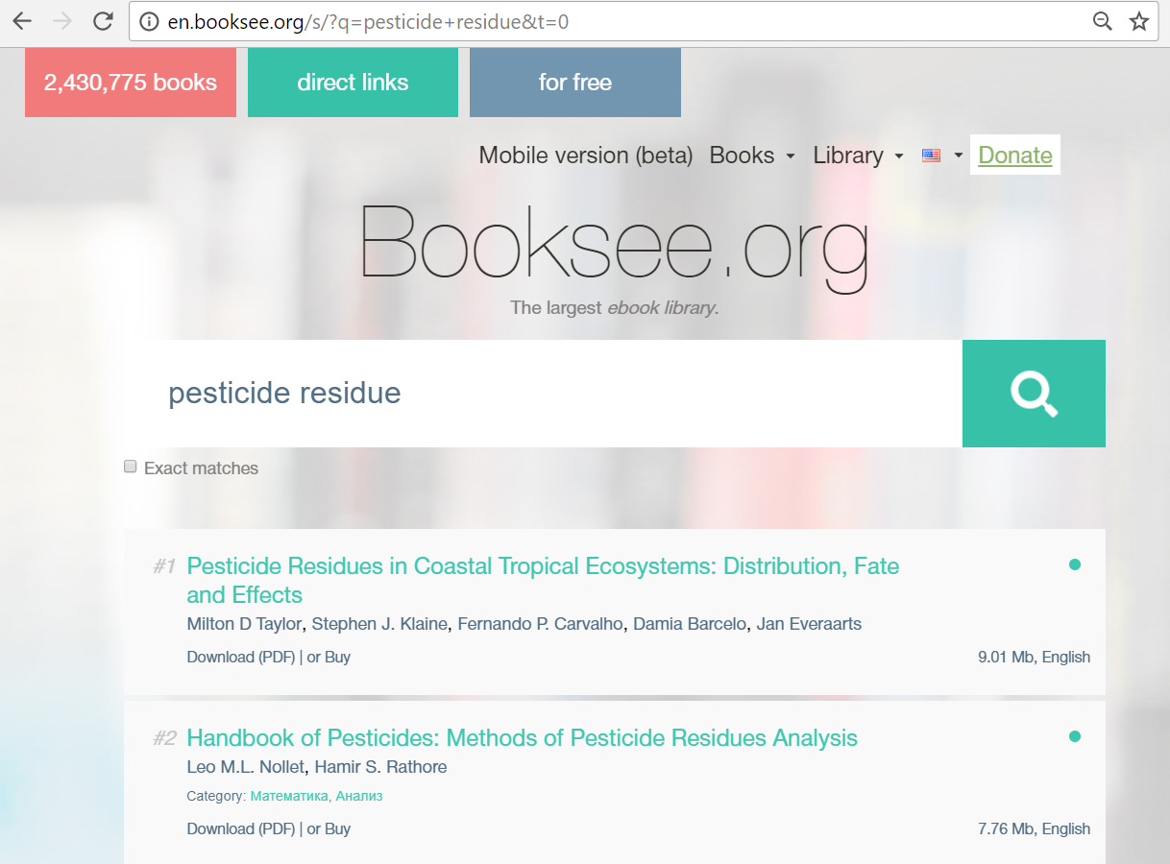
Results for the pesticide residue search are listed. Note the option to download PDF. Downloading these files can be a slow process.

Slide 6
The per search limit is 100 titles. If the search results are more than 100 titles, refine the search. The Exact matches box can limit the results (to 13 books if used.)

Slide 7
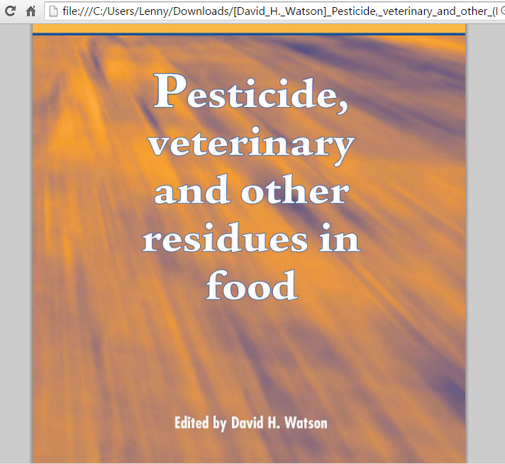
A 7.4 MB PDF has been downloaded. This took approximately 9 minutes.

Slide 8
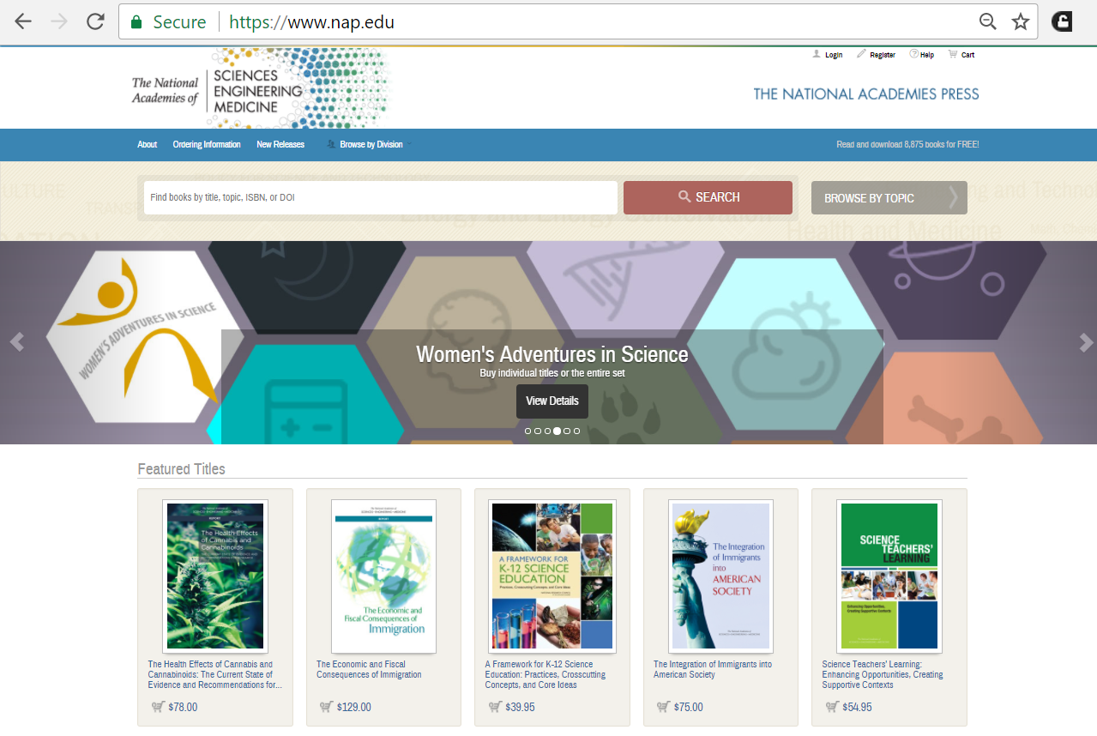
The National Academies Press e-books are downloadable for free and can be accessed by keyword SEARCH or BROWSE BY TOPIC

Slide 9
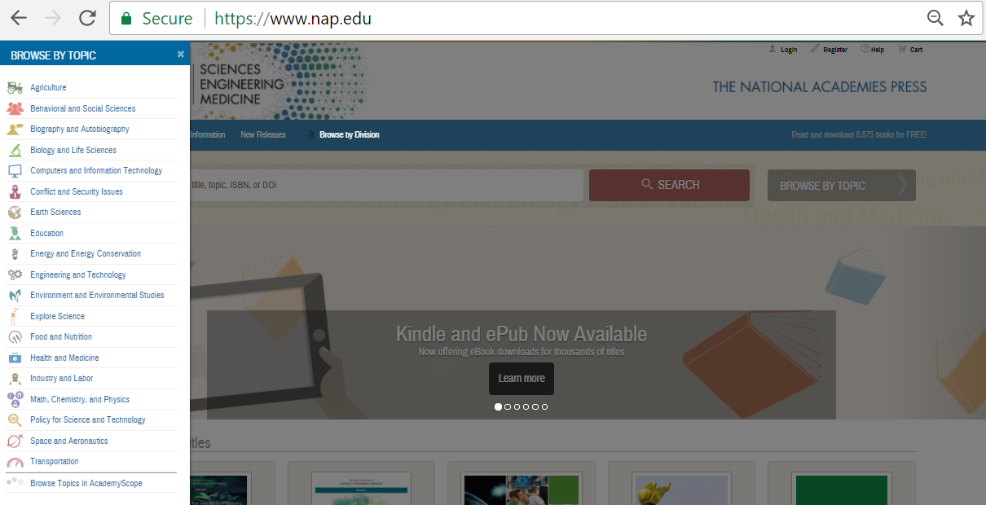
Now opened is the BROWSE BY TOPIC listing that includes Earth Sciences and Environment and Environmental Studies. Some of the other topics also could be of use.

Slide 10
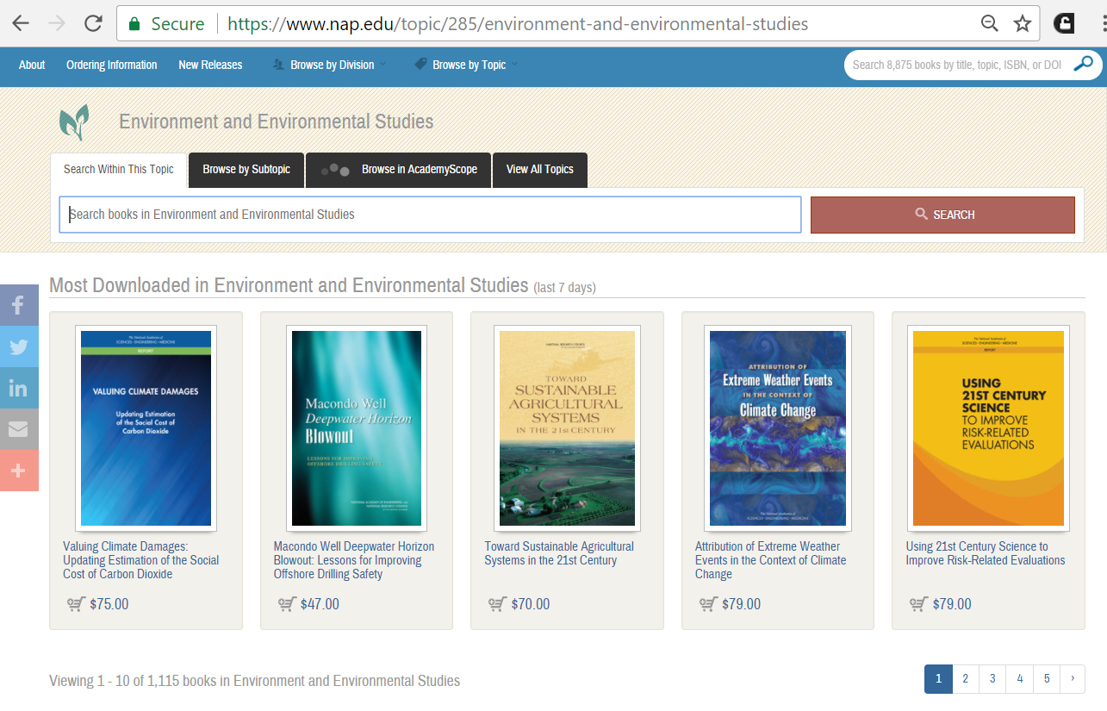
For the Environment and Environmental Studies category, NAP has 1115 books. Note the Search Within Sub-topic option.

Slide 11
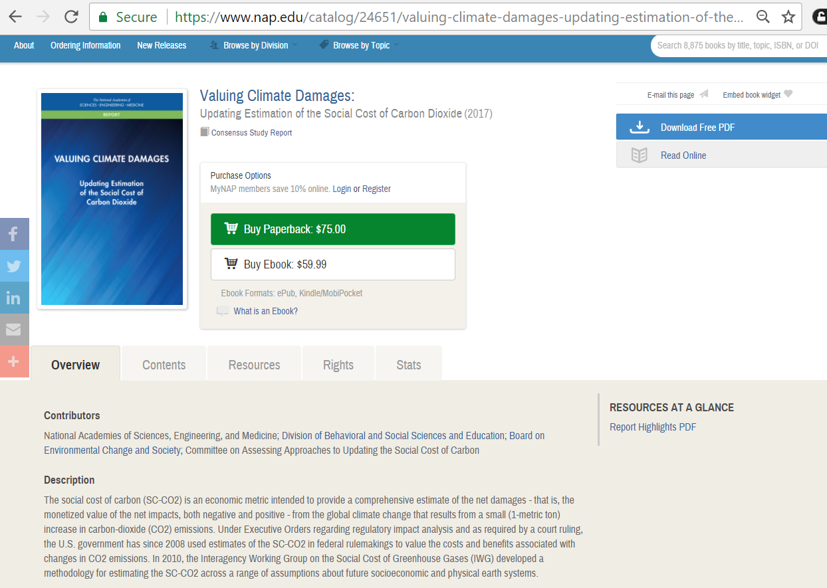
Each title can be read online or Download Free (as) PDF but (free) registration is required – see next slide.

Slide 12
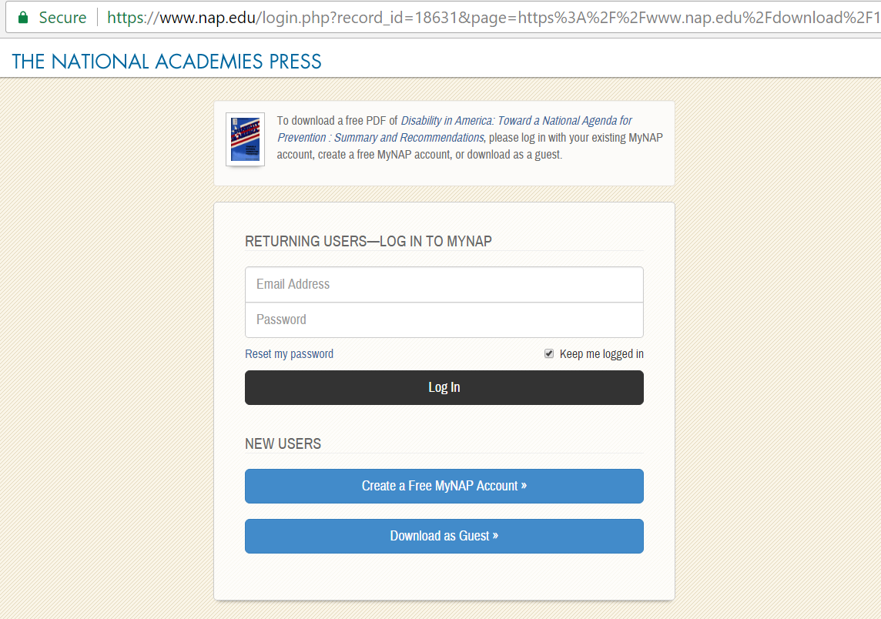
To download a book you must Log in to MyNAP. Registration is free via the Create a Free MyNAP Account link or you can use the Download as Guest option.

Slide 13
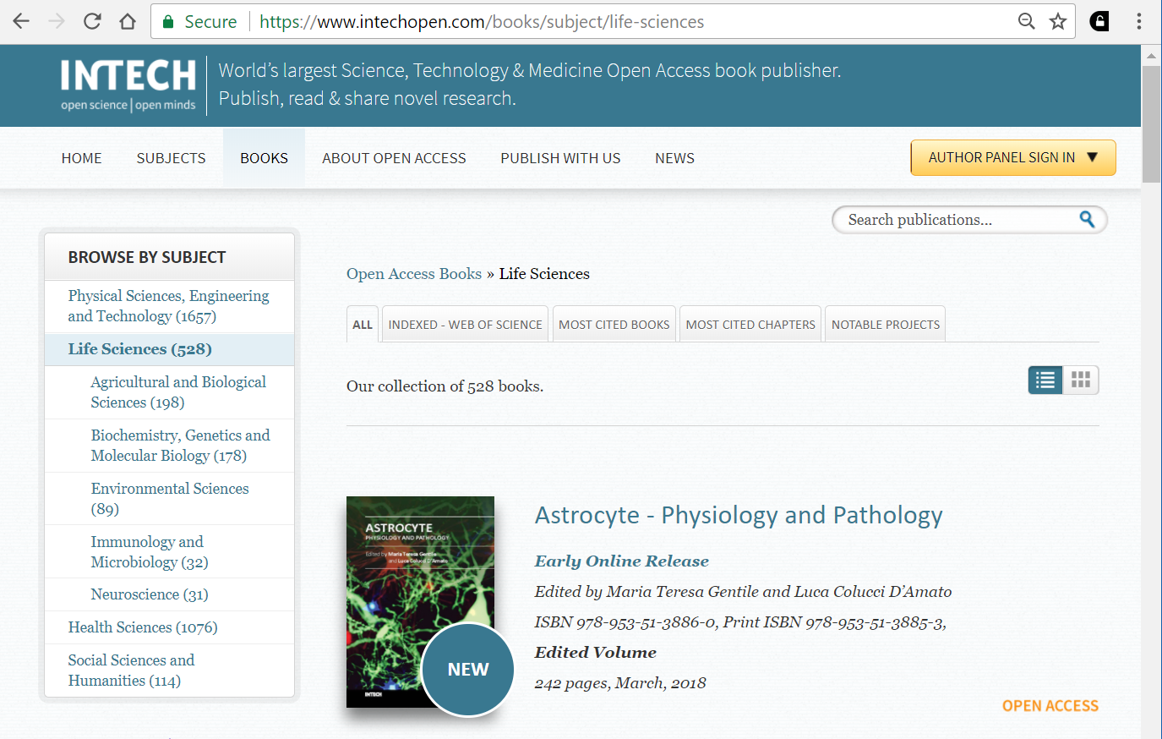
From the Browse By Subject listing, open the Life Sciences/Environmental Sciences list. Note that other subjects also may useful.

Slide 14
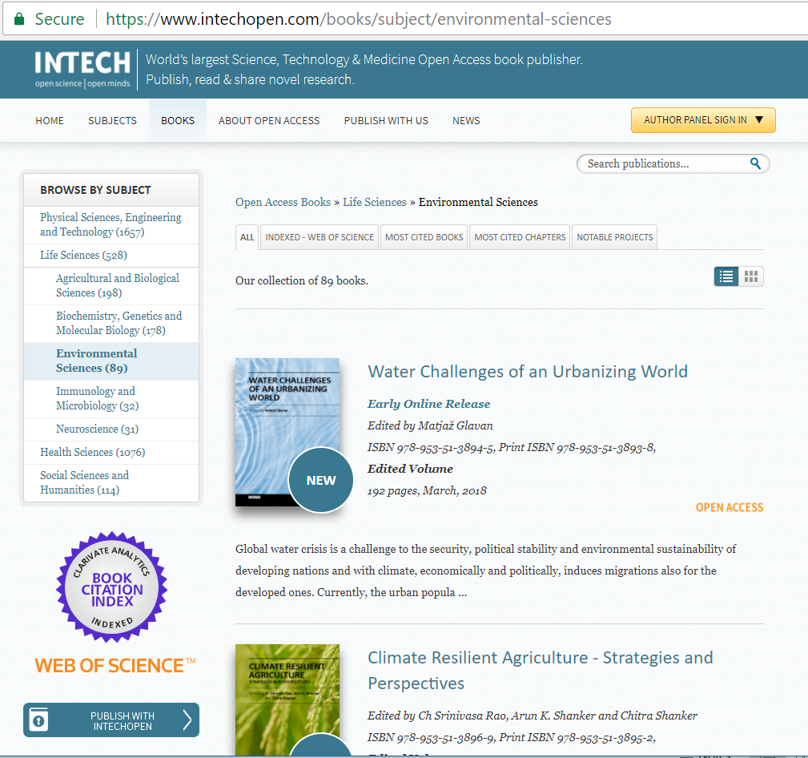
Scroll down the list of 89 Environment Books – to find books of interest. Note the link to the 1st book’s OPEN ACCESS.

Slide 15
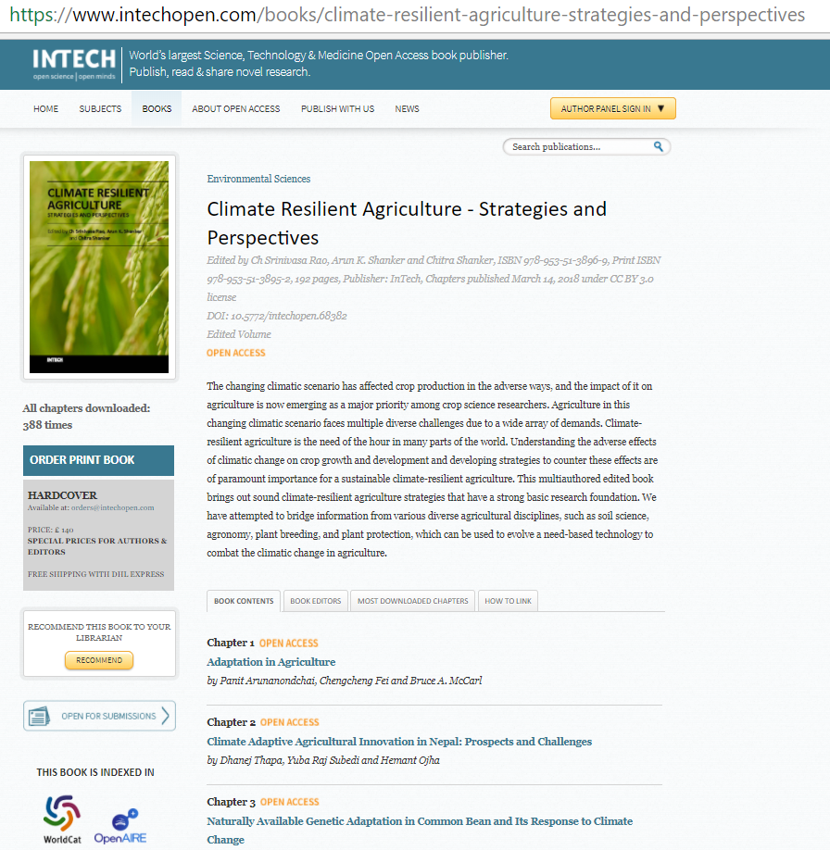
Now opened is the link to the 2nd book; note how each chapter can be downloaded via the OPEN ACCESS links.

Slide 16
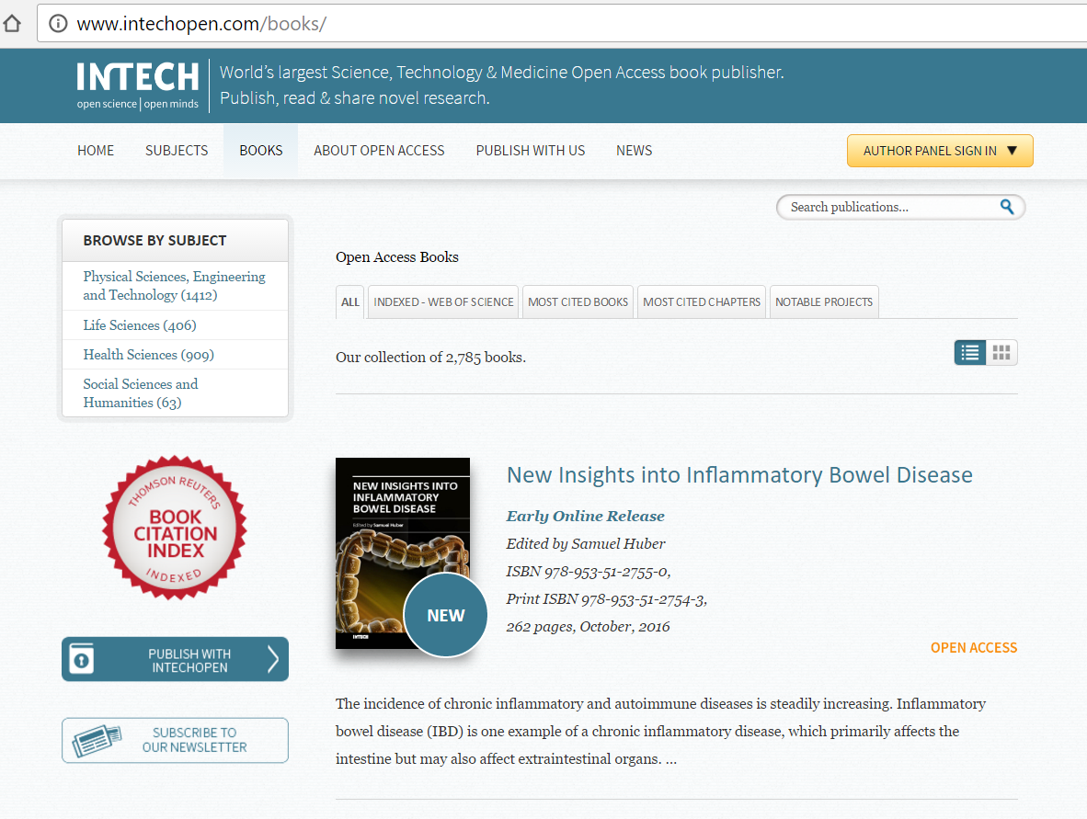
Another source of useful Open Access Books from Browse By Subject is the Physical Science, Engineering and Technology listing.

Slide 17
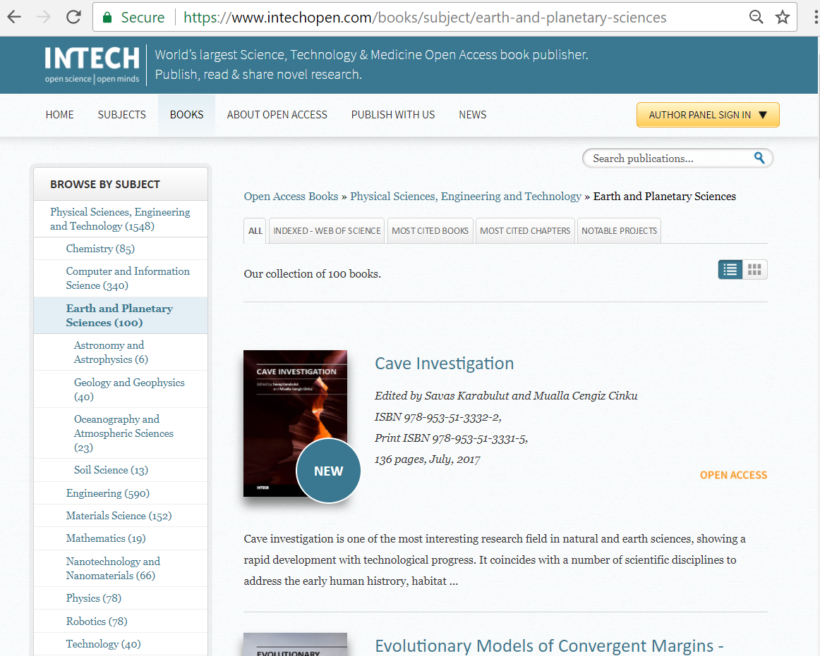
Note the various sub-categories in the Physical Science, Engineering and Technology broad subject category. Some of these may be useful to you or individuals from your institution.

Slide 18
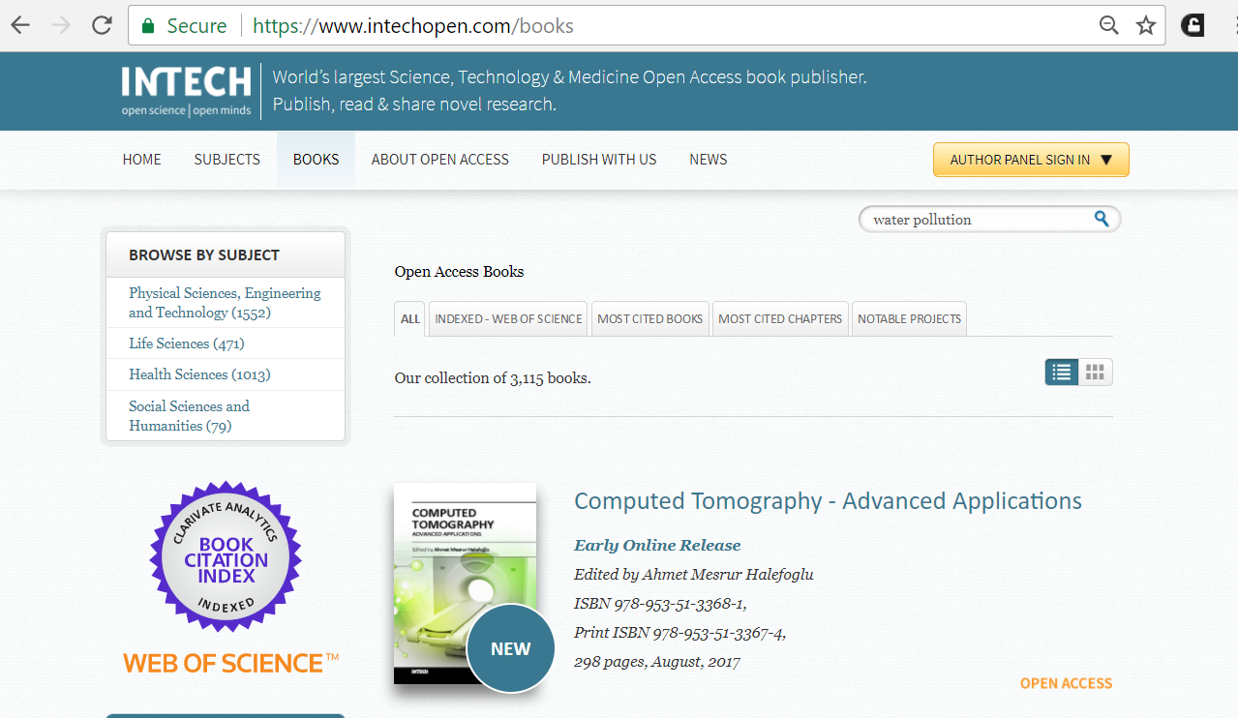
Enter water pollution in the keyword Search box.

Slide 19
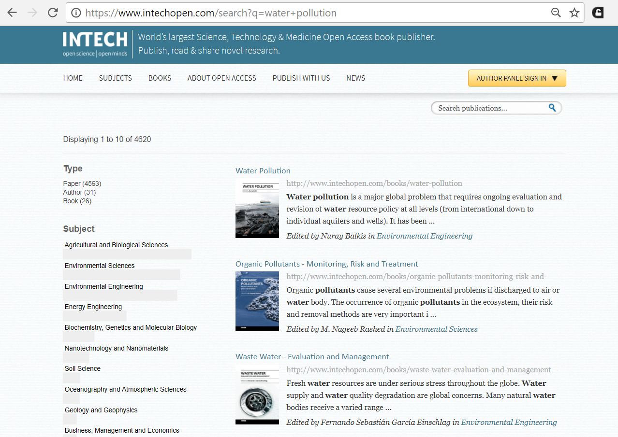
Results from this keyword search are 4020 links to the INTECH titles. Note the Paper, Author and Book (Type) listing.

Slide 20
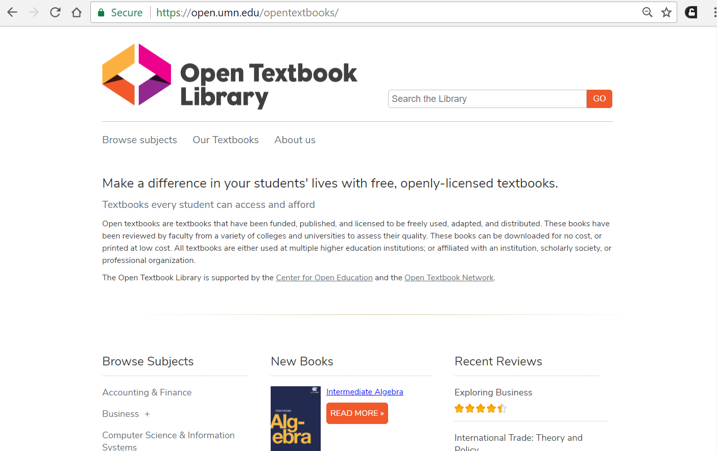
The Open Textbook Library provides a growing catalog of free, peer-reviewed, and openly-licensed e-textbooks - that can be freely used, adapted and distributed. It is supported by the Center for Open Education and the Open Textbook Network.

Slide 21
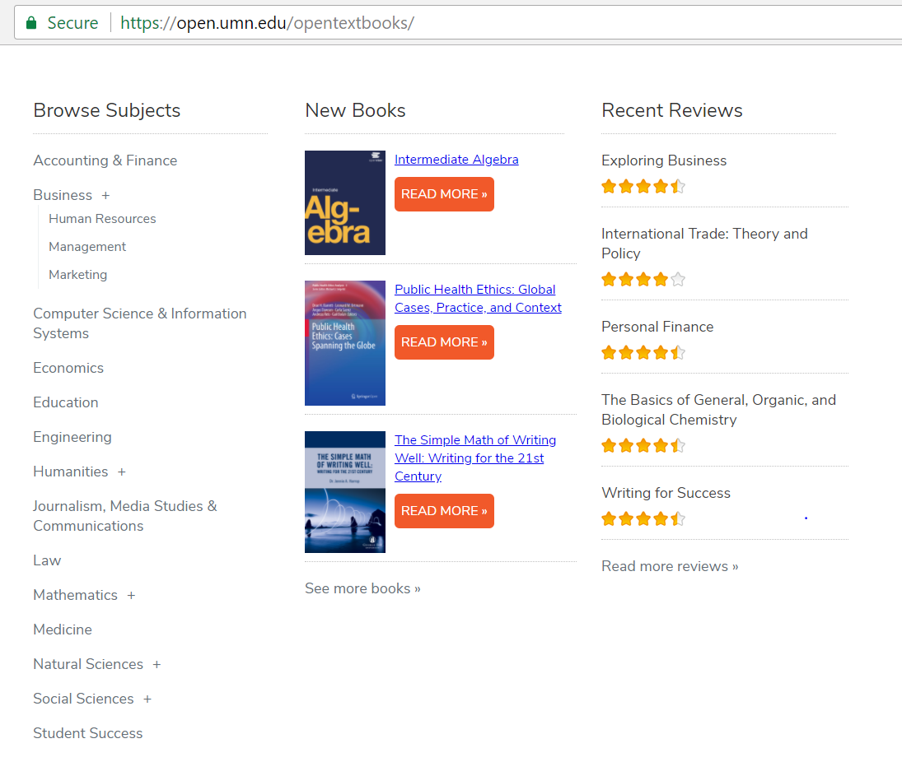
From the initial page, note the Browse Subjects list which includes Natural and Physical Sciences – that contains basic sciences textbooks. Other disciplines at a University also will find this resource useful.

Slide 22
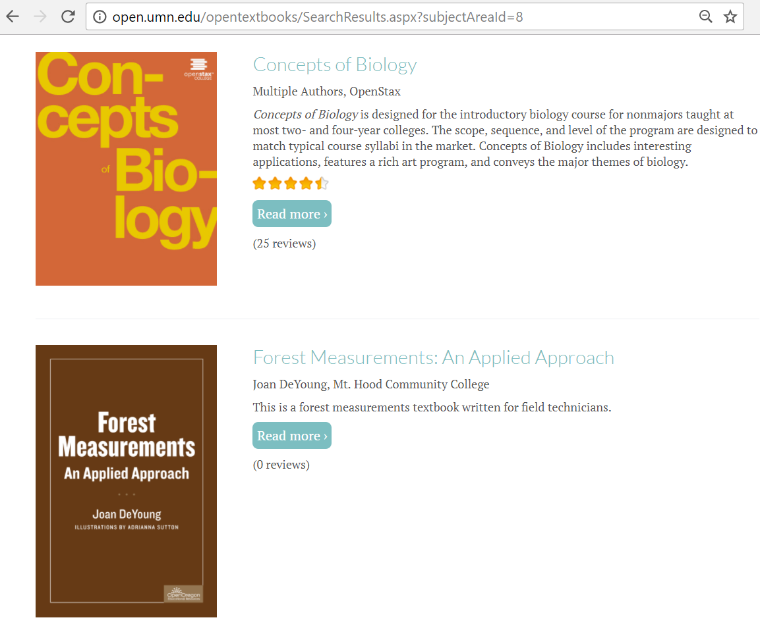
Now displayed is the link to Forest Measurements: An Applied Approach textbook.

Slide 23
Exercises
  This is the end of the OARE Basic Course Module 6B. Exercises for this module are available after Module 6C.
  Please continue with Module 6C: E-journal, E-books and Internet Resources: Environment Gateways/ Portals.
  Updated March 2018

