Slide 1
Stockholm Convention on POPs: The Global Monitoring Plan (GMP) and effectiveness evaluation
Katarina Magulova
Secretariat of the Basel, Rotterdam and Stockholm Conventions

Slide 2
THIS PRESENTATION
Background & mandate
GMP
  Implementation arrangements
  Outcomes to date
  Results: changes in POPs concentrations over time
Effectiveness Evaluation
Acknowledgements

Slide 3
1. Background & mandate

Slide 4
Stockholm Convention
Adopted in 2001, entered into force in 2004: 181 Parties
Covers POPs -15 pesticides and 13 industrial chemicals and by-products:
  Prohibition and/or elimination of the production and use, and the import and export of intentionally produced POPs listed in Annex A
  Restriction of the production and use, and the import and export of intentionally produced POPs listed in Annex B
  Reduction or elimination of unintentional releases of the POPs listed in Annex C

Slide 5
Targeting additional chemicals
  Any Party may submit a proposal for listing a chemical in the Convention
    Hazard assessment showing POPs characteristics: environmental fate and behaviour; eco-toxicological effects
    Monitoring data suggesting presence of a substance far from exposure sources
Submission of proposal for listing a chemical
  POPRC examines the proposal and decides whether screening criteria in Annex D are fulfilled
Screening phase
  POPRC evaluates whether the chemical is likely to lead to significant adverse human health or environmental effects, such that global action is warranted
Risk profile
  Based on the Risk rofile and Risk Management Evaluation, POPRC recommends whether the chemical should be considered by the COP for listing and suggest possible control measures
Risk management evalution
  COP decides on listing the chemical and specifies its related control measures

Slide 6
Mandate for GMP and EE
ARTICLE 16 on Effectiveness Evaluation:
In order to facilitate such evaluation, the Conference of the Parties shall, at its first meeting, initiate the establishment of arrangements to provide itself with comparable monitoring data on the presence of the chemicals listed in Annexes A, B and C as well as their regional and global environmental transport.
These arrangements:
(a) Should be implemented by the Parties on a regional basis when appropriate, in accordance with their technical and financial capabilities, using existing monitoring programmes and mechanisms to the extent possible and promoting harmonization of approaches;
(b) May be supplemented where necessary, taking into account the differences between regions and their capabilities to implement monitoring activities; and
(c) Shall include reports to the Conference of the Parties on the results of the monitoring activities on a regional and global basis at intervals to be specified by the Conference of the Parties.

Slide 7
2.1. GMP: Implementation arrangements

Slide 8
Regional implementation
ROG – Regional Organization Group, 6 members per UN region, monitoring experts
GCG – Global Coordination Group, 15 members in total, 3 from every UN region
ROGs: Every 6 years
Collect information on regional basis in core media on concentrations of POPs (first 2009 - pdf, second 2015 – electronic format: GMP DWH)
Prepare reports (regional/global)
Submit to COP for consideration – and input to evaluate effectiveness of the Stockholm Convention

Slide 9
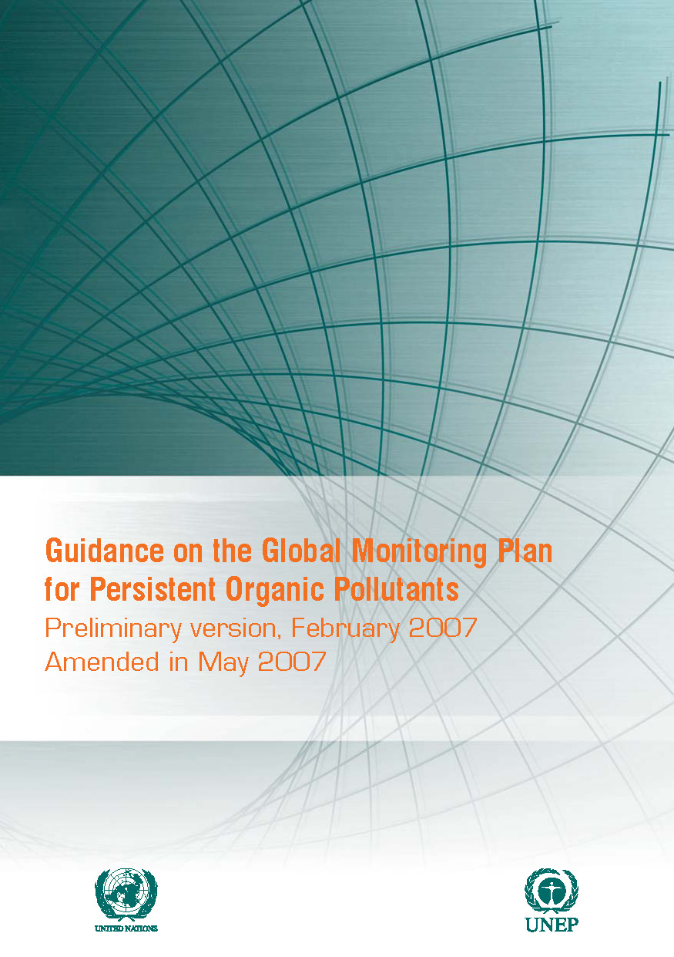
GMP Guidance document
Guidance document = technical (practical document!)
Collection, analysis and reporting of information and data
Statistical considerations
= all that to provide comparable information in all regions
+ also describes a harmonized regime for the preparation of monitoring reports
Updated to increase comparability and consistency, broadened core media (ambient air, human breast milk, blood + newly – surface water for PFOS)
Information on sampling and analysis of POPs listed in 2009&2011 harmonized regime for monitoring reports…
Separate guidance chapter addressing ESB
Latest version of the Guidance document (UNEP/POPS/COP.7/INF/39) http://chm.pops.int/TheConvention/ConferenceoftheParties/Meetings/COP7/tabid/4251/mctl/ViewDetails/EventModID/870/EventID/543/xmid/13075/Default.aspx

Slide 10
Monitoring activities
The objective of monitoring activities is to generate comparable data on levels of POPs in core media:
ambient air,
human milk and human blood,
surface water for water-soluble POPs (PFOS)
POP substances to be monitored = Annexes of the Stockholm Convention
Substances are in more detail in Chapter 2 – GMP Guidance Document = congeners, isomers, degradation products or parent compounds that bring most comprehensive information
Existing monitoring programmes (air: AMAP, EMEP, GAPS, IADN, MONET… human milk / blood: UNEP WHO, AMAP, national programmes..).

Slide 11
Strategic Partnerships
Arctic Monitoring and Assessment Programme (AMAP)
Global Atmospheric Passive Sampling (GAPS) Network
Cooperative Programme for Monitoring and Evaluation of the Long-range Transmission of Air Pollutants in Europe (EMEP)
South-East Asia air monitoring programme
Research Centre for Environmental Chemistry and Ecotoxicology (RECETOX)
United Nations Environment Programme (UNEP Chemicals and Waste)
World Health Organization (WHO)

Slide 12
Region | Air | Human matrices | Water | Other media
Africa | Global Atmospheric Passive Sampling Network (GAPS) MONET Africa UNEP GEF GMP1 project | UNEP/WHO human milk survey UNEP GEF GMP1 project | MONET Africa pilot project UNEP GEF pilot project | Limited monitoring dealing with the contamination of water, soil, sediments and food by POP pesticides
Asia Pacific | POPs Monitoring Programme in East Asian Countries China national POPs monitoring programme Japan national monitoring programme MONET Fiji UNEP GEF GMP1 project | China monitoring programme on human milk Japan POPs monitoring programme on human milk Japan monitoring programme on human blood UNEP/WHO human milk survey | United Nations University program “Environmental Monitoring and Governance in the Asian Coastal Hydrosphere’’ National water monitoring programmes: China, Japan | Japan national programme on water, ground water, bottom sediments, soil, biota, food
CEE | APOPSBAL Arctic Monitoring and Assessment Programme (AMAP) GAPS European Monitoring and Evaluation Programme (EMEP) MONET - Europe MONET - CEE MONET - CZ | UNEP/WHO human milk survey | Joint Danube Survey (2009) MONET-Europe NORMAN - NORMAN Association | National programmes on e.g. soil, sediments and biota are available in the region but rather variable, episodic
GRULAC | GAPS Latin Passive Air Monitoring Network (LAPAN) UNEP GEF GMP1 project | UNEP/WHO human milk survey UNEP GEF GMP1 project
WEOG | AMAP Australian Pilot Monitoring Programme –air (AGAM) EMEP GAPS Integrated Atmospheric Deposition Network (IADN)/ Environment Canada’s Air Monitoring in the Great Lakes Basin (GLB) Northern Contaminants Programme (NCP) Norwegian Troll Station Monitoring Network in the Alpine Region for Persistent and other Organic Pollutants (MONARPOP) MONET - Europe U.S. EPA’s National Dioxin Air Monitoring Network (NDAMN) UK-Norwegian Transect The UK Toxic Organic Micro Pollutants (TOMPs) | AMAP Australia “snap shot” surveys (under the Australian pilot monitoring programme) CDC/CCEHIP/-NCEH CHMS and FNBI ESB Germany GerES New Zealand “snap shot” surveys Sweden national programmes: Uppsala, Stockholm UNEP/WHO human milk survey | Australian Pilot Monitoring Programme International Council for Exploration of the Sea (ICES) database | AMAP Australian Pilot Monitoring Programme Great Lakes HELCOM OSPAR MEDPOL NCP

Slide 13
2.2. GMP: Outcomes to date

Slide 14
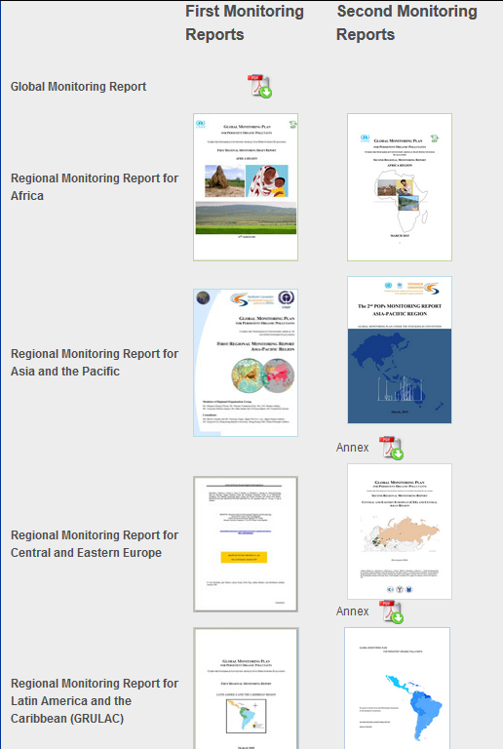
Regional and global monitoring reports
Second Global POPs Monitoring report will be presented in May 2017 at the 8th meeting of the Conference of the Parties to the Stockholm Convention
Global synthesis of 11 years of POPs monitoring data collection under the GMP since the entry into force of the Convention
Key input to effectiveness evaluation

Slide 15
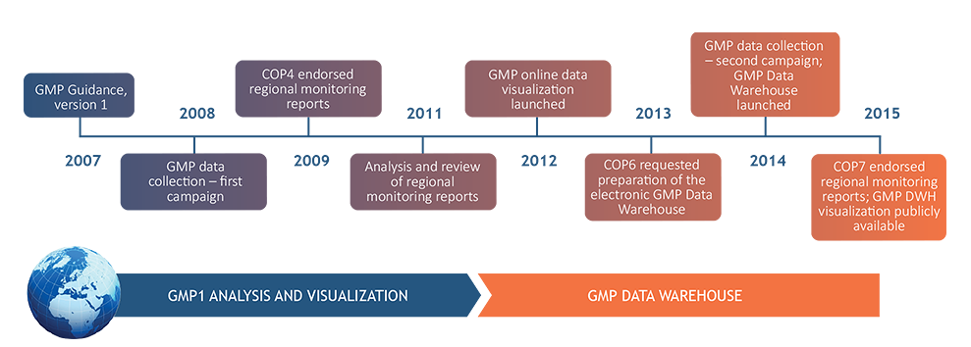
GMP Data warehouse
http://www.pops-gmp.org/

Slide 16
Data Availability

Slide 17
2.3. GMP Results: changes in POPs concentrations over time

Slide 18
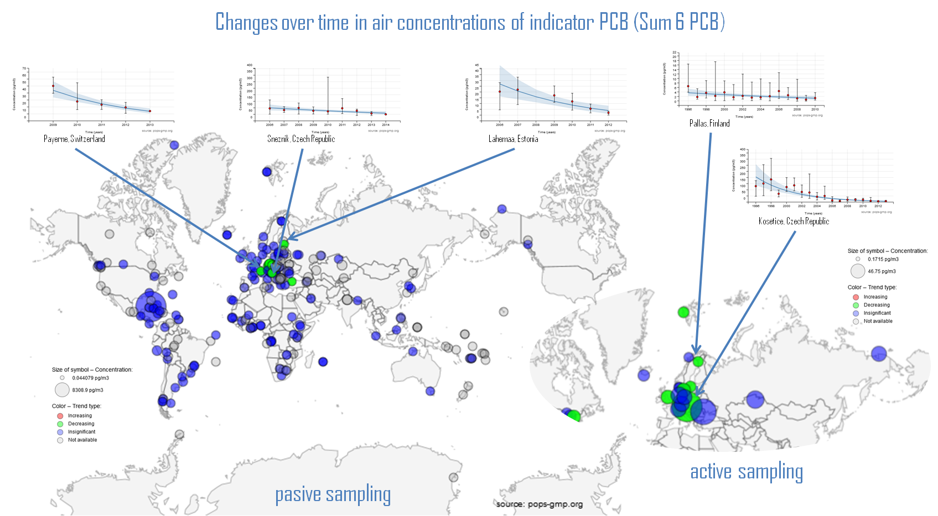
Changes over time in air concentrations of indicator PCB (Sum 6 PCB)

Slide 19
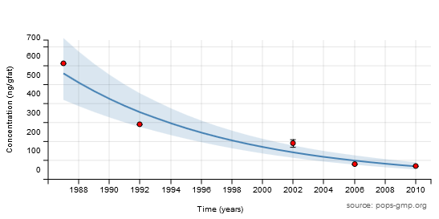
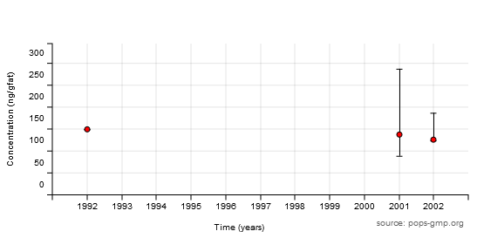
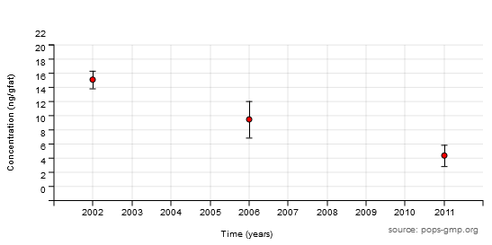
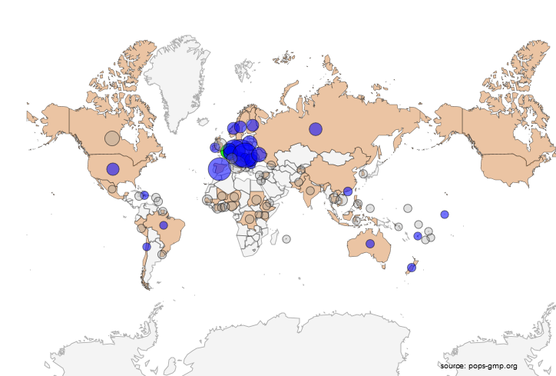
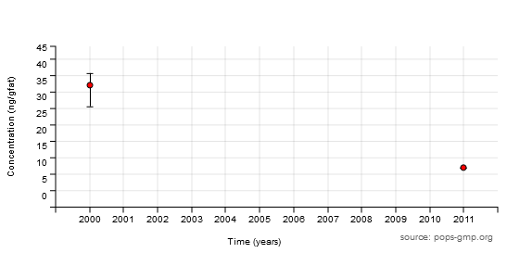
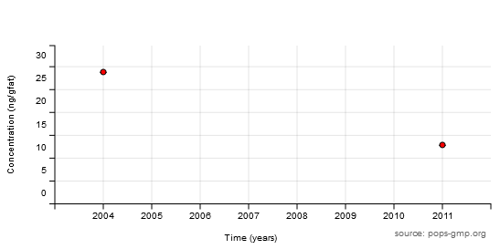
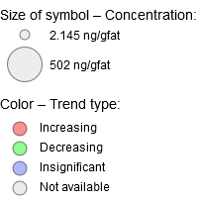
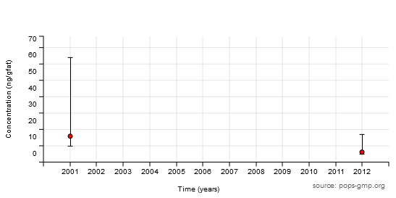
Changes over time in concentrations of indicator PCB in human milk (Sum 6 PCB)
Belgium
Russian Fed.
Fiji
New Zealand
Haiti
Brazil

Slide 20
Concentrations OF indicator PCB IN HUMAN MILK (Sum 6 PCB)

Slide 21
Concentrations OF pcdd/pcdf IN HUMAN MILK (Sum 17 PCdd/pcdf)

Slide 22
Changes over time in air concentrations of DDT (Sum 3 DDT)

Slide 23
Concentrations OF ddt IN HUMAN MILK (Sum 6 ddts)

Slide 24
3. Effectiveness evaluation

Slide 25
Process for effectiveness evaluation
Purpose of the effectiveness evaluation
Framework for effectiveness evaluation
Effectiveness evaluation committee
Assess whether the Convention has succeeded in achieving its objective of protecting human health and the environment from persistent organic pollutants;
Determine the effectiveness of the specific measures taken to implement the Convention;
Identify ways to improve the effectiveness of the Convention.
Process for effectiveness evaluation adopted by:
SC-6/22: Effectiveness evaluation;
Framework set out in document:
UNEP/POPS/COP.6/27/Add.1/Rev.1;
Set of process and outcome indicators to evaluate effectiveness of implementation of the various article.
Established in May 2015 (SC-7/24)
Consists of 14 experts, as follows:
Ten experts designated by parties;
One from GMP GCG;
One identified by compliance committee (when and if established);
Two internationally recognized experts.
First stage: Information collection and compilation
Second stage: Information synthesis and evaluation
Independent compilation of information gathered through existing arrangements under the Convention, including the reports from the global monitoring plan, the compilation of national reports, technical assistance reports by the Secretariat and reports from the entity entrusted with administering the financial mechanism, as well as reports generated in accordance with the compliance procedure under Article 17, once established.
Secretariat prepares a preliminary report, including compilation of the various information and data available in the information obtained from the first stage.
The effectiveness evaluation committee reviews and evaluates the information compiled by the Secretariat, draws conclusions as to the effectiveness of the Convention, and makes recommendations to the Conference of the Parties on any improvements that might be warranted.

Slide 26
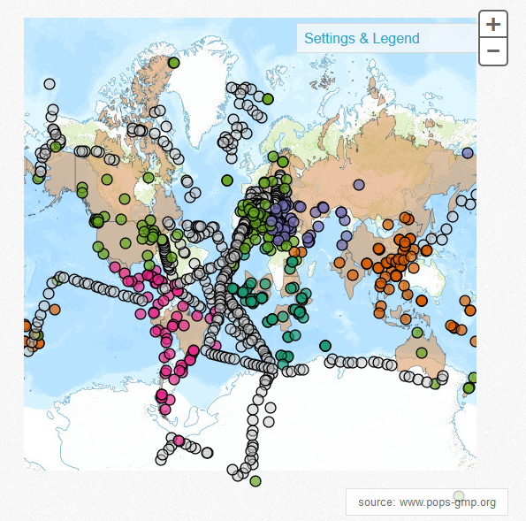
Sources of information
  Information on environmental monitoring in core media provided through the global monitoring plan;
  Information from parties provided through national reports submitted pursuant to Article 15;
  Information on non-compliance provided through procedures to be established under Article 17.

Slide 27
Timeline
2009
2010
2011
2012
2013
2014
2015
2016
2017
2018
2019
2020
2021
2022
2023
Meetings of the Conference of the Parties
COP 4
COP 5
COP 6
COP 7
COP 8
COP 9
COP 10
COP 11
Global Monitoring Plan
Human survey
Amendment of GMP Guidance
Human survey
Ongoing air monitoring activities
Human survey
Monitoring activities
ROG
GCG
ROG
GCG
ROGGCG
GCG
ROG
ROGGCG
GMP Meetings
GCG
1st report
2nd report
3rd report
GMP Reports
Reporting under Article 15
Reporting
Compiled reports
Reporting
Compiled reports
Reporting
Compiled reports
Reporting
Compiled reports
Reporting and Evaluation of progress towards BDEs elimination
Reporting
Progress evaluation
Reporting
Progress evaluation
Reporting
Progress evaluation
Reporting and Evaluation of the continued need for PFOS
Reporting
Progress evaluation
Reporting
Progress evaluation
Reporting
Progress evaluation
Reporting and Evaluation of the continued need for DDT
Reporting
Detailed evaluation
Reporting
Detailed evaluation
Reporting
Detailed evaluation
Reporting
Detailed evaluation
Reporting
Detailed evaluation
Effectiveness Evaluation
EEWG
EEWG
EEC
EEC
EEC
Meetings
Procedure
Partial evaluation
Effectiveness evaluation
Effectiveness evaluation
Reports

Slide 28


OuTcomes
First Meeting of the committee
16-18 February 2016, Geneva
Second meeting of the committee
4-6 October 2016, Geneva
30 April 2016
Extended deadline for submission of 3rd national reports pursuant to
Article 15
Finalize effectiveness evaluation report including conclusions and recommendations as to the effectiveness of the Convention
Review of the preliminary analysis for effectiveness evaluation
Need for additional sources of information to support conclusions and recommendations of the committee
Additional reports submitted by 30 April taken into account in the committee’s review of the effectiveness of the Convention
COP-8
24 April to 05 May 2017
To consider the effectiveness evaluation report

Slide 29
4. Acknowledgements

Slide 30
The worldwide implementation of the Global Monitoring Plan is made possible thanks to the generous contributions to the Stockholm Convention Voluntary Trust Fund from the Governments of Japan, Norway, Sweden, and through the European Commission’s Thematic Programme for Environment and Sustainable Management of Natural Resources, including Energy (ENRTP). Further, the contribution of the projects to support POPs monitoring activities in regions, funded through the Global Environment Facility (GEF) and the Strategic Approach to International Chemicals Management (SAICM), is greatly acknowledged. Monitoring activities, and data collection and analysis are implemented in the five UN regions in cooperation with strategic partners and through involvement of Regional Organization Groups and Global Coordination Group.

Slide 31
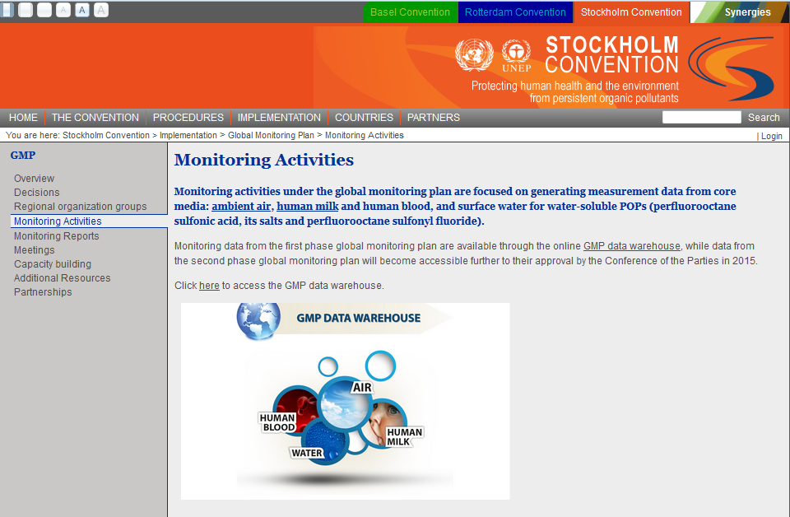
More information at:
chm.pops.int

Slide 32
Thank you for your attention

