Slide 1








“Develop a plan for global monitoring of Human exposure to and environmental concentration of Mercury”: next steps
Nicola Pirrone
Alessandra Fino, Antonella Macagnano, Francesca Sprovieri
CNR-Institute of Atmospehric Pollution Research, Rome, Italy
www.iia.cnr.it
UNEP-GEF Project Meeting
Geneva, 7 June 2017

Slide 2

Development of a Plan for Global Monitoring of Human Exposure to and Environmental Concentrations of Mercury
Air monitoring (CNR-IIA):
Development of a monitoring plan on presence of mercury in ambient air
Activity 1: Establish a network for atmospheric samples by developing passive air samples to complement the GMOS work
Activity 2: Conduct a pilot testing of the atmospheric network for one year
Activity 3: draft a proposal for a worldwide air monitoring plan, including interaction between active and passive sampling techniques.
      Cooperation between UN environment - GEF, WHO and GMOS network (www.gmos.eu) lead by CNR-IIA
is a global scale monitoring network established within the project funded by the European Union (FP7).
Expected Outcome:
Enhanced understanding of mercury concentrations in ambient air through the strengthening of the Global Monitoring Observation System (GMOS) and the development of the complementary passive air sampling (PAS) network for ambient air concentrations.
CNR-Institute of Atmospheric Pollution Research, Italy
http://www.iia.cnr.it

Slide 3
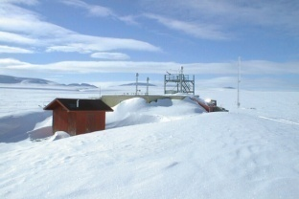
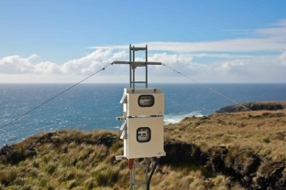
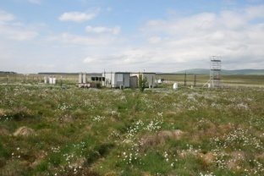
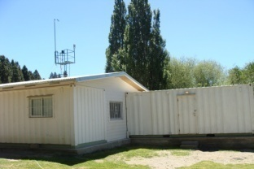
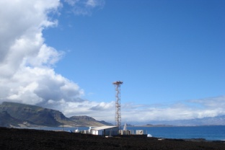
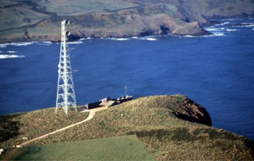

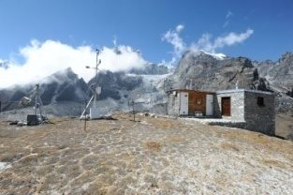
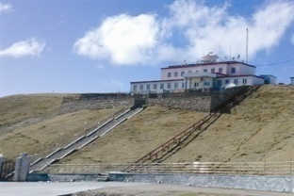
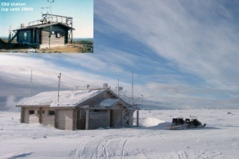
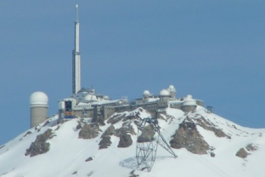
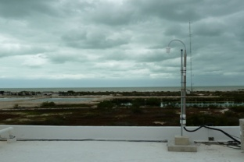
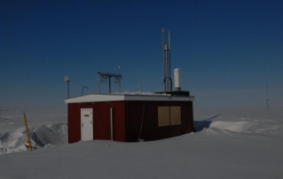

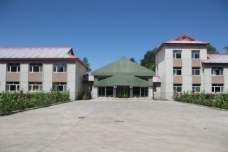
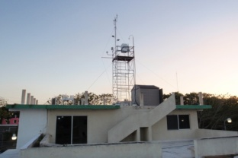
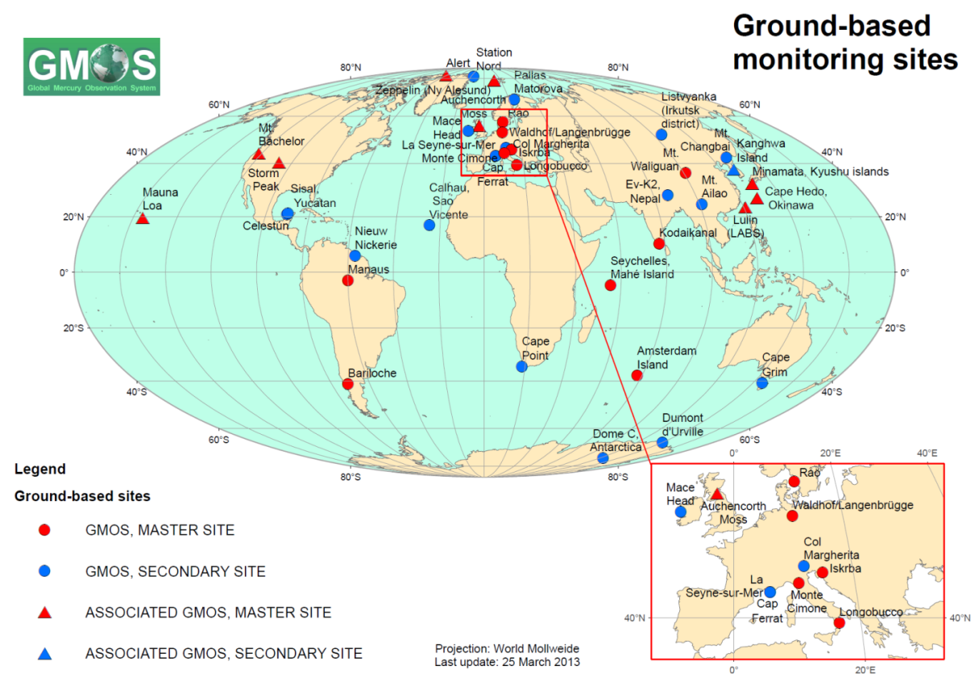
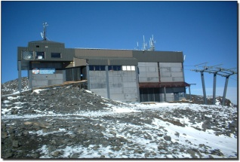
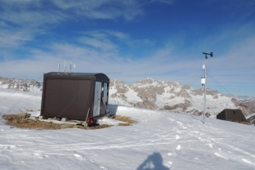
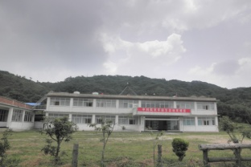
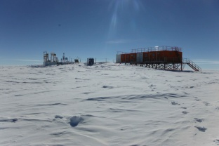
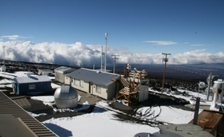
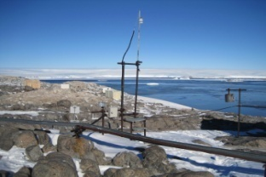
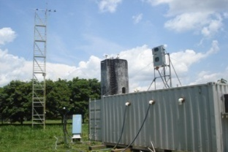
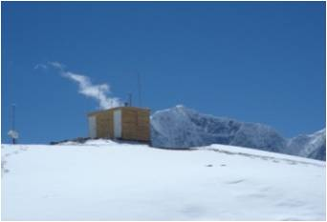
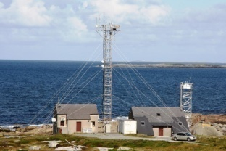
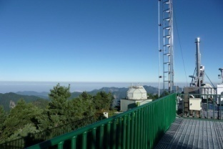
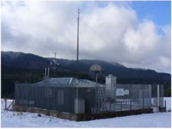
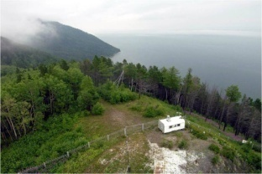
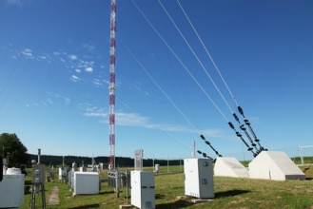
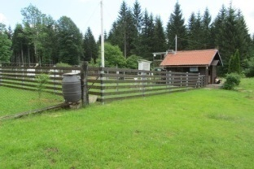
GMOS: ground-based monitoring network
GMOS: ground-based monitoring network

Slide 4
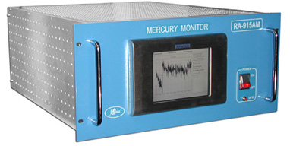
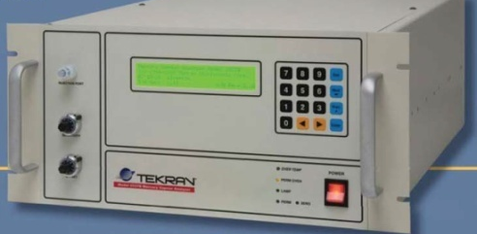
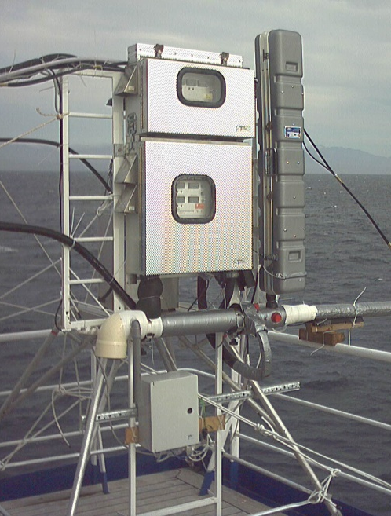
  Equipment installed at all GMOS sites
Standard Operating Procedures (SOPs) for Hg
To ensure high quality, comparable atmospheric Hg measurements at all GMOS sites.
  TGM/GEM: Tekran 2537 or Lumex RA 915 AM
  Speciated Hg: Tekran 2537/1130/1135
CNR-Institute of Atmospheric Pollution Research, Italy
http://www.iia.cnr.it

Slide 5
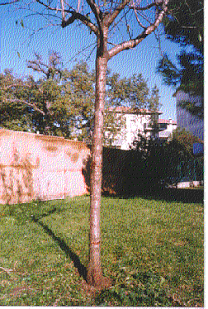
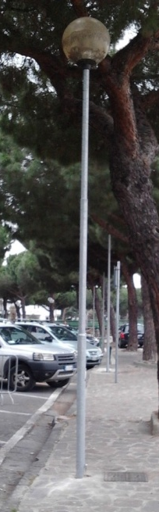
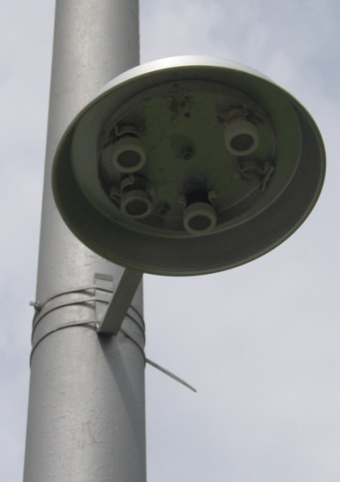
Passive air sampler (PAS) as a tool for long-term Hg air pollution monitoring
Due to the complexity of the detecting equipment, requiring highly cost items for more than 40 monitoring sites constituting the GMOS network, as well as trained operators is clearly increasing the need to develop technologies and new sensing systems for rapid Hg detection.
Passive sampler is becoming an effective alternative for conventional active sampler in exposure and health effects studies, given its simplicity and low cost (i.e., no electricity, no pumps, stand alone, compact, smart etc.).
2/3 m
h
They also, are capable of providing comparable performance to active samplers in terms of sensitivity and reproducibility.
Typical deployment (placements) of PASs in the field
CNR-Institute of Atmospheric Pollution Research, Italy
http://www.iia.cnr.it

Slide 6
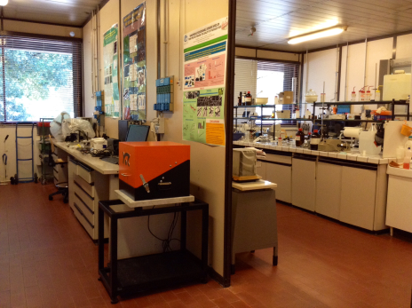
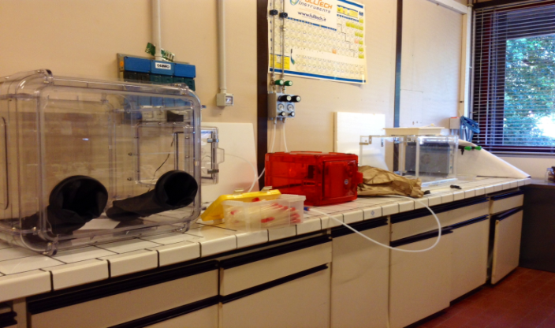
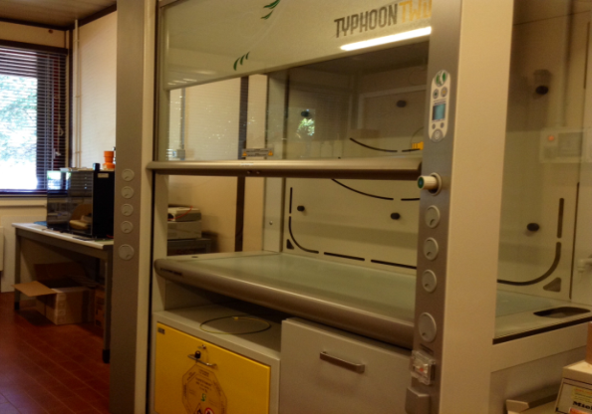
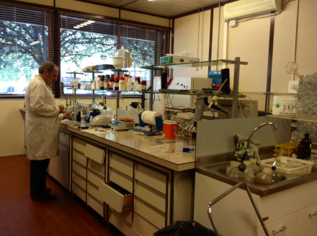
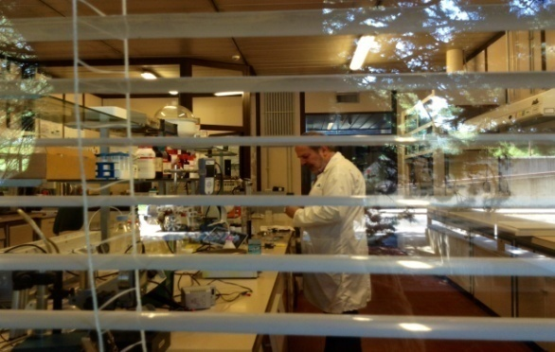
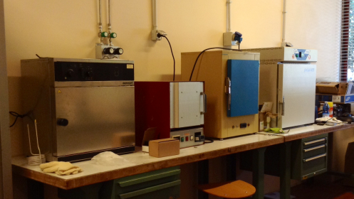

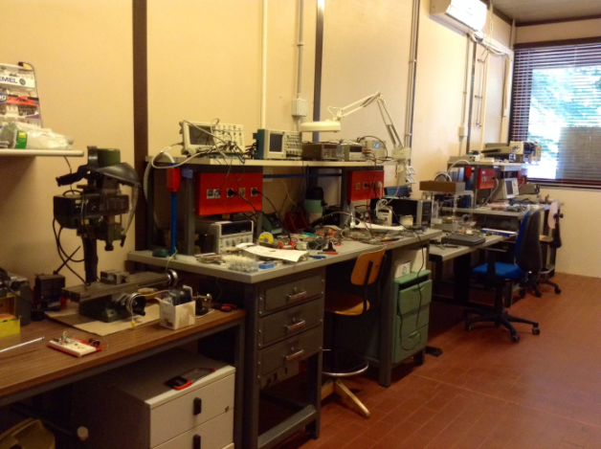
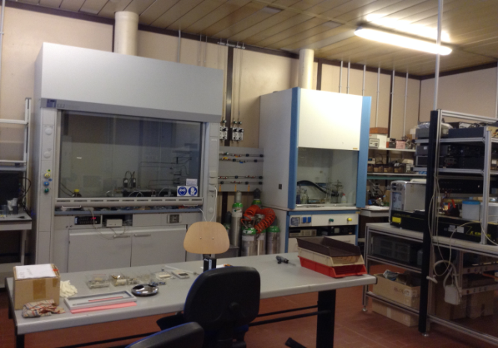
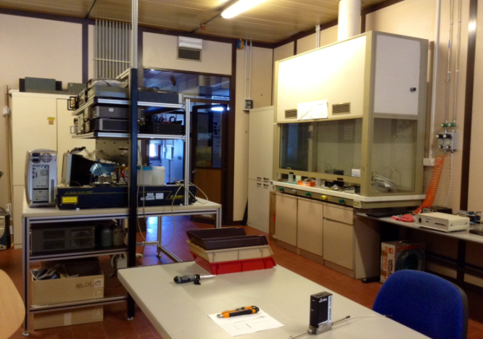
Nanomaterials: synthesis, deposition and characterization
Our Laboratories
Biosensors: design, bio-preparation, test
Electronics lab
Sensing measurement lab

Slide 7
Passive air sampler (PAS) as a tool for long-term Hg air pollution monitoring
A passive air sampler consists of a collection surface that has a high affinity for the chemical of interest and a method to eliminate turbulence and create a region of stagnant air between the ambient atmosphere and the collection surface where only diffusion occurs.
Collection Surface
Base
Stagnant Region
Microporous screen plate
Shield
Gas molecules are collected by passing through the barrier, slowly diffusing through the region of stagnant air, and sorbing to the collection surface.
CNR-Institute of Atmospheric Pollution Research, Italy
http://www.iia.cnr.it

Slide 8
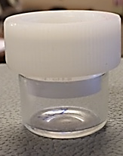
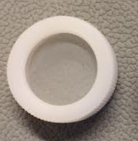
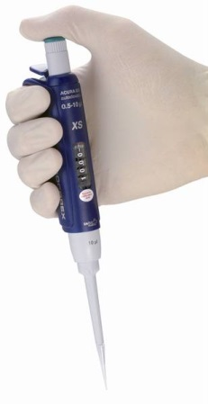
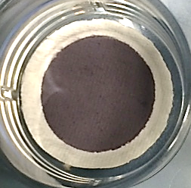
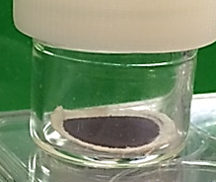
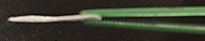
CNR-IIA Passive Sampler Design and nanoparticle film preparation
The body of the sampler is a
cylindrical glass vial
(inner diameter of 2.04 cm, length 2.54 cm) with a screw cap at one end.
Microporous
nylon fabrics
Coated adsorbing membrane
To avoid turbulent diffusion inside the vessel during exposition, the open end is protected using a fine micro-porous nylon screen
Top view of the
passive membrane
Passive membrane
sealed into
the sampler housing
Nanocomposite Material
Deposition
TGM is collected on a quartz filter coated
with a specific chemical solution.
The filter is placed at the bottom of the vial and held in position by a supporting ring.
CNR-Institute of Atmospheric Pollution Research, Italy
http://www.iia.cnr.it

Slide 9


Gold Nanoparticles film during exposure to Hg vapor
After the sampling, passive samplers are analyzed directly by thermal desorption at 550°C.
CNR-Institute of Atmospheric Pollution Research, Italy
http://www.iia.cnr.it

Slide 10








Towards the passive sampling: the sequence
Labeled passive sampler
1°: sampling bag
2°: bag opening
3°: capped glass
vessel pickup
001#01A07ITA
4°: removing
the cap
5°: screwing the
hollow cap
6°: cap storage in
the same bag
Top view of the passive sampler
001#01A07ITA
CNR-Institute of Atmospheric Pollution Research, Italy
http://www.iia.cnr.it

Slide 11






Hg Passive sampler Materials
CNR-Institute of Atmospheric Pollution Research, Italy
http://www.iia.cnr.it

Slide 12












Removal, Packaging, Storage and Transportation
Storage (T: 4°C)
CNR-IIA
001#01A07ITA
CNR-Institute of Atmospheric Pollution Research, Italy
http://www.iia.cnr.it

Slide 13


Selected 10 Sampling Sites
Italy
Russian Federation
Mongolia
Japan
China
Ghana
Costa Rica
India
Argentina
South Africa
Conditions defined by the project
PAS and disks distributed to and utilized at least at 6 sites.
At least 4 locations for co-exposure of active and passive air samplers
At least 3 master sites established that deliver results for simultaneous capture of mercury using active and passive samplers.
Regarding the UN regions, there is a reference that "it is attempted to cover all UN regions"
and that the report presenting PAS data covers at least 3 developing country regions.

Slide 14
Selection of monitoring sites
From GMOS & WHO networks
GMOS – Selected monitoring sites
Background sites
Monte Curcio (Italy)
Bariloche (Argentina)
Cape Point (Sud Africa)
Cape Hedo (Japan)
WHO- Selected sampling sites
Polluted sites
Ghana
Mongolia
India
Costa Rica
China (*Mt. Ailao *substituted site)
Russian Federation (*Listvyanka - substituted site)
All GMOS sites are located in background locations in order to obtain measurements that are representative of a large region (important for trends analysis),
Some sites for our co-monitoring will be located at polluted sites affected by ASGM, mining activities or other types of pollution
CNR-Institute of Atmospheric Pollution Research, Italy
http://www.iia.cnr.it

Slide 15
Hg Monitoring Program:
3 Intensive Sampling Campaigns have been planned
during three different seasons (different meteorological conditions)
Toward the final workshop and the
COP1
First campaign
(February-March 2017)
Second campaign
(June-July2017)
Third campaign
(October - November 2017)
Carried out and completed in:
- Mongolia
- Ghana
- India
- China
- Italy
- Argentina
- South Africa
- Japan
- Russian Federation
→COSTA RICA (NOT YET STARTED)
In progress in:
- Italy
- Argentina
- South Africa
- Japan
To be carried out in:
- Mongolia
- Ghana
- India
- China
- Italy
- Argentina
- South Africa
- Japan
- Russian Federation
- Costa Rica (??)
CNR-Institute of Atmospheric Pollution Research, Italy
http://www.iia.cnr.it

Slide 16

Hg Monitoring Program:
Sampling schemes at polluted sites
The pilot survey within this project is aimed to perform a global scale validation of sampling devices (PAS) and gather ambient Hg data for exposure assessment along with WHO biomonitoring campaigns.
Samplers will be co-locate (with active air samplers, at GMOS sites) and will be exposed for 1, 2 and 3 weeks in parallel (at polluted sites); this will allow us to cross check the following QA/QC key parameters:
linearity over time, reproducibility and behaviour of samplers at different climate conditions.
The gathered data will be representative of seasonal Hg concentration levels at all site.
CNR-Institute of Atmospheric Pollution Research, Italy
http://www.iia.cnr.it

Slide 17

Hg Monitoring Program:
Sampling schemes at background sites
CNR-Institute of Atmospheric Pollution Research, Italy
http://www.iia.cnr.it

Slide 18

1st Campaign: PASs desorption procedure
Examples of couples of PASs
In order to desorb Hg⁰ from the membrane, 5 min under air flow at 500° C are sufficient to collect and measure (by Tekran) the amount of the pollutant adsorbed after exposure to the environment.
Each membrane can be recovered !
CNR-Institute of Atmospheric Pollution Research, Italy
http://www.iia.cnr.it

Slide 19
Monte Curcio - ITALY
ng/m³
PAS data
Bariloche - ARGENTINA
ng/m³
PAS data
CNR-Institute of Atmospheric Pollution Research, Italy
http://www.iia.cnr.it

Slide 20
Cape Point - SOUTH AFRICA
ng/m³
Passive samplers data
Listvyanka - RUSSIA
ng/m³
Passive samplers data

Slide 21
INDIA
MONGOLIA
ng/m³
Passive samplers data
ng/m³
Passive samplers data
CHINA
JAPAN
ng/m³
Passive samplers data
ng/m³
Passive samplers data
(partial program)

Slide 22









1° PASSIVE SAMPLING CAMPAIGN DRAWBACKS
To avoid:
to shift of the adsorbent septum
to partially seal samplers
to wet samplers
to introduce sand/powder within the samplers (by handling?)
to expose Blanks too (no-offset)
a partial obstruction of the diffusing barrier
CNR-Institute of Atmospheric Pollution Research, Italy
http://www.iia.cnr.it

Slide 23

Future activities - Towards the COP1
Preparation of Progress Report including all laboratory results and inter-comparisons.
Organization of a side event at COP1, presenting intermediate results of the project to all participating countries and organizations.
Organization of the Final workshop aiming at pointing out the possible contribution of the project to the implementation of the Minamata Convention (with particular regard to art. 22 on Effectiveness Evaluation)
CNR-Institute of Atmospheric Pollution Research, Italy
http://www.iia.cnr.it

Slide 24
Thank you
CNR-Institute of Atmospheric Pollution Research, Italy
http://www.iia.cnr.it

