Slide 1

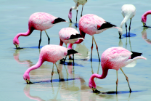
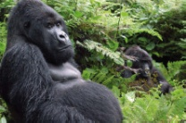
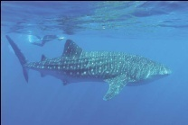
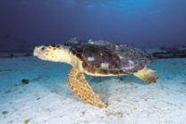
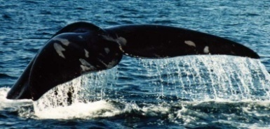
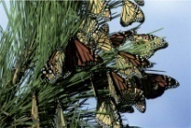
Convention on the Conservation of Migratory Species of Wild Animals
An Introduction to the Twelfth Meeting of the
Conference of the Parties, Priorities and
High-Level Events

Slide 2
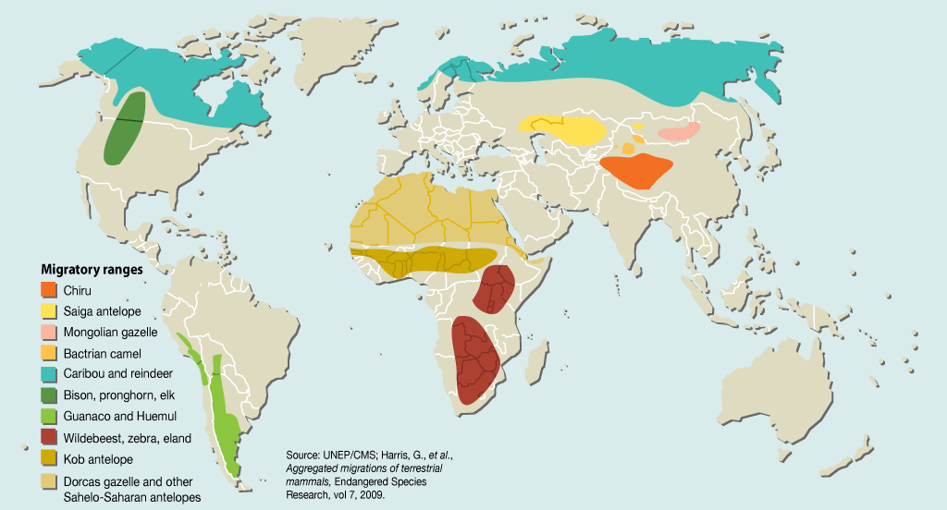
They run…
Selected migratory ranges for ungulates

Slide 3
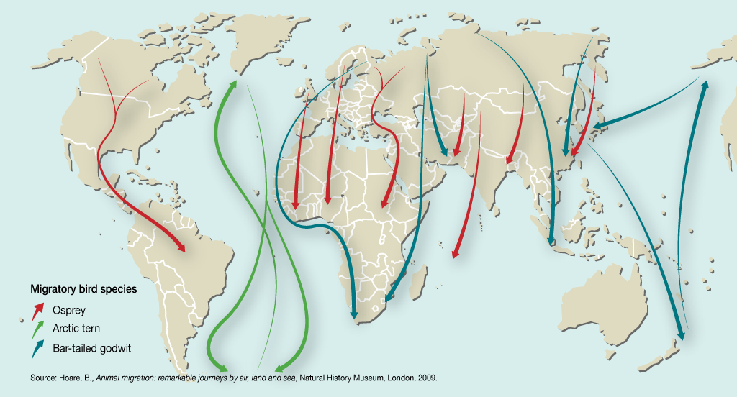
They fly…
Selected migratory routes for birds

Slide 4
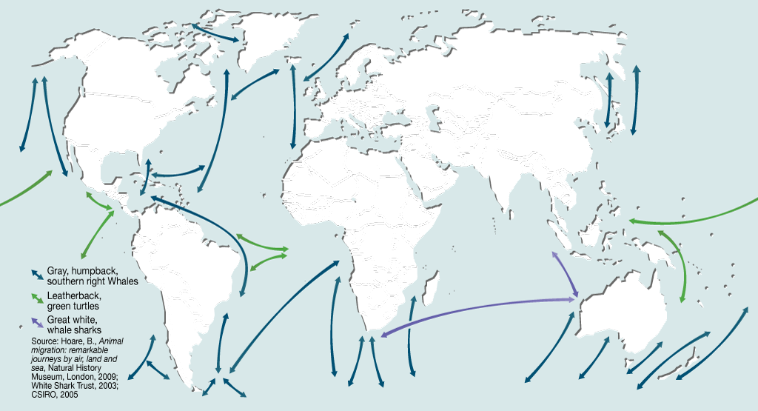
They swim…
Migratory routes for selected marine species

Slide 5
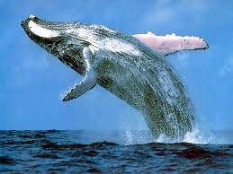
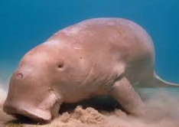
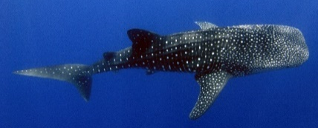
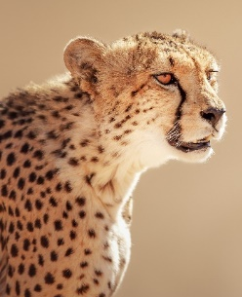
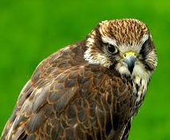
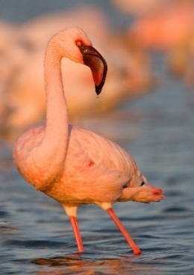
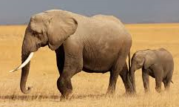
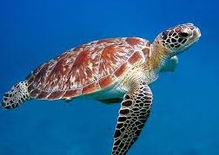
What is CMS?
A framework for countries to conserve migratory species throughout their entire range
An entire population or any geographically separate part of the population of any species, significant number of whose members cyclically and predictably cross one or more national jurisdictional boundaries.
Definition ⇒
Appendix I
Appendix II
Migratory species threatened with extinction
Migratory species whose conservation requires international cooperation

Slide 6
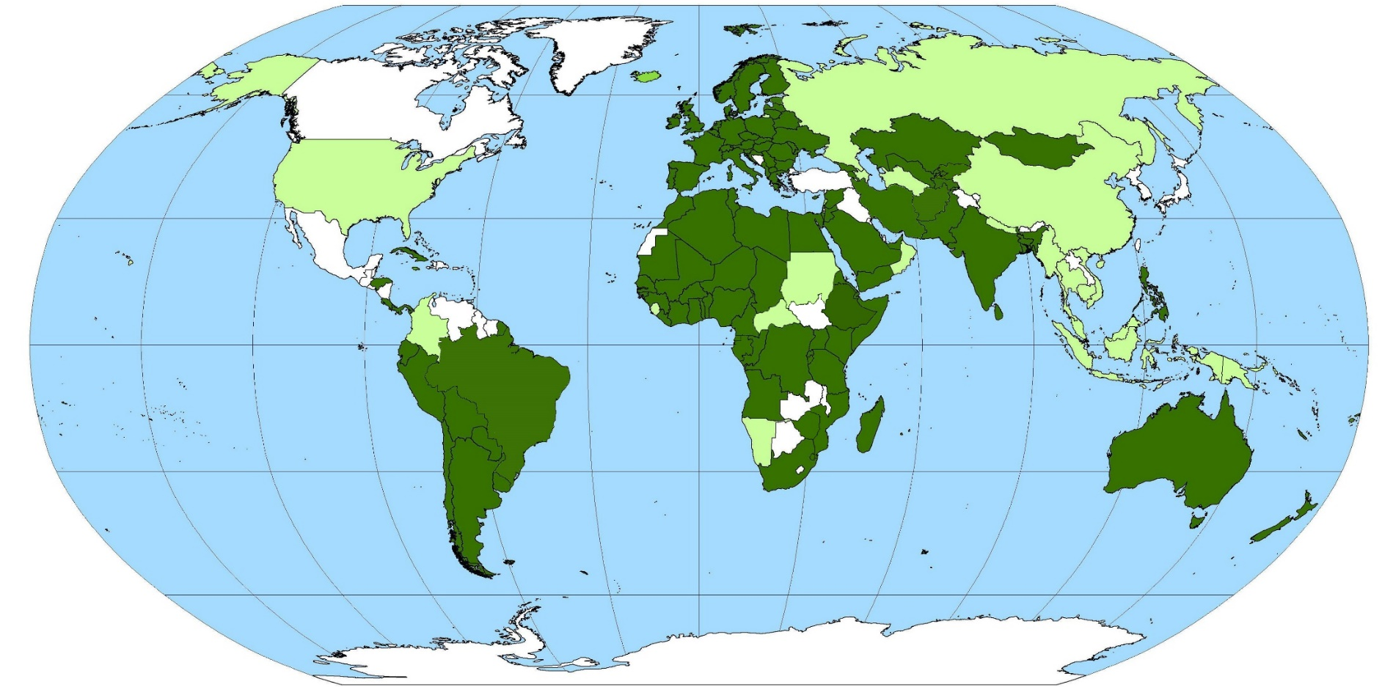


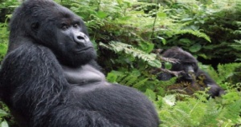
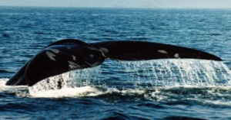

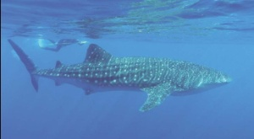
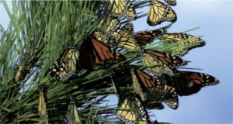
Map of Parties (124 as of 1 August 2016)

Slide 7

Twelfth Meeting of the
Conference of the Parties
When: 23 – 28 October 2017
Where: Manila, the Philippines
Theme: Sustainable Development and Migratory Species
Associated events: Standing Committee Meeting and High-Level Events on 22 October
Participation of UN Environment Goodwill Ambassadors
Key facts

Slide 8
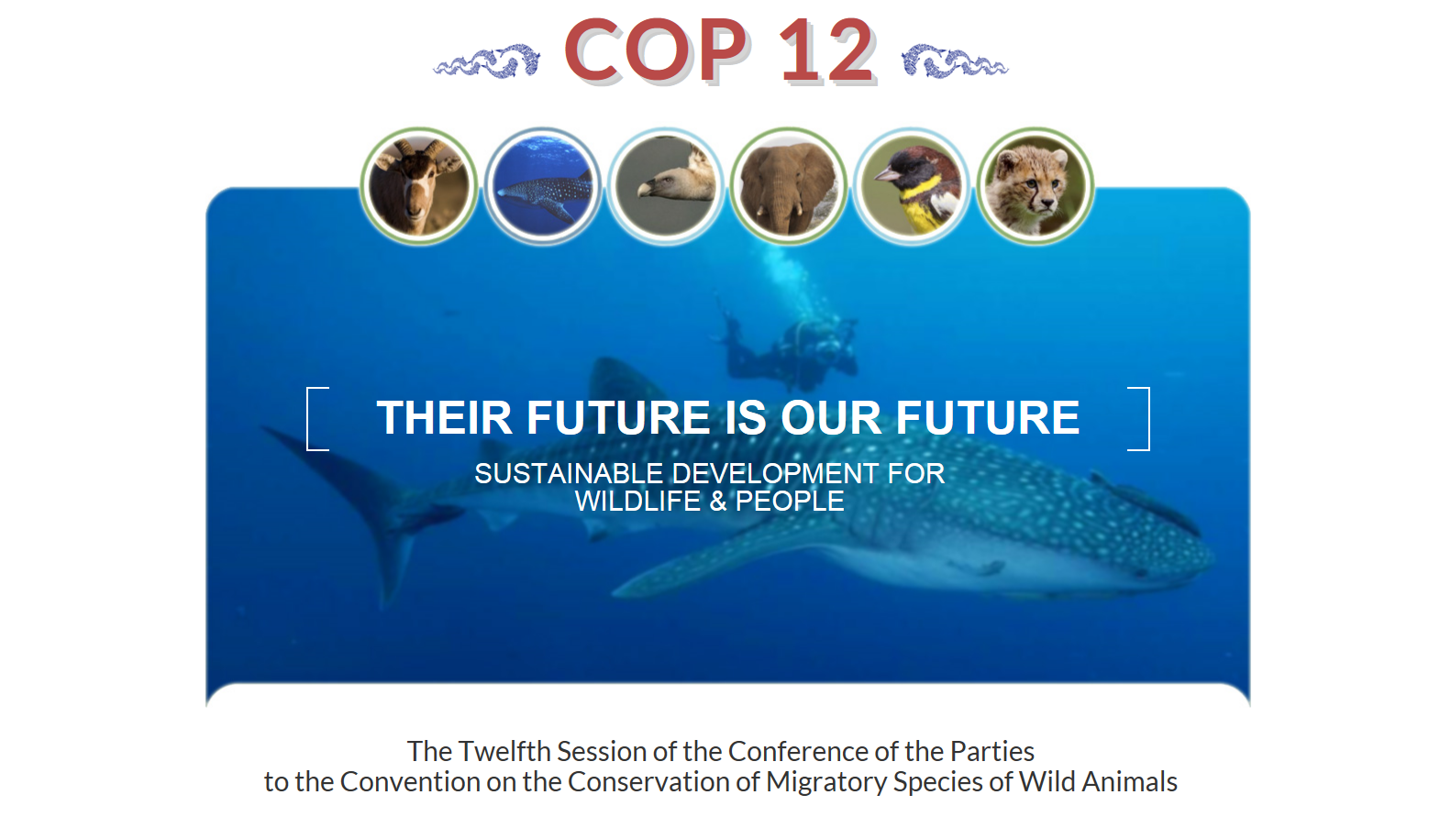
Official COP12 webpage
http://www.cms.int/cop12

Slide 9
High-Level Events
Three High-Level Events will be held on 22 October:
A Leadership Dialogue Breakfast, chaired by Erik Solheim, on the CMS agenda and the main theme of the third session of the United Nations Environment Assembly (UNEA3) “Pollution Free Planet”. It will result in a message to be conveyed from the COP to UNEA3;
A High-Level Panel Discussion on the role of wildlife conservation in the attainment of the Sustainable Development Goals. The discussion will be facilitated by a leading international broadcast journalist and will result in a Declaration to be submitted to the Conference for endorsement;
An award ceremony under the Migratory Species Champion Programme aiming to recognize governments, organizations or individuals that provide long-term support for the implementation of specific initiatives.

Slide 10
Species proposals
Common name | Proposed Amendment
MAMMALS
Chimpanzee | Inclusion in Appendix I & II
Four species of Lasiurus bats
Southern Red Bat | Inclusion in Appendix II
Eastern Red Bat | Inclusion in Appendix II
Hoary Bat | Inclusion in Appendix II
Southern Yellow Bat | Inclusion in Appendix II
Lion | Inclusion in Appendix II
Leopard | Inclusion in Appendix II
Gobi Bear | Inclusion in Appendix I
Caspian Seal | Inclusion in Appendix I & II
African Wild Ass | Inclusion in Appendix I & II
Przewalski’s Horse | Inclusion in Appendix I
Indian Gazelle | Inclusion in Appendix II
Giraffe | Inclusion in Appendix II
Common name | Proposed Amendment
BIRDS
Christmas Frigatebird | Inclusion in Appendix I
Black Noddy | Inclusion in Appendix II
Steppe Eagle | Inclusion in Appendix I
Four Asian vulture species
White-rumped Vulture | Inclusion in Appendix I
Indian Vulture | Inclusion in Appendix I
Slender-billed Vulture | Inclusion in Appendix I
Red-headed Vulture | Inclusion in Appendix I
Five sub-Saharan vulture species
White-backed Vulture | Inclusion in Appendix I
Cape Vulture | Inclusion in Appendix I
Rüppell’s Vulture | Inclusion in Appendix I
Hooded Vulture | Inclusion in Appendix I
White-headed Vulture | Inclusion in Appendix I
Lappet-faced Vulture | Inclusion in Appendix I
Yellow Bunting | Inclusion in Appendix II
Great Grey Shrike | Inclusion in Appendix II
Lesser Grey Shrike | Inclusion in Appendix II
Common name | Proposed Amendment
FISH
Whale Shark | Inclusion in Appendix I
Dusky Shark | Inclusion in Appendix II
Blue Shark | Inclusion in Appendix II
Angelshark | Inclusion in Appendix I & II
Common Guitarfish | Inclusion in Appendix I & II
White-spotted Wedgefish | Inclusion in Appendix II

Slide 11
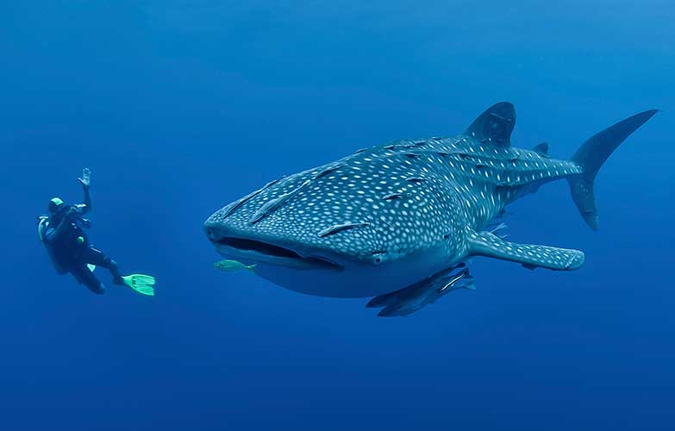
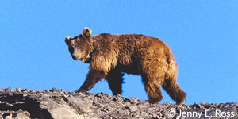
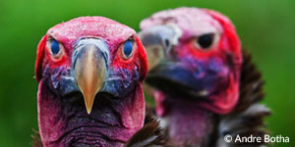
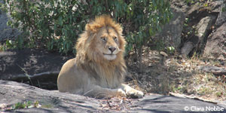
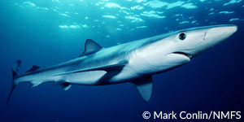
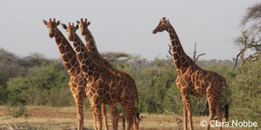
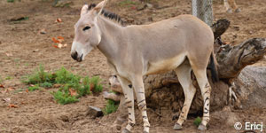
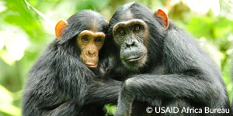
Species proposals - highlights
Appendix I
Migratory species threatened with extinction
Appendix II
Migratory species whose conservation requires international cooperation
Both Appendices
Notes:
Appendix I -Whale Shark, the Gobi Bear and several vultures including the Lappet-Faced Vulture and Asian Wild Horse
Appendix II -Giraffe, the Lion, Blue shark and the Leopard
Both appendices –Chimpanzee, Wild African Ass

Slide 12
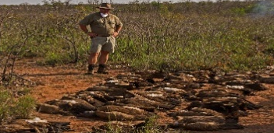
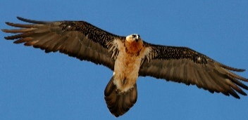
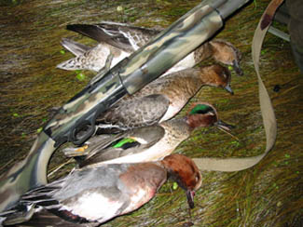
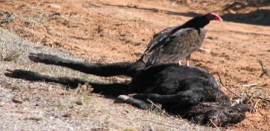
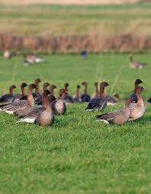
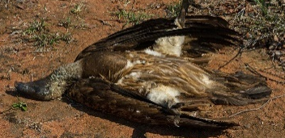
Preventing Poisoning – focus on Lead
Background
Poisoning - One of the major threats to birds worldwide
CMS COP11 adopted Guidelines to prevent risks associated to 5 poisons including lead
Dedicated global Working Group under CMS to facilitate concerted efforts
WG also tasked with addressing either poison types or geographical regions for implementation of guidelines
Phasing out of lead in ammunition and fishing weights still to be implemented
Endorse establishment of a global Lead Task Force to bring together key players and promote actions to minimize use of lead in hunting ammunition, fishing weights as well as leaded paint, discarded lead and that emanating from industrial mining and smelting processes.
Action Requested

Slide 13
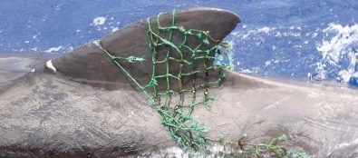
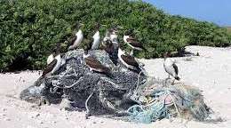
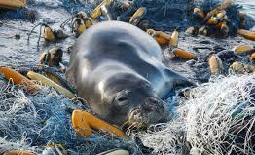
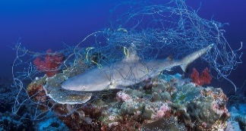
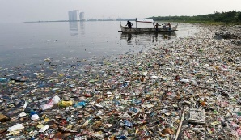
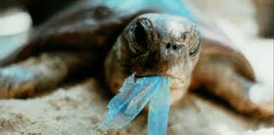
Marine Debris
Background
5.25 trillion pieces of plastic debris in the ocean;
Micro-platics, now prevalent in all the world’s oceans, carry an additional risk: research has shown that toxins attach easily to plastics, which therefore concentrate contaminants
640,000 tonnes of ‘ghost gear’ - abandoned, lost or otherwise discarded fishing gear – currently in our ocean, accounting for about 10 per cent of the total plastic waste in the sea;
Marine debris can be harmful to humans and animals by causing direct injuries, damaging boat engines, destroying coral reefs, entangling animals or blocking their digestive systems
Adopt Resolution to tackle the problem, including that of ‘ghost gear’ and micro-plastics.
Action Requested

Slide 14

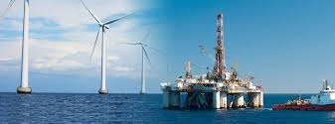
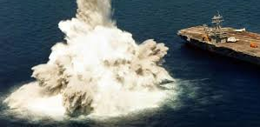
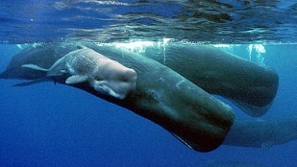
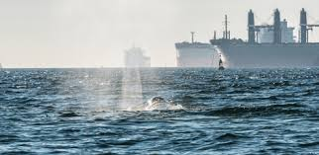
Underwater Noise
Background
Marine wildlife, particularly mammals and fish, depend on sound for all aspects of their life
The direct detrimental impacts of human-generated noise which these species can suffer are multiple and depend on the nature of noise
Noise has been shown to be deadly for at least some species of whales with evidence linking intense military sonars with fatal whale strandings. Reduced fish catch rates of 50-80 per cent near seismic surveys have also been reported in some species affecting fishing activities and communities
Adopt CMS Family Guidelines on Environmental Impact Assessments for Marine Noise-generating Activities which were developed following an extensive consultation process involving governments, organizations and private sector
Action Requested

Slide 15
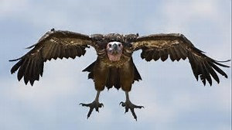
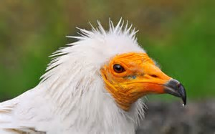
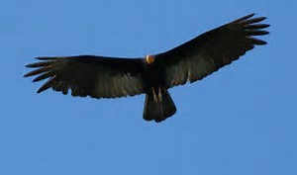



Vultures
Background
Vultures play a fundamental role in cleaning up animal carcasses and preventing the spread of disease.
Vultures are killed on an unprecedented scale across Africa, taken for use in traditional medicine and electrocuted on power lines.
Main threat is poisoning. Pesticides are used illegally as poison baits to kill carnivores as a means of protecting both livestock and humans. Unfortunately, vultures too are lured to these baits and become unintentional victims. Furthermore, in recent years, poachers have been intentionally targeting vultures using similar baiting techniques to hide their illicit activities – birds circling above a kill is often how wardens become aware of poaching.
Adopt Multi-species action plan for the conservation of African Eurasian vultures. The plan covers the whole geographic ranges of 15 species of Old World vultures.
Action Requested

Slide 16






Conservation of African Lions & Carnivores
Background
The Lion is Vulnerable at the global level (2015 IUCN Red List Assessment) - populations declined by 60% in Western, Central and Eastern Africa and increased by 12% in Southern Africa
Lion Range State meeting (May 2016) – First Joint Meeting of CMS and CITES
Possible listing on CMS Appendices at COP12 followed by establishment of conservation plans and strategies, capacity building, public awareness and projects to promote lion conservation
Adopt African Carnivores Initiative, joint with CITES and IUCN, to provide framework to coordinate conservation activities in the region and coherently address common issues
It would cover Wild Dog, Cheetah, Leopard and Lion (all listed under CITES apart from Wild Dog. Currently Wild Dog and Cheetah listed under CMS)
Action Requested

Slide 17
Review Process under CMS
Background
COP11 launched an intersessional process to explore possibilities for strengthening implementation of the Convention through the development of a review process and to report to COP12.
A dedicated Working Group was tasked to (i) Discuss a comparative analysis of best practices of existing review mechanisms of MEAs, including pros, cons and costs involved and (ii) Prepare options for a CMS review process.
Adopt one of the two proposed options: Zero option and review process option.
Two open questions for COP12: who can trigger the process (only Parties?) and who can review it (Standing Committee or dedicated body)
Action Requested

Slide 18
Towards COP12
Ensure highest countries representation;
Raise additional funding to support the participation of all delegates from countries eligible for funding;
Complete all documents by given deadline i.e. Resolutions and Decisions that do not include a scientific element by 24 July (90 days) and all remaining documents in all languages by 23 August (60 days)

Slide 19



VISIT TO KNOW US
www.twitter.com/BonnConvention
www.facebook.com/bonnconvention
http://www.cms.int/

