Slide 1
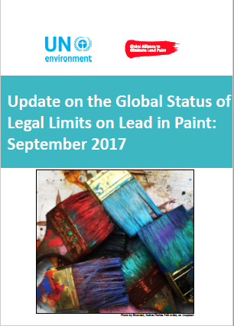
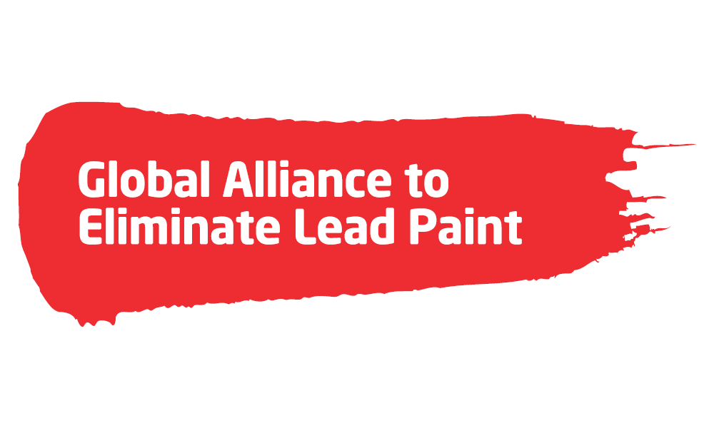
Global Status of Lead Paint Laws
Caribbean Seminar on the Establishment of Legal Limits on Lead in Paint
Friday, December 1, 2017
Norman Manley Law School, University of the West Indies
Kingston, Jamaica
Patrick Huber
United States Environmental Protection Agency
Office of International and Tribal Affairs

Slide 2
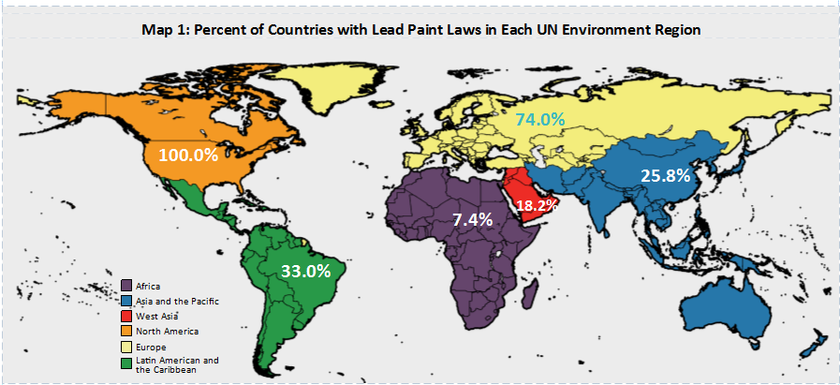
Why Lead Paint?
Very Few Countries Prohibit Lead Paint
Source: WHO 2017
Notes:
This map shows the work that needs to be done – it shows the percentage of countries where lead paint laws have been confirmed by WHO.
You can see we have a lot of work to do in most regions of the world.
NOTE: This is one of the maps in the new Global Status Update.

Slide 3
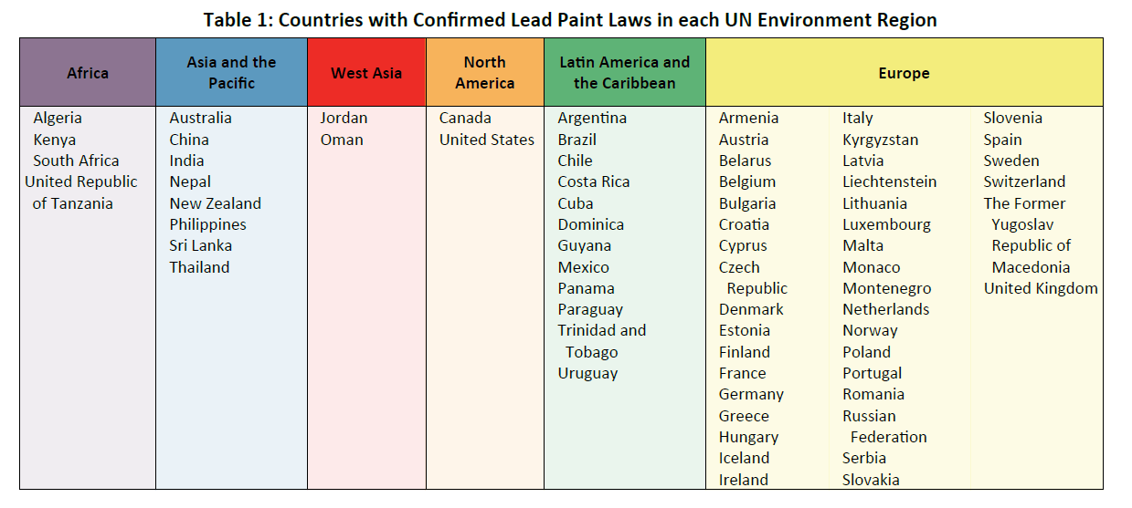
Only 67 Countries have Lead Paint Laws
Source: UNEP Global Status Update 2017

Slide 4
Global
Meetings/events/webinars
  Annual International Lead Poisoning Prevention Week of Action (since 2013)
  Ongoing training of Environment, Science, Technology and Health officers in US Embassies
    Central Asia, South America, Africa – done; Asia Pacific, CEE and Middle East upcoming
    US embassies potentially available to help raise awareness in target countries
American Bar Association Resolution (August 2017)
UNEA3 (December 2017)
  Government commitment to laws (Alliance developed model language)
  NGO/industry commitments (Alliance developed model language)
  USG Resolution on lead paint (Argentina co-sponsoring)
World Bank Report (March 2018 TBC)

Slide 5
Global
Global Environment Facility (GEF) funded Project on Lead Paint
  Project timeline 2018 – 2020
  Goals
    Legal: 40 countries to pass lead paint laws / or improve existing laws
    Paint Industry: Demonstration projects with Small and Medium Enterprises in 5-6 countries
  Legal activities: implemented by IPEN and the American Bar Association Rule of Law Initiative
  Paint industry activities: implemented by Cleaner Production Centers in cooperation with IPEN
  EPA to be on Project Steering Committee

Slide 6
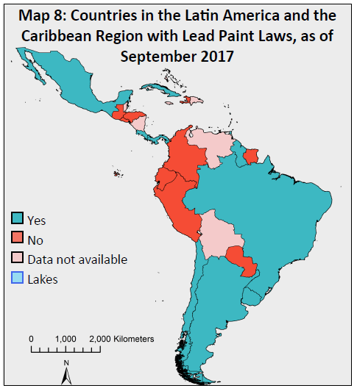
UN Environment Latin American and Caribbean Region
Country | Lead Paint Laws
Argentina | 600 ppm total lead concentration limit for manufacture, import and sale of paint (Mexico – soluble?)
Brazil
Chile
Costa Rica
Dominica
Guyana
Mexico
Panama
Trinidad and Tobago
Uruguay
Paraguay | Not confirmed by WHO -- 90 ppm soluble lead concentration
Cuba | 20,000 ppm lead limit
Source: WHO 2017

Slide 7
STATUS OF LEAD PAINT REGULATION - CARICOM
Antigua and Barbuda No data
Bahama No data
Barbados No data
Belize No data
Dominica Yes
Grenada No data
Guyana Yes
Haiti No
Jamaica No data
Saint Kitts and Nevis No data
Saint Lucia No
Saint Vincent & Grenadines No data
Suriname No
Trinidad and Tobago Yes

Slide 8
STATUS OF LEAD PAINT REGULATIONS:
DOMINICA and GUYANA
Dominica:
The legally-binding standard (DNS 19: Part 3: 2007, ICS: 87.040 ) sets the maximum limit on the lead content in paints and varnishes supplied in fluid form that are used in households, on domestic furniture and appliances, in buildings and places open to the public, shops, offices, factories, or for commercial purposes. The limit is 0.06% (600 ppm) by dry weight.
This standard was adopted by the Dominica Bureau of Standards on February 20, 2002, and is an adoption of the Revised CARICOM Standard: The Limit of Lead Content in Paint.
Guyana:
Under Pesticides and Toxic Chemicals Control Act 2000 (No. 13 of 2000) and Pesticides and Toxic Chemicals Control Regulations 2004 (No. 8 of 2004), licenses are only granted for the importation and manufacture of paints that do not exceed the limit of 0.06% (600 ppm) of lead.

Slide 9
STATUS OF LEAD PAINT REGULATIONS:
TRINIDAD AND TOBAGO
Trinidad and Tobago has two voluntary and one compulsory standard for the maximum limit on the lead content in paint and varnishes supplied in fluid form. These standards are:
1. TTS 166 Architectural coatings – water-borne paints – specification, [87.040; 25.220] Voluntary
2. TTS 165 Architectural coatings – solvent-borne paints – specification, [25.220] Voluntary
3. TTS 164 Architectural coatings – general requirements, [25.220] Compulsory

Slide 10
STATUS OF LEAD PAINT REGULATIONS:
GRENADA
Grenada has four voluntary standards for lead content in paint issued by the Grenada Bureau of Standards. The four standards are adopted Caribbean Community (CARICOM) Standards. These standards are:
1. GDS 11: Part 1: 1992 – Specification for Paint: Interior and Exterior-Oil Modified Alkyd
2. GDS 11: Part 2: 1992 – Specification for Paint Interior and Exterior-Emulsion Type, Flat
3. GDS 11: Part 3: 1992 – Specification for the Limit on Lead Content in Paint
4. GDS 15: 1992 – Methods of Test for Paint and Surface Coating
Notes:
The voluntary standards replicates the Caribbean Community (CARICOM) voluntary standard. This standard prescribes a maximum limit on the lead content in paints and varnishes supplied in fluid form. Lead Content: means the percentage by weight (mass) of lead (expressed as Pb) in a dried film of a paint or varnish, or in the total solids content of the paint or varnish. The standards for the maximum lead content of paints or varnishes is 0.06% by weight, calculated on the basis of the total solids (non-volatile) content.

Slide 11
Ongoing Efforts:
Argentina modifying law to go from 600 to 90 ppm.
Paraguay just passed a law (August 2017) with a 90 ppm lead paint standard, as recommended by the Lead Paint Alliance Model Law
  Missing some key elements for an effective law (soluble limit, scope not clear
  Lowest standard in the region
International Paint and Printing Ink Council (IPPIC) worked with paint manufacturing associations in Latin America to co-sponsor two workshops in Colombia in October 2016. These workshops encouraged the elimination of lead additives from paint through best industry practices. Considering workshop in Ecuador.
Lead Paint Alliance sent letters to environment and health ministers in CARICOM countries in October 2016 and conducted a technical webinar to promote lead paint laws in April 2017; follow-up workshop in Jamaica December 1, 2017

Slide 12
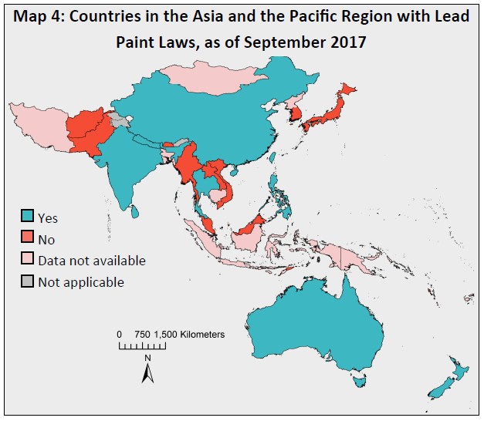
UN Environment Asia Pacific Region
Country | Lead Paint Laws
Australia | 1000 ppm lead limit for the sale, manufacture, export, and import of all paints
China | 90 ppm soluble lead concentration limit for decorative, household and automotive paint. 1000 ppm soluble lead limit depending on the use of the paint
India | 90 ppm lead limit for manufacture, trade, import and export of household and decorative paints
Nepal | 90 ppm lead limit for any paint imported, produced, sold or used
New Zealand | 1000 ppm lead limit for the sale, manufacture, export, and import of all paints
Philippines | 90 ppm lead limit for architectural, decorative, household and industrial paint
Sri Lanka | 90 ppm lead limit for interior and exterior emulsion paint or 600 ppm lead limit for floor and enamel paint. Paints used in the building industry that contain lead must be labelled as such, including the lead content
Thailand | 100 ppm lead limit for all paint
Source: WHO 2017

Slide 13
Ongoing Efforts:
Cambodia Draft Law:
  Lead paint law in Cambodia was included as a part of an overall environmental law reform
    In-country support for stronger environmental laws to reduce pollution and improve public health
  Cambodia brought in experts from international organizations and the United States to assist in drafting their environmental code and key implementing directives
  Draft lead paint directive is based on the Model Law and Guidance, e.g., lead paint limit - 90 ppm
World Bank working in Laos on a lead paint law for 2019
Bangladesh draft guidance – 50 ppm (possibly soluble); registered uses allowed; enforcement unclear

Slide 14
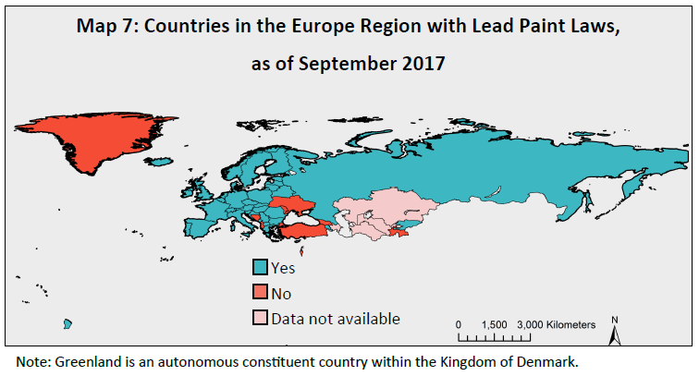
UN Environment European Region and Central Asia Sub-region
Country | Lead Paint Laws
Armenia | 5,000 ppm limit for lead in driers in household paints and 150,000 ppm limit for lead in pigments in paints
Belarus | 5,000 ppm limit for lead in driers in household paints and 150,000 ppm limit for lead in pigments in all paints
31 EU countries | EU REACH restricts the addition of certain specific lead compounds to paints
The Former Yugoslav Republic of Macedonia | Restricts use of certain lead compounds in paint
Kyrgyzstan | Restricts use of certain lead compounds in paint
Monaco | Restricts use of certain lead compounds in paint
Montenegro | Restricts use of certain lead compounds in paint.
Russian Federation | Prohibits the use of lead in paints used in “construction for interior works”
Serbia | Restricts use of certain lead compounds in paint. For industrial paints containing lead, precautionary labelling is required
Switzerland | 100 ppm lead limit for all paints offered for sale by manufacturers
Source: WHO 2017
Notes:
Department of Commerce
Moldova workshop

Slide 15
Ongoing Efforts: Draft Technical Regulation
Eurasian Economic Union (EAEU) draft Technical Regulation under consideration by the Eurasian Economic Commission
  EAEU Member States: Armenia, Belarus, Kazakhstan, Kyrgyzstan and the Russian Federation
  Kazakhstan is the lead government for the Technical Working Group – may be a champion for change
  Based on former Customs Union Technical Regulation
    Lead paint limit 5,000 / 150,000 ppm depending on the type of paint
    Also prohibits use of lead compounds in any paint

Slide 16
Ongoing Efforts:
Moldova Workshop - highlighted need for guidance on laws
US Department of Commerce Project
  Working with Kazakhstan, Kyrgyzstan, Tajikistan, Uzbekistan, Turkmenistan and Afghanistan
  Have begun a Central Asian regional dialogue – two meetings held so far (Almaty March and Washington DC in September)
  Tajikistan offering a tender for a lead paint lab
  Kazakhstan exploring revision of EAEU TR
UN Environment and IPEN conducting country assessments of each EAEU country (December 2017)

Slide 17
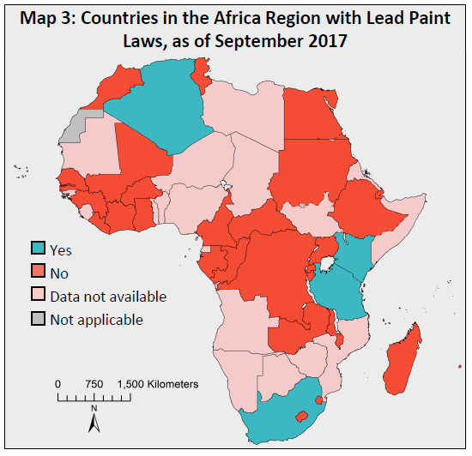
UN Environment Africa Region
Country | Lead Paint Laws
Algeria | 1000 ppm total lead limit for manufacture, import and sale of paint.
Kenya | 90 ppm total lead limit for manufacture, import and sale of all paint; sampling and testing requirements.
Tanzania | 90 or 100 ppm total lead limit depending on type of paint
South Africa | 600 ppm total lead concentration limit for manufacture, import and sale of paint; no testing or certification requirements
Source: WHO 2017

Slide 18
Ongoing Efforts: Setting Regional Standards
In 2015 the Lead Paint Alliance held a sub-regional workshop in East Africa (only 4 Sub-Saharan countries have lead paint laws)
  15 East and West African countries agreed to work toward a common standard of 90 ppm total lead (group discussion outcomes available)
The East African Community is in the process of revising an existing regional standard
  Existing standard is 100 ppm soluble lead; some gaps
  Kenya and Tanzania passed a revised national lead paint standards of 90 ppm total lead in 2017 – both approaches could be models for the regional standard but they too have some gaps
  Burundi chairs the EAC Technical Committee in charge of the standard
The Economic Community of West African States had a draft regional standard of 600 ppm soluble and may be considering changing it to 90 ppm
Cameroon - regulation on lead paint enacted in September; some gaps

Slide 19
Thank you!
2017 Global Status Update on Lead Paint Laws
available on the Lead Paint Alliance Web site: http://web.unep.org/chemicalsandwaste/what-we-do/technology-and-metals/lead/global-alliance-eliminate-lead-paint

