Slide 1
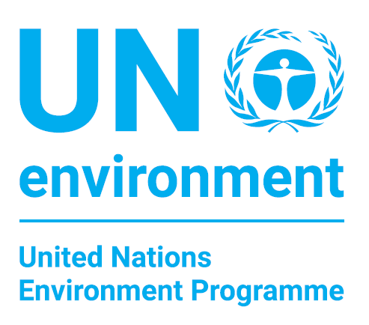

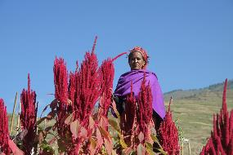

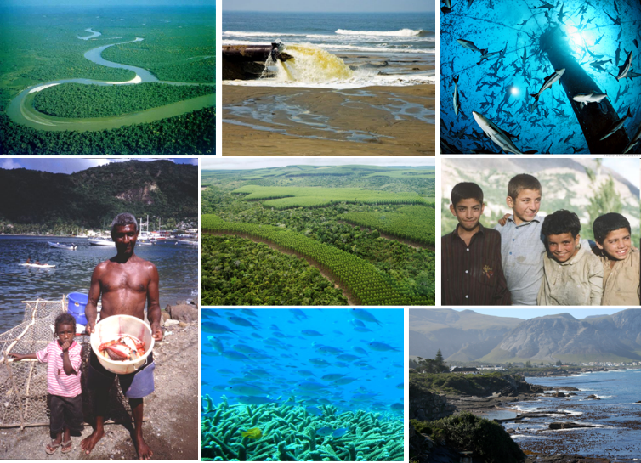
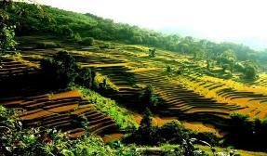
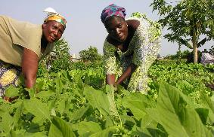
Healthy and Productive Ecosystems
Programme Performance Report
January - June 2018

Slide 2

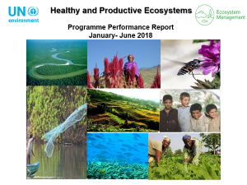
Objectives and
Expected Accomplishments
Overall objective:
Marine, freshwater and terrestrial ecosystems are increasingly managed through an integrated approach that enables them to maintain and restore biodiversity, long-term ecosystems functioning and the supply of ecosystem goods and services. .
a) The health and productivity of marine, freshwater and terrestrial ecosystems are institutionalized in education, monitoring and cross-sector and transboundary collaboration frameworks at the national and international levels
2 Expected Accomplishments
(b) Increase in the number of countries and transboundary collaboration frameworks that demonstrate enhanced knowledge of the value and role of ecosystem services
Notes:
The Programme works in four broad areas:

Slide 3
Key Changes Since 2016-2017
Expected Accomplishment (a)
Increase in the number of countries and transboundary collaboration frameworks that have made progress to monitor and maintain the health and productivity of marine and terrestrial ecosystems;
Increase in the number of countries and transboundary collaboration frameworks that demonstrate enhanced knowledge of the value and role of ecosystem services;
Increase in the number of countries and groups of countries that improve their cross-sector and transboundary collaboration frameworks for marine and terrestrial ecosystem management;
Increase in the number of education institutions that integrate the ecosystem approach in education frameworks
Expected Accomplishment (b)
Increase in number of public sector institutions that test and consider the incorporation of the health and productivity of marine and terrestrial ecosystems in economic decision making;
Increase in the number of private sector entities that test and consider inclusion in their business models mechanisms to reduce their ecosystem-related risks and/or negative impacts on marine and terrestrial ecosystems.
Notes:
All six indicators for 2018-2019 are new. Direct comparison with the indicators in the Programme of Work 2016-2017 cannot be made, nor can the 2016-2017 targets be used as 2018-2019 baselines.

Slide 4
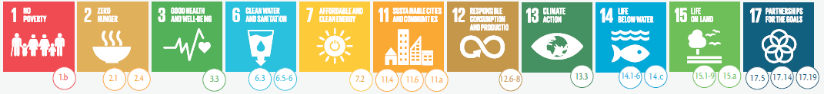






Countries manage marine and terrestrial ecosystems through an integrated approach to maintain and restore their long-term functioning and the supply of ecosystem goods and services
PoW Indicators
Monitor and maintain the health and productivity of ecosystems
Enhanced knowledge of the value and role of ecosystem services
Improvement in collaboration frameworks for ecosystem management
Incorporation of ecosystems in economic decision-making
Private sector reduces ecosystem-related risks and/or impacts
Ecosystem approach in education frameworks
EA.(a) - Institutionalization of ecosystems in education, monitoring and cross-sector and transboundary collaboration frameworks
EA.(b) - inclusion of ecosystems in economic decision-making
SDG Targets
A1 –Ecosystem health and wildlife
A2 – Economics and ecosystems
B1 –Poverty-Environment Action
(hosted by Environmental Governance)
B2- UN Environment Finance Initiative (hosted by Resource Efficiency)
$6M
$8M
$ 40-60M
$15-20M
$1.3M
$1M
A3 – Integrated marine ecosystem management
A4 – Integrated Land & Water Management
$3.6M
$8M
$80-100M
$ 100-130M
A5 – Education for sustainability (hosted by Healthy and Productive Ecosystems)
$0.8M
$3-5M
A6 – Ecosystems communication and outreach
$0.8M

Slide 5

FINANCIAL OVERVIEW
January – June 2018
Notes:
UN Environment’s third programme focuses on ecosystem management, where the overarching goal is to enable countries to maintain healthy and productive ecosystems that provide important services and goods, such as water, food, flood control, biodiversity, climate regulation, among others. This work thus contributes to a large number of the sustainable development goals.
Available resources have been high primarily from extra-budgetary resources received in 2016 and prior to this year that is dedicated to projects running now and going beyond 2016.

Slide 6
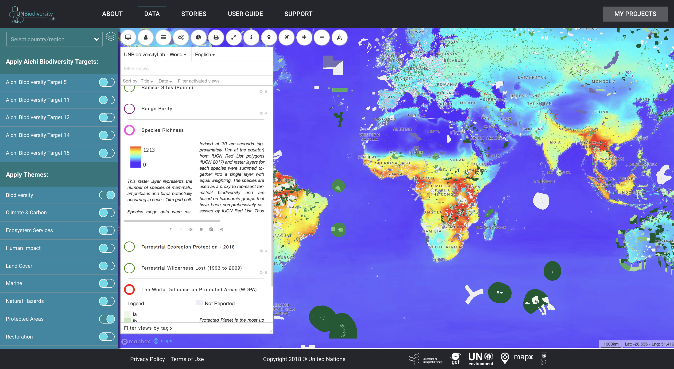
Progress January – June 2018
Monitor and maintain the health and productivity of ecosystems
The UN Biodiversity Lab (http://unbiodiversitylab.org),
a new spatial data platform
Notes:
The UN Biodiversity Lab is an online spatial data platform developed by UN Environment in collaboration with UNDP, UNEP GRID Geneva and UNEP-WCMC with funding from the Global Environment Facility. The UN Biodiversity Lab allows policymakers and other stakeholders to access global data layers, upload and manipulate their own datasets in a secure platform, and query multiple datasets for information and data related to spatial elements of the Aichi Biodiversity Targets (ABTs) and nature-based Sustainable Development Goals (SDGs). Using more than 80 layers from multiple providers currently data available on UN Biodiversity Lab, policymakers can deliver on their commitments to the Convention on Biological Diversity through better conservation planning and reporting. This first iteration of the Lab supports policymakers to produce data-driven Sixth National Reports to the CBD. The UN Biodiversity Lab can be accessed at https://unbiodiversitylab.org/.

Slide 7
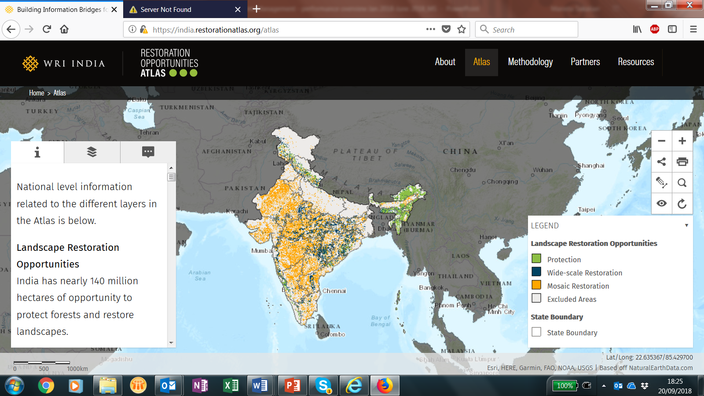
Progress January – June 2018
Monitor and maintain the health and productivity of ecosystems

Slide 8
Progress January – June 2018
Monitor and maintain the health and productivity of ecosystems
New publication in forest and landscapes New publication providing facts, figures and key messages to encourage more investments in forest and landscape restoration
Encourage more (private) investments into forest and landscsape restoration
Encourage more (private) investments into forest and landscape restoration
Provide inspiration through case studies (5 in the report: Brazil, Burkina Faso, China, Nepal, US)
Publish revised Principles for Forest and Landscape Restoration

Slide 9
Progress January – June 2018
Enhanced knowledge of the value and role of ecosystem services
The TEEB for Agriculture and Food Scientific and Economic Foundations report was launched in Delhi on 4 June 2018.
The report:
a) Discusses the role of the evaluation framework in contributing to a new more holistic, multi-dimensional, systems-thinking paradigm and
b) Explores the potential impact for decision-makers in policy, business and farming, and in contributing to the 2030 Agenda and Sustainable Development Goals.

Slide 10
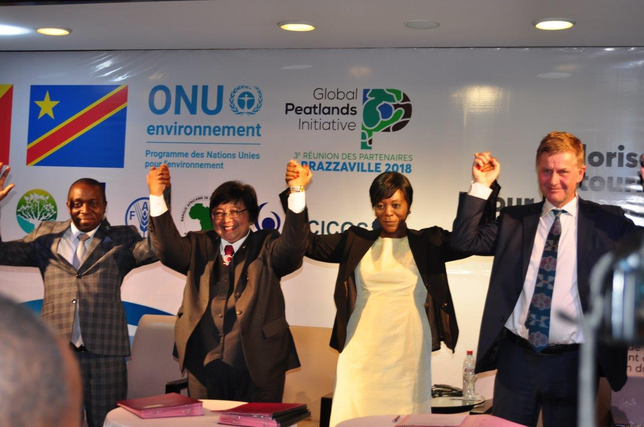

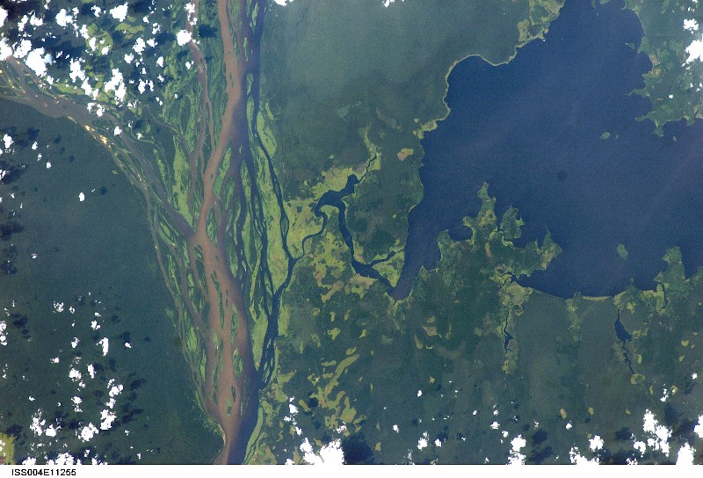
Progress January – June 2018
Improvement in collaboration frameworks for ecosystem management
Brazzaville Declaration signed by Democratic Republic of the Congo, Republic of the Congo and Indonesia to
protect world’s largest tropical peatland
http://www.globalpeatlands.org/
Notes:
The Global Peatlands Initiative is a new global initiative led by UN Environment to save peatlands as the world's largest terrestrial organic carbon stock.
Peatlands are found in over 180 countries and occur in both the tropics and in temperate zones – and while they cover only three percent of the global land surface area, they are estimated to store over 500 billion tonnes of carbon– equal to the carbon that is contained in all terrestrial biomass and twice as much as in all the world’s forest biomass.
However, being poorly understood, peatlands across the globe are under threat from drainage and burning for agricultural, forestry, infrastructure and other related development uses. The Global Peatland Initiative partners are trying to counter and avoid these threats and save peatlands globally - as the world’s largest terrestrial organic carbon stock.
Peatlands Matter for the climate. Peatlands matter for people. Peatlands Mater for the planet.
And you must have heard that recently that Peatlands Matter for the Congos - home to the world’s largest tropical Peatland– the Cuvette Centrale. Recently at the 3rd Meeting of the partners of the Global Peatlands Initiative, Ministers of the Republic of the Congo, the Democratic Republic of the Congo and Indonesia signed the Brazzaville Declaration – an historic agreement to protect the world’s largest tropical peatland which contains 30 gigatons of carbon – equivalent to the amount of carbon the United States economy emits over 15-20 years.
Photo credits:
Signing of the Brazzaville Declaration on Peatlands – Hans Joosten
A view of the Cuvette Centrale Peatlands from the International Space Station - courtesy of NASA and kindly shared by Roberta Bondar, the first Canadian Woman Astronaut.

Slide 11

Challenges and Opportunities
Resource constraints
Increase in finance from Global Environment Facility 7 expected
High level engagement:
CBD COP 14 and UNCCD COP 14
Alignment with post-2020 global biodiversity framework
Notes:
Main financial projections are presented under the budget presentation but we anticipate to continue our dependency on extra-budgetary resources with a shift from Global Environment Facility.

Slide 12
2020 - 2021 Programme of Work
Clear alignment to Sustainable Development Goal Indicators at both impact and expected accomplishment level
Rationalization of some indicators under expected accomplishment b

Slide 13
Questions & Discussion
Programme Ag. Lead Director
Ms. Monika MacDevette
Ecosystems Division
UN Environment Programme Nairobi
monika.macdevette@un.org
Programme Coordinator
Ms. Marieta Sakalian
Ecosystems Division
UN Environment Programme Nairobi
marieta.sakalian@un.org

