Slide 1



Passive Air Sampling Pacific 2017-2018
Rianne van Dijk, Jacob de Boer

Slide 2
Participating Countries in Asia
Fiji
Kiribati
Marshall Islands
Niue
Palau
Samoa
Solomon Islands
Tuvalua
Vanuatu

Slide 3
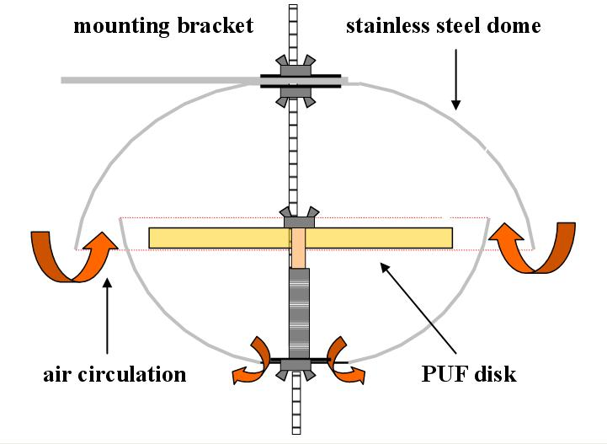
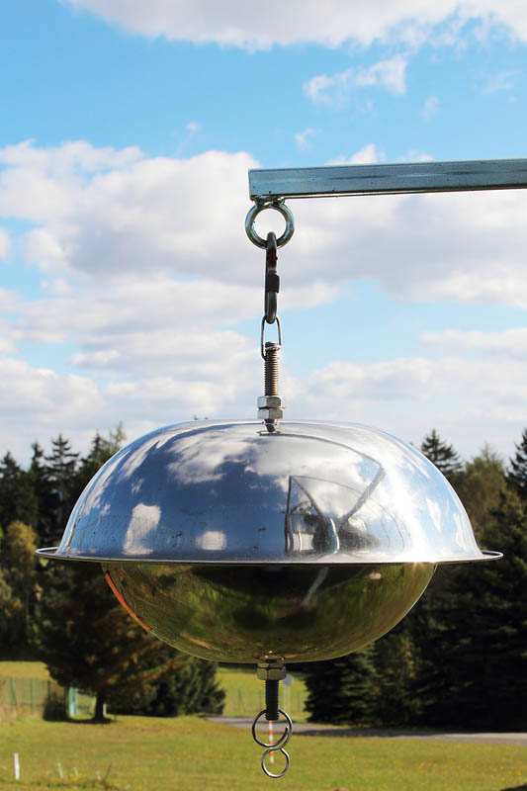
Air sampling: PUFs

Slide 4
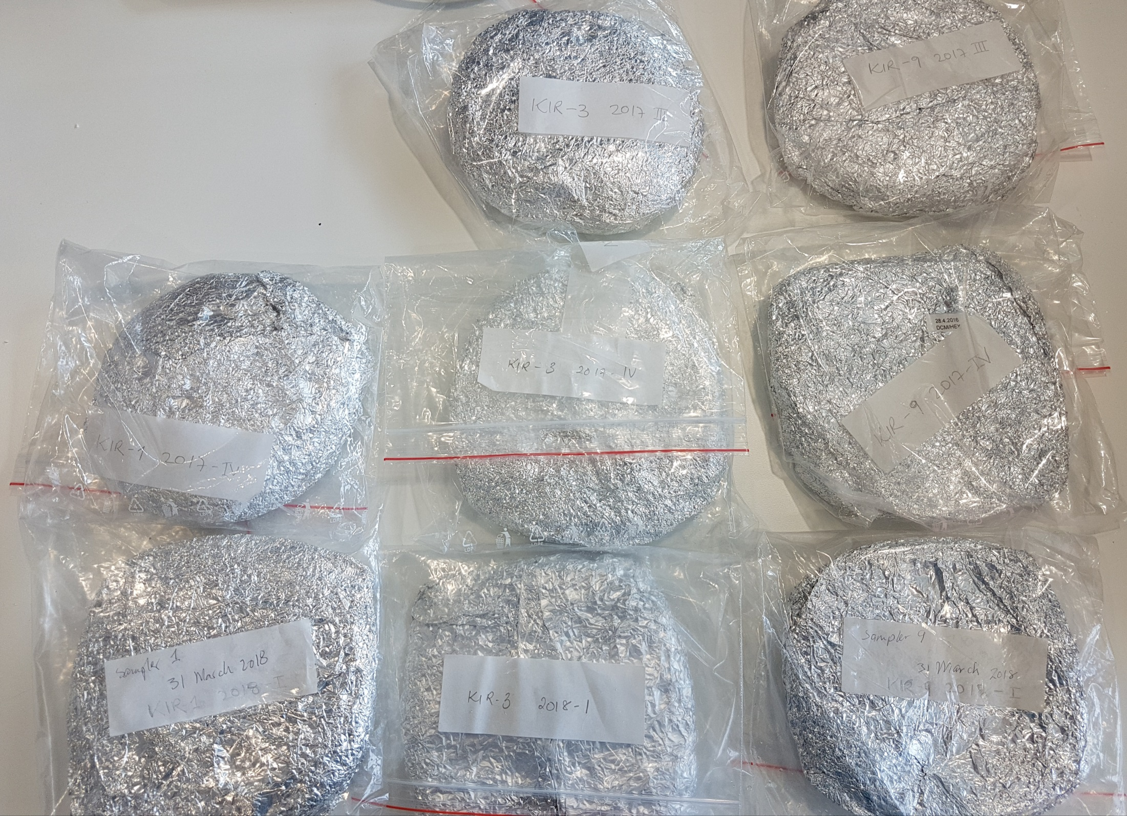
Kiribati PUFs

Slide 5
PUFs 2017 I and II
Pacific Islands |  | PUF 1 | PUF 2 | PUF 3 | PUF 4 | PUF 5 | PUF 9 | PUF 10 | PUF 11
Fiji | FJI
Kiribati | KIR
Marshall Isl. | MHL
Niue | NIU
Palau | PLW |  |  |  |  | PLW-5 (2017-I) | PLW-9 (2017-I) |  | PLW-11 (2017-I)
Samoa | WSM
Solomon Isl. | SLB
Tuvalu | TUV
Vanuatu | VUT
Pacific Islands
Fiji
Kiribati
Marshall Islands
Niue
Palau
Samoa
Solomon Islands
Tuvalu
Vanuatu
PUF 1 | PUF 2 | PUF 3 | PUF 4 | PUF 5 | PUF 9 | PUF 10 | PUF 11
 |  |  |  | PLW-5 (2017-II) | PLW-9 (2017-II) |  | PLW-11 (2017-II)

Slide 6
PUFs 2017 III and IV
Pacific Islands
Fiji
Kiribati
Marshall Islands
Niue
Palau
Samoa
Solomon Islands
Tuvalu
Vanuatu
PUF 1 | PUF 2 | PUF 3 | PUF 4 | PUF 5 | PUF 9 | PUF 10 | PUF 11
 |  | KIR-3 (2017-III) |  |  | KIR-9 (2017-III)
SLB-1 (2017-III) |  | SLB-3 (2017-III) |  |  | SLB-9 (2017-III)
Pacific Islands
Fiji
Kiribati
Marshall Islands
Niue
Palau
Samoa
Solomon Islands
Tuvalu
Vanuatu
PUF 1 | PUF 2 | PUF 3 | PUF 4 | PUF 5 | PUF 9 | PUF 10 | PUF 11
FJI-1 (2017-IV) |  | FJI-3 (2017-IV) |  |  | FJI-9 (2017-IV)
KIR-I (2017-IV) |  | KIR-3 (2017-IV) |  |  | KIR-9 (2017-IV)
NIU-1 (2017-IV) |  | NIU-3 (2017-IV) |  | NIU-5 (2017-IV) | NIU-9 (2017-IV) |  | NIU-11 (2017-IV)
SLB-1 (2017-IV) |  | SLB-3 (2017-IV) |  |  | SLB-9 (2017-IV)

Slide 7
PUFs 2018 I and II
Pacific Islands |  | PUF 1 | PUF 2 | PUF 3 | PUF 4 | PUF 5 | PUF 9 | PUF 10 | PUF 11
Fiji | FJI | FJI-I (2018-I) |  | FJI-3 (2018-I) |  |  | FJI-9 (2018-I)
Kiribati | KIR | KIR-I (2018-I) |  | KIR-3 (2018-I) |  |  | KIR-9 (2018-I)
Marshall Islands | MHL
Niue | NIU
Palau | PLW
Samoa | WSM
Solomon Islands | SLB | SLB-I (2018-I) |  | SLB-3 (2018-I) |  |  | SLB-9 (2018-I)
Tuvalu | TUV | TUV-1 (2018-I) | TUV-1 (2018-0)BL | TUV-3 (2018-I) | TUV-3 (2018-0)BL |  | TUV-9 (2018-I) | TUV-9 (2018-0)BL
Vanuatu | VUT | VUT-I (2018-I) |  | VUT-3 (2018-I) |  |  | VUT-9 (2018-I)
Pacific Islands
Fiji
Kiribati
Marshall Islands
Niue
Palau
Samoa
Solomon Islands
Tuvalu
Vanuatu
PUF 1 | PUF 2 | PUF 3 | PUF 4 | PUF 5 | PUF 9 | PUF 10 | PUF 11
SLB-I (2018-II) |  | SLB-3 (2018-II) |  |  | SLB-9 (2018-II)
TUV-1 (2018-II) | TUV-1 (2018-0)BL | TUV-3 (2018-II) | TUV-3 (2018-0)BL |  | TUV-9 (2018-II) | TUV-9 (2018-0)BL
VUT-I (2018-II) |  | VUT-3 (2018-II) |  |  | VUT-9 (2018-II)

Slide 8
Overview 2017
PUF NO.: | 1 | 2 | 3 | 4 | Total received | Total required
Fiji | 0 | 0 | 0 | 3 | 2 | 12
Kiribati | 0 | 0 | 2 | 3 | 5 | 12
Marshall Isl. | 0 | 0 | 0 | 0 | 0 | 12
Niue | 0 | 0 | 0 | 5 | 5 | 12
Palau | 3 | 3 | 0 | 0 | 6 | 12
Samoa | 0 | 0 | 0 | 0 | 0 | 12
Solomon Isl. | 0 | 0 | 3 | 3 | 6 | 12
Tuvalu | 0 | 0 | 0 | 0 | 0 | 12
Vanuatu | 0 | 0 | 0 | 0 | 0 | 12

Slide 9
Overview 2018
PUF NO.: | 1 | 2 | 3 | 4 | Total received | Total required
Fiji | 3 | 0 | 0 | 0 | 3 | 12
Kiribati | 3 | 0 | 0 | 0 | 3 | 12
Marshall Isl. | 0 | 0 | 0 | 0 | 0 | 12
Niue | 0 | 0 | 0 | 0 | 0 | 12
Palau | 0 | 0 | 0 | 0 | 0 | 12
Samoa | 0 | 0 | 0 | 0 | 0 | 12
Solomon Isl. | 3 | 3 | 0 | 0 | 6 | 12
Tuvalu | 6 | 6 | 0 | 0 | 12 | 12
Vanuatu | 3 | 3 | 0 | 0 | 6 | 12

Slide 10
Analyses
Analyses (PCB, OCP and PBDE) have just started
In some samples we propose to analyse also HCBD,
CPs and PCNs

Slide 11
Note when sending samples
We had to pay import taxes for some samples:
- State that the samples are of No commercial value or less then 1 Euro

