Slide 1
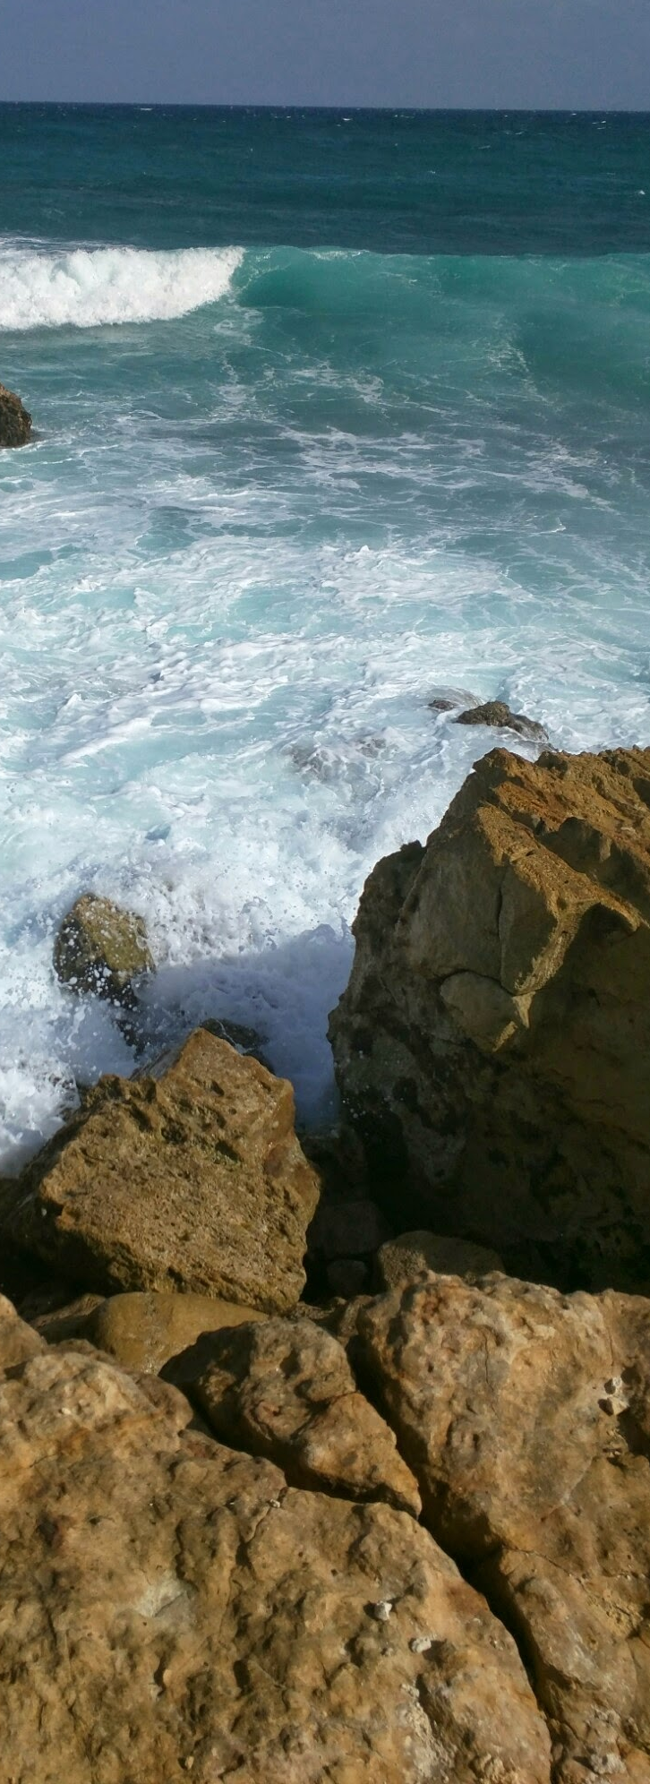





Implementing Agenda 2030
Republic of Albania Case
Senida Mesi
Former Deputy Prime Minister Albania
Member of Parliament
July 2019

Slide 2


SDGs 3I-s:
Implementation
Integration
Inclusiveness

Slide 3


The GoA since September 2015 has worked to integrate and mainstream Agenda 2030 across the national development policy framework.
Align Agenda 2030 implementation with an ambitious policy and governance reform agenda, to prepare Albania for eventual membership in the European Union (EU).
Accession to the European Union (EU) is an over-arching development priority supported by all major political parties in Albania
EU integration processes have been key development drivers.
Focus

Slide 4

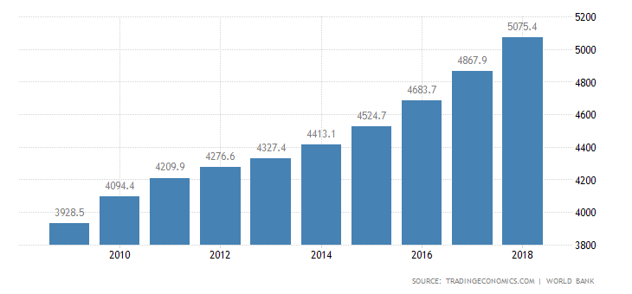
Albania’s sustainable development policy context
Population 2.8 Million
GDP Growth 4.3 %
Unemployment rate: 12.3%
Figure 1—Per-capita GDP in Albania
(1989-2017)
Figure 2—Average annual improvements in Albania’s Human Development Index (2000-2015)
Source: World Bank
Source: UNDP Human Development Report Office.

Slide 5
SDGs Milestones 2016-2018
Cooperation Program on Sustainable Development 2017-2021
UN & GoA
October 2016
Baseline Report on SDGs
Actual status of 17 Objectives
October 2017
Parliament Approves the resolution for Agenda 2030
December 2017
Albania, present the VNR
July 2018
SDG Acceleration Fund approval concept
December 2018
Regional meeting WB6 for national Gender Agencies
September 2018
Albania lead the “Regional Forum on SDG” UNECE region
March 2019
Inter-Ministerial Committee on Agenda 2030 Implementations
May 2017
University Commitment
October 2017
MAPS Mission
April 2018

Slide 6
Institutional responsibility for SDG implementation in Albania

Slide 7

Stakeholders
Parliament
Government
Civil society
Regional and International Cooperation
Businesses
Academia (Universities& Schools)

Slide 8
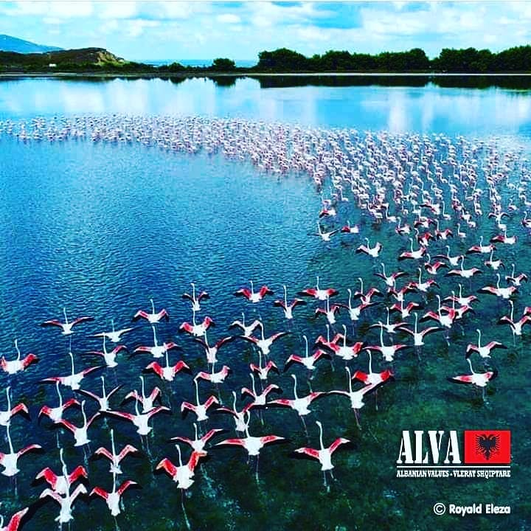
To Dos
  Design of a “Vision 2030 on sustainable development);
  Work on the mid-term review and assessment of the GoA-UN Programme of Cooperation for Sustainable Development (2017-2021) and the design of its successor;
  Continuing improvements in Albania’s official statistics, as well as in other national systems for monitoring development results;
  Include Civil Society
  Include Business and business association
  Set supporting strategy from Academia
  Fund the SDG Acceleration Fund
  WB6 SGD perspective/Hub

Slide 9
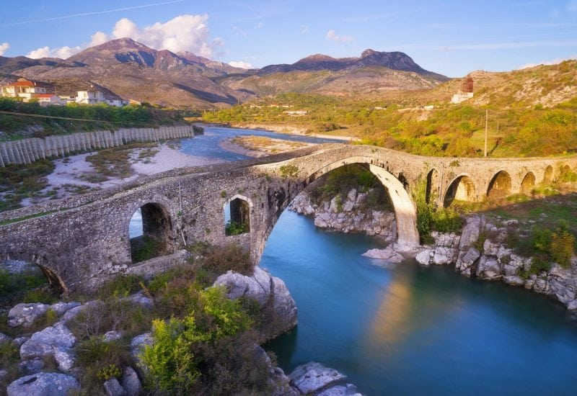
Contact
Thank you
Senida MESI
Former Deputy PM
Member of Parliament of Albania
senidamesi@gmail.com senida.mesi@parlament.al
Mob: +355 692046183

