Slide 1
Why the GMP matters

Slide 2
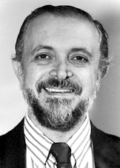
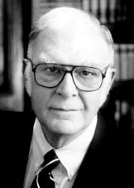

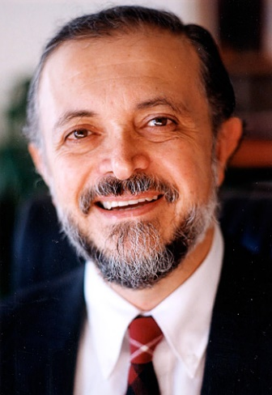
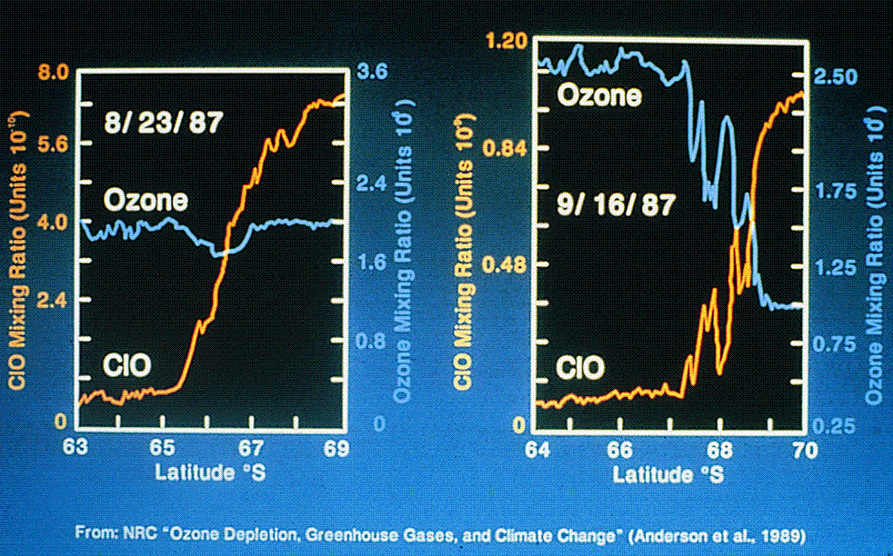
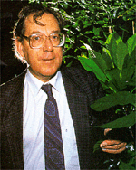
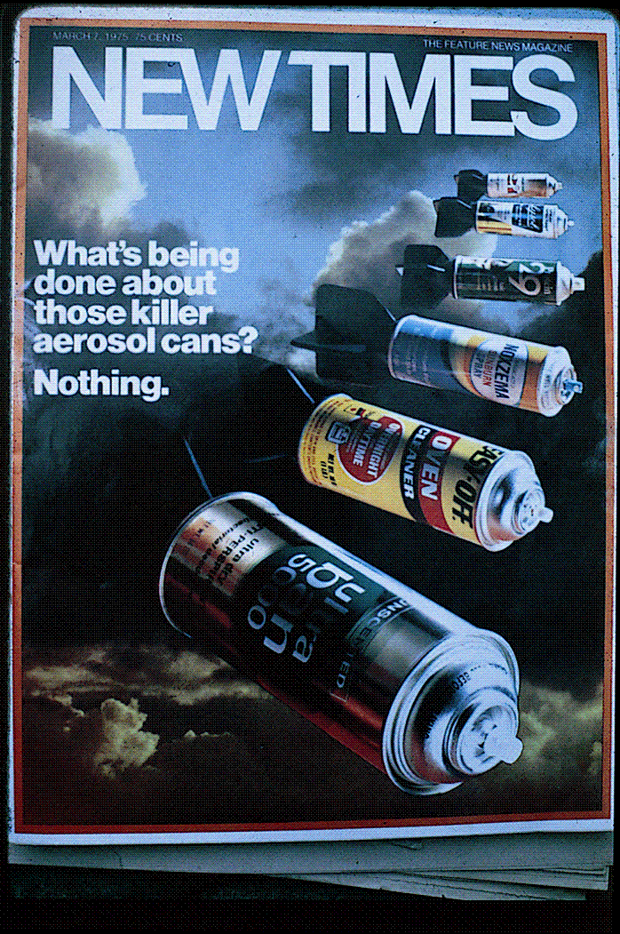
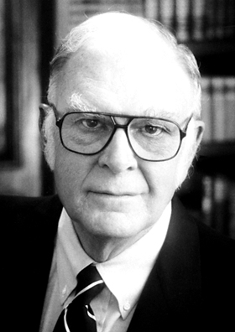



Nobel Prize in Chemistry 1995
Paul Crutzen, Mario Molina and Sherwood Rowland
"for their work in atmospheric chemistry, particularly concerning the formation and decomposition of ozone".
Mario Molina
Paul Crutzen
1985, first paper on observations of springtime losses of ozone over Antarctica
linking CFC-derived chlorine to the ozone hole
with airplane observation.
Sherwood Rowland

Slide 3
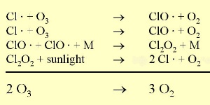
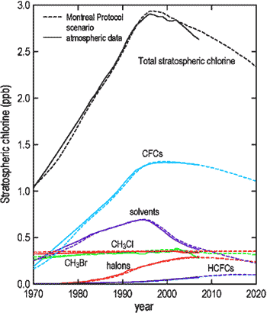
Understanding – Acting - Checking
2050 Forecast: Ozone layer is restored…
Dahlem Conference, Berlin 1982—Ralph Cicerone, Paul Crutzen, FSR and MJM

Slide 4
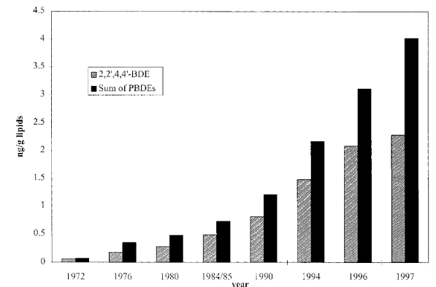
Why the GMP matters (POPs)
Meironyte et al. (1999) discover BDE47 rapidly increasing in Breastmilk from Sweden

Slide 5
Why the GMP matters
In 2008 we find that PBDEs concentration
are much higher in small children
compared to adults (Toms et al. 2008)
Meironyte et al. (1999) discover BDE47 rapidly increasing in Breastmilk from Sweden

Slide 6
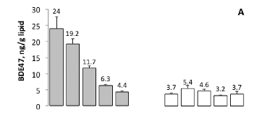
Why the GMP matters
In 2008 we find that PBDEs concentration
are much higher in small children
compared to adults (Toms et al. 2008)
Meironyte et al. (1999) discover BDE47 rapidly increasing in Breastmilk from Sweden
Last year we showed that PBDE47 has rapidly
decreased in infants and children but not
really in adults (Toms et al. 2018)

Slide 7
Why the GMP matters
Monitoring is fundamental to understanding what works and what does not work in chemical regulation
In 2008 we find that PBDEs concentration
are much higher in small children
compared to adults (Toms et al. 2008)
Meironyte et al. (1999) discover BDE47 rapidly increasing in Breastmilk from Sweden
Last year we showed that PBDE47 has rapidly
decreased in infants and children but not
really in adults

Slide 8
This meeting is to contribute to a sustainable GMP…

