Slide 1

Future of the Global Environment Outlook (GEO)
Briefing to the 8th Annual Subcommittee meeting of the Committee of Permanent Representatives,
October 26, 2021
Ivar Baste Co-chair of the Future of GEO Steering Committee
Notes:
Thank you Jian and thank you madam chair,
Let my start by recalling very briefly UNEA resolution 4/23……

Slide 2

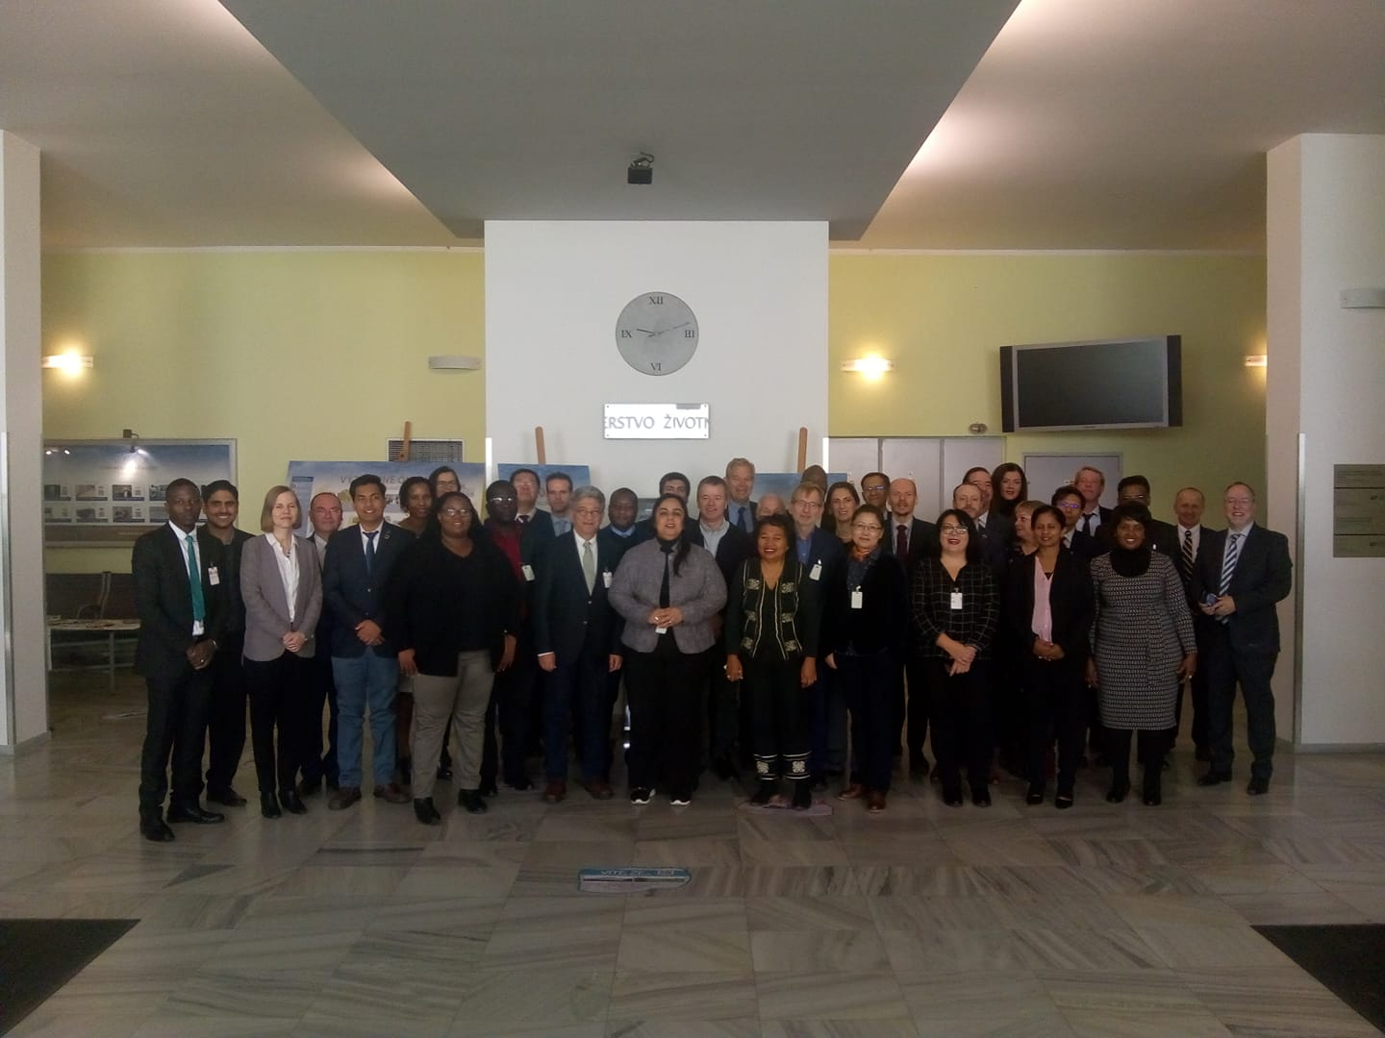
UNEA Resolution 4/23
Established an intergovernmental consultation on options for the future of the GEO overseen by a Steering Committee of 37 Member State experts which:
Has met in-person once & virtually some 20 times in meetings and work-shops
Consulted member states, stakeholders and experts on draft material in 2020
Presented its interim report to UNEA-5.1 in February 2021
Just consulted on a draft feasibility study on administrative and financial implications
Will consider its final options report in a digital workshop 8-11 November and present it to UNEA 5.2
Notes:
UNEA Resolution 4/23….
…..It established an intergovernmental consultation on options for the future of the GEO overseen by a Steering Committee of 37 Member State experts.
This picture serves to prove that the committee has met in-person once before the pandemic - and virtually some 20 times in meetings and work-shops
We have consulted member states, stakeholders and experts on draft material in 2020
Presented our interim report to UNEA-5.1 in February 2021
Just consulted on a draft feasibility study on administrative and financial implications
Will consider our final options report in a digital workshop 8-11 November and present it to UNEA 5.2
2020 consultation: showed and overwhelming support for the continuation of GEO….

Slide 3
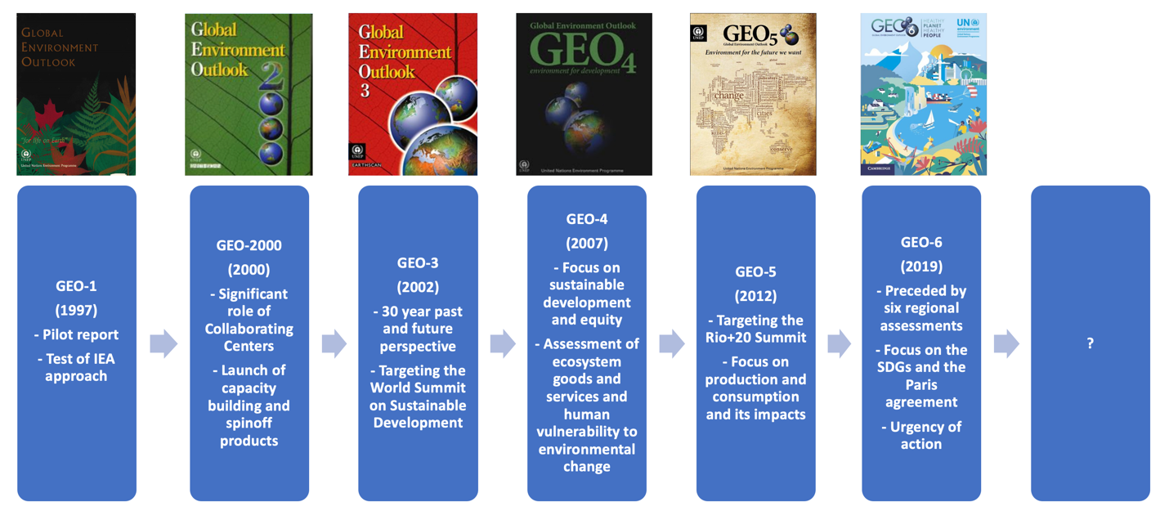
Which way for future GEO…
2020 consultation: - overwhelming support for the continuation of GEO
?
Finalising potential resolution points UNEA may wish to consider with pros and cons:
Setting the rationale for GEO
Affirming the objectives, functions, design criteria and process for GEO
Establishing GEOs governance and implementation structure (2 alternatives +1 hybrid) & requesting it to:
  Develop a set of agreed procedures (2 alternatives)
  Prepare future GEO assessments (3 partly complementary options +1 hybrid)
  Identify needs & provide capacity building, knowledge generation and policy support services
Requesting the ED to administer the GEO process and facilitate its resourcing
Notes:
2020 consultation: showed and overwhelming support for the continuation of GEO….
It was actually favored by 98% of Member States, 96% of assessment experts and 94% of stakeholders
The steering committee is now finalising potential resolution points UNEA may wish to consider and presenting the implications, pros and cons of the options. These potential resolution points include
Setting the rationale for GEO
Affirming the objectives, functions, design criteria and process for GEO
Establishing GEOs governance and implementation structure (2 alternatives +1 hybrid) & requesting it to:
Develop a set of agreed procedures (2 alternatives)
Prepare future GEO assessments (3 partly complementary options +1 hybrid)
Identify needs & provide capacity building, knowledge generation and policy support services
Requesting the ED to administer the GEO process and facilitate its resourcing
If we first look at the rationale for the future GEO…….

Slide 4

The rationale for the future GEO
UNEA may wish to:
Be mindful of UNEPs science-policy mandate on – keeping under review the world environmental situation –promoting the contribution of the scientific communities - providing policy guidance & recommendations
Acknowledge that the growing body of environmental knowledge, is key to achieving a sustainable future set out in the 2030 Agenda and its SDGs
Recognise the role of credible, relevant and legitimate intergovernmental expert led assessments in promoting dialogues between the science and policy communities on environmental issues vital for a sustainable future
Recognise that the Global Environment Outlook (GEO) process since 1995 has generated flagship reports and strengthened UNEPs science-policy interface, - mobilises in-kind support from experts and partner institutions
Recall its resolution 4/23 on the future of the GEO process; and welcome the inputs received through the consultative process
Notes:
If we first look at the rationale for the future GEO…….
UNEA may wish to:
Be mindful of UNEPs science-policy mandate on – keeping under review the world environmental situation –promoting the contribution of the scientific communities - providing policy guidance & recommendations
Acknowledge that the growing body of environmental knowledge, is key to achieving a sustainable future set out in the 2030 Agenda and its SDGs
Recognise the role of credible, relevant and legitimate intergovernmental expert led assessments in promoting dialogues between the science and policy communities on environmental issues vital for a sustainable future
Recognise that the Global Environment Outlook (GEO) process since 1995 has generated flagship reports and strengthened UNEPs science-policy interface, - mobilises in-kind support from experts and partner institutions
Recall its resolution 4/23 on the future of the GEO process; and welcome the inputs received through the consultative process
Before continuing with the operative elements that UNEA may want to consider let me show you
How we see the overall orientation of the GEO process …….

Slide 5
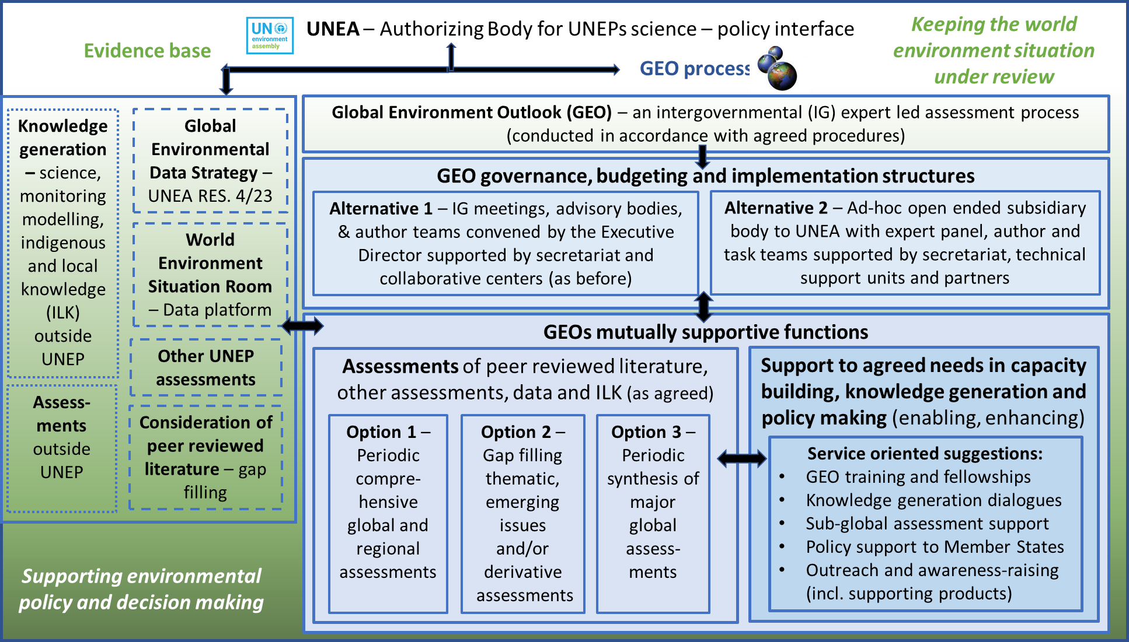
Overall orientation of the GEO process
Notes:
How we see the overall orientation of the GEO process …….
………After significant deliberations, both in the preparation of the interim report and this feasibility study, the Steering Committee has developed a schematic of the overall GEO process and how the proposed options fit within it:
The schematic presents the GEO as an intergovernmental and expert-led assessment process under the purview of UNEA situated in UNEPs science policy interface.
The GEO process draws from an evidence base that includes the following elements: - the Global Environmental Data Strategy - The World Environment Situation Room - elements of knowledge generation within and outside UNEP – assessments science, monitoring modelling indigenous and local knowledge
The schematic reflects the proposal that the GEO process takes place in accordance with agreed procedures.
The schematic furthermore presents two alternative approaches to governance, budgeting and implementation structures
Finally, the schematic presents options and suggestions related to the implementation of GEOs mutually supportive functions which is comprised of the assessment function with three options and the provision of support to agreed needs in capacity building, knowledge generation and policy making
I will now revert to these elements more in detail
Let's first start with GEO’s objectives, functions, criteria and process…….

Slide 6

GEO’s objectives, functions, criteria and process
UNEA may wish to consider:
a) Affirming that the objective of GEO is to keep the world environmental situation and outlook under review in order to periodically inform and support action by UN Member States, stakeholders and other actors, while strengthening UNEP’s science-policy interface
b) Affirming that GEO’s functions is - undertaking intergovernmental expert led assessments and providing support to agreed needs in capacity building, knowledge generation and policy making
c) Acknowledging that the design of GEO should be guided by principal criteria - for ensuring mandate consistency, relevance, legitimacy, credibility, accessibility, added value and overall feasibility
d) Recognizing that the intergovernmental and expert led GEO process is vital to achieving the principal design criteria for GEO:
  Planning, budgeting and scoping of deliverables
  Nomination and selection of experts and drafting of assessments
  Expert, government and stakeholder review and quality control
  Clearance of assessments and deliverables and their use
From the IPBES Assessment Guide
Notes:
Let's first start with GEO’s objectives, functions, criteria and process…….
………UNEA may wish to consider:
a) Affirming that the objective of GEO is to keep the world environmental situation and outlook under review in order to periodically inform and support action by UN Member States, stakeholders and other actors, while strengthening UNEP’s science-policy interface
b) Affirming that GEO’s mutually supportive functions is - undertaking intergovernmental expert led assessments and providing support to agreed needs in capacity building, knowledge generation and policy making
c) Acknowledging that the design of GEO should be guided by principal criteria - for ensuring mandate consistency, relevance, legitimacy, credibility, accessibility, added value and overall feasibility
Recognizing that the intergovernmental and expert led GEO process is vital to achieving the principal design criteria for GEO
The snake figure here is taken from the IPBES guide to assessment and shows the many steps of the iterative process where science meets policy – I is also highly representative of the current GEO process which includes
Planning, budgeting and scoping of deliverables
Nomination and selection of experts and drafting of assessments
Expert, government and stakeholder review and quality control
Clearance of assessments and deliverables and their use
Such a process needs a governance and implementation structure….

Slide 7

GEO's governance and implementation structures
UNEA may wish to either:
  Request the Executive Director of UNEP to convene open-ended intergovernmental and multistakeholder meetings, advisory group, scientific panel and author teams supported by the secretariat and collaborative centers (as before); or
  Establish a standing ad-hoc open-ended subsidiary body to UNEA open to observers with bureau, expert panel, author and task teams supported by the secretariat, technical support units and partners (building of the future of GEO experience); or
  Set up a hybrid where a steering committee is established to oversee the request made to the Executive Director in alternative a) above and preside over the intergovernmental and multistakeholder oversight meetings requested there
Annual cost estimate for the alternatives are:
  0.5 million USD for intergovernmental oversight
  0.1 million USD for scientific oversight
Notes:
Such a process needs a governance and implementation structure….
….and the current GEO process already has an elaborate structure in place
UNEA may wish to either:
More or less continue the current practice and Request the Executive Director of UNEP to convene open-ended intergovernmental and multistakeholder meetings, advisory group, scientific panel and author teams supported by the secretariat and collaborative centers (as before); or
Establish a standing ad-hoc open-ended subsidiary body to UNEA open to observers with bureau, expert panel, author and task teams supported by the secretariat, technical support units and partners (building of the future of GEO experience); or
Set up a hybrid where a steering committee (akin to the current future of GEO Steering Committee) which is established to oversee the request made to the Executive Director in alternative a) above and preside over the intergovernmental and multistakeholder oversight meetings requested there
Annual cost estimate for the alternatives are similar because the complexity and cost items are more or less the same (thye difference is perhaps that alt b would give GEO a bit higher standing and predictability):
0.5 million USD for intergovernmental oversight
0.1 million USD for scientific oversight
In adition comes the cost of preparing assessments, support services and other deliverables
UNEA may wish to request the relevant parts of the structure to……..

Slide 8
Task GEO's governance and implementation structure
UNEA may wish to request the relevant parts of the structure to:
  a) Develop a set of procedures agreed by Member States - either a comprehensive set of procedures, or - a leaner & flexible set complemented by technical guidelines;
  b) Plan, budget, scope and undertake one or several among 3 options and 1 hybrid the following intergovernmental expert led GEO assessments (next slide):
  c) Identify the needs for support to capacity building, knowledge generation and policy making and to plan and budget services for addressing those needs in partnership with relevant institutions.
Integrating capacity building in the GEO process trough training and fellowships, exchanges, and dialogues
Partnerships meeting capacity needs in the science policy interface (support to sub-global assessments)
Dialogues with research, modelling, scenario and data communities to address knowledge generation needs
Working with Indigenous and Local Knowledge (ILK)
Support the use of GEO findings in support of policymaking as requested by Member States and stakeholders
Outreach and awareness-raising (incl. supporting products)
Estimated annual costs 0.9 million USD
Notes:
UNEA may wish to request the relevant parts of the structure to…
…….:
a) Develop a set of procedures agreed by Member States - either a comprehensive set of procedures (we have developed such a set as a resource), or - a leaner & flexible set complemented by technical guidelines (the latter was the case for GEO) – the development could be done as an integral part of undertaking the next GEO;
b) Plan, budget, scope and undertake one or several among 3 options and 1 hybrid the following intergovernmental expert led GEO assessments (next slide):
Identify the needs for support to capacity building, knowledge generation and policy making and to plan and budget services for addressing those needs in partnership with relevant institutions – suggestions include capacity building inside and outside the GEO process – pursuing knowledge generation needs including working with ILK – supporting policy making – undertaking outreach and awareness raising- The annual cost is stipulated to 0.9 million USD.
Lets the look at the assessment options for GEO….

Slide 9
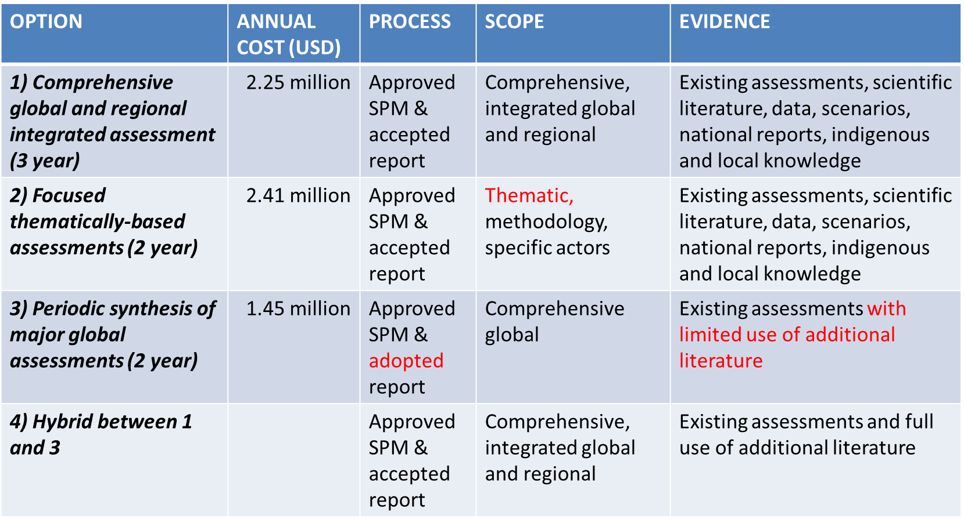
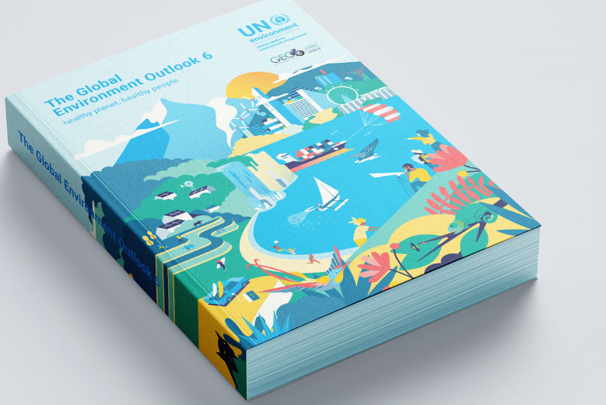


Assessment options for GEO
The GEO options would follow the same process and include Summaries for Policy Makers (SPMs)
Notes:
Lets the look at the assessment options for GEO….
The GEO options would follow the same process and include Summaries for Policy Makers (SPMs) aimed at supporting the decision-making processes at UNEA, the development of UNEP’s Medium-term Strategy (MTS) and the Secretary General’s Global Sustainable Development Report
Option 1 is a comprehensive global and regional integrated environmental assessment – it would take 3 year – be undertaken every 4 year - annual implementation cost is estimated to be 2.25 million USD - the intergovernmental and scientific oversight component on 0.6 million USD presented earlier comes on top of that implementation cost. That goes for all options. - the SPM would be approved by governments – and the main report accepted – that is to say it would not be subject to a line by line or a para by para consideration – it would draw from the broadest possible evidence base
Option 2 is periodic focused thematically-based assessments – it would take 2 years, - undertaken periodically to address issues identified by Member States. - the annual implementation cost is estimated to be 2.41 million USD – process similar to option 1 – scope obviously thematic – could also focus on methodologies or actors – like alternative 1 it would draw from the broadest possible evidence base
Option 3 periodic synthesis of major global assessments - it would take 2 years, -undertaken at periodicity as identified by Member States - The annual implementation cost is estimated to be 1.45 million USD. But as with the other options oversight cost on 0.6 million USD comes on top of that - it is distinguished from option 1 and 2 by being a shorter and more policy-oriented document, by using a narrower evidence base primarily limited to existing assessments, a less extensive expert process and a more extensive intergovernmental clearance process
A hybrid between and 3 1 and 3 which would be a comprehensive global and regional assessment which features a periodic synthesis of relevant global assessments, but is not limited to it;
UNEA could leave it to the GEO governance structure to decide how the options best could be combined such as in a rolling plan.
Finally, UNEA may wish to set out the directions for how GEO should be administered and resourced….

Slide 10
Administer and resource the GEO process
UNEA may wish to request the Executive Director to:
a) Administer the GEO process, including by providing its secretariat, by facilitating partnerships with collaborating centres and technical support units; and
b) Facilitate the mobilization of extrabudgetary resources for the process, including by creating a Trust Fund to receive voluntary contributions from donors for the implementation of the GEO process in accordance with a budget agreed by Member States
Annual resource mobilization needs over and above core funding is in the range of 2 million USD
Planning, budgeting and scoping is key to predictability of funding, stability of the process, maintaining the GEO community and UNEAs authoritative role in the transition to a sustainable future
Notes:
Finally, UNEA may wish to set out the directions for how GEO should be administered and resourced….
UNEA may wish to request the Executive Director to:
a) Administer the GEO process, including by providing its secretariat, by facilitating partnerships with collaborating centres and technical support units; and
b) Facilitate the mobilization of extrabudgetary resources for the process, including by creating a Trust Fund to receive voluntary contributions from donors for the implementation of the GEO process in accordance with a budget agreed by Member States
Annual resource mobilization needs over and above core funding is in the range of 2 million USD
Planning, budgeting and scoping is key to predictability of funding, stability of the process, maintaining the GEO community and UNEAs authoritative role in the transition to a sustainable future
The steering committee is now working to finalise our analysis and conclude our final options report. In so doing, we will draw on the outcomme of the consultation now in 2021 and any feedback received here at the annual CPR. Our report will also be supported by aditional documentation.
With that I would like to thank you for the oportunity to present the state of our ongoing work and I look forward to hear your views.
Thank you

Slide 11
Thank you! Ivar Baste: Co-chairs of the Future of GEO Steering Committee UNEP-Science-GEOHead@un.org

