Slide 1


Notes:
‘0’ This lecture explains the analysis of hair, blood, and urine, which are the media related to human health. The analysis of these media is particularly useful for the risk assessment of vulnerable populations such as children and women of child-bearing age, or high-risk groups with vocational mercury exposures.

Slide 2

Notes:
‘1’ Mercury is an element with many unique physicochemical properties, and its behaviour in the human body differs from that of other organic and inorganic chemical substances. This section introduces the characteristics of mercury in the human body. These unique characteristics are important factors for conducting mercury surveys in the human body.

Slide 3
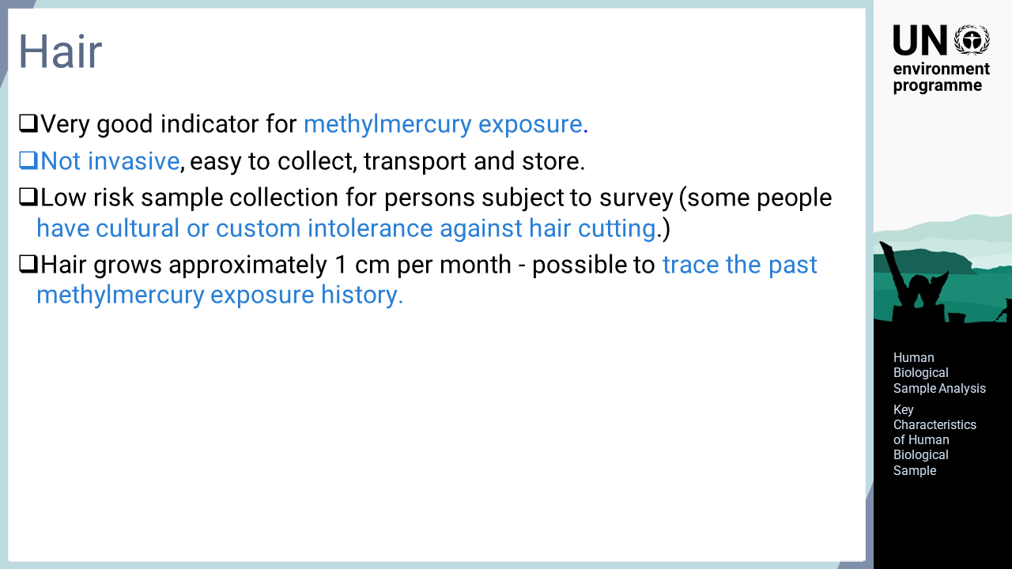
Notes:
‘2’ Hair is the most typical monitoring medium for mercury surveys. Hair can take up methylmercury during growth. The methylmercury level in hair is much higher than that in other parts of the body; therefore, hair is a very good indicator for evaluating the exposure to methylmercury. Since hair sampling is non-invasive, it does not burden the person subject to the survey very much. However, the survey should be very carefully planned, as some people or groups have cultural or customary intolerance against cutting hair. Because hair itself is a stable medium and most mercury in hair is in the form of methylmercury, samples are relatively easy to transport and store. In addition, as hair grows, the past exposure information is recorded toward the tip of the hair. Thus, analysing mercury in hair from the root to the tip can provide information about the historical methylmercury exposure of the individual.

Slide 4
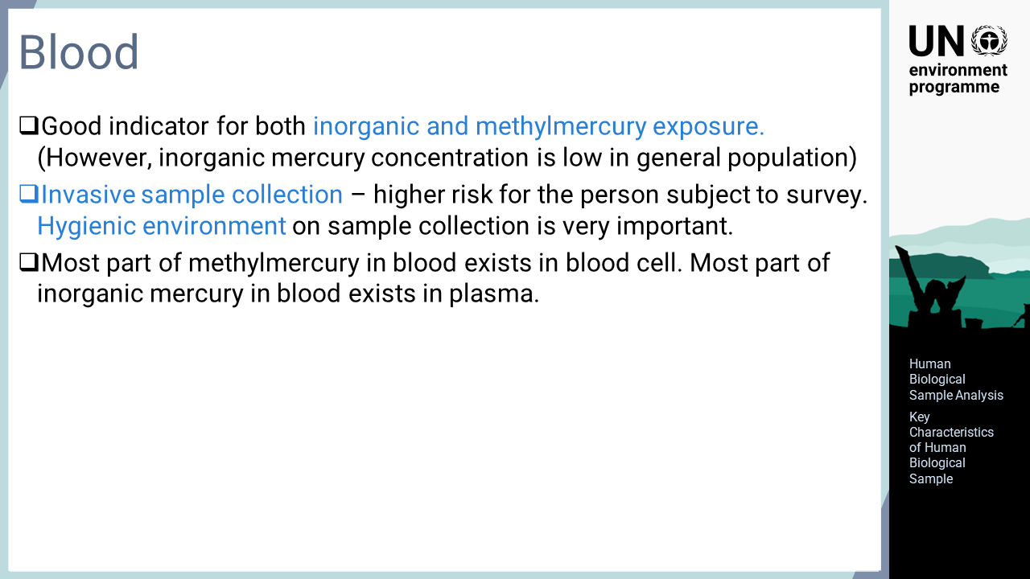
Notes:
‘3’ This slide describes the characteristics of blood samples. Blood plays an important role in the metabolism of many chemical substances in the human body, including mercury in both organic and inorganic forms. For this reason, blood can be a good indicator of both inorganic mercury and methylmercury. However, it should be noted that the level of inorganic mercury in the blood of the general population is usually low as their exposure is low. Blood sampling is an invasive means of sampling, so the risk to the person subject to blood collection is higher than the risk during hair or urine collection. Therefore, the hygienic conditions for sample collection must be properly managed. Another important aspect of mercury in blood is that most methylmercury exists in red blood cells and most inorganic mercury exists in plasma. This feature is particularly important when analysing mercury in samples other than whole blood.

Slide 5

Notes:
‘4’ The characteristics of urine are explained in this slide. Elemental or inorganic mercury taken into the body by inhalation of mercury vapour is not accumulated in hair but mostly excreted in urine. For this reason, urine is a very good indicator for exposure to elemental or inorganic mercury. Similar to hair sampling, urine sampling is non-invasive and can be done relatively easily without much health risk to the person subject to the survey. Although sample collection is rather easy, urine samples need particular care when handling after collection. Most mercury in urine is in the form of inorganic mercury, which is unstable and easily evaporated; therefore, the collected samples should be promptly frozen or otherwise treated. If on-site stabilisation is not possible, the samples should be sent to the laboratory as soon as possible at the lowest possible temperature, and then treated using an appropriate method, such as freezing. Another important aspect, which is not limited to mercury, is that the concentration of chemical substances in urine significantly varies due to the amount of water excreted. The mercury concentration also varies in each excretion, so it is evaluated against the creatinine concentration, which is stable throughout the day. The concentrations of mercury and creatinine are analysed separately, and the body burden for the person subject to the survey is evaluated based on these concentration.

Slide 6

Notes:
‘5’ In this section, the procedure for collecting hair sample, which is unique to mercury surveys, is explained.

Slide 7
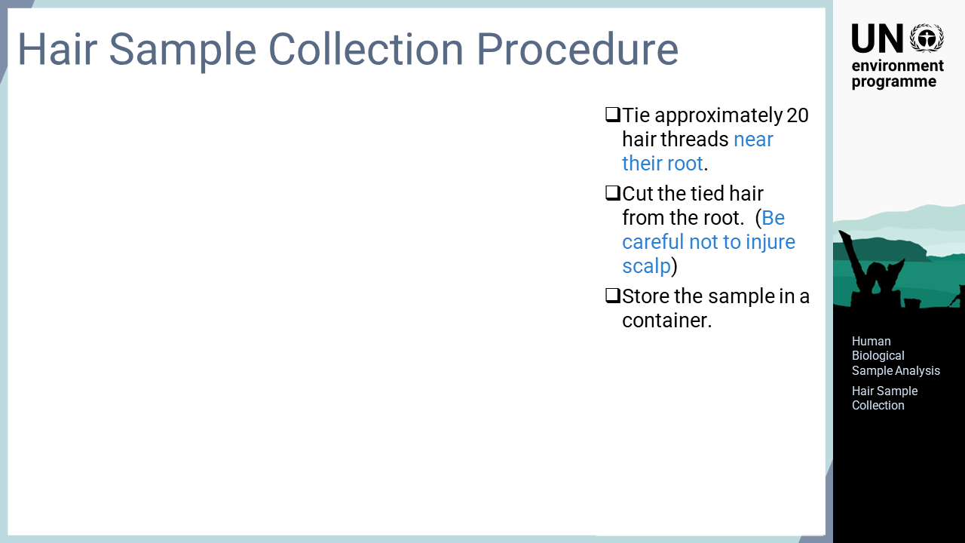
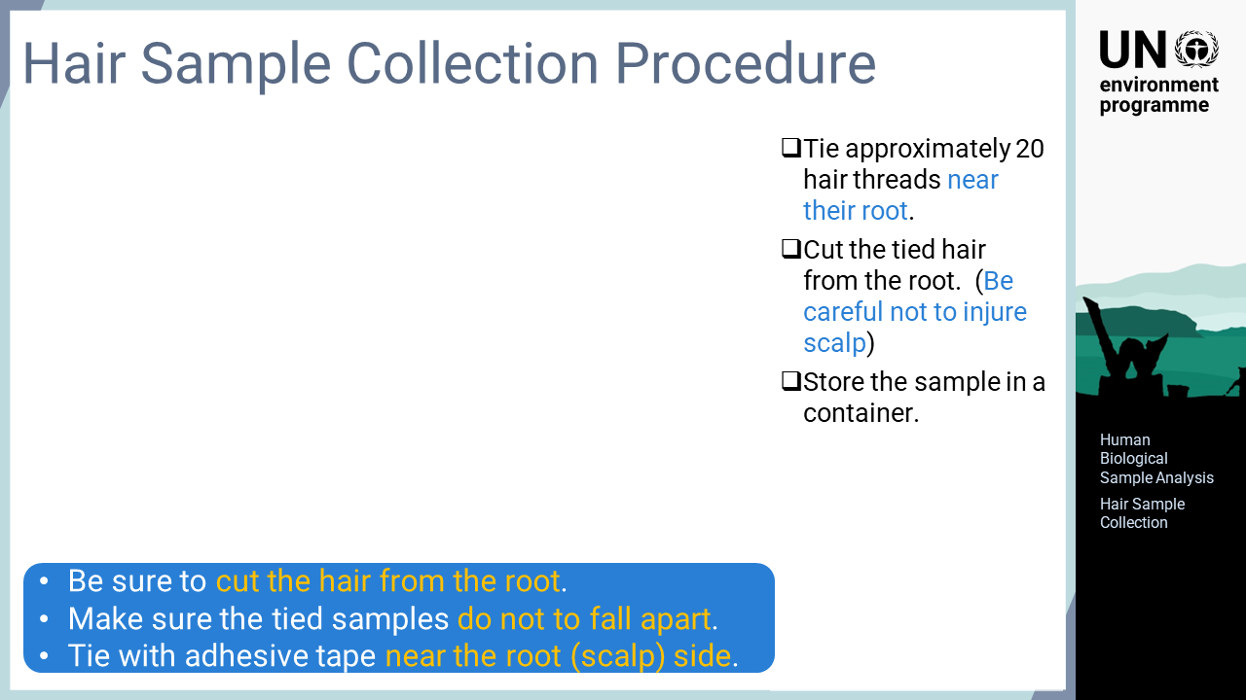
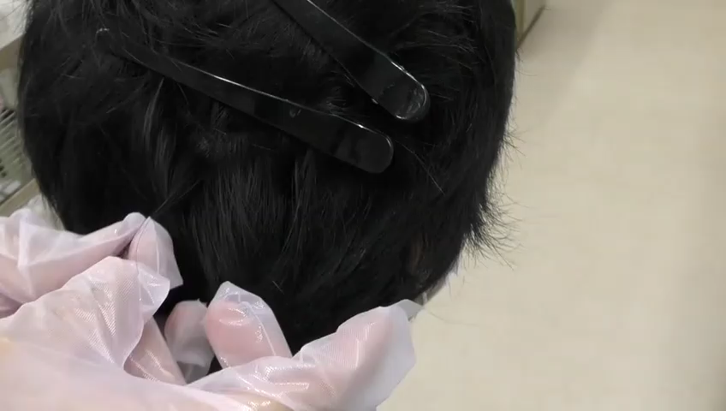
Notes:
‘6’ This video shows the actual collection scene for hair samples. Firstly, approximately 20 threads of hair are grabbed and tied near the root with adhesive tape. The bundle of hair is then cut from the root with scissors so as not to injure the scalp. The collected hair is put in a container for transportation to prevent scattering and keep it away from dust. Small envelopes are suitable for this purpose. Hair sample collection itself is easy, but some care needs to be taken to avoid improper handling that will spoil the credibility of the data. It should be ensured that the hair is collected from the root so that the recent exposure status at the time of collection can be evaluated. Additionally, the hair should be securely bundled so that the bundle does not fall apart after collection. The bundle should indicate either root or tip end of the hair. It is recommended that hair is tied at the root end to confirm the direction of growth.

Slide 8
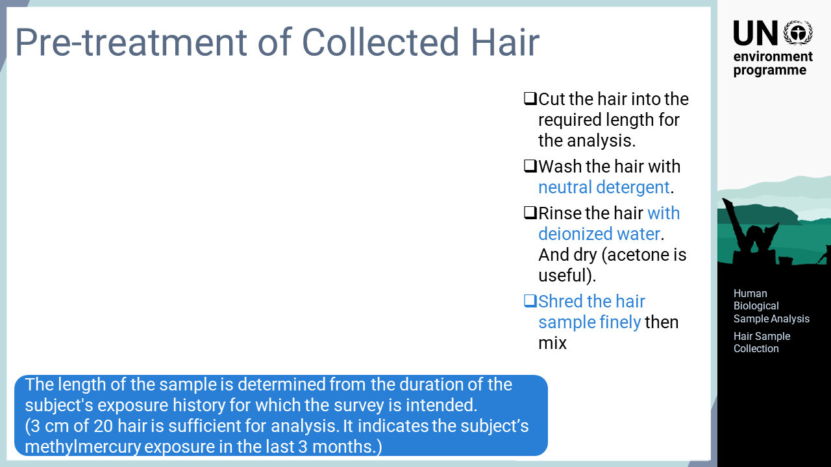
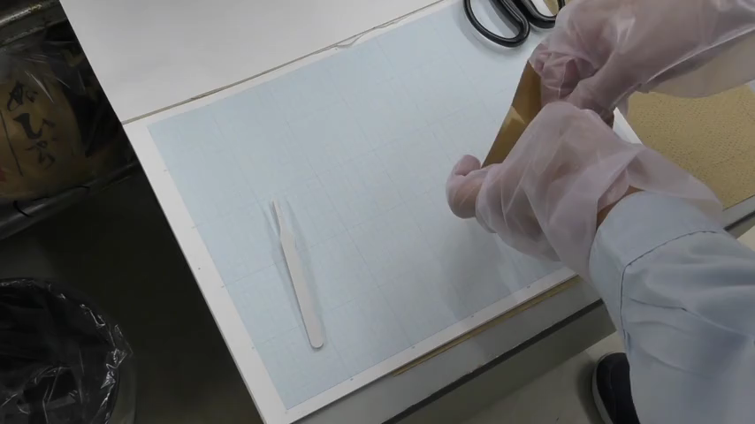
Notes:
‘7’ After taking the collected hair back to the laboratory, the sample is cut to the required length for the purpose of the evaluation. For a person subject to methylmercury exposure, 20 threads of hair with three cm are sufficient to evaluate the exposure environment over approximately three months. After cutting the hair to the required length, it is washed with detergent to remove dust on the surface. Then, it is rinsed well with deionized water, dried with acetone, put in a glass container such as a petri dish, and shredded into fine pieces with scissors.

Slide 9

Notes:
‘8’ The analysis of total mercury in biological samples can be performed using either acid digestion-reduced aeration atomic absorption spectrophotometer or thermal decomposition atomic absorption spectrometer. This section explains the former methodology.

Slide 10
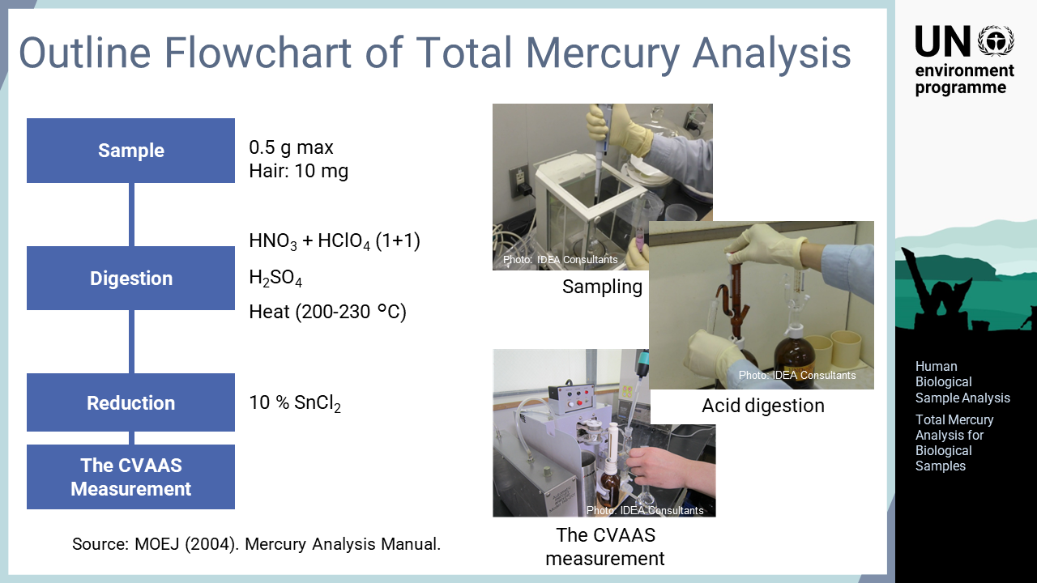
Notes:
‘9’ This operation flow involves the acid digestion-reduction aeration cold vapour atomic absorption spectrometry, CVAAS, analysis method. Firstly, a sample is digested with nitric acid, perchloric acid, and sulphuric acid in an open vessel. After digestion, mercury in the sample solution exists in a divalent oxidized form, which is highly soluble in water. Once mercury is reduced with tin chloride to elemental mercury, which has low water solubility, it is vaporized and introduced into the CVAAS instrument for measurement.

Slide 11


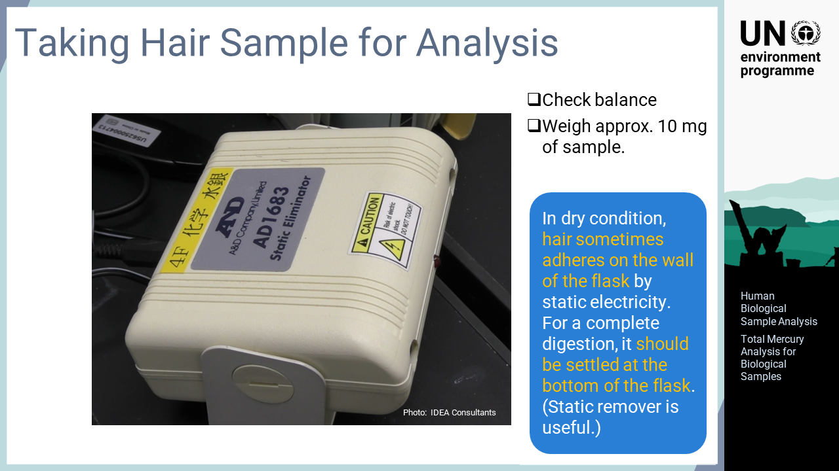
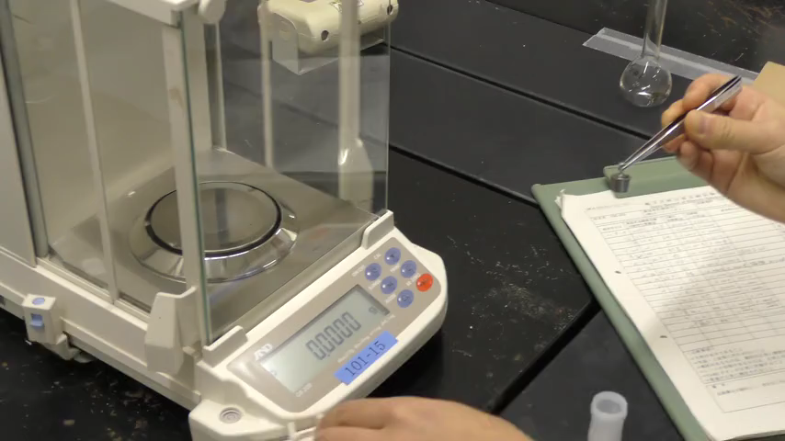
Notes:
‘10’ Firstly, the collection of analytical samples is explained. Before measuring the actual sample, the working condition of the analytical balance is confirmed. Specifically, weights or other references are measured before using the balance every day to ensure that the correct value is displayed. Then, shredded hair is mixed thoroughly in a container, and approximately 10 mg of the sample is placed in the acid digestion vessel using tweezers or a spatula. In this video, a 50 mL volumetric flask is used for digestion, as the shape is suitable for recirculating the digestion liquid. The collected hair often adheres to the wall of the digestion vessel by static electricity. Hair adhered on the upper side of the digestion vessel is not digested sufficiently during the operation, so it should be ensured that the sample is settled at the bottom of the vessel. The use of static remover is beneficial.

Slide 12

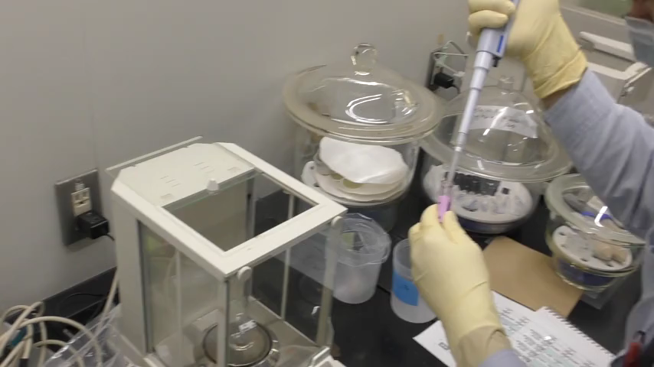
Notes:
‘11’ For blood and urine samples, approximately 0.5 g or two mL of sample is collected using a pipette. Attention should be paid to the formation of clots in blood or precipitates in urine, which compromise the homogeneity of the sample. The sample for analysis should be mixed well and used in a homogeneous condition.

Slide 13

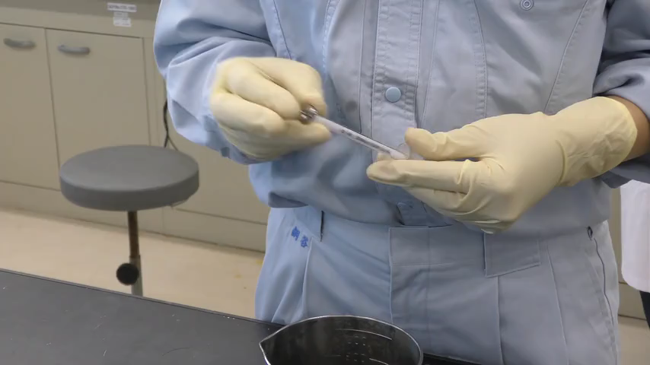
Notes:
‘12’ When collecting samples, standard solutions for calculating the sample concentrations are also prepared. Amounts of mercury corresponding to those required to create the calibration curve are taken from the standard stock solution with a syringe and placed in digestion vessels. An operation blank without any additions, that is, neither standards nor samples, is also prepared. The prepared standards are digested as done for the collected samples and analysed using CVAAS.

Slide 14
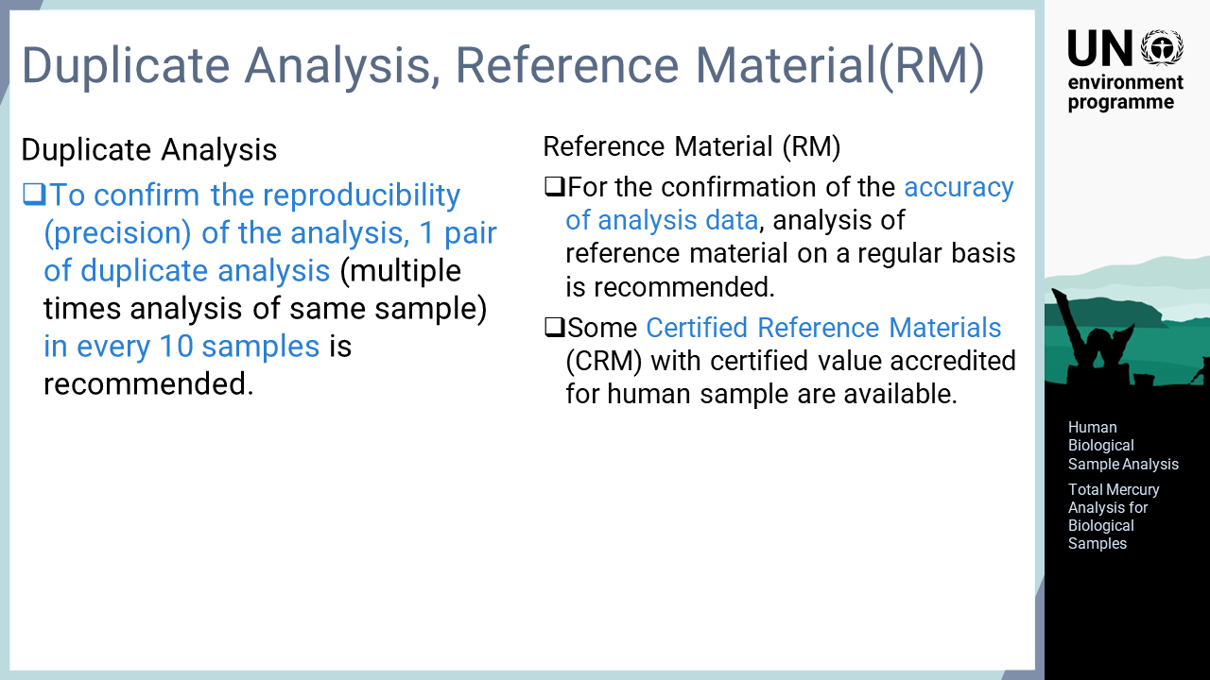
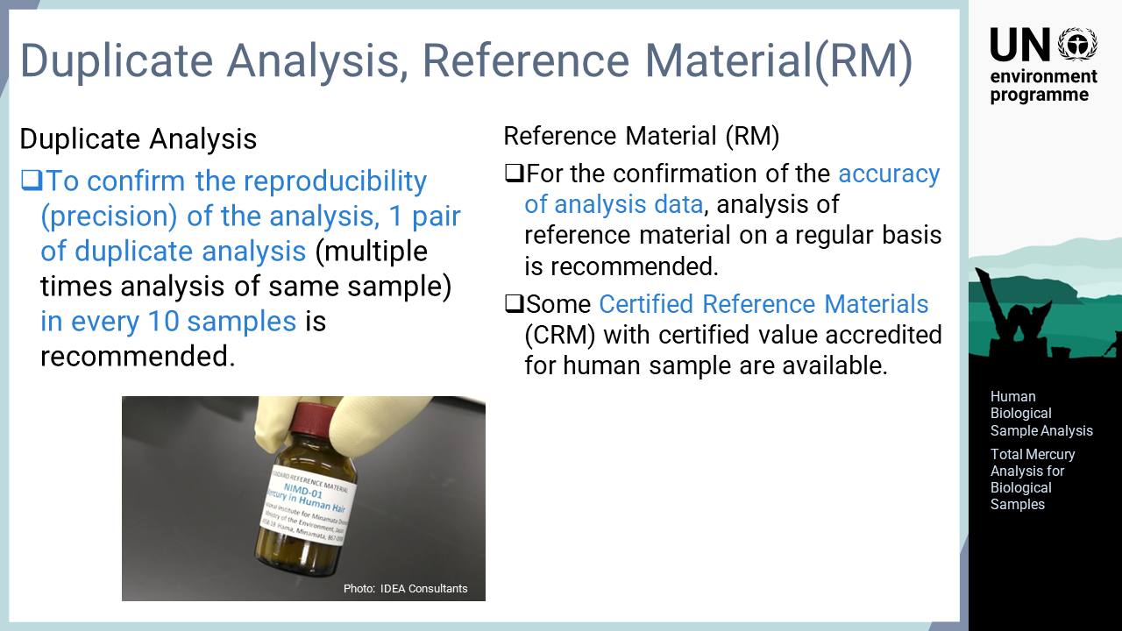
Notes:
‘13’ To confirm the reproducibility of the analysis, that is, the difference in results for analysing the same samples, duplicate analysis should be performed at a certain frequency. Analysing the same sample twice or more is recommended approximately once in every 10 samples. The reproducibility of the analysis within a day can be evaluated by duplicate analysis. It is also effective to compare the results between different days. For this purpose, it is recommended that a reference material of the same type is analysed to confirm the variation for such reference materials on a regular basis. Certified reference materials with traceable certified values given by national or international standards are commercially available for human bio-samples. By analysing these certified reference materials in the laboratory, the accuracy of the analysis can be evaluated.

Slide 15
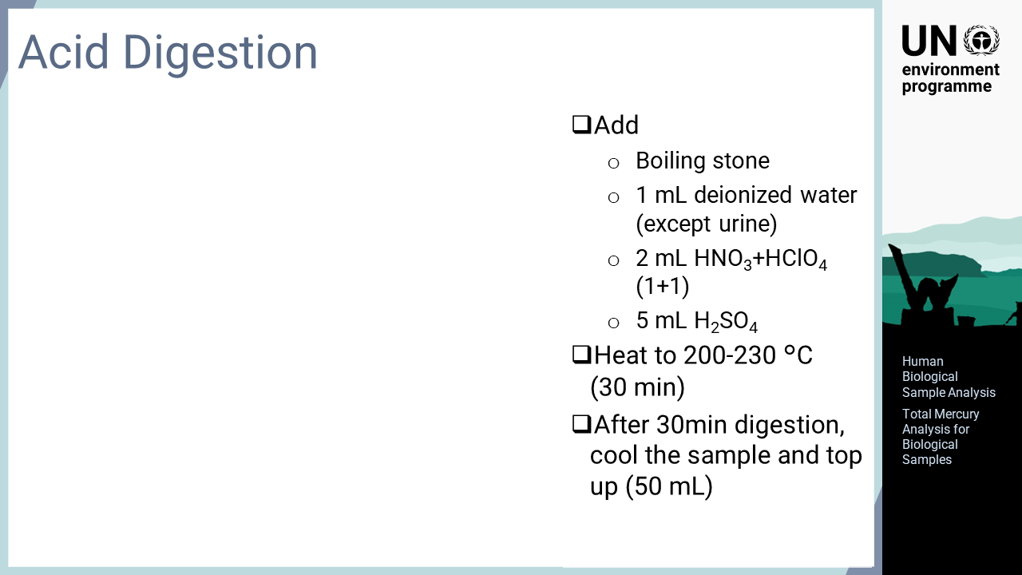
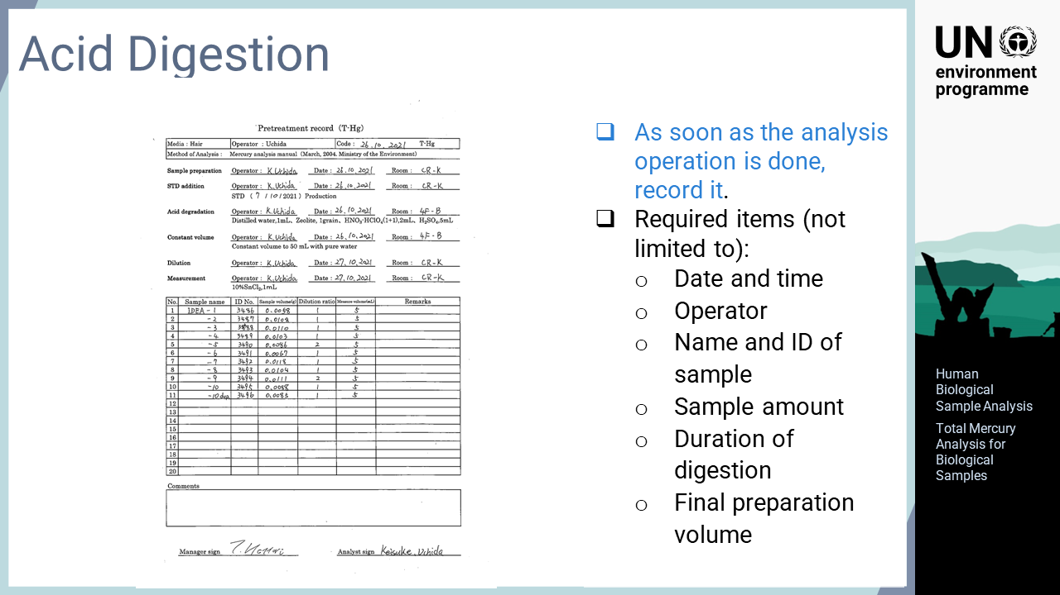
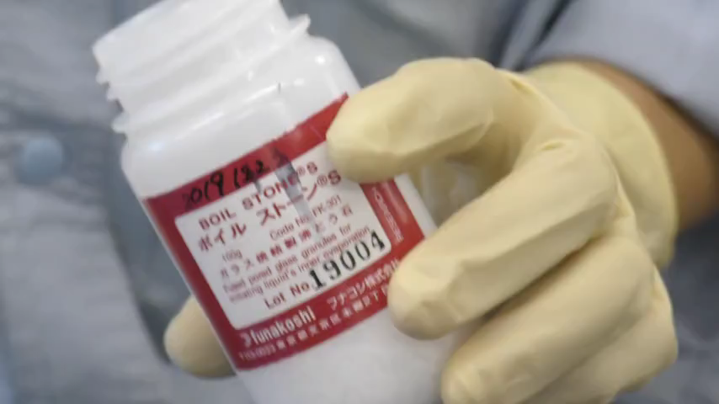
Notes:
‘14’ After preparing the samples, they are digested with acid. A piece of zeolite boiling stone is placed in each sample and then one mL of deionized water, a one-to-one mixture of nitric acid and perchloric acid, and sulphuric acid are added. Then, the sample is heated and digested at approximately 200 to 230 °C. Deionized water should not be added to urine samples. After digesting for 30 minutes, the heating is stopped and the samples are left to cool to room temperature. Then, the volume of each sample is adjusted to 50mL. As soon as the digestion is conducted, the operation details should be recorded. The necessary information for this pre-treatment operation includes date and time, operator, sample amount, duration of digestion, and final preparation volume.

Slide 16
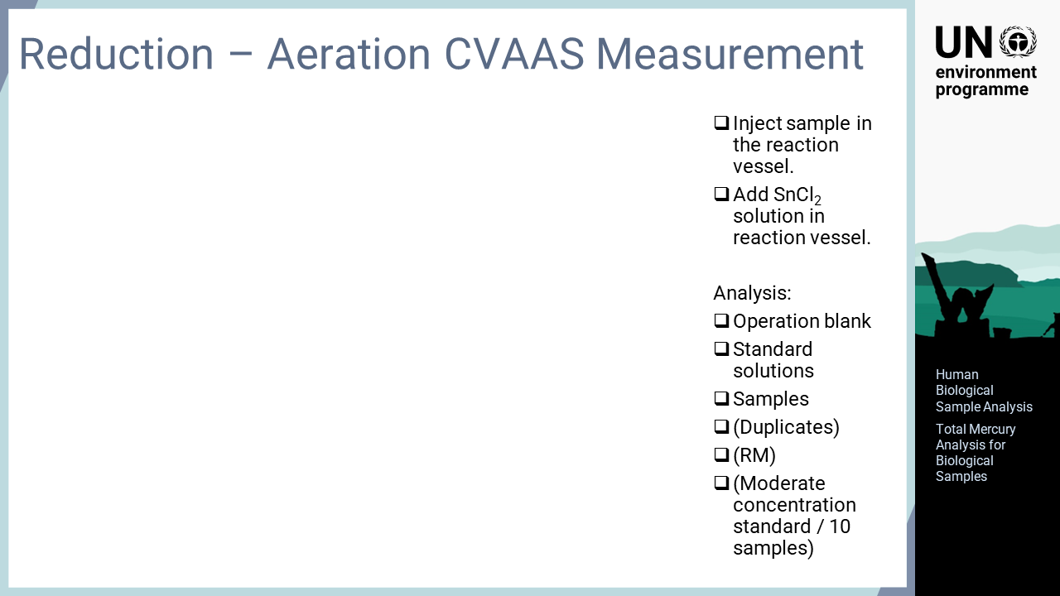
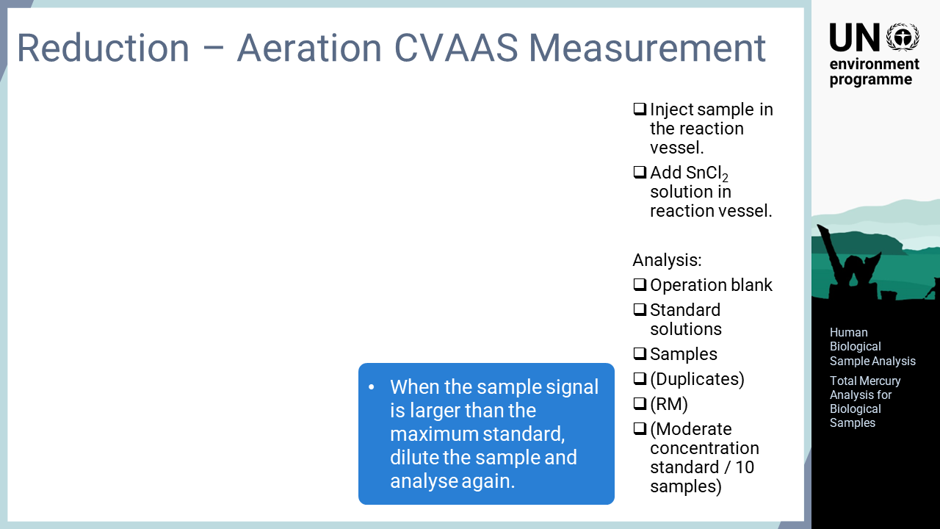
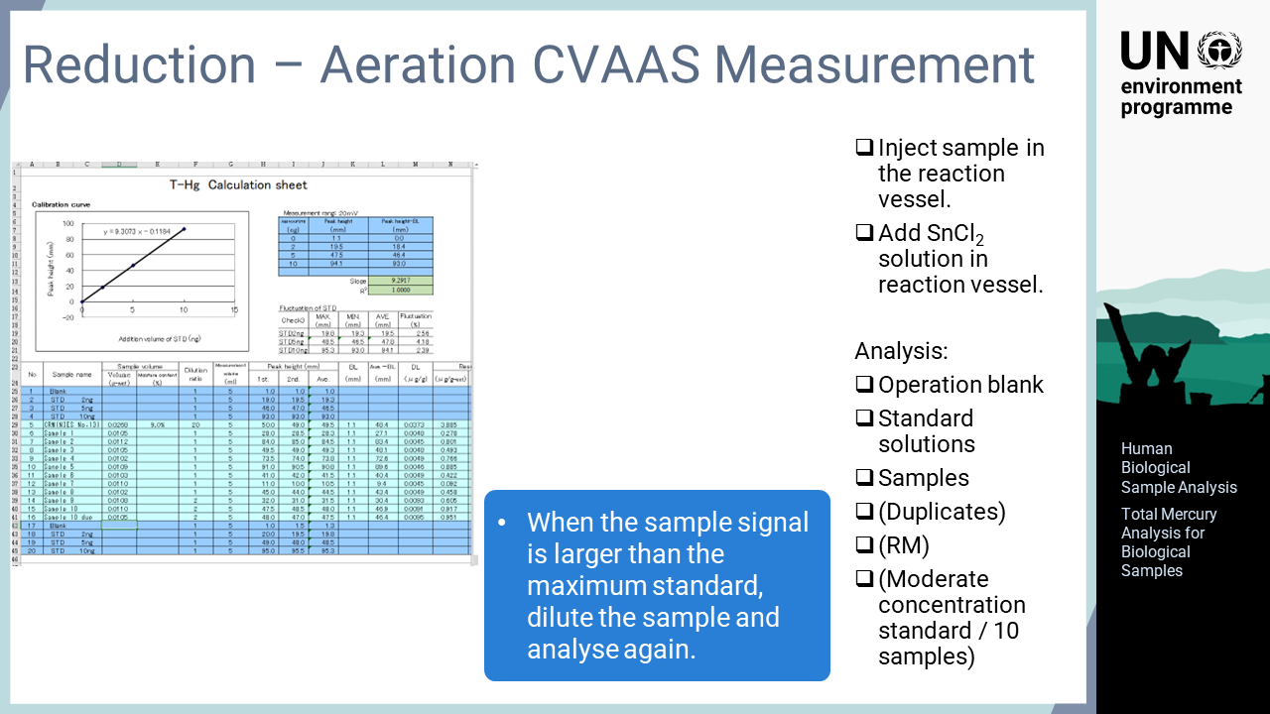
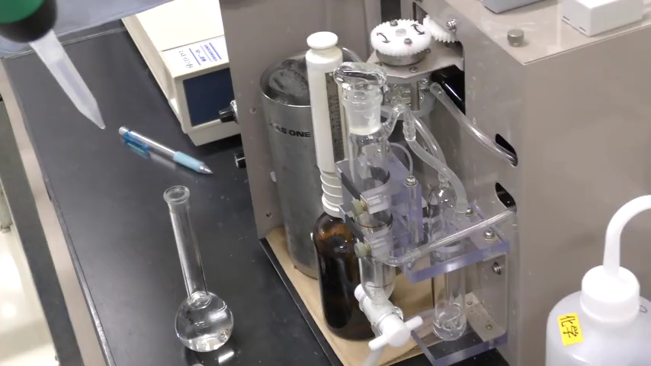
Notes:
‘15’ After acid digestion, the sample is analysed using reduction aeration CVAAS. Firstly, the sample is placed in the reaction vessel and the lid is closed. Then, tin chloride solution is added to the vessel. Mercury in the sample solution in the instrument is reduced by tin chloride, vapourised, and introduced into the detector. These operations may differ in different instruments, many of which operate automatically, so reference should be made to the instruction manual of the instrument being used. The analysis is performed in the order of operation blank, standard solutions for the calibration curve, and then the samples to be analysed. If the number of samples exceeds 10, it is recommended that a standard solution from the middle of the calibration curve is analysed every 10 samples to confirm that the sensitivity of the instrument has not drifted. Human exposure to mercury differs substantially depending on the living environment and diet, and even a person living in a non-contaminated environment may sometimes have mercury levels beyond the range of the calibration curve. In this case, the sample should be diluted and analysed again to ensure that the concentration falls within the range of the calibration curve. After analysis of the samples, a calibration curve is prepared using the analytical results for the standard solutions to calculate the concentrations of the samples.

Slide 17
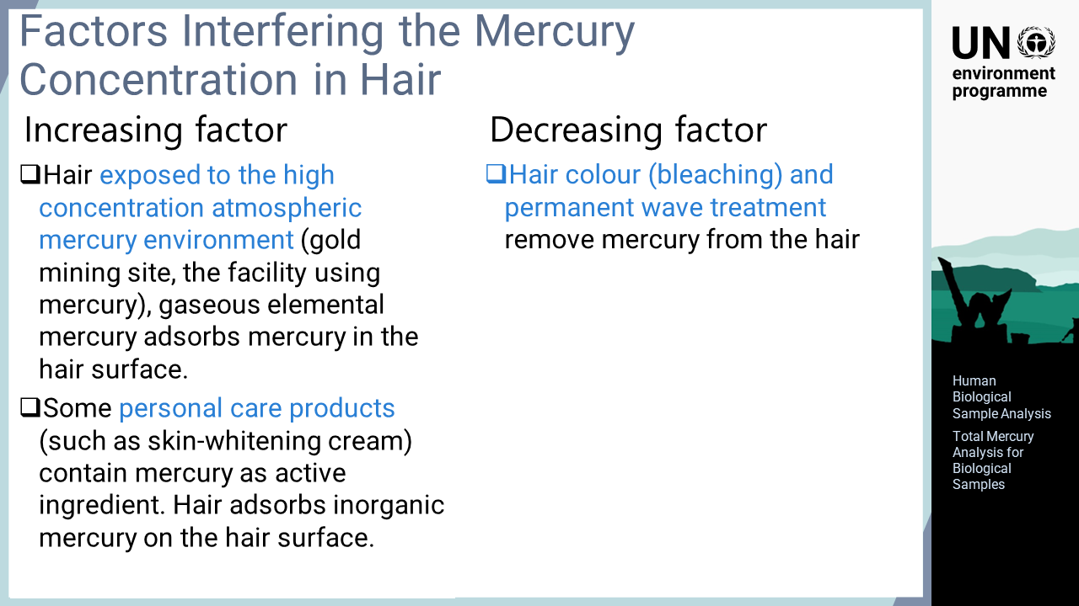
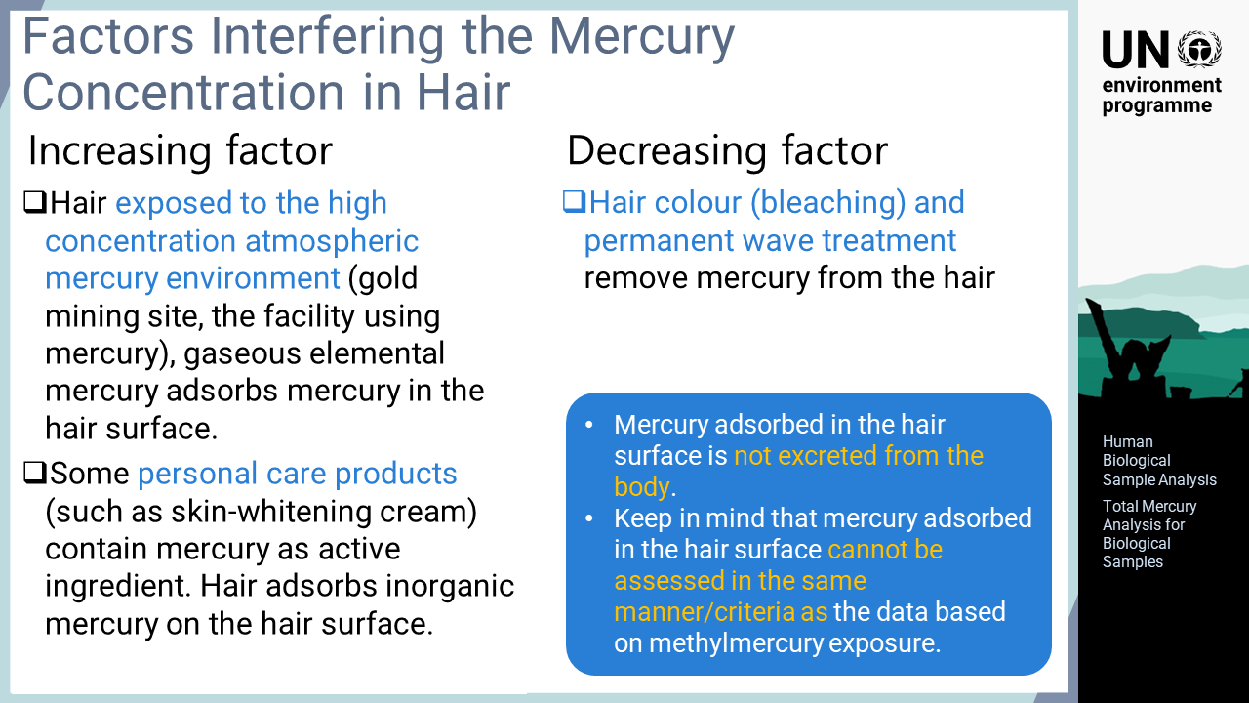
Notes:
‘16’ This slide explains the external factors that may affect the mercury levels in hair both positively and negatively. Hair is a very good indicator for surveying people subject to methylmercury exposure. In some cases, however, mercury may adhere to the outside of the hair. This may occur when a person is exposed to air containing high concentrations of mercury at gold mining sites or in mercury-using facilities. This may also be the case if a person is using a personal care product that contains mercury as an active ingredient. These cases may result in a high level of elemental or inorganic mercury adhered to the hair surface. Since mercury adhered to the surface is not caused by the digestion of methylmercury, it should not be assessed to evaluate the actual exposure and the risk of methylmercury. Therefore, special care must be taken when assessing hair samples with high mercury concentrations on the external surface. On the other hand, hair bleaching and permanent treatments can remove some of the methylmercury in hair. Therefore, the same care should be taken when assessing the actual methylmercury exposure. Such supplementary information can be obtained from the person subject to the survey using a questionnaire, which will provide useful information.

Slide 18

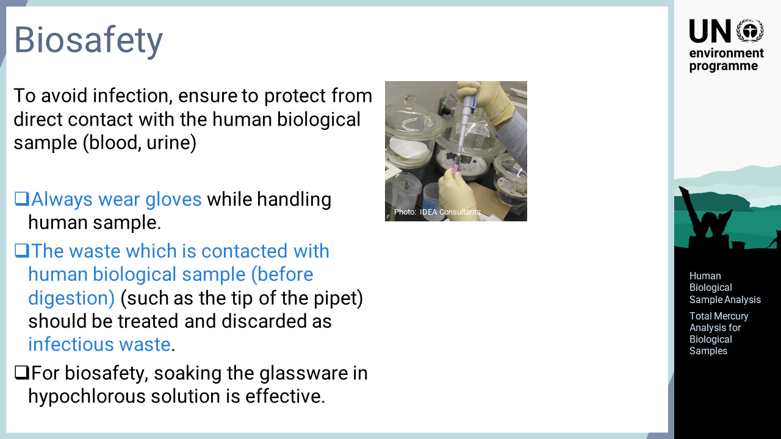
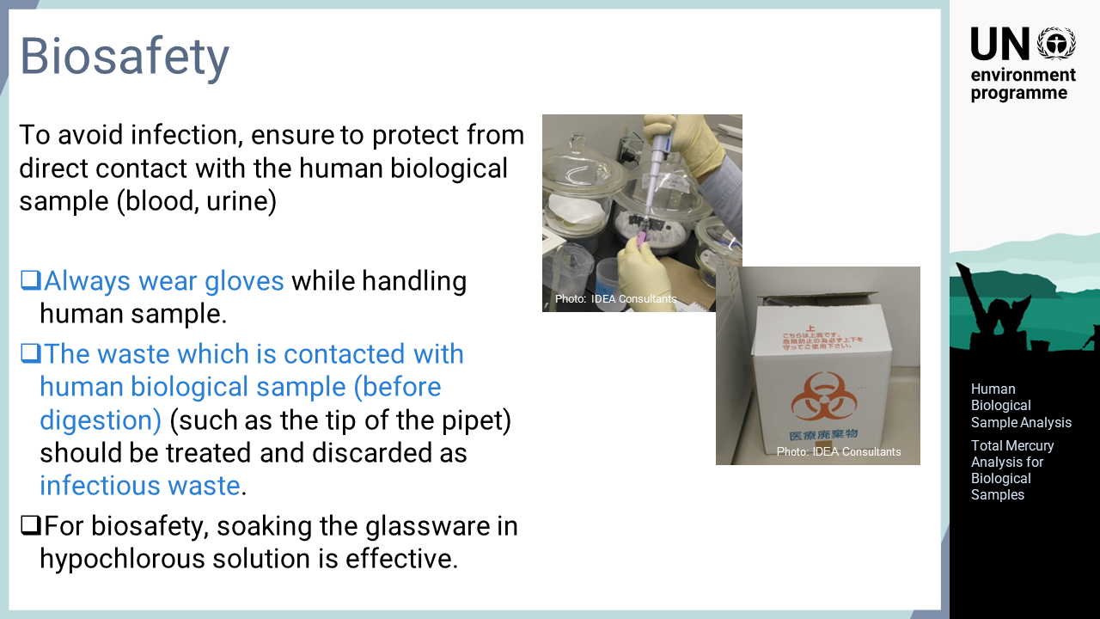
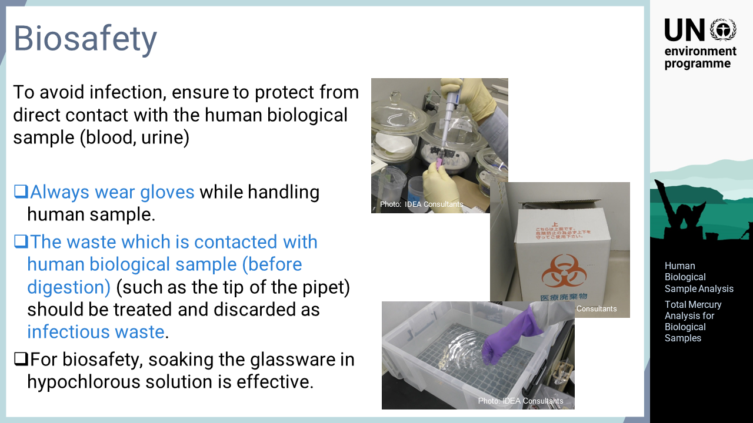
Notes:
‘17’ The importance of infection prevention during the handling of human bio-samples is explained in this slide. Human samples such as blood may be contaminated with infectious bacteria, viruses, etc. Therefore, great care must be taken to avoid direct contact with the sample. Gloves must be used at all times when handling human specimens. The tools or devices use for analysing biological samples may cause infectious diseases if they are left unattended after use. The pipette tips and empty containers used for collecting blood samples should be disposed of as infectious waste. The glassware used for blood analysis should be soaked in a sodium hypochlorite solution for a while and then washed.

