Slide 1
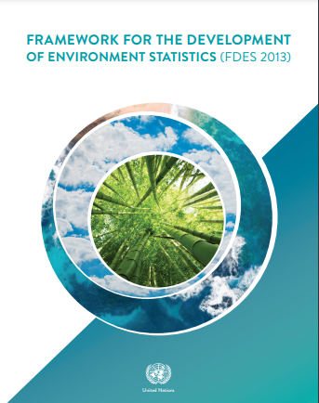
Framework for the Development of Environment Statistics (FDES)
National Workshop on Climate Change and Disaster-related Statistics

Slide 2
Adoption of the FDES 2013
The UN Statistical Commission endorsed the revised FDES 2013 at its 44th session in 2013 as the framework for strengthening environment statistics programmes in countries.
The Statistical Commission also recognized the FDES 2013 as a useful tool in the context of sustainable development goals (SDGs) and the post-2015 development agenda.
The objectives are:
  Help international and regional institutions to support strengthening capacity in countries to develop environment statistics
  Enhance comparability and availability of environment statistics using a common framework
  Better inform policy making decisions
Download FDES 2013 at https://unstats.un.org/unsd/envstats/fdes.cshtml in English, Spanish, Arabic, Portuguese, Russian and forthcoming French.

Slide 3
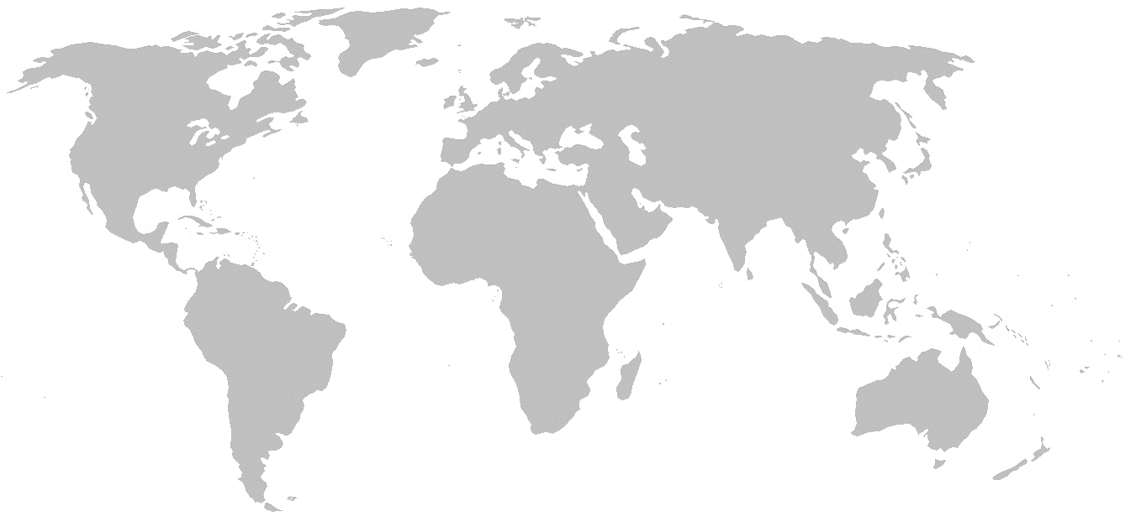
Countries applying the FDES to environment statistics and climate change statistics compendia
Burkina Faso
Botswana
Burundi
Cabo Verde
Ethiopia
The Gambia
Ghana
Guinea
Madagascar
Mali
Mauritius
Namibia
Rwanda
Tanzania
Zambia
Zimbabwe
Bangladesh
India
Indonesia
Philippines Nepal
Jordan
UAE
Curacao
Grenada
Guatemala
Jamaica
Montserrat
Peru
Suriname
Costa Rica
Panama
Forthcoming:
Kenya
Uganda
All compendia available at https://unstats.un.org/unsd/envstats/fdescompendia.cshtml
Notes:
These are the countries that UNSD knows about but we believe that there are more.

Slide 4
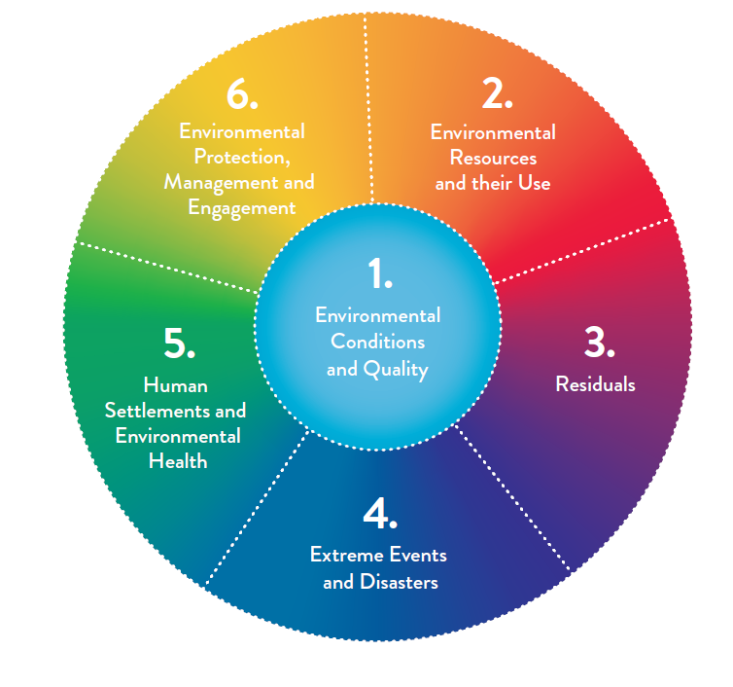
FDES is structured into 6 components
FDES covers biophysical aspects of the environment; aspects of the human sub-system that directly influence the state and quality of the environment, and the impacts of the changing environment on the human sub-system.
It includes interactions within and among the environment, human activities and natural events.
The FDES can be applied to inform about cross-cutting policy issues important to countries at any given time.
Examples:
  Water and the environment
  Energy and the environment
  Climate change
  Agriculture and the environment
Notes:
Component 1: shows the environmental system: statistics related to the conditions and quality of the environment and their change.
Component 2: statistics related to environmental resources and their use (dependence of human sub-system on environment for provisioning
Component 3: statistics related regulating services of the environment for the discharge of residuals from production and consumption processes and supporting
Component 4: Extreme events and disasters
Component 5: Human settlements and environmental health – important impact on the environment
Component 6: Management and Policy- responses and economic measures to protect the environment and managing environmental resources.

Slide 5
Main Attributes of the Components of the FDES
FDES Component | Description | Types of Data | Main Sources and Institutions | Relation to DPSIR and the SEEA
1 Environmental Conditions and Quality | Meteorological, hydrographical, geological, geographical, biological, physical and chemical conditions and characteristics of the environment that determine ecosystems and environmental quality | Geospatial Physical Qualitative | Monitoring and remote sensing data Environmental, meteorological, hydrological, geological and geographical authorities or institutions | State and Impact element in DPSIR Experimental ecosystem accounts of the SEEA
2 Environmental Resources and their Use | Quantities of environmental resources and their changes, and statistics on activities related to their use and management | Physical Geospatial | Statistical surveys, administrative records, field surveys, land registers Sector statistics on production and consumption activities, infrastructure Remote sensing data Statistics databases of respective national authorities and institutions such as mining, energy, agriculture, water and forest | Driving force, Pressure and State elements in DPSIR Asset and physical flow accounts of the SEEA-CF
3 Residuals | Generation, management and discharge of residuals to air, water and soil | Physical | Administrative records Estimates based on activity statistics and technical coefficients Sector statistics Monitoring data | Pressure and Response elements in DPSIR Physical flow accounts of the SEEA-CF

Slide 6
Main Attributes of the Components of the FDES (cont.)
FDES Component | Description | Types of Data | Main Sources and Institutions | Relation to DPSIR and the SEEA
4 Extreme Events and Disasters | Occurrence and impact of natural extreme events and disasters, and technological disasters | Physical Monetary Geospatial Qualitative | Administrative records Remote sensing National emergency and disaster authorities Seismic, meteorological monitoring and research centres Industrial complexes that work with hazardous substances and processes Insurance companies | Pressure, Impact and Response elements in DPSIR Asset accounts of the SEEA-CF
5 Human Settlements and Environmental Health | The built environment in which humans live, particularly with regard to population, housing, living conditions, basic services and environmental health | Geospatial Physical | Population and housing censuses, household surveys, administrative records, and remote sensing Health and administrative records Housing and urban planning and oversight authorities Cartographic authorities Transport authorities Health authority | Driving force, Pressure and Impact elements in DPSIR
6 Environmental Protection, Management and Engagement | Environmental protection and resource management expenditure, environmental regulation, both direct and via market instruments, disaster preparedness, environmental perception, awareness and engagement of the society | Monetary Qualitative | Administrative records Surveys Entity producing government expenditure statistics Statistical entity in charge of national or sub-national surveys Environmental authority and other sector authorities | Response element in DPSIR Environmental activity accounts and related flows of the SEEA-CF
Environment Statistics Section, United Nations Statistics Division

Slide 7
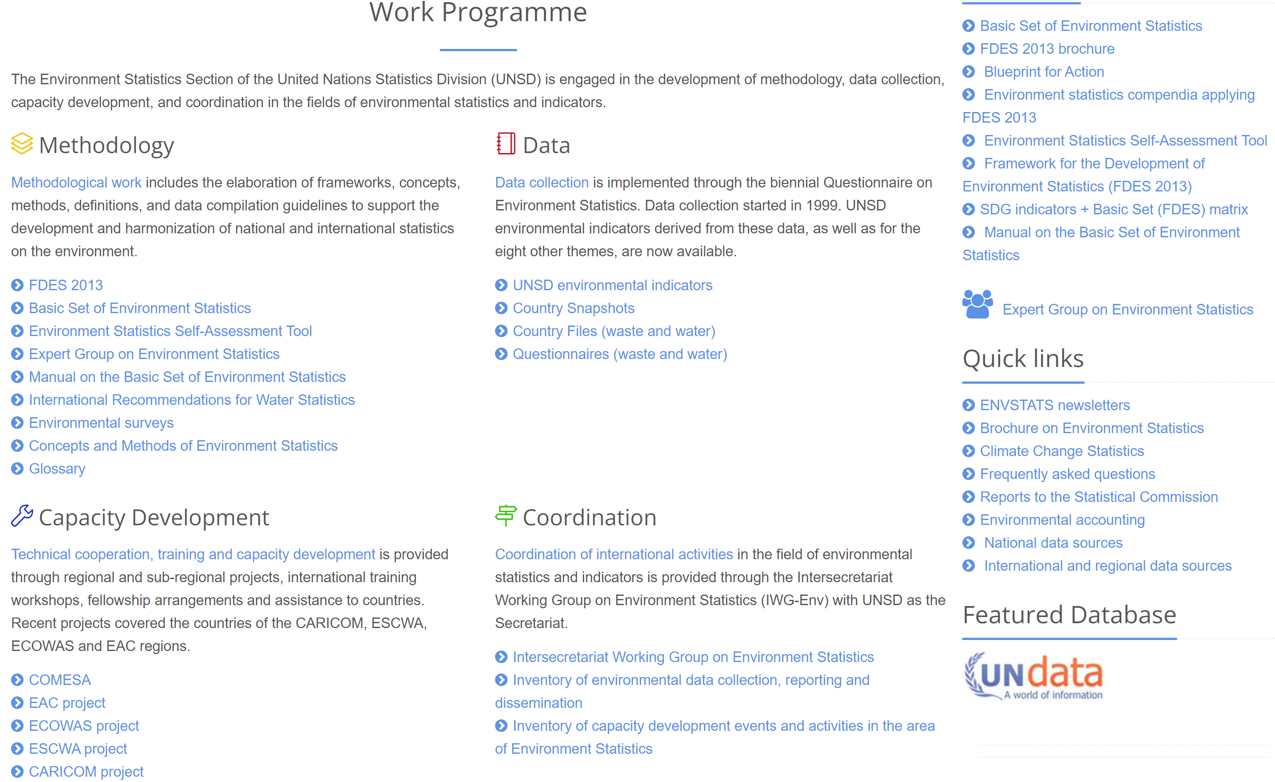
Methodological Development and
Dissemination of Know-how on UNSD website
https://unstats.un.org/unsd/envstats/fdes.cshtml
https://unstats.un.org/unsd/envstats/index.cshtml
Notes:
Env website serving as a knowledge base

Slide 8
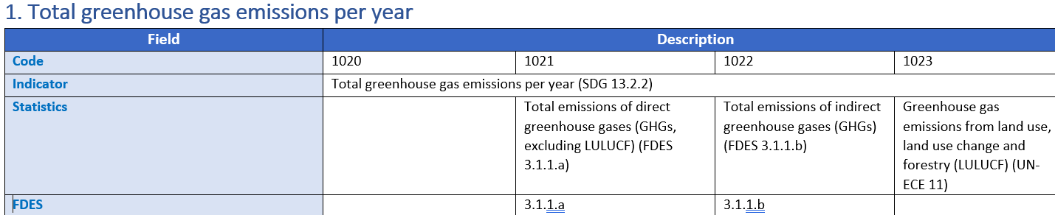
FDES and the Global Set of Climate Change Statistics and Indicators (1)
Main decisions of the UN Statistical Commission, 47th session, March 2016:
For countries: Use the FDES 2013 to guide the development of climate change statistics and indicators given the close interrelationship between environment statistics and climate change statistics.
In UNSD’s global consultation to countries, every statistic and indicator that had metadata applicable to the Basic Set of Environment Statistics of the Framework for the Development of Environment Statistics was referenced as such. For example:

Slide 9
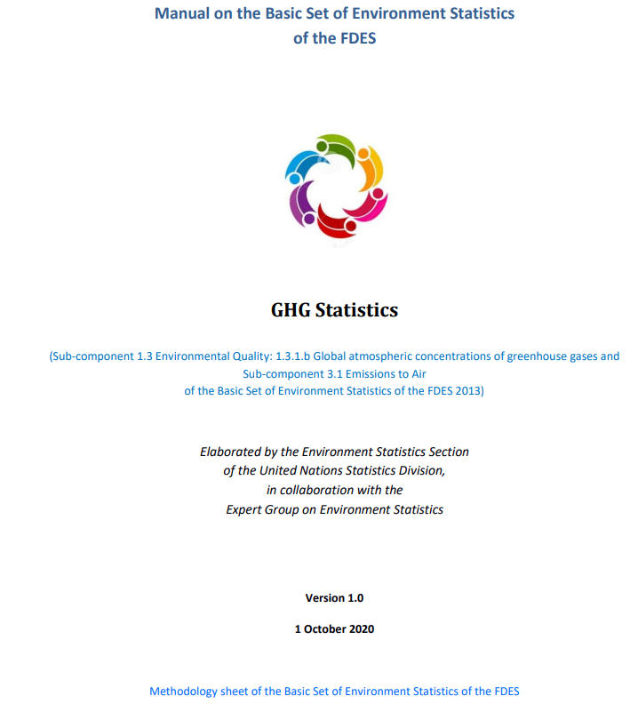
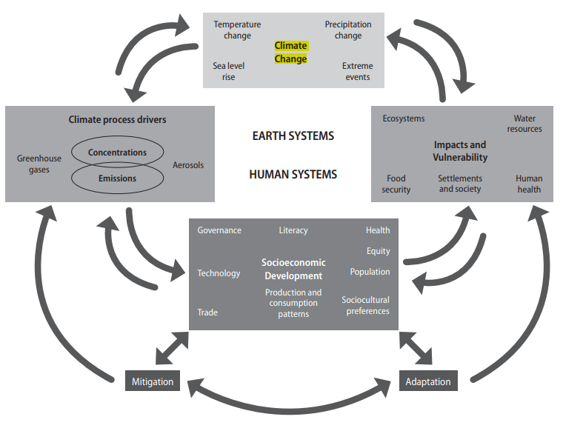
FDES and the Global Set of Climate Change Statistics and Indicators (2)

Slide 10
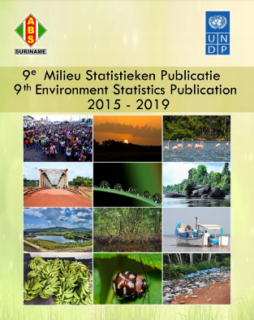
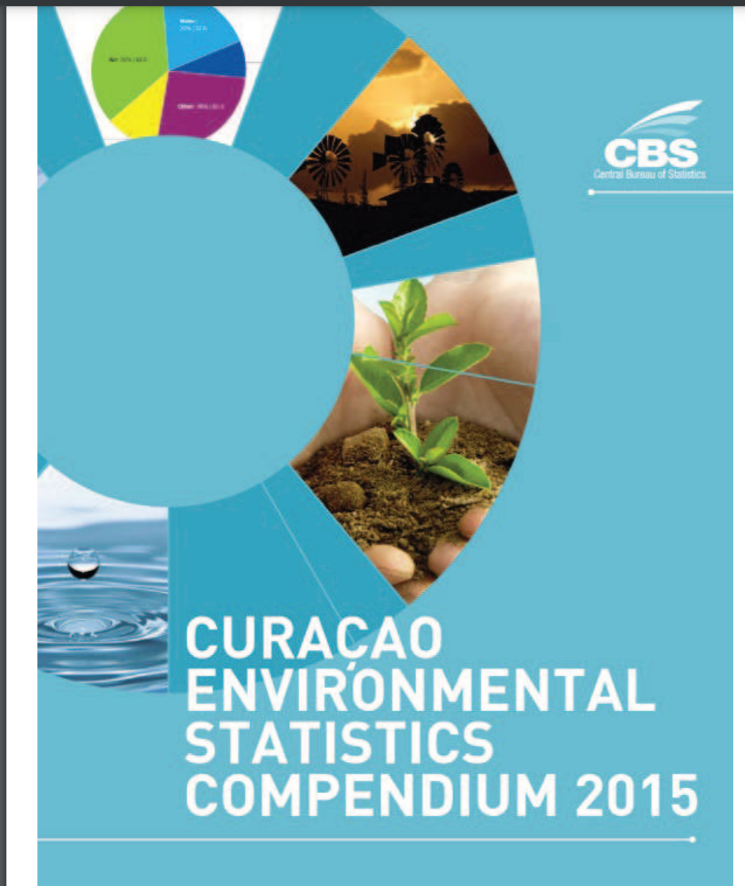
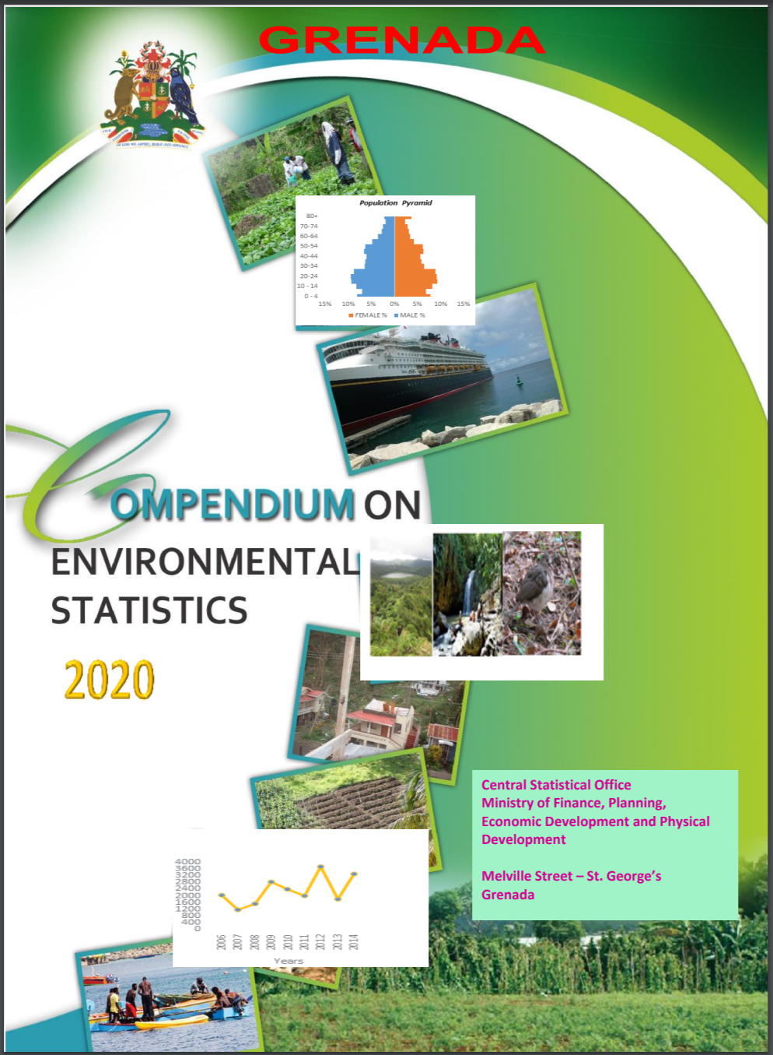
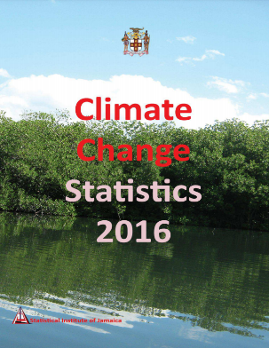
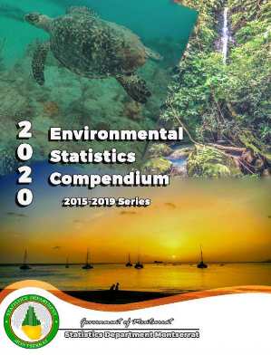
Concluding Remarks
FDES offers guidance to countries to develop standalone environment statistics, which
  apply to support national policies on environmental management,
  assist international reporting requirements (MEA, SDGs, Sendai Framework).
Countries have developed their own frameworks based on the FDES and are encouraged to publish compendia and dissemination outputs according to the FDES to help policy makers address policy questions.
  In the region: Suriname, Curaçao, Grenada, Jamaica, Montserrat, etc.
Several themes, such as climate change (in chapter 5), biodiversity, disasters are particularly dynamic, with new terminology and classifications.

Slide 11

Thank you for your attention!
For more information please contact the Environment Statistics Section
at the United Nations Statistics Division:
E-mail: envstats@un.org
Website: https://unstats.un.org/unsd/envstats/

