Slide 1
Quality control and validation of Environment and Climate Change Statistics

Slide 2

    Uncertainty in environmental and climate data and statistics
Unlike many areas of social and economic statistics, environment is subject of big uncertainties and data quality issues, because:
Inherent strong variations (e.g. precipitation, temperatures)
Often data is produced with small samples (for ex. vegetation sampling)
Remote sensing inputs (on land cover, vegetation)
Modelling (often needed to fill in gaps, impute data)

Slide 3
    Role of NSO and NSS
The main purpose of developing national programmes of environment / climate change statistics is to ensure that high-quality, transparent and sustained production of such statistics is set in place.
This will be done via including all the needed statistics to monitor climate change, its impacts, and support the implementation of mitigation and adaptation actions in the National Statistical System (NSS).
[definition] National Statistical System, comprises the national statistical office (NSO) and all the other producers of official statistics in the country.
Legislation stipulates formalized relationships of data exchange, quality control and dissemination
The key role of NSOs is to lead the processes of expanding/consolidating the NSS to include climate change statistics, which includes stipulating what constitutes official statistics, applying criteria and standards for the compilation, validation and dissemination of official climate statistics. These processes will face challenges in novel statistical areas, such as environmental and climate change statistics and continuous assessment and learning, exchange of lessons and good practices will be necessary.
The main vehicle to transform unofficial/alternative data and statistics into official statistics is from applying the Fundamental Principles of Official Statistics.

Slide 4
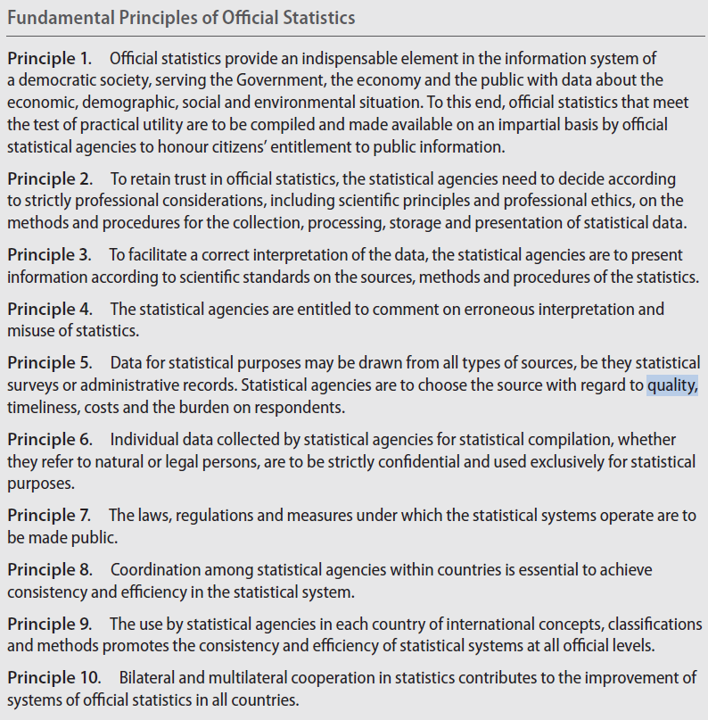
Developed by UNSD
Adopted by the Statistical Commission in 2013
Adopted by the General Assembly in 2014
Source: United Nations Statistics Division. Fundamental Principles of Official Statistics, available from http://unstats.un.org/unsd/dnss/gp/fundprinciples.aspx
Notes:
At its forty-second session in 2011, the Statistical Commission discussed the Fundamental Principles of Official Statistics and acknowledged that the Principles were still as relevant today as they had been in the past and that no revision of the 10 Principles themselves was necessary. The Commission recommended, however, that a Friends of the Chair group revise and update the preamble of the Fundamental Principles in order to take into account new developments since the time when the Principles were first formulated. At its forty-fourth session in 2013, the Statistical Commission adopted the revised preamble.2014
At the same session the Commission recommended to the Economic and Social Council the adoption of a draft resolution on the Fundamental Principles of Official Statistics. In accordance with that recommendation, the Council endorsed the Fundamental Principles in its resolution 2013/21 of 24 July 2013. In the same resolution, the Council recommended the Fundamental Principles to the General Assembly for endorsement. Pursuant to the recommendation of the Economic and Social Council, the representative of Hungary, together with 48 co-sponsors, introduced a draft resolution on the matter at the sixty-eighth session of the General Assembly. After a short informal consultation process, the Assembly, in its resolution 68/261 of 29 January 2014, endorsed the Fundamental Principles of Official Statistics.

Slide 5
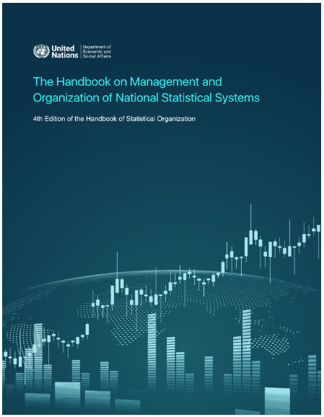
UN Handbook on Management and Organization of National Statistical Systems
Chapter 7 of the UN Handbook on Management and Organization of National Statistical Systems provides comprehensive guidance to NSOs on quality management systems and standards; frameworks, guidance and tools, evaluation and implementation. Included in the chapter are descriptions of quality tools, developed by the United Nations and other agencies, that have been used by NSOs. https://unstats.un.org/capacity-development/handbook/html/topic.htm#t=Handbook%2FC7%2FImplementing_a_quality_management_framework.htm
Chapter 7. Quality Management
7.1 Introduction
7.2 Generic quality management systems and other relevant standards
7.3 Quality assurance frameworks, guidelines, and tools
7.4 National quality assurance frameworks, guidelines, and tools
7.5 Designing and developing a quality management framework
7.6 Evaluation of a statistical process and its outputs
7.7 Quality evaluation and certification of NSOs
7.8 Relationships with other organizational policies, strategies, and frameworks
7.9 Implementing a quality management framework
7.10 Relevance to other producers of official statistics

Slide 6
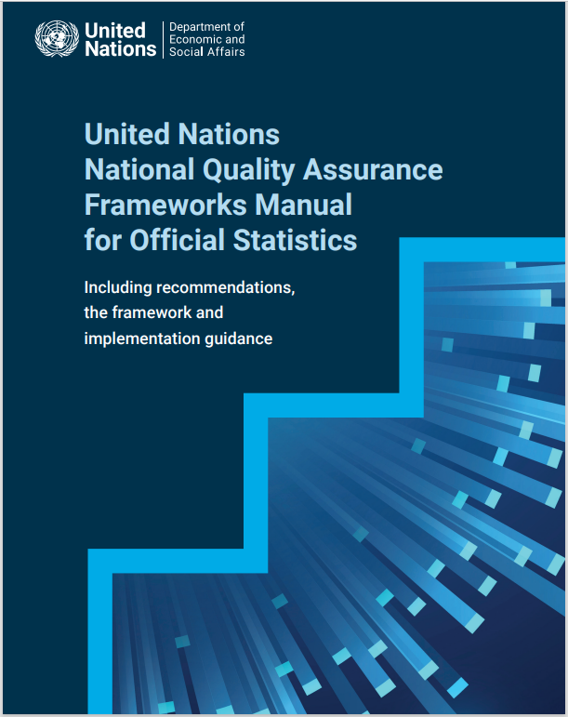
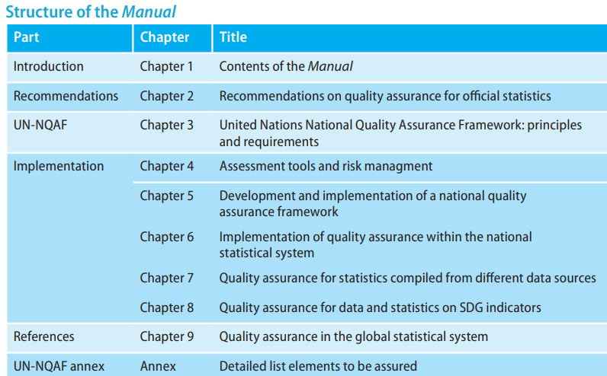
    United Nations National Quality Assurance Frameworks Manual for Official Statistics
Chapter 6 of the National Quality Assurance Framework (UN NQAF) focuses upon implementation of quality assurance within a statistical system. Emphasis is put on the fact that such a system spans well beyond the NSO itself, and must include other producers of official statistics, typically, statistical units of government ministries, departments, agencies, and regional and local government offices. The harmonization of concepts, definitions, classifications and sampling frames is necessary. The upholding of confidentiality while striving for efficiency via data sharing agreements is also paramount.

Slide 7
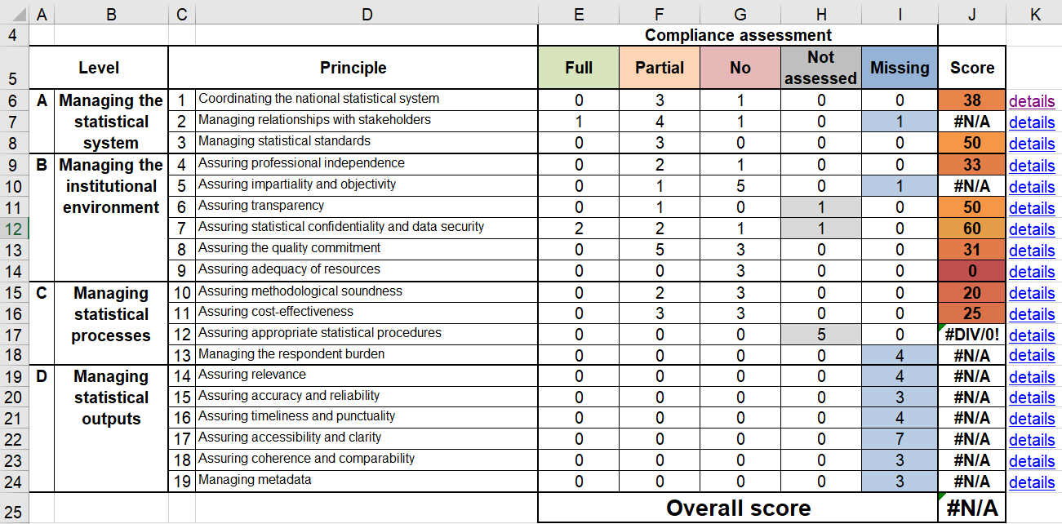
    United Nations National Quality Assurance Frameworks Manual for Official Statistics
A self-assessment checklist for organisations, based on the UN NQAF, can be accessed at https://unstats.un.org/unsd/methodology/dataquality/tools/. This tool can be used to: conduct quality assessments to identify improvement actions; provide initial assessments for learning purposes; or introduce staff members to quality assurance.

Slide 8
    Six Quality Dimensions of official statistics
1. Relevance, considers the coverage and contents of the needed information;
2. Accuracy, is ‘The closeness between an estimated result and the (unknown) true value';
3. Timelines and punctuality, is the time-lapse between the publication of data and referred period
4. Accessibility and clarity, refer to clarity of metadata; easiness of users to understand the data;
5. Comparability, is 'the degree to which data can be compared over time and domain', spatial domains include sub-national, national and international;
6. Coherence, is 'the degree to which data derived from different sources or methods produce similar output.
European Statistical System (http://epp.eurostat.ec.europa.eu)

Slide 9

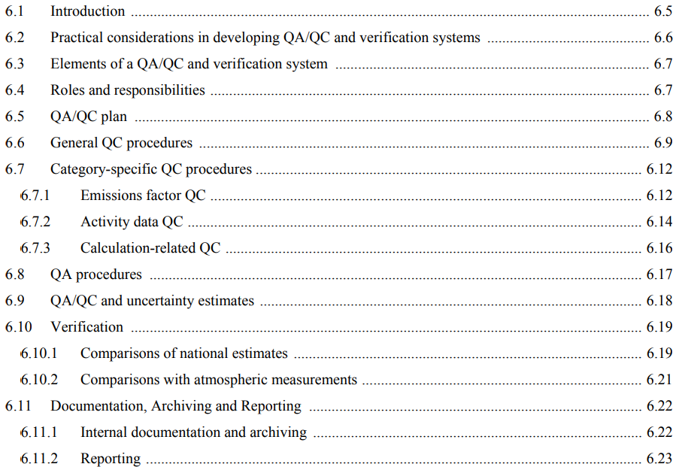
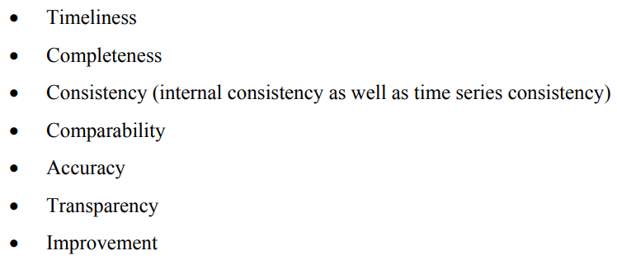
    Quality in the Implementation guidelines for the Global Set
For the MRV transparency process, usually countries are responsible for organizing their quality assurance framework (QA/QC). You can check the IPCC 2006 guidelines – section 1 General issues where you should find a chapter on QA/QC guidance. QA at national level; QC at international.
CHAPTER 6: QUALITY ASSURANCE / QUALITY CONTROL AND VERIFICATION
Publications - IPCC-TFI (iges.or.jp)
Microsoft Word - V1_Ch6_QA_QC_final_v2.doc (iges.or.jp)
Notes:
Quality Control (QC) is a system of routine technical activities to assess and maintain the quality of the inventory as it is being compiled. It is performed by personnel compiling the inventory. The QC system is designed to: (i) Provide routine and consistent checks to ensure data integrity, correctness, and completeness; (ii) Identify and address errors and omissions; (iii) Document and archive inventory material and record all QC activities. QC activities include general methods such as accuracy checks on data acquisition and calculations, and the use of approved standardised procedures for emission and removal calculations, measurements, estimating uncertainties, archiving information and reporting. QC activities also include technical reviews of categories, activity data, emission factors, other estimation parameters, and methods. Quality Assurance (QA) is a planned system of review procedures conducted by personnel not directly involved in the inventory compilation/development process. Reviews, preferably by independent third parties, are performed upon a completed inventory following the implementation of QC procedures. Reviews verify that measurable objectives (data quality objectives, see Section 6.5, QA/QC Plan.) were met, ensure that the inventory represents the best possible estimates of emissions and removals given the current state of scientific knowledge and data availability, and support the effectiveness of the QC programme. Verification refers to the collection of activities and procedures conducted during the planning and development, or after completion of an inventory that can help to establish its reliability for the intended applications of the inventory. For the purposes of this guidance, verification refers specifically to those methods that are external to the inventory and apply independent data, including comparisons with inventory estimates made by other bodies or through alternative methods. Verification activities may be constituents of both QA and QC, depending on the methods used and the stage at which independent information is used

Slide 10
    Regional frameworks
European Statistical System covers regulations, standards, guidelines and tools directed towards countries in the European Union. It includes the European Statistics Code of Practice (ES CoP), with a Quality Declaration, Principles, Quality Assurance Framework of the European Statistical System, European Central Bank - Statistics Quality Framework, Handbook for Quality and Metadata Reporting as well as Other ESS Quality Management Tools.
International Monetary Fund - Data Quality Assessment Framework (DQAF) is designed for use by IMF staff and NSOs in assessing the quality of specific types of national datasets. Its aim is to complement the IMF Special Data Dissemination Standard (SDDS) and the Enhanced General Data Dissemination System (e-GDDS) and mainly covers economic and finance statistics but can be adopted for social statistics. In Jamaica, the e-GDDS includes population statistics.
African Charter on Statistics has six quality principles in 25 quality statements covering most of the quality principles in the ES CoP but reorganized and tailored to the African situation.
ECLAC – Code of Good Practice in Statistics for ECLAC was modelled on the European Statistical Code of Practice (2008) and extended to include coordination of the NSS.
Caribbean Community – Statistics Code of Practice is based on the ES CoP and has 15 principles and 78 indicators.
ASEAN Community Statistical System Code of Practice is also modelled on the ES CoP (2008) but has fewer principles and indicators.
UNECE Quality Indicators for the Generic Statistical Business Process Model (GSBPM) sets out a template for describing surveys and administrative data collections in eight phases and 44 sub-processes with a set of indicators to monitor the quality of the production processes for each phase.
United Nations Statistical Quality Assurance Framework (UN SQAF) is a generic quality assurance framework used by UN agencies in managing their statistical data. Agencies without a quality framework are able to use this generic version. United Nations Statistics Division, United Naitons National Quality Assurance Framework (with particular attention to chapter 6: Implementation of quality assurance within the national statistical system), available at: https://unstats.un.org/unsd/methodology/dataquality/references/manual-2019/UNNQAFManual_Chapter%206%20Implementation%20of%20quality%20assurance%20within%20the%20NSS-WEB.pdf (accessed 23 November 2022).

Slide 11
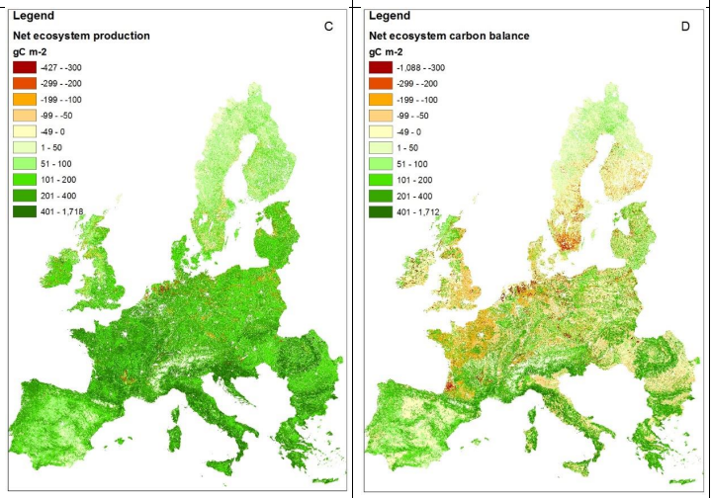
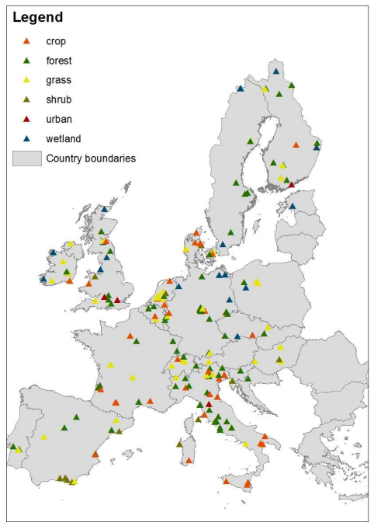
    Personal example – from PhD thesis
Ivanov, Emil. "Evaluating interactions between carbon sequestration and provisioning ecosystem services in Europe." PhD diss., University of Nottingham, 2021.
PhD_thesis_E_Ivanov_final_8June2021.pdf (nottingham.ac.uk)

Slide 12
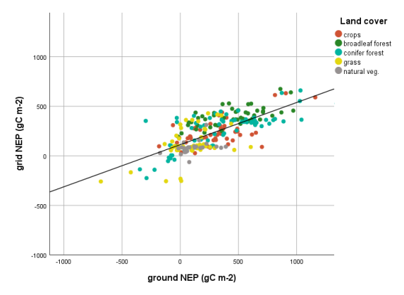
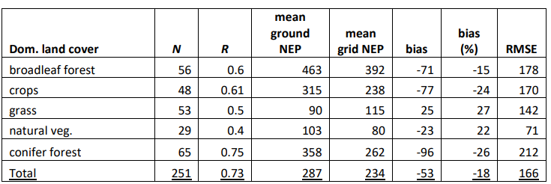
    Personal example – from PhD thesis
Ivanov, Emil. "Evaluating interactions between carbon sequestration and provisioning ecosystem services in Europe." PhD diss., University of Nottingham, 2021.

Slide 13


Thank you for your attention!
For more information please contact the Environment Statistics Section
at the UN Statistics Division:
E-mail: envstats@un.org
website: http://unstats.un.org/unsd/ENVIRONMENT/

