Slide 1

GIS and Earth observation
Global Geospatial Information Management
https://ggim.un.org/
SEEA Central Framework
https://seea.un.org/content/seea-central-framework
SEEA Ecosystem Accounting
https://seea.un.org/ecosystem-accounting
SEEA CF Land cover classification
1 Artificial surfaces (including urban and associated areas)
2 Herbaceous crops
3 Woody crops
4 Multiple or layered crops
5 Grassland
6 Tree-covered areas
7 Mangroves
8 Shrub-covered areas
9 Shrubs and/or herbaceous vegetation, aquatic or regularly flooded
10 Sparsely natural vegetated areas
11 Terrestrial barren land
12 Permanent snow and glaciers
13 Inland water bodies
14 Coastal water bodies and intertidal areas
Geospatial information in the FDES
Notes:
typically key themes like infrastructure, vegetation, topography are in NSDI, where GGIM provides guides (Global geospatial information management)
Geospatial information allows for the visual display of statistics in a map-based layout, which can make it easier for users to work with and understand the data. The ability to overlay multiple data sets using software, for instance on population, environmental quality and environmental health, allows for a deeper analysis of the relationship among these phenomena.

Slide 2
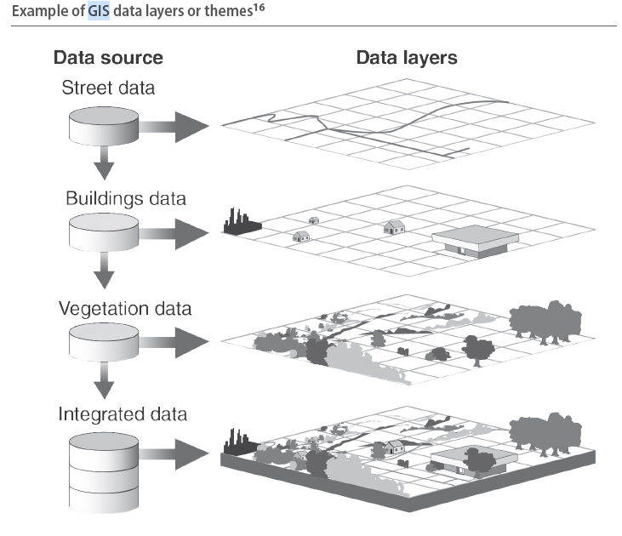
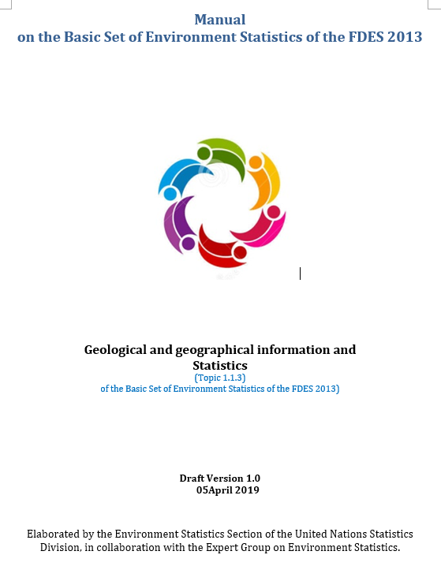
Geospatial information in the FDES
It adds significant value and utility to environment statistics
Notes:
- Possibly work with all environmental data and statistics could involve GIS at certain stage – from processing inputs, quantifying national values, validating
GIS is what integrates across all domains, it allows to analyze relationships between different themes, based on location. For example agric. area affected by a flood – delimited on two statistical topics – 1 agric. from land cover, 2 water spilled – area of disaster event.

Slide 3
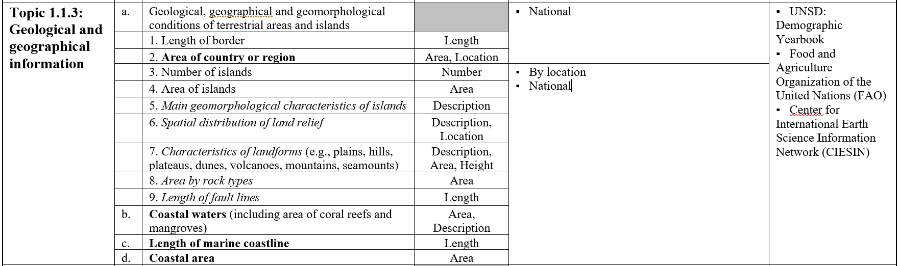
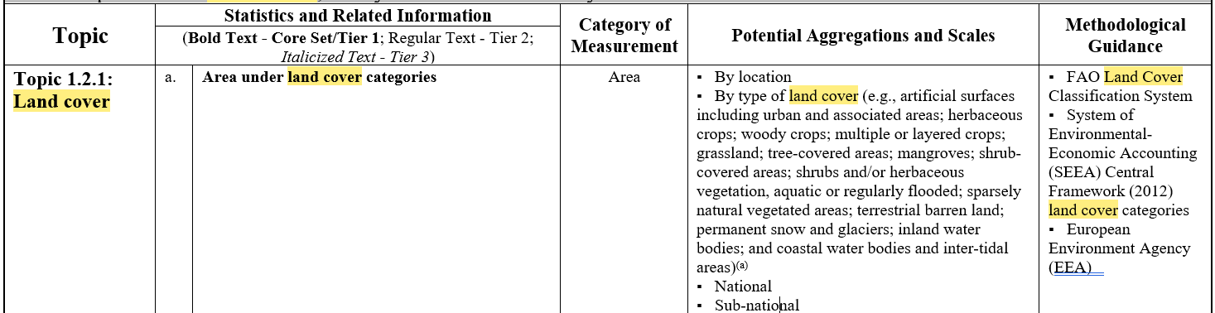
Geographic and geological statistics in the BSES
About a quarter of all BSES statistics have geospatial element, e.g. 85 statistics measured by area, 5 by length

Slide 4
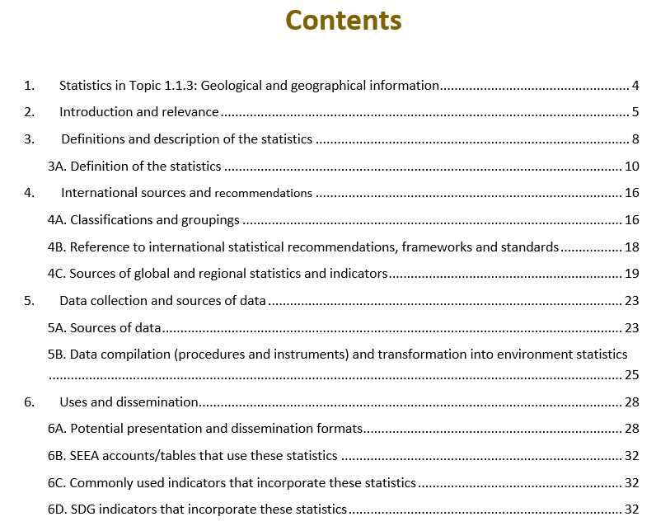
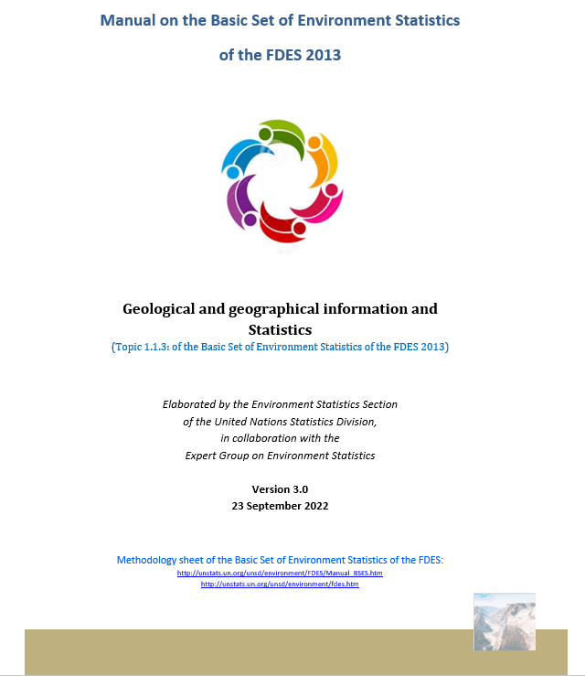
Geographic and geological statistics in the manual of the BSES

Slide 5
Geographic and geological statistics in the manual of the BSES
Statistics on geographic and geological characteristics of a country comprise most common and mostly static properties, such as border length, country area, relief and bedrocks.
Yet if rare, any changes either caused by geologic processes or human actions affected these properties, can have big impacts on the population, for example: border changes, landslides and earthquakes.
Even though, not obvious in official statistics, geology and its branches have traditionally been used to develop fundamental national data and information, including topographic maps, geographic names and geodetic networks of reference points.
During the past centuries, this topographic, geographic and geodetic data has been instrumental for the development of most national and international infrastructures such as national cadastres (property registers), navigation activities, among others, and in recent decades also for monitoring sea level rise.

Slide 6
Geographic and geological statistics in the manual of the BSES
  Geospatial Information - provides the digital and graphical connection between a geographic place, location, its people and their activities, and is used to illustrate what is happening – where, how and why.
  A National Spatial Data Infrastructure (NSDI) identifies technology, policies, standards, good practices, and human resources necessary to acquire, process, store, disseminate, and analyse the use of geospatial information. The NSDI concept has been replaced by the IGIF as the overarching framework for strengthening geospatial information.
More related or relevant terms can be consulted in the Global Statistical Geospatial Framework: Implementation Guide (https://unstats.un.org/unsd/statcom/53rd-session/documents/BG-3x-EG-ISGI-GSGF-Implementation-Guide-E.pdf) and
Glossary of Terms for the Standardization of Geographical Names (https://unstats.un.org/unsd/ungegn/pubs/documents/Glossary_of_terms_rev.pdf).

Slide 7
Examples of definitions
1.1.3.a. Geological, geographical and geomorphological conditions of terrestrial areas and islands.
1.1.3.a.1 Length of border
Length of border is defined as the border line that divides two countries. Total length of the country border and length of segments bordering other countries or entities are relevant. Border or boundary concept is defined as a line marking the limits of a unit of land, often a geographical region, but also of economies or societies, ^{[1]}Remarks:
This information may be obtained from data or maps in official national/international sources.
National borders are delimited in accordance with national and international organizations legal backing.
Statistical information of the length of the border, can be represented by geographical location of border, total length as well as length of separate bordering entities, e.g. countries.
1.1.3.a.2 Area of country or region
An area of land that forms an independent political unit with its own government.^{[2]}
Related definitions:
Land area is a country's total area, excluding area under inland water bodies, national claims to continental shelf, and exclusive economic zones. In most cases the definition of inland water bodies includes major rivers and lakes.^{[3]}
Total surface area refers to the total area of the country which comprises land area and inland waters.^{[4]}
^{[1]}Oxford dictionary of Geography, https://ia801908.us.archive.org/34/items/geography-encyclopedia/Oxford%20Dictionary%20of%20Geography.pdf (accessed 23 September 2022)
^{[2]} Cambridge dictionary, https://dictionary.cambridge.org/us/dictionary/english/country (accessed 23 September 2022)
^{[3]} The World Bank, data, https://data.worldbank.org/indicator/AG.LND.TOTL.K2 (accessed 23 September 2022)
^{[4]} UNSD, Environmental Indicators, https://unstats.un.org/unsd/environment/totalarea.htm (accessed 23 September 2022)

Slide 8
Examples of definitions
1.1.3.c. Length of marine coastline
Coastline is not a uniformly defined concept, because of complexities such as fractal dimensions. Coast is generally defined as ‘broad area of land that borders the sea’. Coastal countries may have more specific definitions and official estimates of its length. Because of the many natural and engineering construction impacts affecting the coastline, its length and shape can vary substantially from one point in time to another.
1.1.3.d. Coastal area
Coastal areas are commonly defined as the interface or transition areas between land and sea, including large inland lakes. Coastal areas are diverse in function and form, dynamic and do not lend themselves well to definition by strict spatial boundaries. Unlike watersheds, there are no exact natural boundaries that unambiguously delineate coastal areas.
Encyclopedia Britannica, https://www.britannica.com/science/coast (accessed 23 September 2022)

Slide 9
4. International sources and recommendations:
4A. Classifications and groupings
Standard country or area codes for statistical use (M49) - UNSD has developed the UN M49 as the Standard Country or Area Codes for Statistical Use. Standard country or area codes for statistical use (M49), https://unstats.un.org/unsd/methodology/m49/ (accessed 23 September 2022)
Geographic regions - Based on the M49 coding, UNSD has developed a geographic regions scheme which groups 249 countries and territories in the world into six regional, 17 subregional, and nine sub-subregional groups.
Geographic names - United Nations Group of Experts on Geographical Names (UNGEGN) is one of the nine standing expert bodies of ECOSOC, has a long and rich history, beginning in 1967, of leading national geographical names standardization in jurisdictions around the world. United Nations Group of Experts on Geographical Names (UNGEGN), http://unstats.un.org/unsd/geoinfo/geonames/ (accessed 23 September 2022)
Classifications of Biomes
Classifications of ecoregions and biogeographic regions
Classification of fault lines

Slide 10
4B. Reference to international statistical recommendations, frameworks and standards
UN-GGIM https://ggim.un.org/
UNESCO https://en.unesco.org/
UN, Oceans and the Law of the Sea, UN Division for Ocean Affairs and Law of the Sea, https://www.un.org/depts/los/index.htm
USGS, United States Geological Survey, https://www.usgs.gov/
GFGS, Global Forum for Geography and Statistics, https://www.efgs.info/about-efgs/global-forum-for-geography-and-statistics
UGI, International Geographic Union, https://igu-online.org/
IGS, International Geoscience Services, https://www.igsint.com/
BGS, British Geological Survey, https://www.bgs.ac.uk/
The International Organization for Standardization (ISO) has developed a series of standards and technical specifications on Geographic information and Geomatics.
ISO 19101-1:2014, Geographic information — Reference model — Part 1: Fundamentals
ISO 19104:2016, Geographic information — Terminology
ISO 19112:2019, Geographic information — Spatial referencing by geographic identifiers
ISO 19115-1:2014, Geographic information — Metadata — Part 1: Fundamentals.
International Organization for Standardization (ISO), https://www.iso.org/committee/54904/x/catalogue/#:~:text=ISO%20%2D%20ISO%2FTC%20211%20%2D%20Geographic%20information%2FGeomatics

Slide 11
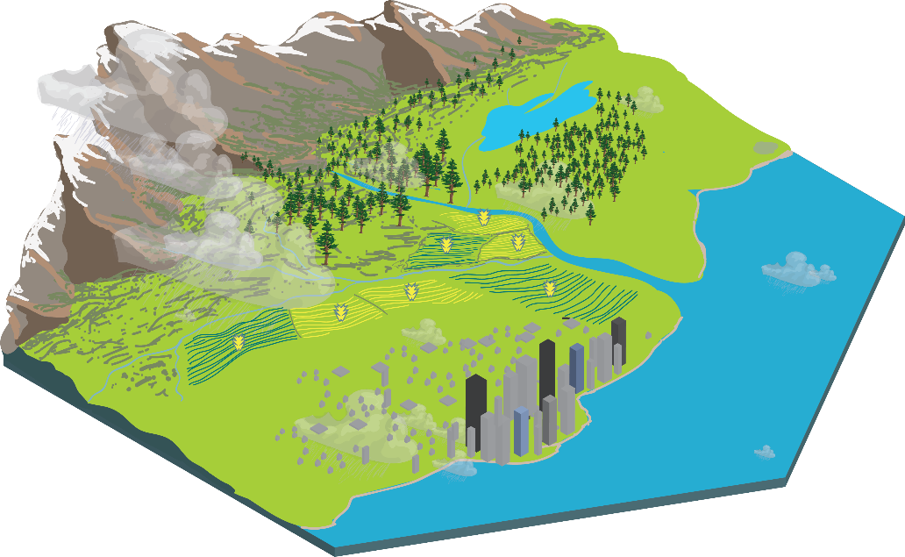











Ecosystem extent accounts: Ecosystem assets
Ecosystem assets (EAs) are contiguous spaces of a specific ecosystem type characterized by a distinct set of biotic and abiotic components and their interactions
Ecosystem assets are classified by ecosystem type (ET)
ET1
ET8
ET4
ET6
ET4
ET11
ET5
ET1
ET3
ET2
ET1
ET3
ET3
ET2
ET2
ET5
ET7
ET10
ET9
ET5
Notes:
Ecosystem assets play a key role in ecosystem accounting.
They are the statistical units for ecosystem accounting, i.e., the ecological entities about which information is sought and about which statistics are ultimately compiled. This includes information concerning their extent, condition, the ecosystem services they provide and their monetary value.
An ecosystem type reflects a distinct set of abiotic and biotic components and their interactions. Components include, for example, the animals, plants, fungi, water, soil, minerals present in ecosystems.
Conceptually, ecosystem assets are envisaged as three-dimensional spaces. For example, for terrestrial systems, the biotic components usually extend from the plant roots below the surface to the vegetation growing above the surface. The abiotic components are those components that directly interact with these living components: the soil, the surface and soil water, and also the air from the atmosphere.

Slide 12
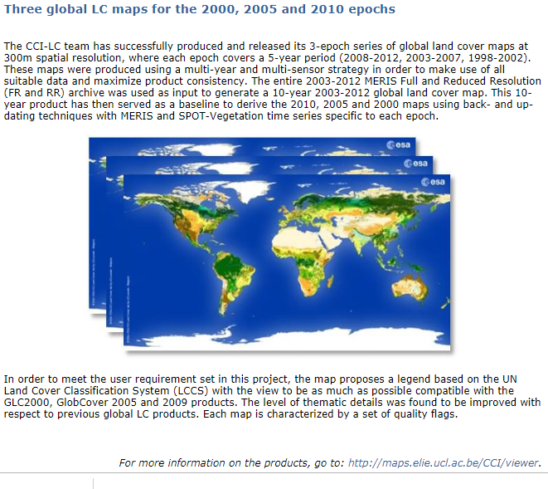
Input data options and sources
  International data sources
    European Space Agency
    NASA
    Many more
Source:
https://www.esa-landcover-cci.org/?q=node/158
Viewer: http://maps.elie.ucl.ac.be/CCI/viewer/index.php

Slide 13
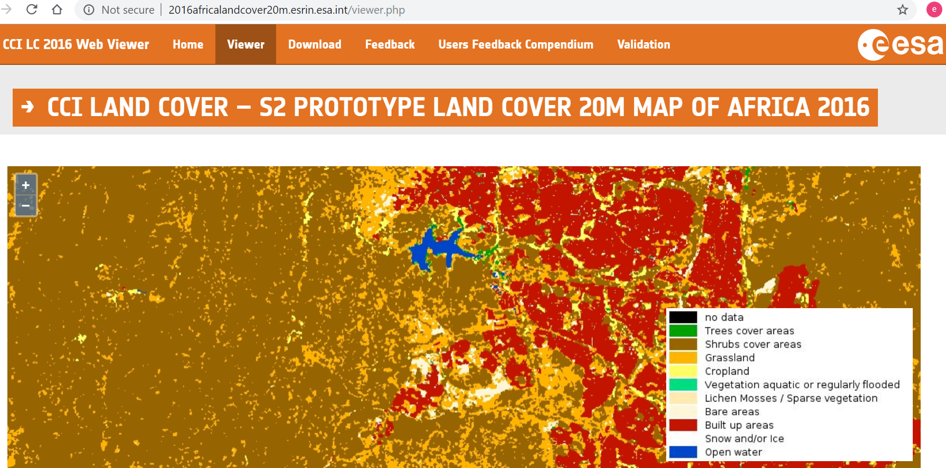
Spatial data: CCI LAND COVER – S2 PROTOTYPE LAND COVER 20M MAP OF AFRICA 2016
Source: http://2016africalandcover20m.esrin.esa.int/
Viewer: http://2016africalandcover20m.esrin.esa.int/viewer.php

Slide 14
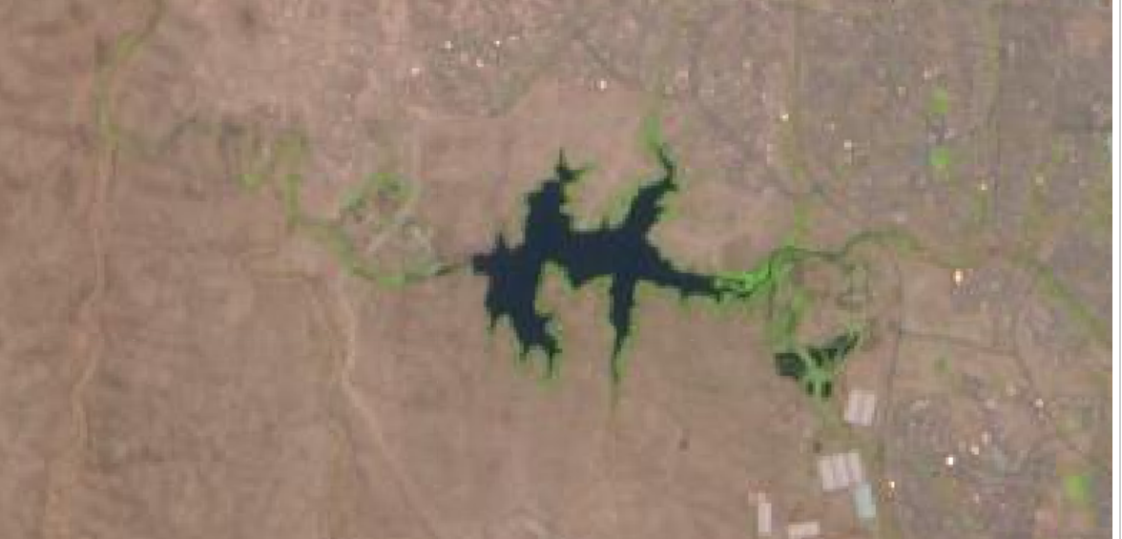
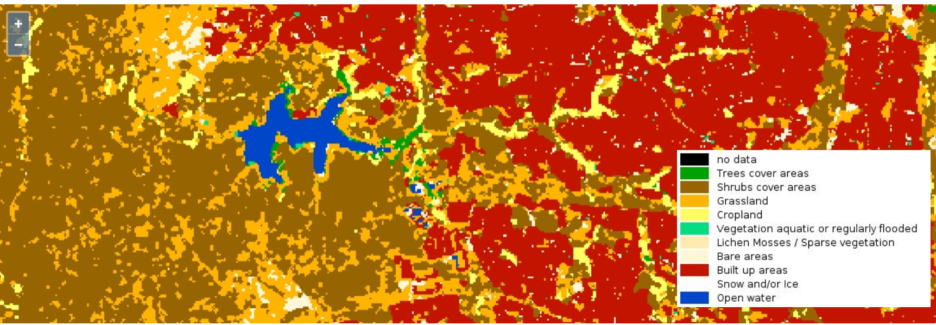
Data type
Source: http://maps.elie.ucl.ac.be/CCI/viewer/index.php

Slide 15
SDG indicators that incorporate these statistics
Goal | Target | Indicators | Metadata
Objective 14. Conserve and sustainably use oceans, seas and marine resources for sustainable development. | 14.2 By 2020, manage and protect in a sustainable way the marine and coastal ecosystems to avoid effects important adversities, including strengthening their resilience, and measures to restore them to improve the health and productivity of the oceans. | 14.2.1 Proportion of national exclusive economic zones managed through ecosystem-based approaches. | https://unstats.un.org/sdgs/tierIII-indicators/files/Tier3-14-02-01.pdf
15.1.1 | Forest area as a proportion of total land area
15.1.2 | Proportion of important sites for terrestrial and freshwater biodiversity that are covered by protected areas, by ecosystem type
15.3.1 | Proportion of land that is degraded over total land area
15.4.1 | Coverage by protected areas of important sites for mountain biodiversity
15.4.2 | Mountain Green Cover Index

Slide 16
Additional information

Slide 17
Main concepts and definitions on GIS
GIS is “An integrated collection of computer software and data used to view and manage information about geographic places, analyze spatial relationships, and model spatial processes” Source: ESRI
The underlying assumption is that any geographic entity can be depicted as a Feature (point, line or polygon), or group of Grid cells
A set of feature data representing a concrete theme is called vector layer, for example layer of post offices (points), layer of roads, layer of rivers (lines), layer of cadastral properties (polygons). Multiple layers can be overlaid and visualized as composite landscape structures on a single layout map.
A raster layer references a raster file as its data source and a raster renderer that defines how the raster data should be rendered and any additional display properties. Source: ESRI
The single maps are ‘fixed’ as a Data frame (containing several layers and grids as separate files) and saved as a Project
Geodatabase is a set of shapefiles (either points, lines, polygons) and grids linked in a single structure
Complete list of terms available from ESRI here: http://webhelp.esri.com/arcgisserver/9.3/java/geodatabases/definition_frame.htm
Notes:
17

Slide 18
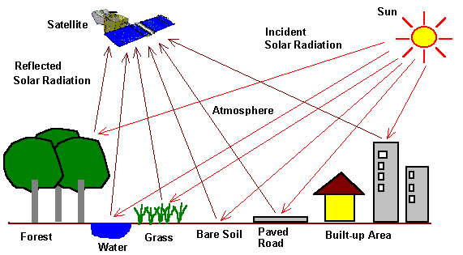
Main concepts and definitions on Earth Observation
1. Remote sensing: the science and art of identifying, observing, and measuring an object without coming into direct contact with it. This process involves the detection and measurement of radiation of different wavelengths reflected or emitted from distant objects or materials, by which they may be identified and categorized by class/type, substance, and spatial distribution (NASA).
Measures continuous arrays of reflectance values and the (approximate!) geographic location of pixels or grid-cells
2. Optical remote sensing: Satellite and Aerial: for land cover and use
3. Synthetic Aperture Radar: for biomass, peatlands, elevation

Slide 19
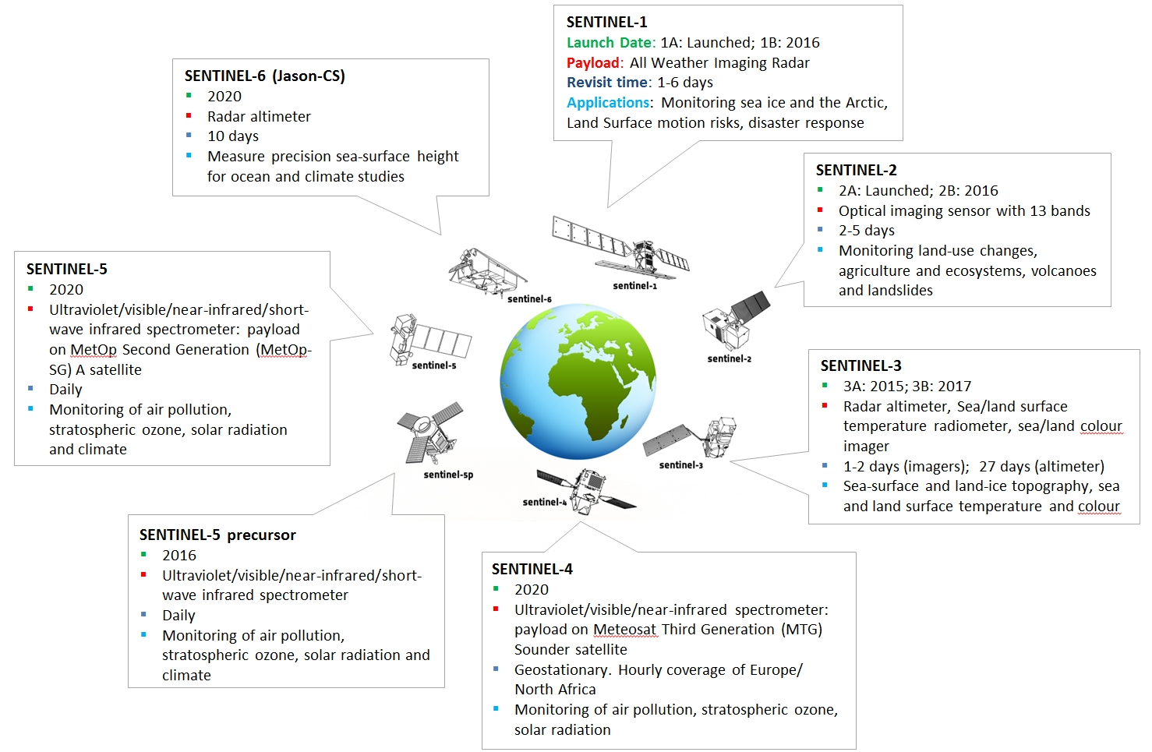
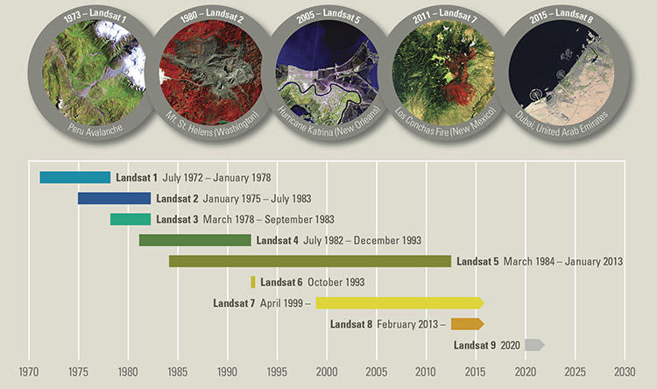
    Satellite instruments
High resolution
NASA’s Landsat
ESA’s Sentinels
SPOT
Very high resolution
QuickBird
Ikonos
Moderate resolution
NASA’s MODIS
ESA’s MERIS
SAR
ALOS-PALSAR

Slide 20
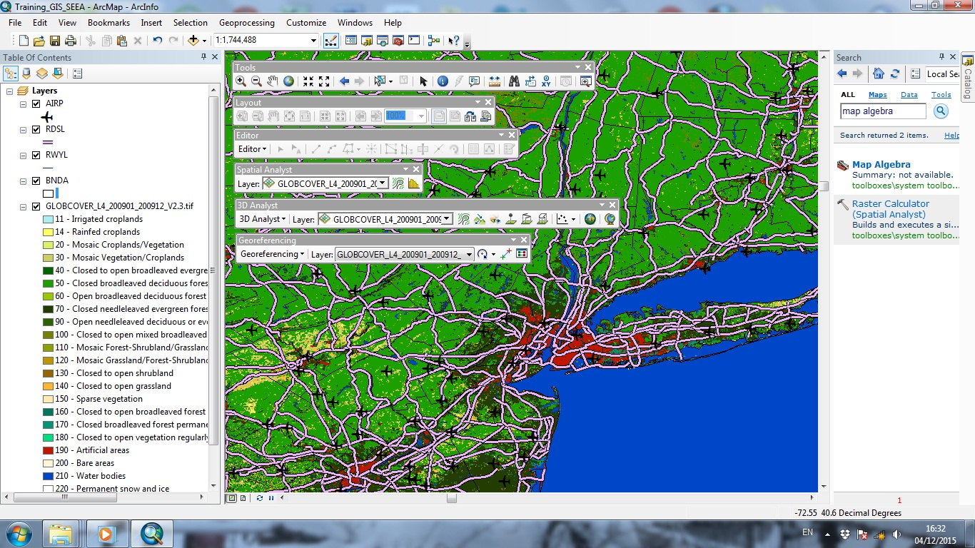
    Interface of ArcMap
Select feature
Check Value
Change Layout template
    Main Toolbars and functions (in menu Customize/Toolbars …..)
Edit shapefiles
Notes:
20
The interface contains ‘usual menus’ and GIS specific tools
Concrete operations/commands can be invoked from the toolbars or searched by keyword (someone need to tell you the exact name of each needed command)

Slide 21
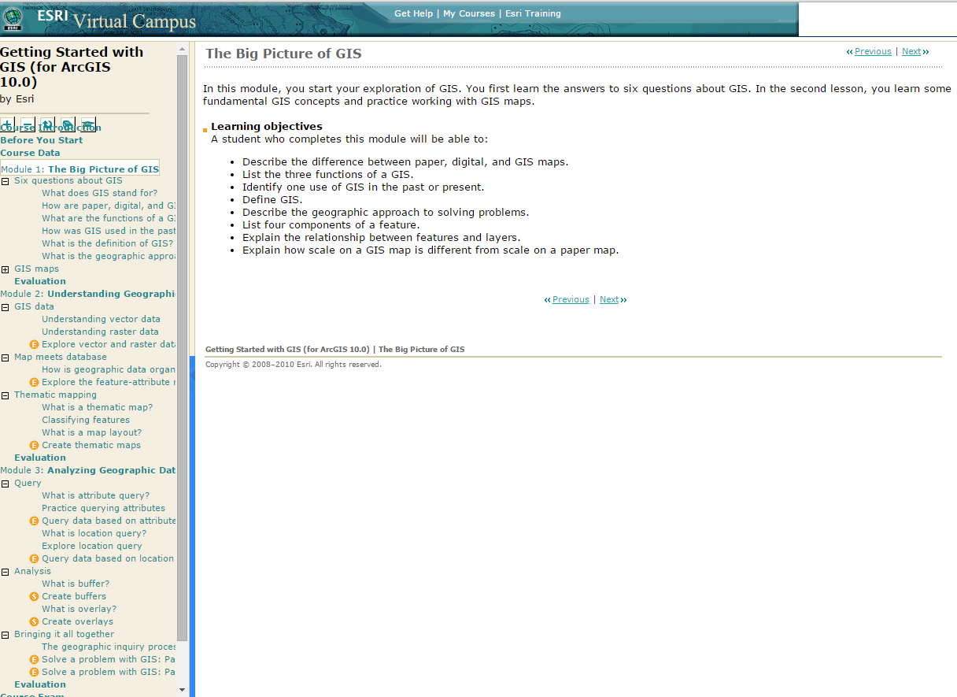
Overview: What is GIS and how it works
http://training.esri.com/gateway/index.cfm?fa=catalog.webCourseDetail&CourseID=1911
    Course is based on personal experience and is designed to aid ecosystem accounting purposes
    More basic introductions to GIS with online training are available from ESRI: http://training.esri.com/gateway/index.cfm?fa=catalog.webCourseDetail&CourseID=1911
    Situation: you are a statistician and you are faced with GIS data: examples raster file of Land cover (GlobCover2009) and UNmap vector data on countries
    You need to learn how to load, explore and understand the attributes with the spatial data
E-learning course designed to introduce thorough conceptual and practical issues in 3 modules.
Notes:
21
Possibly this should be a prerequisite for session 1 here

Slide 22


Thank you for your attention!
For more information please contact the Environment Statistics Section
at the UN Statistics Division:
E-mail: envstats@un.org
website: http://unstats.un.org/unsd/ENVIRONMENT/

