Slide 1
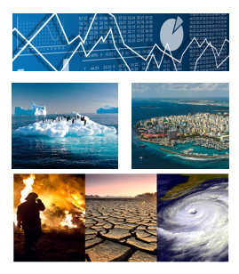
Implementation Guidelines
for the Global Set of Climate Change
Statistics and Indicators

Slide 2
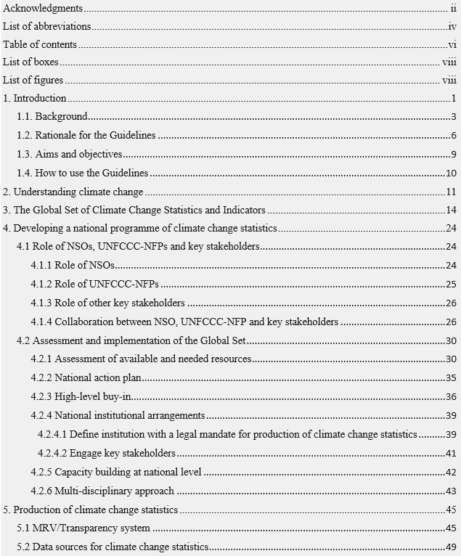
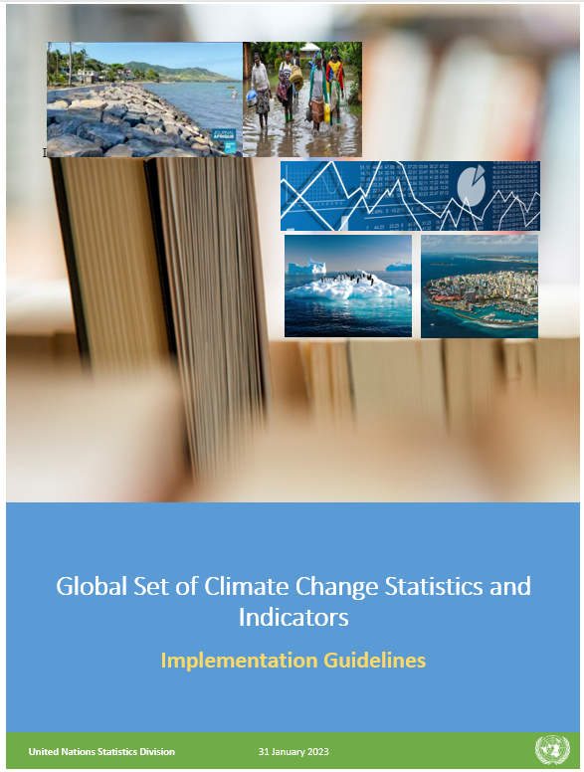
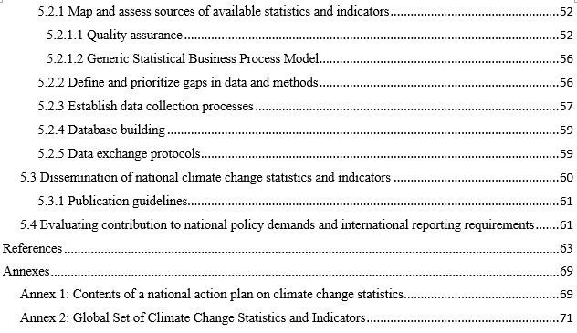
Implementation Guidelines
Table of contents
https://unstats.un.org/unsd/envstats/Climate%20Change/Implementation_Guidelines.pdf

Slide 3
Aims and objectives
The Guidelines aim to help countries improve the monitoring of climate change, its impacts and response actions by better informing the UNFCCC-NFPs about the benefits of official statistics and by guiding the NSOs to increase their engagement in the area of climate change. The overall objectives of the Guidelines are to:
help countries to set up the national consultation processes which can embrace this multidisciplinary statistical work in a way complementary to the ongoing and future reporting to UNFCCC;
deepen countries’ self-assessment activities using the Global Set; and
provide the basis for countries to initiate the development of a national programme for sustained production of climate change statistics within the national statistical system (NSS).

Slide 4
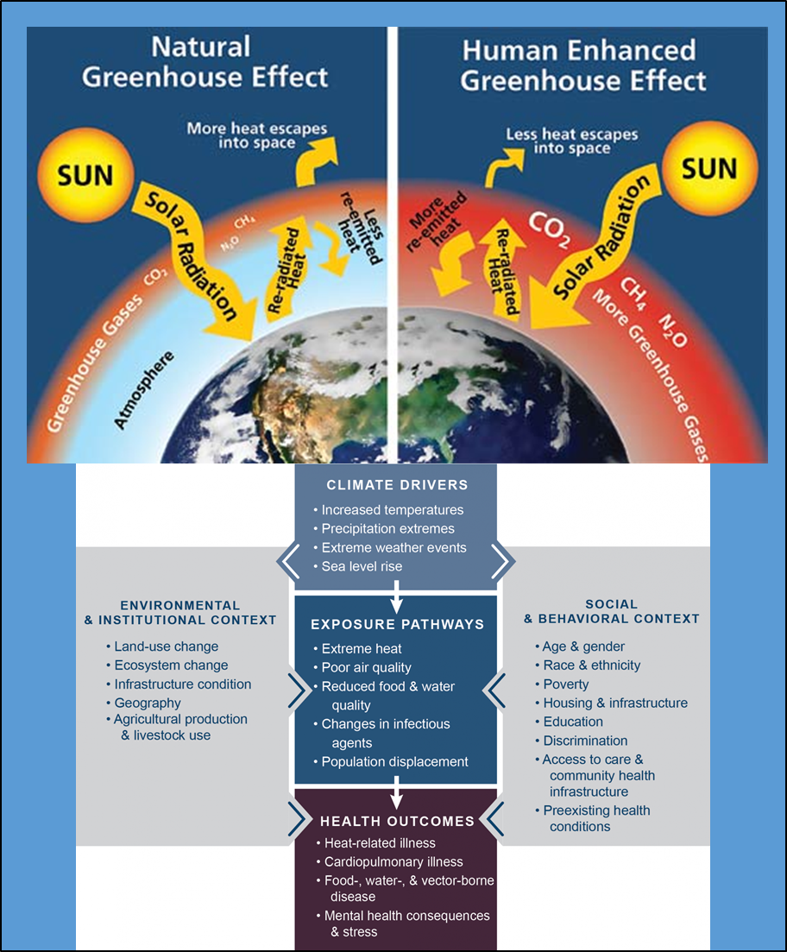
2. Understanding Climate Change
Understanding climate change processes. Source: Adapted from Land Trust Alliance (2021), How Does the Greenhouse Effect Work?, (quoted from W. Elder, NPS), available at: https://climatechange.lta.org/get-started/learn/co2-methane-greenhouse-effect/, and US Global Change research program, available at: https://health2016.globalchange.gov/temperature-related-death-and-illness

Slide 5
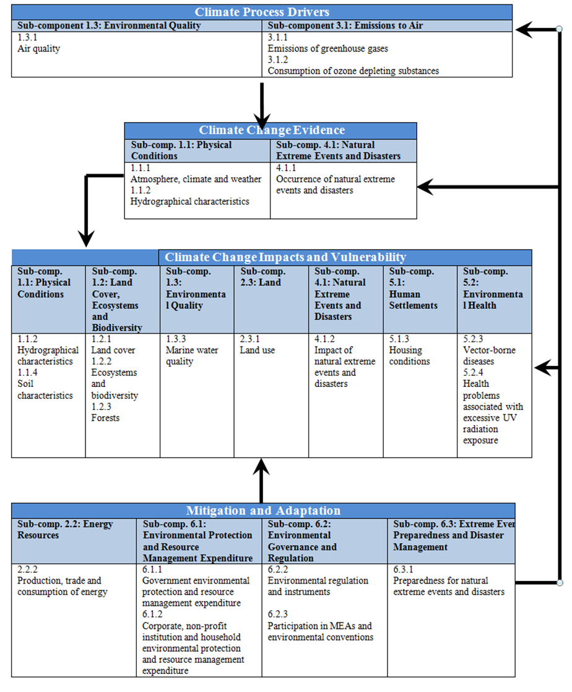

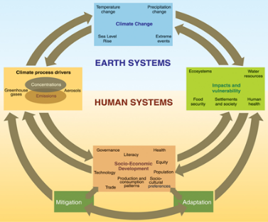

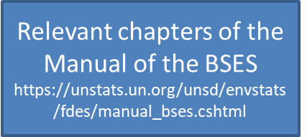
3. Global Set of Climate Change Statistics and Indicators
Given that there was no underlying framework linking the reporting requirements stemming from the Paris Agreement and the necessary statistics or indicators to support climate policy action, UNSD worked closely with UNFCCC to develop such a framework explicitly for climate change.
The Global Set, developed in close collaboration with UNFCCC, is structured according to the IPCC framework and FDES, with a tiering system as in the FDES and the SDG indicators.
Goal 13
Framework for the Development of Environment Statistics (FDES 2013)
IPCC, 2007, Fourth Assessment Report
FDES cross-cutting application
(Chapter 5) links climate change
and environment statistics
based on the IPCC Framework

Slide 6
4. Developing a national programme of climate change statistics
4.1 Role of NSOs, NFPs and key stakeholders
4.1.1 Role of NSOs
4.1.2 Role of National Focal Points and climate policy authorities
4.1.3 Role of other key stakeholders
4.1.4 Collaboration between NSO, NFP and key stakeholders
4.1.5 National examples
Institutional dimensions

Slide 7
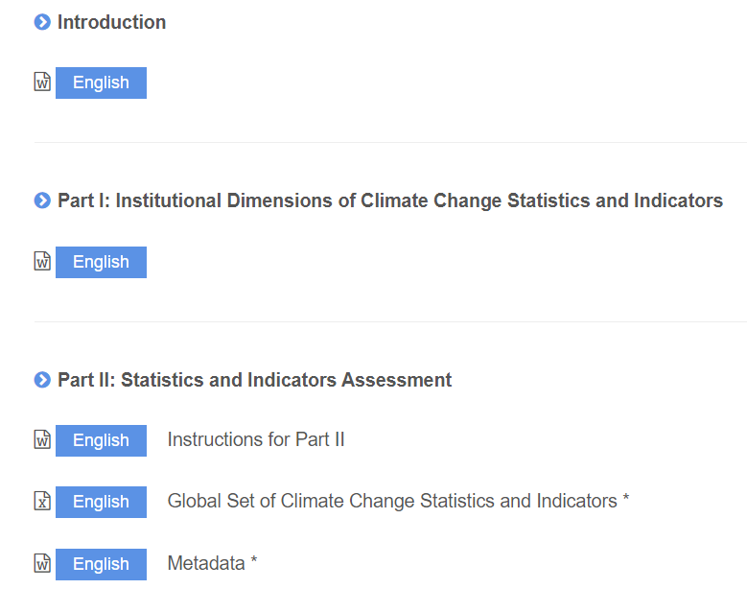
4.2.1 Assessment of available and needed resources
Prioritize the statistics and indicators and statistics to the country;
Part of a multi-stakeholder consultation and discussion process;
Highlight any efforts needed to advance the collection of CC stats and indicators in order to support the country’s climate policy objectives;
Apply CISAT
Self-assessment

Slide 8
Steps | Activities | Year 1 |  |  |  | Year 2 |  |  |  | Year 3
 |  | Q1 | Q2 | Q3 | Q4 | Q1 | Q2 | Q3 | Q4 | Q1 | Q2 | Q3 | Q4
1 | Establish/strengthen relationship between NSO and UNFCCC-NFP
2 | Engage stakeholders and complete the self-assessment using the CISAT
3 | Establish a committee, inter-institutional working group or task force or expand an existing one
4 | Define an institution with a legal mandate
5 | Establish collaboration/communication channels between stakeholders and make institutional arrangements
 | Designate national thematic experts
 | Develop ToRs/MoUs
6 | Engage high-level support for TWG - data collection/formation of unit / mobilizing resources
 | Conduct institutional review and skills capacity assessment
 | Develop project proposals/applications
7 | Strengthen human resources
 | Provide training and capacity building
 | Designate desk officers/core team
 | Hire staff/consultants
8 | Improve technical resources
 | Improve IT infrastructure (software and hardware)
9 | Develop a national programme/national action plan on climate statistics
 | Develop national set of climate indicators (consistent/complementary with NDCs/NAPs/NCs) and metadata
 | Map the data sources and assess data quality
 | Define gaps and prioritize work on methods and data collection
 | Develop data collection methods (such as climate change surveys)
 | Integrate the programme/plan into NSDS and national climate policies
10 | Undertake data collection/database building
 | Establish data exchange protocols
 | Compile statistics/indicators
 | Prepare analysis of key findings and draft a report
 | Organize a validation workshop/TWG and stakeholders
11 | Prepare contributions to national policies and the reports for UNFCCC
12 | Disseminate statistics and indicators
13 | Conduct user surveys
14 | Evaluate and define priorities for future improvements
4.2.2 National action plan
Self-assessment for building a National action plan on climate change statistics
The self-assessment will produce the needed understanding of what are the available resources (human and technical), available data, data gaps and what is (still) needed to support national climate policies and activities. Prioritisation of the needed data-related activities should be done taking into account the suitability of data collection methods including costs and reliability

Slide 9
4.2.3 High-level buy-in – mobilize resources
It is recommended that the NSO and the focal points to the UNFCCC and other focal points obtain high-level support from their heads of ministries and agencies. Stakeholders will be more amenable to participating; provide more support for budgeting for meetings, staffing, etc. This would contribute to ensure the continuity of resources for the activity.
The agencies/funds which may offer direct financial assistance to countries are:
Green Climate Fund (GCF) was established at COP16, under the UNFCCC, to support developing countries with projects, programmes, policies and other activities related to climate mitigation and climate adaptation.
Global Environment Facility (GEF)
GIZ or Deutsche Gesellschaft für Internationale Zusammenarbe, is a German development agency that provides services in the fields of environmental protection, resource conservation, and climate change mitigation, among others.
Mobilize resources

Slide 10
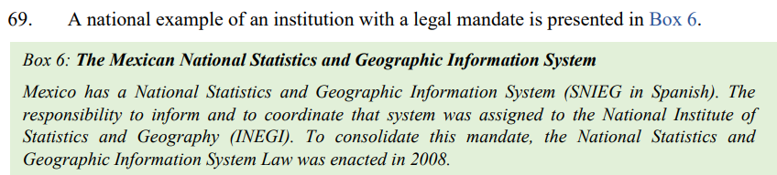
Institution with a legal mandate for the production of statistics on climate change
A national (or focal) institution with legal mandate will perform the following functions:
Set up a department/service or division in charge of climate change statistics;
Develop a legal framework of collaboration with other institutions (Ministry of the Environment, meteorological institute, research institutes, etc.) with a view to sharing statistics on climate change;
Submit training needs, a work plan and budget proposal to the government;
Establish/strengthen a climate change and/or environment statistics committee;

Slide 11
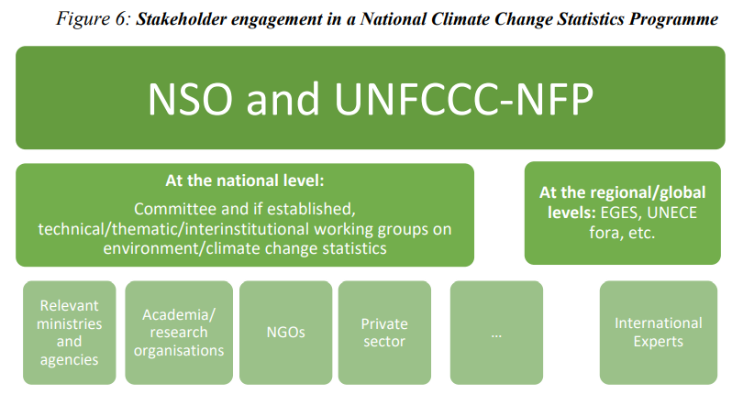
The committee may perform the following functions:
Develop a roadmap for the implementation of the Global Set and agree on the expected results of the work.
Organize the validation of the data, statistics, indicators and reports produced by the technical/thematical/interinstitutional working groups (if established) before submission to a higher-level body for approval/information as appropriate
Develop a communication strategy and agree on the dissemination of the national set of climate change statistics and indicators.
Integrate the national programme/plan of climate change statistics into the NSDS and national climate policies

Slide 12
4.2.5 Capacity building at national level
Capacity can be enhanced by operating manuals/technical guides in the language(s) used in the country, through regional, national/sub-regional workshops, country visits/study tours, through bilateral consultations or online training.
Completing the CISAT;
Collecting and estimating climate change data;
Reporting on climate change;
Developing climate change surveys;
Developing metadata and indicators for climate change statistics;
Filling information gaps;
Establishing baselines for climate change indicators;
Translating the tools/materials (ESSAT, CISAT, MRV, etc.) to indigenous languages;
Training of trainers.
Training

Slide 13
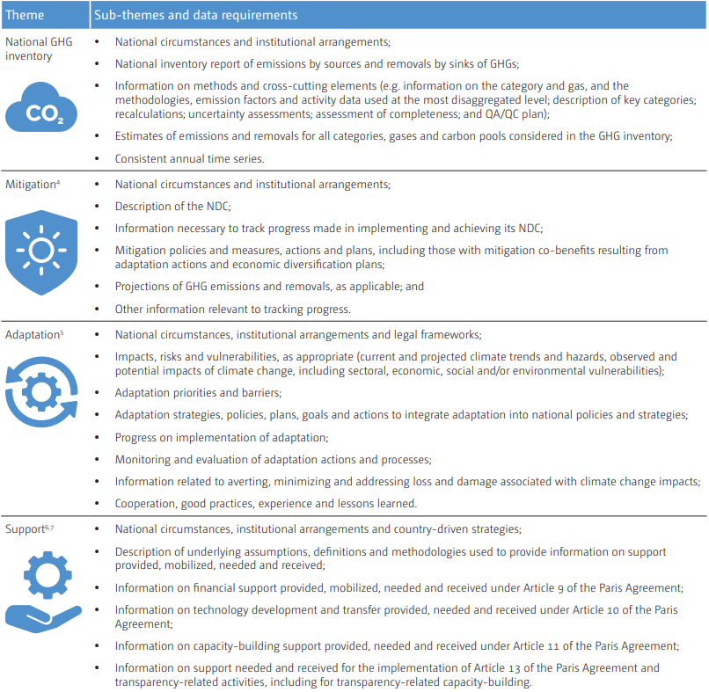
5. Production of climate change statistics
5.1 MRV/Transparency system
Key requirement of a national programme on climate change statistics is to inform and support the planning of climate actions as required in the Nationally Determined Contributions (NDCs) and the National Adaptation Plans (NAPs)
The Global Set can support the above by providing suitable indicators and statistics which will assist with the improved monitoring of the planned actions and can be applied in the revision of the above planning instruments. The Global Set can also be applied to strengthen the establishment and implementation of a national MRV/Transparency system.
Production of statistics

Slide 14
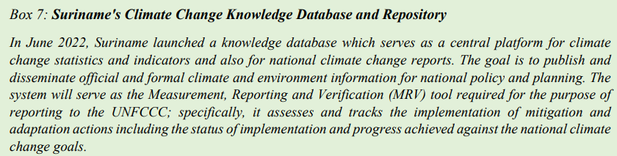
5.2 Data sources for climate change statistics
Define the sources of data on climate change
Map sources of available indicators/statistics and assess them in terms of quality and utility
Define and prioritize gaps in data and methods
Establish data collection processes
Build database of CC stats and indicators
Establish Data Exchange Protocols
Production of statistics

Slide 15
    5.3 Dissemination of national climate change statistics and indicators
Environment/climate change statistics compendium;
Statistical yearbook, including environment statistics or chapter/section within a yearbook;
Climate change statistics bulletin/report;
State of the environment report; and
Websites, databases and portals.
----
    Establish publication guidelines
Dissemination

Slide 16
    5.4 Evaluating contribution to national policy demands and international reporting requirements
Contributions and benefits of applying the Global Set will be reflected in the NCs and BRs for Annex I Parties; and NCs and BURs for non-Annex I Parties but mostly in the new BTRs under the Paris Agreement to be submitted from 2024.
Assessment and implementation of the Global Set requires a multi-annual plan/programme and will assist in mobilising resources
Improved knowledge and understanding of climate science, the direct and indirect impacts of climate change (supported by qualitative and quantitative evidence where possible);
Changes in data and information;
Changes in data collection, management and storage of data;
Economic conditions and the availability and access to funding mechanisms;
Changes in financial, technical and human resources; and
Results from a monitoring and evaluation (M&E) framework.
Evaluation

Slide 17

Thank you for your attention!
For more information please contact the Environment Statistics Section
at the United Nations Statistics Division:
E-mail: envstats@un.org
Website: https://unstats.un.org/unsd/envstats/

