Slide 1
Training workshop on monitoring the Sendai framework for disaster risk reduction and disaster loss data collection

Slide 2
Session 5 :
Introduction to the Sendai Framework monitoring process and its tools, the SFM

Slide 3
What is disaster loss data? What is Sendai reporting?
Event-based database (DesInventar, EM-DAT)
"an event" - getting precise data on impact of distinct disaster events
Place: Where the disaster took place?
Date: When the disaster took place?
Hazard: Which type of hazard triggered the disaster?
Impacts: Which where the human and economic impacts –direct losses
Aggregated database (SFM)
"getting the big picture" - Annual figures & understanding the trends
Geography/place - where are the losses / impacts located
Hazard – what are annual losses associated with a distinct hazard
Impacts: the human and economic impacts over a period of a year

Slide 4
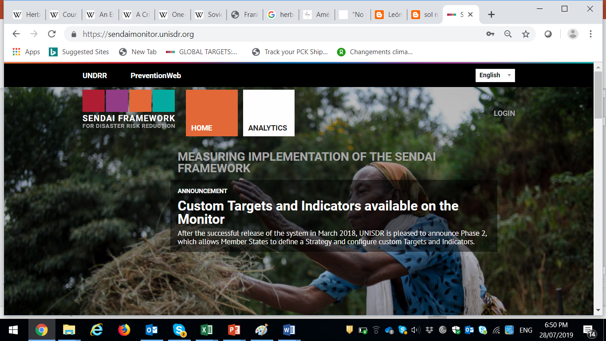
The Sendai Framework Monitor
SFM

Slide 5
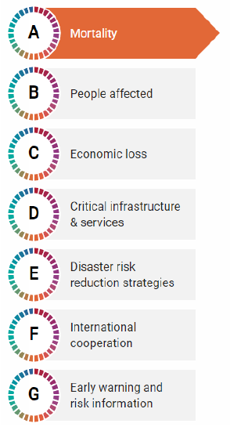
Sendai Framework: Evaluating Progress
What is the Sendai Framework Monitoring process?
What is being monitored?
How is monitoring performed?
  Roles and responsibilities of the national institutions
  Institutional arrangements for the Sendai Framework Monitor

Slide 6
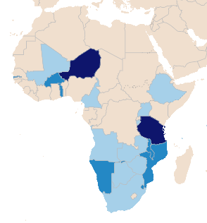
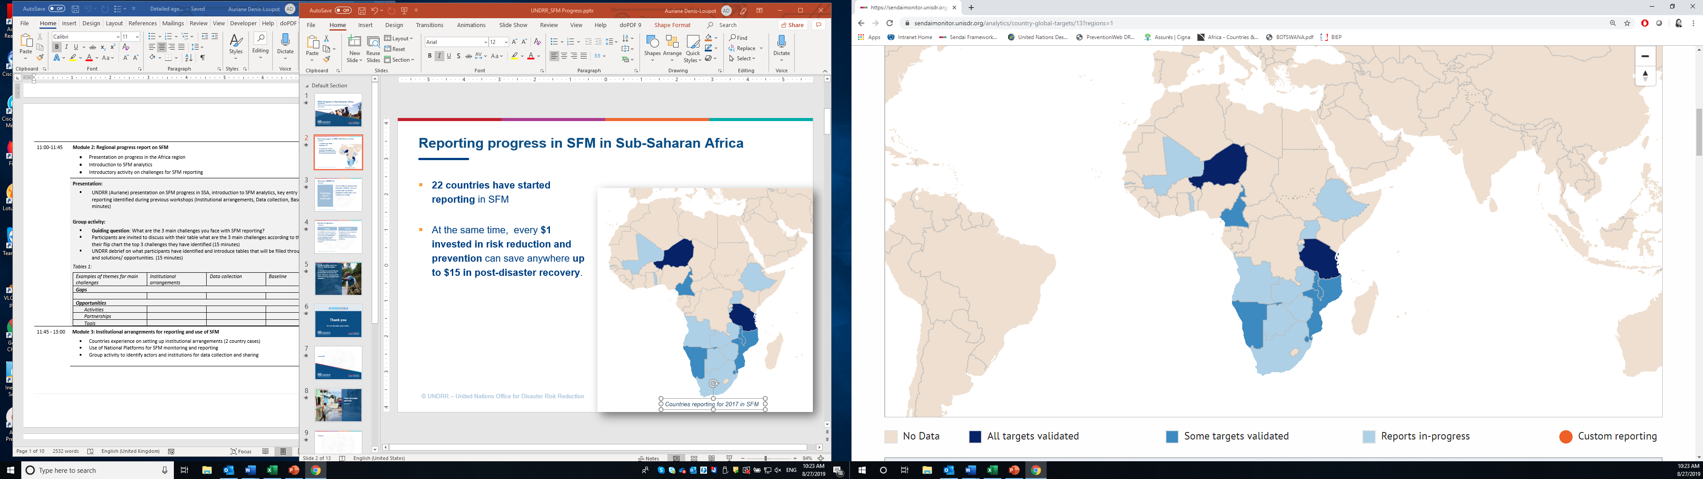
Key milestones
2022
Mid-Term Review of the Sendai Framework
January 2021
27 countries in Sub-Saharan Africa report in the SFM
2015
Adoption of the Sendai Framework
August 2021
Launch of the regional module
2018
Launch of the Sendai Framework Monitor
Sept. 2021
First key milestone, measuring achievement of Target E
Countries reporting for 2021 in SFM

Slide 7
Sendai Framework Monitor (SFM) in a nutshell
SFM data are sent to UNDESA to report on indicators linked to DRR – SDG 1, 11 and 13.
Measures progress against Sendai targets
Helps countries to track progress against their DRR commitments.
Led by Governments the process promotes an inclusive approach.
An official and inclusive process
Contributes to SDG reporting
Focal points are designated by Note verbale.

Slide 8
Several layers of reporting
GLOBAL TARGETS
NATIONAL / CUSTOM TARGETS
REGIONAL TARGETS
Common targets for all countries (Targets A to G).
Agreed through the OIEWG
Measure DRR progress by 2030
Progress is documented in the biennial Global Assessment Reports (GAR).
Possibility to add national custom indicators.
Based on country priorities, usually from the national DRR strategy
Will be reflected in the national DRR reports of the countries.
Reporting against regional targets from the Programme of Action for the implementation of the Sendai Framework in Africa (PoA).

Slide 9
Sendai Framework Reporting: What’s new?
Hyogo Framework for Action
Reporting heavily reliant on country reporting capacity
Mostly Qualitative
Reporting every two years
No coherence with Millennium Development Goals (MDG) reporting
Self-assessed ratings
Sendai Framework for Disaster Risk Reduction
Blend of Quantitative and Qualitative
Coherence with SDG reporting
Partner input options for reporting (Country Contributors)

Slide 10
SFM timeline for reporting and milestones for 2022
31 March 2023
Provision of baseline data for indicators under Targets A and B and optionally under Targets C and D for the period January 2005 to December 2014.
Reporting of required data for indicators under Targets A, B, C, D and E for the period January 2015 to December 2021.
30 September 2023
Data for all Targets A-G till December 2022
Notes:
The information provided by the upcoming reporting milestone will be used to report on progress towards related SDG indicators with the UN Department of Economic and Social Affairs (UN DESA). It will further serve as input to the SDG Report 2021, which will be presented at the High-Level Political Forum on Sustainable Development in July 2021. The data reported by Member States for indicators under Targets A-E will be submitted by UNDRR for reporting on the following SDG indicators: for SDG 1 (Indicators 1.5.1, 1.5.2, 1.5.3, and 1.5.4); SDG 11 (Indicators 11.5.1, 11.5.2, 11.b.1, and 11.b.2,) and SDG 13 (Indicators 13.1.1, 13.1.2, and 13.1.3).

Slide 11
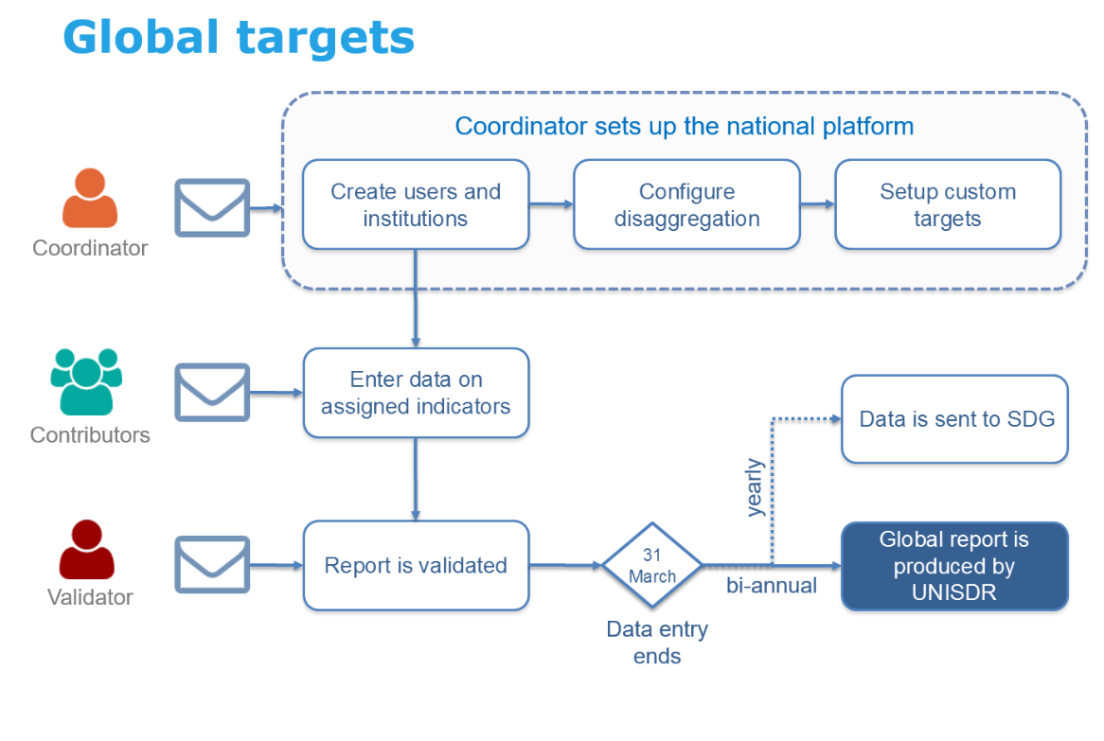
Roles in SFM
Coordinator: defines institutions, local entities, users, as per their roles and responsibilities
Contributor: In charge of entering and maintaining data of one or more indicators
Observer: User who can read the data and make comments and suggestions
Validator: In charge of approving data of one or more Targets
Notes:
Starting from next year the validator function will be removed and all date inserted will be authomatically validated. The coordinator normally is the SFM focal point that assigns responsibilities to other institutions when seeking additional data and metadata.

Slide 12
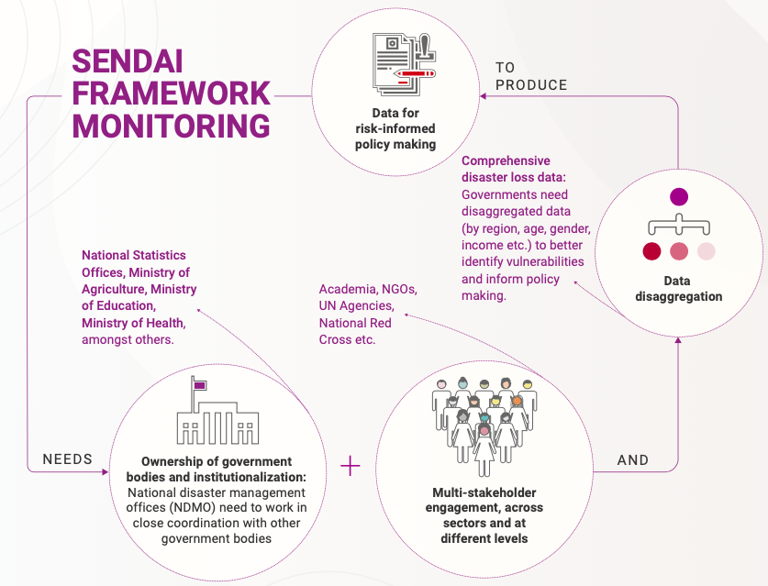

    Disaggregation, including hazard disaggregation, is optional but strongly encouraged in order to better understand vulnerabilities
Notes:
In order for SFM to work there is a need to have a cross sectoral approach

Slide 13
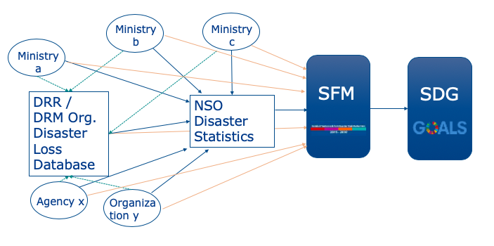
Different options for coordination
Example 1: Multiple users in the system
Advice: limit the number of users per institution

Slide 14
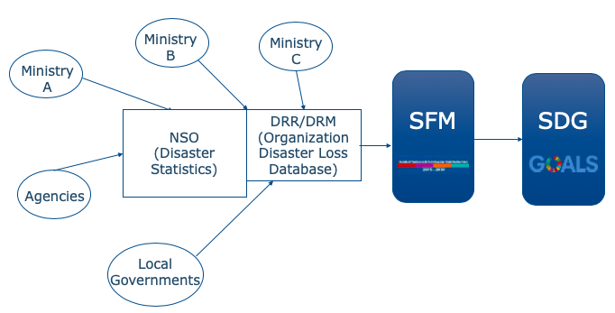
Different options for coordination
Example 2: Off-line coordination then data is validated and imported by the National Disaster Management Office or Agency
Experience from Member States
Core working group for SFM data collation
National DRR platforms

Slide 15
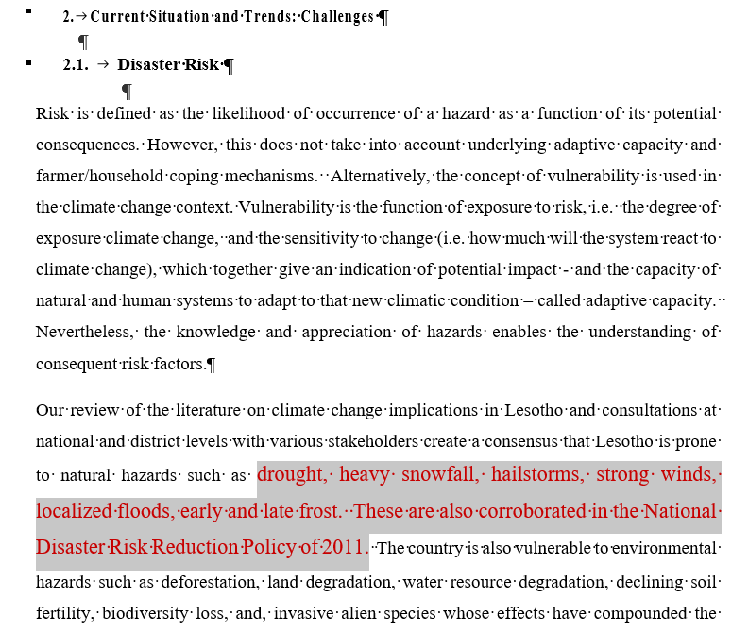
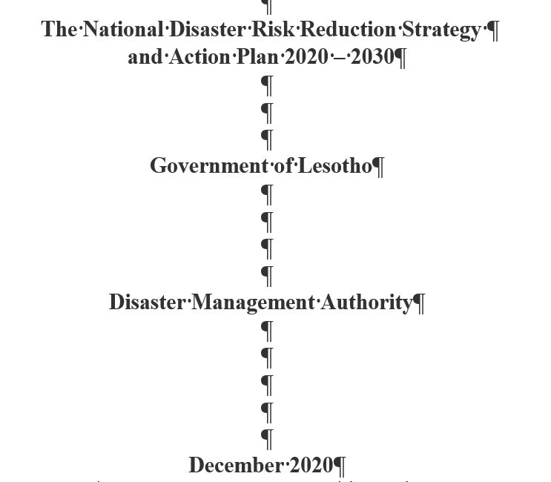
Prioritizing hazards (15 minutes discussion)

Slide 16

SFM – The Tool
SFM key enabler:
UNDRR advocates the importance of having in place:
A National DRR Platform/Committee that assigns technical focal points from representative institutions / ministries to form a team for SFM reporting.
A National Disaster Loss and Damage Database (using DesInventar tool as option)
Team of technical focal points to:
Map where the data needed for each indicator is kept at national level.
Determine the owner and contributors for each target or indicator in SFM.
Agree on timeline for setting up institutional arrangements on SFM and for periodic reporting on SFM
Agree on the level of disaggregation of data available or aspired to help analysis and inform policy and decision-making

Slide 17
Exercise
 | Mortality (Target A) | People affected (Target B) | Economic losses (Target C) | Critical infrastructures & services (Target D) | Development assistance (Target F) | EWS (Target G)
Data available | Yes but it is fragmented. | Yes. | Yes but it is fragmented. | Yes | Yes | Yes
Data sources (actual / potential) | Bureau of Statistics, Ministry of Health, Home Affairs, Police, Civil Society Organizations | Ministry of Health, DMA, Bureau of Statistics | Various ministries, departments and agencies including Ministry of Works, Ministry of Agriculture | Department of Roads, Local Government, Ministry of Natural Resources and Department of Water Affairs and Rural Water Authority, Ministry of Health, Fire Rescue Section of the Ministry of Local Government, Police, Evacuation Centers via DMA and Red Cross, Ministry of Education, | Ministry of Finance, Red Cross, World Vision, Red Cross, WFP etc. | DMA, UN Agencies, NGO, Lesotho Met Office (LMS), BOS
Mandates | DMA | DMA | DMA | DMA and BOS | DMA and BOS | DMA and LMS

Slide 18
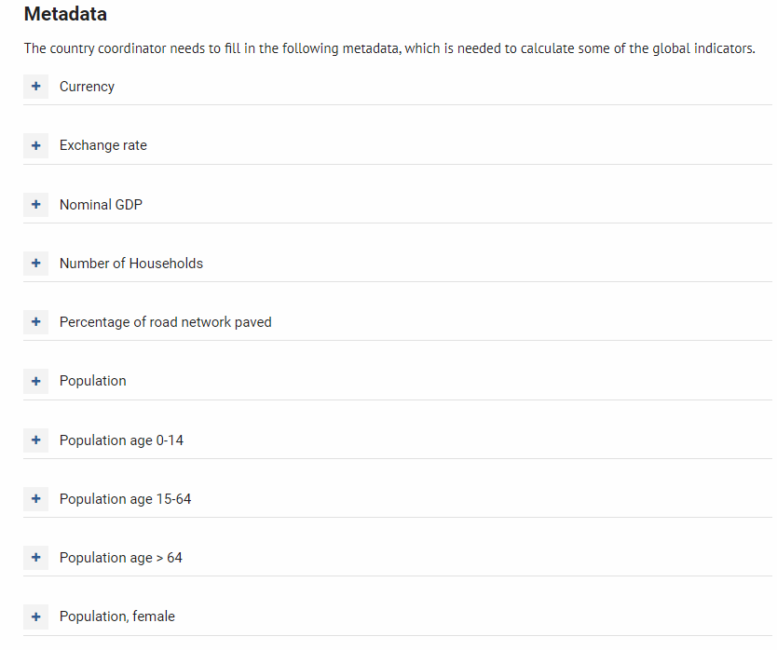
Metadata
Metadata are data necessary to calculate global indicators for every reporting year

Slide 19
Session 5 :
Data on mortality and affected people (Targets A and B)

Slide 20
Mortality
Target A

Slide 21
Disaster mortality in Lesotho
Disaster mortality (no. of deaths) 1968-2016

Slide 22
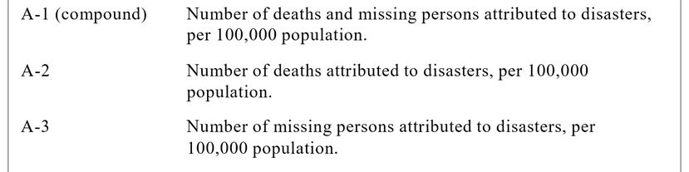
Indicators – Target A
Target A:
Substantially reduce global disaster mortality by 2030, aiming to lower average per 100.000 global mortality between 2020-2030 compared with 2005-2015.
Options for data disaggregation:
Hazard
Sex (Male / Female)
Age (Children 0–14 yo ; Adults 15–64 yo Seniors 65+)
People with disabilities
Income level (below poverty line)
Notes:
Key terms​
Death: The number of people who died during the disaster, or directly after, as a direct result of the hazardous event​
Missing: The number of people whose whereabouts is unknown since the hazardous event. It includes people who are presumed dead, for whom there is no physical evidence such as a body, and for which an official/legal report has been filed with competent authorities.​
Note from the Secretariat: The data on number of deaths and number of missing/presumed dead are mutually exclusive, so no-one should be double counted. ​
Note from the Secretariat: According to the definition of "Missing" the Secretariat suggests that the data is contingent upon the existence of legal reports or declarations.

Slide 23
Sources of data
Sources of information in the system include:
  Disaster Management Agency or Department (14)
  PDNA or other reports (5)
  Police (4)
  Ministry of Health / Health Departments (3)
  Other: National Red Cross (1), Fire & rescue services (2), National DRM Platform (1), National Emergency Center (1)

Slide 24
Affected people
Target B

Slide 25
People affected by disasters
People affected (no. ( injured, homeless) 1968-2016

Slide 26
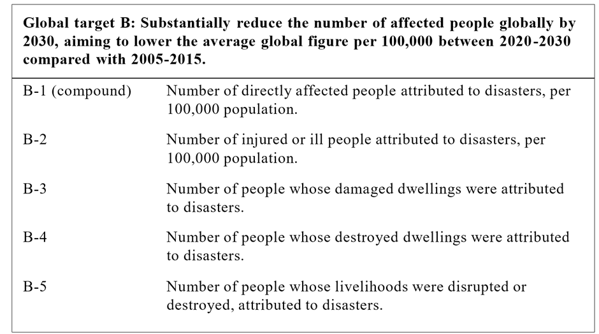
Indicators – Target B
Directly affected people :
  suffered injury, illness or other health effects;
  were evacuated, displaced, relocated;
  have suffered direct damage to their livelihoods, economic, physical, social, cultural and environmental assets.
Target B :
Substantially reduce the number of affected people globally by 2030, aiming to lower average per 100.000 global mortality between 2020-2030 compared with 2005-2015.
Options for data disaggregation:
Hazard
Sex (Male / Female)
Age (Children 0–14 yo ; Adults 15–64 yo Seniors 65+)
People with disabilities
Income level (below poverty line)
Notes:
B-1 compound indicator of B-2, B-3, B-4 and B-5.
Key terms
Directly affected: People who have suffered injury, illness or other health effects; who were evacuated, displaced, relocated; or have suffered direct damage to their livelihoods, economic, physical, social, cultural and environmental assets.
Indirectly affected: People who have suffered consequences, other than or in addition to direct effects, over time due to disruption or changes in economy, critical infrastructures, basic services, commerce, work or social, health and physiological consequences.
** Given the large number of variables eligible for consideration in ‘Affected’, it is important to emphasize that no single indicator will provide an absolutely precise, accurate and exhaustive measure of affected population. The OIEWG indicators will provide a proxy of those directly affected. Double counting will occur between the current indicators. Indicators B-3 and B-4 (people living in damaged or destroyed dwellings will be an estimation and includes those evacuated, displaced and relocated, avoiding additional double counting.

Slide 27

Indicator B-2 – Number of ill and injured people
Overview of data
Data disaggregation
Sources of data
High variations of numbers between countries depending on the hazards reported on. Data can range from 0 to +500.000 people ill or injured / year.
Most countries report injuries/illness on the following hazards:
  Biological – Epidemics (10)
  Hydrometeorological – Floods, Winds, Rain, Storm, Lightening (15)
  Technological – accidents (3)
Countries disaggregate by hazards (70%) and geography (42%). But disaggregation by sex, age, income and disability is very rare.
.
Ad-hoc sources: Very few countries include Ministries of Health as sources of data (20%)
Other sources: reports, disaster loss databases
Notes:
Without data disaggregation more difficult to understand what caused very high levels of ill or injured people and more difficult to use it for better planning and policy making.
The source of data and methodology used by each Member State will be determined depending on the laws, the health and emergency management system of each country, and the type of hazard.
It is strongly recommended that the number of injure/ill persons should be backed up by official health statistics or by an official report stating these numbers.
In most sudden-onset disasters morbidity figures are collected initially during the Response, and Search and Rescues phases. However, some illnesses will occur some time after the event (for example mental health issues).
Slow onset disasters and events associated to certain hazards require different methodologies, such as Excess Morbidity calculation. Examples are Droughts, heat waves, epidemics and biological hazards. (WHO presentation)

Slide 28

Indicators B-3 & B-4 – Number of people whose dwellings were damaged and destroyed
B-3
Damaged dwellings
B-4
Destroyed dwellings
Overview of data
Data disaggregation
Sources of data
Most countries report on Hydrometeorological hazards – Floods, Winds, Fire, Rain (17)
Most countries report manually rather than automatic calculation.
About 50% of countries disaggregate by hazard.
About 25% of countries disaggregate by geography.
Other disaggregation is almost non-existent.
Ad-hoc sources: Housing department (1), PDNA (1), IOM (1), UNICEF (1)
Other sources: reports, disaster loss databases

Slide 29

Indicators B-5– Number of people whose livelihoods were disrupted or destroyed
Overview of data
Data disaggregation
Sources of data
Most countries report on Hydrometeorological hazards – Drought, Winds, Fire, Rain
Drought is the hazard most disaggregated by under B-5.
One country added data related to Covid-19 disruptions the agriculture sector and its impact on people.
Disaggregation is scarce. About 10% disaggregate by hazard types.
Main sources of data are Civil protection/ NDMA.
Ad-hoc sources: Police, Statistics, Ministry of Agriculture, Ministry of Environment, Ministry of Finance
Other sources: national reports on early warning assessments, drought relief etc.

Slide 30
UNDRR proposed methodology for indicator B-5
If a national methodology is not available, UNDRR proposes the following:
B-5 = hectares of crops damaged/destroyed * average workers per hectare
+ livestock lost * average workers per livestock
+ sum of productive assets and infrastructure damaged/destroyed * average workers per facility
This methodology is based on data reported as part of target C:
The number of hectares of crops damaged/destroyed is reported under sub-indicator C-2C
The number of livestock lost is reported under sub-indicator C-2L
The number of productive assets and infrastructure damaged/destroyed are reported as part of C-2LA, C-3 and C-5.
    For indicator B-5, the ‘automatic calculation’ option is currently not available. But MS can use the above methodology and the pre-defined ratios in the ‘set-up’ to calculate the number of people who had their livelihoods disrupted.

Slide 31
Session 5 :
Data on economic losses and disruptions of services (Targets C & D)

Slide 32
Economic losses
Target C

Slide 33
Indicators - Target C
Target C: Reduce direct disaster economic loss in relation to Global Domestic Product (GDP) by 2030.
C-1 (Compound C2-C6) | Direct economic loss attributed to disaster in relation to GDP
C-2 | Direct agricultural loss attributed to disasters including the crops, livestock, fisheries, apiculture, aquaculture and forest sectors as well as associated facilities and infrastructure.)
C-3 | Direct economic loss to all other productive assets attributed to disasters (includes economic sectors).
C-4 | Direct economic loss in the housing sector attributed to disasters.
C-5 | Direct economic loss resulting from damaged or destroyed critical infrastructure attributed to disasters (education, health, other)
C-6 | Direct economic loss to cultural heritage attributed to disasters.
Options for data disaggregation:
Type of crops
Type of infrastructures
Type of asset
….
Notes:
Economic Loss:
Total economic impact that consists of direct economic loss and indirect economic loss.
Direct economic loss: the monetary value of total or partial destruction of physical assets existing in the affected area. Direct economic loss is nearly equivalent to physical damage.
Indirect economic loss: a decline in economic value added as a consequence of direct economic loss and/or human and environmental impacts.
Annotation: Examples of physical assets that are the basis for calculating direct economic loss include homes, schools, hospitals, commercial and governmental buildings, transport, energy, telecommunications infrastructures and other infrastructure; business assets and industrial plants; production such as crops, livestock and production infrastructure. They may also encompass environmental assets and cultural heritage.
Direct economic losses usually happen during the event or within the first few hours after the event and are often assessed soon after the event to estimate recovery cost and claim insurance payments. These are tangible and relatively easy to measure.
Indirect economic loss includes micro-economic impacts (e.g. revenue declines owing to business interruption, impacts on natural assets, loss of revenue or income due to missing assets, interruptions to transportation networks, supply chains or temporary unemployment) and macroeconomic impacts (e.g. price increases, increases in government debt, negative impact on stock market prices, and decline in GDP). Indirect losses can occur inside or outside of the hazard area and often with a time lag. As a result they may be intangible or difficult to measure.

Slide 34
Method to measure losses
Two options:
Countries use their own methodology (consistent over time)
Countries use the proposed methology in SFM based on methodologies from the FAO (agriculture) and UN ECLAC (other economic losses)
Three steps
Collect data
Convert physical losses into economic value
Conversion from LCU to USD
Notes:
Member States have freedom to choose between nationally-defined methodologies or the methodologies proposed by the Secretariat by which direct economic loss to damaged or destroyed productive assets attributed to disasters is determined.
The following major groups of methods are developed in the Technical Guidance Note to be used when estimating direct economic losses:
C-1 compound indicator is expressed as a simple sum of Indicators C-2 to C-6 in relation to GDP.
Estimation of Agricultural Sector losses (C-2): Jointly developed by FAO and UNDRR (for example, to assess economic loss on crops).
Assessment of built environment losses (C-3, C-4, C-5): Developed by UNDRR, based on ECLAC/DALA (for example, to assess economic loss on houses).
Assessment based on replacement value and unit prices (for example, to assess economic loss on vehicles or vessels)

Slide 35
Indicators – Target D
Target D: Substantially reduce disaster damage to critical infrastructure and disruption of basic services, among them health and educational facilities, including through developing their resilience by 2030
D-1 (Compound D2-D4) | Damage to critical infrastructure attributed to disasters.
D-2 | Number of destroyed or damaged health facilities attributed to disasters
D-3 | Number of destroyed or damaged educational facilities attributed to disasters
D-4 | Number of other destroyed or damaged critical infrastructure units and facilities attributed to disasters.
D-5 (Compound D6-D8) | Number of disruptions to basic services attributed to disasters.
D-6 | Number of disruptions to educational services attributed to disasters
D-7 | Number of disruptions to health services attributed to disasters
D-8 | Number of disruptions to other basic services attributed to disasters
Damages
–
Reported under C-5
Disruption of services
Notes:
Critical infrastructure
The physical structures, facilities, networks and other assets which provide services that are essential to the social and economic functioning of a community or society
Protective Infrastructure: The set of built elements designed to protect human life and societal assets from different hazards such as floods, tsunamis, wind, landslides and many others.
Green Infrastructure: Green infrastructure is a strategically planned network of natural and semi-natural areas with other environmental features designed and managed to deliver a wide range of ecosystem services such as water purification, air quality, space for recreation and climate mitigation and adaptation, and management of wet weather impacts that provides many community benefits.

Slide 36
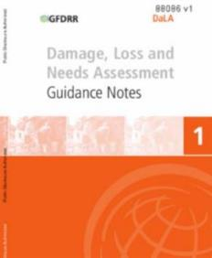
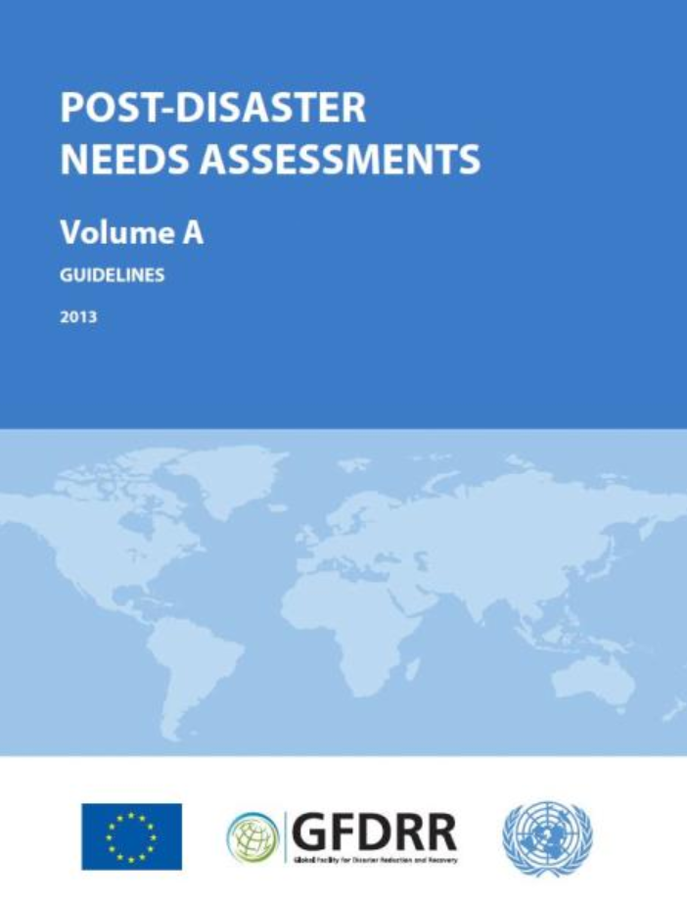
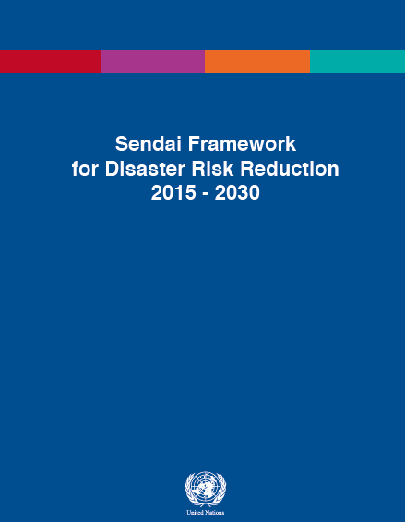

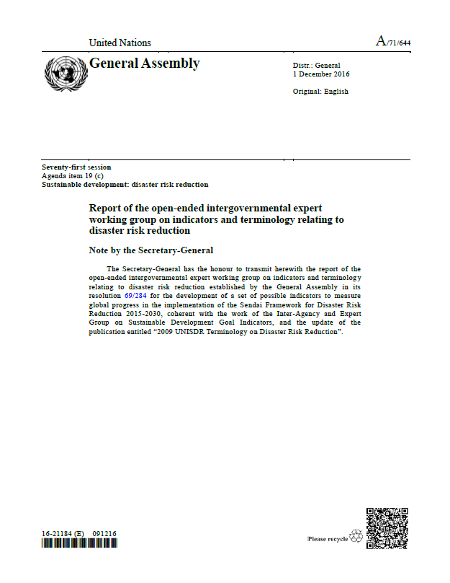

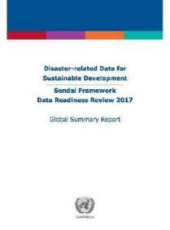
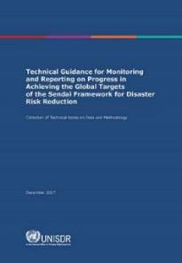
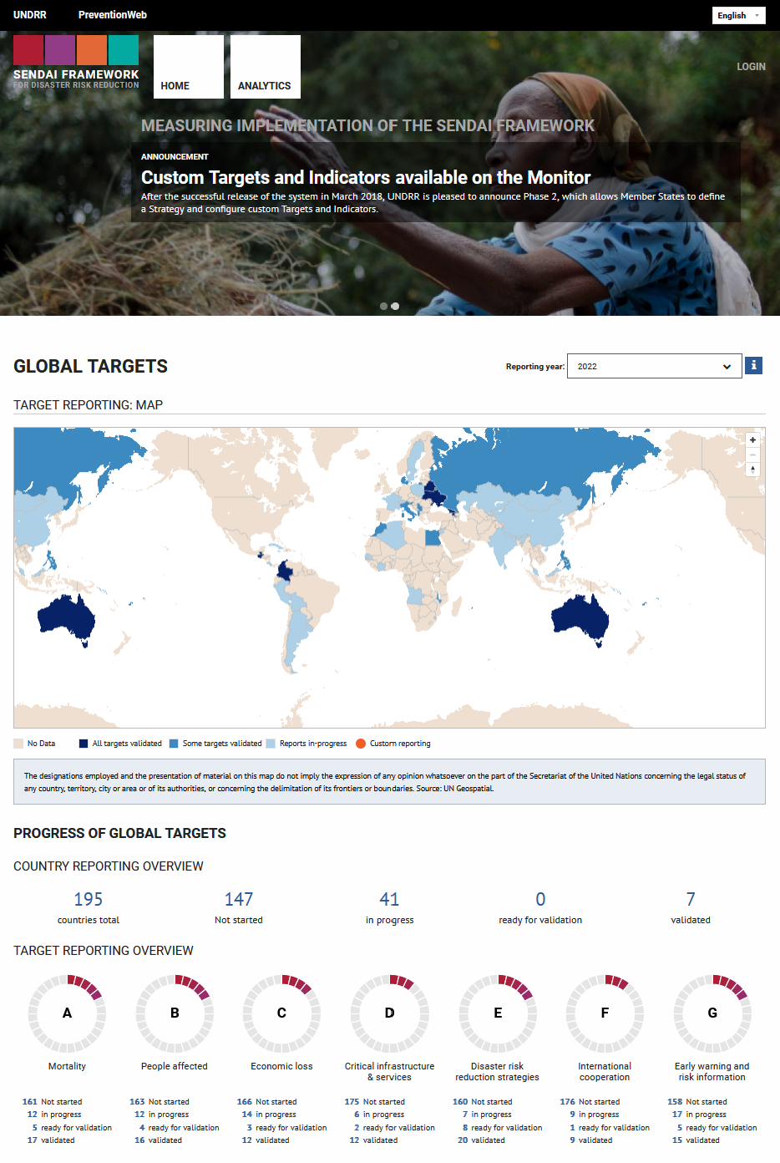
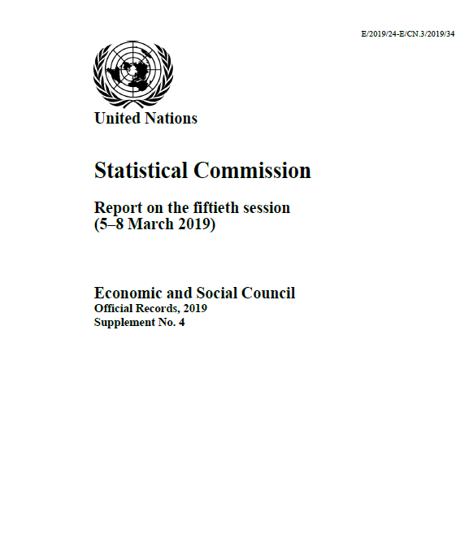

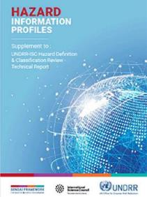
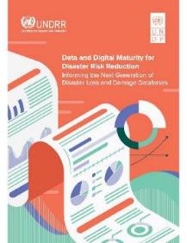
Strengthen standardization - methodologies (selection)
Since 1972
Damage and loss assessment (DaLA)
Since 2007
Post disaster needs assessment (PDNA)
2015
Sendai Framework
Since 2016
Cataloguing of hazardous events (CHE)
2017
Report of the OIEWG on indicators and terminology…
SDG metrics alignment for Sendai
Data readiness review
2018
Technical guidance for monitoring and reporting ... Sendai
Sendai Framework Monitor online portal
Disaster-related statistics
2020
Hazard definition and classification review
2021
Hazard information profiles (HIPs)
2022
Data and digital maturity for DRR (DDRRMM)

Slide 37
Session 8 :
Evaluating DRR policies and measures (Targets E-F-G)

Slide 38

Target E – National and local strategies
Target E : Substantially increase the number of countries with national and local disaster risk reduction strategies by 2020
E-1 | Number of countries that adopt and implement national disaster risk reduction strategies in line with the Sendai Framework for Disaster Risk Reduction 2015-2030.
E-2 | Percentage of local governments that adopt and implement local disaster risk reduction strategies in line with national strategies.

Slide 39
How to measure alignment to the Sendai Framework
The 10 Key elements
1 | Have different timescales, with targets, indicators and time frames
2 | Have objectives and measures aimed at preventing the creation of risk
3 | Have objectives and measures aimed at reducing existing risk
4 | Have objectives and measures aimed at strengthening economic, social, health and environmental resilience
5 | Address the recommendations of Priority 1, Understanding disaster risk
6 | Address the recommendations of Priority 2, Strengthening disaster risk governance to manage disaster risk
7 | Address the recommendations of Priority 3, Investing in DRR for resilience
8 | Address the recommendations of Priority 4, Enhancing disaster preparedness for effective response and to “Build Back Better”
9 | Promote policy coherence and compliance, notably with the SDGs and the Paris Agreement
10 | Have mechanisms to follow-up, periodically assess and publicly report on progress
Self-assessment
-
Qualitative indicator
Notes:
Sources:
- internal- government source, agencies, ministries
- external- NGOs, Academia, UN, IFRC etc.

Slide 40
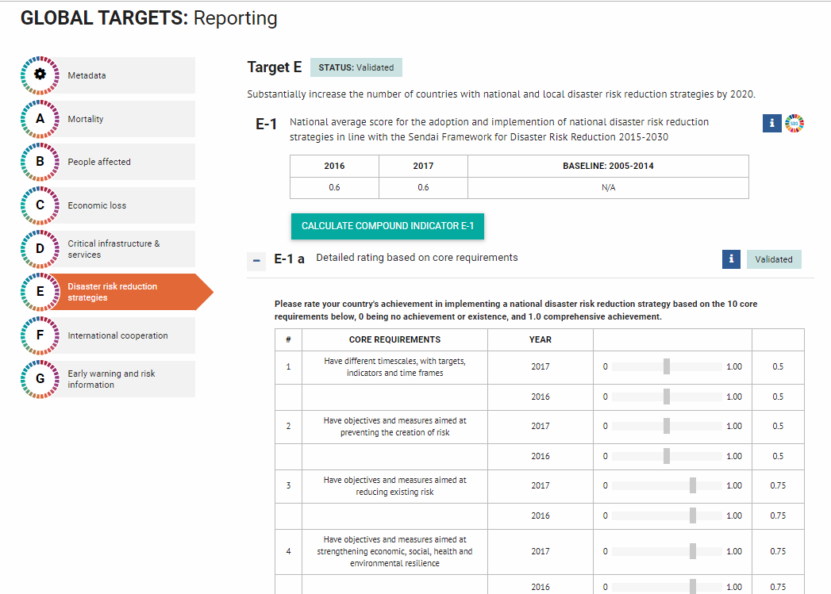
DRR strategies in the Sendai Framework Monitor (SFM)
Key messages
Average score in Africa is 0.63.
Countries report lowest scores for the following items:
  Item 7: Address the recommendations of Priority 3, Investing in DRR for resilience
  Item 9: Promote policy coherence and compliance, notably with the SDGs and the Paris Agreement
  Item 10: Have mechanisms to follow-up, periodically assess and publicly report on progress
24 countries
started

Slide 41
Target F – International cooperation and investments
Target F: Substantially enhance international cooperation to developing countries through adequate and sustainable support to complement their national actions for implementation of the present Framework by 2030.”
Highlight the role of international cooperation in accelerating the implementation of the Sendai Framework.
8 indicators which measure progress in:
  Financing (ODA)
  Technology transfer
  Capacity development

Slide 42
F-1 | Total official international support, (official development assistance (ODA) plus other official flows), for national actions in disaster risk reduction.
F-2 | Total official international support (ODA plus other official flows) for national actions in disaster risk reduction provided by multilateral agencies.
F-3 | Total official international support (ODA plus other official flows) for national actions in disaster risk reduction provided bilaterally.
F-4 | Total official international support (ODA plus other official flows) for the transfer and exchange of technology related to disaster risk reduction.
F-5 | Number of international, regional and bilateral programmes and initiatives for the transfer and exchange of science, technology and innovation in disaster risk reduction for developing countries.
F-6 | Total official international support (ODA plus other official flows) for building capacity in disaster risk reduction.
F-7 | Number of international, regional and bilateral programmes and initiatives for building capacity in disaster risk reduction in developing countries.
F-8 | Number of developing countries supported by international, regional and bilateral initiatives to strengthen their statistical capacity related to disaster risk reduction.
2 types of indicators
Financial flows
Number of programmes
Disaggregation option
Donor/Recipient
Type of finance
Type of support
Sector
Notes:
Blue – Finance
White – Number of programmes

Slide 43
Overview reporting on Target F
Key messages
Target F is the target least reported on
Financial and technical support to DRR is increasing according to the reports made over several years. More information is needed to understand why.
Notes:
Financial and technical support to DRR is increasing according to the reports made over several years. Need additional information to understand the cause of the increase (internal: reporting systems, or external ODA increasing?)
List of countries reporting:
Angola, Botswana, Burundi, Cameroon, Eswatini, Ethiopia, Malawi, Mali, Mozambique, Namibia, Niger, South Africa, United Republic of Tanzania, Zambia

Slide 44
Overview reporting on Target F
Key messages
Indicators related to the number of programmes are less reported on than financing indicators.
Main sources of information include:
  Ministries of Finance
  UN System (UNDP, UNICEF etc.)
  NDMA / DRM Department
Notes:
Most countries use both data from MoF and partners.
Mention the issue on double counting

Slide 45

Target G – Early warning systems
Target G: Substantially increase the availability of and access to multi‑hazard early warning systems and disaster risk information and assessments to the people by 2030.”
Why ?
The capacity to issue early warnings is critical to DRR, because advance notification can allow to significantly reduce and even prevent impacts on human lives, particularly losses in lives, livelihoods, economic assets and damage to critical infrastructures.

Slide 46
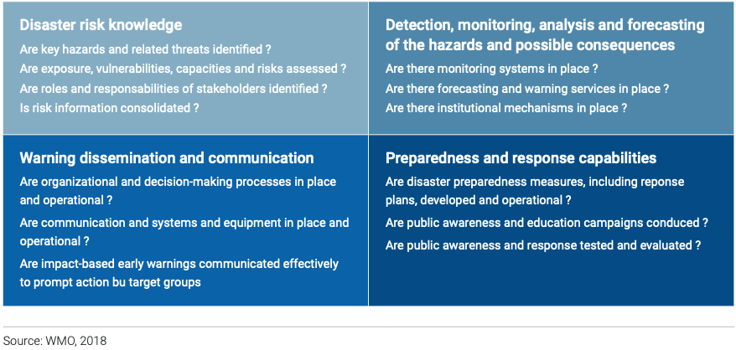
Target G - How do we measure progress?
How do we measure it?
6 global indicators which measure progress regarding availability of and access to multi-hazard early warning systems and disaster risk information.
The 4 elements of a people-centered EWS promoted by the World Meteorological Organization (WMO)
G-5
G-2
G-3
G-4
Notes:
Early warning systems
“An integrated system of hazard monitoring, forecasting and prediction, disaster risk assessment, communication and preparedness activities systems and processes that enables individuals, communities, governments, businesses and others to take timely action to reduce disaster risks in advance of hazardous events.”
- UNDRR, 2017

Slide 47
Indicators
G-1 (compound G2-G5) | Number of countries that have multi-hazard early warning systems.
G-2 | Number of countries that have multi-hazard monitoring and forecasting systems.
G-3 | Number of people per 100,000 that are covered by early warning information through local governments or through national dissemination mechanisms.
G-4 | Percentage of local governments having a plan to act on early warnings.
G-5 | Number of countries that have accessible, understandable, usable and relevant disaster risk information and assessment available to the people at the national and local levels.
G-6 | Percentage of population exposed to or at risk from disasters protected through pre-emptive evacuation following early warning.
Monitoring & Forecasting
Dissemination & Communication
Preparedness & Responses
Understanding risk
Indicators rely on self-assessment methods and quantitative data

Slide 48
Overview of reporting on Target G
Key messages
Target G is overall well reported (about 80% of countries who started reporting)
Information provided is often incomplete, notably for indicators G-2, G-4 and G-5
Trends cannot yet be established

Slide 49
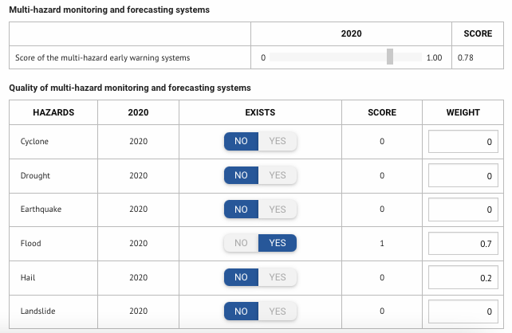
Indicator G-2 – Quality of multi-hazard monitoring and forecasting systems
Key messages
Countries indicate whether they have monitoring and forecasting systems for major hazards in their country.
2 options: simple or detailed.
According to the reporting, most common EWS by hazard type are for floods, drought, epidemics, wildfires.
Disaggregation by hazard type is mandatory. Countries who have not set up the disaggregation by hazard cannot report on G-2.
More than 50% of countries who have validated data have a score of 0 because they do not indicate the WEIGHT (basic and detailed options).)
Reporting challenges
Example of data entry for option 1 (basic information) for indicator G-2.

Slide 50
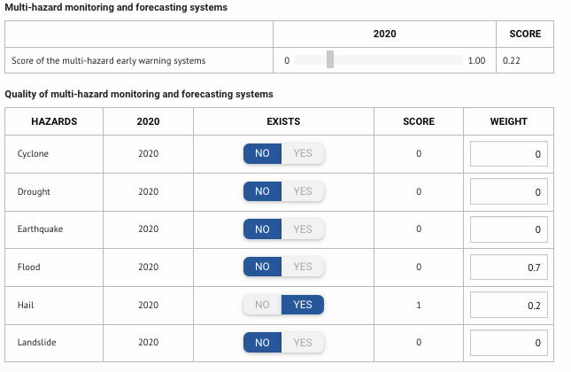
Assessing the weight of hazards
Example 1 – Hazard with high impact but no EWS = Low score
Example 2 – Hazard with high impact and EWS = High score
Determining the weight of hazards: based on potential impacts on humans, historical records, risk assessments etc.
Inputting the weight in the system: countries can choose to report out of a 100, 1 or as a ratio. But total weight should be equal to 100, 1 or respective ratio.

Slide 51
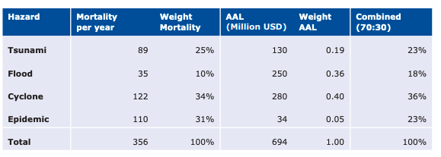
More information available in the Technical Guidance
Potential impacts on human or natural hazard risk of a certain level of frequency and intensity/severity of each hazard. These thresholds can be decided by countries reflecting their vulnerability conditions. For example, multi-hazard national risk assessments may provide risk metrics such as Average Annual Loss or Probable Maximum Loss, that can be used for a quantitative determination of weights. The weight given to each hazard could be determined by prorating the loss by the total multi-hazard loss.
Historical records on impacts: for example, using baseline data for the Target A and Target B, i.e. number of deaths, missing persons and directly affected persons attributed to disasters, between 2005 and 2015 by hazard types. Then hazard weights should be prorated accordingly.
Example of weighting hazards, provided in the Technical guidance note for SFM.
https://www.preventionweb.net/files/54970_techguidancefdigitalhr.pdf

Slide 52
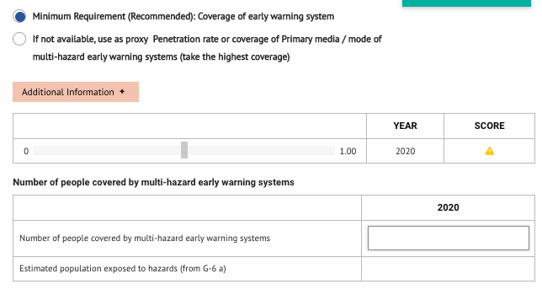
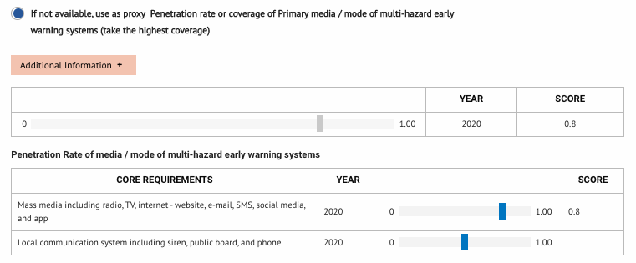
Indicator G-3 – People covered by early warning information through local governments or national dissemination
Key messages
Countries assess the population covered by the dissemination of warning.
2 options:
  Number of people covered by EWS
  Proxy: countries self-assess (score) the penetration rate of mass media and local communication systems – Selected by most countries
If you choose the Proxy option to report, move the scale to report score.
Option 1: Number of people covered
Reporting challenges
Option 2: Proxy

Slide 53
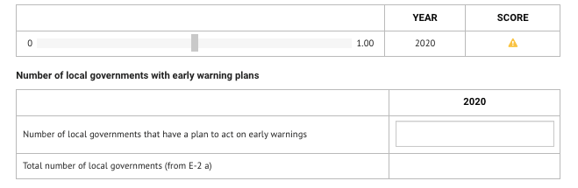
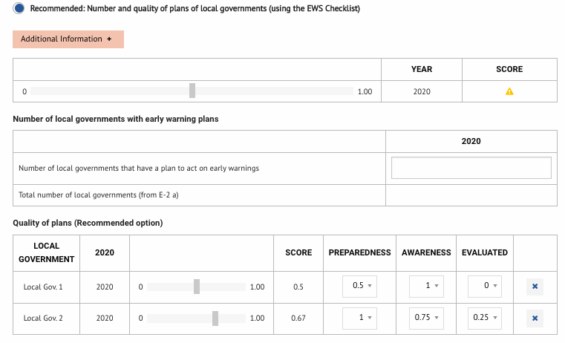
Indicator G-4 – Percentage of local governments having a plan to act on early warnings
Key messages
Countries indicate the number of local plans and the total number of local governments
2 options: simple or detailed.
Most countries select Option 2– Detailed (recommended)
For option 2 (detailed), countries need to assess the quality of each plan. If not, the indicator will not be calculated.
Currently, almost all of the countries who chose the recommended option didn’t provide this information. → Change the reporting option.
Option 1: Number of local plans
Reporting challenges
Option 2: Number and quality of local plans

Slide 54
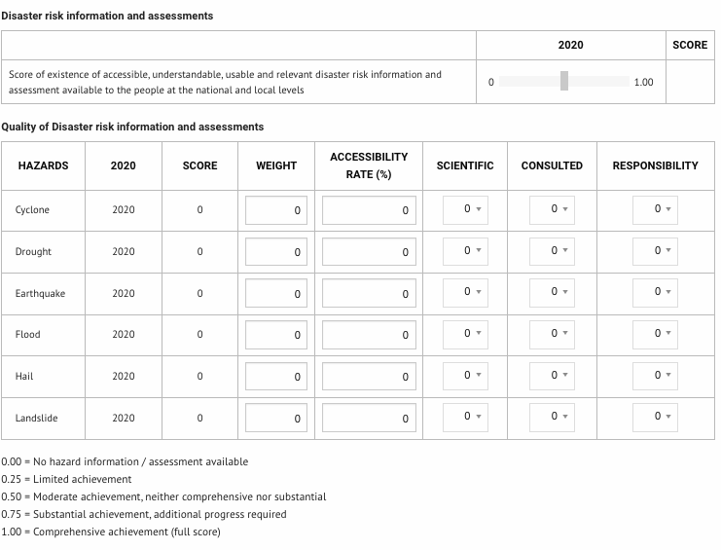
Indicator G-5 - Disaster risk information and assessment available to the people at the national and local levels
Key messages
Most countries report a score of 0 and do not fill the data. Reasons:
  Indicator not understood?
  Information not available?
Quality of assessments is done considering 4 sub-indicators:
  are they accessible;
  are they based on the most scientific approach;
  are they the product of a national consultation;
  do they have clear responsibilities for decision making, planning, and storing data and information.
Notes:
Quality of assessments is done considering 4 sub indicator:
accessibility rate;
are they based on the most scientific approach;
are they the product of a national consultation;
do they have clear responsibilities

Slide 55
Indicator G6 - Population exposed to or at risk from disasters protected through pre-emptive evacuation following early warning
Reminder
Number of people protected through pre-emptive evacuation
AND
Estimated population exposed to hazards.
If the data of “population exposed to hazards” is not available, the total population in the municipalities, districts, or communities in the affected geographical areas shall be considered as exposed.
Key messages
No major reporting challenges
50% of countries reporting, report 0, indicating that the population is not protected by pre-emptive evacuation.

Slide 56
Updates on Target G new custom indicators
Upcoming: Target G custom indicators to assess effectiveness of EWS
Developed in partnership with WMO and Member States under the CREWS initiative
Piloting training at national and regional levels
More information to come

Slide 57
Sendai Framework Monitor: Hands-on
Connecting to the platform
Getting familiar with the Platform
Exercises
    BLANK OR 0?
    Countries sometime leave some indicators blank if there are no losses incurred. However, blank does not mean zero. Blank means there are no data available.

Slide 58

Connecting to the platform
Official website
Once the Coordinator has created your profile:
https://sendaimonitor.undrr.org/
Training environment
For training:
Email: LSO@sendai.com
Password: 123456
Please DO NOT change the password of the training account.
https://sendaimonitortraining.undrr.org/

Slide 59

Session 9 :
Conclusion & next steps

Slide 60

ADDITIONNAL RESOURCES AND SUPPORT

Slide 61
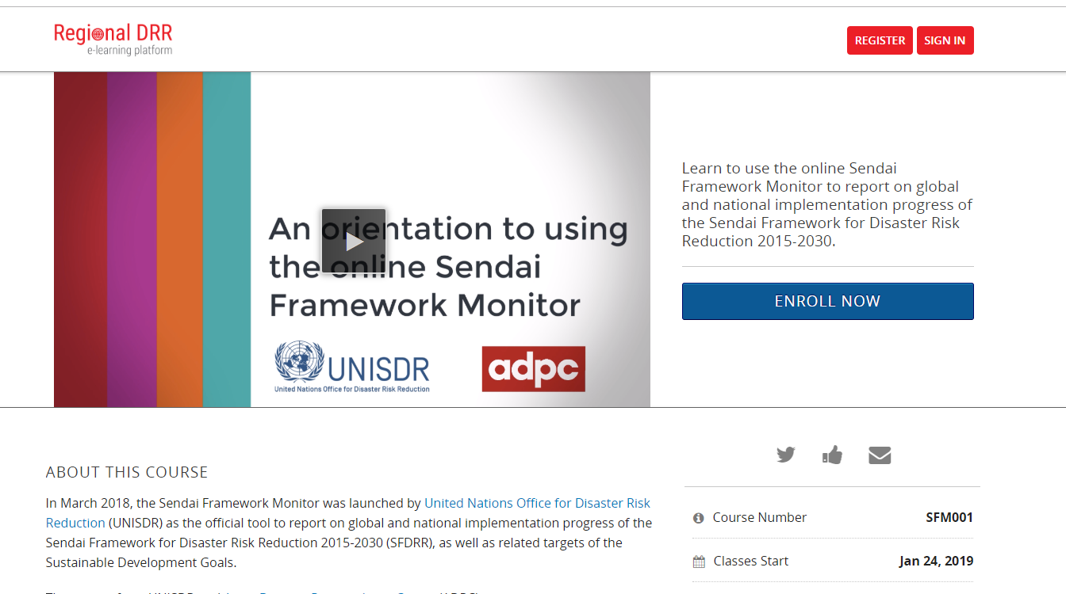

Available resources & training tools
Report of the Open-ended Intergovernmental Expert Working Group on Terminology and Indicators related to disaster risk reduction (OIEWG)
https://www.preventionweb.net/files/50683_oiewgreportenglish.pdf
UNDRR Technical Guidance note on SFM: 6 languages, update available soon
https://www.preventionweb.net/publications/view/54970
UNDRR-ADPC free online learning course on SFM (new languages coming soon).
https://courses.adpc.net/courses/course-v1:UNISDR+SFM001+2019Y1/about
Notes:
For the moment, only available in English

Slide 62
Covid-19 reporting in SFM
Official WHO Technical guidance notes on Sendai Framework reporting for Ministries of Health https://reliefweb.int/sites/reliefweb.int/files/resources/9789240003712-eng.pdf
UNDRR-WHO Working paper: Inclusion of the impacts of the COVID-19 pandemic on health and health services in reporting for Sendai Framework Monitoring in 2021

Slide 63


Slide 64
Thank you !

