Slide 1


UNEP’s view on performance indicators and nutrient use efficiency
Presented by:
Vincent Sweeney
Coordinator, GPA

Slide 2
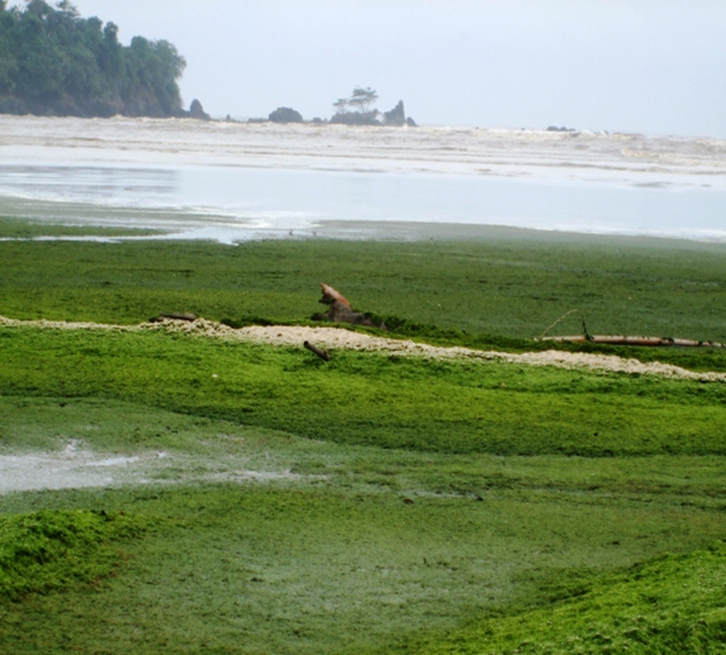
Notes:
The UN General Assembly, in its resolution 65/37, expressed its concern regarding the spreading of hypoxic dead zones in oceans as a result of eutrophication fuelled by riverine run-off of fertilizers, sewage outfalls and reactive nitrogen resulting from the burning of fossil fuels and causing serious consequences for ecosystem functioning. The GA called upon States to enhance their efforts to reduce eutrophication and, to that end, to continue to cooperate within the framework of relevant international organizations, in particular the Global Programme of Action for the Protection of the Marine Environment from Land-Based Activities (GPA).

Slide 3
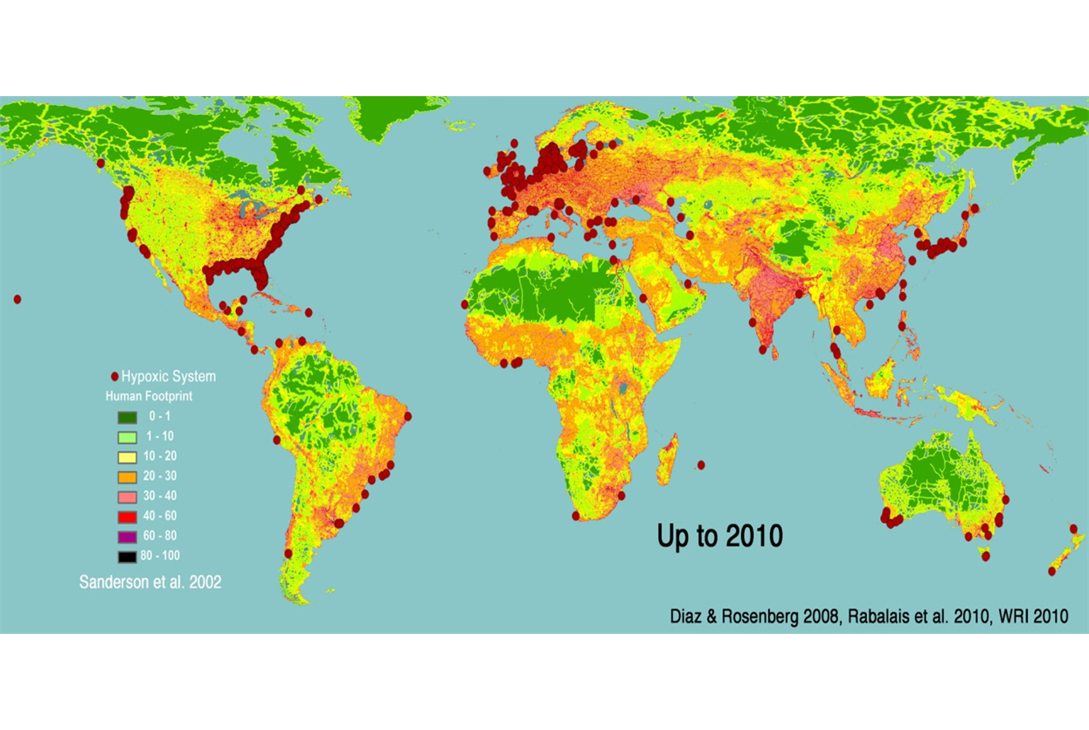
Notes:
Effective action on nutrients and wastewater, which are major contributors to eutrophication, has proven elusive, especially in developing countries, with some 417 eutrophic and associated oxygen-depleted areas being identified in 2007.

Slide 4
The GPA, adopted in 1995, is a voluntary, action-oriented, intergovernmental programme hosted by UNEP, to prevent the degradation of the marine environment from land-based activities.
The Manila Declaration in 2012, gave GPA the mandate to establish three global multi-stakeholder partnerships for the priority areas nutrients, marine litter and wastewater
Notes:
Given that the situation is deteriorating and these source categories continue to be priority issues, as requested by the General Assembly, it was suggested at the last Intergovernmental Review (IGR-3) of the GPA in January 2012, that in the implementation of the GPA over the coming years, further attention be paid to tackling these sources of pollution. It was proposed at the same IGR-3 that Governments formally agree to establish and/or develop partnerships on nutrients, wastewater and marine litter with clear government ownership and impetus.

Slide 5
  The GPA now hosts and serves as Secretariat for the following partnerships:
  The Global Partnership on Nutrient Management (GPNM), which was launched at the UN CSD in New York, May 2009
  The Global Partnership on Marine Litter (GPML), which was launched at Rio+20, June 2012
  The Global Wastewater Initiative (GWI), which was announced by UNEP’s Executive Director, Achim Steiner in May, 2013;
Notes:
The partnerships would have their overall objectives and aims, including, possibly, targets on reducing discharges, reuse and recycling, which were expected to be agreed upon by Governments at the IGR-3 meeting.

Slide 6
UNEP, through the GPNM, recognizes the need for strategic advocacy and co-operation at the global and regional levels and has facilitated discussion since 2012 IGR-3
There is now an emerging consensus on the potential for improving NUE
Notes:
UNEP has facilitated discussion since 2012 on the critical importance of nutrients for global food security which has emphasized the need to review the present nutrient use and management practices that are stimulated by government policies and agronomical practices driven by market forces. Participants at these discussions have recognized the need to recover nutrients from wastes and recycle them back into food chains for sustainable nutrient management. There was consensus among the participants on the potential for improving nutrient use efficiencies (especially nitrogen and phosphorus) of fertilizers and manures in crop and animal production. There was also consensus among the participants on the potential for improvements by dietary changes in animal husbandry and human dietary choices.

Slide 7
The GPNM held a Partnership Forum during the 2nd Global Land-Oceans Connections Conference, Oct 2013:
Recommended solutions to nutrient loading included:
Promoting Fertilizer Best Management Practices (such as soil fertility and soil conservation); and
Improving nutrient use efficiency in agriculture
A number of research topics and economic assessments were proposed, as well as indicator development, awareness-raising and education. Details available from www.unep.org/gpa

Slide 8
National level:
Governments encouraged to consider setting some achievable targets and timeframes in addressing the use efficiencies at specific steps of individual nutrient cycles (such as nitrogen fertilizer use efficiency or dietary choices), and/or full chain nutrient use efficiencies that allow more flexibility
Notes:
National governments have been encouraged therefore, by UNEP, to consider setting themselves some achievable targets and timeframes in addressing the use efficiencies at specific steps of individual nutrient cycles (such as nitrogen fertilizer use efficiency or dietary choices), and/or full chain nutrient use efficiencies that allow more flexibility to mix and match multiple interventions for overall sustainability.
It was agreed that setting quantitative target(s) for improved nutrient management and/or nutrient use efficiency provide a powerful incentive for action. Even on a voluntary basis, such targets would be useful in encouraging change.

Slide 9
Regional & global level:
Setting of global policy goals
Global recognition of the need for countries/regions to improve quantification of their nutrient cycles
Working with diverse stakeholders to demonstrate co-benefits across sectors
Notes:
The issues that have been suggested for governments’ consideration include:
• Setting of global policy goals for sustainable nutrient management and greening of economies
• Global recognition of the need for countries/regions to improve quantification of their nutrient cycles
• Working with diverse stakeholders to demonstrate co-benefits from improved nutrient managements across sectors (e.g., coastal-marine ecosystems, food security, energy security, climate change mitigation, protection of the quality of water, air and soil, health and biodiversity)

Slide 10
Regional & global level:
• Considering working towards common goals/targets /timeframes for improved nutrient management
• Considering the establishment of a target for improved nutrient management and nutrient use efficiency
Notes:
The issues that have been suggested for governments’ consideration also include:
• Considering working towards common goals/targets/timeframes for improved nutrient management
• Considering the establishment of a target for improved nutrient management and nutrient use efficiency

Slide 11
The following proposals have been made:
o Set a global goal to improve NUE by 20 % at country level.
o Set a mutually agreed timeframe for the above goal
o Implement the goal through complementary indicators:
• To improve crop NUE by 20% relative to the base year for each country, towards an eventual NUE of 70%
• To improve full chain NUE by 20% relative to the base year for each country, towards an eventual full chain nutrient use efficiency of 50%
Notes:
The following proposals have been made:
o To set a global goal to improve/work towards improving NUE by 20 % at a country level.
o To set a mutually agreed timeframe for the above goal to be realized (e.g., by 2016), compared with a baseline year
o To implement the global goal through two complementary indicators:
• To improve crop NUE by 20% relative to the base year for each country, towards an eventual NUE of 70%
• To improve full chain NUE by 20% relative to the base year for each country, towards an eventual full chain NUE of 50%

Slide 12
Crop NUE was defined as the nutrients in harvested crops in a country as a % of the total nutrient input (mineral fertilizer input plus crop biological nitrogen fixation).
Full-chain NUE was defined as the nutrients in food available for consumption in a country as a % of the total inputs (fertilizer, crop+grass BNF and import).
Notes:
Crop NUE is here defined as the nutrients in harvested crops in a country as a % of the total nutrient input (mineral fertilizer input plus crop biological nitrogen fixation). Full-chain NUE is defined as the nutrients in food available for consumption in a country as a % of the total inputs (fertilizer, crop+grass BNF and import). The target is set relative to the base year e.g. if the base year for a country is at NUE 25%, the relative improvement would aim for a target of NUE at 30%. It was felt that the use of two indicators for NUE allows for maximum flexibility for countries to optimize nutrient management according to local conditions. For example, the full chain approach allows a government to intervene at any or all components of a nutrient cycle, be it at the level of fertilizer, manure, sewage, fuel, or consumption choices.

Slide 13
Ambition level – may vary, according to:
the % improvement (e.g., 15, 20%),
baseline and timeframe (e.g., 2008-2016),
the eventual NUE for setting exemptions from the target for nutrient limited countries,
the extent to which countries agree to achieve the targets on a voluntary basis or agree to make progress towards the targets.
Notes:
Ambition level of the proposal may be varied according to the % improvement, baseline and timeframe, the eventual NUE for setting exemptions from the target for nutrient limited countries, and the extent to which countries agree to achieve the targets on a voluntary basis or agree to make progress towards the targets.

Slide 14
Choice of the nutrient use efficiency indicators:
The indicators were identified based on the simplicity of their calculation from available FAO data
Allowing maximum flexibility in the means to improve nutrient management (e.g., including all sectors including crops, livestock and sewage).
Notes:
• The indicators were identified based on the simplicity of their calculation from available FAO data and, being integrators, allowing maximum flexibility in the means to improve nutrient management (e.g., including all sectors including crops, livestock and sewage).
In the longer term, further efforts may be put into developing nutrient balances to calculate surpluses and to calculate nutrient inputs into different marine areas. These have benefits but require further data to support their calculation.

Slide 15
Action to date:
  A Draft Proposal for a decision at the First UNEA in June 2014 on “Nutrient Benefits and Threats” was prepared but was not tabled. The Decision had proposed that UNEA:
  Welcome the work undertaken by the GPNM, with the support of the Global Environment Facility (GEF), on establishing the Global Foundations for Nutrient Management, including the building of consensus on the use of indicators for assessing field-level nitrogen use efficiency;
  Call upon Governments, IGOs, NGOs, the private sector and others to cooperate with the GPA and the GPNM to implement the Manila Declaration, including the development and eventual attainment of one or more Sustainable Development Goals for nutrient use efficiency
  The next UNEA will be convened in May 2016. It will be necessary for the GPNM to decide how it wishes to proceed with these recommendations or other modified recommendations. UNEP stands ready to facilitate.
Notes:
Formal follow-up by UNEP since the IGR3 in 2012 has been limited. A Draft Proposal for a decision at the First UNEA on “Nutrient Benefits and Threats” was prepared but was not tabled due to factors including late receipt of the proposal and the lengthy process required in order to formally introduce Draft Decisions. The Decision had proposed, inter alia, that UNEA:
• Welcome the work undertaken by the GPNM, with the support of the GEF, on establishing the Global Foundations for Nutrient Management, including the building of consensus on the use of indicators for assessing field-level nitrogen use efficiency;
• Call upon Governments, IGOs, NGOs, the private sector and others to cooperate with the GPA and the GPNM to implement the Manila Declaration, including the development and eventual attainment of one or more Sustainable Development Goals for nutrient use efficiency
The next UNEA will be convened in May 2016. It will be necessary for the GPNM to decide how it wishes to proceed with these recommendations or other modified recommendations. UNEP, through the GPA and GPNM Secretariat stands ready to facilitate.

Slide 16

Thank you!
Questions/Comments?

