Slide 1
GEF Component B
Actual start: January 2013

Slide 2
GEF component B
Italics: will be completed end 2014
Underlined: completed
UP = Un. Philippines
WSU = Washington State Un.
UU = Utrecht University

Slide 3
Component B
B1. Overview of existing tools for source-impact analysis of nutrients (UU)
B2. Global database development (UU, WSU)
B3. Nutrient impact modeling (UU, WSU)
B4. Manila Bay (UP)
B5. Toolbox Component C (UU, WSU)
B6. Training workshop (IOC/UNESCO, UU, WSU, UP)
B7. Nutrient source-impact guidelines (IOC/UNEP)

Slide 4
GEF Component B
B: Overview of existing tools for source-impact analysis of nutrients: draft delivered November 2014
B2: Global database development
  B2.1: Global NEWS: Completed and available on GPNM website (UU)
  B2.2: Aquaculture: published (UU)
    Reviews in Fisheries Science 21, 112-156 (2013)
    Reviews in Fisheries Science 19, 331-357 (2011)
    Spatial allocation freshwater aquaculture was completed in 2013 (UU together with UBC)
    Spatial allocation marine aquaculture will be completed January 2015

Slide 5
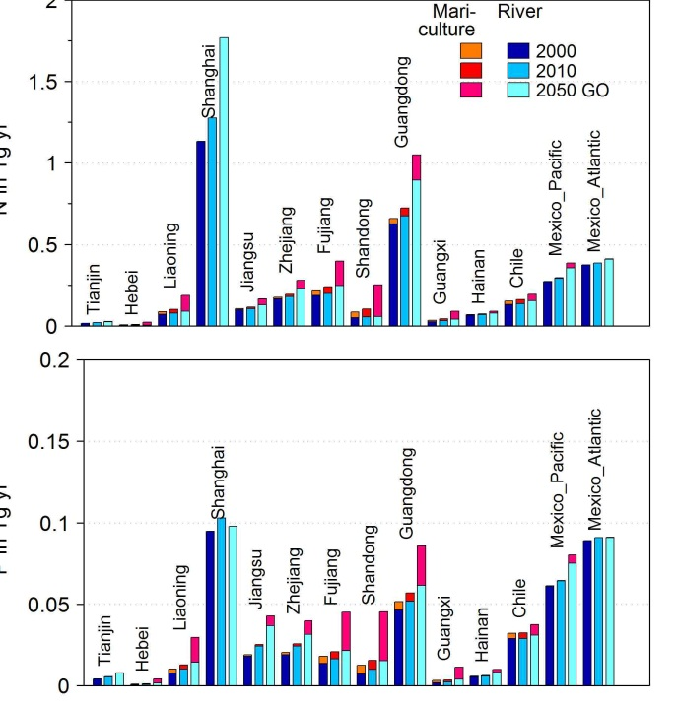
GEF Component B
Combine Global NEWS and aquaculture:
Published in
Environmental Research Letters 2013 044026
doi:10.1088/1748-9326/8/4/044026
See the video abstract:
http://iopscience.iop.org/1748-9326/8/4/044026/
N in Tg/yr
P in Tg/yr

Slide 6
GEF Component B
  B2.3: Coastal conditions and coastal effects: in progress (WSU, UU) will be completed 2015
  B2.4: Observed impacts
    B2.4.1: Occurrences of hypoxia and harmful algal blooms (WSU, UU); expected 2015
    B2.4.2: Impacts on fisheries (WSU); expected 2015
B3: Nutrient impact modeling; in progress
  B3.1: Enhance predictive capability of models (UU, WSU)
    McCrackin, M., J.A. Harrison, and J.E. Compton, (2014) Factors influencing seasonal export of dissolved inorganic nitrogen by major rivers, Global Biogeochemical Cycles, DOI: 10.1002/2013GB004723.
    Liu, M., K. Rajagopalan, S. H. Chung, X. Jiang, J. Harrison, T. Nergui, A. Guenther, C. Miller, J. Reyes, C. Tague, J. Choate, E.P. Salathé, C.O. Stöckle, and J. C. Adam, (2014) What it is the importance of climate model bias when projecting the impacts of climate change on land surface processes? Biogeosciences, doi:10.5194/bg-11-2601-2014.
  B3.2: Assess effects of nutrient loading (WSU, UU)
  B3.3: Analyze maps of past, current and future contributions of different nutrient sources (WSU, UU)
    McCrackin, M., J.A. Harrison, and J.E. Compton, (2014) Future riverine nitrogen export to US coastal regions: prospects for improving water quality amid future population growth, Journal of Environmental Quality, 10.2134/jeq2014.02.0081
    Sobota D.J., J.E. Compton, and J.A. Harrison (2013) Reactive nitrogen in the United States: How certain are we about sources and fluxes? Frontiers in Ecology and the Environment. doi:10.1890/110216.
    McCrackin, M., J.A. Harrison, and J.E. Compton, (2013) A comparison of NEWS and SPARROW models to understand sources of nitrogen delivered to US coastal areas, Biogeochemistry, doi:10.1007/s10533-012-9809-x.
    Harrison, J.A., J. Mogollón, A.F. Bouwman, and A.H.W. Beusen, Insights from a New Accounting and Synthesis of Coastal Nutrient Delivery at the Global Scale, Oral Presentation and Abstract, IMBER, Bergen, Norway, 7/14

Slide 7
GEF Component B
B4. Development of regional models of coastal effects under different physical regimes using regional data
B4.1: Database covering the watersheds discharging to Manila Bay (UP)
  Will be updated to include results from concluded studies from partner agencies (BSWM, PNRI, PEMSEA)
  Nutrient data from earlier draft database will be updated (PEMSEA)
  Final to be delivered April 2014 (original timeline)
In progress: Preparation to modelling; interaction and cooperation of PEMSEA

Slide 8
GEF Component B
B4.2: High resolution river export model (UP)
  Preliminary nutrient load model completed after working visit at Utrecht with Bouwman and Beusen (UU) (100%)
  Currently updating data and maps needed for improvement of nutrient load model (80%)
  Processing of inputs in a finer resolution grid
  Addition of agricultural and aquaculture component to model (80%)
  Update for export of other N forms as input to DELFT3D
B4.3: Ecosystem model for Manila Bay (UP)
  Work in progress
  2D model has been set up, work on 3D model (60%)
  B4.3: set up DELFT3D WAQ for B4.3 to complement the hydrodynamic and water quality models
  Review of related literature for model parameters (local values, emission rates, etc) (50%)
  Set up of grid system, boundary conditions (50%)

Slide 9
GEF Component B
B4.4. Testing and application (UP)
  Scenario building (50%)
Sabbatical John Harrison (WSU) at UU (October 2013-April 2014) worked together and shared experiences, models and data
Working visit of UU to UP last April 2014
  Modeler’s workshop with PEMSEA and other partners (April 2014)
  Follow up workshop in October 2014
Work visit Lara Sotto (UP) (October 2013) to Utrecht.
Working visit of UP to UU (April or May 2015)
Publications:
  Sotto, L. Jacinto, G., Villanoy, C. 2014. Spatiotemporal variability of hypoxia and eutrophication in Manila Bay, Philippines during the northeast and southwest monsoons. Marine Pollution Bulletin 85: 446-454.
  Oral presentation of “Nutrient ;oad estimates for Manila Bay using population data.” at the IOC WESTPAC in Vietnam (April 2014)
    Paper submitted for publication, under review, Ocean Science Journal

Slide 10
Poster presentation as a result of working visit of Lara Sotto and Cesar Villanoy;
UU (Bouwman, Beusen) will travel to Manila 6 April

Slide 11
Component B
B5: Develop summary models of nutrient impact on coastal eutrophication for use in toolbox under component C
  Summary model for impact of nutrients on harmful algal blooms: in progress, to be completed spring 2015 (UU)
  Model for impacts of nutrients on hypoxia: in progress, to be completed 2015 (WSU)
  Analysis of relationships between N loading, hypoxia, and fisheries (WSU): in progress, to be completed 2016.
B6: Training workshop
(IOC/UNESCO, UU, WSU, UP)
  Completion: Preliminary scheduled for IWC8 VN late 2015

Slide 12
Component B
B7: Nutrient source-impact guidelines
(IOC/UNESCO and UNEP/GPA, WSU, UU, UP)
  Completion: WP says Mid-term review (24 months): first version; 30 months: final version

