Slide 1
Concepts for the environmentally sound management of surplus mercury
Sven Hagemann
GRS

Slide 2
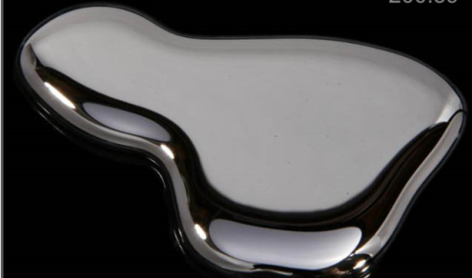
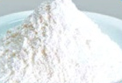
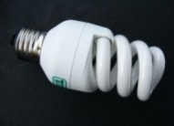
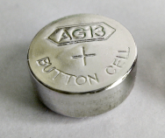
What is Surplus Mercury?
National/ regional mercury supply
National/ regional surplus
Elemental Hg &
Hg compounds like calomel
Need to manage
surplus mercury
→ storage
→ disposal
National / regional demand for products & proceses

Slide 3
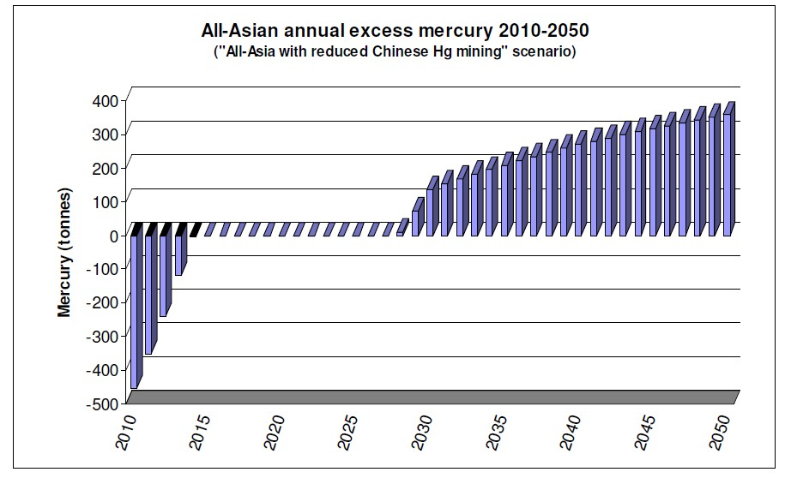
How Much Surplus Mercury Will Have to be Managed in South/ South East and East Asia? (Concorde 2009)
Main assumptions:
VCM production: decrease of consumption after 2015
Zinc smelting: strong increase of Hg recovery between now an 2030
Regional surplus
5,500 t (2029-50)
Possibly national surpluses
?
?
Alternative scenario:
7,500 t 2027-50
(reduced supply for ASM)
Management options for
surplus mercury?
AIT/RRCAP study (2010)

Slide 4
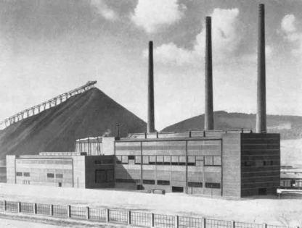
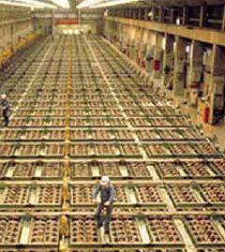
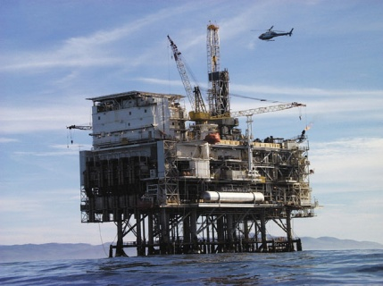
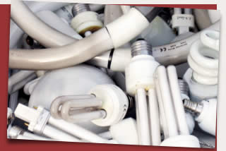
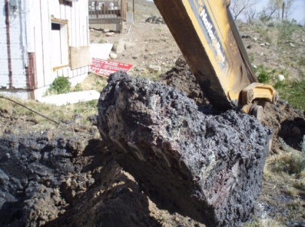
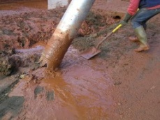

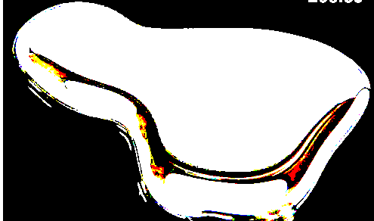
Important Sources of Surplus mercury
Decommis-sioning of mercury cells
(chlor alkali)
Contaminated sites
Non –ferrous metal production (zinc, gold)
Oil & gas industry
End of life products
Primary waste type
Mercury contaminated material
Mercury containing products
Mercury compounds
Elemental
mercury
Export

Slide 5
What is Environmentally Sound Manage of Wastes?
Taking all practicable steps to ensure that
    hazardous wastes or other wastes are managed in a manner which will
      protect human health and
      the environment
      against the adverse effects which may result from such wastes
      (Basel Convention, Article 2.8)

Slide 6
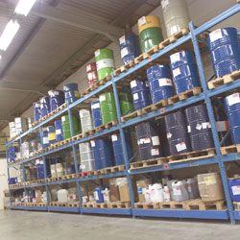
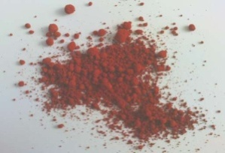
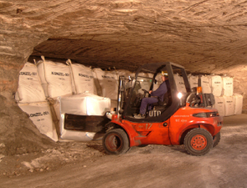
Practised Surplus Mercury Management Options
Surplus mercury
Temporary storage
Removal from the market (storage)
Elemental mercury
Aboveground storage in warehouses (up to 40 years or more)
Stabilization
Temporary storage
Mercury compounds like calomel (mercurous chloride)
Removal from the biosphere (disposal)
Possible interim step (up to a few years)
Permanent storage in underground mines
Polluter-pays principle:
producer to bear all storage/ disposal cost

Slide 7
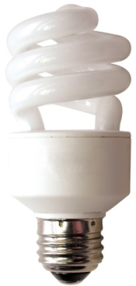
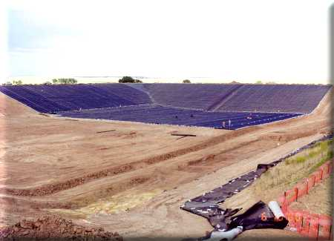
Management Options for Mercury Wastes
Extraction
Use
Temporary storage
Waste containing mercury
(e.g. end of life products)
Stabilization
?
Specially engineered landfill
Temporary storage
Stabilization
Waste contaminated with mercury
(e.g. soil, debris)
Permanent storage in underground mines

Slide 8
Range of Removal Strategies –in Use
and Under Investigation
Surplus mercury
Waste containing or contaminated with Hg
Mercury compounds
e.g. calomel
Elemental Hg
Stabilized mercury waste
(e.g. mercury sulphide)/
Temporary storage
of Hg compounds
Temporary storage
of elemental Hg
Temporary storage
of stabilized Hg
Removal from
the market
Aboveground warehouse storage
(not time-limited)
Underground storage
(final disposal)
of Hg compounds
Underground storage (final disposal) of elem. Hg
Underground storage (final disposal)
of stabil. Hg
Specially
engineered
landfills
Deep well injection
Removal from the biosphere (final disposal)
8

Slide 9
Potential elements of environmentally sound management of surplus mercury
Effective Collection
Early Stabilization
Safe Disposal
Remove mercury from the market
Obligation to deliver/ store surplus mercury
Temporarily store elemental mercury
Avoid transport and storage of elemental mercury
Stabilize mercury
Temporarily store stabilized mercury and mercury compounds
Isolate mercury from the biosphere
Underground storage
Specially engineered landfills?
Deep injection?

Slide 10
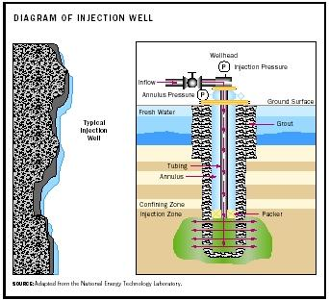
Brief overview on storage and disposal concepts
Aboveground storage in warehouses (up to 40 years or more)
Specially engineered landfill
Temporary storage
Permanent storage in underground mines
Deep well
injection

Slide 11
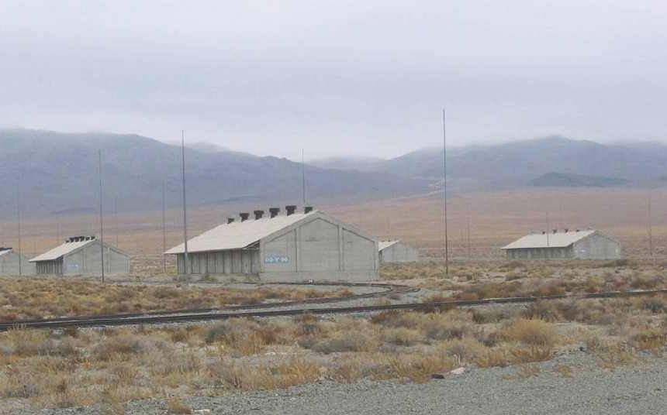
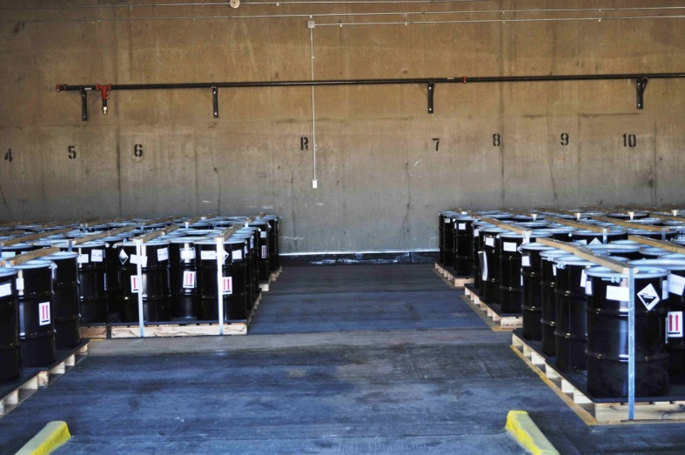
Long-term Management and Storage of Elemental Mercury in Warehouses
Concept
Placement of containers in aboveground warehouses
Technical safety measures:
  flooring, containers, fire protection
Organizational safety measures
  Monitoring, inspection, security
Implementation and options
USA: several facilities in use
Global options: locations with distance to sensible areas (population, water basins) and
low risk of environmental hazards
Notes:
In the USA, elemental mercury has been safely stored in form of govermental stockpiles for more than 50 years.
Costs:
US DOD: 15,000 USD/t for 40 years (US DOD storage facility for 4436 t). Project costs: 68,2 Mio USD. One-time costs: 11,2 Mio USD, Rent for 40 years: 57 Mio USD. Source Lynch (2007) DNSC Mercury Storage Costs
US DOE: 2400 – 7000 USD/t for 40 years (US DOE storage facility for 7,500 to 10,000 t). Project costs 17,8 to 51 Mio USD (all net present values)
Costs include closures costs (addtional 10 years of storage or stabilization & disposal). Source: USEPA 2007 Mercury Storage Cost Estimates

Slide 12
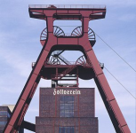
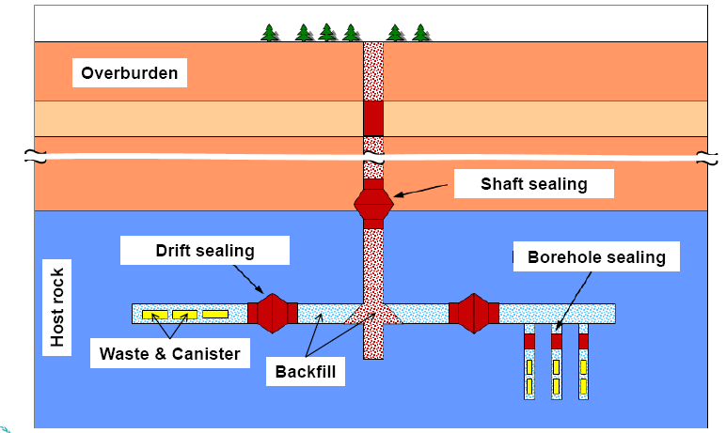

Underground Storage (Disposal) of
Stabilized Mercury and Mercury Compounds
Concept:
Placement of containers in an underground mine
Sealing of mine and permanent isolation of mercury from the biosphere: >10,000 years
Passive long-term safety through multibarrier system (geological + technical barriers)
Implementation and options
Some European countries
Global options:
Existing underground mines
(salt, metal ore, other) with suitable geology
Notes:
Costs: Stabilization + disposal: 2,000 EUR (2,700 USD) (one time cost). Source: DELA/ SAKAB

Slide 13
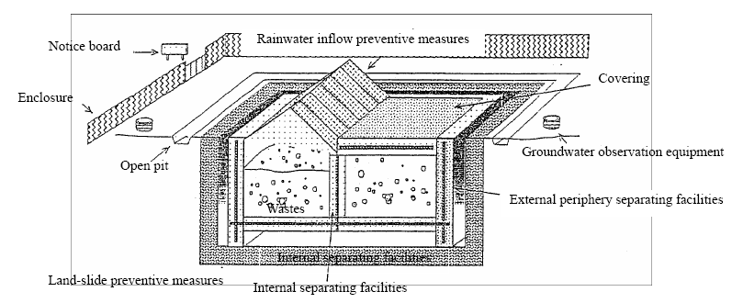
Specially Engineered Landfill I
Complete isolation of wastes from the biosphere through
  combination of a geological barrier and a bottom liner system during the operational phase
  combination of a geological barrier and a top liner during the closure and post-closure phase
For a defined time period, a landfill site can be engineered to be environmentally safe
Notes:
Under EU legislation only waste containing as leaching limit value 0,2 mg/kg dry substance (L/S= 10 l/kg, landfills for non-hazardous wastes); and leaching limit value 2 mg/kg dry substance (L/S = 10 l/kg, landfills for hazardous wastes) can be accepted.

Slide 14
Specially Engineered Landfill II
Complete isolation from the biosphere by:
  Before operation: Protection of groundwater: geological system + bottom liner
  After closure: top liner
Operation and management
  Landfill gas control
  Drainage and leachate control
  Waste acceptance criteria
  Environmental Monitoring
Notes:
Under EU legislation only waste containing as leaching limit value 0,2 mg/kg dry substance (L/S= 10 l/kg, landfills for non-hazardous wastes); and leaching limit value 2 mg/kg dry substance (L/S = 10 l/kg, landfills for hazardous wastes) can be accepted.

Slide 15
Specially Engineered Landfill III
Final resort, only if other efforts to avoid or eliminate Hg contamination failed
May be operated for
  mono-disposal: only one waste stream
  Co-disposal: many wastestreams including municipal waste (more complex, not recommended)
Only after stabilization/ solidification
Only if waste acceptance criteria are met (e.g. leaching limit)
In some countries not allowed for waste with high Hg content
Notes:
Under EU legislation only waste containing as leaching limit value 0,2 mg/kg dry substance (L/S= 10 l/kg, landfills for non-hazardous wastes); and leaching limit value 2 mg/kg dry substance (L/S = 10 l/kg, landfills for hazardous wastes) can be accepted.

Slide 16
Specially engineered landfills III
Opportunities and challenges
Opportunities
Well established concept, already present in many developing countries
Relatively low costs
Challenges
Safety may only predicted for some tens of years
Mercury sulfide not thermodynamically stable in above ground landfills (oxidation, formation of elemental mercury)
Present landfills may become future source of releases

Slide 17
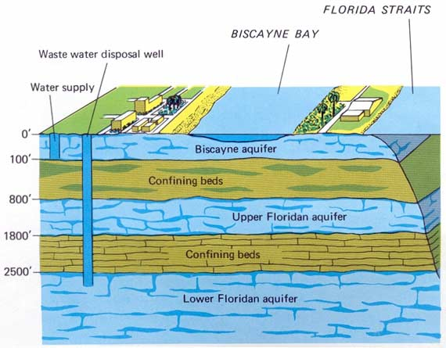
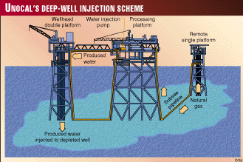
Deep Well Injection of waste I
Injection of liquid or liquified waste into deep geological formations
Formations shall have no connection to higher groundwater levels >10.000 y.
Use of existing wells
  depleted oil/ gas deposits
  Salt caverns
Newly drilled wells

Slide 18
Deep Well Injection of waste II
Typically used in the oil/gas industry, e.g. for Hg contaminated sludges
Examples: Thailand, Croatia
In few countries used to dispose waste from other sources (chemical industy, CO₂)

Slide 19
Deep Well Injection of waste III
Opportunities and challenges
Opportunities
Well known concept in the oil & gas industry for waste from this sector
Challenges
Typically not used for waste from other sources
Requires careful well construction and sealing to avoid contamination of higher groundwater levels during or after operation
No control after injection, retrieval technically impossible

Slide 20
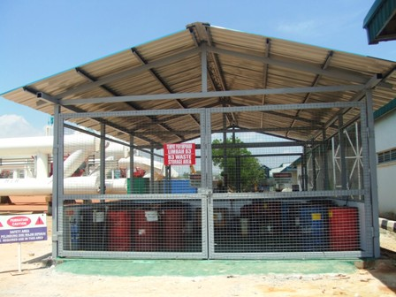
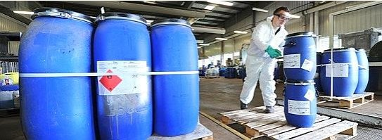
Temporary storage
Temporary holding of waste before waste is
collected
stored elsewhere
disposed
Interim/ preliminary storage: by the owner/ producer
Storage: by waste management company (private/ state) before waste is submitted for treatment, final disposal, recycling or recovery

