Slide 1
Temporary storage
Sven Hagemann
GRS

Slide 2
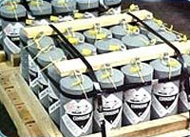
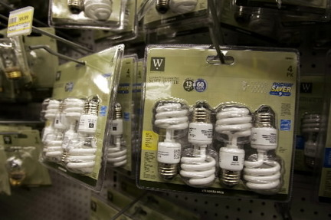

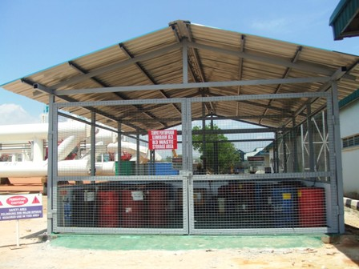
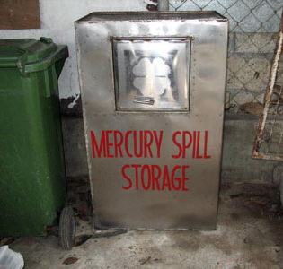
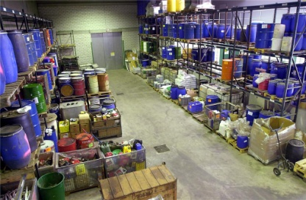
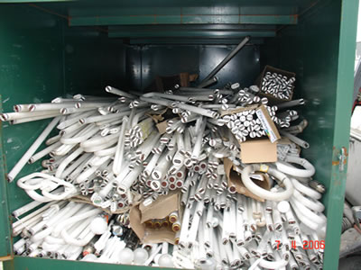
Types of temporary storage
Storage of commodity mercury
→ Dealer, wholesaler, governmental stocks
Storage of mercury added products
→ Dealer, user, owner
(Preliminary/ interim/ temporary) Storage of waste by the owner or last user before collection
  Industrial waste
  End of life products (e.g. thermometers in hospitals)
Storage of waste pending other disposal operations
→ Public or private waste storage facilities

Slide 3
Temporary Storage of Mercury Waste (Industry)
Purpose: Store hazardous waste until they are collected and tranbsported to waste management company

Slide 4
Temporary Storage of Mercury Waste (Industry)
Typically, within existing on-site storage facilities for hazardous waste
Permit to store waste for a limited time (e.g. 1 year)
Unlimited storage of goods and products
Increasing strength of requirements depending on waste types and volumes
May easily be built or use expanded and then serve as a national mercury waste storage facilites.

Slide 5
Temporary Storage of Mercury Waste (Industry) - Requirements
Has to fulfil legal requirements for management of hazardous materials and waste
Protection against
Weather
Unauthoried access (e.g. through locked cabin, room, area with fence and guard)
Fire
Physical impact
Operation
Storage of mercury and mercury waste in separated sections of the facility
If in building, separate storage area from rest by non flammable Walls.

Slide 6
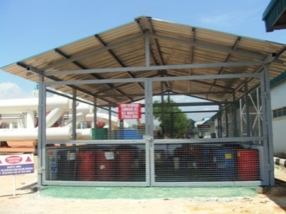
Temporary Storage of Mercury Waste (Industry) – Opportunities and Challenges
Opportunities
Broadly available
May be used for other hazardous waste types as well
Challenges
Private operators of existing facilities may not accept waste from other sources

Slide 7
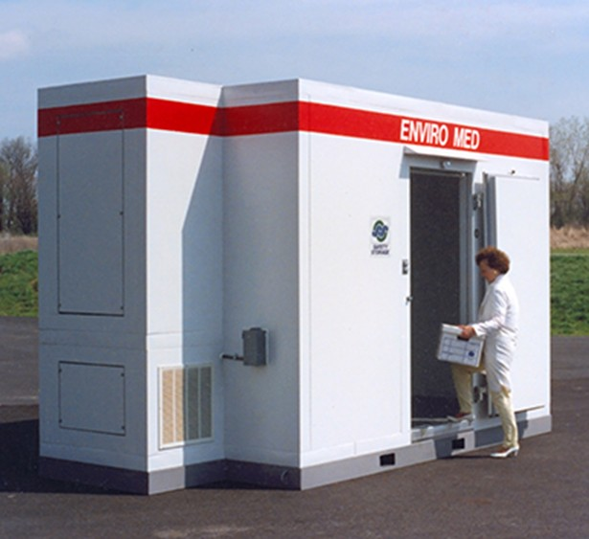
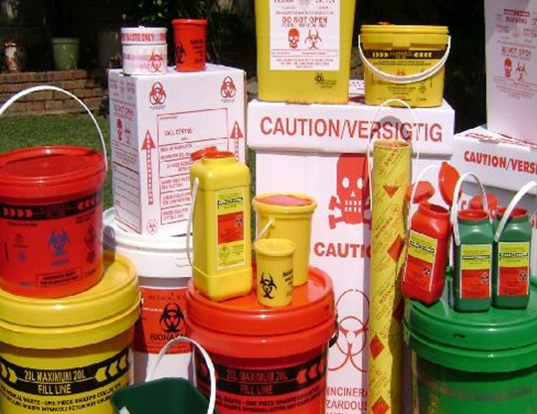
On-site storage in hospitals
Purpose: Store waste until it is collected for disposal or recycling

Slide 8
On-site storage in hospitals
Siting within the building
secure, restricted-access area
storage space should be locked to prevent theft
readily accessible to personnel who are authorized
Equipment
Exhaust vent
A roof and walls that protect from the weather, insects, and other animals;
Floor made of a material that is smooth and impervious to mercury
Containment tray directly below the waste containers

Slide 9
On-site storage in hospitals
Packaging, Containers
Devices + lamps: store in original packaging if available
Other waste types: store in closed unbreakable container, put primary container in secondary container to add safety
Clear labeling and warning signs
Operation
Mercury waste should be kept segregated from other waste forms
Personnel protection equipment, a spill kit, and wash areas
Should be kept cool and dry (ideally below 25°C)
Entrance marked with warning signs

Slide 10
On-site storage in hospitals
– Opportunities and Challenges
Opportunities
May be easiliy implemented with available cheap materials
Challenges
Hospital not the right place to store hazardous waste: storage should be as short as possible
What to do, if centralized storage facility for mercury waste does not exist?

Slide 11

Centralized storage facility I
Purpose
Store waste until it may be shipped to a final disposal or recycling facility

Slide 12
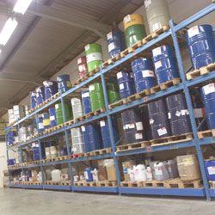
Centralized storage facility I
Siting
At least 150 m distance to sensitive areas
Secure area to prevent theft
Accessible to trucks
Not in areas prone to natural disasters (otherwise measures needed so that facility withstand environmental impact)

Slide 13
Centralized storage facility II
Design
Size sufficient to hold waste expected for the region being served
Natural or forced ventilation
Fire detection and fire suppression system
4 separate areas: receiving, inspection, storage, administrative
Separate drainage/ waste water collection
Sealed floor and sinks
Storage racks with plastic containment trays
Operation
Mercury monitoring
No storage with incompatible waste (e.g. metals, gases …) or other liquids
Personal protection equipment available
Emergency plans
Record keeping, reporting
Documented procedures, training

Slide 14
Centralized storage facility
– Opportunities and Challenges
Opportunities
May be used for other hazardous waste types as well
Releases hospitals and other non-industrial waste producers from storing hazardous waste
Challenges
Significant investment, possibly similar to warehouse storage of elemental mercury
Needed rather soon
Difficult to predict necessary size since final disposal facilities not yet available

Slide 15
Conclusions
Requirements Facilities for storage of mercury waste exist
Well established experience
Centralized storage facilities are needed in almost countries to safely manage mercury and mercury waste until final disposal facilities become available
In larger countries possibly need for several centralized facilities
Siting
At existing facilities for hazardous waste management (recycling, disposal facilities)
In industrial areas
Possibly usage of existing warehouses or factory workshops after their technical improvement

