Slide 1
GPNM Task Team on Nutrient Performance Indicators and Nutrient Use Efficiency Workshop
Terry L. Roberts,
International Plant Nutrition Institute
December 8-9, 2014
USDA South Building, Rom 3109
140 Independence Ave SW
Washington, DC

Slide 2
Background …
GPNM established the Performance Indicator/NUE Task Team in May 2013 to:
  develop definitional parameters for NUE, define base line NUE data at the global as well as regional level, offer a suite of nutrient performance indicators, and establish NUE targets for major crops.
Workshop goal: develop a GPNM position statement and/or recommendations on tools policy makers might use to assist in making decisions about NUE and indicators
Notes:
Our Task Team was established by GPNM in May 2013. We were asked to:
Develop definitional parameters for NUE (due by Mar 31, 2014)
Define base line NUE data at the global and regional level ( due by Mar 31, 2014)
Offer a suite of nutrient performance indicators (due June 30, 2014)
Establish NUE targets for major crops (due July 2015)
We met in March in Bhubaneswar, India and had a conference call in July … made some progress.

Slide 3
Task Team Members
Albert Bleeker, ECN, Netherlands/INI
Simon Costanzo, U of Maryland Center for Environmental Science
Eric Davidson, Woods Hole Research Center, MA/INI
Achim Dobermann, Rothamsted Research, UK
Jan Willem Erisman, Louis Bolk Institute, Netherlands
Ray Knighton, Washington, DC, USDA-NIFA
N. Raghuram, GGS Indraprastha University, India/INI
Rob Norton, IPNI Australia/New Zealand
Terry Roberts, IPNI, USA (Task Team Chair)
Amit Roy, IFDC, USA
Mark Sutton, Centre for Ecology & Hydrology, Scotland/INI

Slide 4
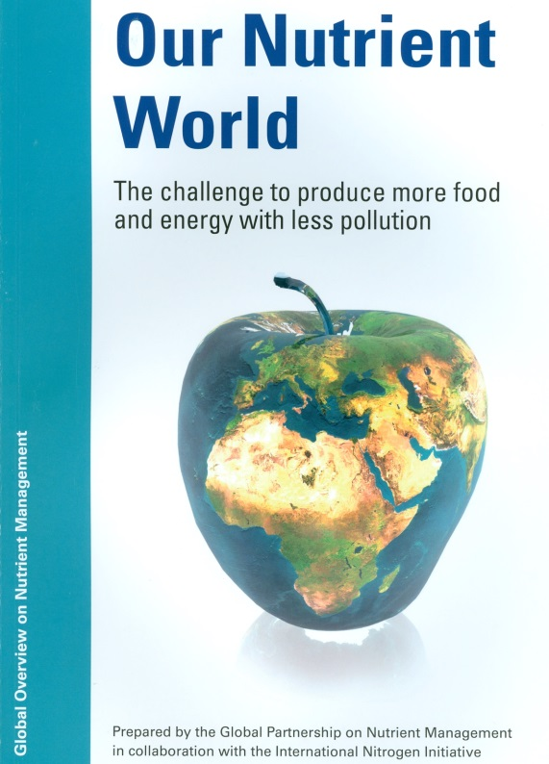

Background …
  Proposed an aspirational goal of 20% increase in crop NUE and full-chain NUE by 2020
  Proposed a 30% increase in crop NUE by 2030, relative to current levels in countries with low efficiency
Notes:
SDSN has 12 thematic groups … Group 7 released there report Sustainable Agriculture and Food Systems in September, 2013.
From Goal 6a in the report: Ensure sustainable food production systems with high yields and high efficiency of water, nutrients, and energy, supporting nutritious diets with low food losses and waste.
Indicator: Full-­‐chain nitrogen [phosphorus] use efficiency (% or rate of progress relative to a defined gap to close)
Comments: Defined as the ratio of nutrients in final products (e.g., human food consumed) to new nutrient inputs into terrestrial, aquatic and atmospheric cycles (e.g., nitrogen from chemical synthesis or biological N fixation, minerals mined and applied as fertilizers, etc.). It takes into account livestock and other stages of the food chain, as well as recycling. This indicator could track improvements in nutrient efficiencies along the full chain in countries with low efficiency levels. Because of different contexts, specific targets would have to be country-­‐specific, i.e., defined so as to reduce the gap between current and targeted full-­‐chain nutrient use efficiency levels. This indicator could also be disaggregated further, for example for major food systems (chains). A backcasting approach should be applied to identify technology and policy options for achieving specific full-­‐chain efficiency targets.
Aspirational outcomes: Full-­‐chain efficiency of nitrogen and phosphorus has increased by [x]% relative to current
levels in each country with sub-­‐ optimal efficiency (e.g., high nutrient consumption relative to actual yield). For countries with low full-­‐chain efficiency an aspirational target could be to reach, by 2030, a 30% increase relative to current levels.
Indicator: Crop nitrogen use efficiency (%)
Comments: Defined as the ratio of nitrogen in harvested crop products to the amount of nitrogen applied (per cropping season or year). It is directly related to the efficiency of fertilizer use on agricultural land, including new technologies and stewardship programs targeting farmers and advisors41. Interpretation and specific targets for crop nitrogen use efficiency are
context-­‐specific, primarily depending on yield, current nitrogen use, soil quality and other factors.
Aspirational outcomes: Crop nitrogen efficiency increased by [30]% relative to current levels in countries with low efficiency. Unsustainable soil nutrient depletion halted and reversed in countries with insufficient nutrient use, resulting in increased crop production and economic return.

Slide 5
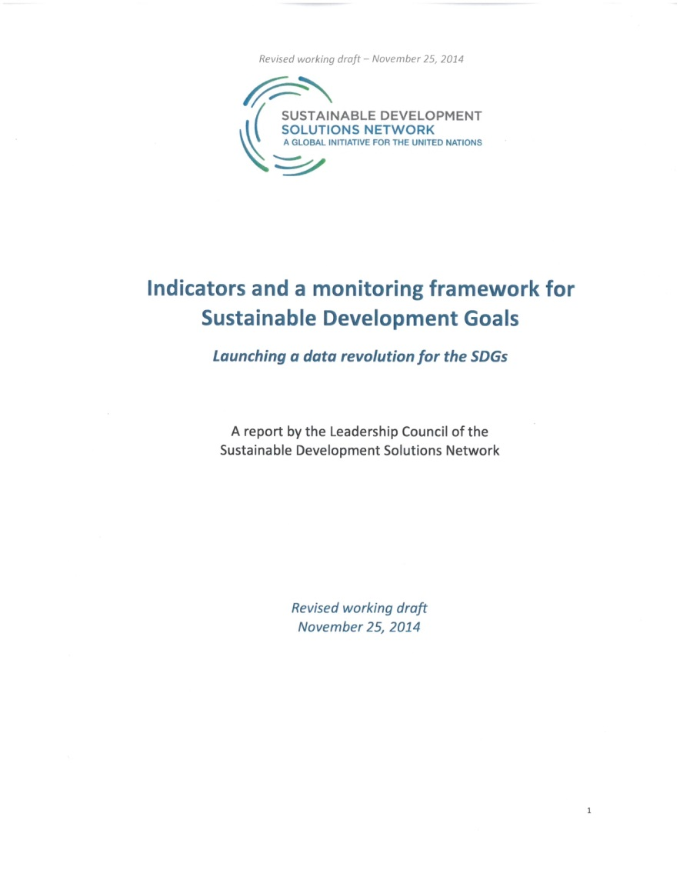
SDSN’s suggested indicators …
Goal 2. End hunger, achieve food security and improved nutrition, and promote sustainable agriculture.
10 Crop yield gap (actual yield as % of attainable yield)
12 [Crop N use efficiency (%)] – to be developed
13 [Excessive loss of reactive N [and P] to the environment (kg/ha)] - to be developed
Source: http://unsdsn.org/resources/publications/indicators/

Slide 6
Challenging task … NUE can be defined and calculated in many ways
Measure | Calculation | Typical Levels for N (Maize and Wheat
Partial Factor Productivity | PFP = Y/F (kg grain/kg N) | 40-80
Agronomic Efficiency | AE = (Y-Y₀)/F (kg grain/kg N) | 10 – 30
Partial Nutrient Balance | PNB = R/F (kg N/kg N) | >1 = deficiency <1 = surplus
Recovery Efficiency | RE = (U – U₀)/F (%) | 0.3 – 0.5
Y=yield, F=fertilizer, R=removal, U=uptake
Source: Dobermann, 2007
Notes:
The different forms of nutrient use efficiency have different uses.
Partial factor productivity is useful for evaluating yield of a particular crop in comparison to nutrient input, within a system. Simple to measure, it can be evaluated at a wide range of scales with readily available data. For cereals, typical values range from 40 to 80 units of yield per unit of nitrogen input. Comparing to crops grown for non-carbohydrate components like protein or oil, however, requires some adjustment to a common basis, for example, calorific value.
Agronomic efficiency is similar, but compares the yield response instead of the total yield. Since this requires a check strip, it is usually limited to research situations.
While both PFP and AE are useful for many crop attributes, they ignore the crop content of the nutrient in question. Since the nutrients applied to crops can often be nutritionally valuable, this is a concern.
The concern can be addressed by using in their place a term with the nutrient in the numerator, like partial nutrient balance or recovery efficiency.
Partial nutrient balance, also known as removal to use ratio, is a crude but useful metric. While its exact target can be a matter of debate, values in excess of 100% indicate eventual deficiency as the soil is depleted or mined by successive crops. Values well below 100% indicate accumulation of surplus. PNB only tells us how much nutrient is removed in the harvested, it does not consider other transfer processes so is not an indicator of nutrient loss to the environment.
Recovery efficiency focuses more closely on the crops ability to access and take up nutrients applied. While it can be informative for study of physical and physiological process, it means little in terms of annual system performance. Like agronomic efficiency, it requires unfertilized yields to be low in order for the efficiency to be high, implying high dependency on annual inputs. The environmental impact of residual nutrients varies with the soil’s ability to retain nutrients: for example, residual P remains plant-available in many soils and climates, and in arid and semi-arid environmental like Western Canada, and I imagine parts of Australia, even nitrate can have residual value from one crop to the next.
So, nutrient use efficiency takes on many forms and meanings, but is always a ratio of output to input.

Slide 7
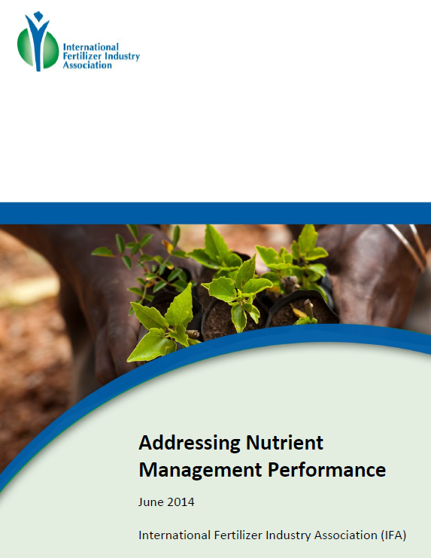
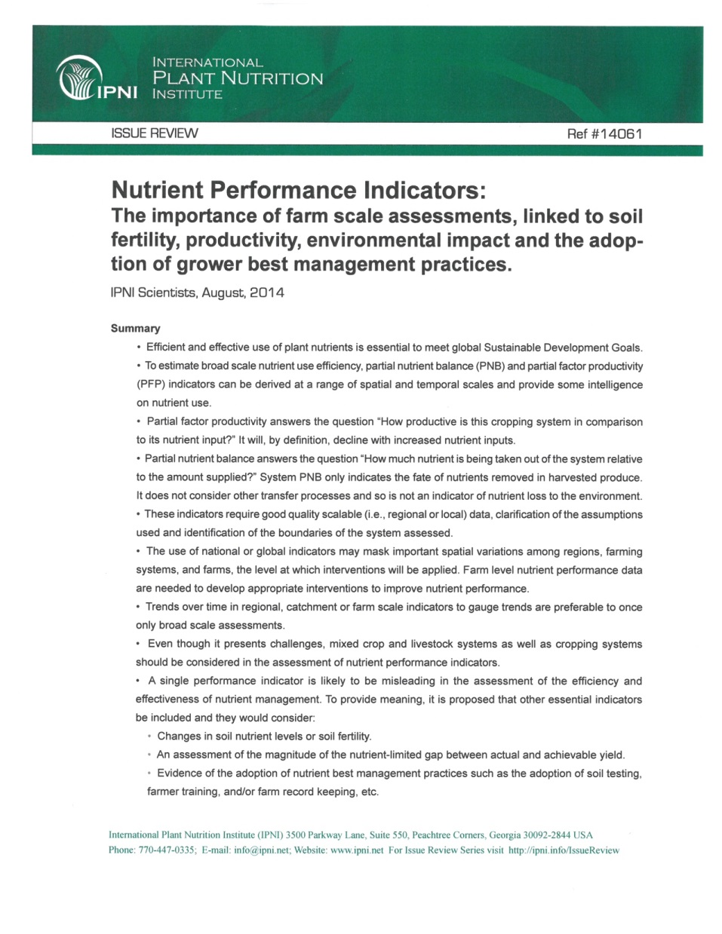
Challenging task … addressed by the fertilizer industry in recent publications

Slide 8
Task Team to date …
Identified Partial Nutrient Balance (PNB) as an appropriate measure of NUE.
  PNB is also known as “removal efficiency” or “output/input ratio”
  Expressed a ratio of nutrient output per unit of nutrient input (removal to use ratio) … PNB = Removal/Fertilizer
    Values > 1 indicate a deficiency
    values < 1 indicate a surplus
Useful indicator, but its prone to misinterpretation or could be misleading unless considered with other indicators such as PFP.
Notes:
PNB (also known as removal efficiency) is the simplest form of nutrient recovery efficiency.
It is usually expressed as a ratio of nutrient output in the harvested crop per unit of nutrient input as fertilizer, i.e. removal to use ratio. Its advantage is it can be measured or estimated at a farm field level or a regional or national level. It is called a partial balance because it does not account for nutrients removed by erosion or leaching or nutrients added via biological fixation,
It assumes if the ratio is close to 1, then soil fertility will be sustained at a steady state. If PNB is <1 then nutrient input is greater than removal suggesting that there could be avoidable nutrient losses and therefore a need for improved NUE. Values > 1 mean more nutrients are being removed in the harvested crop than applied by fertilizer and/or manure, i.e. mining of soil nutrients.
PNB is a useful indicator of NUE, but can be misleading unless considered with other indicators.

Slide 9
Our challenge …
To develop a position statement and/or recommendations GPNM might use to assist others in understanding and making decisions about NUE and indicators
This afternoon we will hear of some of the related activities of other groups and gain a better understanding of the complexities and uses of NUE
  Tomorrow will be open for a round table discussion and input from all the participants and hopefully arrive at a general consensus of an appropriate definition and baseline parameters and related performance indicators

