Slide 1
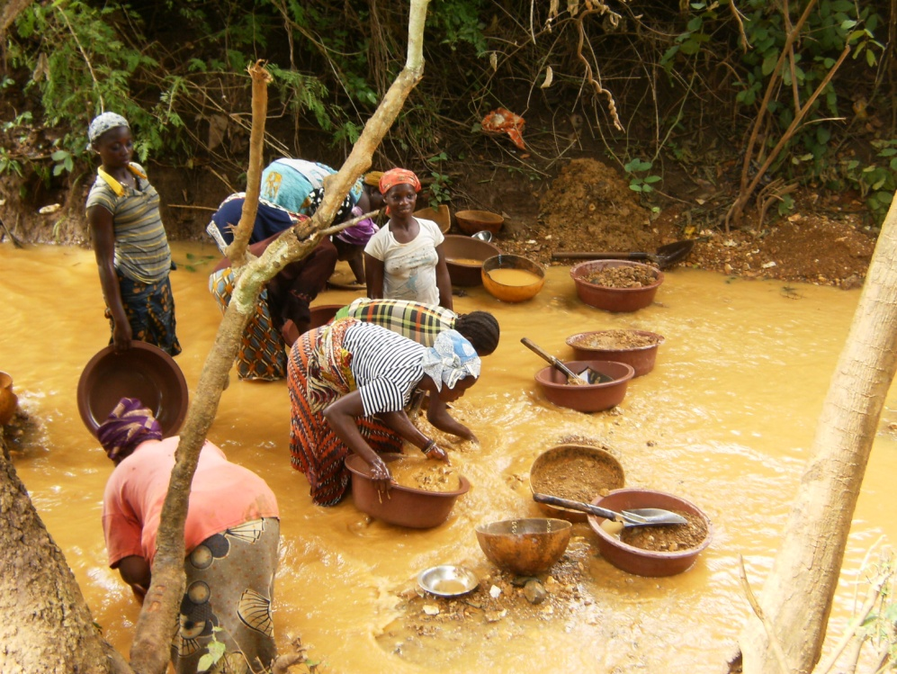
Bilateral funding of ASGM projects
Criteria for selecting partners:
JANE DENNISON
Mercury Program Officer
U.S. Department of State
September 2013
Notes:
ASGM site in Seguela, Cote d’Ivoire- mercury-free!

Slide 2

How do donors select program areas?

Slide 3
Donors want “success”!
In-country reception of project:
    Does the host government welcome?
    Do non-governmental organizations support?
    Does the public support?
Is the project sustainable?
Notes:
A donor is likely to be much more receptive to a project idea if the government has considered the issue deeply and has a strategy for addressing ASGM. Then the government may be able to identify parts of the strategy donors might be interested in assisting, according to their expertise. A carefully thought out request for assistance can be very persuasive.

Slide 4
Other elements a donor might consider
Size of ASGM sector and mercury issue
Is the project innovative? A new model or technique?
Other in-country projects?
  If so, are they coordinated?
  Can funding be leveraged for additional assistance?

Slide 5

Can the donor add value?
Are there on-going activities in-country that the donor can coordinate with?
Is there a specific need for the kind of experience that a particular donor has?
Could a project in a country serve as a model for other countries?

Slide 6
Type of Project?
Technical, training, small-scale mining techniques
Market-based such as mercury-free supply chains
Formalization systems
Good governance such as mining cadastre
Good governance and transparency in extractive industry sectors
Raising awareness: Health impacts
Holistic approaches with multiple considerations
Notes:
Each donor has preferred kinds of projects, depending on size, capacity, specialization

Slide 7

Is the project sustainable?
Will the project be taken on by others in-country after it is complete?
Does the project lead to a positive outcome?
Or will it end up being a report and sit on a shelf?

Slide 8

Let’s get to work!

Slide 9

Jane Dennison, Ph.D.:
Mercury Program Officer
DennisonJE@state.gov

