Slide 1
ASGM
MULTI-STAKEHOLDER REGIONAL WORKSHOP, LAGOS NIGERIA 8-10 JUNE 2011
GOLD IN THE EASTERN REGION OF THE GAMBIA AND THE POSSIBLE IMPACTS OF MERCURY
PRESENTED BY
ALIEU JAWO
GEOLOGICAL DEPARTMENT OF THE GAMBIA

Slide 2
Introduction
Occurrence of Gold in the eastern region of The Gambia
Mercury is use close to the Gambian border
Renewed interest and Prospect for gold
The possibility of mercury been use in the Gambia
Our concern on the use of mercury for gold mining

Slide 3
Gold in the Eastern Region
The occurrence of gold was first reported in 1927
Panning of disintegrated conglomerate materials
Reconnaissance in 1988 and 1995
Traditional land owners practice panning

Slide 4
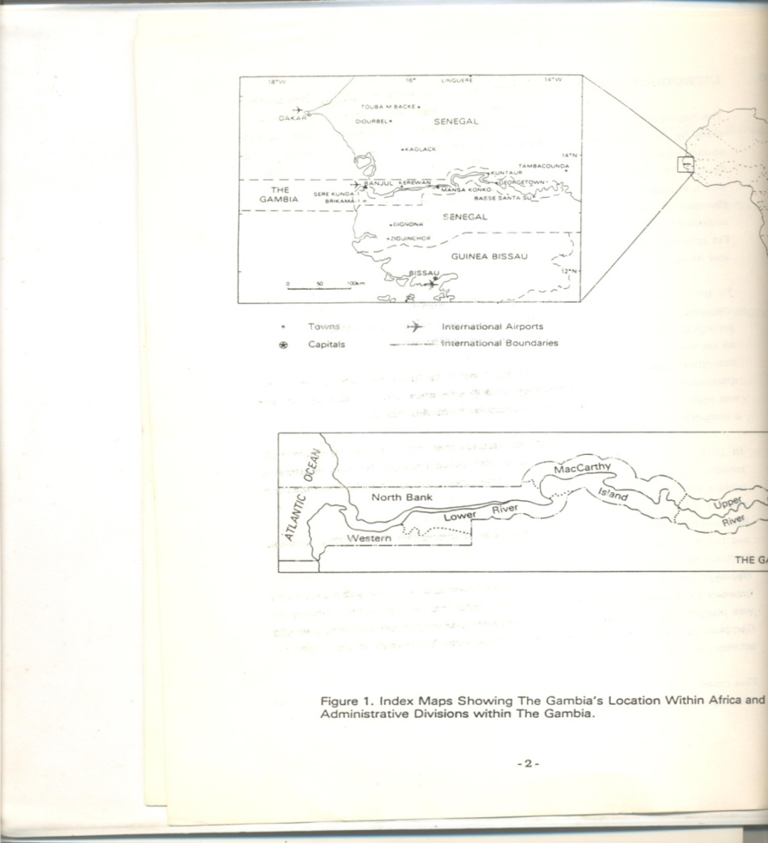
Gold in the Eastern Region- Gambia
Figure 1: showing the map of the Gambia

Slide 5
The practice of using mercury close to the Gambian border
The Tambacounda region in Eastern Senegal shares border with the eastern region of the Gambia
Existence of small scale gold mining
The use of mercury in gold mining
The practice to combine gold and mercury to form amalgam
Possibilities for Gambians involvement in daily mining activities

Slide 6
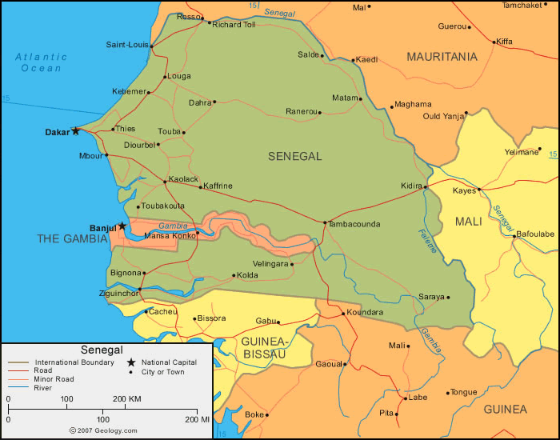
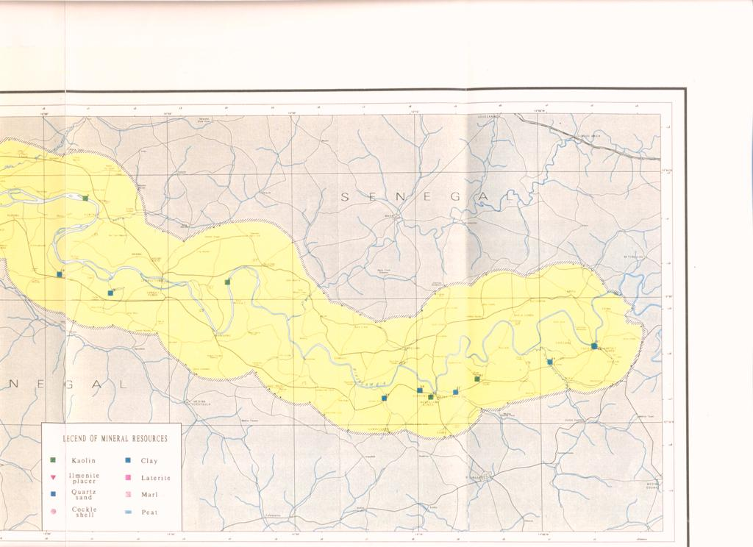
Senegal
Alohungari Sabi
Figure 2: showing the eastern region of the Gambia and the region in Senegal where gold is mining

Slide 7
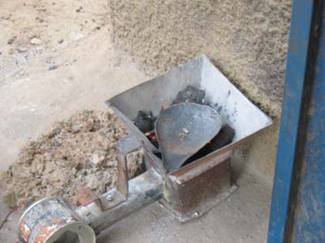
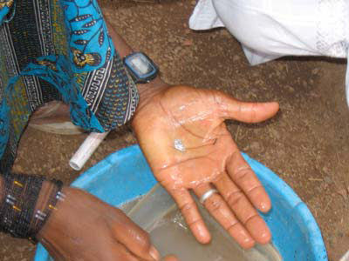
Miners using mercury
Amalgam heated with torch
amalgam
Figure 3:Photo showing how amalgam is made, taken from www.blacksmithinstitute.org

Slide 8
Renewed interest and Prospect for gold in The Gambia
Increase interest in gold prospecting
Government desire to explore its natural resource
The Sabi Alohungari and Sudowol anomalies

Slide 9
The possibility of mercury been use in The Gambia
Illegal miners borrowing the technology from across the border
Cross border trade in gold and mercury
The opening of organise mining could lead to the use of mercury

Slide 10
Our concern on the use of mercury for gold mining and conclusion
The Gambia remain concern on the use of mercury
Impacts of mercury from across the border
The prospects of opening gold mines, could trigger the use of mercury
Gambian readiness to joint efforts to reduce the use of mercury

Slide 11
Thank you

