Slide 1
UNIDO’s Industrial Energy Efficiency Programme
Rana Ghoneim
UNIDO Department of Energy
Opportunities, methodology and results
28 June 2016, Vienna - Austria

Slide 2

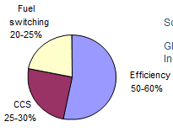
The Importance of Industry
Industry accounts for 1/3 of global energy use:
40% of electricity
77% of coal & derivatives
37% of natural gas
Global Primary Energy Demand by 2030:
50% increase expected
87% from non-OECD countries (industry biggest user)
Opportunities and challenges for industry in the future:
Potential for reduction in energy intensity and emissions by up to 32%, particularly in non-OECD countries
Long-term CO₂ Emission Reduction Potential driven by Efficiency
Industry is the single largest source of GHG emissions:
32% of global emissions
Source: IEA, Technology Transitions for Industry, 2009

Slide 3
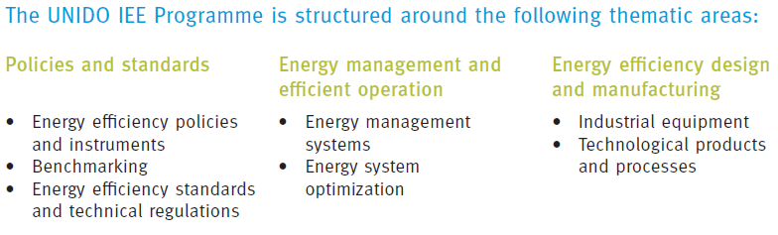
IEE Thematic areas
Notes:
3

Slide 4
Energy efficiency has demonstrated, time and again, that
  It saves industrial firms money
  It increase reliability of operations
  It has a positive effect on productivity and competitiveness
  It can offer attractive financial and economic returns
  Reduces exposure to rising energy prices
  Increases security of supply
  ….
then
Why it is not happening?

Slide 5
Barriers to Industrial Energy Efficiency
Management focus is on production and not on energy efficiency
Lack of information and understanding of financial and qualitative benefits
Lack of adequate technical skills for developing and implementing EE measures and projects
Poor monitoring systems and data
First costs more important than recurring costs → disconnection between capital and operating budgets
When EE knowledge exists it very often resides with individuals rather than with the company/ organization → sustainability risk
……
5
Notes:
5

Slide 6
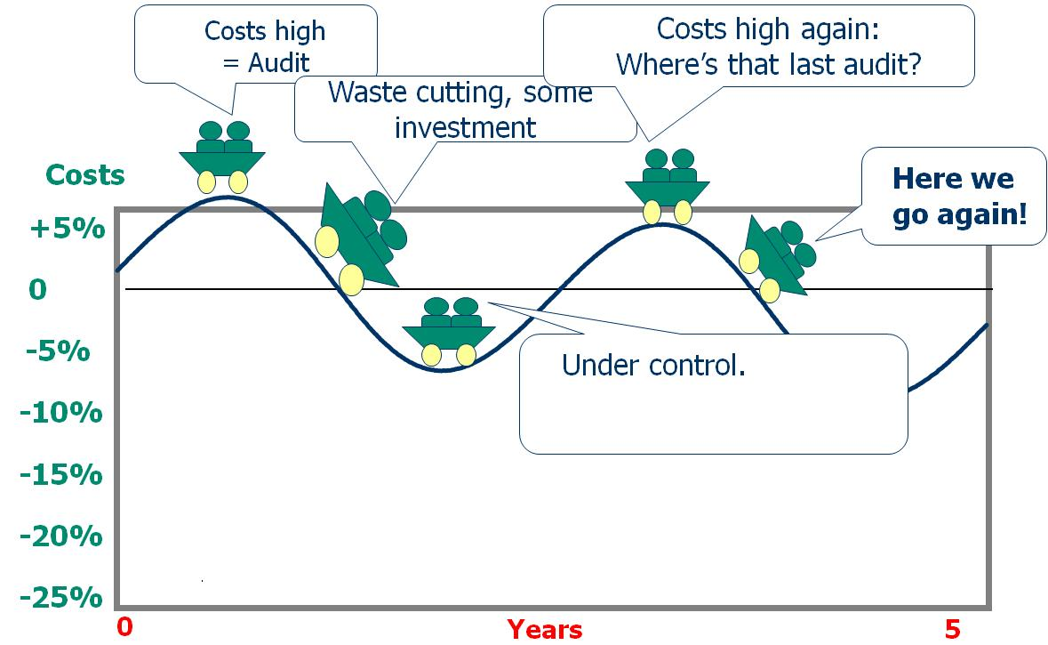
EnMS Goals
Ad-hoc Energy Management Approach

Slide 7
Energy Management Systems & Standards
Energy Management Systems (EnMS) provide structured and systematic approach to integrate Energy Efficiency into industry corporate culture and daily management practices. EnMS provides:
  A framework for understanding significant energy uses
  Action plans for continually improve energy performance
  Structure and organizational framework to sustain energy performance improvements over time and change of personnel
EnMS Standards provide demonstrated policy-driven and market-based tools to disseminate energy management best-practices and support their implementation
Notes:
7

Slide 8
EnMS Goals
Systematic Approach
Senior management commit to EnMS
Costs
+5%
Initial savings
sustained
0
-5%
Housekeeping first – then investment
-10%
EE becomes company culture
-15%
-20%
-25%
Investment
0
Years
3

Slide 9
Component v system approach
Component approach involves segregating components and analyzing in isolation
  Can result from education by particular technology sales engineer, e.g. variable speed drive, steam trap, etc.
System approach involves looking at how the whole group functions together and how changing one can help or impact another
  Requires more knowledge of the system and its interactions
The energy savings opportunities from systems are far greater than from individual components
  2-5 % efficiency gains for individual components against 15-30% average efficiency gains through system optimization

Slide 10
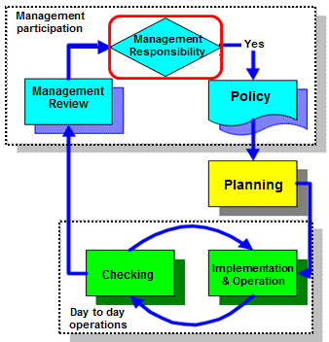
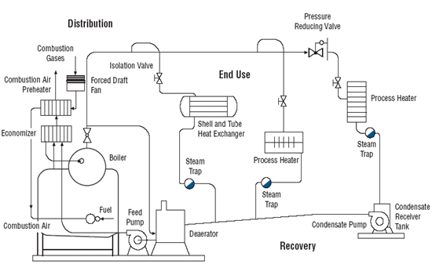
UNIDO Industrial Energy Efficiency Focus Areas
Energy Management Systems
by 2030
Energy System Optimization
by 2030
Distribution
End Use
Recovery
Generation
N.B: Auxiliary energy systems account for over 50% of final manufacturing energy consumption
5 to 15% energy savings in first 1-2 yrs
15-30% average efficiency gains
With no capital investment
4-5% of individual components

Slide 11
UNIDO’s Global IEE Portfolio
Russia
Belarus
Moldova
Ukraine
Kazakhstan
Macedonia ( FRY)
Georgia
Albania
Armenia
Azerbaijan
Turkey
China
Morocco
Tunisia
Lebanon
Jordan
Iran
Algeria
Pakistan
Cuba
Egypt
United Arab Emirates
India
Dominican Republic
Cape Verde
Chad
Laos
Vietnam
Gambia
Burkina Faso
Cambodia
Philippines
Costa Rica
Guinea
Nigeria
Thailand
Colombia
Sierra Leone
Liberia
Maldives
Malaysia
Ecuador
Cote d‘Ivoire
Indonesia
Brazil
Bolivia
Chile
South Africa
TC projects in over 50 Countries

Slide 12
UNIDO IEE-EnMS Programme Outputs
EnMS-ISO 50001 success in delivering expected benefits and impact to organizations and countries will depend on:
Level and quality of policy support, including regulation, granted to the implementation EnMS/ISO50001
Availability of competent professionals to guide, train & assist organizations in implementation
Linking up to financial institutions and developing bankable projects
Policies & Institutions
EnMS Skills, Implement. & Services
Financing
12
Notes:
12
Achieving impact and market credibility
Project work
Technical Assistance for IEE Policies and Programs development and institutional strengthening
IEE market development support through skills and services upgrade, pilot implementation and demand creation
Partnerships for scaling-up IEE investments through enhancement of existing financing mechanisms

Slide 13
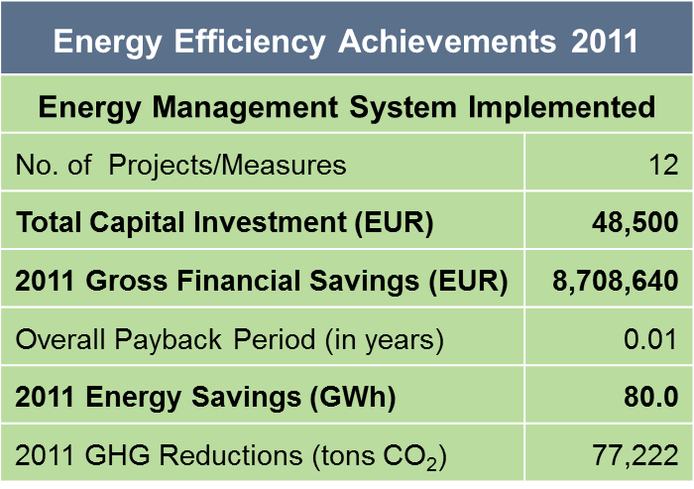
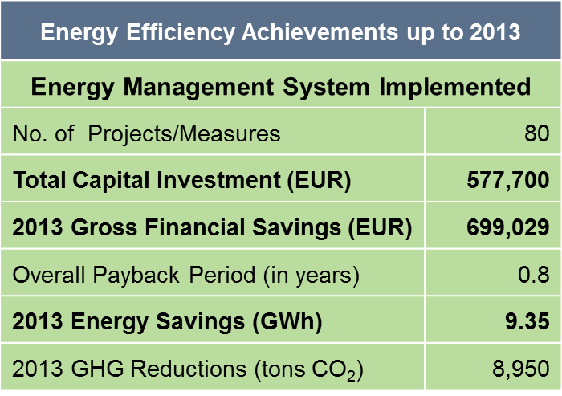
UNIDO EnMS/ISO 50001/ESO Programme in South Africa
ArcelorMittal Saldanha Works
Toyota South Africa
Sector: Steel – Hot Roll Coil
Output: 1.2 Mtons/year
Employees: ~ 700 + 400 contractors
Class of UNIDO Project Intervention: EnMS established and multiple ESO initiatives
Sector: Vehicle Manufacturing
Output: 110,000 units/year
Employees: ~ 8,000
Class of UNIDO Project Intervention: EnMS established and multiple ESO initiatives
Notes:
ArcelorMittal Saldanha Works
Saldanha Works is 1 of 4 Steel plants in ArcelroMittal South Africa. The plant is a flat rolling facility producing 1.2m tons of Hot Rolled coil pa and is primarily focussed on the export market.
The Process :
Integrated Steel Mill producing HRC from Iron Ore
3 Main Production Sections : Iron, Steel and Rolling
Iron :
Consist of a Corex (producing LI) where Coal and Coke is burned to produce CO gas
The gas is utlised for reduction in the top part of the Corex as well as the Midrex Prrocess that produces DRI (solid product).
The Midrex also use around 500t pm LPG
Steel :
The LI and DRI is Feedstock into the Conarc process (combination Converter/Arc furnace) which uses both oxygen and electrcial heating to convert Iron to Steel.
The Conarc is our largest user of electrciity and cost of this process is of great concern to us.
From the Conarc the Steel is poured into ladles an taken to the LHF which also uses electrical heating.
From there is taken to the TSC where is is solidified into a continuous slab of 82mm thickness, cut by a pendulum sheer and carried into a tunnel furnace which primary fuels is the gas left over from the Corex and Midrex processes.
In the situation that the Corex is stopped the RHF switch to pure LPG. It also ahs the capability to enrich the DR gas with LPG should the gas quality not be good enough.
From there the final product of Hot Rolled Coil is produced in the Mills.
We focus on Ultra thin gauge and approximately 30% of our production is 1.2mm and 1mm
We sustain a total of 1100 sustainable jobs (contractors on site + our own staff) , but ultimate impact 7600 sustainable jobs.
Average demand : 160MW
8000 kl/day
Toyota South Africa
Toyota South Africa is located in Durban, KwaZulu-Natal
The produce 5 different vehicles, incl. one light truck and mini-van taxi.
They produce 750 mixed vehicles per day
The implementation of an Energy Management System (EnMS)1 at Toyota SA resulted in a reduction in electricity usage by approximate 35% per vehicle – this a carbon saving of over 460kgs per vehicle.
Total number of projects up to March 2013 is 80 projects up to March 2013 (they are now up to 100 projects by end March 2014.
Total investments required for this total of projects R5.95m (Eur 577,669) for the 80 projects
Total energy saved by this total of projects Total energy saved = 33 649 GJ,
Total cost saving = R7.2m (699,029)
Average exchange rate used 10.3R – 1 EUR.
Toyota’s company policy is to consider all energy initiatives that show a payback period of less than two years. The optimization projects identified and implemented have an overall average payback period of 1.09 years.
As part of the EnMS implementation, in April 2012 the company set up a dedicated Energy Management Department consisting of a senior manager and four engineers, each dedicated to a particular cluster of plants within Toyota Durban, namely:
• Paint and utilities plants;
• Vehicle and component assembly plants, and assembly parts warehouses;
• Welding plants; and
• Non-production areas (administrative areas)
Toyota SA set up a Plan-Do-Check-Act (PDCA) process to ensure effective implementation of the EnMS, including regular and accurate monitoring.
The following steps were then taken:
• An energy policy was developed for Toyota SA, with commitment to continuous improvement;
• Energy audits were conducted and significant energy users identified;
• An automated real-time energy measurement system was implemented for all plants at Toyota SA;
• Energy Performance Indicators (EnPIs), namely GJ/vehicle, were developed;
• Objectives and targets were set and action plans developed to achieve these;
• The plant personnel in all the identified projects were engaged to encourage the necessary support and behavioural change in employees, e.g. switching off equipment during non-production times, such as between shifts and over weekends;
• The energy reduction projects identified and agreed upon were implemented, including the following:
• Occupancy sensors were placed in some of the larger offices;
• Some of the larger, mostly inefficient overhead ventilation systems, were replaced with smaller localised systems;
• Solar water heating was installed in two ablution systems;
• All mercury vapour lighting systems were replaced with energy efficient fluorescent lighting.
• After project implementation, energy-saving results were verified through accurate measurement7.
Throughout the process, feedback was given to senior management on a bi-monthly basis, with demonstration of performance improvement against targets.

Slide 14
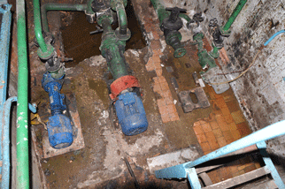
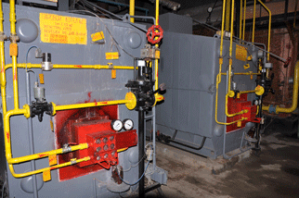
UNIDO EnMS/ISO 50001/ESO Programme in Moldova
LACTIS J.S.C
Open joint stock dairy company (about 10% on Moldovan market)
185 employees
Management started to look into EE in 2009 to reduce production costs and impact of increased energy prices
LACTIS improvements 2011-2012
Energy Management System Implemented
No. of Measures/Projects | 11
Total Capital Investment (USD) | 6,900
Gross Monetary Savings (USD) | 22,000
Overall Payback Period (in months) | 4
Annual Energy Savings (MWh) | 328
2011 GHG Reductions (tons CO₂) | 160
Value of EnMS/EE investments planned in 2012 for 2013-2014 was 410,000 USD
70% implemented so far
Notes:
1 plant with a milk processing capacity of 25,000 tons per year
In September 2011 joined UNIDO Program for implementation of EnMS/ISO 50001
22% annual reduction in natural gas consumption
4% annual reduction in electricity consumption
Same annual production level
Measures implementaed - steam system optimization and adjustments/optimization of production schedules & process; better operations control on production floor, metering and indicators for significant energy uses.
.. .. triggered and driven by EnMS!

Slide 15
UNIDO EnMS/ISO 50001/ESO Programme in Egypt
SIDPEC
Egyptian Joint Stock Company
Petrochemicals sector – Ethylene and polyethylene production
1000 Employees
Excessive Air Utilization
Excessive air from the utility plant was observed. A project was completed which re-directs this excessive air from the utility plant to the Ethylene cracking heaters decreasing the operating hours of decoking compressor.
HS Vents Waste Optimization
Operation conditions for main HS network were closely monitored. By adjusting the operation conditions, steam waste was prevented from the ethylene boiler vent.
25.7 GWh Savings
4.8 Million EGP Savings
ZERO Investment
Results

Slide 16
Summary of Achievements (9 countries)
303 UNIDO Qualified EnMS Experts
271 Enterprises with EnMS implemented
5,183 energy efficiency practitioners and enterprise personnel received training in EnMS
Average annual energy savings of 7,149,215.7 MWh
Annual CO2 emission reductions of 4,302,530 tCO2
Annual savings of $132,000,000 without considering non-energy benefits
NOTE: Please do not quote these numbers because analysis has not been completed yet

Slide 17

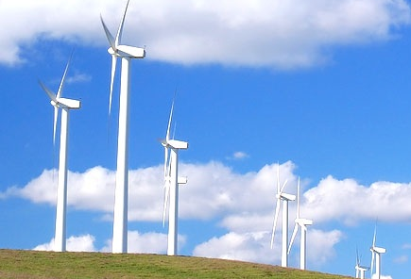
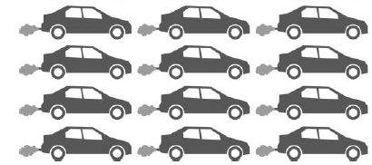
How much energy is 7,000 GWh?
Annual energy consumption of 1,150,000
EU households
CO2 emissions of 1,750,000 middle class cars (running 12,500 km per year)
Annual energy production of
2,000 MW of installed wind power
Annual cost savings of USD 80,000,000 without considering non-energy benefits
Annual CO2 emission reductions of 4.3 million tCO2
17
Notes:
Assumptions for Car equivalence
Car diesel consumption 5 liter/ 100 km
Annual car diesel consumption = 5*12,500/100 = 625 liters
Energy density of diesel = 35.8 MJ/liter
Annual car energy consumption = 625 * 35.8 = 21,875 MJ = 6,078 kWh
Annual energy consumption of 1 mio car = 6,078 GWh
Annual energy consumption of 175,000 cars = 1,060 GWh

Slide 18
Thank you for your attention
For more information:
Rana Ghoneim
Industrial Energy Efficiency Division
Energy Department
UNIDO
Vienna International Centre
P.O. Box 300
A-1400 Vienna, Austria
E-mail: R.Ghoneim@unido.org

