Slide 1
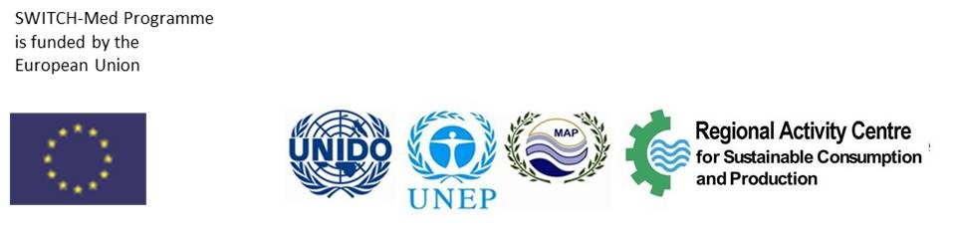
Collaboration with financial institutions
SwitchMed Experience
Carolina Gonzalez
Industrial Resource Efficiency Division
Department of Environment

Slide 2

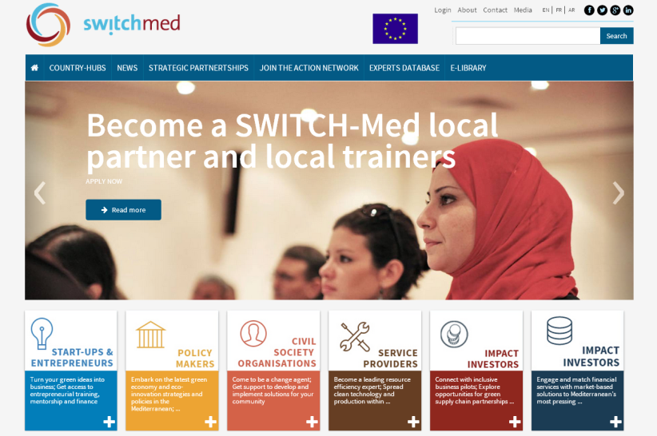
Facilitate the shift toward Sustainable Consumption and Production (SCP) in the Southern Mediterranean Region.
Donor: European Commission, 22 M EUR
Partners: UNIDO, UNEP-DTIE, UNEP-MAP & SCP/RAC
Countries (8): Algeria, Egypt, Israel, Jordan, Lebanon, Morocco, Palestine and Tunisia
Duration: 2014-2018
  POLICY: Strengthen relevant environmental governance and policy frameworks
  DEMONSTRATION:
    Sustainable Production – MED TEST II
    Green Entrepreneurship & Civil Society Empowerment
    SCP National Action Plans demo
  NETWORKING Support the visibility, effectiveness, long-term sustainability and impact of the project
www.switchmed.eu
Notes:
Estimated start date is November or December 2013

Slide 3
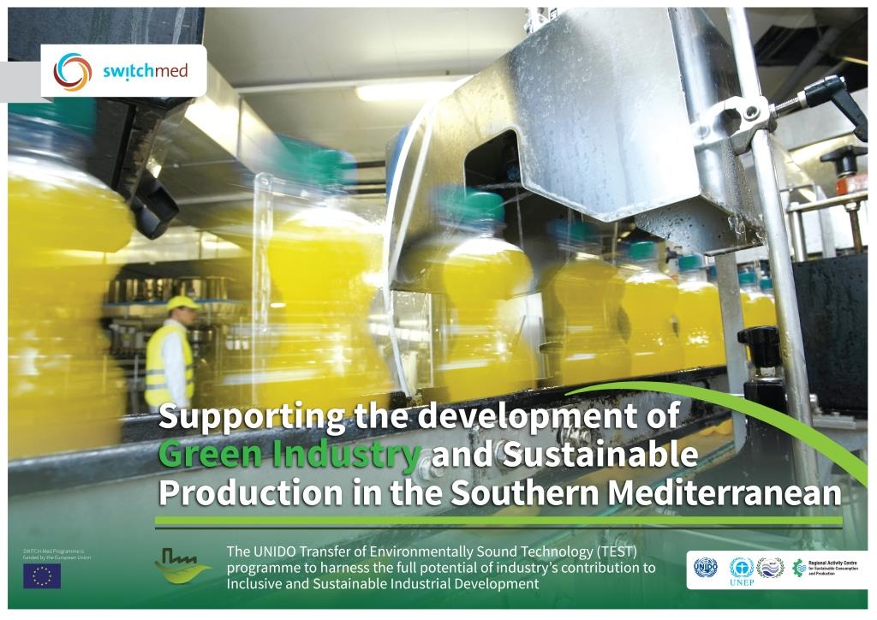
MED TEST II
TEST integrated tools
Resource Efficiency & Cleaner Production (RECP)
Environmental Management Systems (EMS)
Energy Management System (EnMS)
Material Flow Cost Accounting (MFCA)
Corporate Social Responsibility (CSR)
Stimulate the demand and supply of sustainable production services in key manufacturing sectors:
Build capacity of local service providers on TEST approach
Complete industry demonstration projects, consisting in the identification and implementation of sustainable production practices and technologies in key sectors.
Expose local stakeholders including policy makers to the project’s activities, proving inputs for harmonizing and reinforcing policies, and incentive schemes to support the introduction of resource efficient, clean technologies in industry.

Slide 4
Transfer of Environmentally Sound Technologies
TEST
Initial Review
Potential for improvement
Viability and commitment
MFCA – total costs of material losses
RECP – BAT/BEPs
EMS & EnMS – system support
Investment needing measures
Feasibility study, Financing
Evaluation and reflection
Sustainable Enterprise Strategy
Phase 1 RECP, EMS, MFCA
Phase 2 EST
Phase 3 SES/CSR

Slide 5
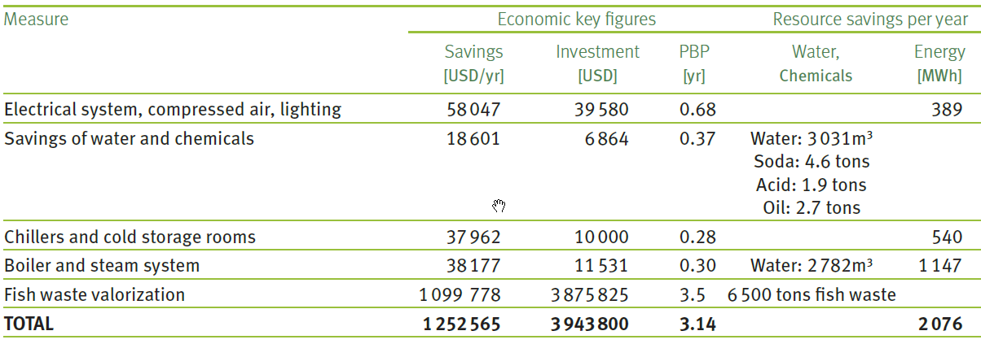
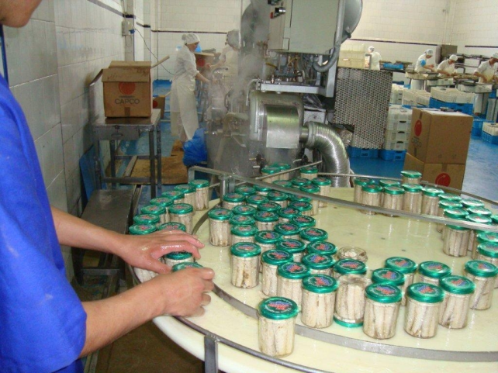
MED TEST I – Case Study
CUMAREX
Cumarex is a Moroccan company, established in 1992, operating in the fish canning sector. Employ 320 people and generate a turn over of approx. 25M USD. The main products are canned tuna, mackerel, and melva, which are 90% destined to export.
The company joined the MED TEST project in order to identify opportunities to implement an efficient use of resources (water and energy), improve production processes, valorise fish solid waste and minimize liquid effluents in light of reducing the investment and operational costs of the future wastewater treatment plant.

Slide 6



Cooperation with the European Bank for Reconstruction & Development (EBRD)
Sustainable Energy Financing Facilities
SEFF finance to the commercial sector typically ranges from a few hundred thousand to a few million euros, most often to support sustainable energy projects through the purchase and installation of equipment, systems or processes.
Credit facility dedicated to financing energy efficiency and small-scale renewable energy investments of private companies in Morocco
www.morseff.com

Slide 7
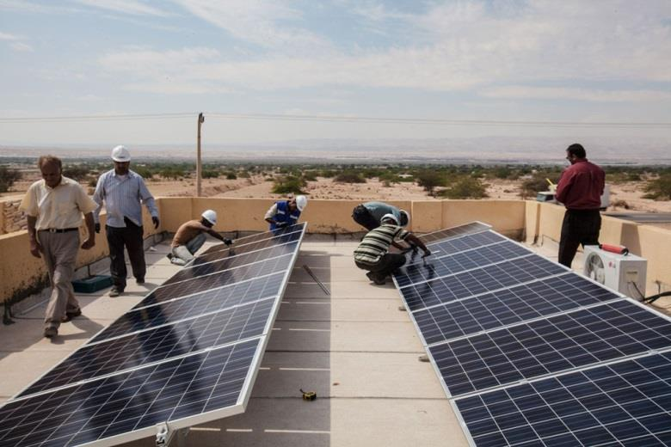
Financing of up to 3 000 000 DH (275 000 EUR) for small-scale projects available through a pre-approved List of Eligible Materials and Equipment and of up to 50 000 000 DH (4.5 M EUR) for larger, more complex investment projects.
Investment incentives of 10% or 15% of financing amount funded by grants from the EU Neighbourhood Investment Facility.
Free-of-charge technical assistance for project assessment and implementation and verification of projects post-implementation; funded by grants from the EU NIF and the SEMED Multi-Donor Account.
Local distribution through Moroccan Participating Banks.
www.morseff.com

Slide 8

Cooperation with MorSEFF
      Feasibility studies are developed for clean technologies and upgrades to industries
      Investment needs identified through MED TEST are submitted to MorSEFF for financing
      Understanding of MorSEFF criteria and requirements facilitates the preparation of “bankable projects” from the start
      UNIDO provides technical assistance to industries to target MorSEFF financing
      EBRD supports with ongoing follow-up to MED TEST II industries in developing EE investment plans.

Slide 9
Cooperation with MorSEFF
Initial Results:
First company has submitted loan request to MorSEFF local bank and been approved for 0.5 M EUR loan for investments in EE
Other companies expected to follow once EE assessments are completed
For the Future:
Currently MorSEFF only supports investments in Energy Efficiency
Next round of SEFF programs will expand to include Resource Efficiency
UNIDO will collaborate with MorSEFF to develop criteria for assessing RE criteria in green loans

Slide 10
Other Financing Opportunities in the region
Palestine: Bank of Palestine offers green loan programme focuses on energy efficiency, renewables and recycling.
  Expand the scope to include resource efficiency investment. UNIDO can quality assure the individual projects, including expected savings to repay the green loans.
Lebanon: Banc du Liban offers green subsidized loans through two mechanisms: National Energy Efficiency and Renewable Energy Action (energy loans) and Lebanese Environmental Action (environmental loans).
Lebanon Pollution Abatement Project (LEPAP) – focus on env. compliance (TA funding from Gov. of Italy and investment component from WB)
Jordan
  Environment Fund: Operated by the Ministry of Environment; focus on relatively small projects in waste and/or water management
  Jordan Enterprise Development Corporation has a financing program of 150 M EUR from the Jordan Government Development Fund
  Jordan Renewable and Energy Efficiency Fund: Credit Line Facility in collaboration with the Central Bank and Commercial Banks

