Slide 1
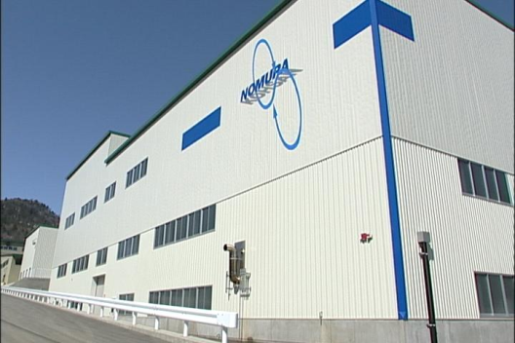
Recycling/Treatment of Mercury Waste from Decommissioning
Nomura Kohsan Co., Ltd.
Sales Department
Hiroki Iwase

Slide 2

Nomura Kohsan’s mercury recycling business
Who we are
  The largest mercury-recycling company in Japan
  Over 40 years of experience in treating Hg waste from all across Japan
  Two plants: Itomuka Plant (Hokkaido) and Kansai Factory (Osaka)
  ISO14001 certified
What we do
  Treatment of Hg waste
  Recycling mercury and other recyclable materials
  Contracted work from Zn and Cu refineries
  Research on Hg stabilization
Nomura Kohsan Co., Ltd.

Slide 3
Quick facts
Nomura Kohsan has handled mercury waste from over 15 chlor-alkali factories
Between 2011 and 2014, we have treated 780 tons of mercury waste from domestic chlor-alkali facilities
Mercury concentration ranges from 42 ppm to 7%
Nomura Kohsan Co., Ltd.

Slide 4
Treatment of waste from chlor-alkali facilities
Background
  1973: Conference for Promoting Countermeasures against Mercury Contamination: conversion of chlor-alkali facilities from the mercury-cell process
  1986: Conversion to alternative processes completed
Examples treatment methods:
  The demolishing and dismantling of facilities and equipment are usually done by construction companies.
  Contaminated equipment and other mercury waste are sent to Nomura Kohsan for treatment & final disposal
Nomura Kohsan Co., Ltd.

Slide 5
Treatment of waste from chlor-alkali facilities
Costs:
  Treatment fee: 150 JPY*/kg (of which 25 JPY/kg is landfill disposal cost)
  Shipment fee: 150,000 JPY/5t
Duration:
  Can take several decades
  Demolition of facility itself can take 1-2 years
*100 JPY = 1 USD
Nomura Kohsan Co., Ltd.

Slide 6
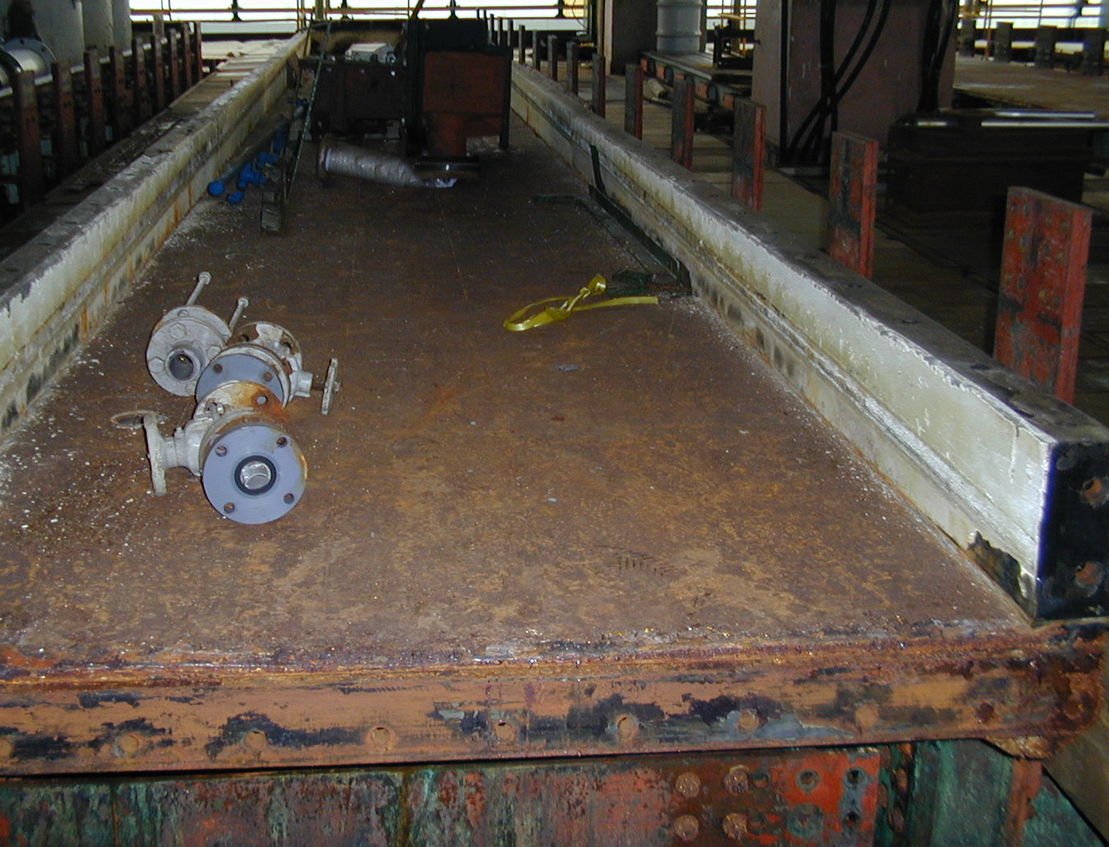
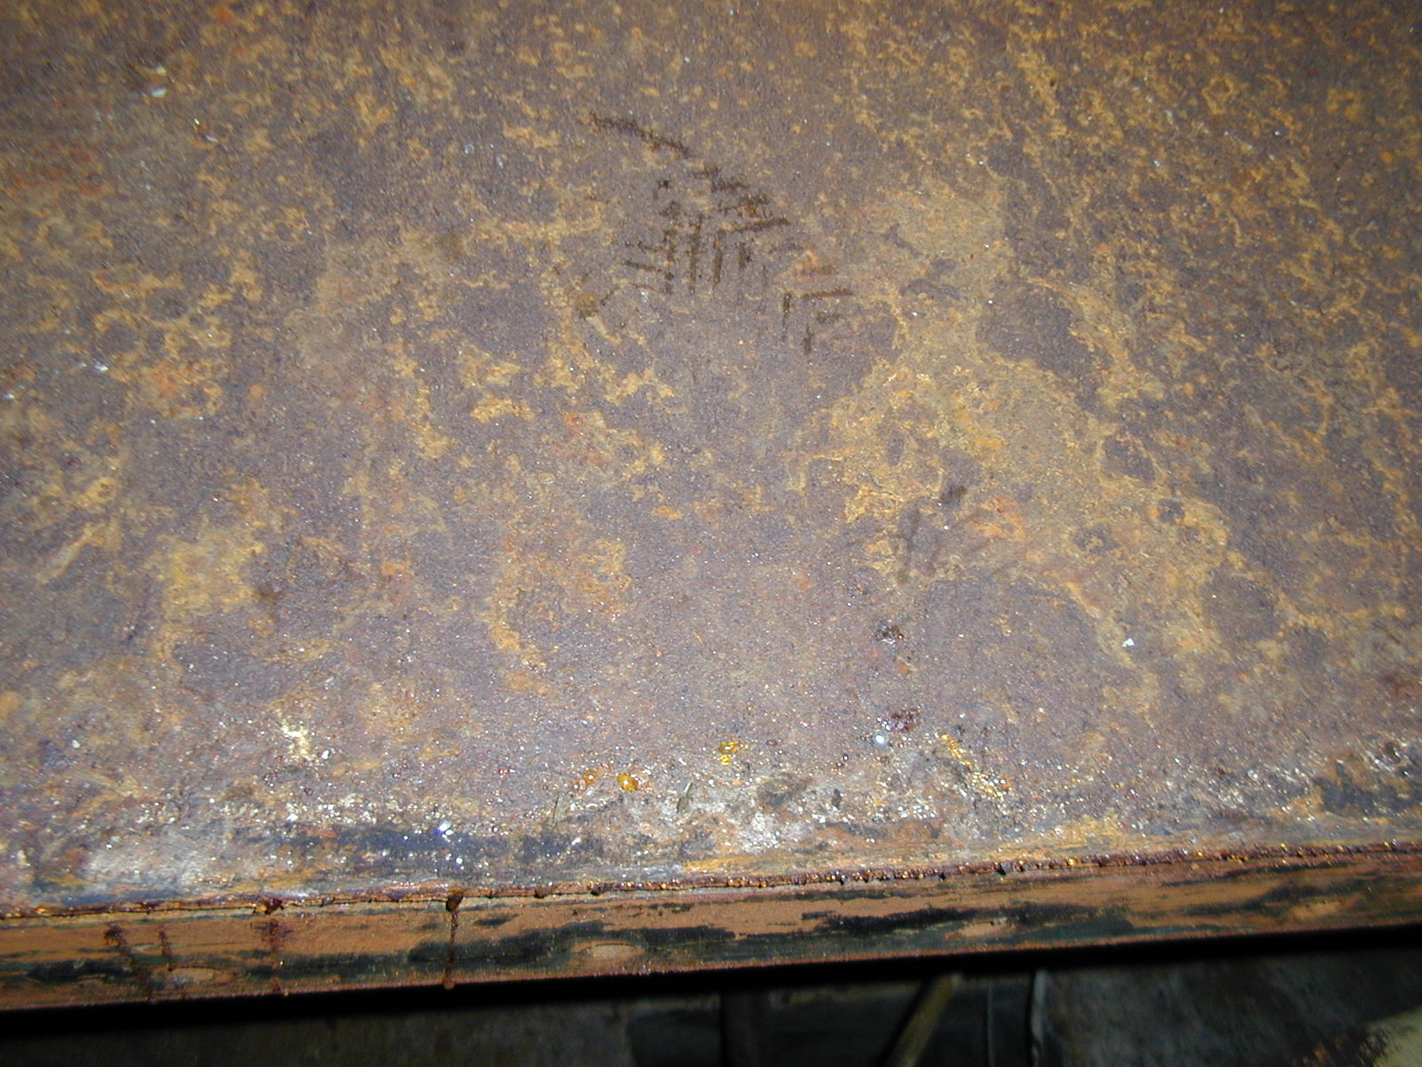
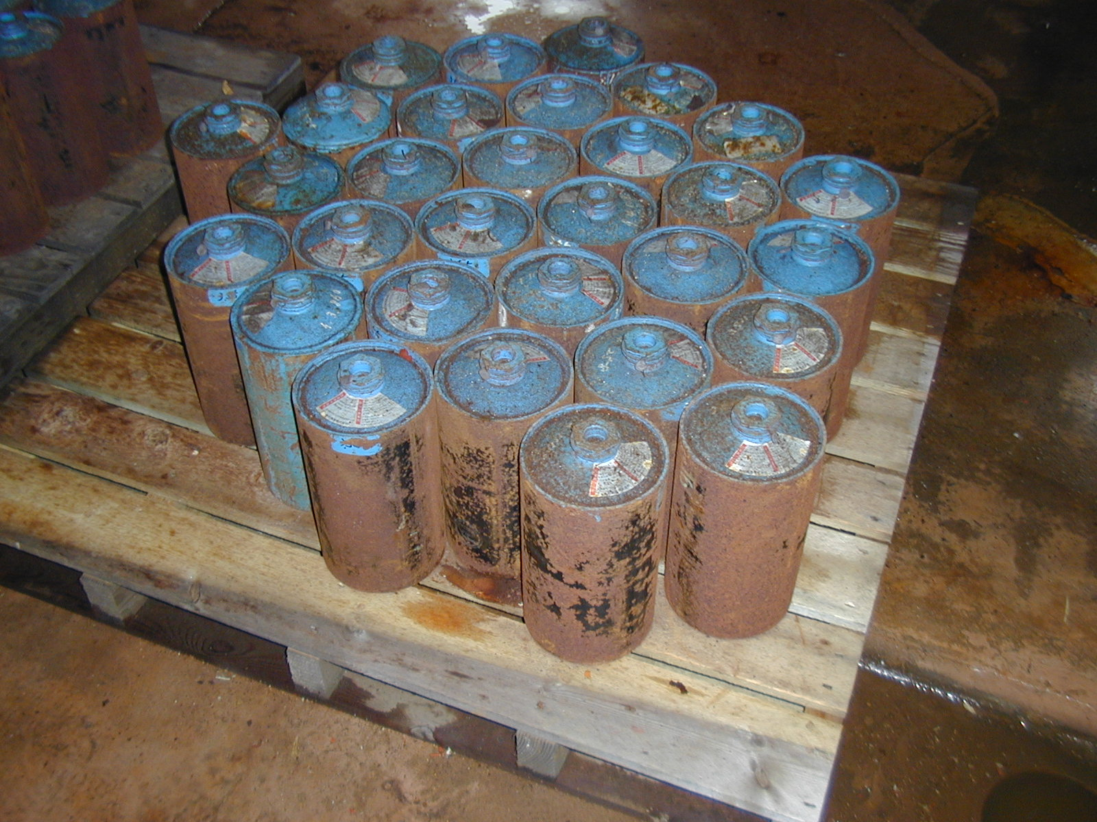
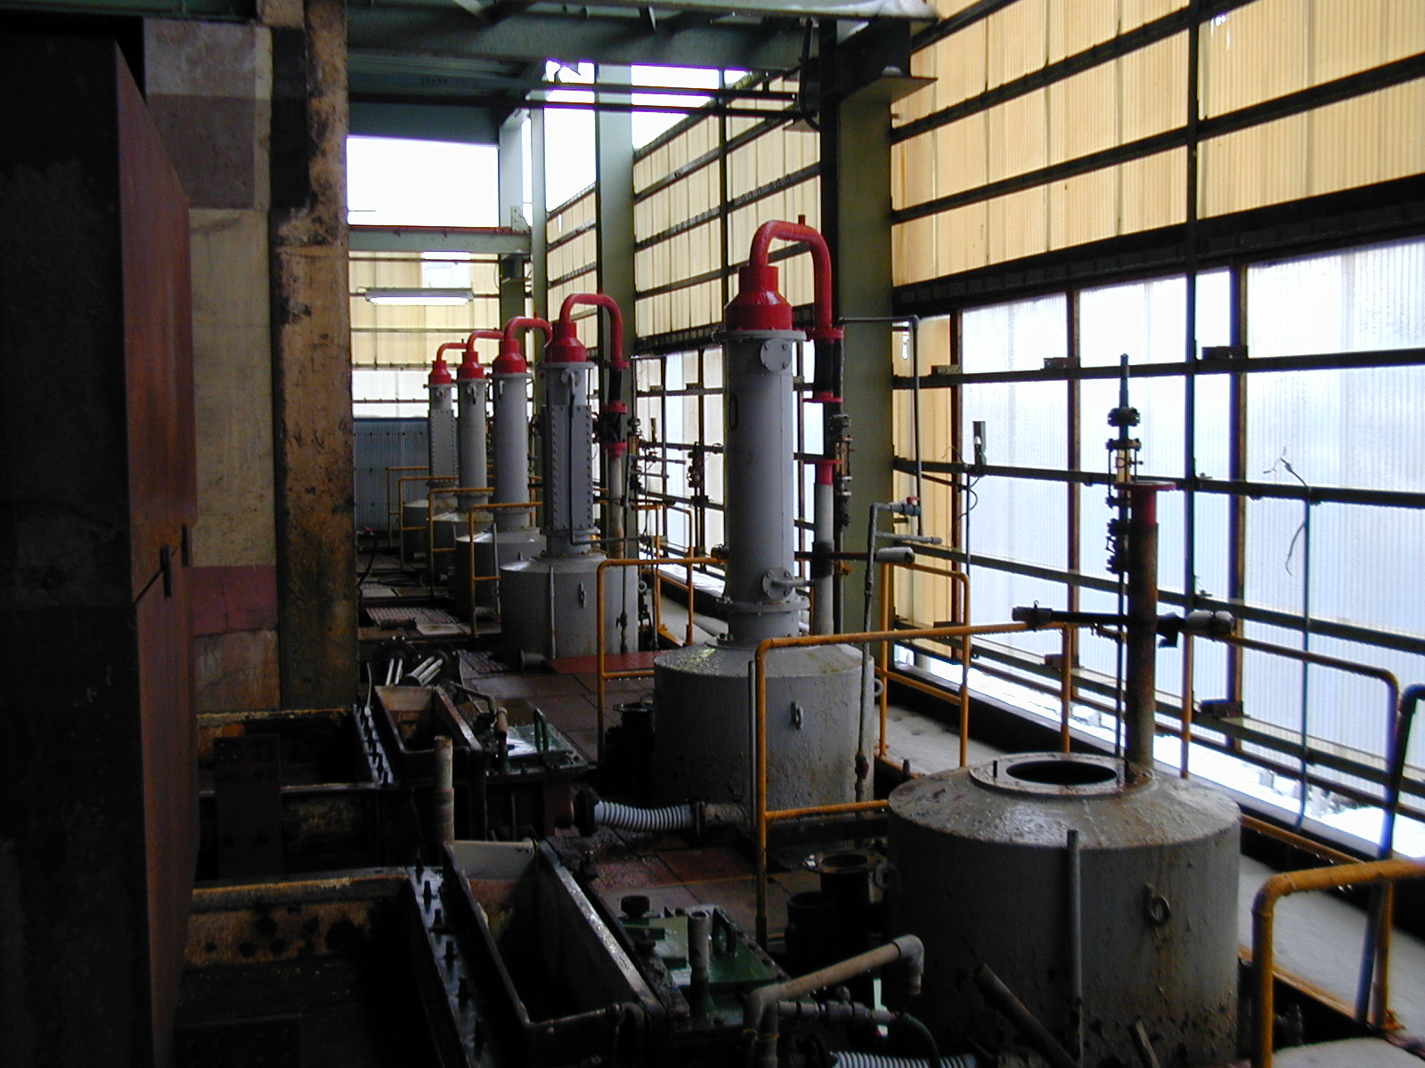
Nomura Kohsan Co., Ltd.

Slide 7
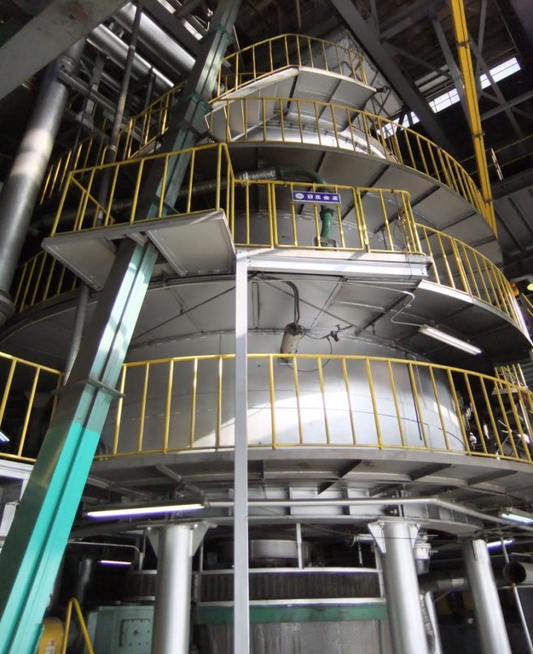
Waste treatment method
Nomura Kohsan Co., Ltd.

Slide 8
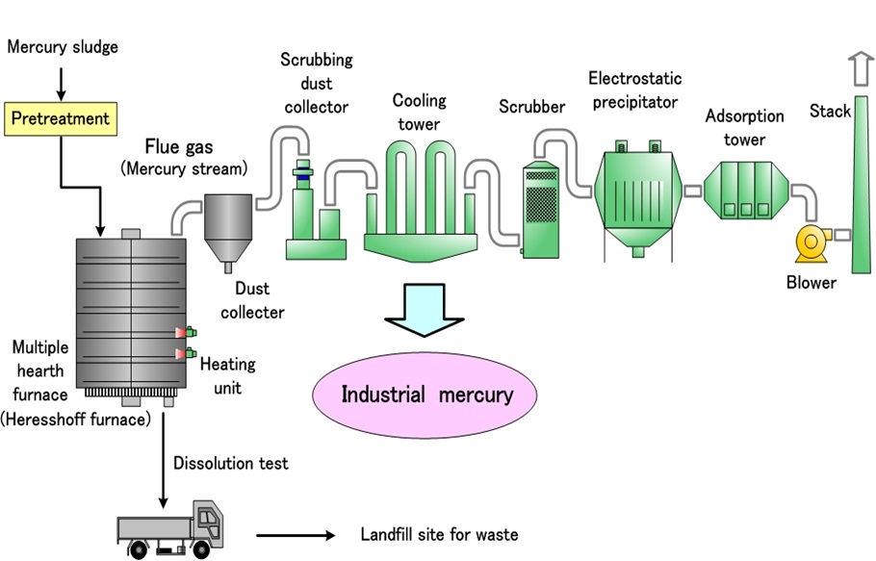
Waste treatment method
Mercury
Nomura Kohsan Co., Ltd.

Slide 9
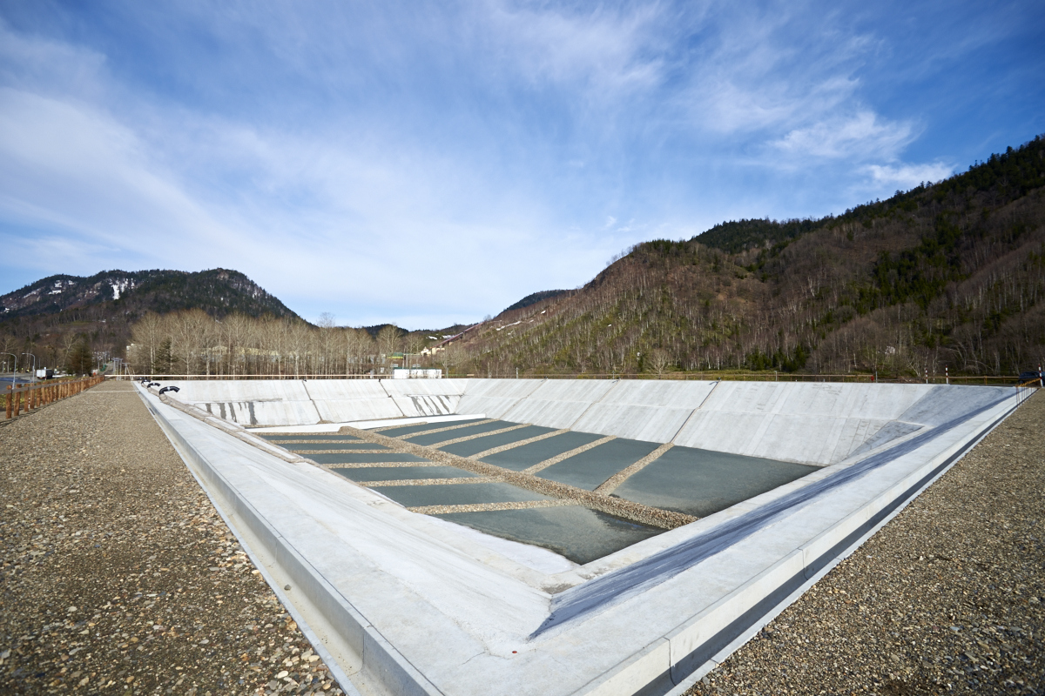
Waste treatment method
Nomura Kohsan Co., Ltd.

Slide 10
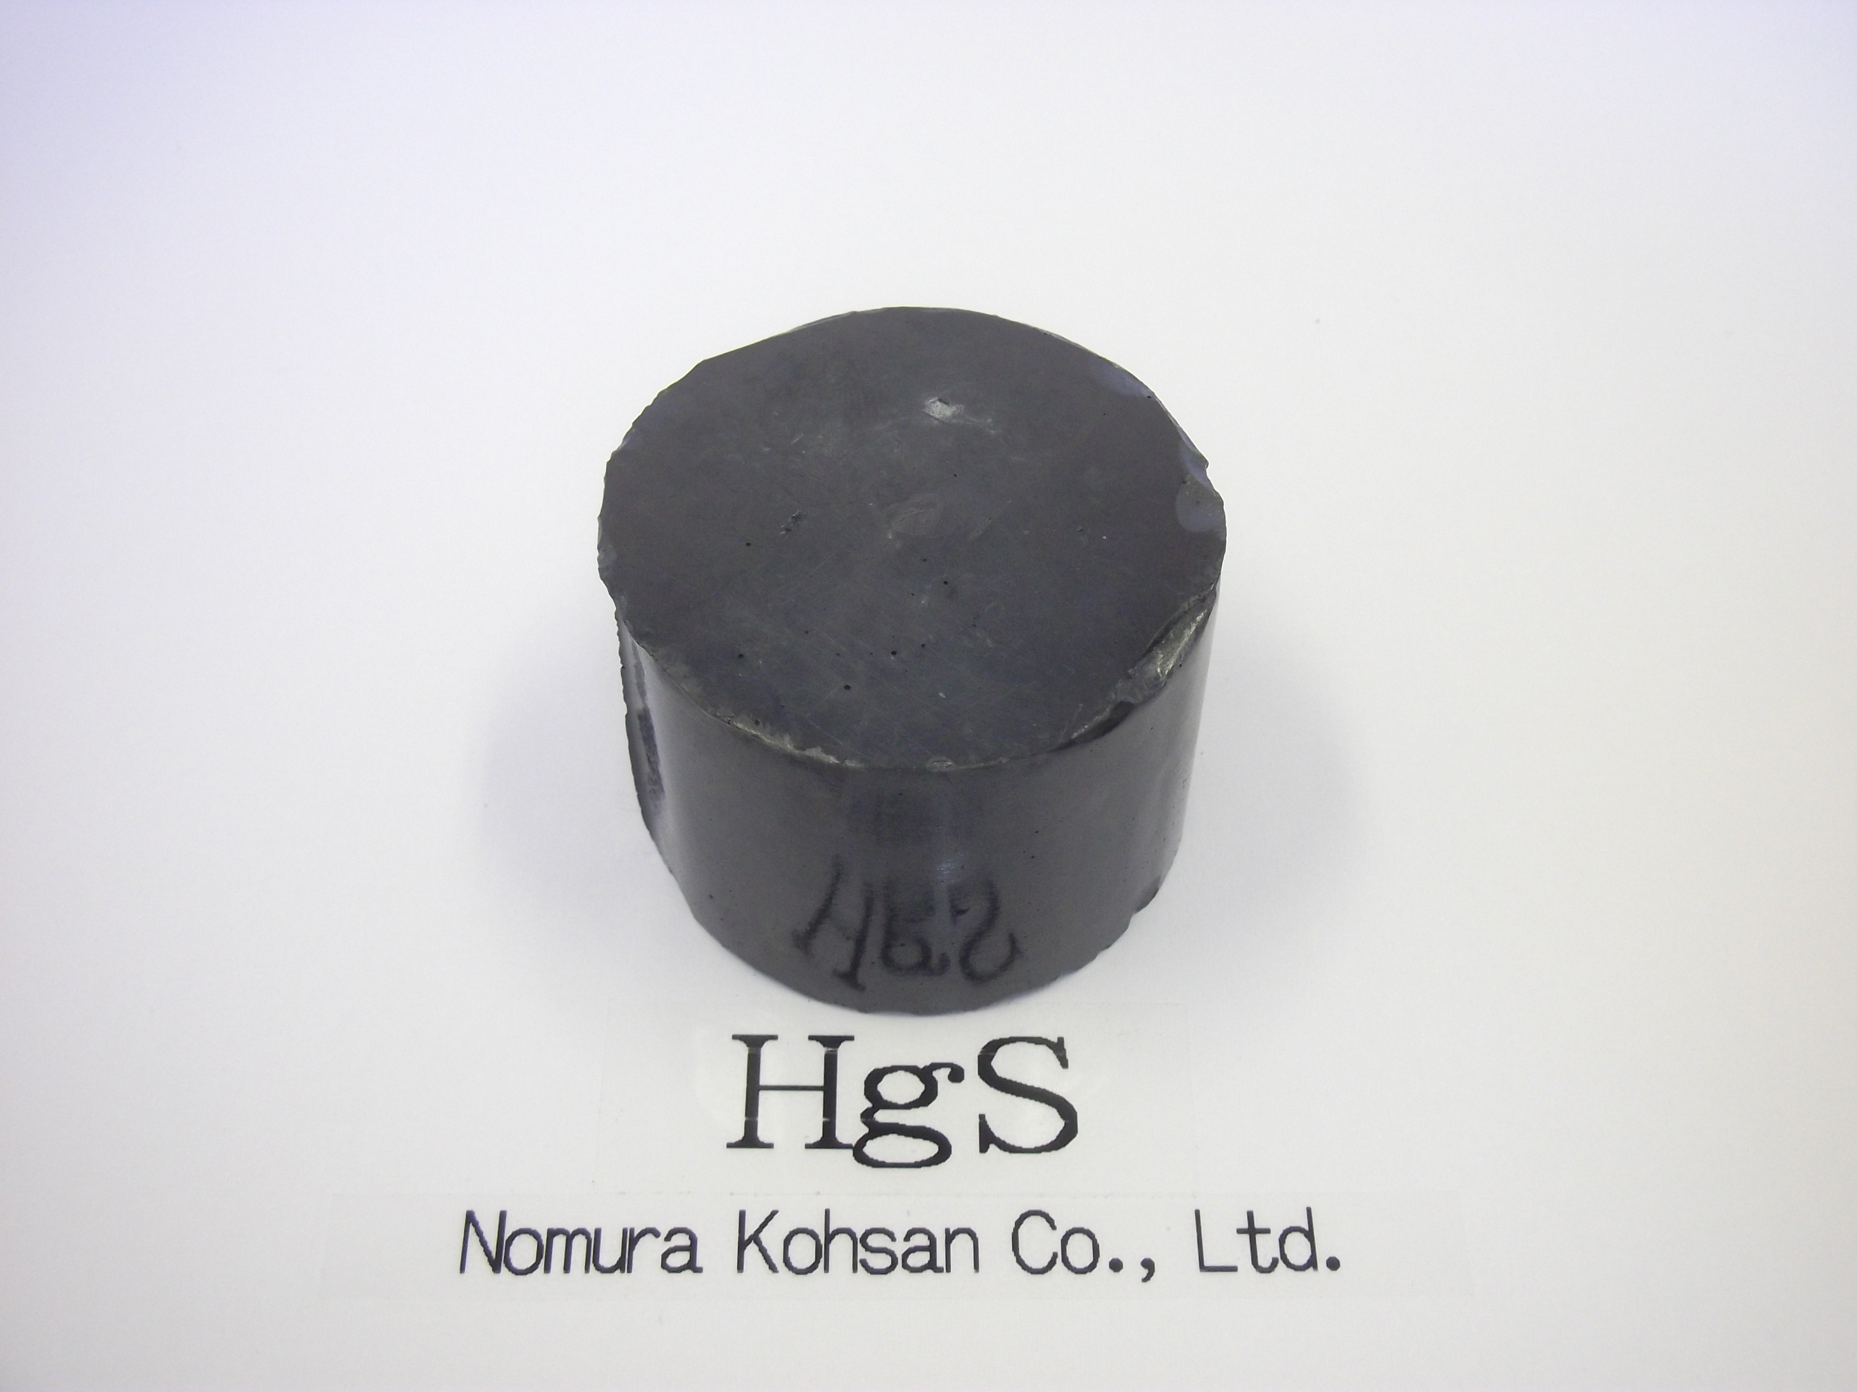
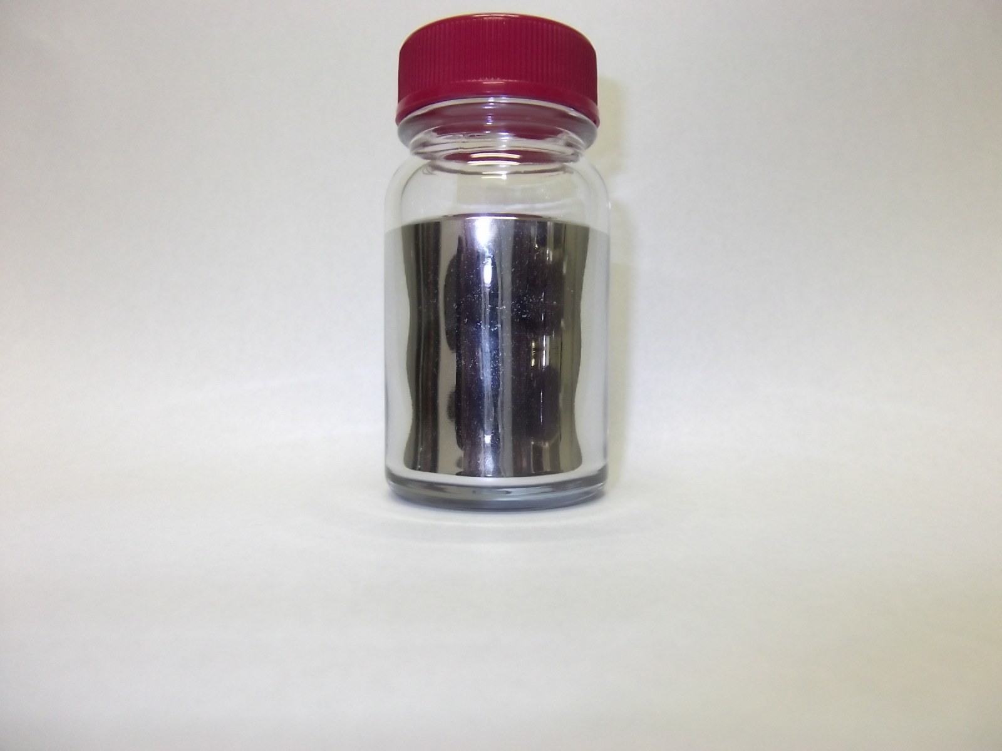
Stabilization & Solidification
Nomura Kohsan Co., Ltd.

Slide 11
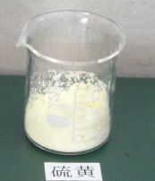
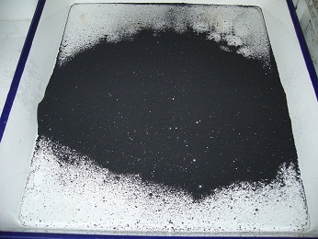

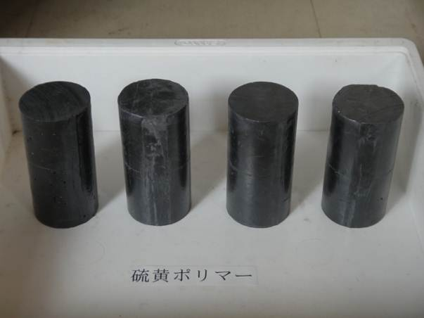
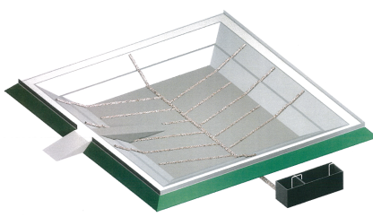
Stabilization & Solidification
Mercury
Sulfur
Black mercury sulfide
Mechanochemical Method
Hg(l)＋S→ HgS
Purity: over 99.9%
headspace method
<1μg/m3
Dissolution Test
<0.005mg/l
Solidification Treatment
Sulfur polymer
headspace method
<1μg/m3
Dissolution Test
<0.005mg/l
controlled landfill
Solidified sulfur polymer
Nomura Kohsan Co., Ltd.

Slide 12
Issues and key concerns related to mercury
Cost of treatment is expensive: waste is bulky and cannot be recycled.
  Transportation cost of waste increases as the volume of waste increases; regardless of the mercury concentration
  The conditions for building landfills are strict and expensive
Due to large volume of waste, treatment is not “one-time only”, instead, the treatment process can be spread out over several decades
Stabilization technology needs to be commercially available; at the same time, long term research on the soundness of the technology is required
Nomura Kohsan Co., Ltd.

Slide 13
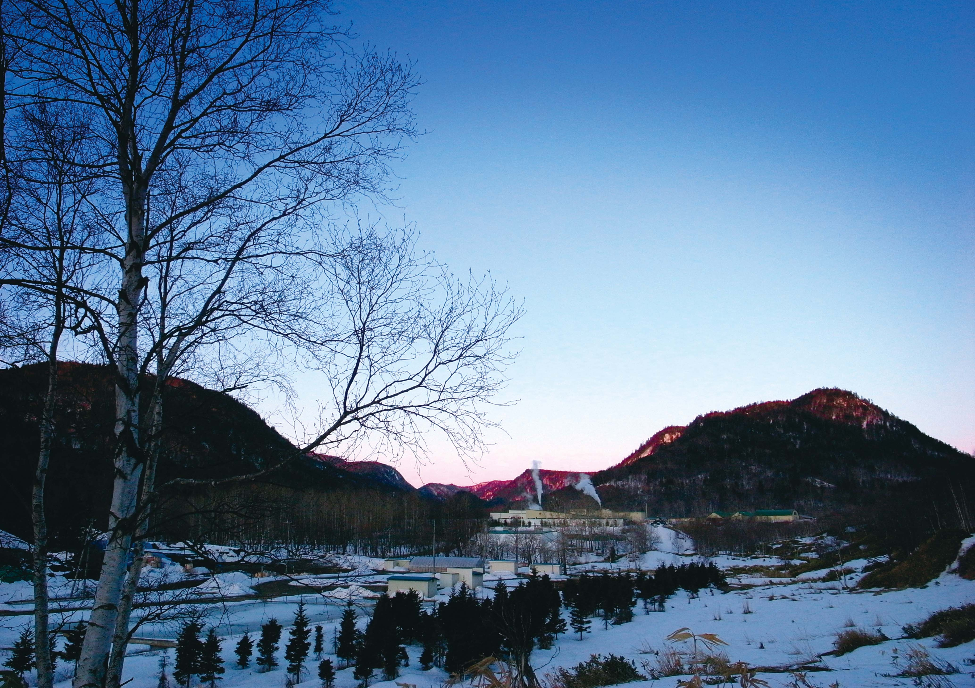
Thank you!
For more information,
please contact:
info@nkcl.jp
Nomura Kohsan Co., Ltd.

