Slide 1
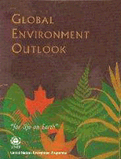
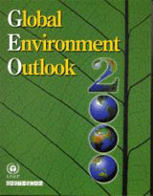
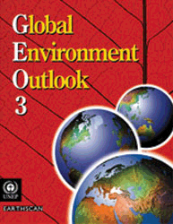

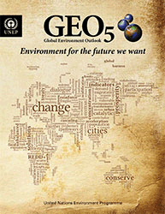

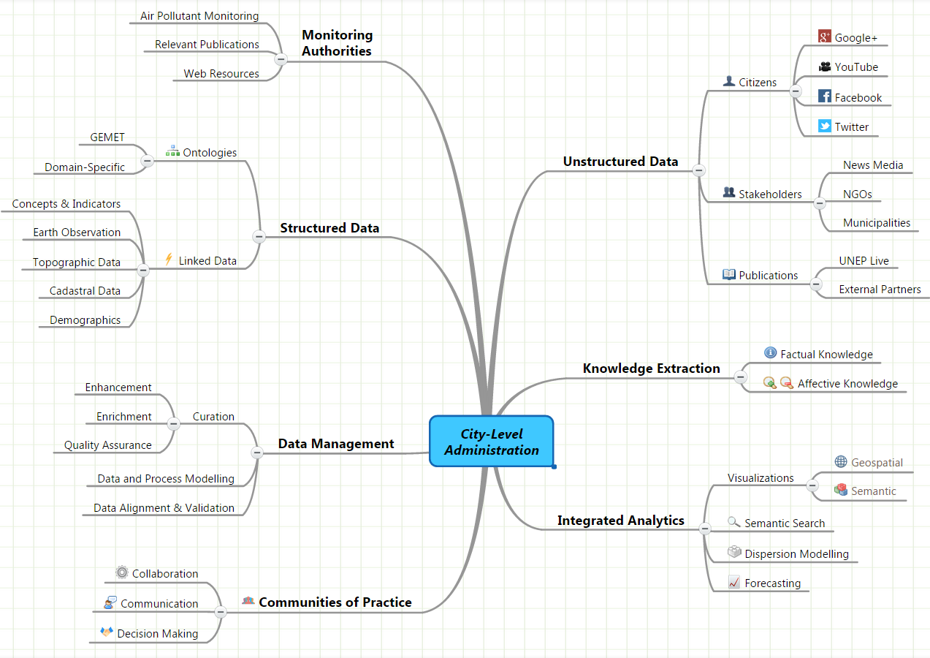
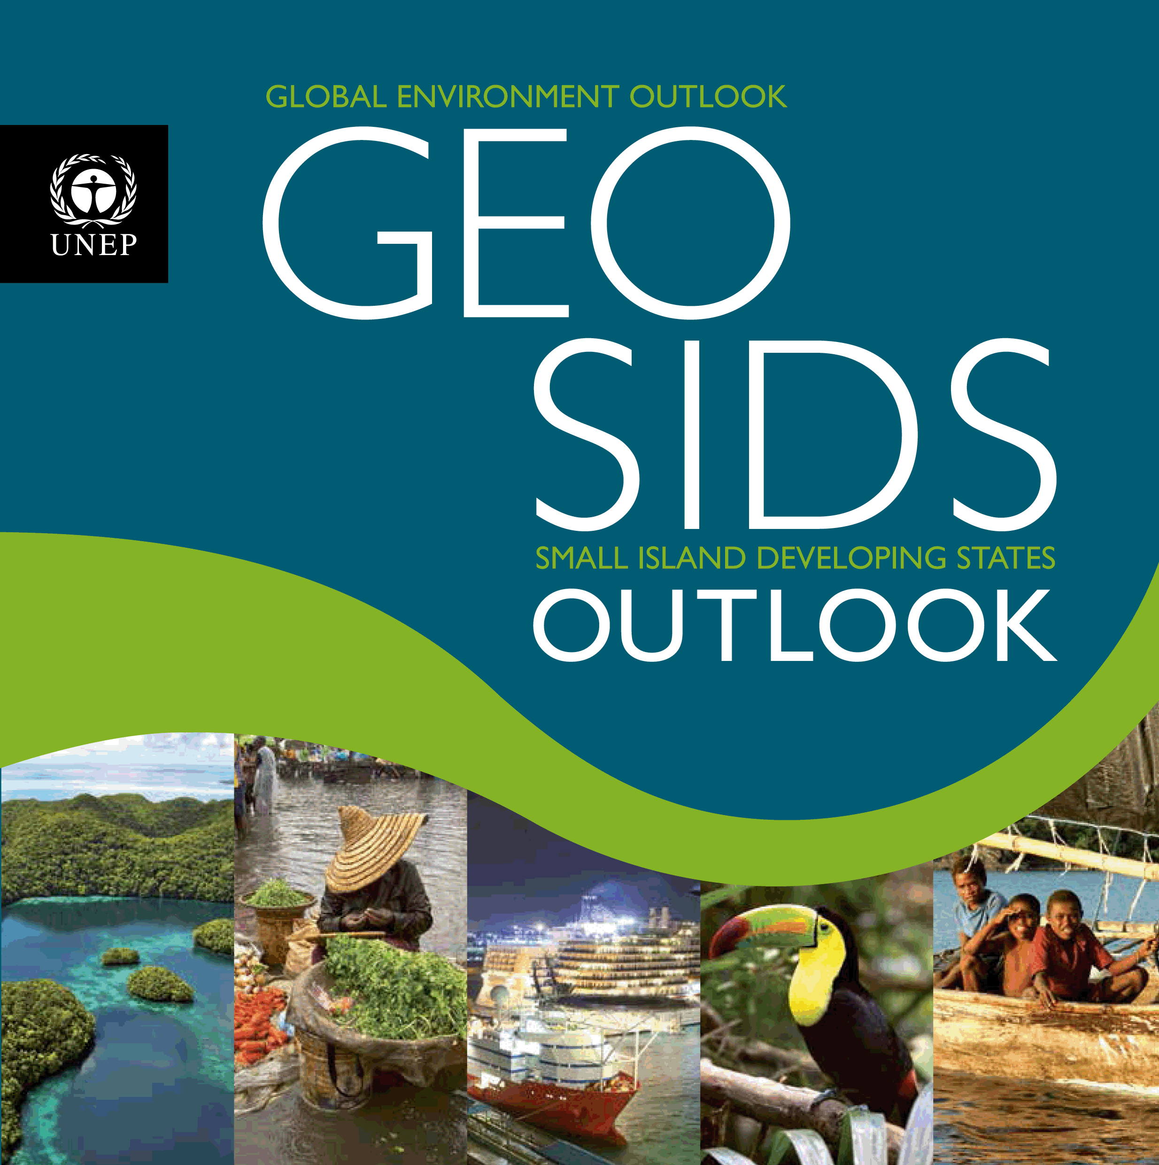
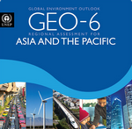
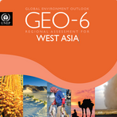

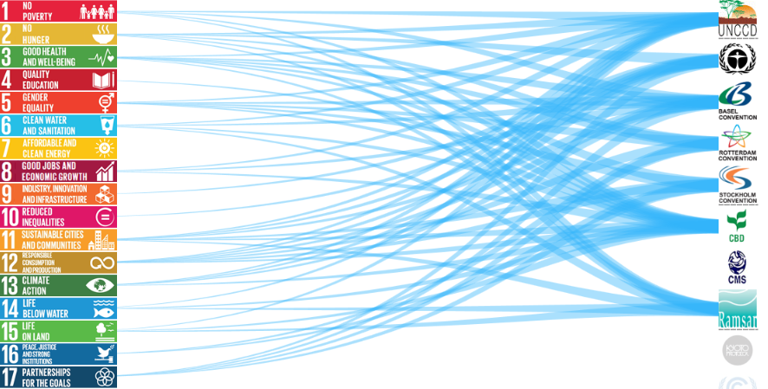
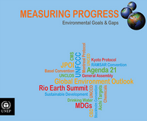
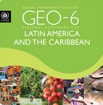
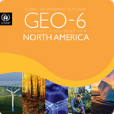
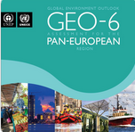
GEO Global Assessments
Open Access UNEP Live e-books
GEO Regional & Thematic Assessments

Slide 2
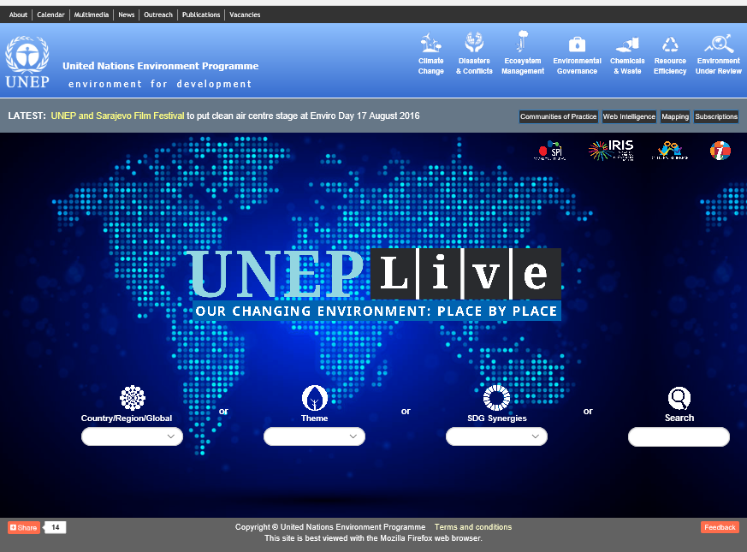

Slide 3
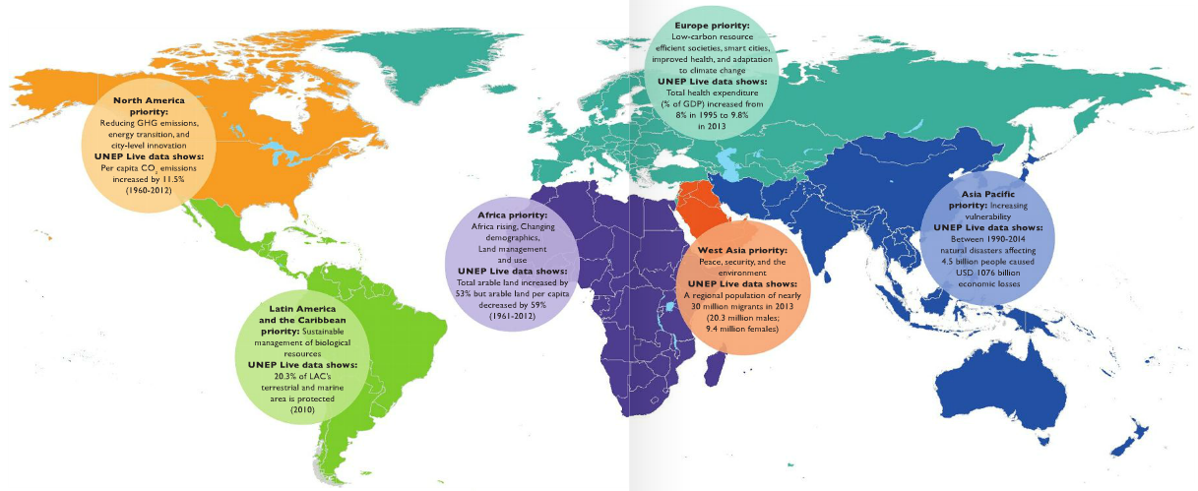
Contents
Regional Priorities and Data& trends
S T A T E A N D T R E N D S
3. Policy Response
G L O B A L R E S P O N S E S

Slide 4
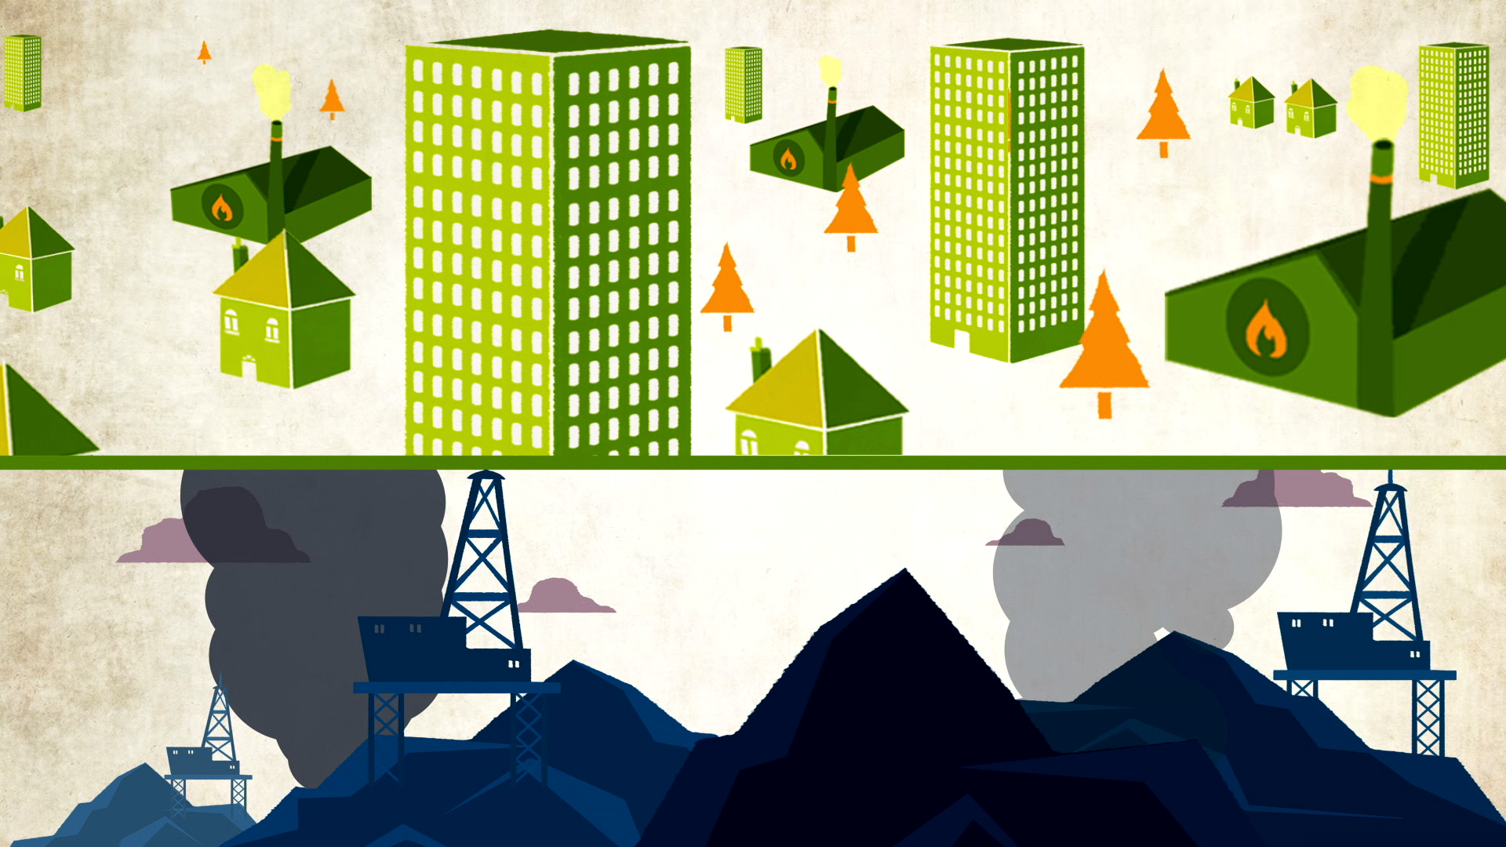

UNHEALTHY ENVIRONMENTS

Slide 5
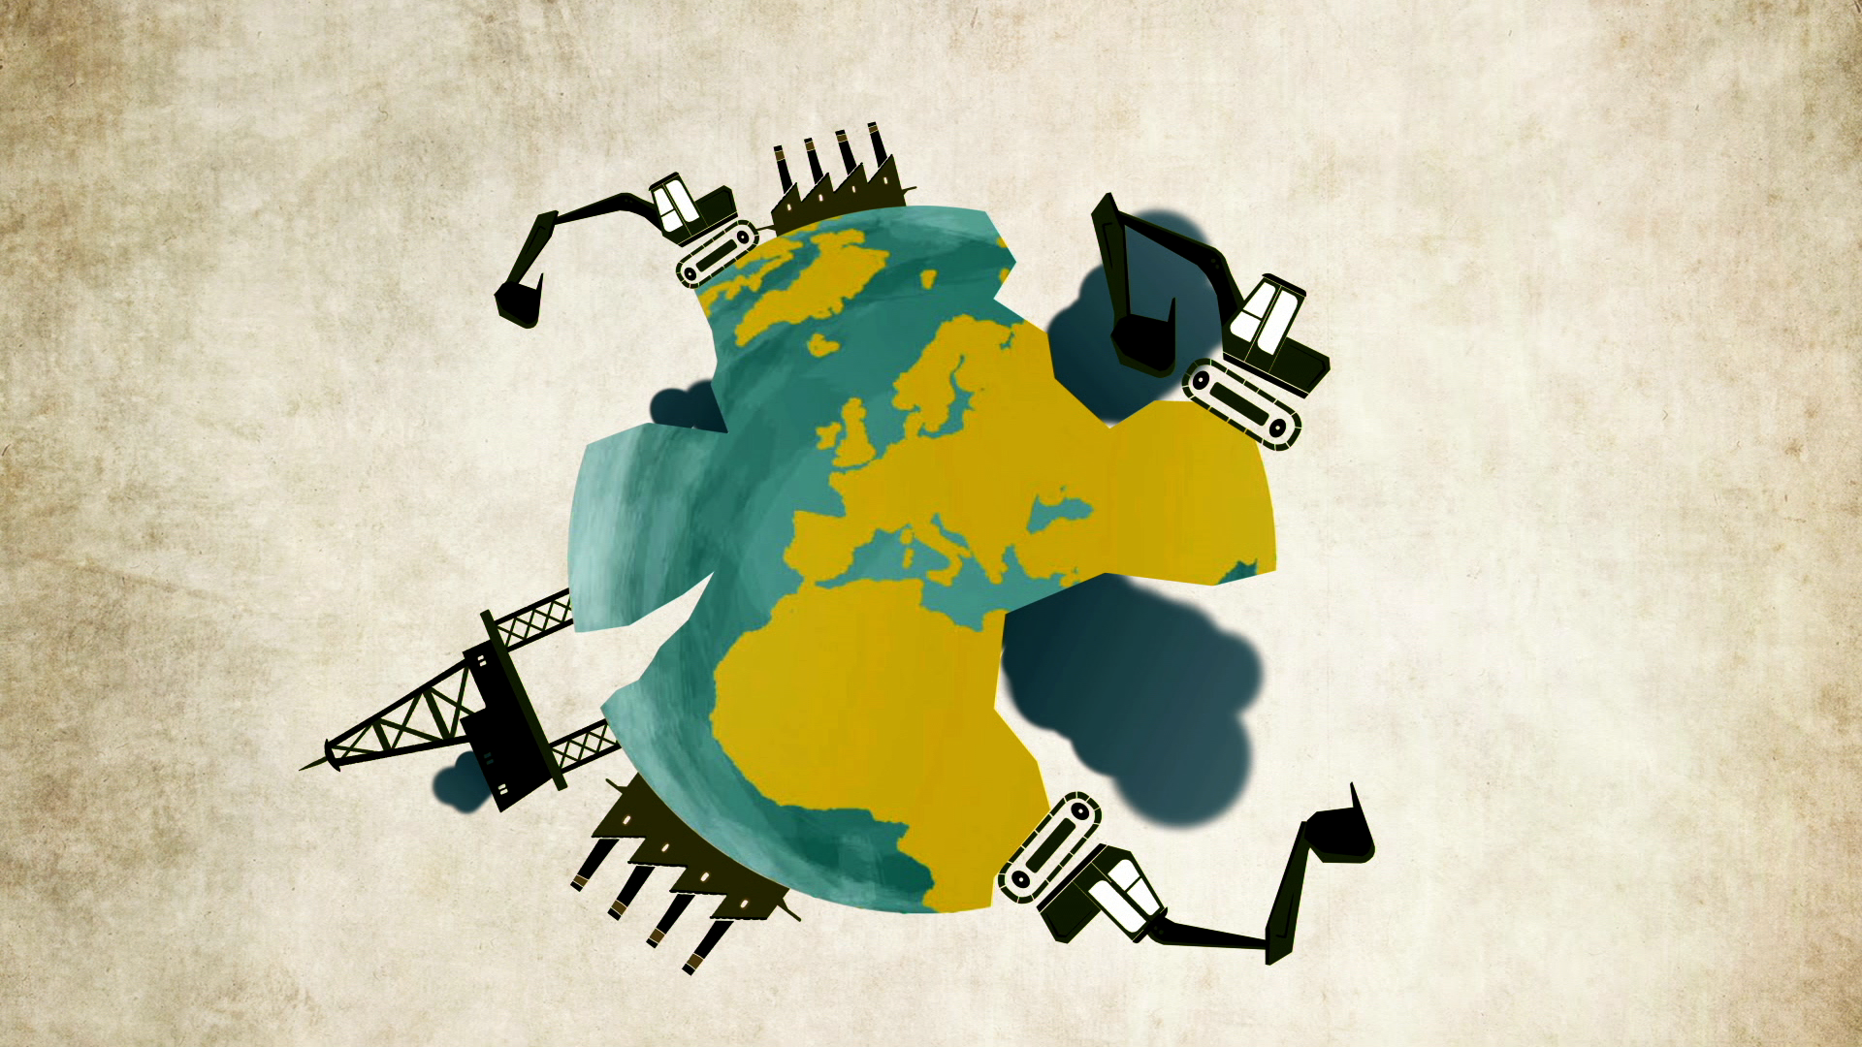
UNSUSTAINABLE PRODUCTION

Slide 6
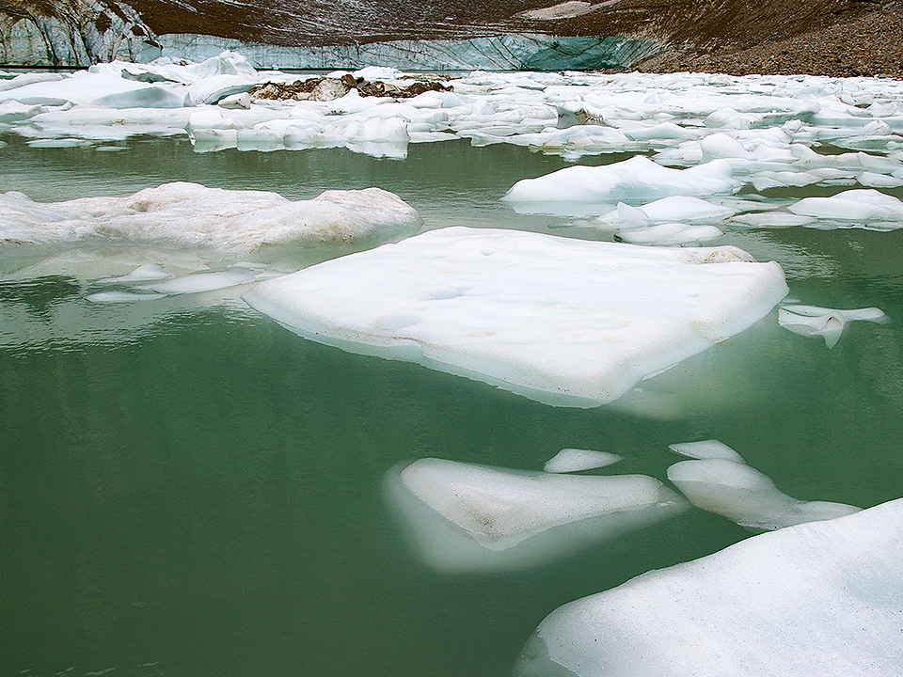
WIDESPREAD
OBSERVED IMPACTS
A CHANGING WORLD
Temperature increases, sea-level rise,
ocean acidification, changing seasons, new rainfall patterns

Slide 7
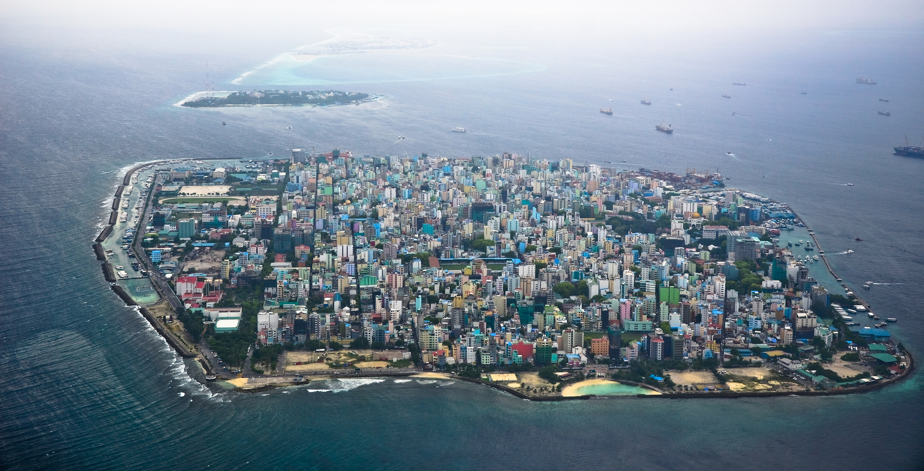
VULNERABLE STATES
threatened by sea level rise
and extreme events

Slide 8
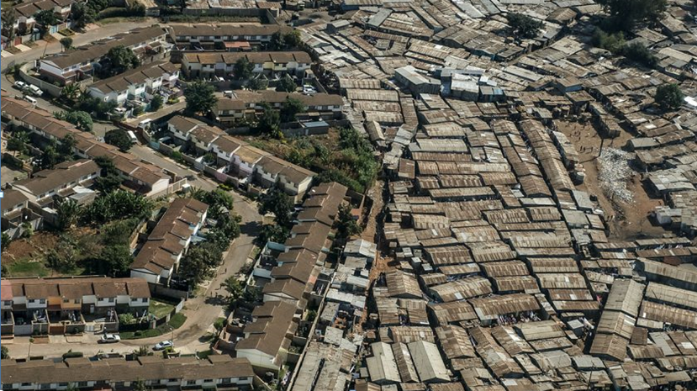
MEASUREMENT OF INEQUITY
GENDER AND THE ENVIRONMENT

Slide 9
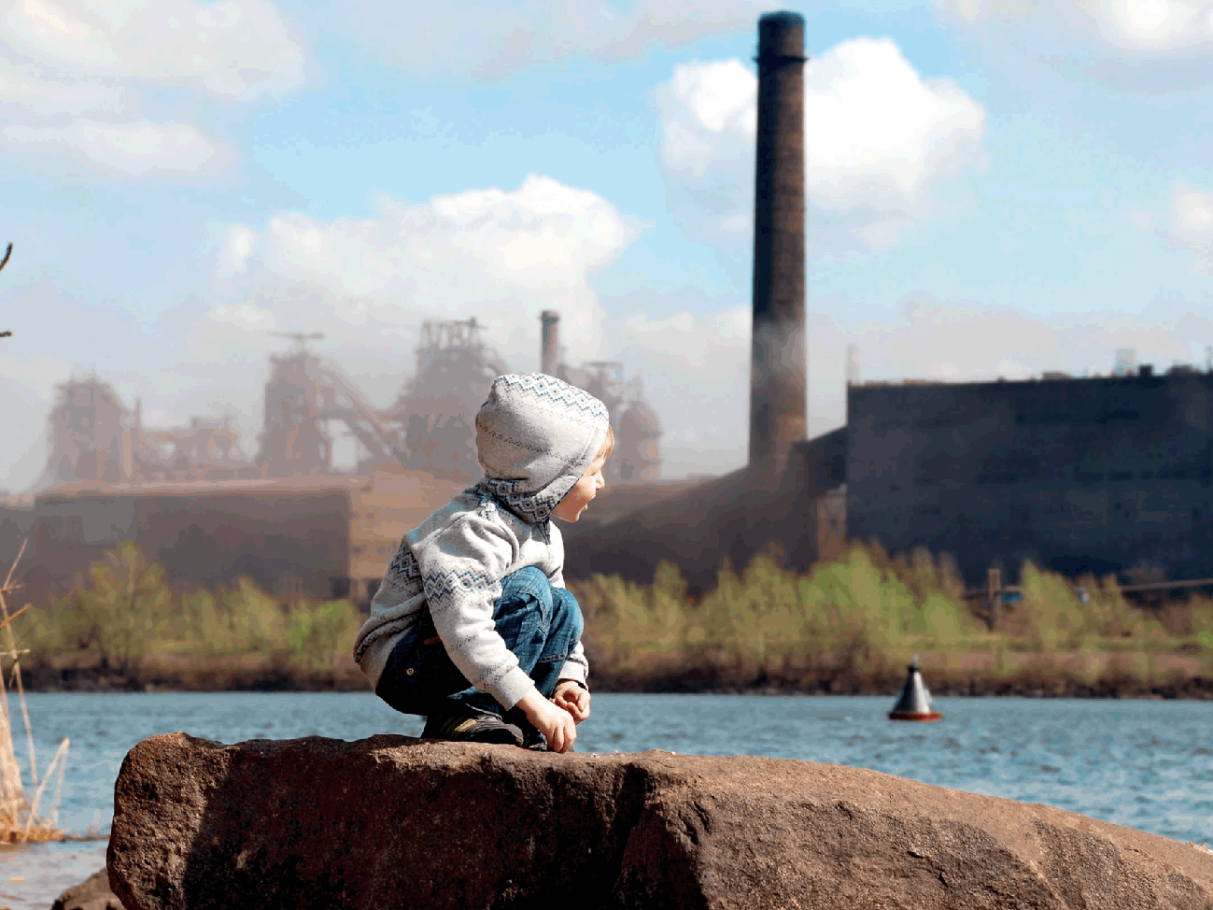

State & trends

Slide 10
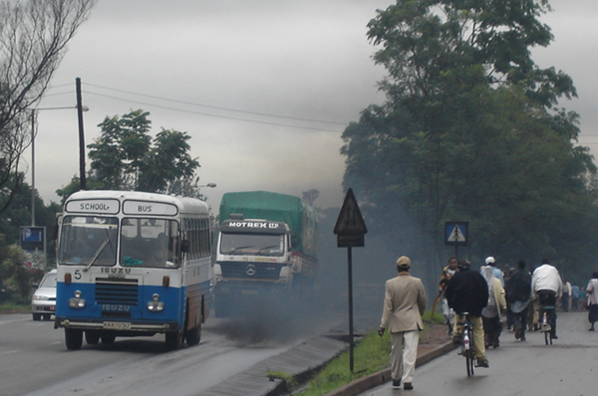
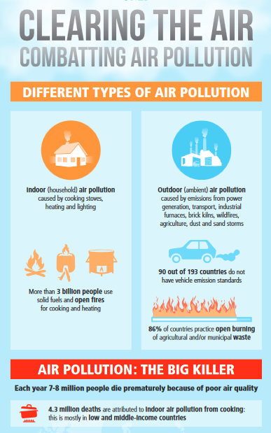
Global Air Quality
1

Slide 11
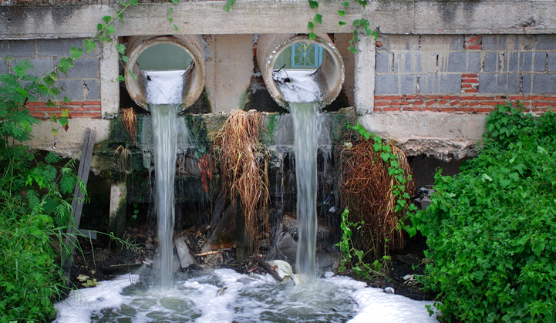
WATER QUALITY
90% wastewater in developing countries flows untreated into rivers, lakes and the sea

Slide 12
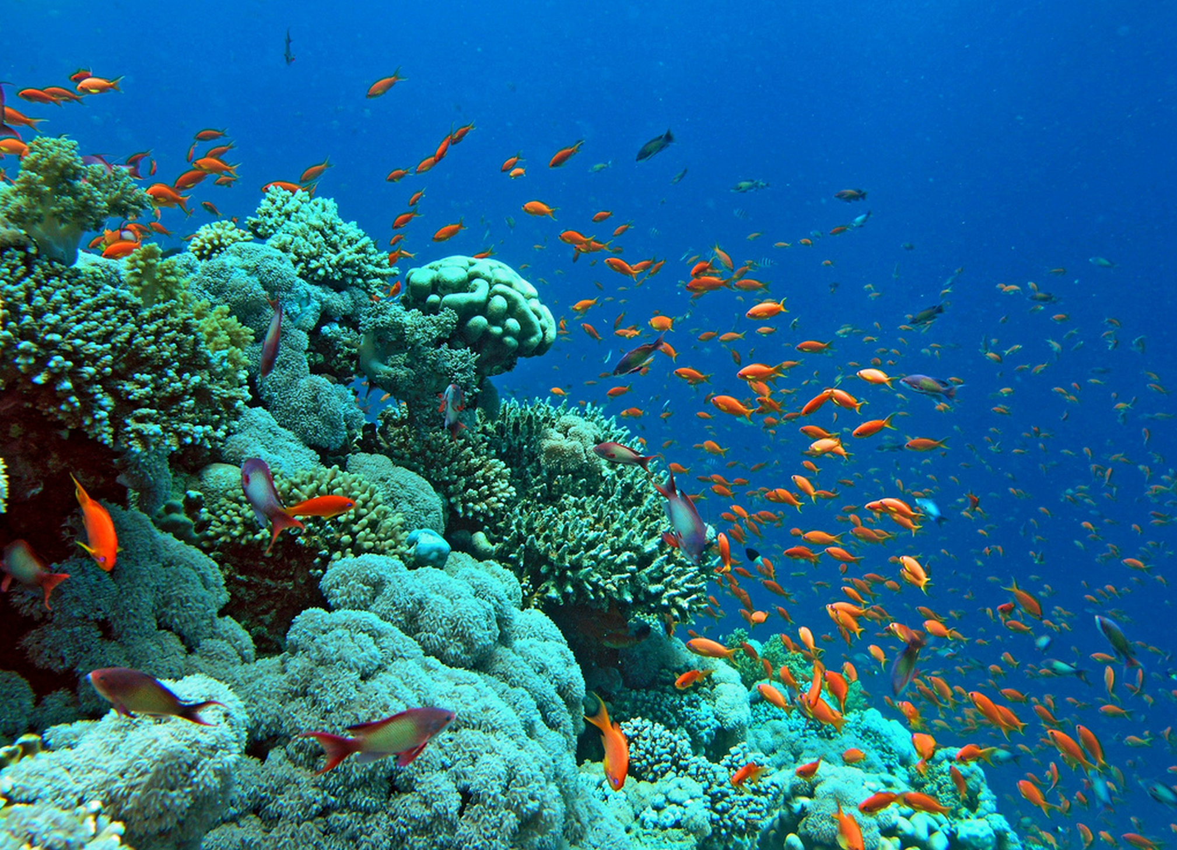
CORAL REEFS
50% globally
threatened due to climate
change, coastal development
& land-based pollution

Slide 13
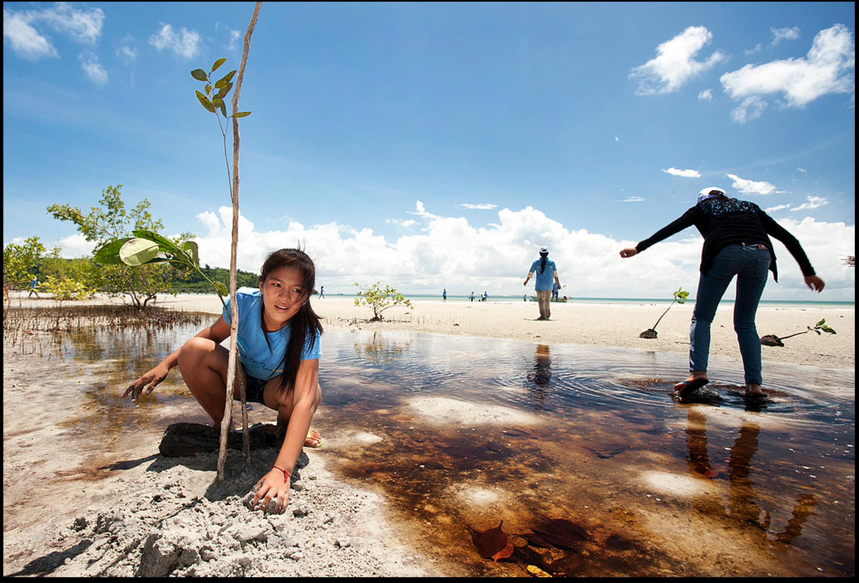
PROTECTED AREAS
40% natural vegetation legally protected by parks and indigenous reserves
>50% marine regionas remain unprotected

Slide 14
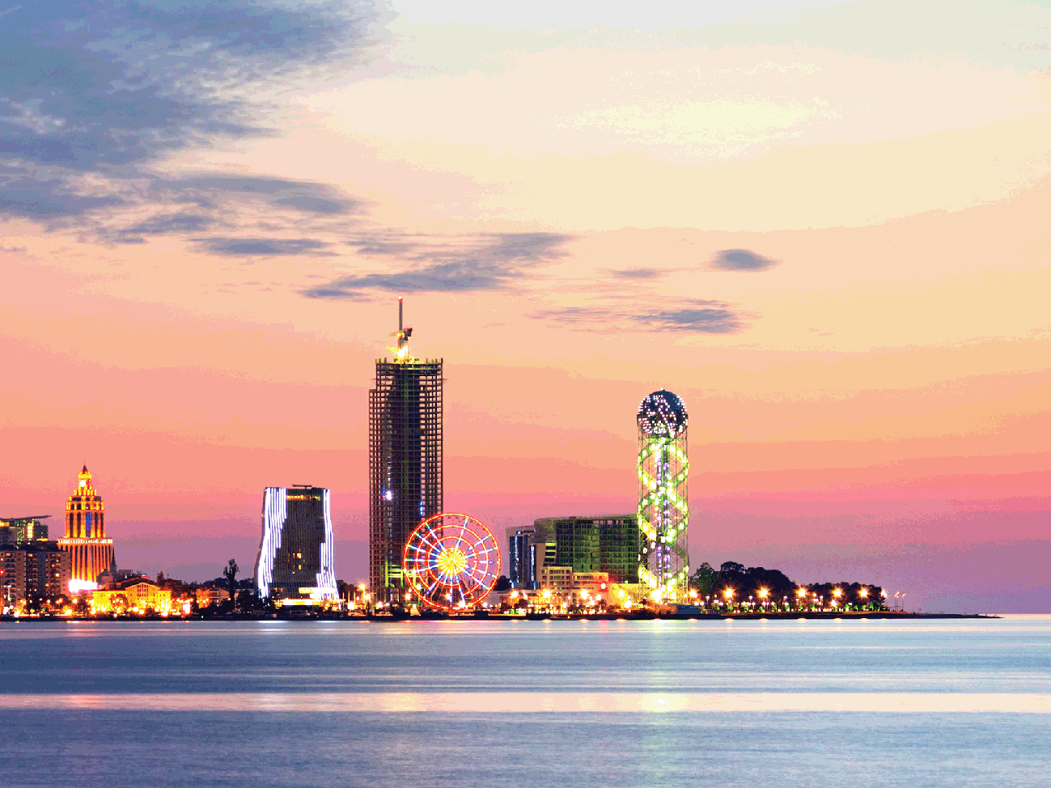
Policy Responses

Slide 15
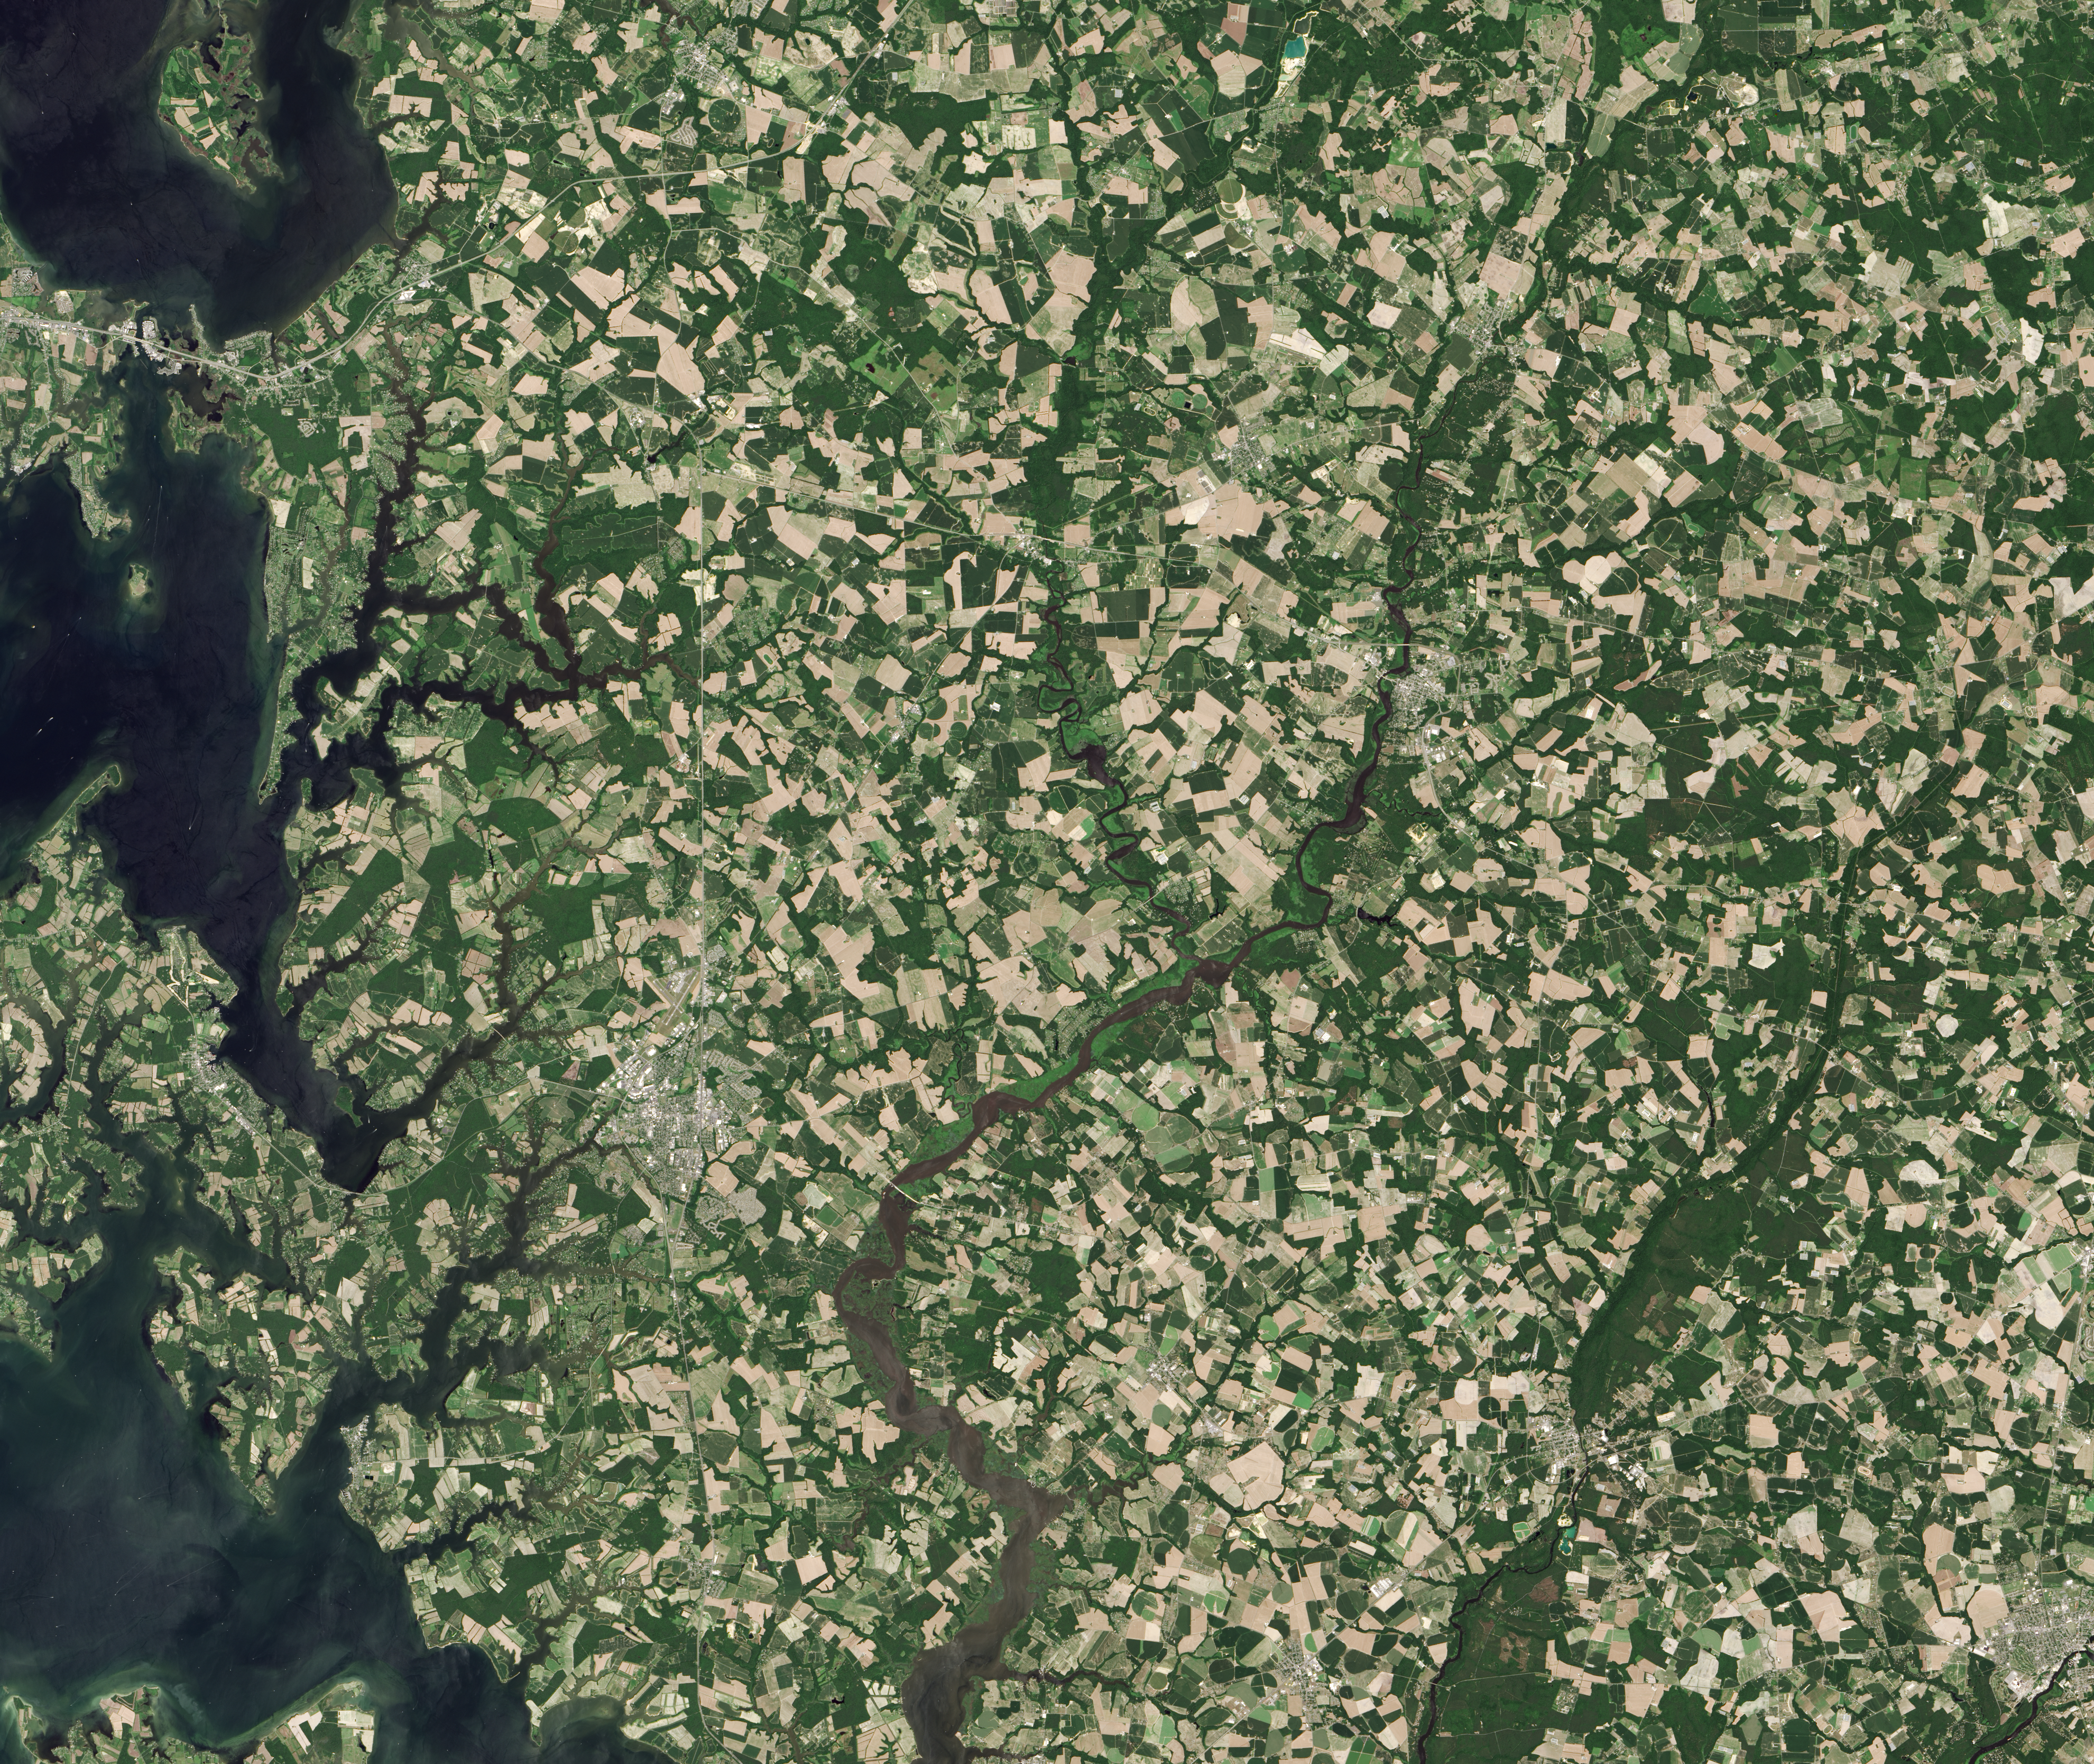

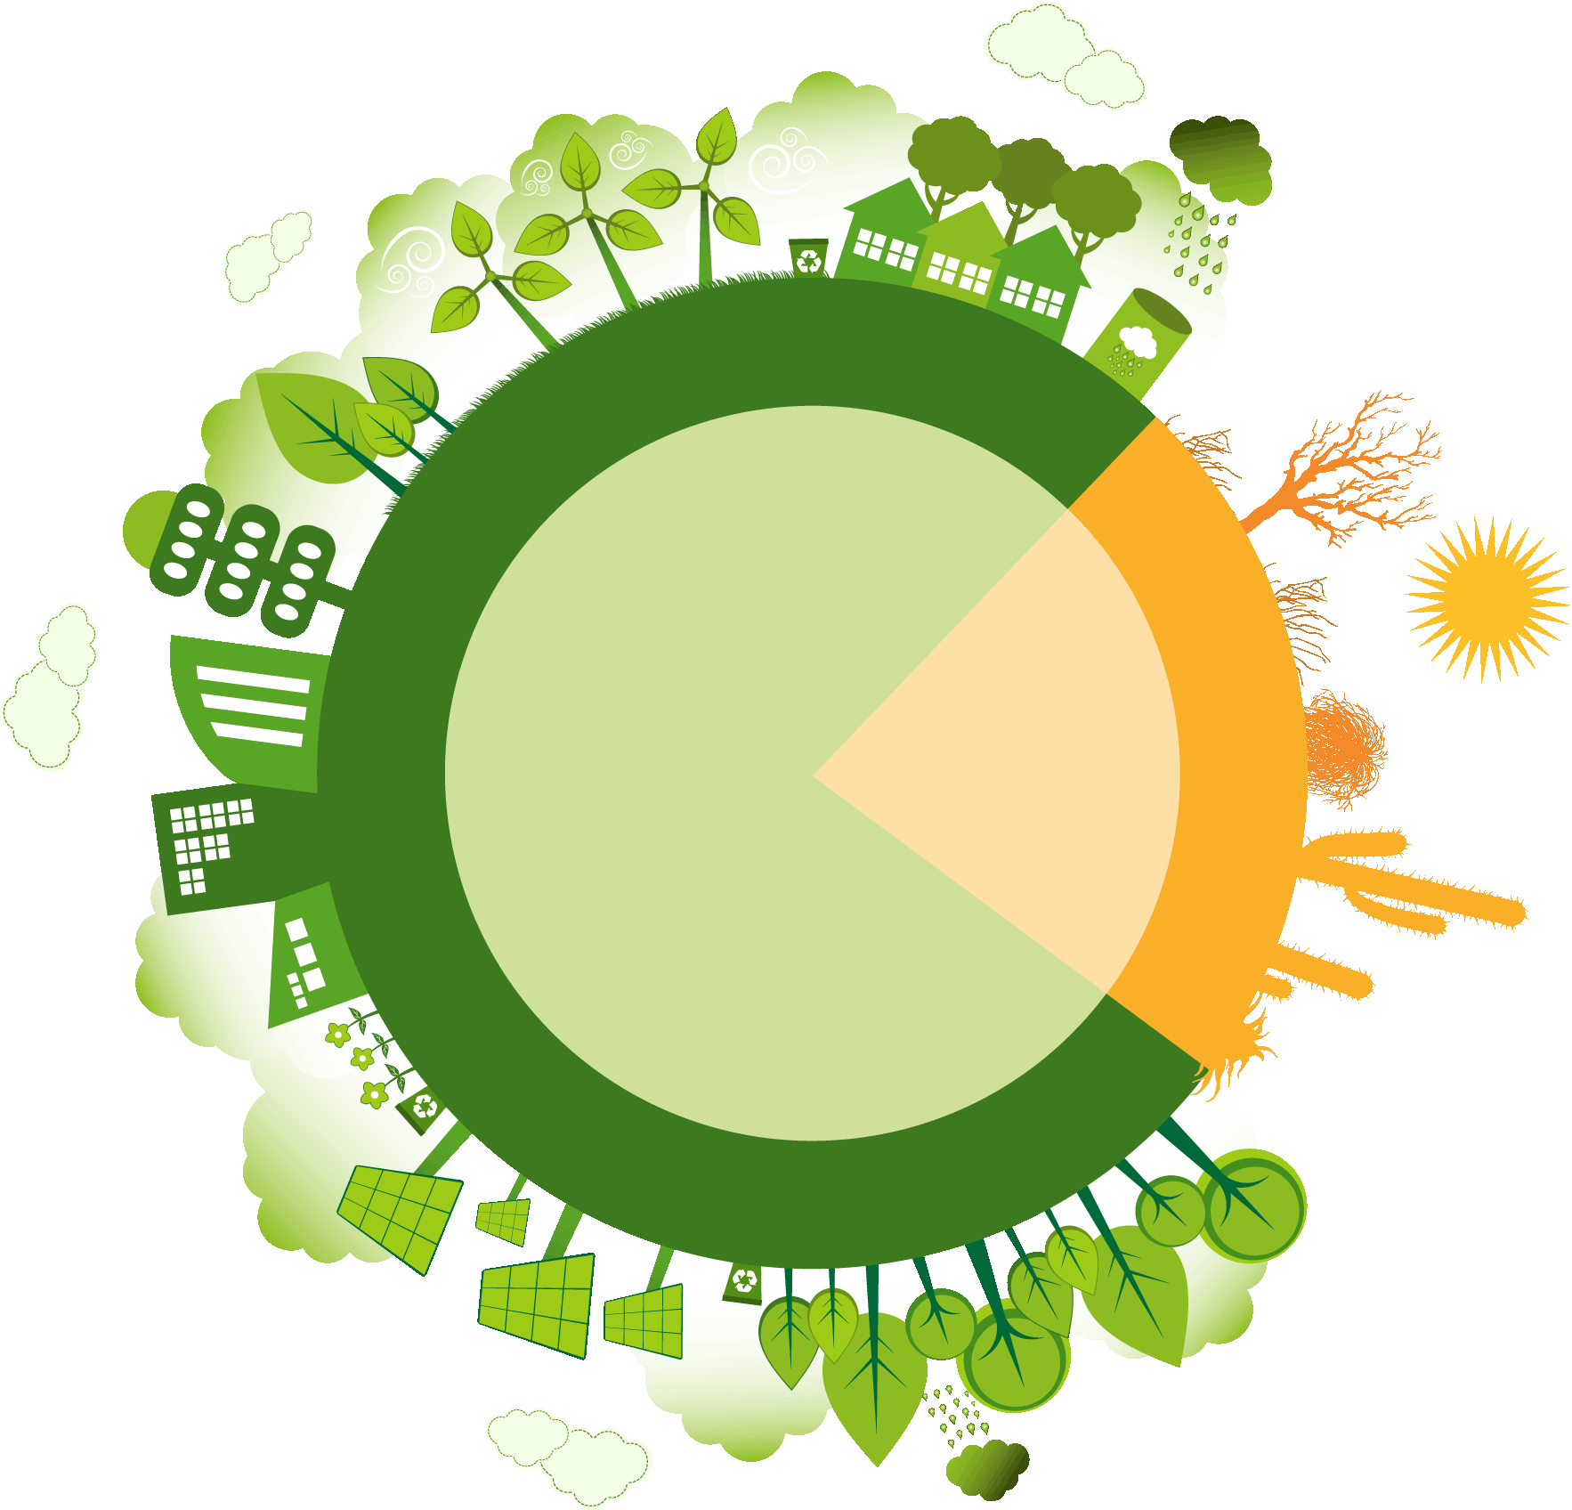
POLICY RESPONSE IMPROVEMENTS
Land Use
Chesapeake Bay
2009 threatened due to pollution
2016 N ↓8%, sediment ↓ 7% P ↓ 20%, shrinking dead zone
Improved air quality, farmer practices and cities wastewater treatment
23%
of global soils are degraded

Slide 16
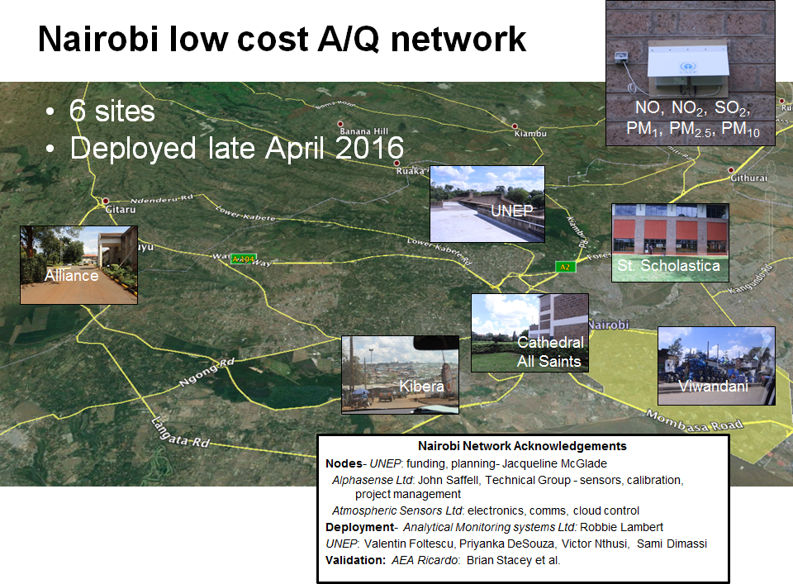
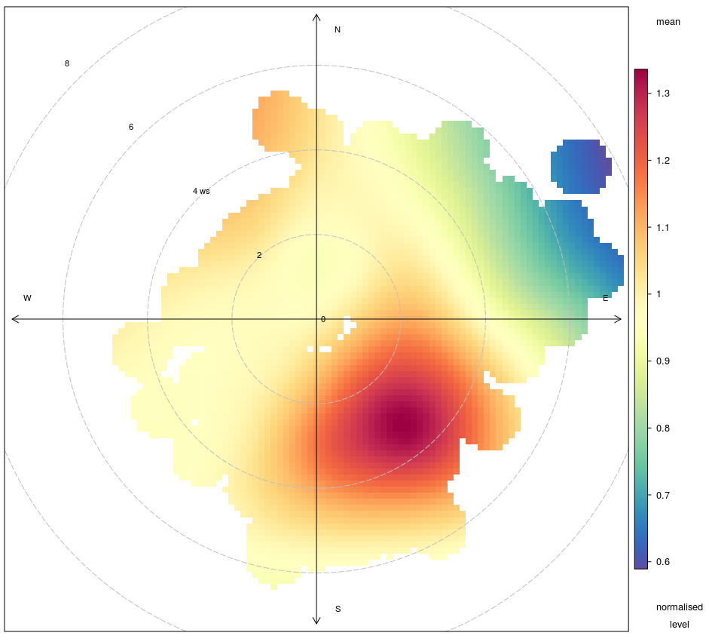
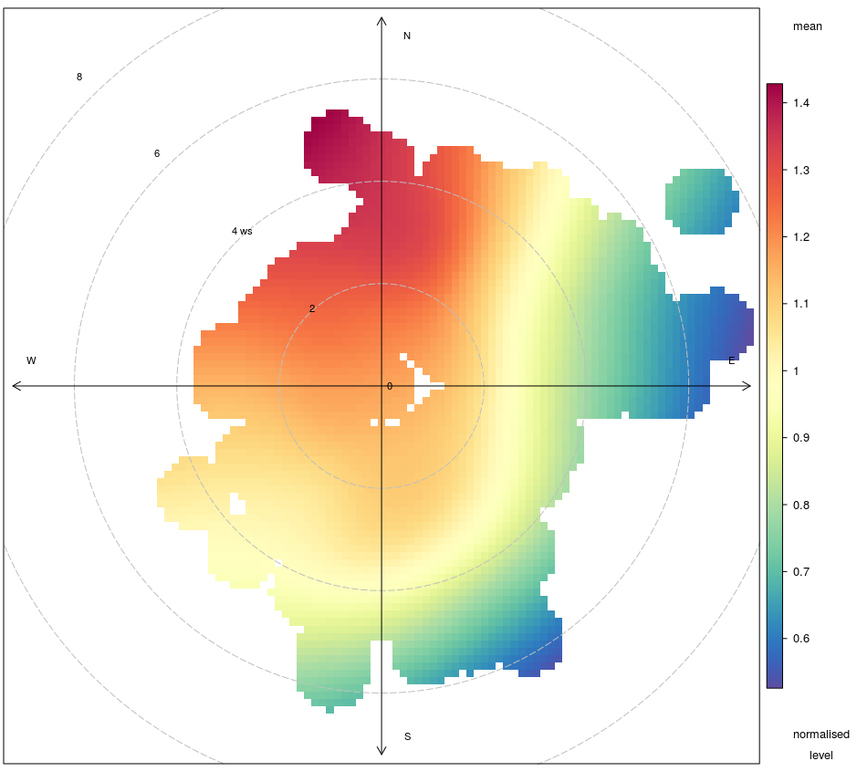
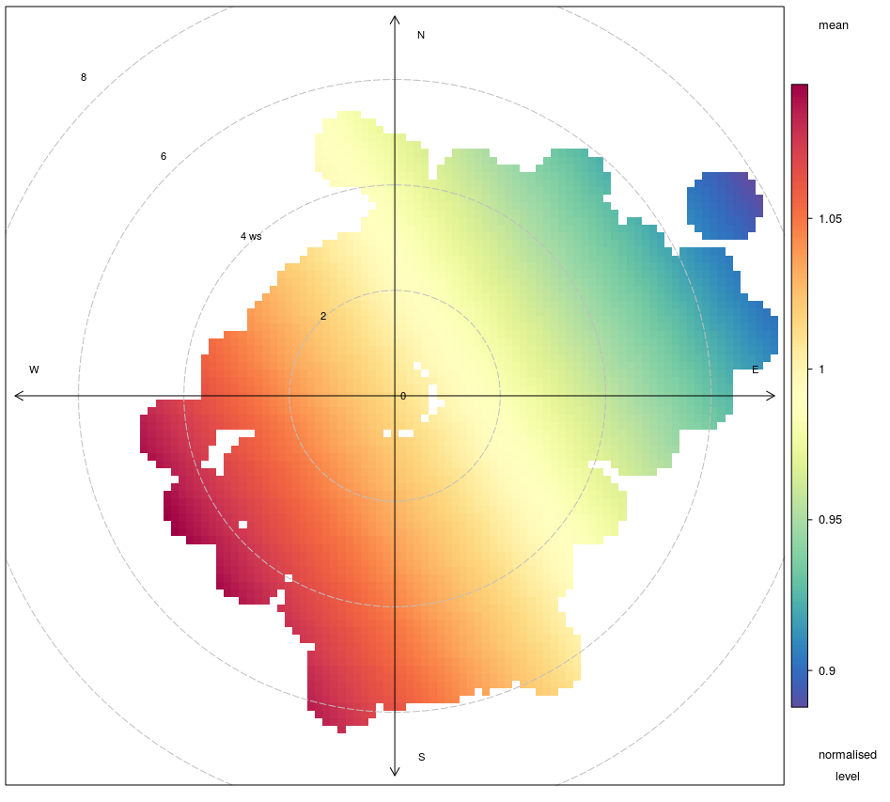
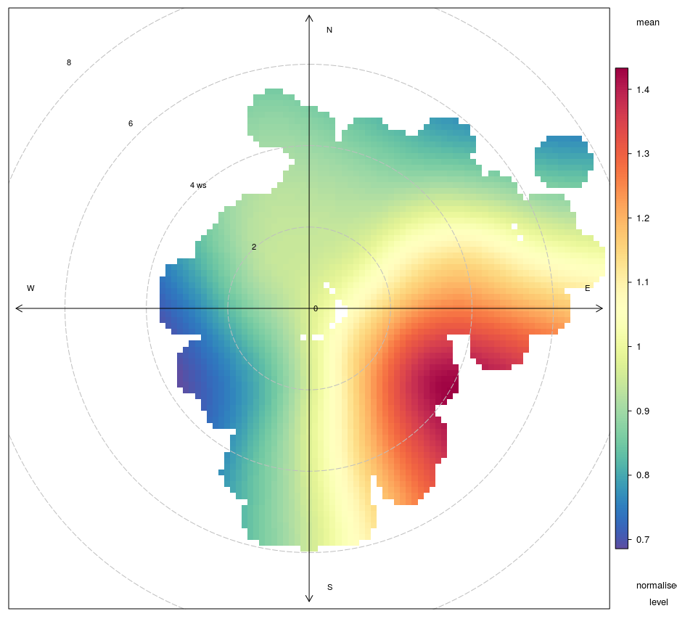
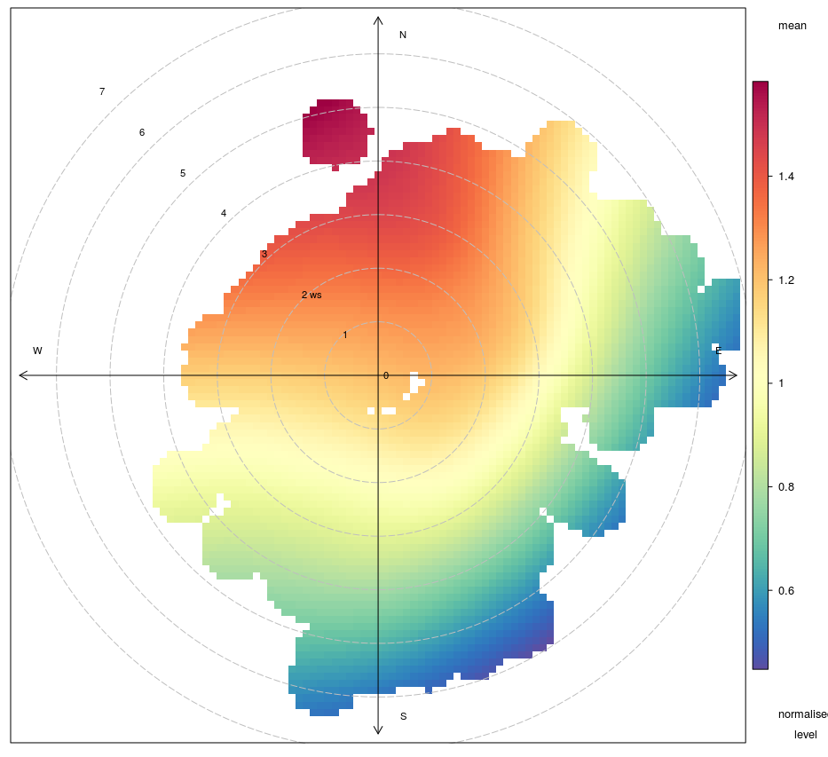

Slide 17
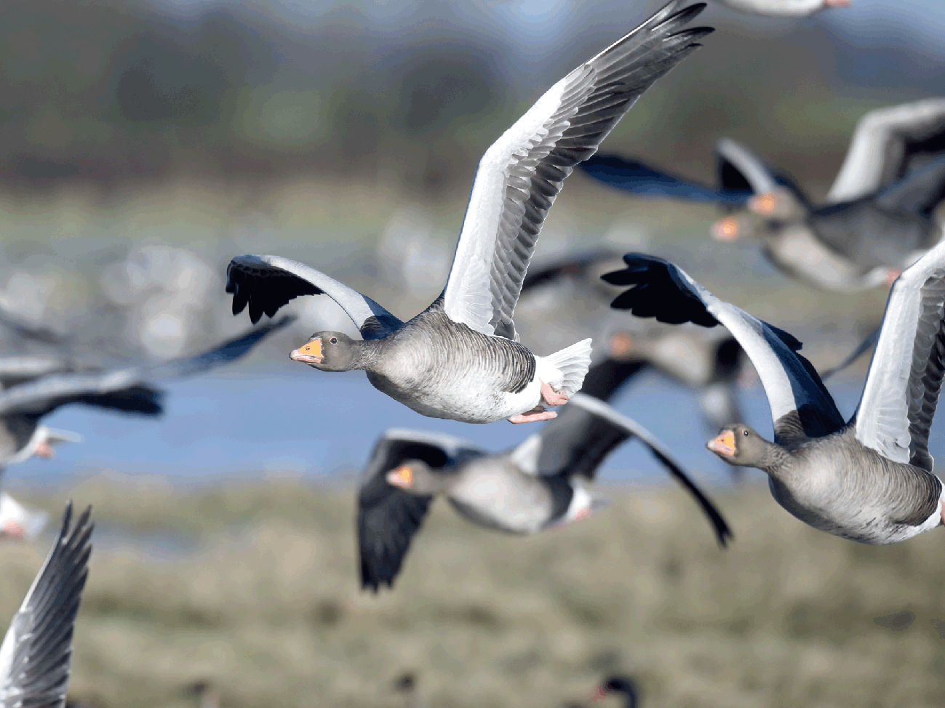
Outlooks

Slide 18
Contents
GEO 6: Structure& trends
1. Global priorities
2016
S T A T E A N D T R E N D S
2. State & trends
3. Policy Responses
3. Policy Response
2017 UNEA 3
4. Outlooks
2018
G L O B A L R E S P O N S E S
Summary for Policy Makers
2019 UNEA 4

