Slide 1






Orientation: Integrated Environmental Assessment Guidelines
Pierre Boileau (GEO Head)
Feb. 20, 2017

Slide 2
Guidelines Development
Over 600 comments
Incorporate comments
Publish Living Document
Road test by GEO authors
Zero Order Draft
2nd Order Draft
2016
2017
Additional Drafting
Review Period
April 11-15
September
December
January
February 20 - 24
May 22-26
Writers Sprint at GRID Arendal
Assessment Methodologies Group
GEO Community 500 +
AMDG and Authors
First global authors’ meeting
Second global authors’ meeting
Requested by Governing Council Decision 27/11 paragraph 1:
“Requests the Executive Director to review best practices and develop a set of transparent procedures, particularly with regard to administrative processes, the selection of participants the inclusion of diverging view points, as well as government and peer reviews to support a wide range of environmental assessments that the United Nations Environment Programme conducts in order to ensure that they are of the highest quality and have maximum impact. These procedures should be based on the knowledge and experience of nationally recognized experts and current best assessment practices should be provided to member states for comments. Those procedures relevant to the sixth Global Environment Outlook assessment should be prioritized to feed into its preparation and should be provided to Member States for review and comment in time for the preparation of the sixth Global Environment Outlook assessment;”
Acronyms: Global Environment Outlooks (GEO), Assessment Methodologies Data and Information Group (AMDG)

Slide 3
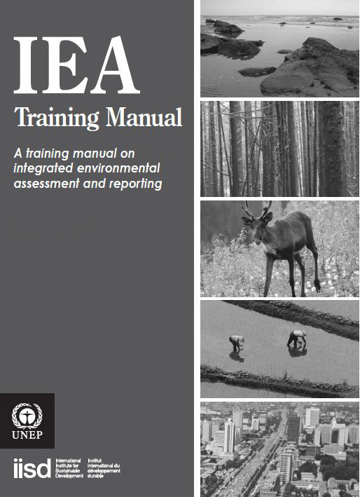
Structure
Follows 2007 manual structure. Guidance in manual still relevant.
New components
  Theory of change
  Policy effectiveness assessment
  Evaluation
Use decision trees to select the type of approach or method to use for the assessment.

Slide 4

Definitions
Assessment findings
Practitioner
Users
Commissioning Entity
Secretariat
Advisory bodies
Integrated Environmental Assessment

Slide 5
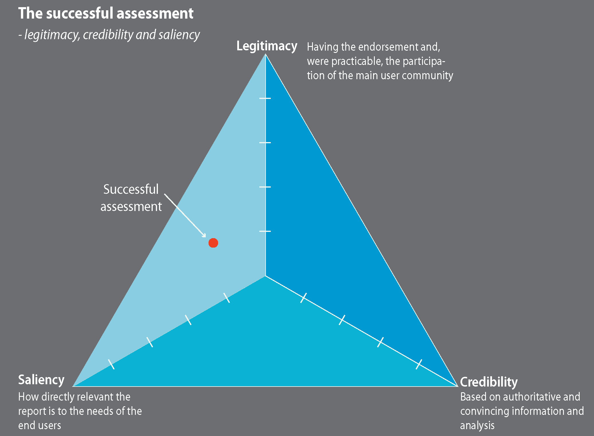
Successful Assessment
Findings of the assessment must be considered
credible,
have legitimacy with the audience, and,
must be considered relevant (salient) to the audience

Slide 6
Theory of Change
Introduction
Mandate, purpose, approach, structure
Drivers
Economy, Population, Climate, Technology
Data/Knowledge
Statistics, citizen science, big data, remote sensing, gender
State and Trends
Pressures, state, impact and current policy response
Air
Fresh Water
Oceans
Land
Biota
Problem statement
Policies, goals, objectives and environmental governance
Effectiveness of policy response and governance models
Theory of Change
Analytical Approach
Air
Fresh Water
Oceans
Land
Biota
Desired state
Outlooks
New Methods
Agenda 2030
Sustainability in 2050
Path to achievement

Slide 7
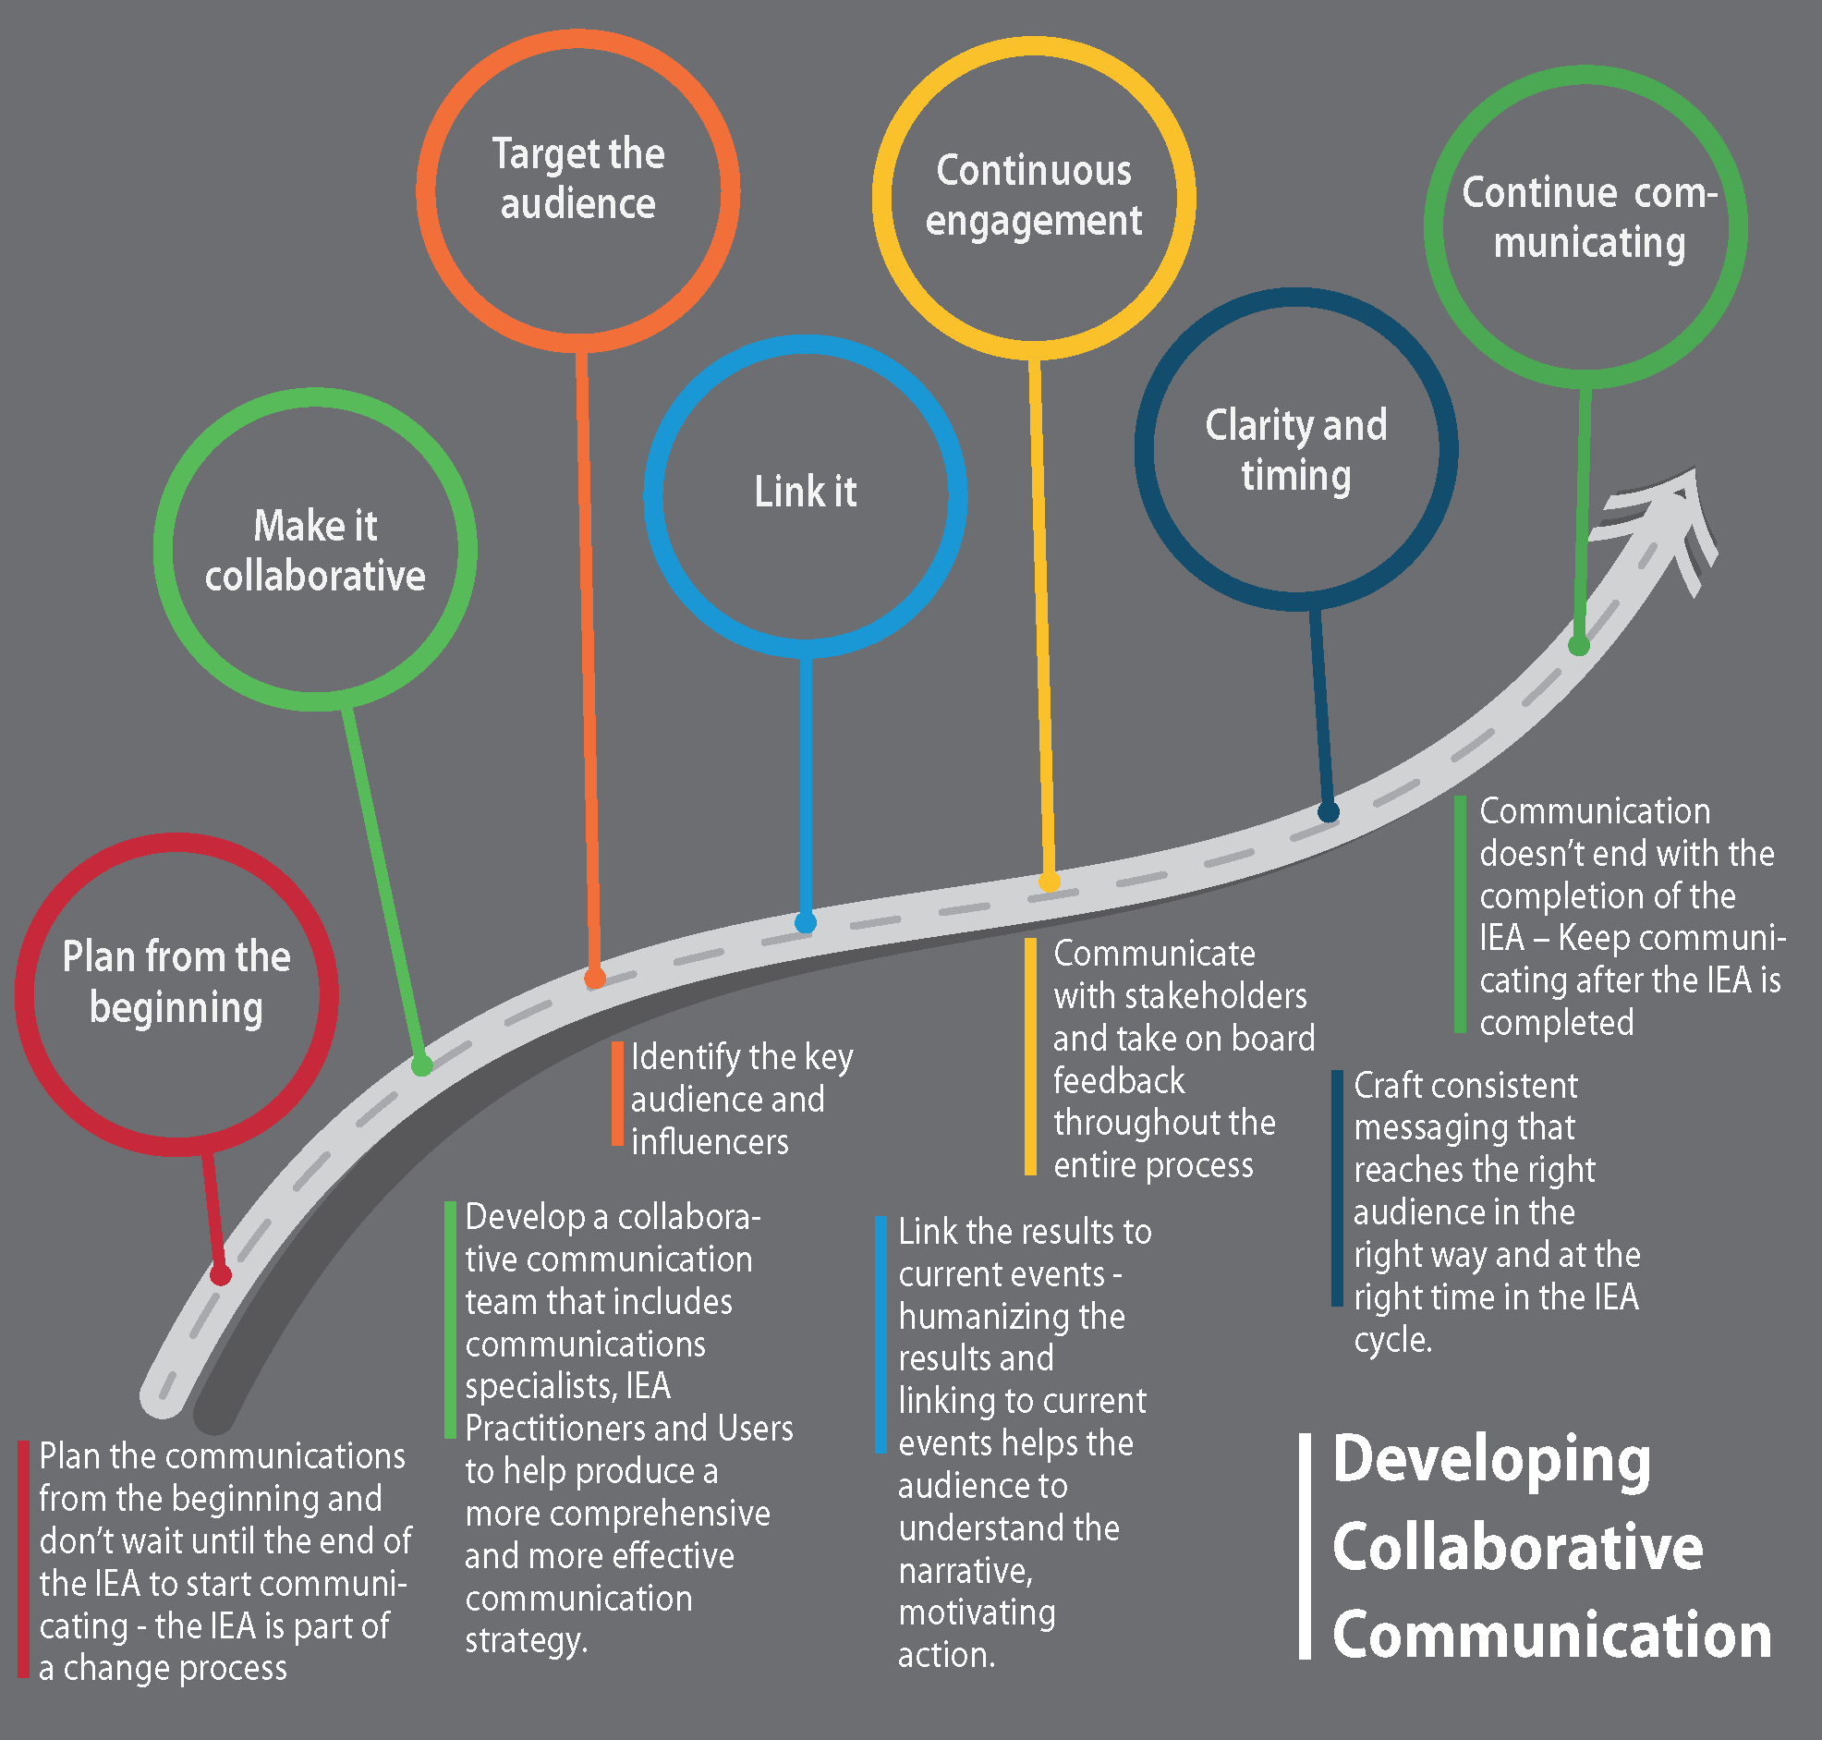
Impact Strategy

Slide 8
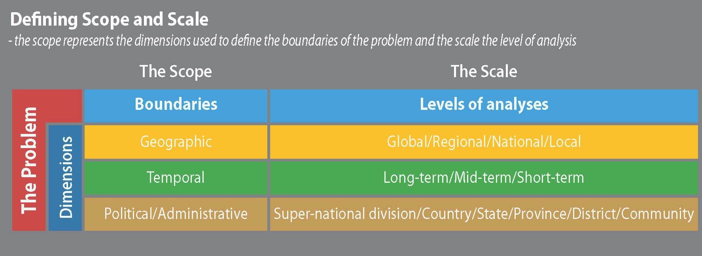
Scope and scale
Decisions may be influenced by available resources

Slide 9
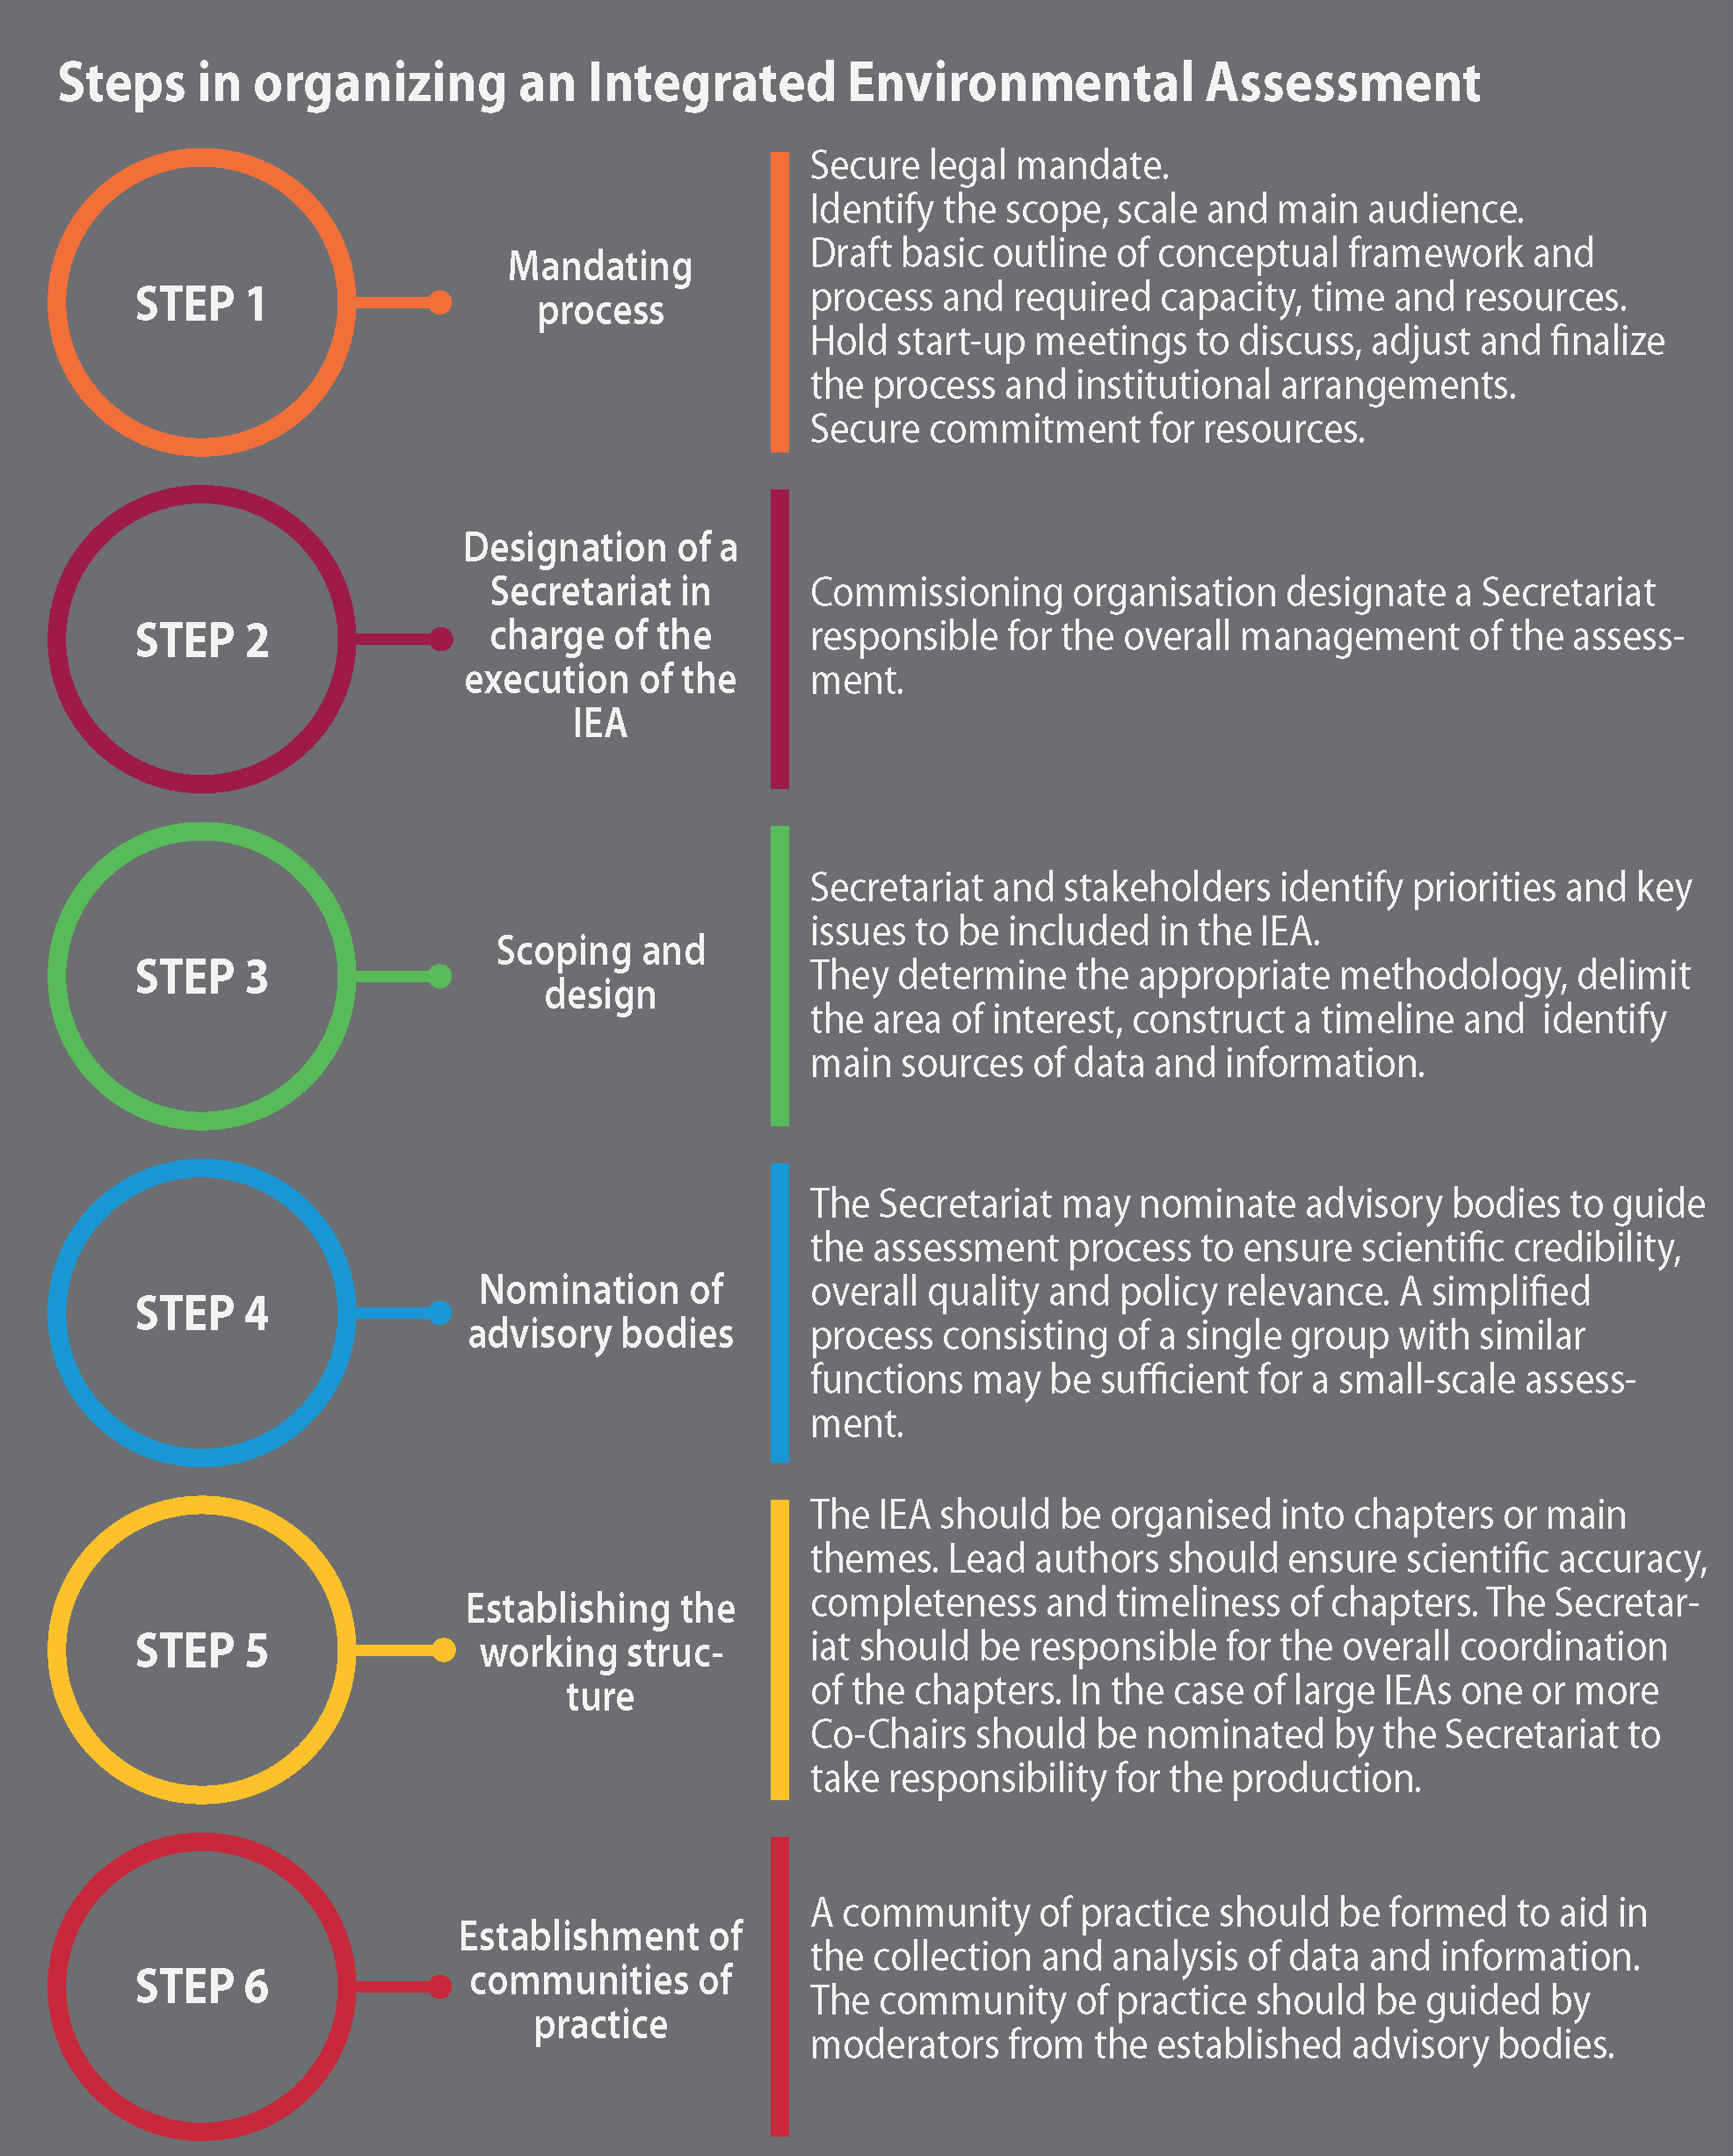
Steps in the process
Nomination process
Selection process
Balance:
  Expertise
  Geographic
  Gender
Availability
Time commitment

Slide 10
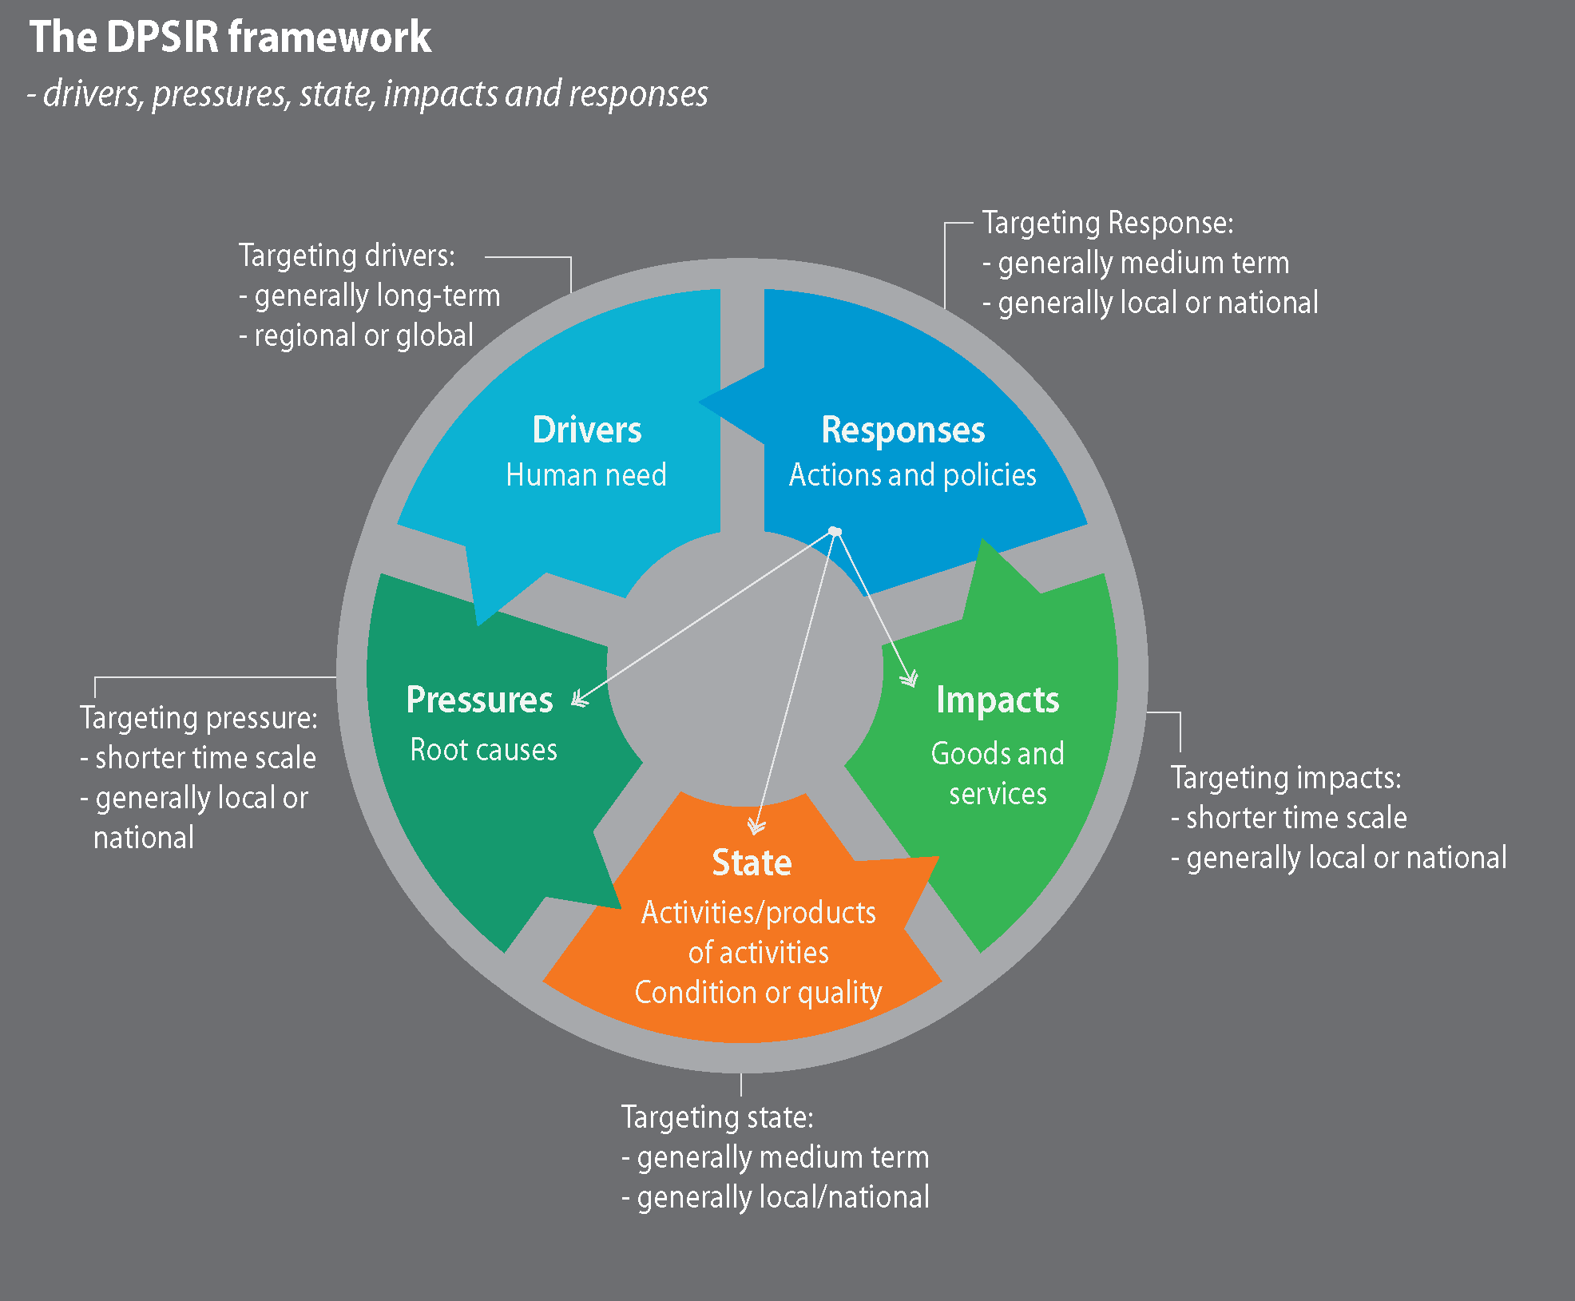
Drivers, pressures, state, impact, response

Slide 11
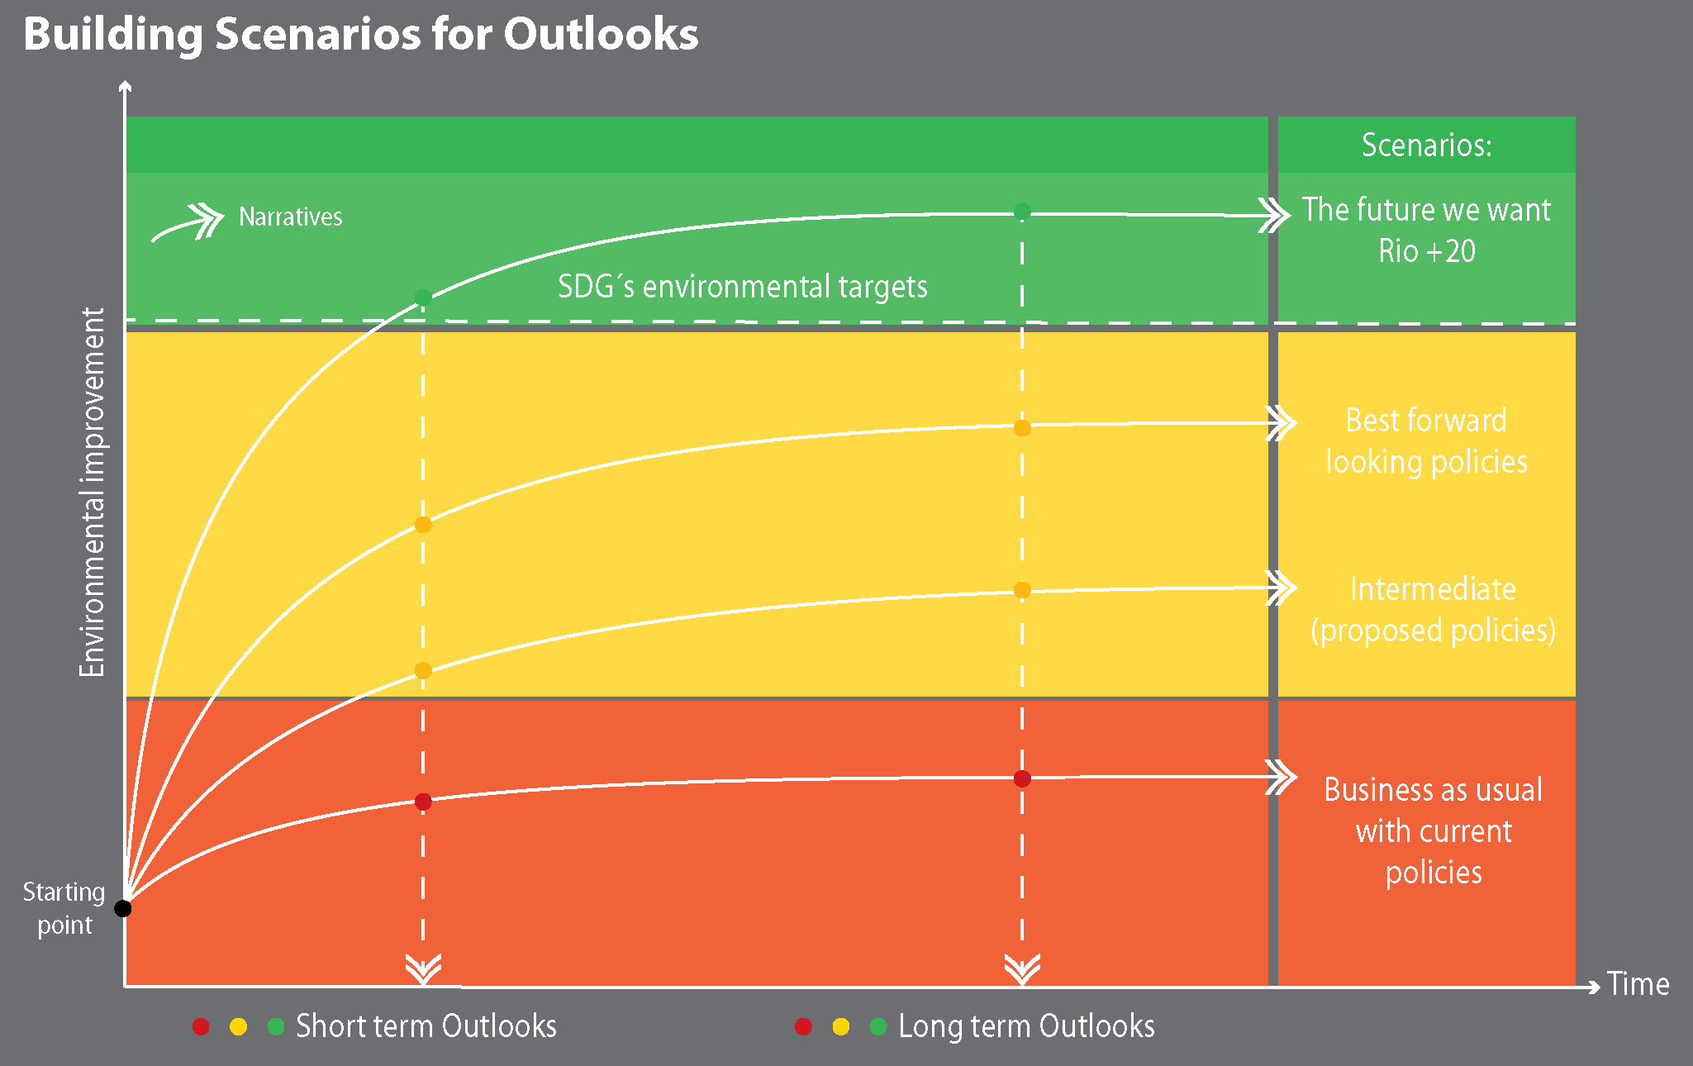
Outlooks?

Slide 12
Evaluation
Different things to consider in an evaluation
Costs | Timetable
Efficiency | Methodologies
Feasibility | Scientific questions
Communication | Usefulness/impact
Capacity building | Dissemination of findings

Slide 13
Questions ???

