Slide 1

OARE Module 6A:
  E-journal, E-books and Internet Resources: Background; Free E-journals Access

Slide 2
Contents Module 6: E-journal, E-books and Internet Resources
Module 6A: Background; Free E-journals Access Options
Module 6B: Free E-book Access
Module 6C:Environment Gateways/Portals

Slide 3
Section A: Background
  Grey Literature – definition
  Types of environmental resources on the Internet
  Open Access journals
  Predatory Publishers; journal article retraction
  Useful Resources including plagiarism checkers,
  Free e-journal access options
  Appendix: DSpace

Slide 4
Grey Literature
  Is defined as ‘that which is produced on all levels of government, academics, business and industry in print and electronic formats, but which is not controlled by commercial publishers.’
  Grey Literature Report, New York Academy of Medicine,
  www.greylit.org/about (accessed 02 January 2015)
  Examples include technical reports from governmental, inter-governmental and non-governmental agencies or research groups, working papers from research groups or preprints, thesis/dissertations and conference papers.

Slide 5
Grey Literature (continued)
  Is a body of materials that cannot be found easily through conventional channels – e.g. indexed databases or publishers’ lists
Lacks strict bibliographic control - basic information such as author, publication date or publishing body and location may not readily available
Is increasingly found on the Internet but can be difficult to identify, access and evaluate

Slide 6
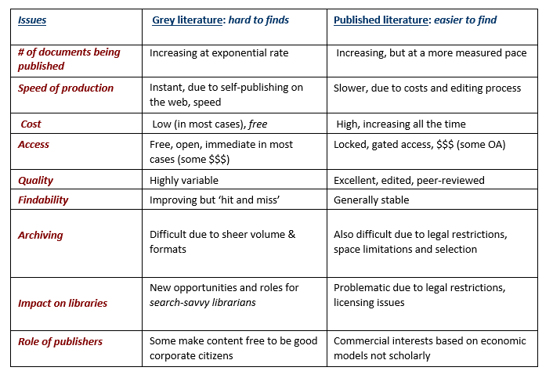
Finding the Hard to Finds: Searching for Grey Literature – 2012 Update hlwiki.slais.ubc.ca/images/5/5b/Greylit_manual_2012.doc (accessed 03 November 2015)

Slide 7
Free (Grey) Resources on the Internet
Library catalogues (FAO and regional offices)
Journals and books
Bulletins, newsletters
Governmental, intergovernmental and non-governmental information resources
Discussion groups
Research databases
Publishers’ databases
Ready reference material e.g. encyclopedias

Slide 8
Open Access Journals
‘Open Access’ (OA) journals are scholarly journals that are available without financial or technical barriers other than Internet access
Articles either are directly accessible from the publisher (e.g. PLOS – OA Gold) or archived in a repository (e.g. PubMed Central – OA Green)
In most cases, the copyright is owned by the author, not the publisher (see Creative Commons copyright licensing)
Some OA journals are subsidized by academic or governmental institutions

Slide 9
OA Journal Options
‘Non-fee based OA journals’ – no fee required by authors; journals funded by governmental or inter-governmental agencies or NGOs
‘Fee-based OA journals’ require payment by the author - often paid by a grant or institution
These OA journals accept articles from authors in low-income countries; the number varies from journal to journal; peer-reviewers (theoretically) do not know if authors have requested fee waivers
‘Delayed open access journals’ where the articles are available between 6 – 24 months
‘Hybrid open access journals’ contain some current articles that are free access (e.g. The Lancet)

Slide 10
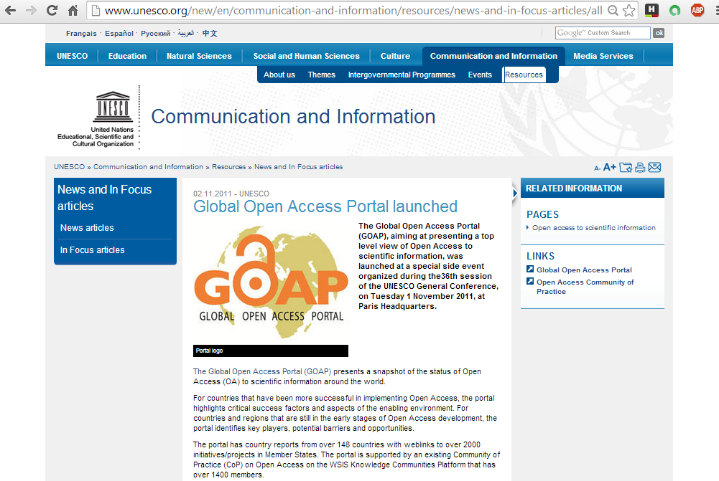
GOAP is a current snapshot of the status of Open Access (OA) in the Scientific World

Slide 11
Some words of caution
With the development of Open Access publishing, some unscrupulous publishers take advantage of authors (predatory publishers)
Examples are stand-alone (one title) publishers, the publisher is the editor, no formal editorial/review board, lack of transparency of publishing operations no policy for digital preservation, name of journal is inflated or incongruent with journal’s mission, false claim of indexing, poor journal standards or practices, excessively broad titles, etc.

Slide 12
Useful resources
Check if the journal is listed in the Open Access Scholarly Publishers Association oaspa.org/ or Directory of Open Access Journals https://doaj.org/
How to spot a PREDATORY PUBLISHER. Claire Sewell, University of Cambridge, Office of Scholarly Communication.
University of Witwatersand’s Open Access, A2K & Scholarly Communication: Predatory Publishers Libguide
  libguides.wits.ac.za/openaccess_a2k_scholarly_communication/Predatory_Publishers

Slide 13
Journal selection tools
How to target a journal that is right for your research (SciDev.Net) www.scidev.net/global/publishing/practical-guide/target-journal-right-research-communicate-publish.html
Journal Author Name Investigator jane.biosemantics.org/
Journal Guide https://www.journalguide.com/
Journal Selector www.edanzediting.com/journal_selector
Think Check Select https://thinkchecksubmit.org/
For further tools on all aspects of publishing, go to:
Authoraid www.authoraid.info
Research4Life Training Portal: Authorship Skills
http://www.research4life.org/training/authorship-skills-2/

Slide 14
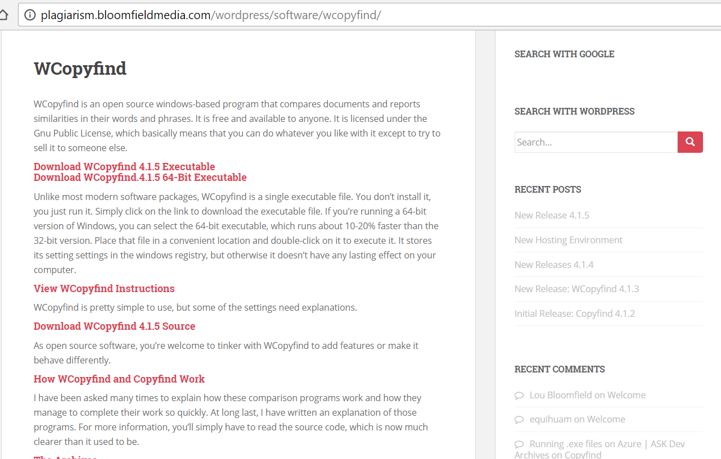
Wcopyfind Download Instructions
(plagiarism tool)
a plagiarism detection software (open source)
which compares strings in different documents;
also can also parse webpages for similarities.

Slide 15
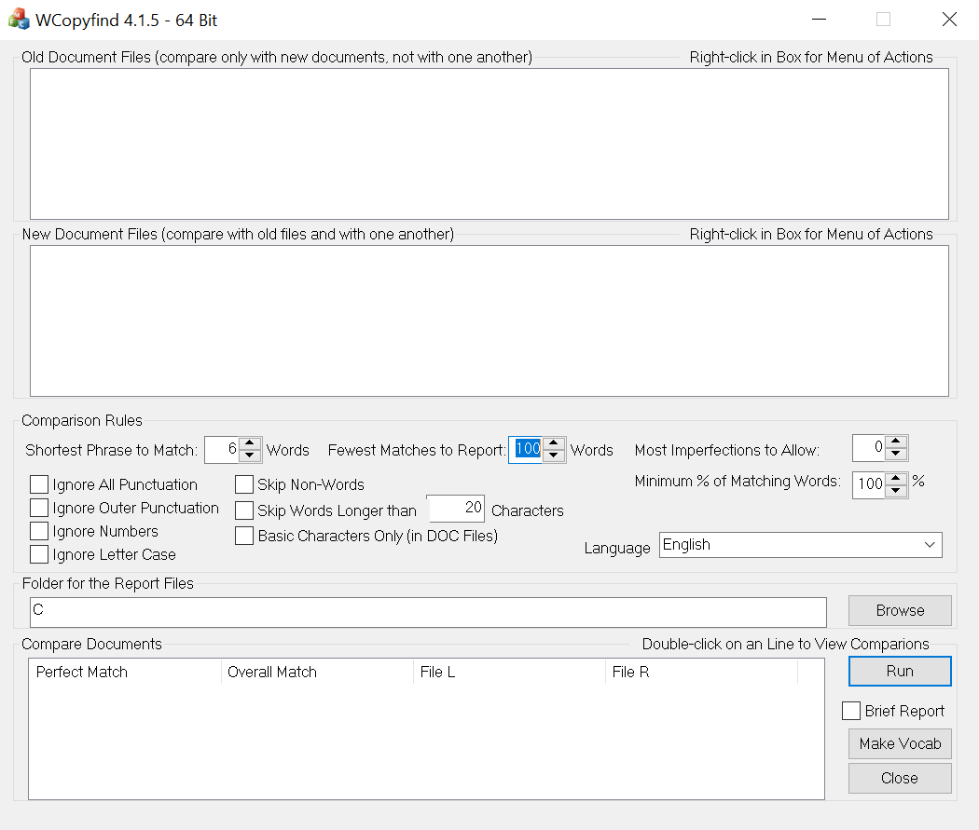
Downloaded 64 bit version

Slide 16
Other Plagiarism Detection Tools
Two useful articles that evaluate the best sources are:
  Top 10 Free Plagiarism Detection Tools for eLearning Professionals (2017 Updated)
  https://elearningindustry.com/top-10-free-plagiarism-detection-tools-for-teachers
  Top 20 free online plagiarism checker tools and websites (2018)
  https://www.digitalgyd.com/top-20-best-online-plagiarism-checker-tools-free/

Slide 17
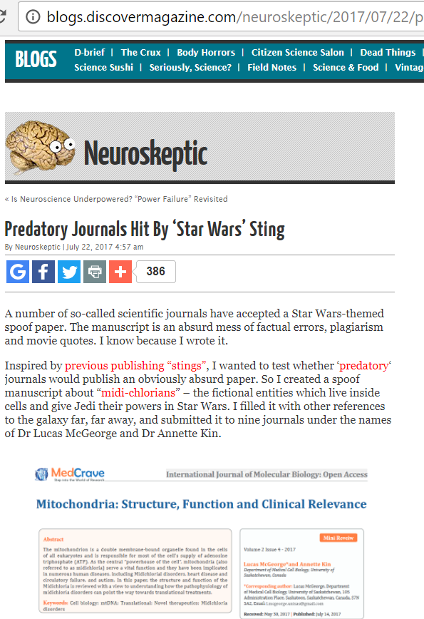
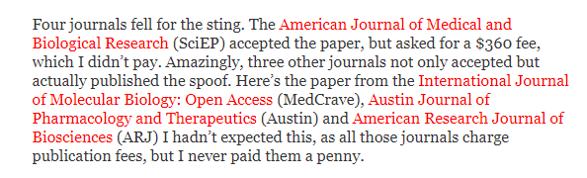
Four predatory publishers accept an article featuring Star Wars characters.
http://blogs.discovermagazine.com/neuroskeptic/2017/07/22/predatory-journals-star-wars-sting/#

Slide 18
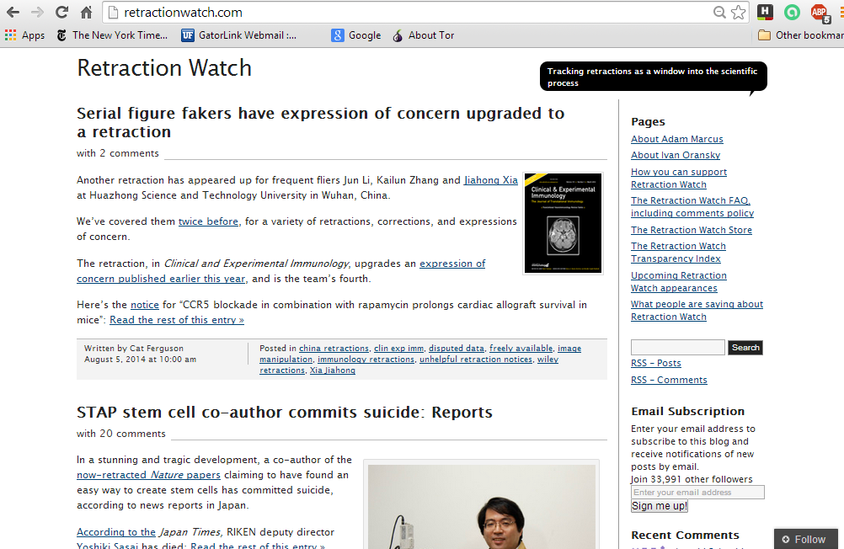
Retraction Watch is a website that tracks the retraction of peer-reviewed papers due to fabrication, faulty research and/or statistics

Slide 19
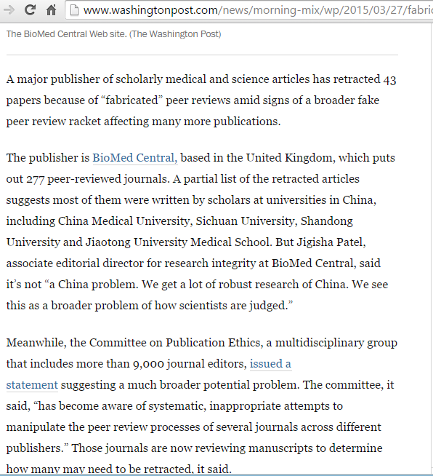
This is part of an article published by the Washington Post – 27 March 2015. It discusses the retraction of 43 papers by BioMed Central.

Slide 20
Section B
Free E-journals Access
  Directory of Open Access Journals
  PubMed
  Unpaywall

Slide 21
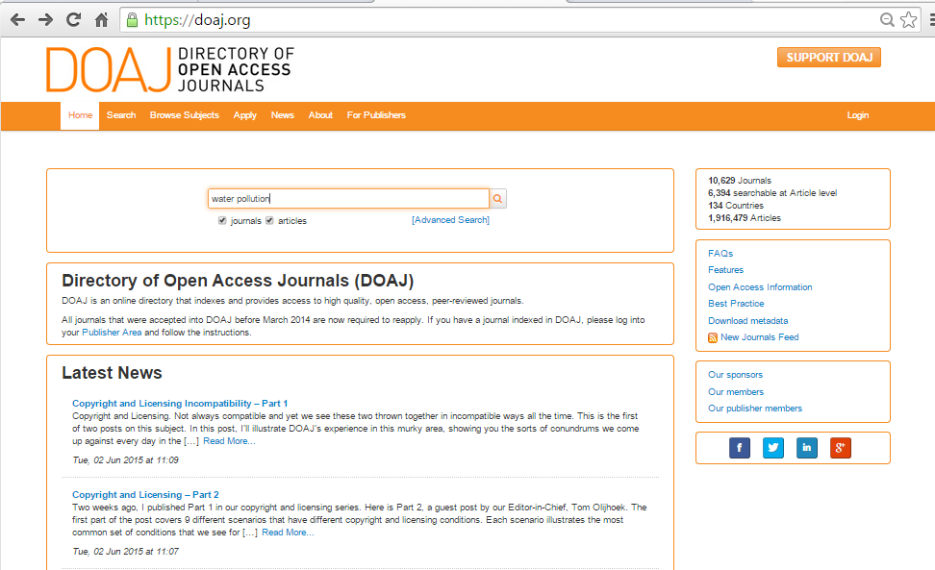
DoAJ is a gateway to over 10,000 open access journals and 1.9 million articles. Search for water quality.

Slide 22
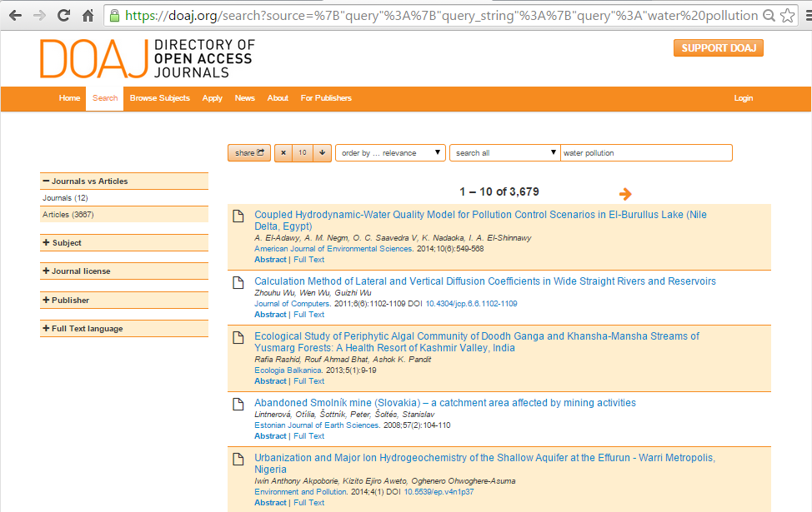
The water quality search results are 3679 articles. Access also is via Subject, Journal Language, Country of Production, Publisher and more.

Slide 23
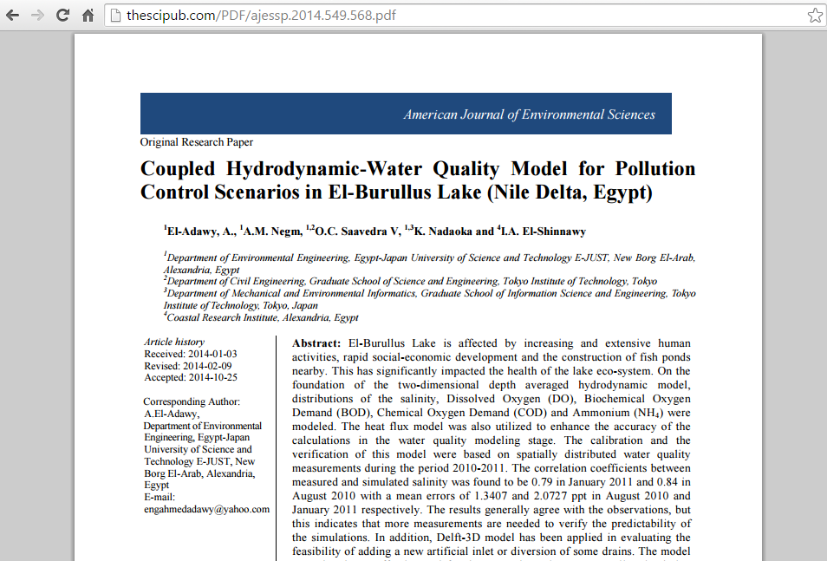
Now opened is the PDF of one of the search results articles

Slide 24
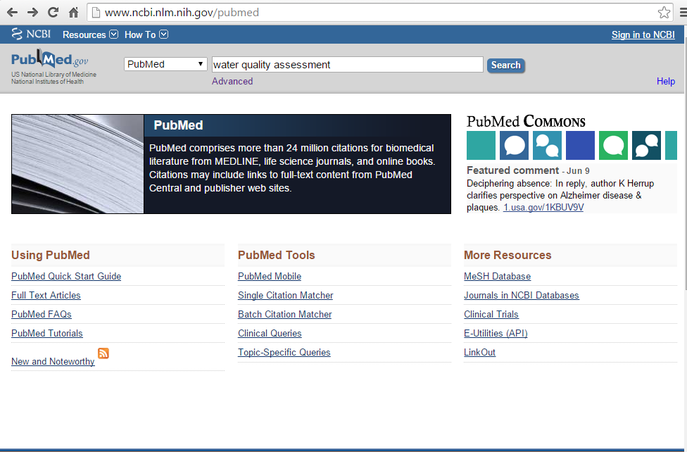
PubMed is a health related database with 26,000,000 article citations. Some environment material – especially health related - is in the database. Search for water quality assessment.

Slide 25
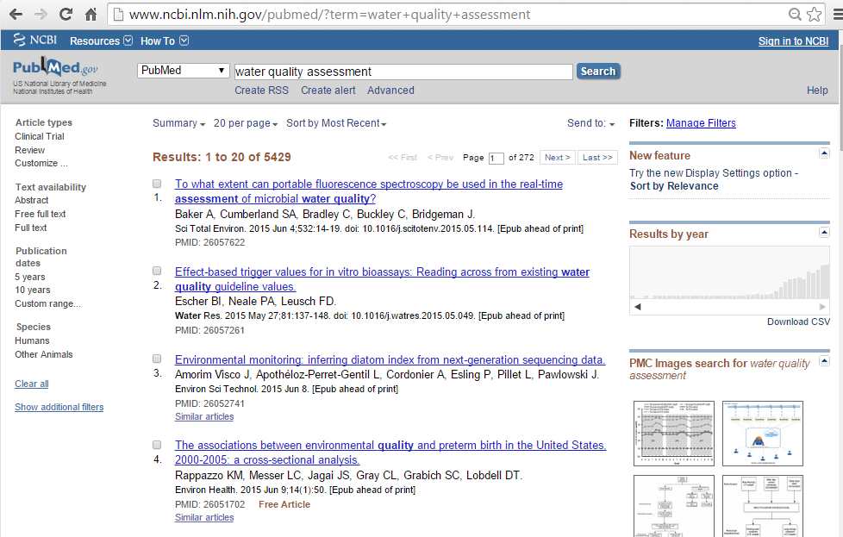
For water quality assessment, there are 5429 citations
The search results are 5429 citations. Click on the Free full text option.
Note: if you are from an R4L registered institution, many of the articles could be available from the OARE or Hinari portals.

Slide 26
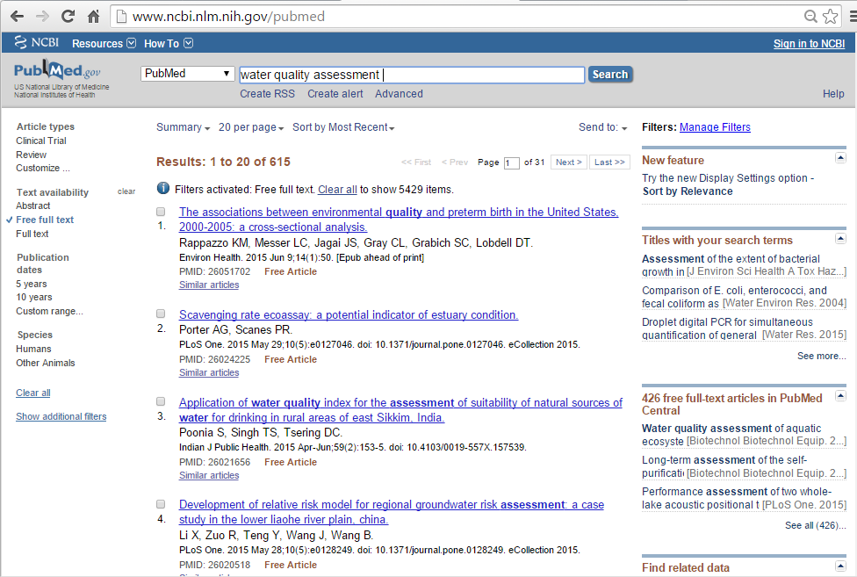
Results now are 615 articles. For the full text articles, click on Free Article or Free PMC Article icons.
Note: do not use this filter if you also want citations for use in R4L portals.

Slide 27
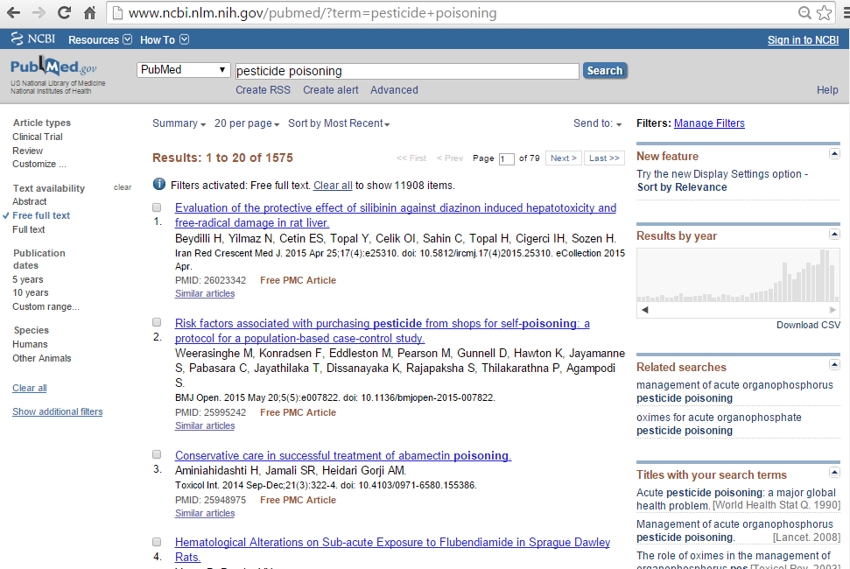
Results for a pesticide poisoning search are 1575 Free full text articles (from a total of 11908). Many other articles will be available from OARE or HINARI.

Slide 28
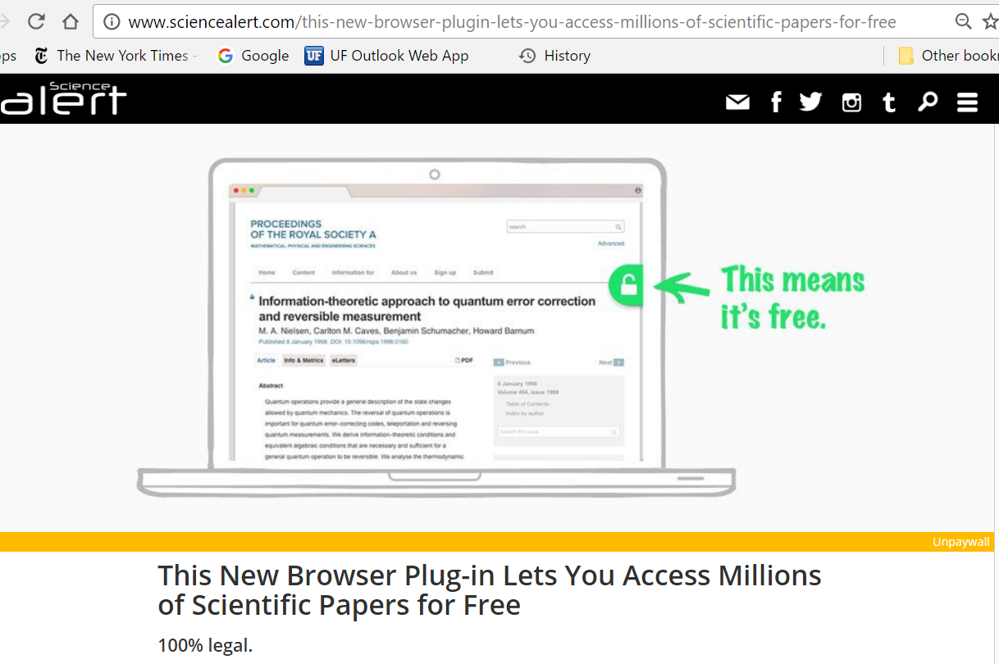
Unpaywall is a plug-in (app) for accessing scientific papers for free.
The content is from numerous open-access repositories including PubMed Central, DOAJ, Crossref licensed information, Google Scholar and BASF. These are PDFs legally loaded by the authors.

Slide 29
‘Unpaywall was launched in April 2017 by the open source not-for-profit Impactstory – funded by the National Science Foundation and the Alfred P. Sloan Foundation. Install the plug-in on your Chrome or Firefox desktop browser.
If the plug-in can find a freely accessible full-text copy of the paper you're looking at, the lock symbol turns from grey to green, and you can click on it to get the PDF. If the lock is gold, the article is already freely available via Open Access.
The full-text copies are totally legal. The plug-in works by scouring a database of over 90 million digital object identifiers (DOIs), looking for publicly accessible copies of papers on pre-press servers and university websites.’
Signe Dean, Science Alert, 21 April 2017 http://www.sciencealert.com/
this-new-browser-plugin-lets-you-access-millions-of-scientific-papers-for-free

Slide 30
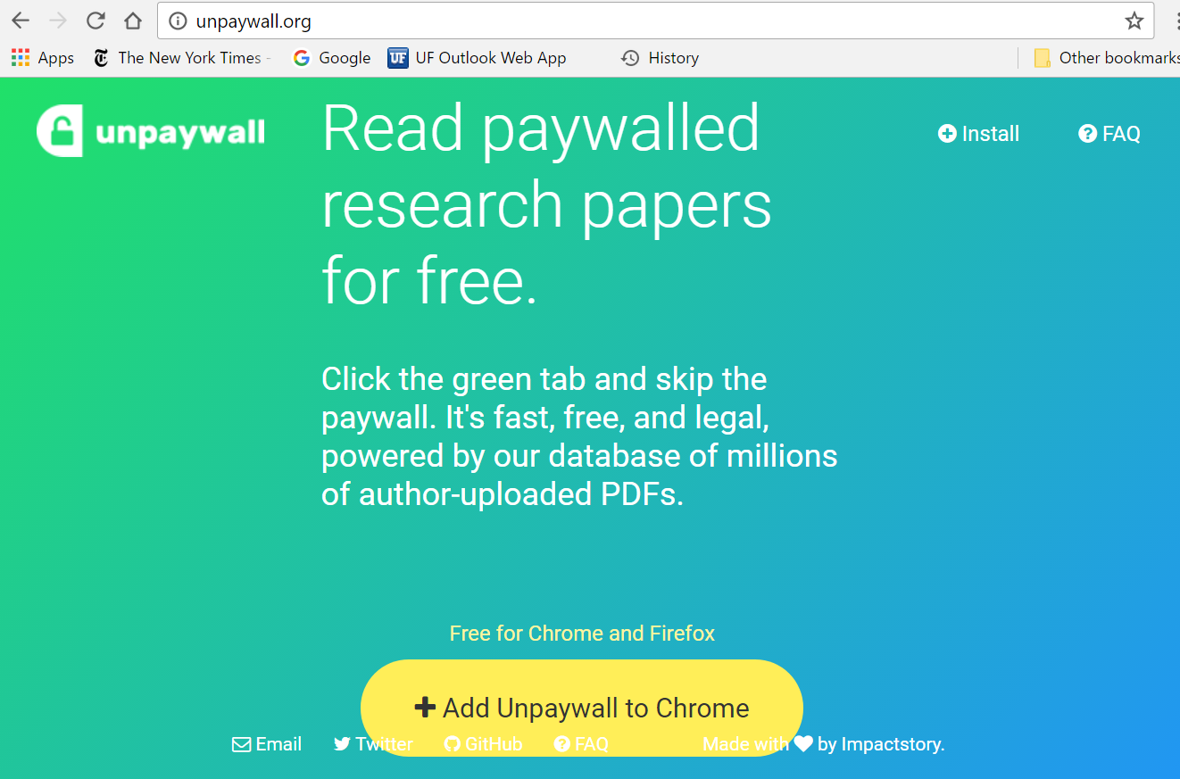
Download the app from unpaywall.org to either Chrome or Firefox web browsers.

Slide 31
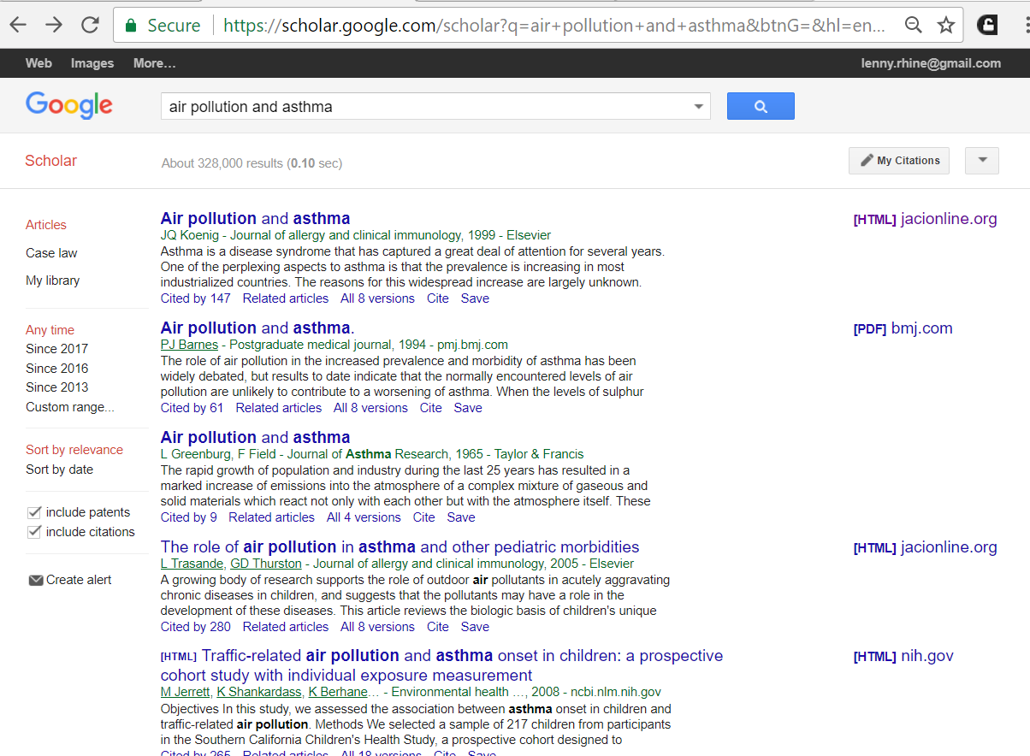
Now completed is a Google Scholar (non-OARE) search for air pollution and asthma. Click on the links to view the (full-text) availability and unpaywall icon.
Note – some of the pdf links do not have the unpaywall icons.

Slide 32
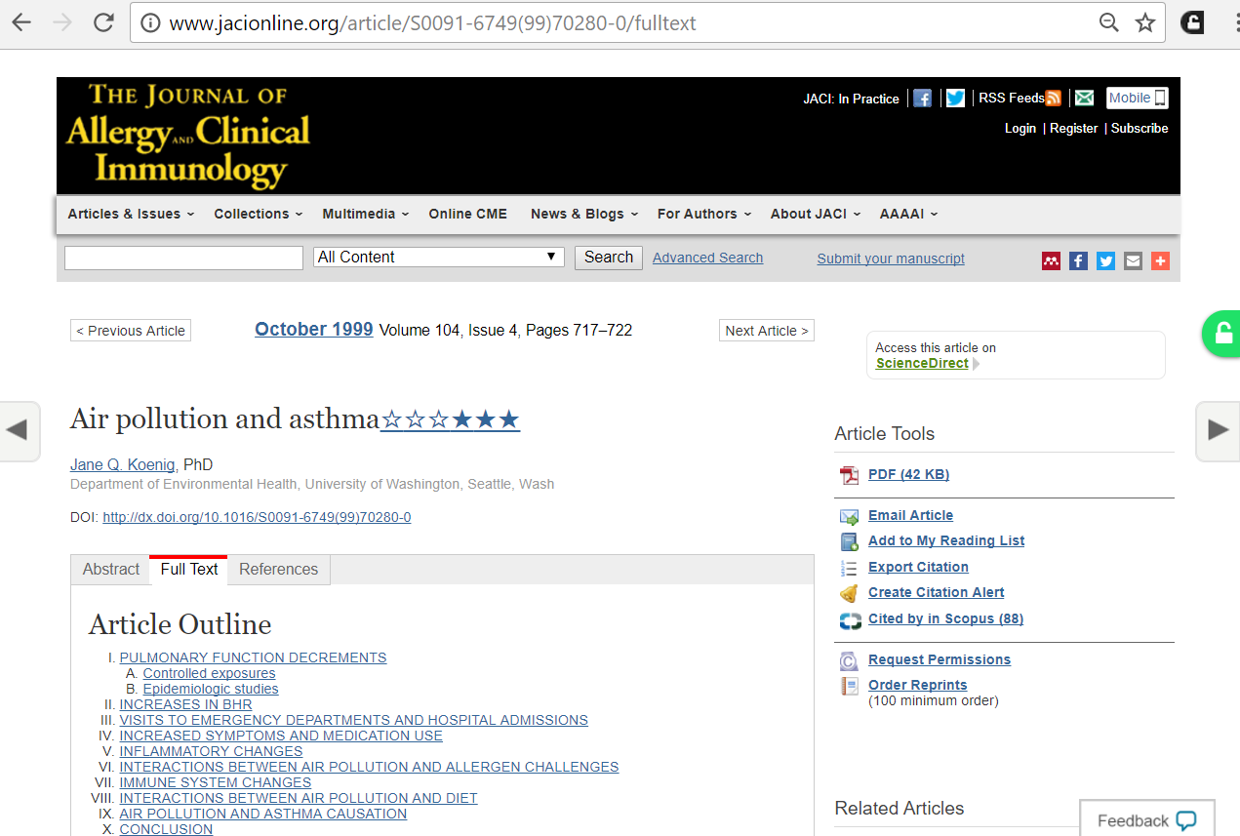
The unpaywall plugin has been added to Google Chrome. Opened is a Journal of Allergy and Clinical Immunology article with a link to Download PDF. Note the unlocked (green) Unpaywall icon.

Slide 33
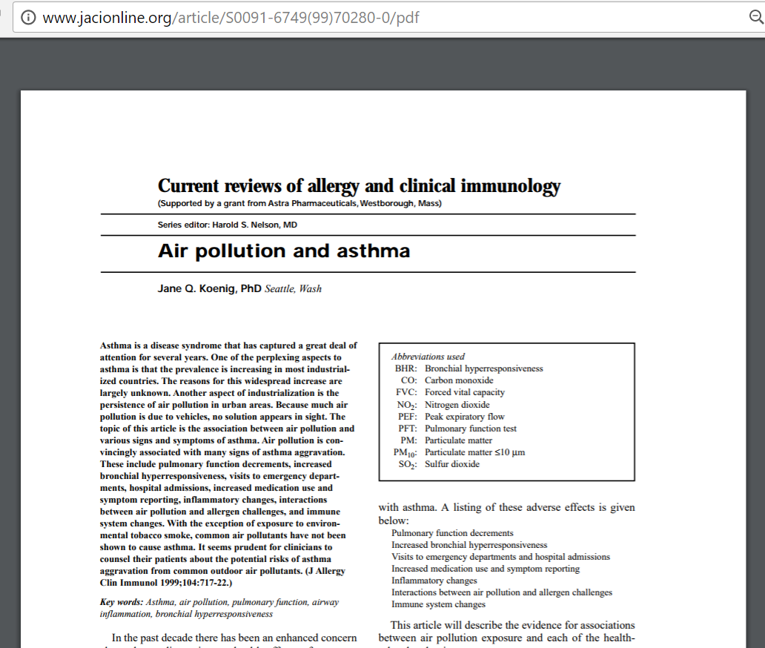
Displayed is the PDF of this article.

Slide 34
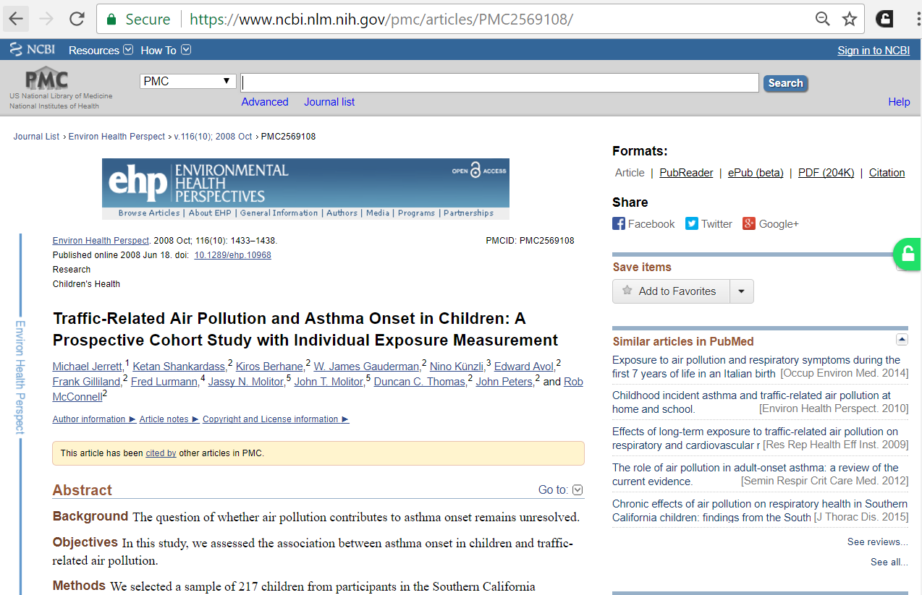
This PMC (PubMedCentral repository) article has access to the PDF with the green unpaywall icon displayed.

Slide 35
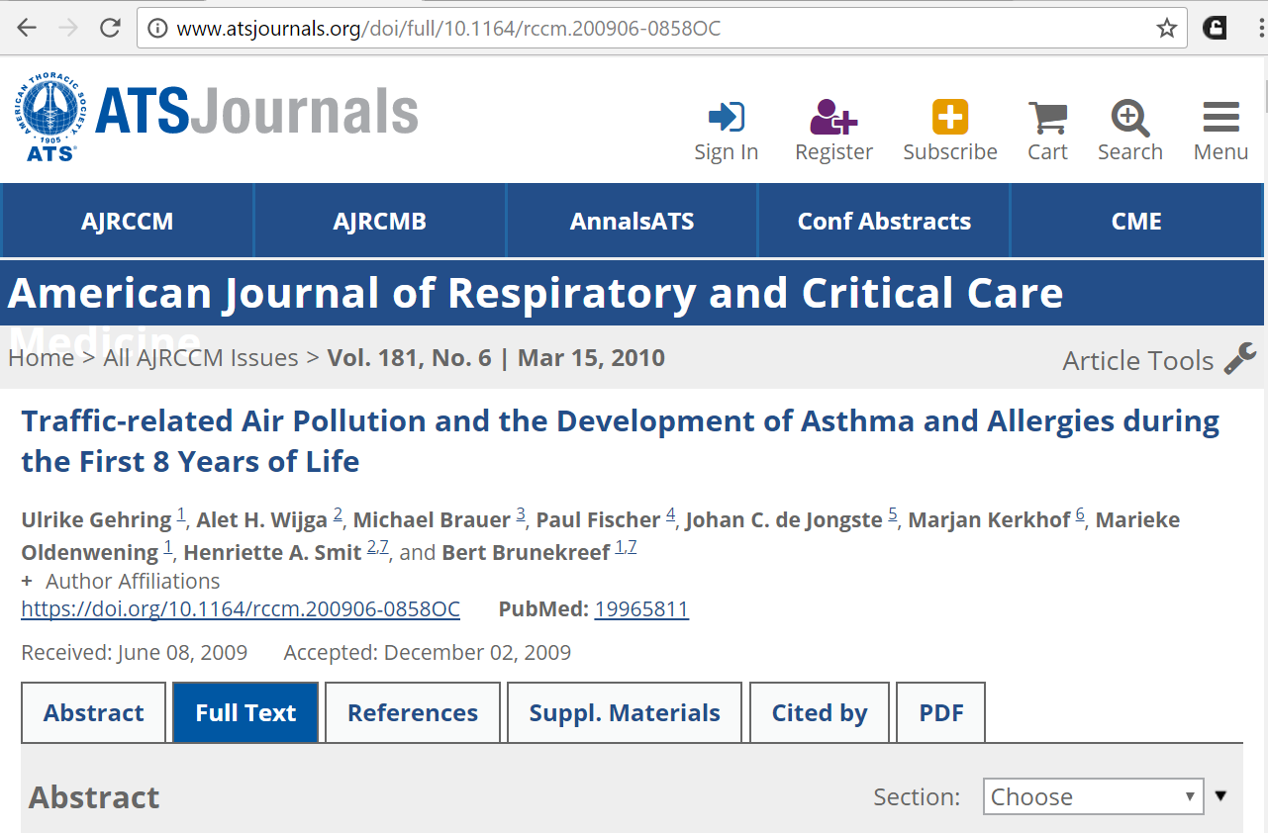
Please note, the app is a useful but not completely reliable tool.
The PDF for the American Journal of Respiratory and Critical Care article is accessible (from the Scholar search results) but the green unpaywall icon is not displayed.

Slide 36
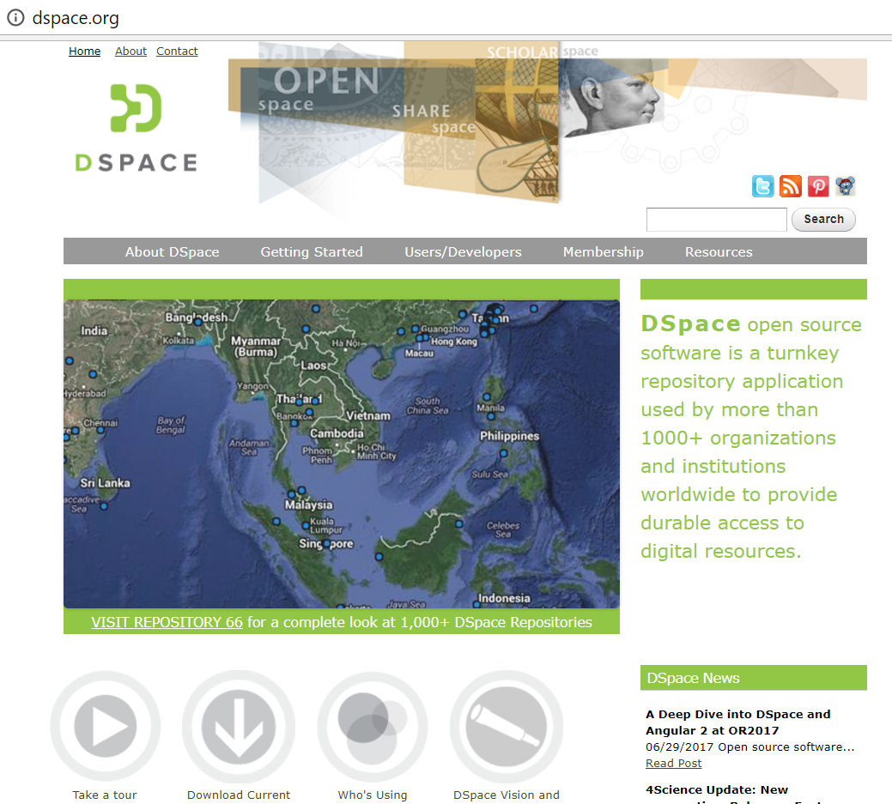
Appendix: DSPACE (institutional repository application software)
Developed by the Massachusetts Institute of Technology, DSPACE (dspace.org) is a free software to build open access repositories - for academic and non-profit organizations. Click on Download Current or Users/Developers drop down menu – for technical instructions.

Slide 37
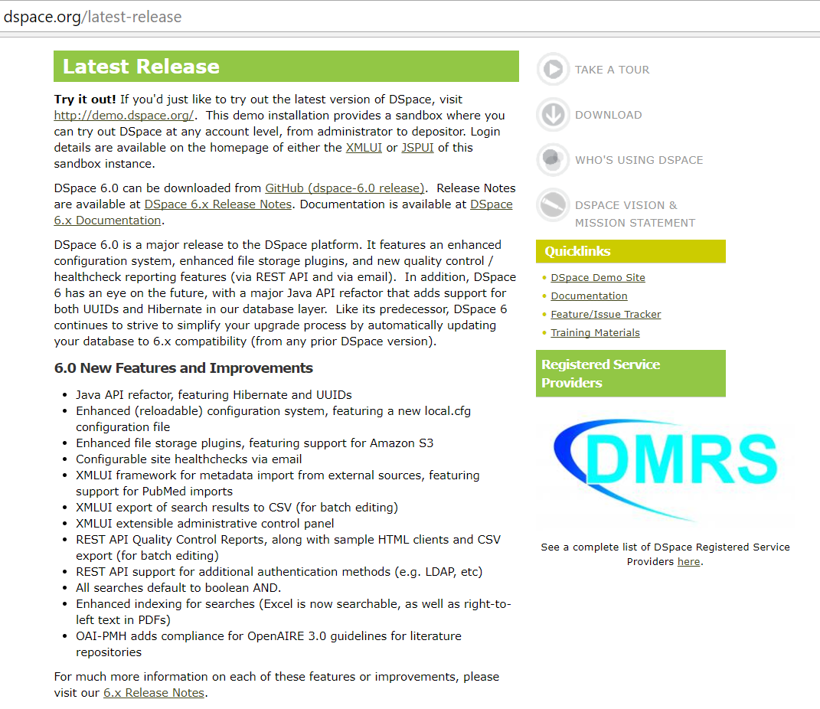
From this DSPACE page, you can download the software and documentation plus learn about new features and improvements.

Slide 38
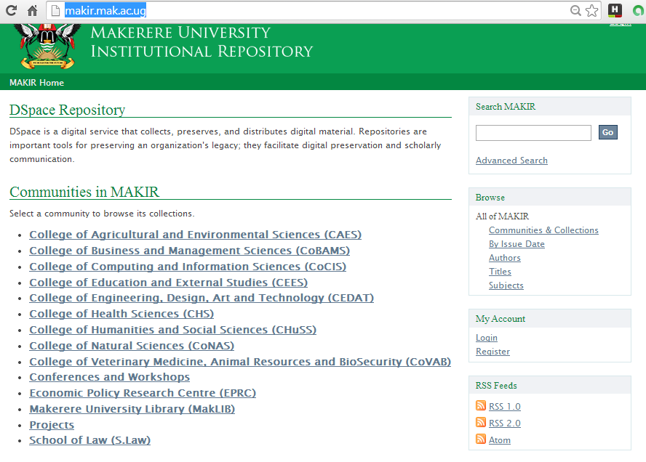
Displayed is the initial page of Makerere University Institutional Repository (MAKIR). Note the Communities within this repository.

Slide 39
Exercises
This is the end of the OARE Basic Course Module 6A. Exercises for this module are available after Module 6C.
  Please continue with Module 6B: E-journal, E-books and Internet Resources: Free E-book Access.
  Updated March 2018

