Slide 1
‘Towards a Pollution Free Planet’
Presentation for the Joint Bureau Meeting
Costa Rica

Slide 2
Structure of the report
Introduction
Section 1- Evidence of a polluted planet: the science, impacts and economic costs
  Air; marine and coastal; land and soil; freshwater; cross-cutting sources: chemicals and waste
  Economic costs
Section 2- A Pollution Free Planet: Agenda 2030 and Multilateral Environmental Agreements
  Opportunities for achieving the 2030 Agenda for Sustainable Development and Sustainable Development Goals
  The pollution mandates of the Environmental Agreements
  Multiple benefits of actions
  Towards a strengthened multi-stakeholder governance
Section 3- A Framework for Transition to a Pollution Free Planet
  Gaps
  Principles
  Key system wide areas of change (transformative actions and enablers)
  Targeted interventions
Conclusion

Slide 3
Key milestones
15 May (2 weeks consultation) | 2nd draft of the report sent to Multilateral Environmental Agreements and UN agencies, and key experts for comments and feedback. Virtual meetings with 1) key technical experts, 2) MEAs 3) UN Agencies
24 May | Presentation of key finding of the report to the Committee of Permanent Representatives
Mid June | Commitments platform available on line (UN Environment Assembly 3 website)
26 June | Draft report of the Executive Director sent to Member states for information
August - September | Final review, sign off by Head of UN Environment, final editing, design and layout
30th September and 30th November | Reporting and analysis of the commitments received

Slide 4
Growth and the pollution paradox
The world has achieved impressive economic growth over the past few decades
Poverty levels have reduced
Fewer people sleep hungry
People are better educated, live longer, and have more choices due to technological advances
People consume more and have higher aspirations
This improved economic and social well being is however accompanied by an increased pollution and impacts on health and wellbeing

Slide 5

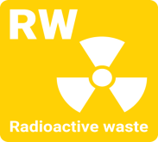
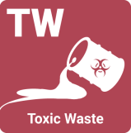






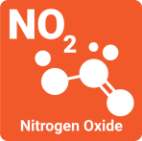

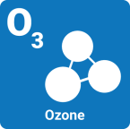


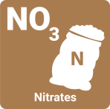







Substances hazardous to human health & ecosystems
Pollutants and Pollution Dashboard
Ambient concentrations of pollutants – exposure thresholds at risk of being crossed with potential long term impacts on human health and ecosystem
Exposure sufficiently understood to cause harm and damage

Slide 6
Pollution impacts (1/2)
air pollution
6,5 million people die due to poor air quality including 4.3 million due to household air pollution
Lower respiratory infections:
  51 million years lost or lived with disability due to household or ambient air pollution
Chronic obstructive pulmonary diseases:
  32 million years life lost or lived with disability because of household air pollution and workers’ exposure
Global costs: $ 5,322 billion; 7.2% GDP
water pollution
58 % of diarrheal disease due to lack of access to clean water; sanitation
57 million years life lost or lived with disability due to poor water, sanitation, hygiene
Global Costs: $ 306 billion; 0.4%GDP
marine and coastal pollution
3.5 billion people depend on oceans for source of food which are used as waste and waste water dumps
Close to 500 ‘dead zones’, regions that have too little oxygen to support marine organisms, including commercial species
Plastics (75% of marine litter) carry persistent bio accumulative and toxic substances
Source: WHO (2016) for global burden of disease; costs from various sources

Slide 7
Pollution impacts (2/2)
land pollution
Open waste dumps and burning affect lives, health and livelihoods and affect soil chemistry and nutrition
Health impacts of chronic exposure to use of pesticides for men, women and children
Salinization of land and ground water affects health, especially of pregnant women and infants
chemicals
Over 100,000 die annually from exposure to asbestos
Lead in paint affects children’s IQ
Impacts of some chemicals such as endocrine disruptors, developmental neurotoxicants and exposure to pesticides and biodiversity are still to be fully assessed
Global costs: $ 480,4 billion; 0.4% GDP
waste
50 biggest active dump sites affect the lives of 64 million people: health, loss of lives and property when collapses occur;
2 billion people without access to solid waste management and 3 billion lack access to controlled waste disposal facilities
Global Costs: $ 216 bn; 0.3% GDP
Source: WHO (2016) for global burden of disease; costs from various sources

Slide 8



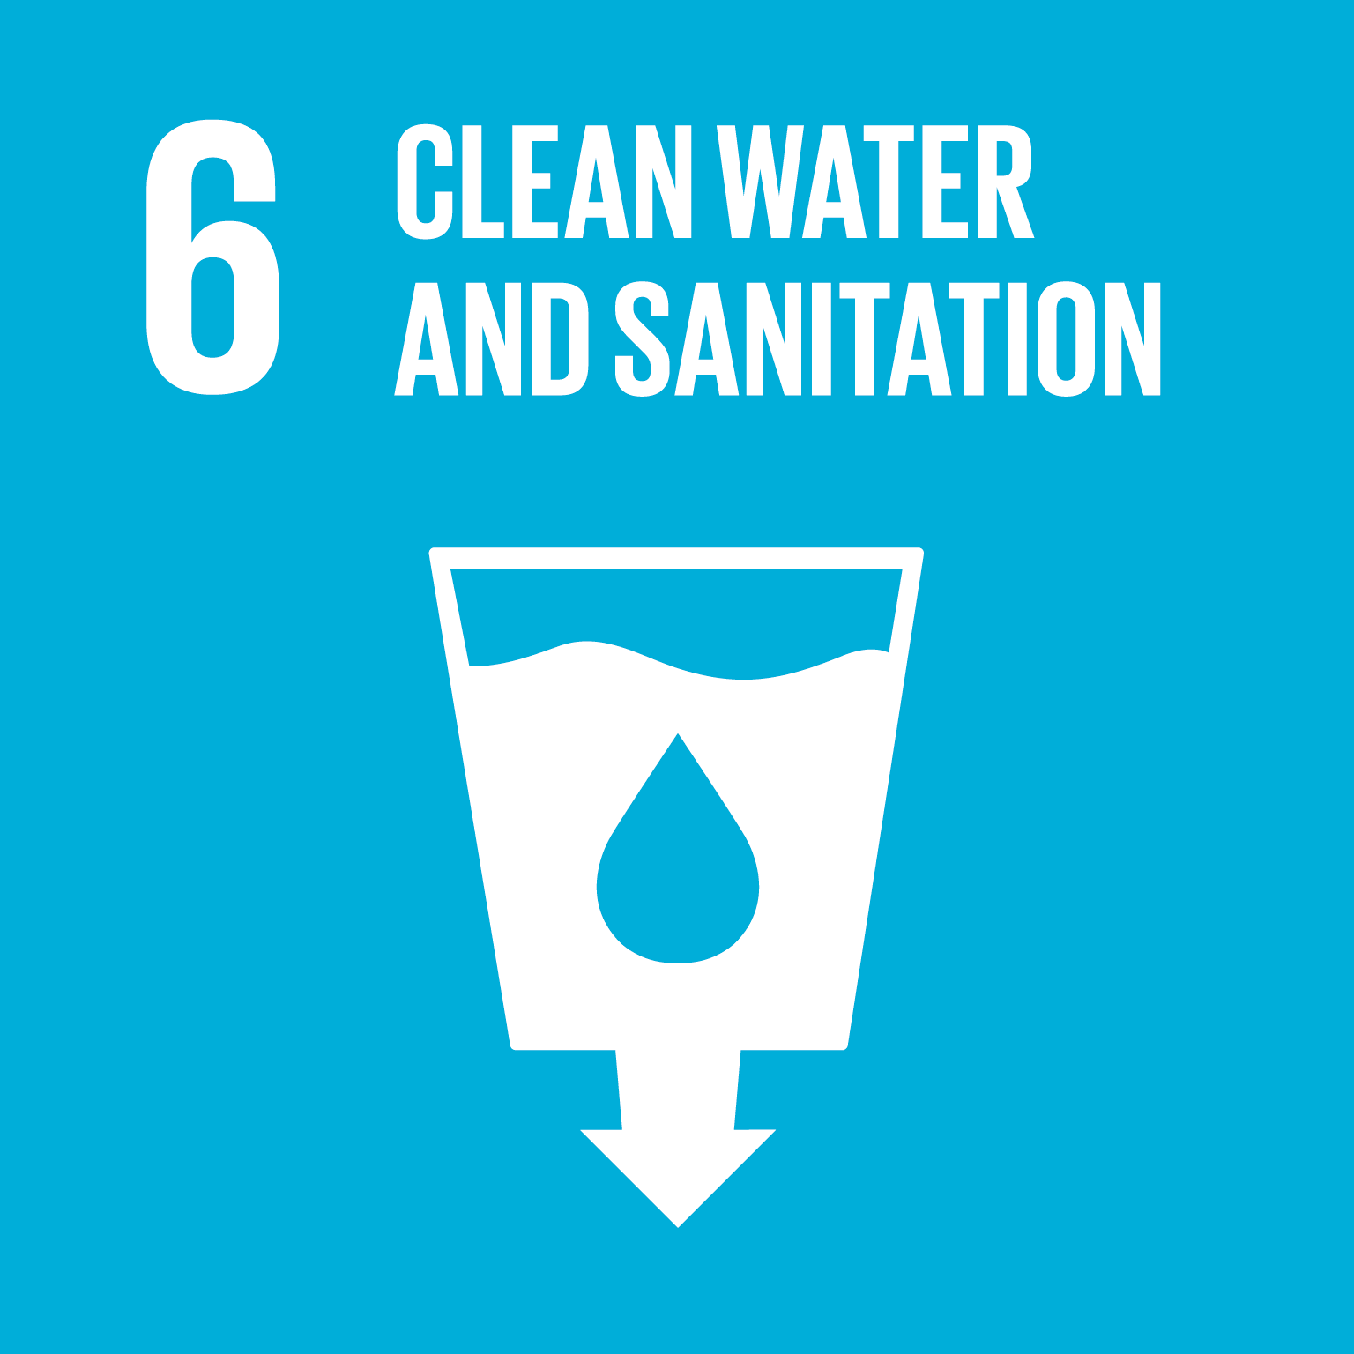

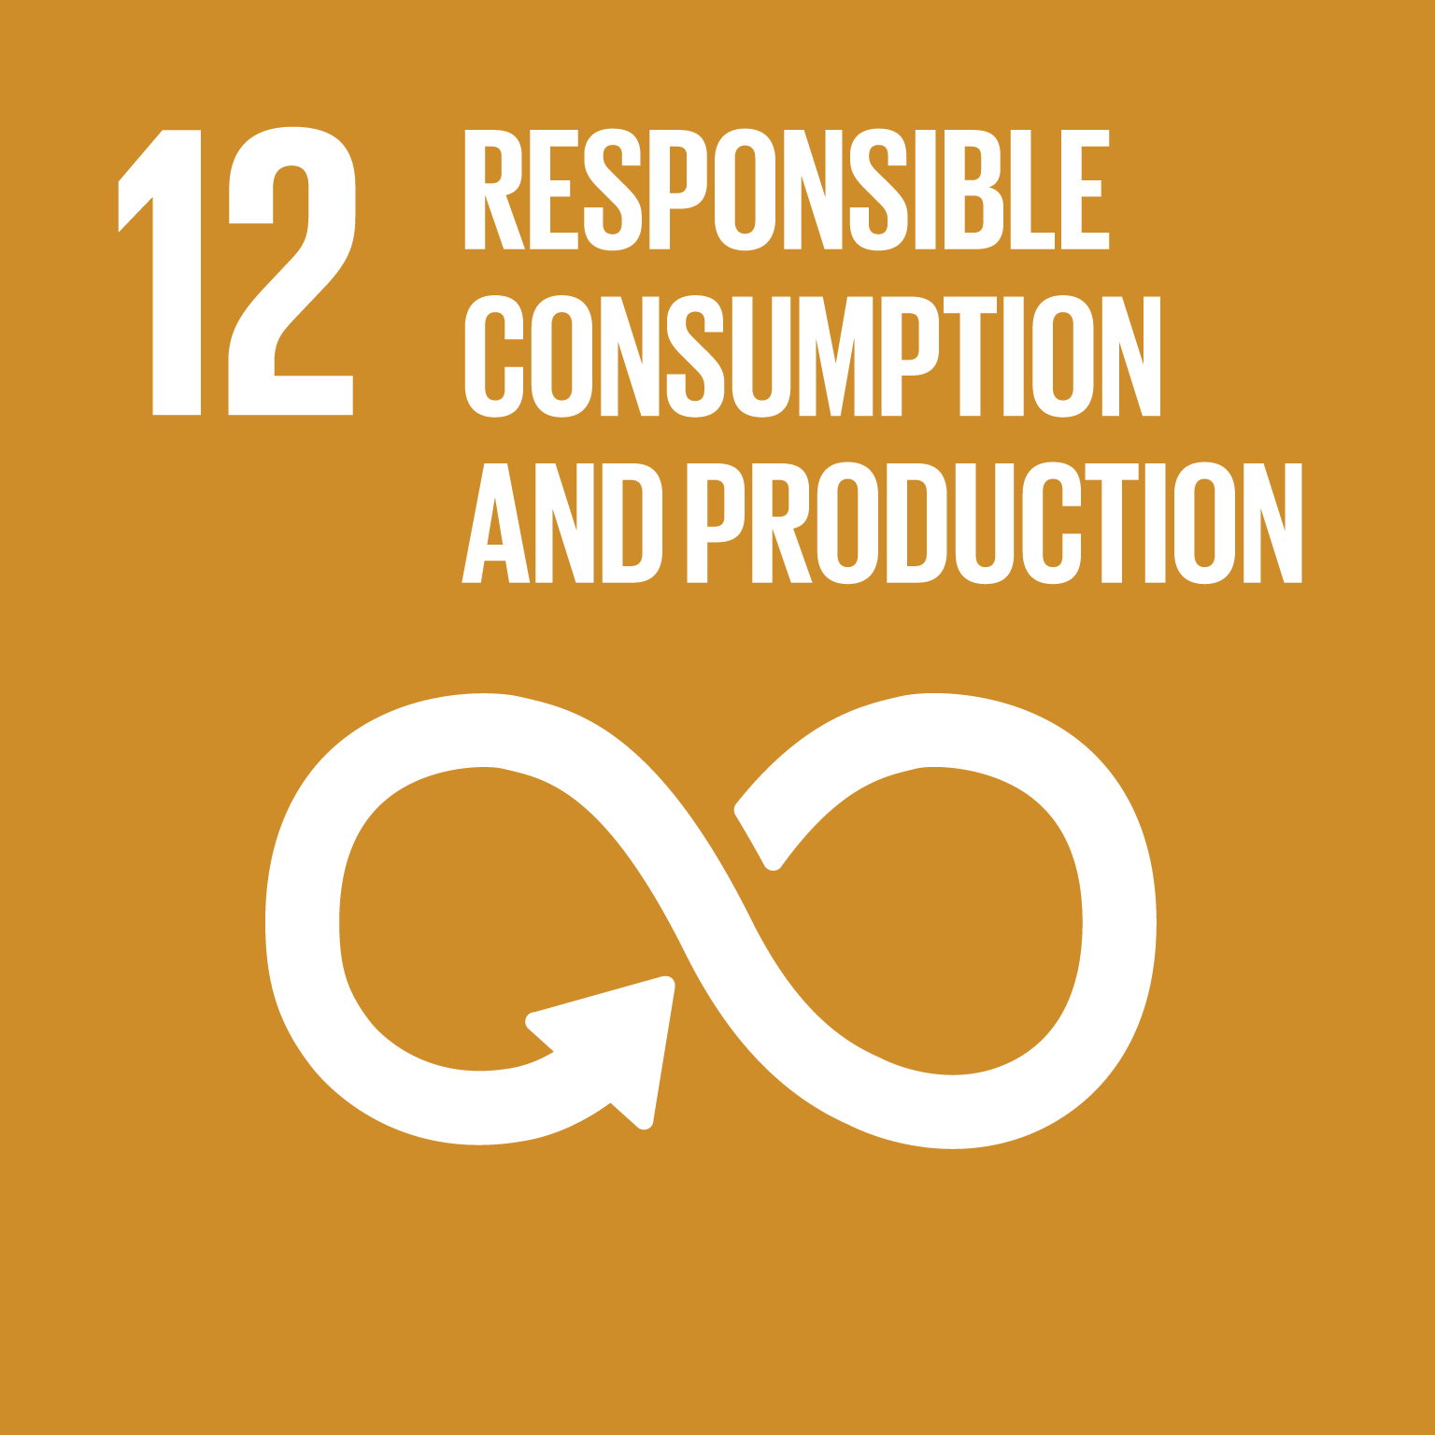
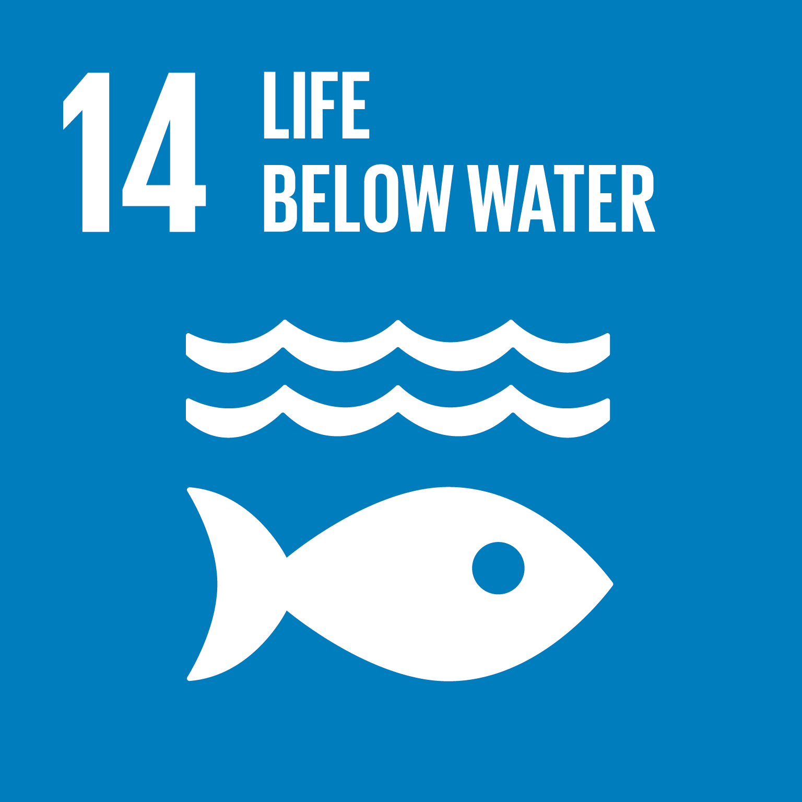
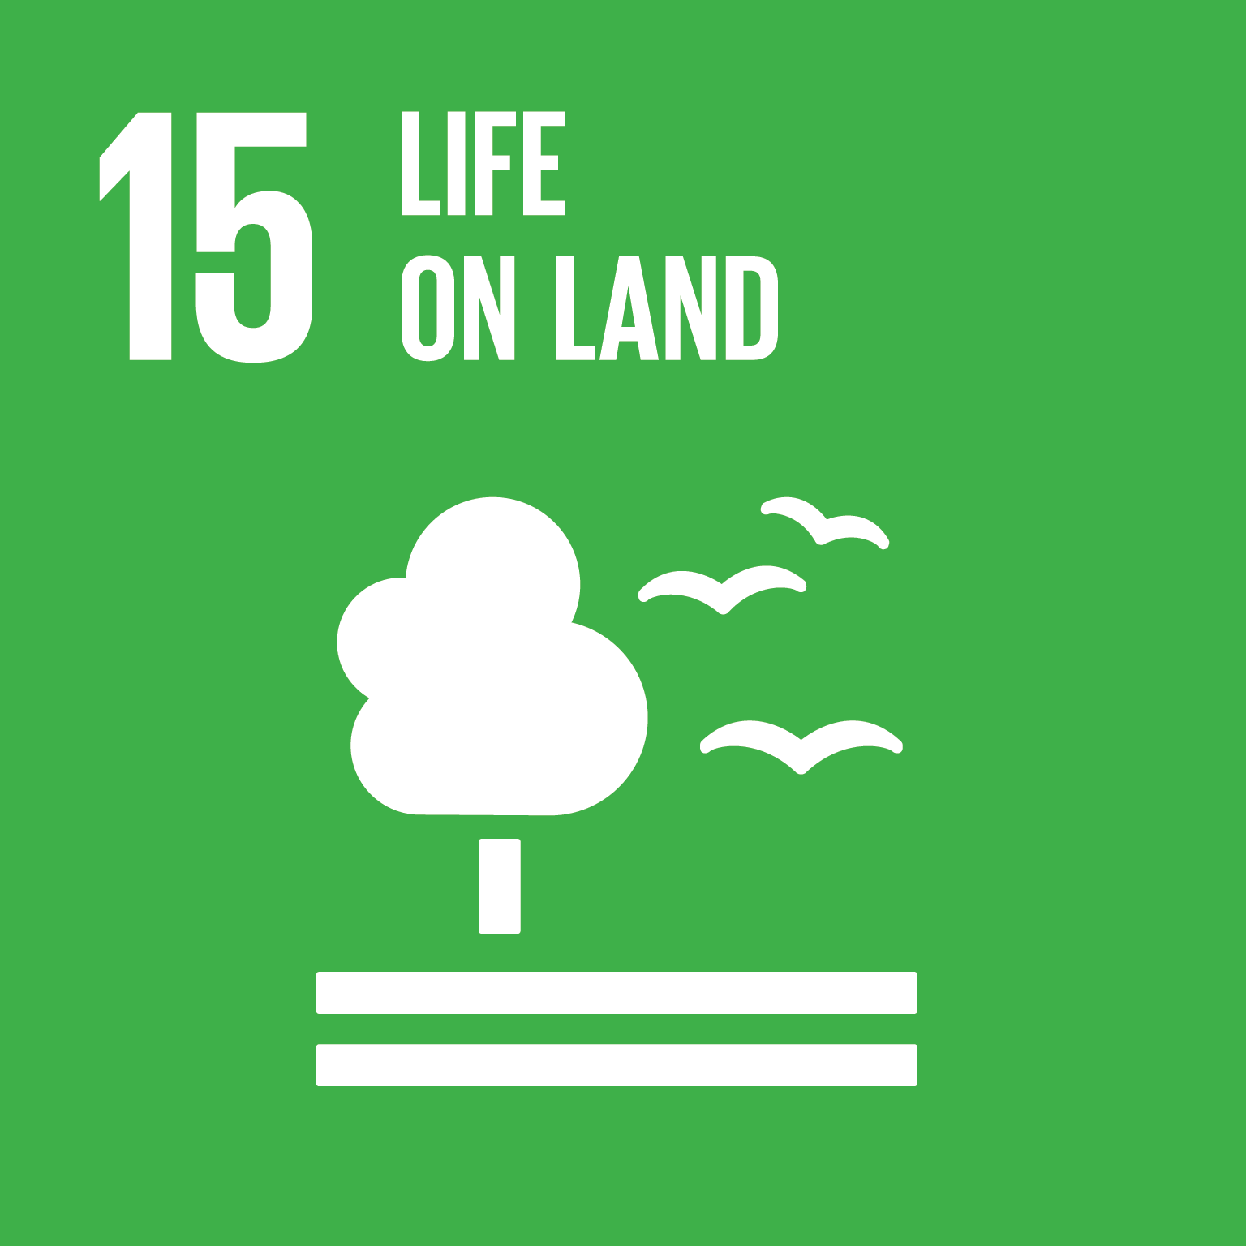


Action on Pollution can contribute to achieving multiple Sustainable Development Goals
Actions towards a pollution free planet would help address our health and well-being at various levels and be central to achieving 10 SDGs
Linkages with some goals are direct:

Slide 9
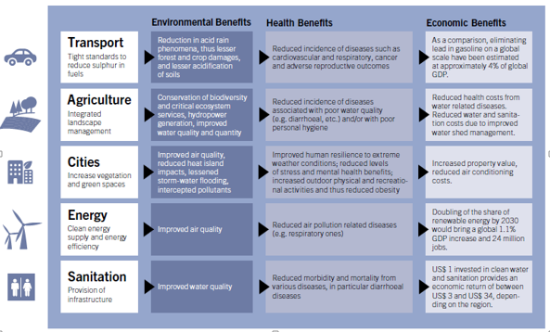
Action on pollution can have multiple benefits
Source: UN Environment (2016)

Slide 10
MEAs and Pollution actions:
The Multilateral and Regional environment agreements provide a framework for time bound actions, and some include compliance related actions, monitoring and reporting.
They provide for the exchange of resources and information, for the sharing of technologies and best practices, for international trade, and for promoting international partnerships on addressing pollution, including among non-state actors.
Success stories exist. The Montreal Protocol being among the most successful
Learning from what has worked well suggests the following:
  Need to strengthen the science policy- society- interface
  Complement multilateral and regional agreements with more voluntary initiatives
  Engagement of diverse actors and stakeholders early on
  Engagement of business and industry in solutions
  Integrated innovations for transitions and social safety nets, job
The problem of pollution, however, is more complex than what can be resolved solely through improved and more coherent environmental governance
The phenomenon is closely connected with technology choices, production and consumption practice, industrial processes, pricing policies, behavioral choices and (absent) ecosystem valuation

Slide 11
Gaps
Issues/gaps have been identified which require attention which is both system wide and targeted to the pollution areas through transformative actions and enablers
Inadequate awareness, data, & information on pollution sources, pathways, impacts, alternatives
Poor regulatory & institutional functioning and absence of infrastructure to monitor, manage and control pollution:
Limited finance & industry leadership on pollution matters
Inadequate investment in research and development for safe alternatives to pollutants
Limited understanding of pollution’s social dimension
Capacity, knowledge sharing, funding and technologies
Mispricing and invisibility of ecosystem values and Absence of Internalization of pollution costs
Behavior of citizens, industry and governments and the non-recognition that choices have pollution consequences
Notes:
I believe that most of these points come down to one issue, what I am calling the weighted metrics of decision making in favour of social and economic priorities almost at the total exclusion of the environment, which is still seen an input to enhance social issues and economic development rather than foundational.

Slide 12
A Framework for a Transition towards a Pollution Free Planet
Has both a preventive and curative slant, based on opportunity and innovations.
Requires political leadership and high level champions and commitments, but with action at the local level in cities, villages, beaches, slums.
Requires interminsterial coordination
Needs to engage governors, mayors, civil society organizations, business leaders and the citizen at large
Principles
System wide
Transformative actions
Enablers
Targeted
Interventions
A pollution free planet is one without direct or indirect alterations of the biological, thermal, physical or radioactive properties of any medium in such a way as to cause a hazard or potential hazard to human health or health, safety and welfare of the living species
(adapted from Eionet)
Notes:
The framework allows for both preventive and curative approaches to pollution

Slide 13
Principles
Draw from the Rio Principles and the 2030 Agenda for Sustainable Development
  - universal, integrative, and leaving no one behind
All sections of society have the responsibility to ensure a pollution free planet. While national governments have a clear role in enabling and guiding actions an including pollution management into development agendas, the state and local authorities, communities, businesses, multi stake holder partnerships and citizens have a clear responsibility to act
A preventive approach is central given the multiple risks to human health and well-being and to ecosystem health. The Precautionary Principle and the Polluter Pays Principle are key to guide change, as these ensure not just responsibility but stewardship by different societal actors
Multiple benefits of action on pollution need to be recognized for political leadership to prioritize action on pollution given many demands on scarce political and administrative resources and short time horizons in which to make the case. This will require a ‘whole-of-government’ and integrated approach
Decision making needs to take into account multiple risks to health and ecosystems of pollutants, reduce policy uncertainty, centre stage innovation and recognize economic opportunity
Access to environmental information and data, education and public participation are key to effective actions and environmental justice

Slide 14
Enablers and Transformative Actions for change in the medium and long term
Transformative actions
(To shift the economy )
Enablers
(To correct market & policy failures and facilitate change)
Evidence-Based Decision-Making
Enhanced Governance
Economic Instruments
Education for Change
Finance and Investments
Innovations and Technology
Production and Supply chains
City level Actions: Sectoral integration to tackle pollution
Sustainable Consumption practices

Slide 15
Possible near term interventions on pollution risk areas
Air Pollution:
Establishment and enforcement of advanced vehicles emissions and fuel standards (e.g. at least Euro 4 level) need to be established and enforced; Addition of electric vehicles only to fleets as of 2030.
Shift to cleaner coal- and gas-fired power plants, and increasingly to non-polluting renewable energy sources such as solar, wind, and tidal
Expansion of natural, petroleum gas or biogas for cooking, along with cleaner cook-stoves to reduce household air pollution
Water pollution
Provision of clean water and toilets for improved sanitation
Investment in low-cost technologies for the management of wastewater. Appropriate technologies and innovative solutions to transform wastewater to valuable products,
Land pollution
Identification and remediation of highly contaminated sites in densely populated areas
Expansion of market availability of new fertilizer formulations that enhance plant uptake efficiency (reduce excess/leakage and soil mining/degradation)
Increase of use of natural alternatives to fertilizers and pesticides
Improvement in nutrient use efficiency in crop and animal production:

Slide 16
Possible near term interventions
Marine and coastal pollution
Phasing- out of single use-plastics; Upgrade/modification of manufacturing processes around plastics in order to reduce packaging and phase out non-recoverable plastic materials, as they potentially accumulate in marine environment;
Chemicals and waste
Commitment to minimize waste, mandate collection and separation
Elimination of open-burning of waste
Reduction of exposure from lead pollution taking into account national priorities (e.g. battery recycling, pottery and paint) and establishment and enforcement of relevant legal limits by 2020 in order to eliminate lead pollution by 2030
Phasing out of the production and use of asbestos
Acceleration of the production and use of mercury-free products (e.g. medical devices, lamps, batteries)
Identification of pollution/ chemicals-related hotspots (e.g. chemical stockpiles, polluted sites) to decontaminate them and minimize exposure.
Extend the use of products through sustainable design, maintenance and upgrades and recovery of broken products
Provision of reliable and effective consumer information, especially on the presence of chemicals in products.

Slide 17

Thank you
www.unep.org

