Slide 1
DG and GHS Classification System
UNEP / ICCA Workshop
TEMA
June 2014

Slide 2

Classification of Chemicals

Slide 3


Dangerous Goods can be either a SUBSTANCE or an ARTICLE:
Gunpowder is a SUBSTANCE but in fireworks, it becomes an ARTICLE.
Lithium is a SUBSTANCE but a battery containing lithium is an ARTICLE.
Dangerous Goods (DG) are sometimes referred to as Hazardous Materials (Hazmat), Hazardous Substances (Haz Subs) and Dangerous Substances (DS).

Slide 4
The UN System for identifying a DG for transport, storage and handling assigns key identifiers:
Proper Shipping Name.
UN Number.
Classification.

Slide 5
Proper Shipping Name (PSN)
The name that MUST be quoted on all packages, bulk containers and documentation.
A chemical or product may have several different names. The designated UN PSN MUST be used.

Slide 6

Proper Shipping Name
Most accurate description of the item on the DG list, e.g.
Potassium Cyanide together with Class and Description:
UN1680 Potassium Cyanide, Solid 6.1
6

Slide 7
UN Number
Overcome Language Barrier
1001–0999 | Explosives.
1000– | Pure chemicals, e.g. Acetone, Sulphuric Acid.
 | Generic ‘families’ of chemicals, e.g. Flammable Liquid.
 | Not Otherwise Specified (N.O.S)
7

Slide 8
Not Otherwise Specified (N.O.S)
Some PSNs cover ‘families’ of chemicals which cannot be considered hazardous. These items are ALWAYS shown as N.O.S. following the PSN.
After the N.O.S. the Active or ‘Hazardous’ product must then be shown in brackets. This provides important information for Emergency Responders. Example: Flammable Liquids N.O.S. (contains isopropanol).

Slide 9
UN Number
Four digit numerical sequence that runs from 0001 to 3472.
0001 – 0999 Class 1 Explosives.
1000 – All other chemicals and products.

Slide 10
UN Classes
There are 9 Classes of DG allocated to Divisions.
Classes are identified by coloured, diamond shaped labels or placards.

Slide 12
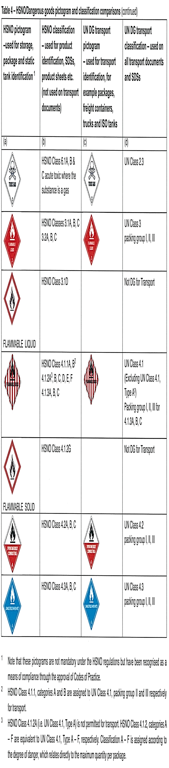

Slide 15


Slide 16
Packing Group
Indicates the degree of danger.
Used only for Classes 3,4,5.1,6.1, 8 and 9.
Always shown in Roman Numerals.
Determines handling, storage, packaging and transport requirements.
Packing Group I High danger
Packing Group II Medium danger
Packing Group III Low danger

Slide 17
Multiple Hazards
Mixtures:
Ingredient A Flammable Liquid.
Ingredient B Toxic Liquid.
Identify Packing Group for each hazard
Class 3 PG II
Class 6.1 PG III
Assign to highest hazard PG II
17

Slide 18
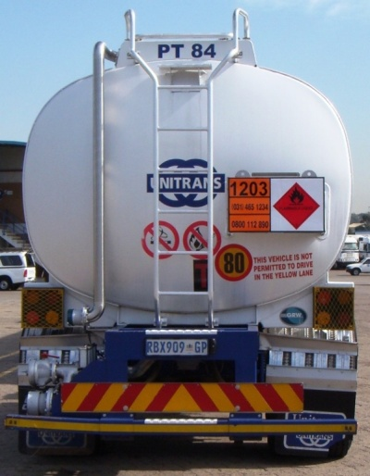

Must be displayed on all transport units (trucks, freight containers, tanks) carrying DG.
Must be displayed on all vehicles carrying Bulk DG.

Slide 19
