Slide 1
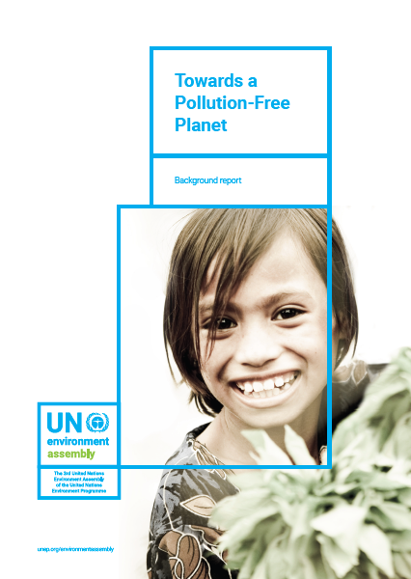
Notes:
This report:
is a call to act towards a pollution-free planet;
It regards the transition to a pollution-free world as driver for innovation and social equity: pollution prevention and regulations provide the opportunity to clean up everyone’s environment, create new jobs, improve economic productivity and protect the rights of all persons – including future generations –and ecosystems;
The report encourages integrated, synergetic, silo-breaking approaches;
It builds directly on existing internationally agreed environmental goals, including those relating to climate change, disaster and risk reduction, and the 2030 Agenda for Sustainable Development, with its numerous pollution targets.

Slide 2
Process
Initial outline to Member States -March 2017
Assessment of the latest science on all forms of pollution
Presentations to the CPR at regular intervals
Advance report - June 2017
Consultations with a large constituency
Collecting and responding to more than 600 comments received from all over the world
Launch – Minamata COP1, 28 September 2017

Slide 3
Section 1: Evidence of a polluted planet: the science, impacts and economic costs
Based on the GEO regional reports, GEO-6 thematic drafts, and other sources
Combining state, trends and impact analysis per pollution theme
Indicating economic costs of inaction

Slide 4
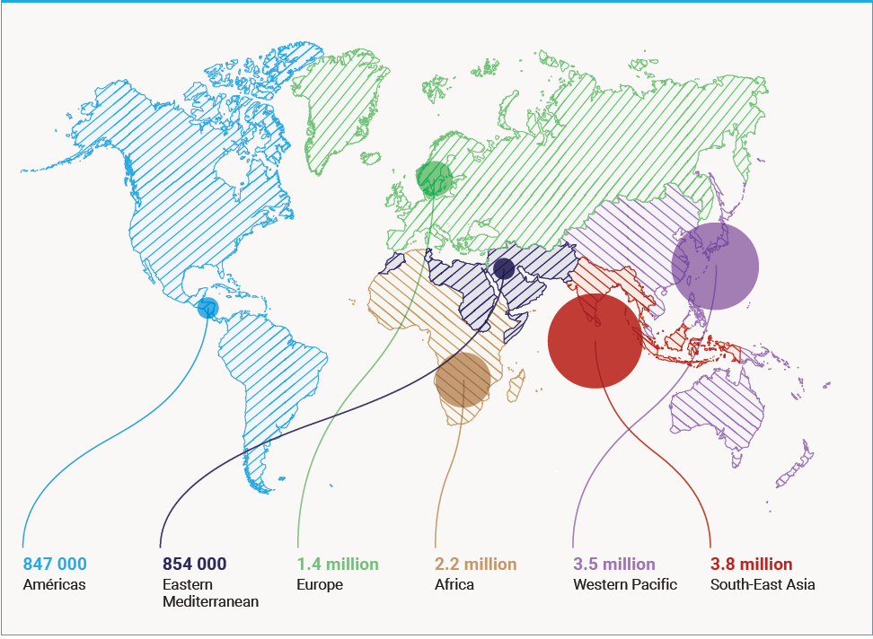
Number of deaths attributable to environment factors, in 2012, by WHO region
Notes:
Pollution directly affects ecosystems and human health and well-being; for example, 6,5 million people a year die prematurely because of air pollution
It is largely controllable and often avoidable, but neglected.
Action and success can only come through collaboration and partnerships across stakeholders, including with the private sector and civil society. There is also a key role to play for each habitant of the planet.

Slide 5
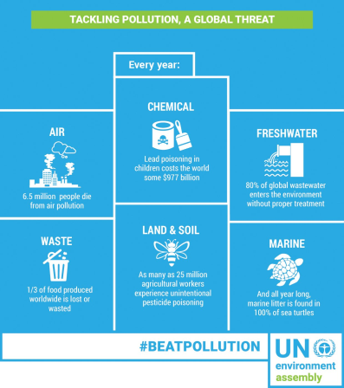
Notes:
Some key figures:
Lower respiratory infections: 51 million years lost or lived with disability annually due to household or ambient air pollution
Ground level ozone pollution is estimated to reduce staple crop yields up to 26% by 2030
58 per cent of diarrhoeal disease due to lack of access to clean water and sanitation and a major source of child mortality
Over 80% of the world's wastewater is released to the environment without treatment
3.5 billion people depend on oceans for source of food yet oceans are used as waste and waste water dumps
Close to 500 ‘dead zones’, regions that have too little oxygen to support marine organisms, including commercial species
4.8 to 12.7 million tonnes of plastic waset enters the ocan every year from inadequate waste management
Over 100,000 die annually from exposure to asbestos
Lead in paint affects children’s IQ
Children poisoned by mercury develop problems in their nervous and digestive systems and kidney damage.
Many impacts of chemicals such as endocrine disruptors and developmental neurotoxicants and long-term exposure to pesticides on human health and well-being and biodiversity and ecosystems are still to be fully assessed
50 biggest active dump sites affect the lives of 64 million people, including their health and loss of lives and property when collapses occur;
2 billion people are without access to solid waste management and 3 billion lack access to controlled waste disposal facilities

Slide 6
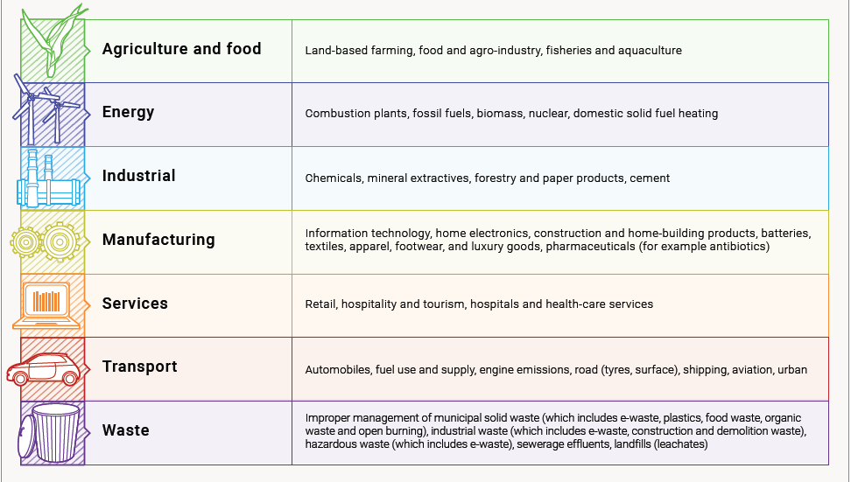
Major sources of today’s pollution
Notes:
Key economic sectors are major sources of today’s pollution, and are also key to solving the pollution problem.

Slide 7
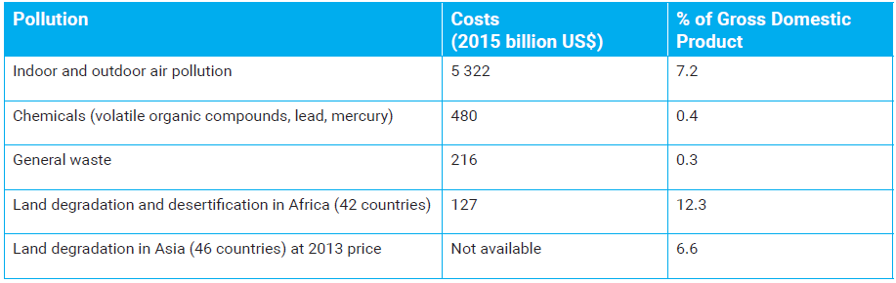
Costs of pollution
Notes:
Many of the economic costs of pollution are unacknowledged, unaccounted, non monetised and remain outside the domain of evaluation of public policies.
In 2013 however, the global welfare costs associated with air pollution were estimated at about $5.11 trillion. The welfare costs of mortality related to outdoor air pollution were estimated at about $3 trillion, and $2 trillion from indoor air pollution. Mortality costs from outdoor air pollution are projected to rise to about $25 trillion by 2060 in the absence of more stringent measures.

Slide 8
Section 2: Addressing pollution: Governance frameworks, challenges and opportunities in the context of the 2030 Agenda
Analysing environmental governance framework in relation to pollution
Highlighting the central role of multistakeholder and multi-level engagement
Demonstrating how addressing pollution is contributing to achieving multiple Sustainable Development Goals and targets
Identifying main challenges and gaps for impactful action

Slide 9
Gaps and Challenges identified
Implementation gaps
Knowledge gaps
Infrastructure gaps
Limited leadership by financial institutions and industry
Mispricing, the invisibility of ecosystem values and externalization of pollution costs
Insufficient recognition by different actors that consumer choices have pollution consequences.

Slide 10
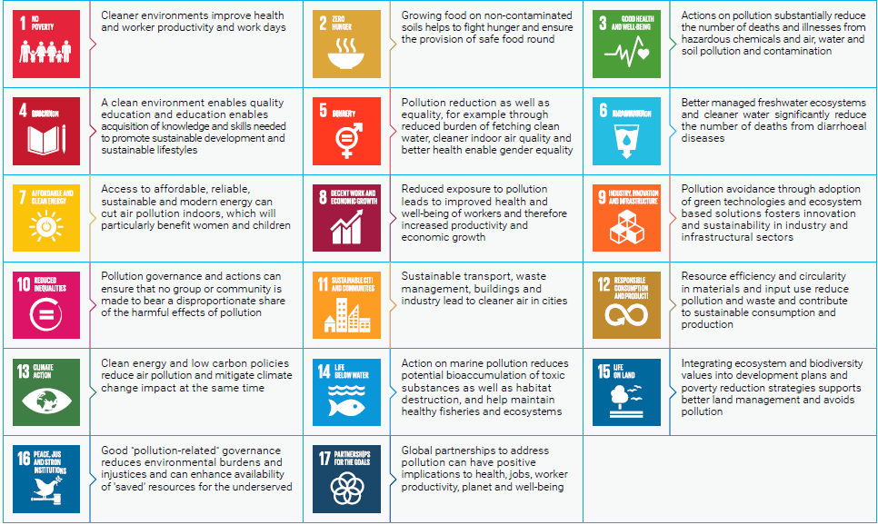
Action on pollution can contribute to achieve many Sustainable Development Goals
Notes:
The 2030 Agenda for Sustainable Development offers a great opportunity to enhance and accelerate action to tackle pollution. Pollution prevention, control and reduction will also create multiple opportunities for achieving the Sustainable Development Goals in a mutually beneficial manner.
Under Goal 3 on health and well-being, one target (Target 3.9) is central, requiring that by 2030 we “substantially reduce the number of deaths and illnesses from hazardous chemicals and air, water and soil pollution and contamination”. Human health and the environment are compromised by the mismanagement of chemicals and waste, which form a fundamental obstacle to the achievement of sustainable development. This is strongly linked to how we produce and consume (Goal 12) and our ability to reduce resource degradation, pollution and waste.
Other goals and related targets are essential to reduce and prevent pollution. Target 6.3 under Goal 6, which aims to improve water quality by reducing pollution, eliminating dumping and minimizing the release of hazardous chemicals and materials. Not only could it significantly reduce the number of deaths from diarrhoeal diseases; it could also provide incentives for more innovative water resource management practices, including recycling and safe reuse. Target 14.1 already addresses pollution explicitly by requesting “the prevention and significant reduction of all kinds of marine pollution, in particular from land-based activities, including marine debris and nutrient pollution”.

Slide 11
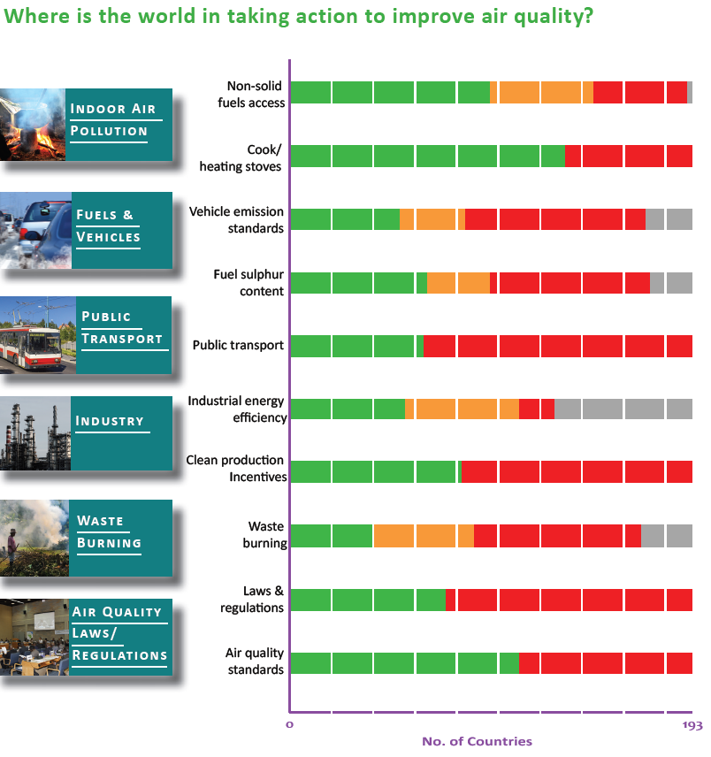
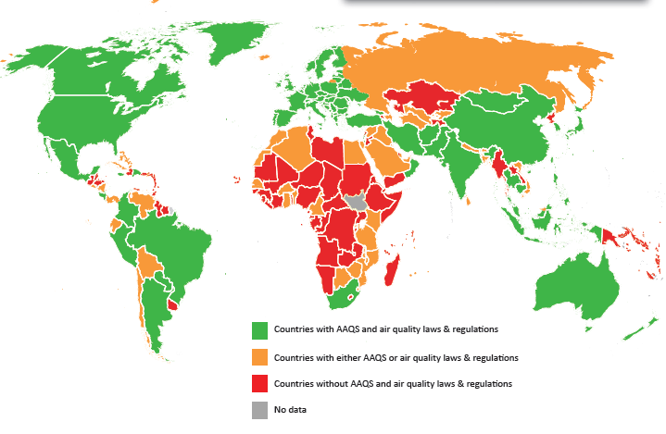
Example: National actions on improving air quality in the world
Standards and Regulations
UNEP 2016
Source: UNEP 2016. Actions on Air Quality
Notes:
Progress can also be tracked in some specific areas of pollution. By 2015, 109 Member States had adopted air quality standards; 73 had a specific air quality policy, act or rules; and 104 had vehicle emission standards

Slide 12
Section 3: A Framework for a Transition to a Pollution Free Planet
  Highlighting key Principles for Action
  Identifying Enablers and System –Wide Transformations required
  Highlighting targeted interventions by pollution areas

Slide 13
A Framework of Actions is proposed
  Targeted interventions, based on risk assessments and scientific evidence of impacts, to address: i. ‘hard-hitting’ pollutants; ii. Areas of pollution (air, water, marine and coastal, land/soil) including cross-cutting categories (e.g. chemicals, waste)
  System-wide transformations at the economy level
  guided and underpinned by:
Principles : universality, sustainability, integration, precaution and inclusiveness
Enablers, or broader supporting actions, that aim to shift incentives, correct market and policy failures and address some of the gaps and issues that make pollution so pervasive and persistent.
Notes:
The report proposes a framework for actions that Member States and other stakeholders may wish to consider to curb pollution around the world:
It seeks to reinforce integration and coherence in the way society responds to social, environmental and economic challenges related to pollution.
It fully recognizes that what already has been achieved by governments and stakeholders needs to be built upon and can be reproduced in other countries and settings through experience sharing, support and the adoption of good practices.
The framework is centered on a dual track of actions:
Targeted interventions, based on risk assessments and scientific evidence of impacts, to address: i. ‘hard-hitting’ pollutants; ii. Areas of pollution (air, water, marine and coastal, land/soil) including the cross-cutting categories of chemicals and waste. They can be both based on global and regional environmental agreements, or direct action beyond these to address the most pressing problems.
In parallel, there is a critical need for system-wide transformations to prevent and control pollution, toward greater resource efficiency and equity, circularity and sustainable consumption and production, and improved ecosystem resilience to support cleaner and more sustainable development
Both targeted interventions as well as transformative actions need to be supported by system-wide enablers, that aim to shift incentives, correct market and policy failures and address some of the gaps and issues that make pollution so pervasive and persistent, to avoid and reduce pollution in the medium and the long term.
The Rio Principles and the 2030 Agenda for Sustainable Development guide this framework for actions
The five principles that underpin the proposed global action agenda- universality, inclusiveness, sustainability, precautionary and integration- respectively imply that:
Everyone in society is responsible for taking action towards a pollution-free planet (universality). While national governments have a clear role in enabling and guiding actions and including pollution management into development agendas, states and local authorities, communities, businesses, multi-stakeholder partnerships and citizens have a clear responsibility to act.
Access for all to environmental information and data, regulatory frameworks, education and public participation, land and resource rights are key to effective actions and enhanced access to justice in environmental matters (inclusiveness)
Multiple and long-term risks to human health and well-being, especially to women, children and vulnerable groups, ecosystem health and future generations require a preventive approach while accelerating mitigation efforts using polluter pays approaches (sustainability)
Precautionary approaches are essential for guiding change, as so much is still unknown. These ensure not just responsibility but stewardship by different societal actors (precautionary).
Multiple benefits of action on pollution require integrated policies and cross-ministerial approaches (integrative). Innovation, collaboration, and leadership are central to tackling pollution, especially cross media, transboundary, and legacy pollution, in an effective and impactful manner
We need to work together towards system-wide transformations, to shift the economy toward greater resource efficiency and equity, circularity and sustainable consumption and production, to prevent pollution
But we cannot wait to act. And this is the reason why the report proposes 50 examples of focused and actionable targeted interventions to address “hard-hitting” pollutants.
Most of these measures are already known and some are already part of agreed conventions or initiatives. Now is the time to act on them.
Example:
Moving to electric mobility,
Treat, recycle, re-use waste water to reduce discharge in freshwater bodies by at least 50 per cent by UNEA3.
Advance safer alternatives for toxic chemicals though sustainability chemistry
Reduce exposure to lead, with in particular action on lead in paint.
Stakeholders and governments are therefore invited to make voluntary commitments to address pollution on UN Environment website (#BeatPollution). They complement the voluntary pledges individual citizens can make to beat pollution

Slide 14
We need to work together towards system-wide transformations
Multiple benefits: health, economic productivity, environmental justice
Ensuring rights of people to a healthy environment
Markets are changing and expanding opportunities to grow but also be clean:
  Competitiveness and first mover advantages
  Green technologies, ecosystems-based solutions
  Innovative project finance
Social perceptions are changing and demands for a healthy environment are increasing
  Civil society
  Non governmental organizations
  Media
Notes:
We need to work together towards system-wide transformations, to shift the economy toward greater resource efficiency and equity, circularity and sustainable consumption and production, to prevent pollution
But we cannot wait to act. And this is the reason why the report makes the case for enhanced action to tackle pollution. It proposes 50 examples of focused and actionable targeted interventions to address “hard-hitting” pollutants.
Most of these measures are already known and some are already part of agreed conventions or initiatives. Now is the time to act on them.
Example:
Moving to electric mobility,
Treat, recycle, re-use waste water to reduce discharge in freshwater bodies by at least 80 per cent by 2030.
Advance safer alternatives for toxic chemicals though sustainability chemistry
Reduce exposure to lead, with in particular action on lead in paint.
Stakeholders and governments are therefore invited to make voluntary commitments to address pollution on UN Environment website (#BeatPollution). They complement the voluntary pledges individual citizens can make to beat pollution

Slide 15
In conclusion: Five overarching messages from the report
A global compact on pollution would make pollution prevention a priority for all
Environmental governance needs to be strengthened at all levels
Sustainable consumption and production needs to be promoted with waste reduction and management prioritized
Investment in cleaner production technologies would help to counter pollution, alongside increased funding for pollution monitoring, infrastructure, management and control
Multi-stakeholder partnerships/coalitions and collaborations would facilitate the addressing of gaps
Notes:
There are 5 overarching messages of the report:
A global compact on pollution would make pollution prevention a priority for all. It would also encourage policymakers to integrate pollution prevention into national and local planning, development processes, poverty reduction strategies and national accounts.
Environmental governance needs to be strengthened at all levels – with targeted actions on “hard-hitting” pollutants through risk assessments and enhanced implementation of environmental legislation (including multilateral environmental agreements) and other measures.
Sustainable consumption and production, through improved resource efficiency and lifestyle changes, should be promoted; waste reduction and management must be prioritized.
Investment in cleaner production and consumption will help reduce pollution; increased funding for pollution monitoring, infrastructure, management and control is also necessary.
Multi-stakeholder partnerships and collaborations are vital for the innovation, knowledge-sharing, and transdisciplinary research needed to develop technological and ecosystems- based solutions.

