Slide 1



Outcomes of the 2017 COPs and update on the programmes of work of the Basel, Rotterdam and Stockholm Conventions
– A future detoxified: sound management of chemicals and waste –
Secretariat of the Basel, Rotterdam
and Stockholm Conventions

Slide 2

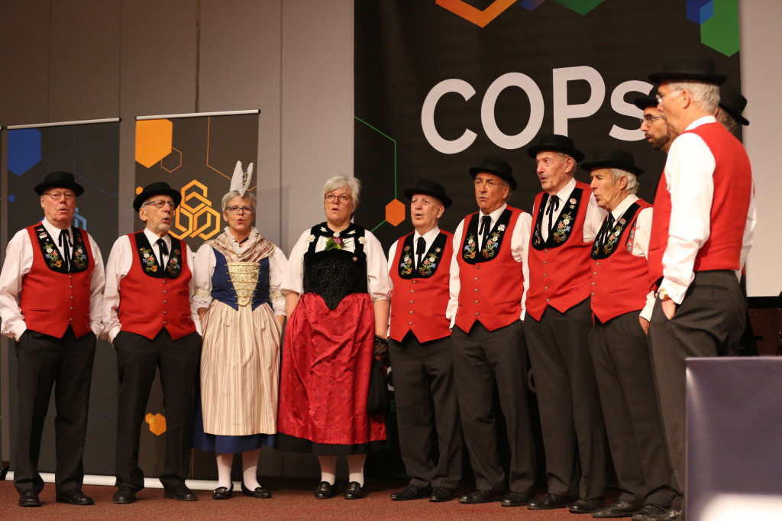
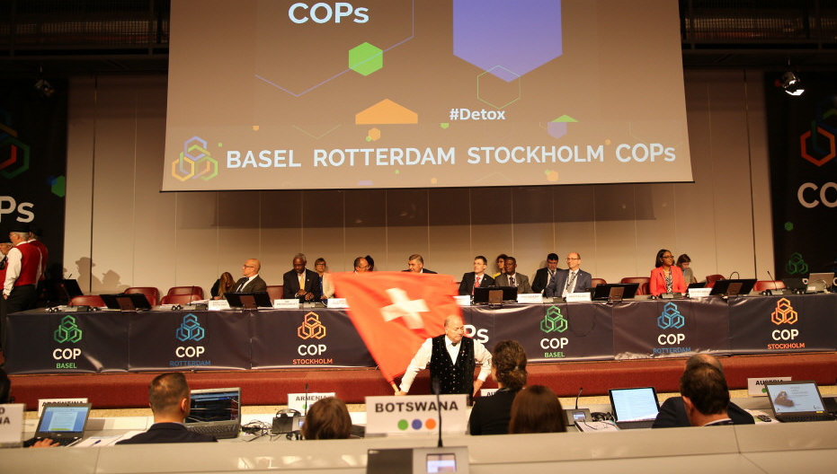
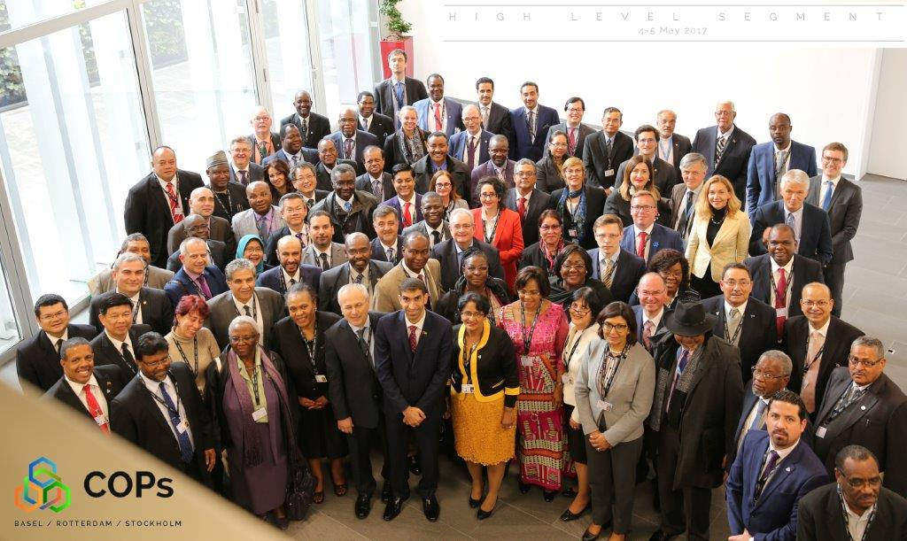
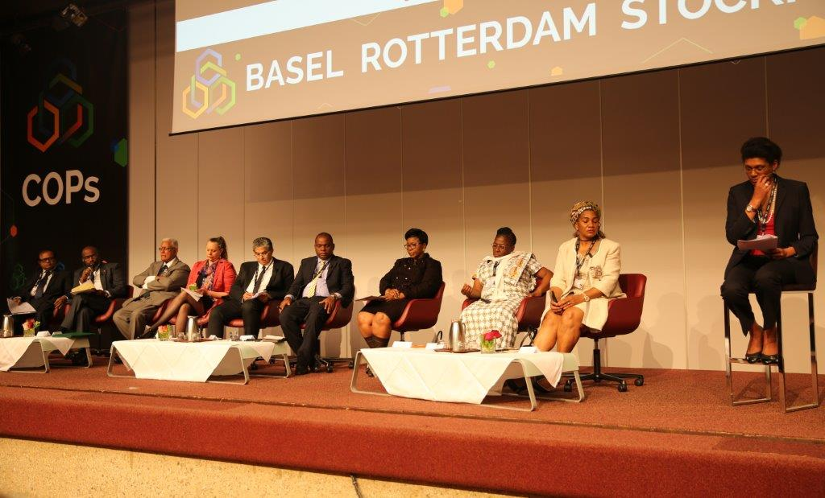
Highlights
Opening ceremony
High-level Segment Participants
High-level Panel
Notes:
The 3rd joint /back-to-back meetings of the Conferences of the Parties to the Basel, Rotterdam and Stockholm Conventions, held in Geneva from 24 April to 5 May 2017
Theme of the COPs was – A future detoxified: sound management of chemicals and waste –
160 Parties, more than 1,400 participants
High-level segment was held during the last two days of the COPs brought together more than 140 Ministers, Deputy Ministers and Ambassador from over 100 countries and focused on the theme of the COPs "A future detoxified: sound management of chemicals and waste“;
delivering as an outcome key messages on opportunities:
for a detoxified future in the 2030 Agenda for Sustainable Development,
for a strengthened implementation through partnerships and
for reducing waste and pollution while enabling economic and social prosperity.

Slide 3
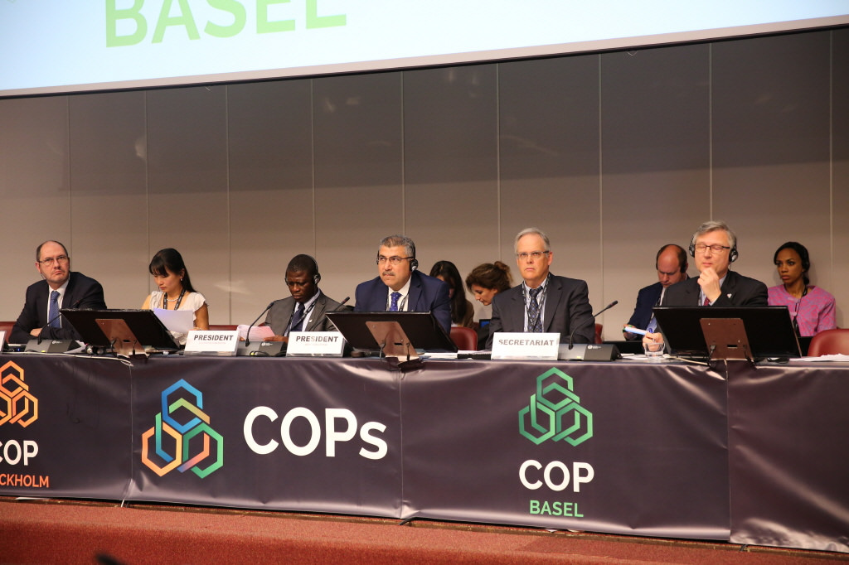
Basel COP-13
Adopted 24 Decisions
Established a New Partnership
Adopted 6 Technical Guidelines
Included “marine litter” in the programme of work of OEWG
Notes:
Summary:
Chaired by Mohamed Khashashneh (Jordan)
Adopted 24 Decisions
To highlight:
The establishment of a new partnership on house-hold waste under the Basel Convention
The adoption of 6 Technical Guidelines on Waste, and
the inclusion of marine litter in the programme of work of the Basel Convention’s Open-ended working group

Slide 4

Basel COP-13:
Adopted 6 Technical Guidelines on POPs wastes (General, Pesticides, U-POPs, HCBD, PCN, PCP)
Adopted “Practical manuals for the promotion of ESM of wastes”
Adopted “Glossary of terms” on the distinction between wastes and non-wastes
Adopted “Guidance on developing efficient strategies for achieving the prevention and minimization of the generation of hazardous and other wastes and their disposal”

Slide 5

Basel COP-13:
Adopted “Guidance on the implementation of the Basel Convention provisions dealing with illegal traffic”
Adopted “Guidance manual on how to improve the sea-land interface”
Adopted, on an interim basis, section 3 of “Guidance document on environmentally sound management of used and end-of-life computing equipment”
Partnership for Action on Computing Equipment (PACE) working group successfully completed its work

Slide 6

Basel COP-13:
Adopted the terms of reference of the Household Wastes Partnership
Launched a process for the review of several Annexes
Agreed on a revised process for the final evaluation of the strategic framework
Adopted the work programme of OEWG for 2018-2019, including new work on marine plastic litter and microplastics and waste containing nanomaterials

Slide 7
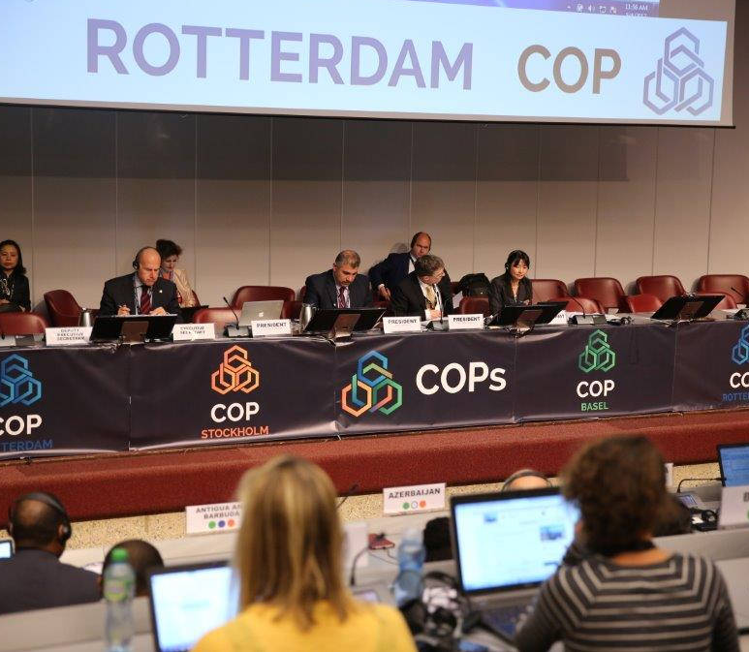
Rotterdam COP-8
                Adopted 17 Decisions
                Included 3 new chemicals in Annex III
Notes:
Summary:
Chaired by Franz Perrez (Switzerland)
Adopted 17 decisions
The highlight was:
The inclusion of three new chemicals in annex III of the Rotterdam Convention bringing the total number of chemicals under the Convention to 51. Two pesticides: carbofuran and trichloforn and an industrial chemical: short-chain chlorinated paraffins. In addition to these chemicals the COP also listed tributyltin (TBT) under the industrial chemicals category; previously it was listed under the pesticides category only.

Slide 8

Rotterdam COP-8:
Listed 4 chemicals in Annex III, approved decision guidance documents:
  Carbofuran (pesticide)
  Trichlorfon (pesticide)
  Short-chain chlorinated paraffins (industrial)
  Tributyltin compounds (industrial)
Amendments entered into force for all Parties on 15 September 2017

Slide 9

Rotterdam COP-8:
Agreed that all requirements for listing of chemicals have been met for the following chemicals, deferred decision on listing to COP-9:
  Carbosulfan (pesticide)
  Fenthion formulations (SHPF)
  Chrysotile asbestos (industrial) (decision RC-3/3)
  Paraquat formulations (SHPF) (decision RC-6/8)

Slide 10

Rotterdam COP-8:
Established a working group on enhancing the effectiveness of the Rotterdam Convention to:
  Identify a set of prioritized recommendations for enhancing the effectiveness of the Convention
  Develop a report identifying further steps for consideration by COP-9
Deferred the decision on compliance to COP-9

Slide 11
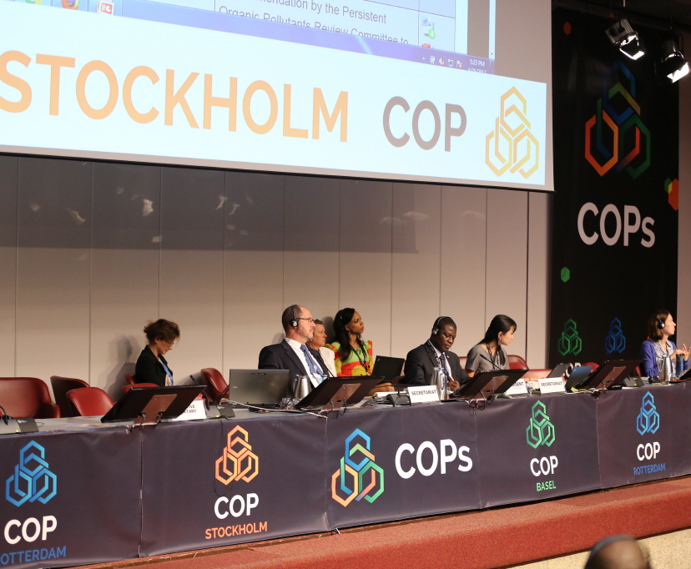
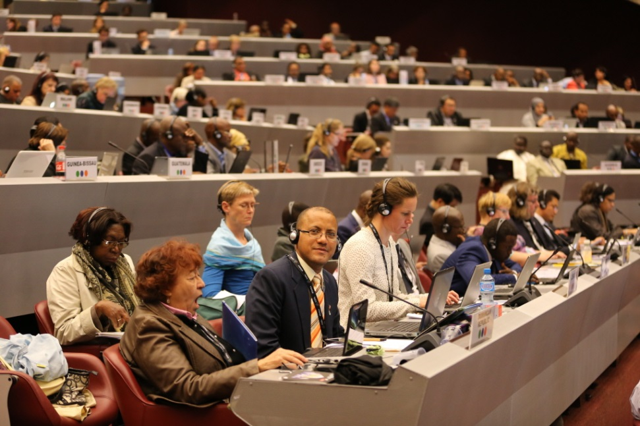
Stockholm COP-8
Adopted 27 decisions
Included 2 New chemicals in the convention
Undertook an effectiveness evaluation of the Convention
Notes:
Summary
Chaired by Sam Adu Kumi (Ghana)
Adopted 27 decisions
Ammended the Convention to listed two new POPs in the annexes to the Convention bringing the total number of POPs to 28
Two new POPs were listed in Annex A of the convention, namely decabromodiphenyl ether (an intentionally produced chemical used as an additive flame retardant including in plastics, textiles, adhesives, sealants, coatings and ink) and short-chain chlorinated paraffins (an industrial chemical with numerous trade names including Chlorowax, A70 (wax) and Chlorofo, used as a softener in paints, plastics fillers and coatings and as a flame inhibitor in rubber, plastics and textiles); it also listed hexachlorobutadiene in Annex C, it was already listed under Annex A of the Stockholm Convention, now additionally listed under Annex C, most commonly used as a solvent for other chlorine-containing compounds.
Undertook an effectiveness evaluation of the Convention

Slide 12
Stockholm COP-8:
Listed the following chemicals:
CHEMICAL | ANNEX | SPECIFIC EXEMPTIONS
Decabromodiphenyl ether (DecaBDE) | A | Vehicles (with further specification) Aircraft and spare parts for aircraft Textile products Plastic housings and parts for heating appliances Polyurethane foam for building insulation
Short-chain chlorinated paraffins (SCCPs) | A | Additives in the production of transmission belts Spare parts of rubber conveyor belts Leather industry Lubricant additives Tubes for outdoor decoration bulbs Waterproofing and fire-retardant paints Adhesives; Metal processing Secondary plasticizers in flexible PVC
Hexachlorobutadiene | C | (Unintentional production)

Slide 13

Stockholm COP-8:
Evaluation on the continued need for DDT: countries that rely on indoor residual spraying for disease vector control may need DDT for that purpose
Evaluation of the continued need for the specific exemptions for BDEs: urged Parties to take determined steps to ensure that BDEs are not introduced into articles, in particular consumer products such as children’s toys
Welcomed “Consolidated guidance on alternatives to PFOS and its related chemicals”
Welcomed “Guidance on BAT/BEP” for PFOS, brominate diphenyl ethers and hexabromocyclododecane

Slide 14

Stockholm COP-8:
Welcomed “Report on the effectiveness evaluation of the Stockholm Convention” and “Second global monitoring report”
Took note of the 12 priority areas for action to address implementation challenges identified by the effectiveness evaluation committee
Adopted additional guidance to the financial mechanism
Appointed 17 new POPRC members (2018-2022)
Deferred the decision on compliance to COP-9
Notes:
Requested the financial mechanism of the Stockholm Convention to consider the following priority areas:
Alternatives to POPs
Restriction of DDT production and use
Elimination of PCB and ESM of PCB waste
BAT/BEP for unintentional POPs
Development and strengthening of national legislation and regulations
NIP update

Slide 15

Joint issues:
Technical assistance
  Welcomed Technical Assistance plan for 2018-2021
  Emphasized the role of the regional centres, UNEP and FAO regional offices and other IOMC organizations in delivering technical assistance
Synergies in combating illegal traffic and trade
  Welcomed the analysis on possible synergies in preventing and combating illegal traffic and trade in hazardous chemicals and wastes, building on lessons learned under the Basel Convention
  Urged Parties to strengthen action under the conventions, including cooperation with other Parties, to combat illegal traffic and trade in hazardous chemicals and wastes

Slide 16

Joint issues:
Enhancing cooperation among the BRS conventions
  Welcomed the reports on synergies reviews
  Requested the Secretariat to continue to seek opportunities for enhanced coordination and cooperation among the BRS conventions
International cooperation
  Requested the Secretariat to continue to enhance cooperation and coordination with the interim secretariat of the Minamata Convention and the SAICM secretariat as well as other international organizations in areas of relevance to the conventions

Slide 17

Joint issues:
Clearing-house mechanism
  Requested the Secretariat to start the work to implement the strategy and workplan, continue to enhance cooperation with existing partners, and keep the strategy under regular review
From science to action
  Emphasized the importance of, and the need to enhance, the interaction between scientists, policymakers and other actors in the policy process to promote exchange, development and joint construction of knowledge with the aim of achieving more informed decision-making for reaching the objectives of the conventions

Slide 18

Joint issues:
Mainstreaming gender
  Welcomed the Secretariat’s gender action plan and requested Secretariat to continue its gender mainstreaming efforts
Programmes of work and budgets
  Approved the budgets of the conventions for 2018-19
  Invited the Executive Secretary to continue cooperating with the interim secretariat of the Minamata Convention on programmatic matters and to provide any secretariat support that may be requested and is fully funded by the COP to the Minamata Convention

Slide 19

Update on implementation of the programmes of work and intersessional work

Slide 20
Intersessional work
GROUP | MEETING
Expert Group on Environmentally Sound Management | 13-15 Nov 2017 Accra, Ghana
Expert Working Group on the E-waste Technical Guidelines | Jan 2018 (TBC) China
Working group of the Household Waste Partnership | Early 2018 (TBC) Port Louis, Mauritius
Expert working group on the review of the Annexes I, III, IV and related aspects of Annex IX | Early 2018 (TBC)
Open-ended Working Group | 4-7 Sept 2018 Geneva, Switzerland
Implementation and Compliance Committee | Sept 2018 (after OEWG) Geneva , Switzerland

Slide 21
Intersessional work
GROUP | MEETING
SIWG on the strategic framework | Work electronically
SIWG to update the technical guidelines on POPs wastes | Work electronically
SIWG to update the technical guidelines on incineration on land and specially engineered landfill | Work electronically

Slide 22
Intersessional work
GROUP | MEETING
Chemical Review Committee | 23-27 October 2017 Rome, Italy
Working group on enhancing the effectiveness of the Rotterdam Convention | May/June 2018
Notes:
13th meeting of the Chemical Review Committee:
23-27 October 2017, at FAO headquarters, in Rome, Italy
Technical work
Review Final Regulatory Action on 13 chemicals: if 2 notifications from 2 PIC regions meet the criteria in Annex II
→ recommend listing in Annex III
Review 2 proposals for listing Severely Hazardous Pesticide Formulations: if meet criteria against criteria in Annex IV
→ recommend listing in Annex III
RC COP-8 established a working group on enhancing the effectiveness of the Rotterdam Convention to:
Identify a set of prioritized recommendations for enhancing the effectiveness of the Convention
Develop a report identifying further steps for consideration by COP-9

Slide 23
Intersessional work
GROUP | MEETING
Expert meeting on BAT and BEP and on the Toolkit for the Quantification of Releases of Dioxins, Furans and other Unintentional POPs | 3-5 Oct 2017 Vienna, Austria
POPs Review Committee | 17-20 Oct 2017 Rome, Italy
Expert meeting on the Global Monitoring Plan Guidance Document | 7-9 Nov 2017 Brno, Czech Republic
SIWG on PCB to prepare the report on progress towards elimination of PCB | Work electronically
SIWG for the development of the manual for Article 15 national reporting | Work electronically
Notes:
13th meeting of the POPs Review Committee:
17-20 October 2017, at FAO headquarters, in Rome, Italy
Technical work:
Two draft risk management evaluations on:
Dicofol
Pentadecafluorooctanoic acid (PFOA), its salts and PFOA-related compounds
A proposal for including perfluorohexane sulfonic acid (PFHxS), its salts and PFHxS-related compounds in Annexes A, B and/or C
Evaluation of PFOS, its salts and PFOSF pursuant to paragraphs 5 and 6 of part III of Annex B
Expert meeting on BAT and BEP and on the Toolkit for the Quantification of Releases of Dioxins, Furans and other Unintentional POPs
3-5 October 2017, Vienna, Austria
Funded by the European Union
Objective: Include POPs listed in 2015 and 2017 in related guidelines and guidance
Expert meeting on the Global Monitoring Plan Guidance Document
7-9 November 2017, Brno, Czech Republic
Funded by the European Union
Objective: Include POPs listed in 2015 and 2017 in GMP guidance document to enable monitoring in 3rd phase

Slide 24
Intersessional work
GROUP | MEETING
Annual joint meeting to enhance cooperation and coordination between the regional centres under the Basel and Stockholm conventions | 6-7 November 2017 Barcelona, Spain
Notes:
Annual joint meeting to enhance cooperation and coordination between the regional centres under the Basel and Stockholm conventions
6-7 November 2017, Barcelona, Spain
Hosted by the regional centre in Spain
Objectives:
Follow up on 2017 COPs decisions;
Prepare for the 2019 COPs evaluation;
Promote opportunities for cooperation.

Slide 25
More information at: www.brsmeas.org
Email: brs@brsmeas.org
Notes:
- The call for information webpages are particularly relevant
- A report on the implementation of the conventions’ programmes of work for the biennium 2016-2017 will be made available at the end of 2017 and circulated to the bureaux.

