Slide 1

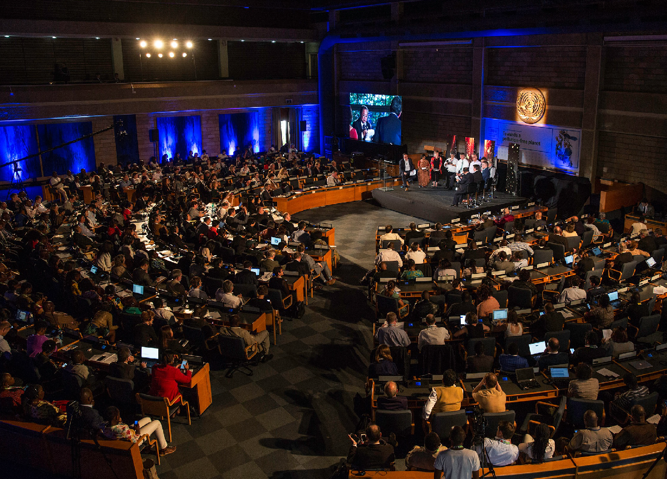



UN SCIENCE-POLICY-BUSINESS FORUM ON THE ENVIRONMENT
A UN-facilitated, Multi-sectoral Platform for Green Solutions

Slide 2

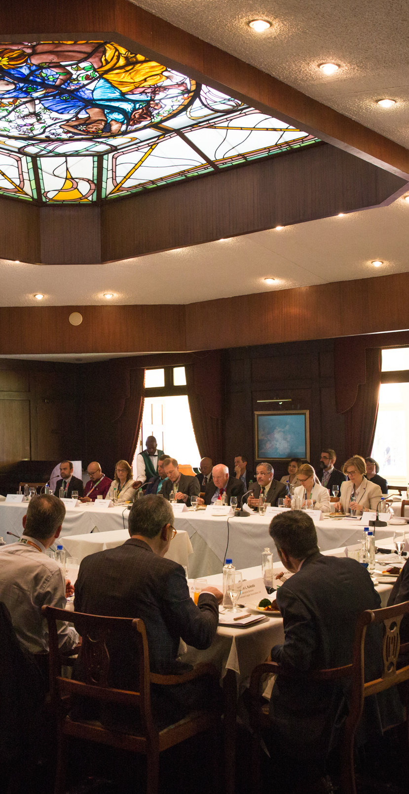
UN-SPBF Who We Are
Strengthen the Science- Policy-Business interface for PoW and SDG delivery
Provide a unique, self- sustained platform for multi- sectoral collaboration
Design innovative solutions to the world’s environmental challenges
WE CONVENE
Technology giants
Startups at the forefront of innovation
Science sector
Citizen science leaders
Policy makers
Governmental organisations
OUR GOAL

Slide 3






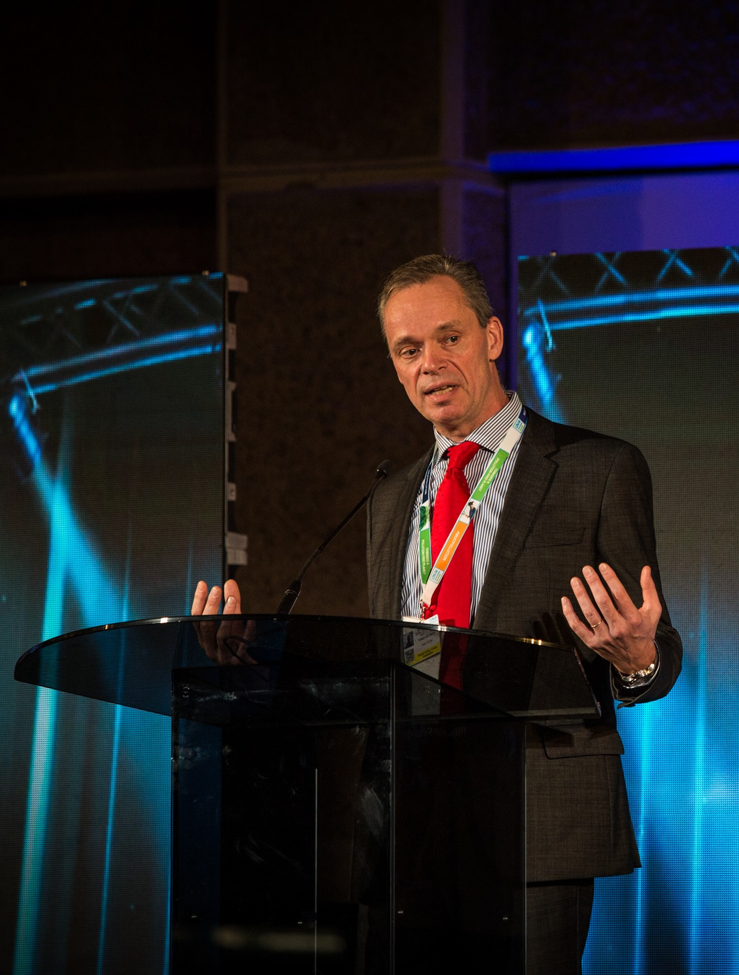












UN-SPBF Who We Are
GOVERNING CONSORTIUM:
" A powerful membership of over 2000 insAtuAons worldwide ”

Slide 4












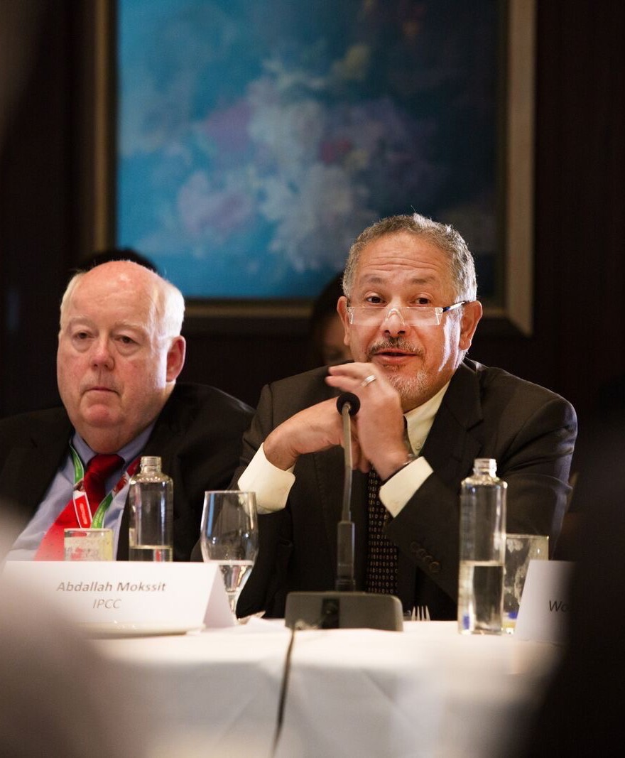
















UN-SPBF Who We Are
CONTRIBUTORS:
" A unique mulA- stakeholder plaDorm to foster green soluAons ”

Slide 5















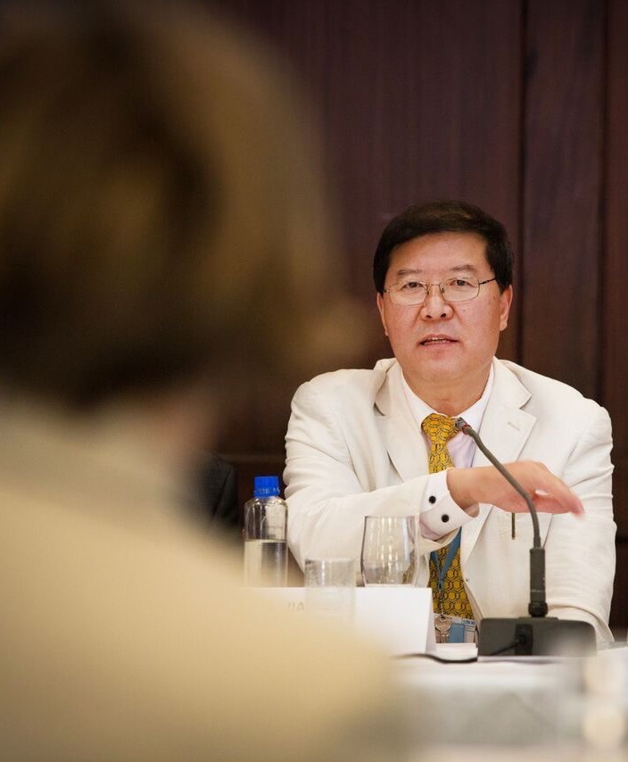





















UN-SPBF Who We Are
CONTRIBUTORS:
" A coaliAon of the Willing and a coaliAon of the Working ”
County Government of Kakamega
Government of Costa Rica

Slide 6
































UN-SPBF Who We Are
CONTRIBUTORS:
" Every Member has something to bring to the table. ”

Slide 7

UN-SPBF What We Do
ACTIVITIES AND INITIATIVES ARE DESIGNED TO:
Strengthen science, policy, business interface for POW and SDG delivery
Encourage innovation and entrepreneurship for the environment
Ensure that the Fourth Industrial Revolution is a GREEN revolution
GOAL
Empower a circular economy transition and growth of green technology markets through sound policies and innovative finance
Harness citizen science
and knowledge
Informs decision makers on policies required to grow green technology markets, encourage a circular economy and foster innovation

Slide 8

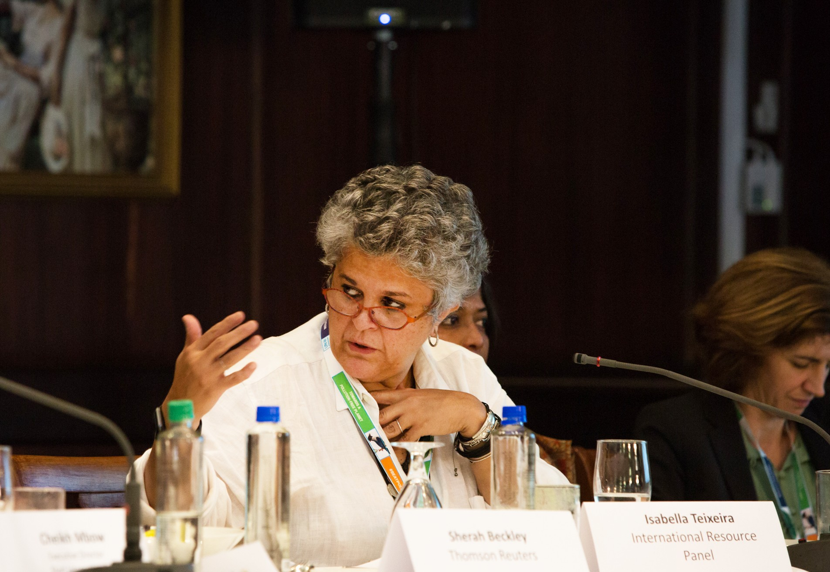
UN-SPBF Milestones
" The Forum is fast evolving
into an incubator of innovaAon and joint iniAaAves for the environment and an accelerator of the circular economy and eﬀorts to sustainably grow green technology markets. ”
May 2019
2nd Forum at UNEA-4
Planetary Data Meeting
Oct 2018
Held in Paris:
- Foundation Session
Held in Tallin:
Sept 2018
-
In Support of the UNEA Bureau
Earth Innovation Summit
May 2018
Held in New York:
1st Steering Committee
-
-
Set the agenda Contributions to PoW
Held in Nairobi:
- Foundation Session
Dec 2017
Forum launch at UNEA-3

Slide 9
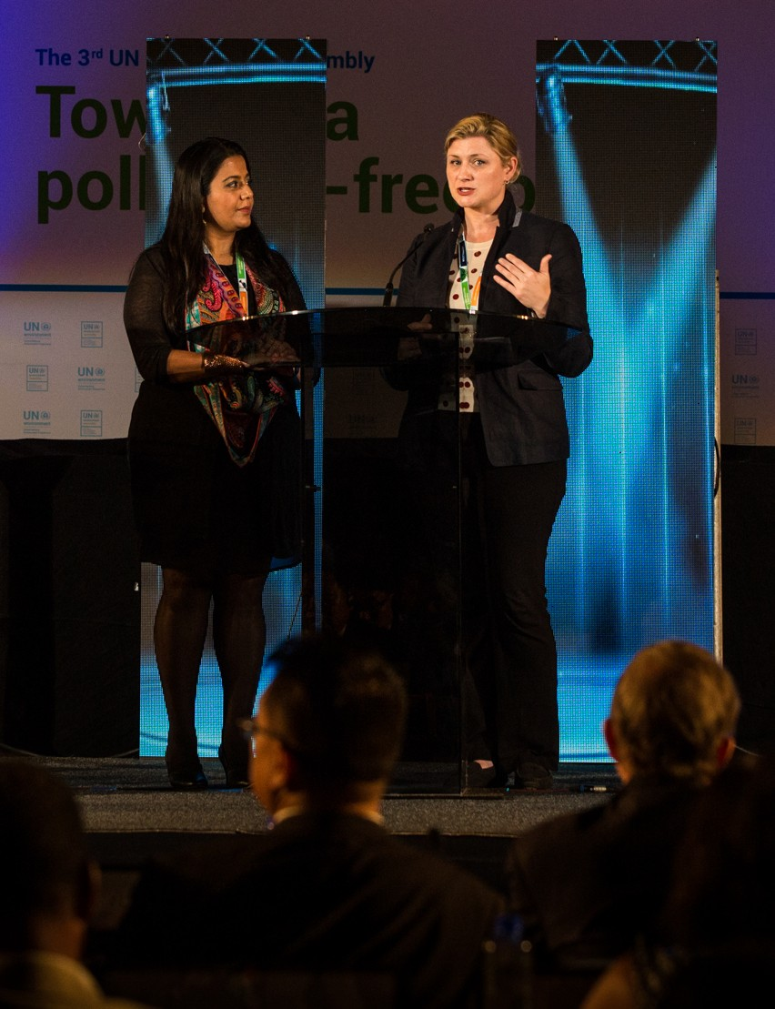
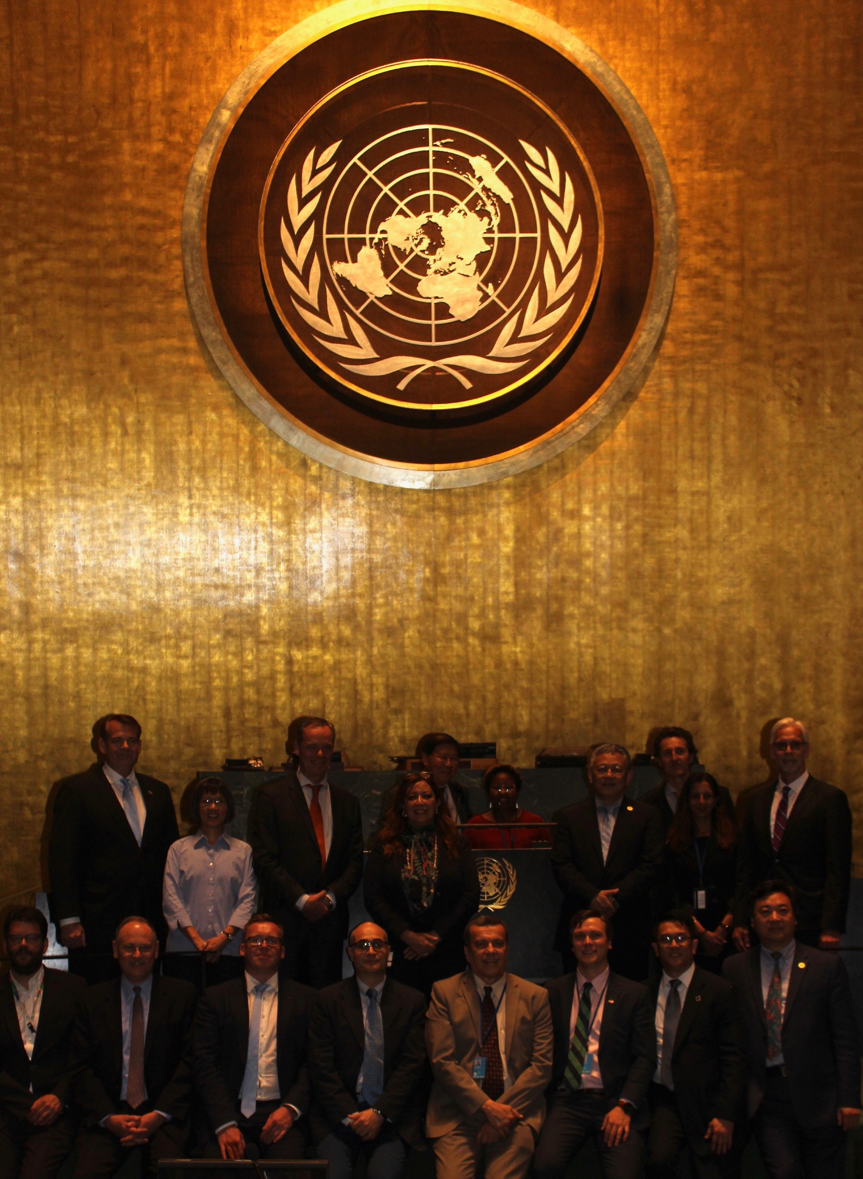
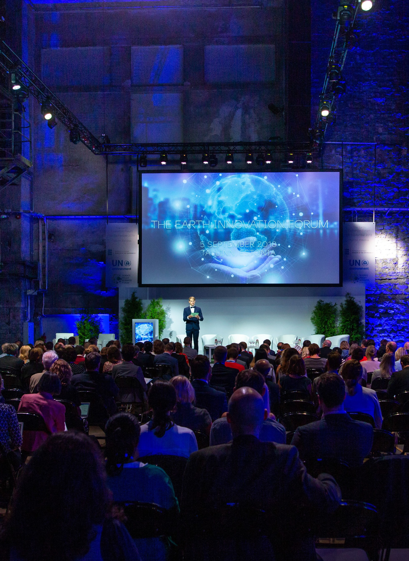
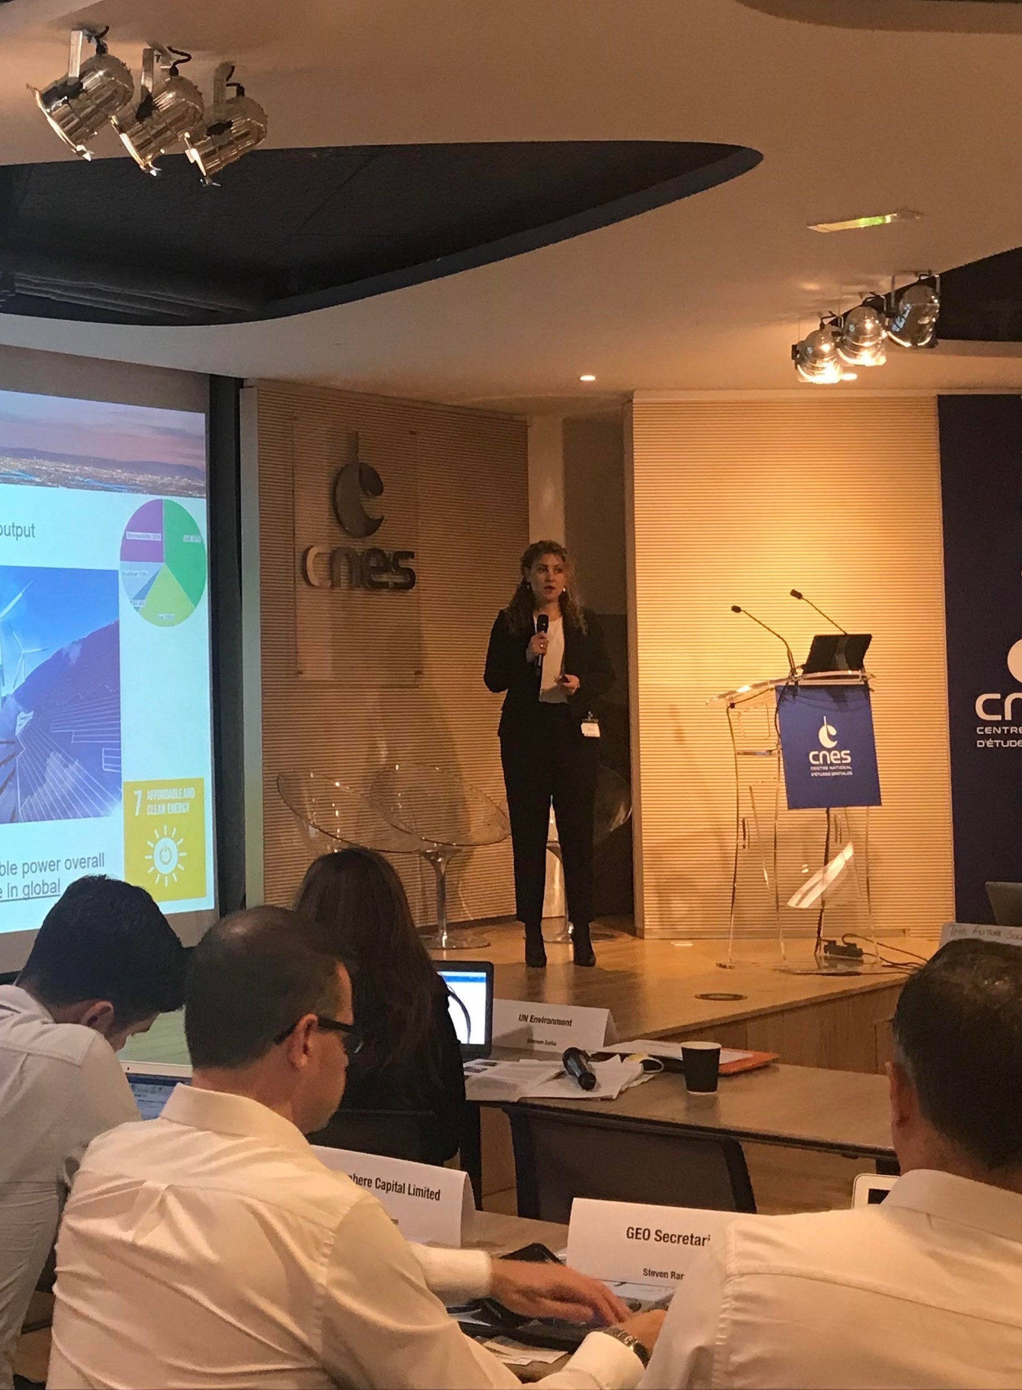
UN-SPBF Milestones
NAIROBI
Dec 2017
NEW YORK
May 2018
TALLIN
Sept 2018
PARIS
Oct 2018
1st Forum Session
1st Steering Committee
Earth Innovation Summit
12 specialised sessions provided unique opportunities for dialogue, presentation of latest technologies, exchange of ideas and consultations that aimed to inform the UNEA bureau and key partners ahead of the Bureau meeting.
Speakers included :
Business sectors leaders, Startup innovators, Scientists and visionaries, Citizen science pioneers, Investors
Planetary Data Meeting
The Forum supported the launch of the world’s first Alliance for Citizen Science.
Twelve months on, we are working with the Alliance to build the first global on- line platform for Citizen Science, hosted by Environment Live and the World Environment Situation Room
The Forum’s Governing Consortium identified work streams to support in 2018-2019, in consultation with relevant UN programmes and sister agencies
An Extraordinary Session was hosted by the Government of France.
Key tracks: Opportunities offered by Artificial Intelligence and Machine Learning; Big Data, Earth observations and remote sensing, Governance, Equity and Ethics; Financing and opportunities in PPP.
Next Steps: Launch a HL working group to strengthen and expedite delivery of the platform in coordination with Environment Live and the UN Environment Situation Room

Slide 10



UN-SPBF 2nd Global Session
NAIROBI - 8 TO 10 MAY 2019:
Launch of international multi-sectoral working group on BIG Data and AI for the environment
Launch of initiatives and white papers on environmental issues
Inauguration of the Green- Tech Start-up hub
8-10
May
Over 800 high level participants
30
specialised sessions aligned with UNEA theme
Creation of 1st Citizen Science Collaborative Platform on the environment

Slide 11

UN-SPBF Key Streams
Global Platform for Big Data on the environment
Science for Decision-Making: Shaping Policies and Market Responses
Explore opportunities offered by AI and machine learning; Big Data, earth observation and remote sensing
Governance
Equity and ethics
Financing
-
Review latest recommendations from flagship environmental assessments and White Papers by Partners
Discussions on the required policy responses/actions by policy makers, the private sector and key stakeholders.
1
-
2
Redesigning Metropolis: Smarter, Greener Solutions for Cities
3
Leverage innovative technologies to tackle urban challenges and encourage the efficient use of natural resources
Review latest in environmentally sound design and infrastructure
Encourage positive resourcing and procurement decisions
In support of UNEA theme
4
Launch Green-Tech Startup Hub
Identify, communicate and shed light on innovative solutions and technologies by this fast-growing sector
Identify and encourage enabling policies
Bridge the technology and policy divide
Encourage investment in green tech
Climate Challenge and Non-State Actors: From Transparency to Leadership
5
6
Empower private sector transparency and leadership to tackle climate change
Review mechanisms to monitor, measure, verifying and report on emissions reductions by industry and non-state actors
Examine how policy and incentives can regulate and strengthen such reporting
Examine how the future Emissions Gap Report will measure and analyse action by non-state actors
Sustainable Food for a Healthy Planet
-
Agricultural transformation: sustainable and climate-smart agricultural models minimizing impacts on pollution
Nutrition and healthy diets: embracing difficult questions and debates about meat vs. vegetarian diets, considering biofortification, plant health
Food waste: measuring and achieving reduction target at global level
-
-

Slide 12

WE WELCOME YOUR ACTIVE PARTICIPATION AND YOUR CONTRIBUTION TO
THE EVENTS
E-mail: forum@un-spbf.org
Website: un-spbf.org

