Slide 1

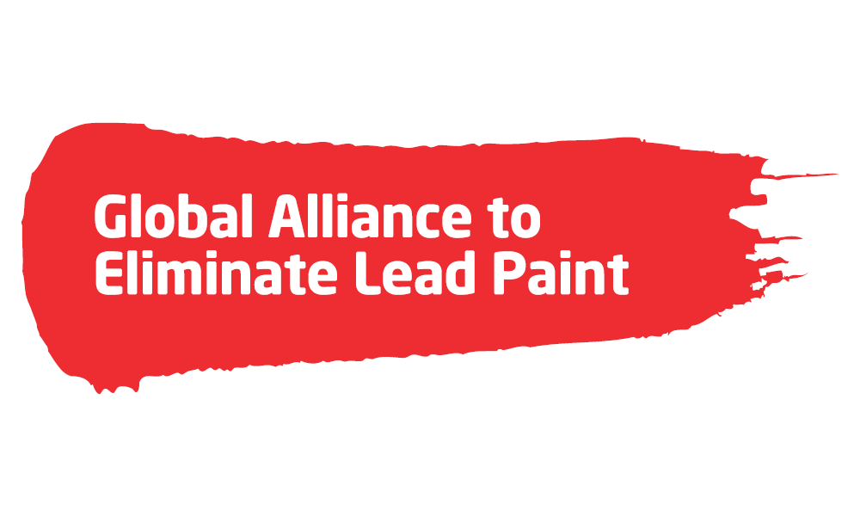
Eliminating Childhood Exposure to Lead Paint:
Overview of the Global Alliance to Eliminate Lead Paint
Caribbean Workshop on the Establishment of Legal Limits on Lead in Paint
Friday, December 1, 2017
University of the West Indies
Kingston, Jamaica
Angela Bandemehr
Office of Global Affairs and Policy,
US Environmental Protection Agency
Chair of the Lead Paint Alliance

Slide 2

Lead is Poisonous
Lead is harmful to health, especially for children
Life-long consequences in children including serious and irreversible neurological damage and behavioral problems
Globally lead paint is a major remaining source of childhood exposure
There is no safe level of exposure to lead
Notes:
Lead is especially harmful to children, affecting their neurological, cardiovascular, reproductive, renal, gastrointestinal and hematological systems.
Children are uniquely vulnerable because, pound for pound, children drink more water, eat more food and breathe in more air than adults and because developing organ systems are more susceptible to the damaging effects of lead exposure.
Exposure to lead can carry life-long consequences. There is simply no safe level of exposure to lead.
Through the Partnership for Clean Fuels in Vehicles, we banned lead in gasoline and this has produced tremendous health, environment, and economic benefits around the world.
However, lead exposure is still a problem and lead in paint is now the major source of childhood exposure to lead.

Slide 3
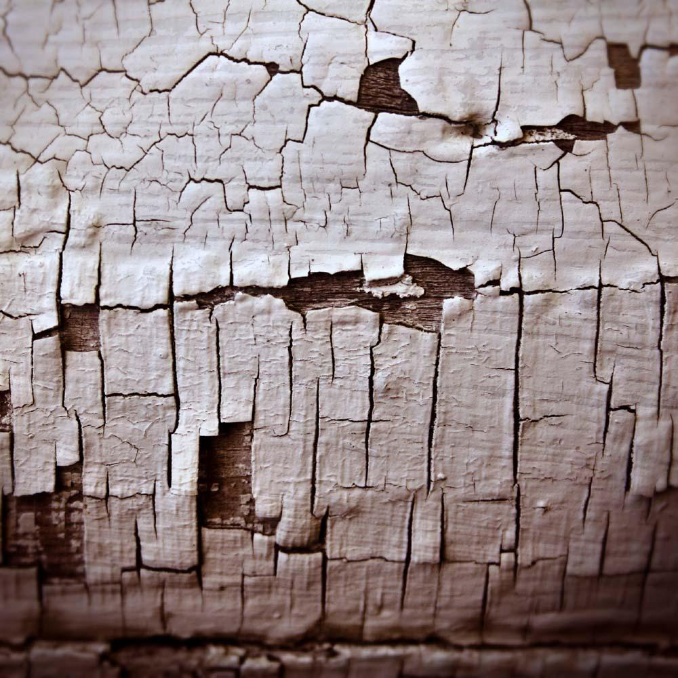
Lead Poisoning’s Health and Economic Costs
Exposure to lead has permanent negative impacts to children's developing brains.
Lifelong consequences are borne by the affected children, their families, and societies at large.
One key impact: reduction in intelligence quotient (IQ), which can be correlated with decreases in lifetime earning potential.
Notes:
In addition to the impacts on children and families, childhood lead exposure has staggering economic costs. One key impact is reduction in intelligence quotient (IQ), which can be correlated with decreases in lifetime earning potential.

Slide 4
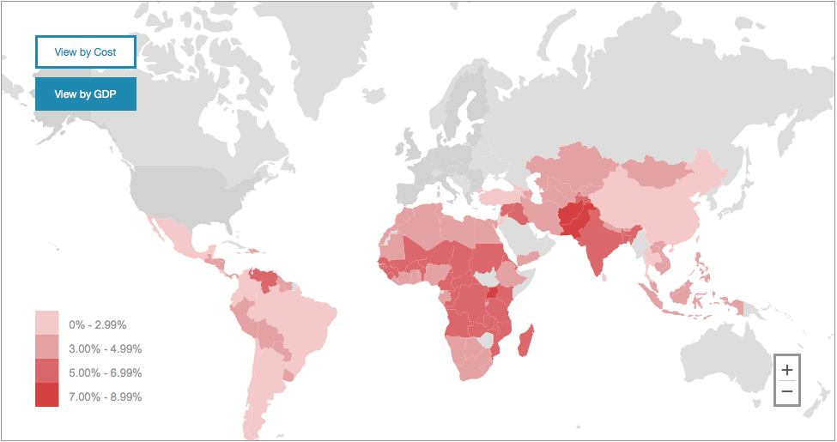
High Cost of Lead Poisoning
Children’s exposure to lead from all sources has staggering economic costs for countries
$977 billion in cost for low and middle-income countries from children’s lost IQ
        $ 135 billion in Africa
        $ 142 billion in Latin America
        $ 700 billion in Asia
Interactive map based on the findings of NYU analysis displays cost and corresponding percent GDP loss for 110 low and middle income countries.
Percent GDP lost each year
Source: http://www.med.nyu.edu/pediatrics/research/environmentalpediatrics/leadexposure
Notes:
An NYU study has estimated the annual cost of children's lost IQ in low and middle income countries at $977 billion – almost a trillion dollars per year.
For some countries the economic cost is 3, 5 or even 7 percent of their GDP.

Slide 5
Economic Impact of Lead Exposure - CARICOM
CARICOM Country | Annual Cost ($ in millions) | % of GDP lost
Belize | 51.5 | 2.15
Grenada | 33.8 | 2.88
Guyana | 72.3 | 2.78
Haiti | 439.9 | 3.68
Jamaica | 387.4 | 1.77
Saint Lucia | 53.4 | 3.24
Saint Vincent + the Grenadines | 32.7 | 2.77
Suriname | 123.3 | 2.98
Source: Environmental Pediatrics at NYU School of Medicine https://med.nyu.edu/pediatrics/research/environmentalpediatrics/leadexposure
Notes:
An NYU study has estimated the annual cost of children's lost IQ in low and middle income countries at $977 billion – almost a trillion dollars per year.
For some countries the economic cost is 3, 5 or even 7 percent of their GDP.

Slide 6

Why Focus on Lead Paint?
Globally lead paint is a major remaining source of childhood exposure (from paint used in homes and schools and on playground equipment and toys).
Other sources of lead exposure may include battery recycling, lead mines and smelters, but these problems are difficult to solve.
Prevention Opportunity: Removing lead from new paint is low cost for manufacturers, and will prevent new exposures.
Lead paint laws are needed.

Slide 7
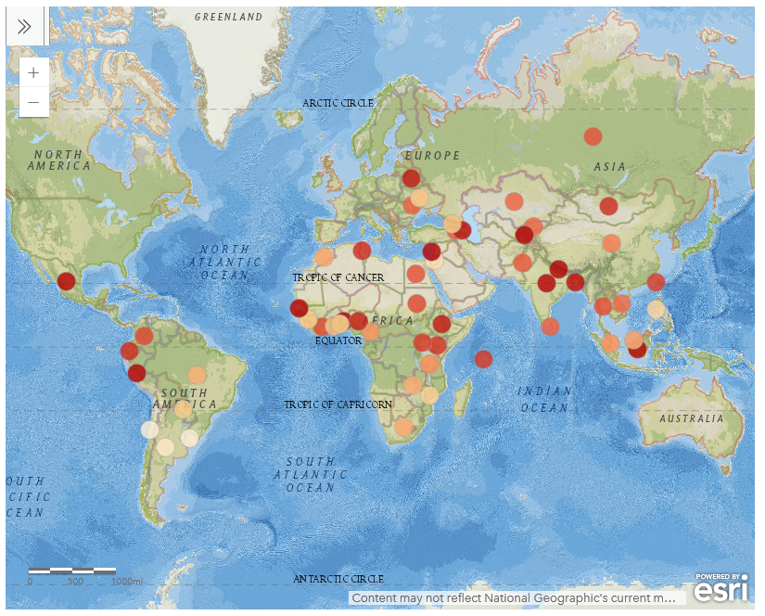
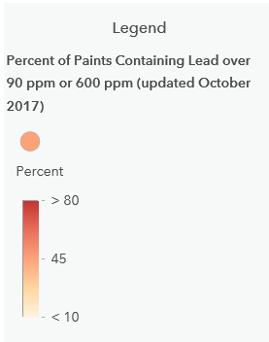
Lead Paint Levels are High Around
the World

Slide 8
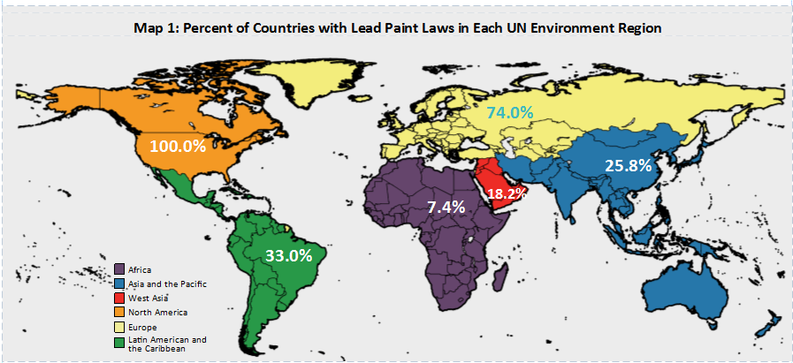
Only 30% of Countries Have Lead Paint Laws
Source: WHO 2017
8
Notes:
This map shows the work that needs to be done – it shows the percentage of countries where lead paint laws have been confirmed by WHO. Only 30% of countries have laws.
You can see we have a lot of work to do in most regions of the world.
NOTE: This is one of the maps in the new Global Status Update by the Lead Paint Alliance that is available on their web site.

Slide 9
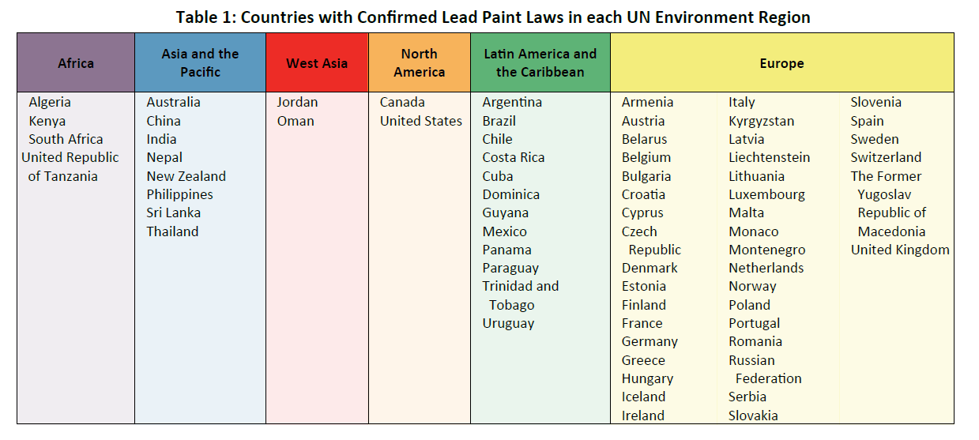
Only 68 Countries have Lead Paint Laws
Source: UNEP Global Status Update 2017

Slide 10


About the Global Alliance to
Eliminate Lead Paint
Lead Paint Alliance is a voluntary global partnership
Launched by Strategic Approach to International Chemicals Management resolution in 2009
Secretariat: UNEP and WHO
Chair of Advisory Council: US EPA
Partners: Governments, NGOs and Industry
Alliance is modeled on successful Partnership for Clean Fuels and Vehicles efforts to eliminate lead in gasoline globally
Global Citizens Earth Day 2015
Goal: Establish laws globally
Notes:
The Lead Paint Alliance was created to address these challenges. Our goal is to phase out lead in paint worldwide by establishing laws in every country by 2020.
The Lead Paint Alliance is a voluntary partnership that is jointly led by the World Health Organization and UNEP.
Partners to the alliance include government agencies, NGOs, Industry and academics.
A subset of governments from each major region in the world, industry, NGOs and international organizations are members of an Advisory Group. EPA serves as the Chair of the Alliance Advisory Group.
Models PCFV, which was successful in phasing out lead in gasoline.
The Lead Paint Alliance is currently working with countries to support them in establishing laws to eliminate lead in paint.

Slide 11
Action Needed: Lead Paint Laws
Laws are the most effective way to eliminate lead in paint.
Countries in the developed world banned lead in paint in 1970s and ‘80s.
However, in most of the developing world, lead paint is still legal.
Lead compounds are added to paints to improve drying time and color brightness.
Alternative paints without added lead are affordable and widely available.
Voluntary labeling of paints is not an effective solution.
Industry and governments agree: Solution is enacting lead paint laws in countries worldwide – 90 ppm limit (US Law)
Notes:
The developed world banned lead in paint in the 70s and 80s.
In countries around the world, lead is still sold on shelves and uses to decorate homes, schools, children’s toys, and all over the environment in which we live everyday.
Lead is intentionally added to paint for drying and color properties, but economically feasible alternatives are available for all lead-containing paint ingredients.
Alternatives to using lead in paint are both affordable and available.
Voluntary labeling is not a solution, because, in order for labels to be effective, an enforceable law with low limits is needed. Without certification and inspection and testing, there is not mechanism to verify if lead levels are low. Also, people do not have control over the paint in schools, hospitals, their friends homes.
And industry and government are in agreement that the only effective solution to this problem is enacting and enforcing lead paint laws in every country around the world so that the children of tomorrow are not exposed to this serious health risk.
Some have suggested that labelling paint for the consumer could be done in place of laws, however, industry partners conclude that this puts a burden on both consumers and producers and does not level the playing field in the manner that legally binding limits on sale, import and use of lead

Slide 12
Key Activities of Lead Paint Alliance
Encourage countries and regions to establish and enforce lead paint laws.
Encourage governments to join the Lead Paint Alliance to support the global effort to establish lead paint laws to ban Lead in Paint.
Provide information and tools:
  Model Law and Guidance
  Information about health and economic impacts, alternatives to lead paint, testing
Model law and information available at:
http://web.unep.org/chemicalsandwaste/what-we-do/technology-and-metals/lead/global-alliance-eliminate-lead-paint
Notes:
Through the GEF project and other efforts, EPA and the Lead Paint Alliance will work with countries to establish and enforce laws.
Whether or not there is a law, to help promote support this for initiative and work with countries to establish laws, it would be helpful to encourage countries to join the Lead Paint Alliance
But is especially important for the countries to establish laws in support opf the global effort to eliminate lead in paint by 2020.
The Alliance now has the tools to help countries achieve this.
Additional information and tools are available from the Lead Paint Alliance at this website. www.unep.org/noleadinpaint. We will here from others in more detail about these and other tools.

Slide 13
Value of Model Lead Paint Law
Governments requested guidance from UNEP on language for lead paint laws. Industry and NGOs also supported development of a model law.
Guidance provides explanation of health and economic benefits to citizens, and key elements needed for effective lead paint laws.
Model law provides internationally best available approach:
  Encourages a consistent lead limit and regulatory approach.
  Reduces global demand for lead paint through lead limits on imported paints as well as locally-produced paints.
  Reduces trade barriers through consistent standards.
  Can be adapted to each country’s regulatory framework.
  Simple to Implement.

Slide 14
Model Lead Paint Law: Key Features
Low concentration limit for lead in paint (90 ppm total lead)
Applies to all types of paints (consumer and industrial uses)
Provisions for effective compliance and enforcement

Slide 15
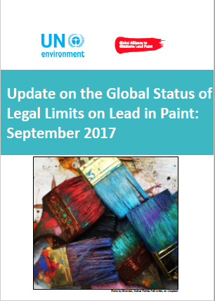
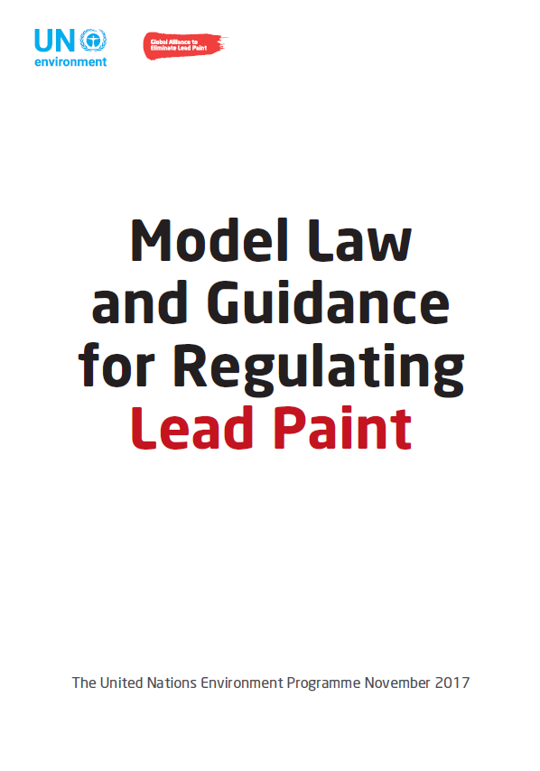
Growing Momentum on Lead Paint
Alliance Model Law and Guidance
Alliance Regulatory Toolkit
UNEP 2017 Global Status Update on Laws
WHO Global Map on Status of Lead Paint Laws
American Bar Association Resolution
UNEA3 Commitments: model language
World Health Assembly Roadmap for Health in Chemicals Management (May 2017) – calls for action on lead paint
NYU Map of Economic Impacts of Childhood Lead Poisoning (NYU School of Medicine)
IPEN Global Map of Lead Paint Testing Data
World Bank Report (final by March 2018)

Slide 16
Key Ongoing and Future Activities
EPA training of Environment, Science, Technology and Health officers in US Embassies by region (ongoing)
Annual International Lead Poisoning Prevention Week of Action (since 2013)
UNEA3
  Science Forum Session on Lead Paint
  Government, NGO, industry UNEA3 commitments to eliminate lead paint
  USG Resolution on lead paint (Argentina co-sponsoring)
Current regional efforts
  West Africa – draft regional waste strategy includes lead paint
  Caribbean - UN Environment / EPA / ABA Launch of Model Law in Jamaica
  Central and Eastern Europe – US Department of Commerce Standards Officials Project and Eurasian Economic Union lead paint technical regulation
Global Environment Facility Project on Lead Paint (2018-2020)
Notes:
Here are some select ongoing and future activities of the Alliance to illustrate the current momentum and future efforts.
EPA is engaged with its counterparts globally by region to encourage the US State Department to reach out to its government contacts to discuss lead paint. We have briefed ESTH officers from three regions (Central Asia, South America and Africa) so far.
The American Bar Association passed a resolution to promote lead paint laws in August 2017. This is a key development, as the ABA has the ability to mobilize legal resources either through its Rule of Law Initiative (ROLI) and through pro bono volunteers. ABA/ROLI is now a key partner in the upcoming GEF project.
Every year the Lead Paint Alliance conducts outreach on lead paint through the week of action. This year we focused on the lead up to UNEA-3 and promoted voluntary commitments to establish laws and promote lead paint elimination.
At UNEA3 several activities occurred to further increase momentum on lead paint:
On the weekend, we had a session on lead paint during the Science Forum.
UNEA3 commitment language was provided to governments, NGOs, and industry – we received …….. Commitments (check with Evonne)
The US government and Argentina proposed a joint lead paint resolution [which was combined with the Africa Group battery resolution]
The World Bank is putting together a report on lead, which will highlight lead paint. We expect this report in the Spring of 2018.
Current regional efforts on lead paint include: (you may want to defer to the regional directors, in case their remarks might cover these)
We just learned that at a recent ministerial meeting the Economic Community for West African States just developed a draft regional waste strategy that includes lead paint elimination.
In the Caribbean we are following up on discussions with CARICOM to have a workshop in Jamaica to launch the Model Law. This is a pilot for the upcoming GEF project, in that ABA/ROLI was engaged for the first time. [Angela to provide update via email after the workshop on Dec 1]
In Central and Eastern Europe the US Department of Commerce is working with Standards Officials to discuss lead paint laws. There is great interest in this issue and EPA is coordinating closely with UNEP and WHO to determine next steps. Some of the countries in the DOC project are also part of the Eurasian Economic Union, which is developing a technical regulation on lead paint. The regulation sets confusing standards, some of which are very high. EPA, UNEP, WHO and IPEN have been working closely together on this.
An upcoming project for the next two years will be the GEF lead paint project, which will seek to establish laws in 40 countries. This effort will build heavily on the Model Law and existing efforts and Alliance partners.
[UNEP may present more about this project]

Slide 17
International Lead Paint Resources
Lead Paint Alliance: http://web.unep.org/chemicalsandwaste/what-we-do/technology-and-metals/lead/global-alliance-eliminate-lead-paint
USEPA Lead Paint Alliance site: https://www.epa.gov/international-cooperation/epa-leadership-lead-paint-alliance
WHO Map of Lead Paint Laws: http://www.who.int/gho/phe/chemical_safety/lead_paint_regulations/en/
World Health Assembly Chemicals Roadmap: http://www.who.int/ipcs/saicm/roadmap/en/
Economic Impact of Childhood Lead Poisoning: http://www.med.nyu.edu/pediatrics/research/environmentalpediatrics/leadexposure
Map of Levels of Lead in Paint:
  http://ipen.org/projects/eliminating-lead-paint/lead-levels-paint-around-world
American Bar Association Resolution on Lead Paint: https://www.americanbar.org/content/dam/aba/images/abanews/2017%20Annual%20Resolutions/109B.pdf
Notes:
As you can see, momentum is building on this issue. We hope to see lead paint laws being passed in the next few years.
For more information, here are links to the resources I mentioned in the presentation.

Slide 18
Thank You!

