Slide 1
The problem with lead paint
Caribbean Workshop on the Establishment of Legal Limits on Lead in Paint
Friday, December 1, 2017
University of the West Indies
Kingston, Jamaica
Dr. Kam Mung
Pan-American Health Organization
Angela Bandemehr
US Environmental Protection Agency

Slide 2
Sequence
  Why is lead paint a problem
  Pathways of exposure
  Children / Pregnant women
  What is Lead Paint?
  Lead compounds have a range of functions in paint
  Types of paint that may contain lead
  Economic costs of lead exposure are high
  Summary

Slide 3
Why is lead paint a problem?
  Source of exposure to lead during manufacture, application, and removal of paint
  Paint breaks down over time, fragmenting into flakes and dust that contaminate the domestic environment and soil
  Lead is persistent in the environment, and when released can remain there indefinitely
  Leaves a legacy of potential human exposure for many years into the future – especially harmful to children

Slide 4
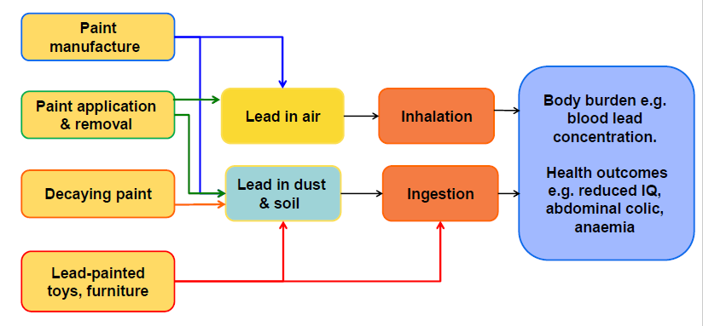
Multiple pathways of exposure to lead from paint

Slide 5
Children are highly vulnerable
  There is no known level of lead exposure that is considered safe
  Children can be highly exposed because they spend time on the ground and frequently put their hands to their mouths
  Childhood lead exposure can damage the brain and nervous system resulting in decreased IQ and behavioral problems
  Lead also causes a significant burden of disease through other long-term impacts on health

Slide 6
Pregnant women are more vulnerable
  Pregnancy mobilizes lead stored in bone, releasing it back into blood where it can be circulated to maternal tissues and the fetus
  Further exposure from the environment raises the blood lead concentration even higher
  Increased risk of hypertension during pregnancy
  Exposure of pregnant women can result in exposure of the fetus – may cause reduced fetal growth

Slide 7
What is Lead Paint?
  Lead paints contain lead compounds that are added to give certain properties
  Wide range of uses
  Water-based paints rarely contain intentionally-added lead
  The term ‘paint’ is used broadly to include varnishes, lacquers, stains, enamels, glazes, primers, and coatings

Slide 8
Lead compounds have a range of functions in paint
  Pigments – The most commonly used are lead chromates and lead molybdates which are bright yellow, orange, or red
  Pigments can also be mixed with others to produce bright colors such as green and purple
  Lead carbonates and lead sulfates can be used as white pigments, but are rarely used
  Pigments may contribute ~ 1500 to > 100,000 ppm of lead

Slide 9
Lead compounds have a range of functions in paint
  Drying agents and catalysts – e.g. lead napthenate and lead octanoate
    Driers may contribute ~ 1200 to > 6000 ppm of lead
  Corrosion resistance agents – Added to paints used on metal surfaces, e.g. lead tetroxide (also called red lead or minium)
  Alternative, non-lead compounds can perform as well as lead-based ones and the paint is of equivalent quality

Slide 10
Completely lead-free paint is not possible
  Trace quantities of lead may be present in the fillers and other earth-based ingredients
  Typically contributes < 90 ppm, though sometimes more

Slide 11
Types of paint that may contain lead
  Decorative paints (architectural paints, home or residential paints)
    Used on the exterior of buildings such as houses, schools, and commercial premises, and on interior surfaces such as walls, ceilings, windows, etc.
  Coatings
    Used in the manufacture of toys, pencils, furniture and other household items
  Glazes
    Used on pottery e.g. food containers, cups, bowls, cooking pots

Slide 12
Types of paint that may contain lead
  Rust and corrosion resistant paints
    used on metal structures e.g. on school playground equipment, bridges, oil rigs
  Industrial paint
    e.g. used as coatings for automobiles, equipment, plastic components, painting road markings, etc
  Artist's paint
    specialized oil paints containing lead pigments, usually exempted from regulatory controls

Slide 13
Economic costs of lead exposure are high
  Estimated economic losses due to reduced IQ from preventable lead exposure is ~1.2% of global GDP
  Largest economic burden is borne by low and middle income countries.
  Economic losses by region (in international dollars):
    – Africa: I$ 134.7 billion
    – Asia: I$ 699.9 billion
    – LAC: I$ 142.3 billion
    – USA: I$ 50.9 billion
Attina & Trasande. 2013 http://dx.doi.org/10.1289/ehp.1206424

Slide 14
Costs of not banning lead paint are high
  Lead-painted homes are an important source of lead exposure for children
In France, 74% of children with elevated blood lead concentration live in homes with lead paint
  Estimated costs of remediating lead-painted homes:
  France: US$ 194 – 499 million
  USA: US$ 1 – 11 billion
  Cost-benefit of remediation significant
  each US$ 1 invested in lead paint hazard control yields return of US$ 17–221
Pichery et al 2011. https://ehjournal.biomedcentral.com/
Gould 2009. http://ehp.niehs.nih.gov/0800408/

Slide 15
Summary
  There is no known safe level of exposure to lead
  Lead paint can contain a range of lead compounds for different purposes
  Lead paint can cause a long-lasting hazard to health in all age groups, however, children are especially vulnerable
  Paints are available that do not contain lead compounds while still having the required properties
  Eliminating lead paint provides a net benefit to society and public health

